Slide 1
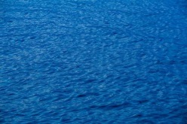
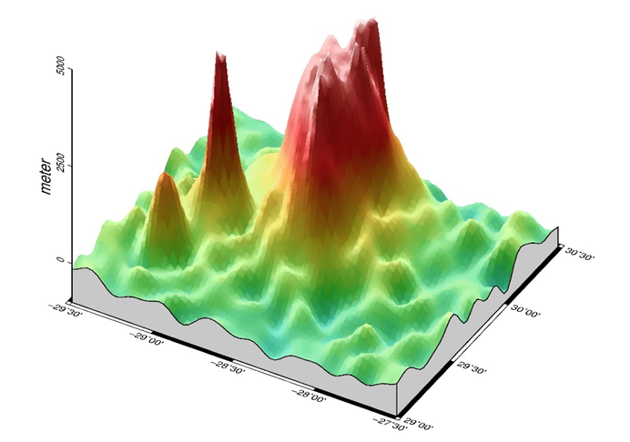
High-resolution 3D seafloor topography
by Kalman filtering of gravity information
Benjamin Beirens, Lucia Seoane, Guillaume Ramillien, José Darrozes
Géosciences Environnement Toulouse (GET) UMR 5563
CNRS/IRD/UPS/CNES
Observatoire Midi-Pyrénées, Toulouse, France

Slide 2
OBJECTIVES
We propose a Kalman Filter (KF) approach to integrate different types of geophysical data, i.e. geoid height and free-air gravity anomalies, single beam sounding ship tracks, etc, for refining seafloor topography estimation.
This new numerical method enables to invert data onto unregularly-sampled grids for producing regional bathymetry with a finer resolution (~km).
Forward problem. Expression of the Newtonian operators have been completely revised from the ones obtained by previous non-linear least-squares developments (Calmant 1994; Ramillien 1998).
Inverse problem. Iterative integration of data made by KF permits to truncate large datasets of unncessary observations, and thus reduce the matrix dimensions of the inverse problem.

Slide 3
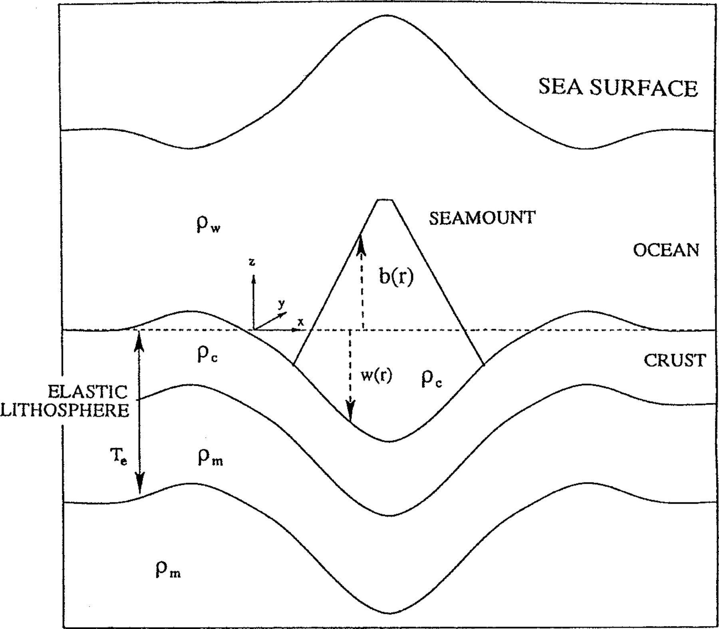
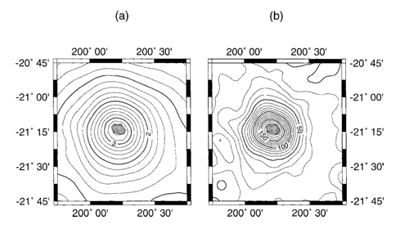
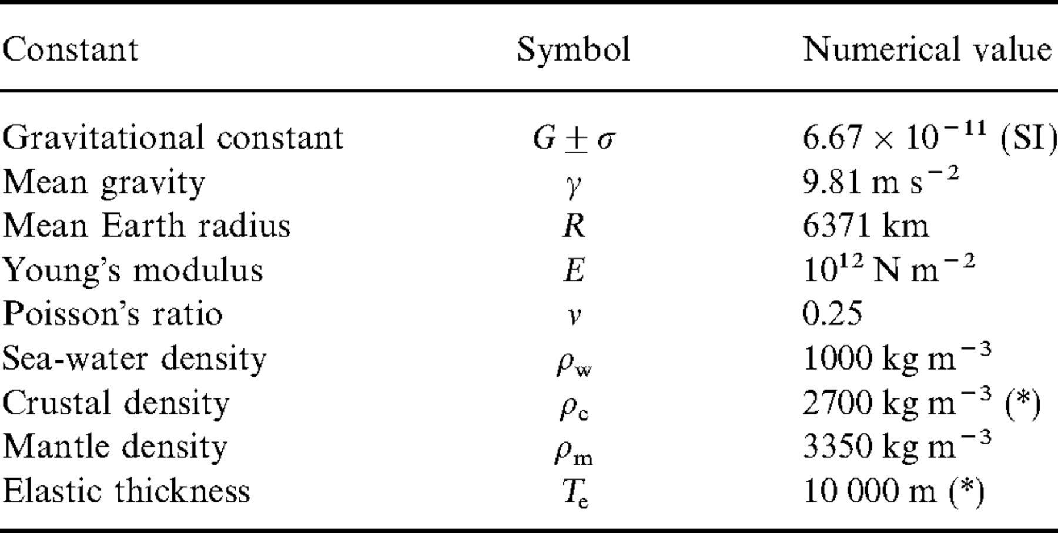
DENSITY INTERFACE MODEL
SEA FLOOR
0m

Slide 4
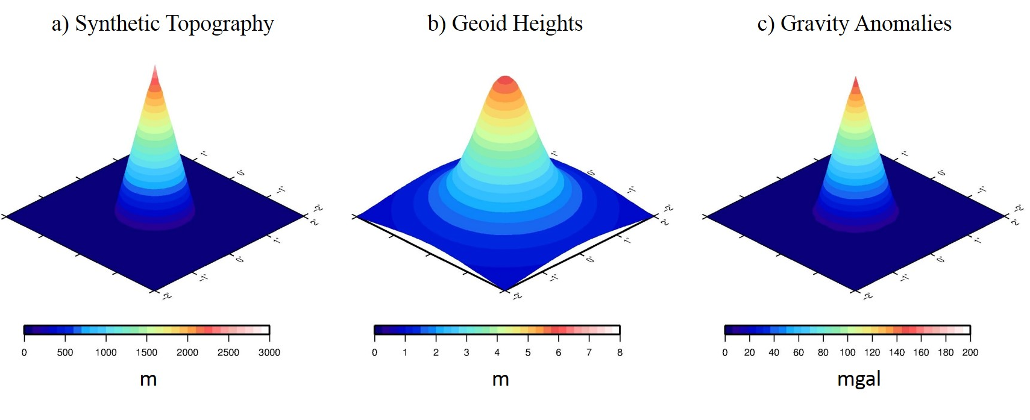
SIMULATED DATA AND RECOVERY TESTS
Generate synthetic topography
Forward problem:
Simulate observations
Inversed problem:
Estimate topography
Comparison with input topography
RMS, inversion parameters sensibility,convergence.

Slide 5
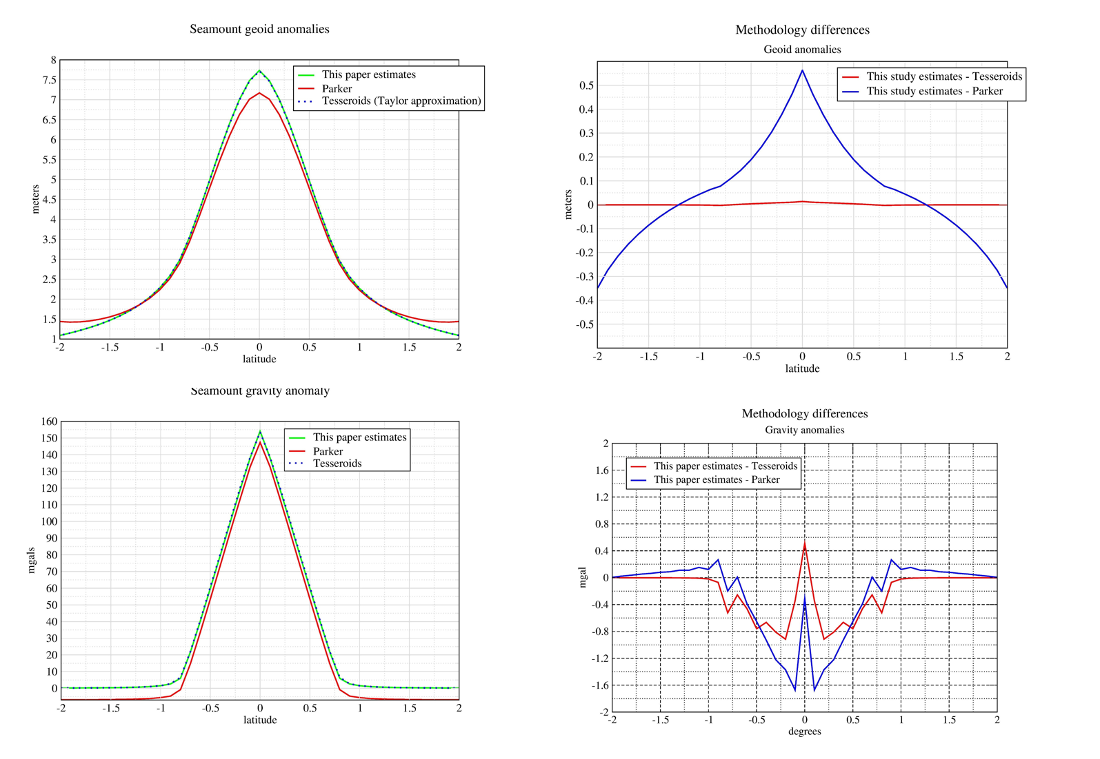
FORWARD PROBLEM: DIFFERENT METHODS COMPARSION

Slide 6
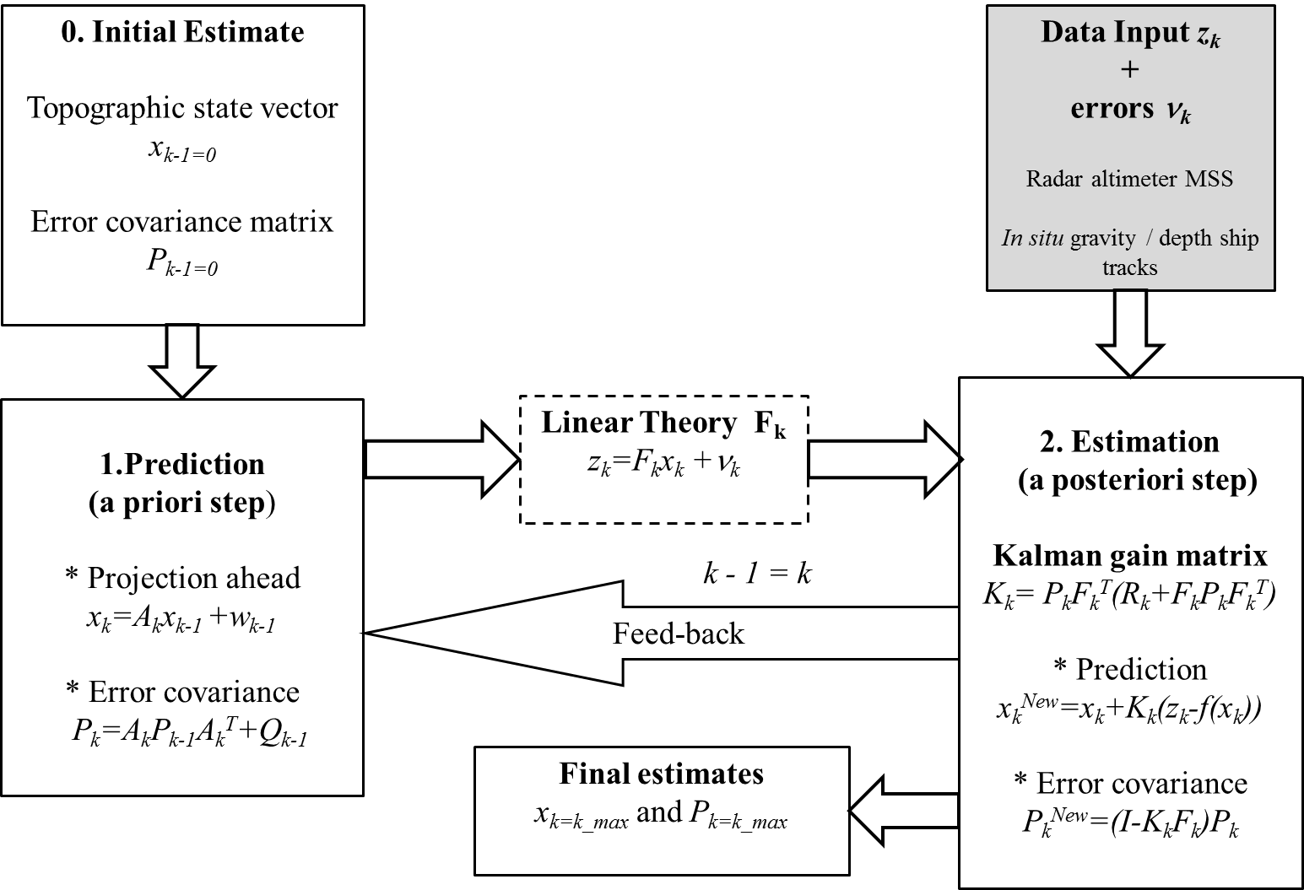
INVERSED PROBLEM: PRINCIPLE OF KALMAN FILTERING (KF)
A priori covariance of the topographic heights
The observation errors are assumed spatially decorrelated
ϕ₀ = 0.2⁰ Calmant et al., 1994

Slide 7
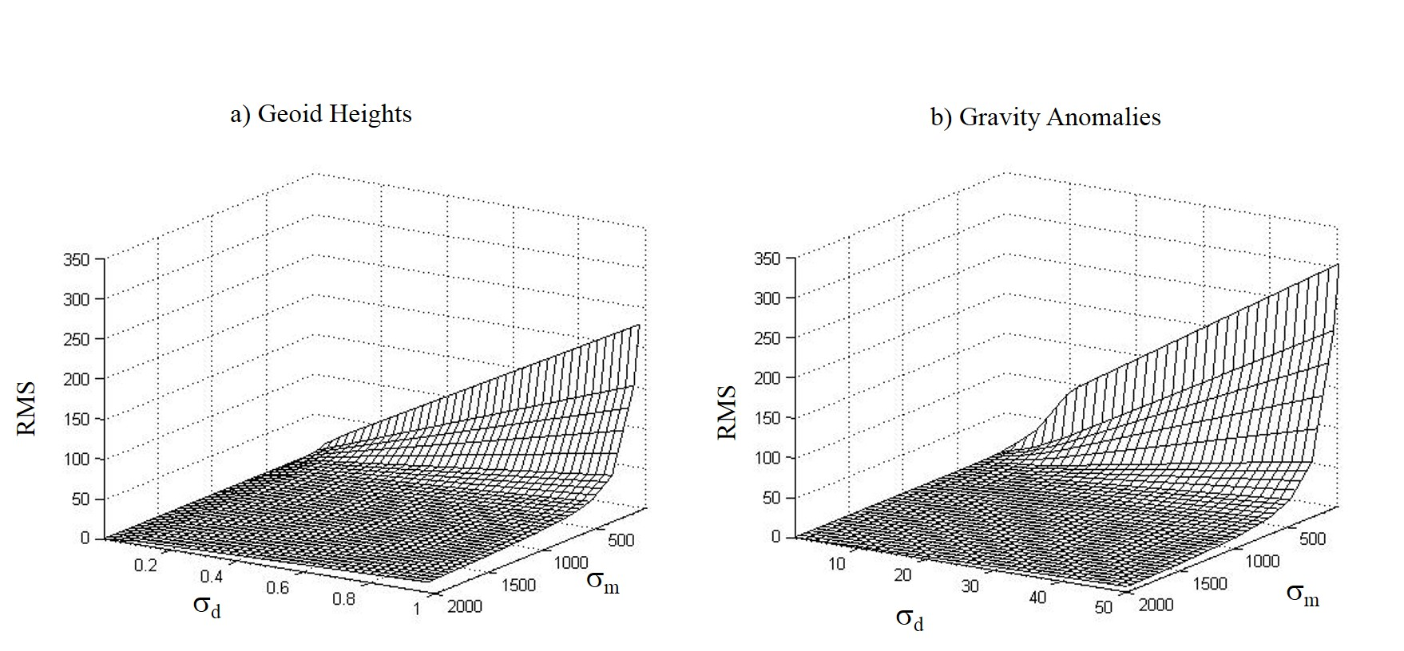
CHECKING INVERSION PARAMETERS (σ_{d}, σ_{m}) SENSIBILITY
σ_{d} is the standard deviation of observations errors
σ_{m} is the a priori standard deviation of topographic heights
(m)
(m)
(m)
(m)
(m)
(mgal)

Slide 8
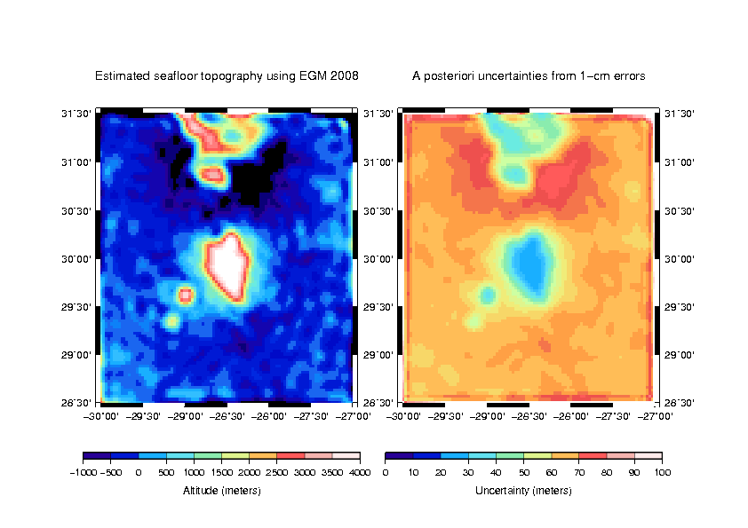
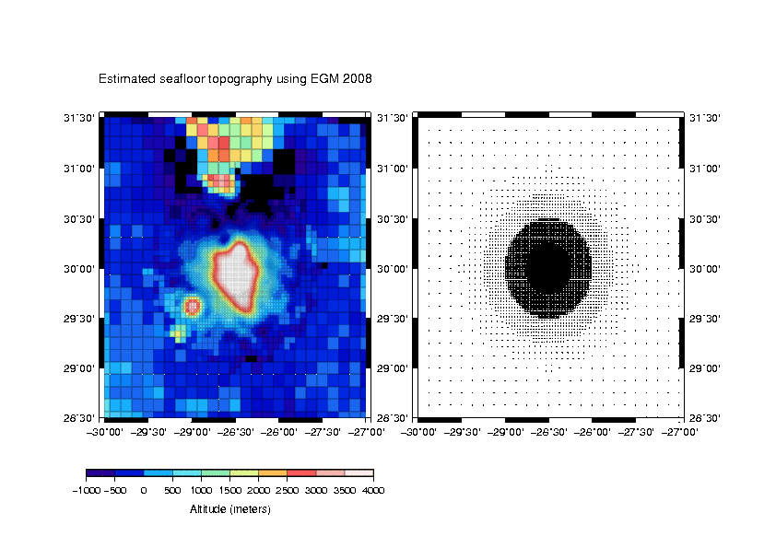
GEOID INVERSION FOR THE GREAT METEOR TOPOGRAPHY
Adaptive grid used:
Reduction of parameters.
Time of computation decreases
Representing the real data resolution (as ship mesaurements)

Slide 9
HIGHLIGHTS & PERSPECTIVES
Each input dataset that could be integrated iteratively in the KF has the possibility to complement - or not, depending upon the data uncertainties - the current regional topography solution.
The non-linear formalism was validated and it enabled to recover topography columns of kilometric sizes, and thus to reach higher spatial resolutions, e.g. Great Meteor guyot.
The numerical computation is optimized using C++ armadillo libraries.
The compensation effects are added to the model but further investigations are needed.
Taking the sediment thickness into account.
Seoane et al. (in preparation)

