Slide 1



Rapid and high precision DI¹⁴C analysis in small seawater samples and its future application as ocean tracer
In Climate: Past, Present, Future
CL5.3 Radiocarbon and the Carbon cycle – novel techniques and applications
Núria Casacuberta, Maxi Castrillejo, Anne-Marie Wefing, Silvia Bollhalder, Kayley Kündig, Hans-Arno Synal, and Lukas Wacker
Laboratory of Ion Beam Physics, ETH-Zurich, Switzerland
Contacts: M. Castrillejo (maxic@phys.ethz.ch)
D3343 | EGU2020-3581
Casacuberta et al.

Slide 2
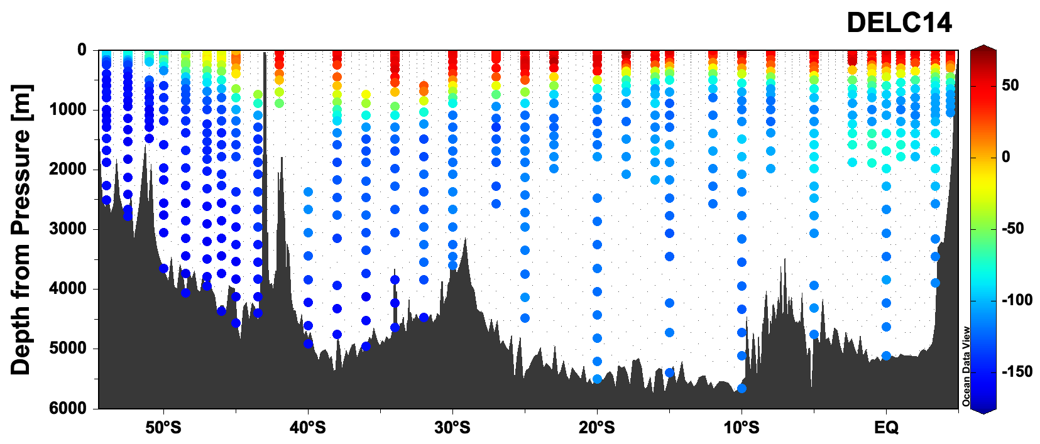
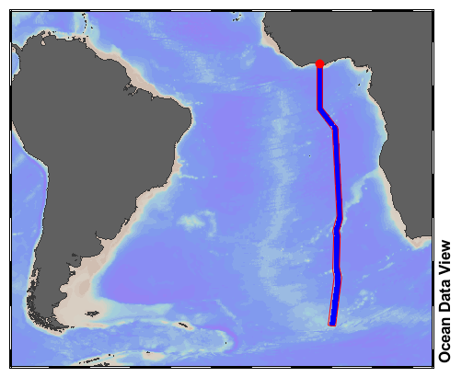
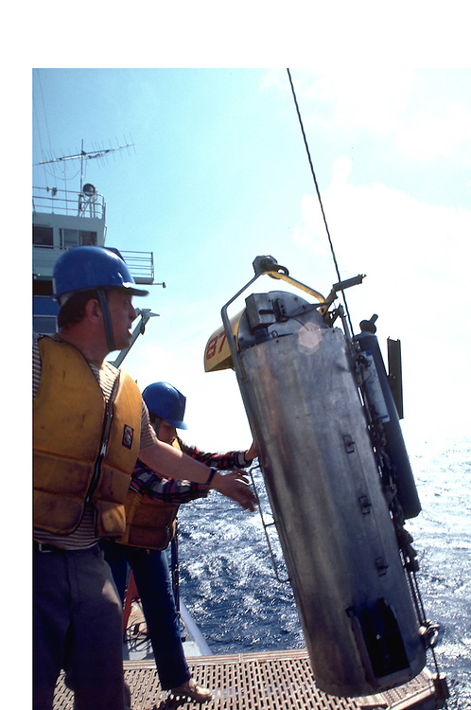
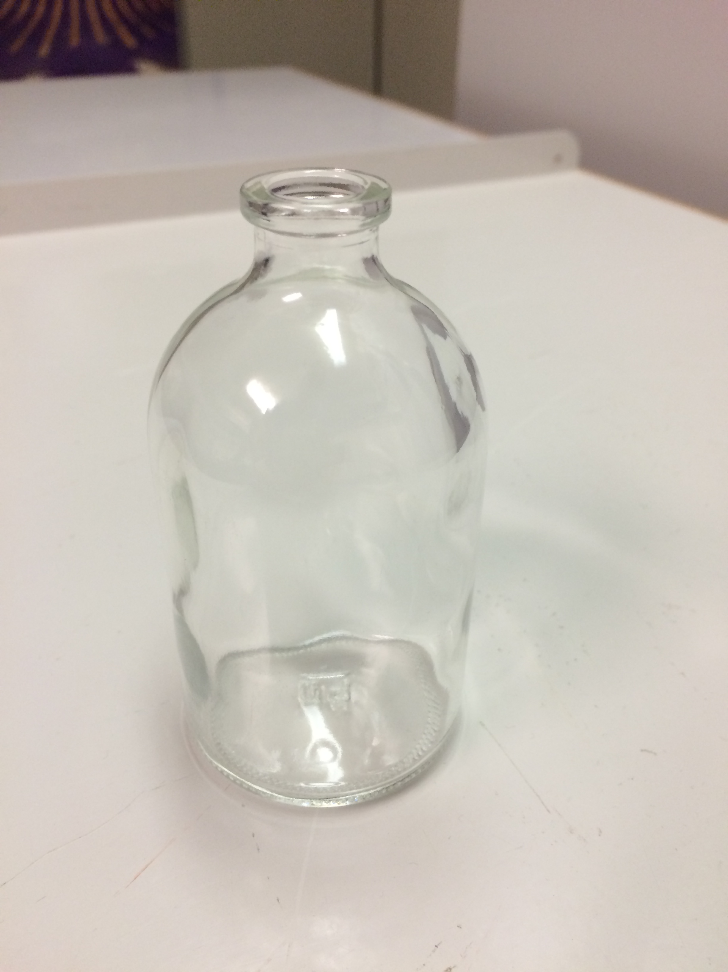
Motivation
APPLICATION
¹⁴C is a valuable ocean tracer: used to estimate water circulation timescales, uptake of atmospheric CO₂, ocean carbon cycling, etc.
Ambitious spatial and temporal sampling resolution is aimed (GO-SHIP program):
  Global oceans covered by reference sections
  Decadal to sub-decadal repetitions of sections
A13.5
Δ¹⁴C (‰)
Depth (m)
TECHNICAL
High quality ¹⁴C data is needed: develop methods to reduce sample volume, reduce potential of cross-contamination, intercalibrate methods…
A13.5
Key, R., and McNichol, A. 2020. Bottle data from cruise 33RO20130803, exchange version. Accessed from CCHDO https://cchdo.ucsd.edu/cruise/33RO20100308. Access date 2020-04-29.
Optimization of method
D3343 | EGU2020-3581
Casacuberta et al. | 1

Slide 3
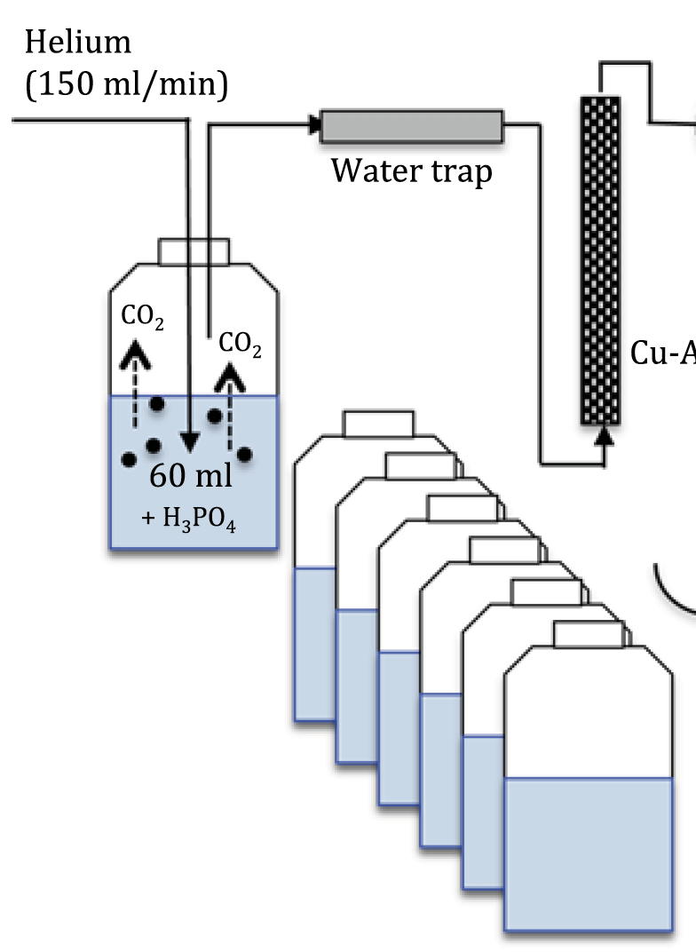
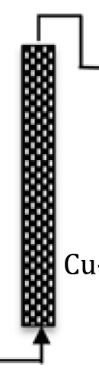
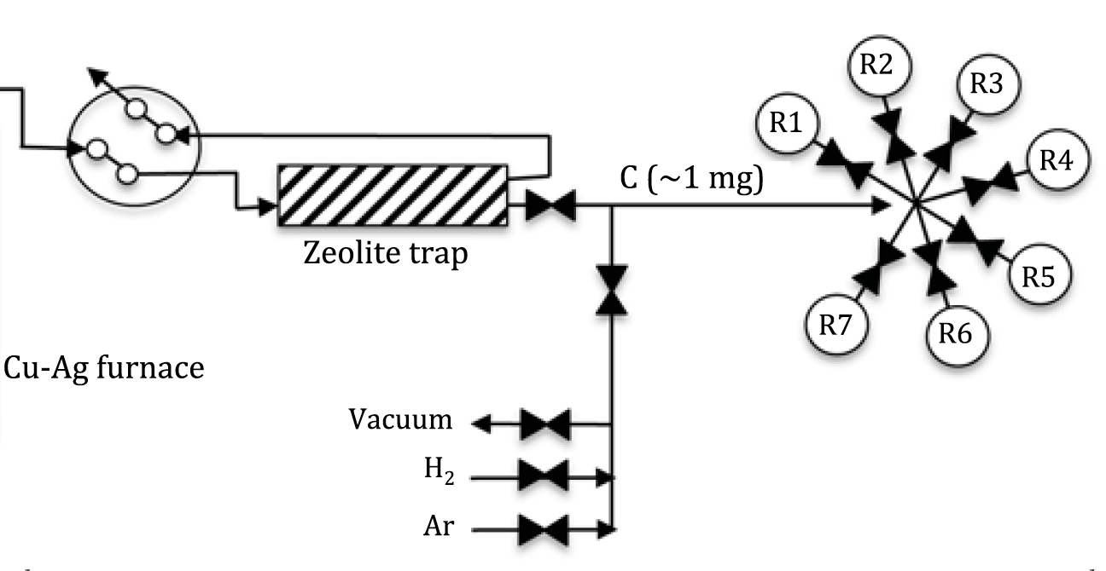
New method for high precision DI¹⁴C in small seawater samples
Fully automated extraction and graphitization steps are coupled in a single line (AGE system ETHZ).
Advantages: small volume (60 mL), fast (4 h), precise (2 ‰) and “cheap” (does not require much labor)
extraction
graphitization
Autosampler
Cu-Ag furnace
Automated Graphitization System (AGE)
Extraction of dissolved inorganic carbon from 7 samples in a row by flushing 60 mL of seawater with He gas to extract CO₂.
Removal of traces of sulfur compounds, nitrogen oxides and halogens results in better and faster graphitization.
Trapping of CO₂ in molecular sieve traps, thermal CO₂ release from trap into reactor. Graphitization performed simultaneously in the 7 reactors. Iron powder is used as catalyst.
Comparison of graphitiza- tion performance without furnace (black), and with two different types of furnace (red and blue).
D3343 | EGU2020-3581
Figures adapted from Casacuberta, N., et al. Radiocarbon, 62, 1, 2020. DOI: https://doi.org/10.1017/RDC.2019.87
Casacuberta et al. | 2

Slide 4
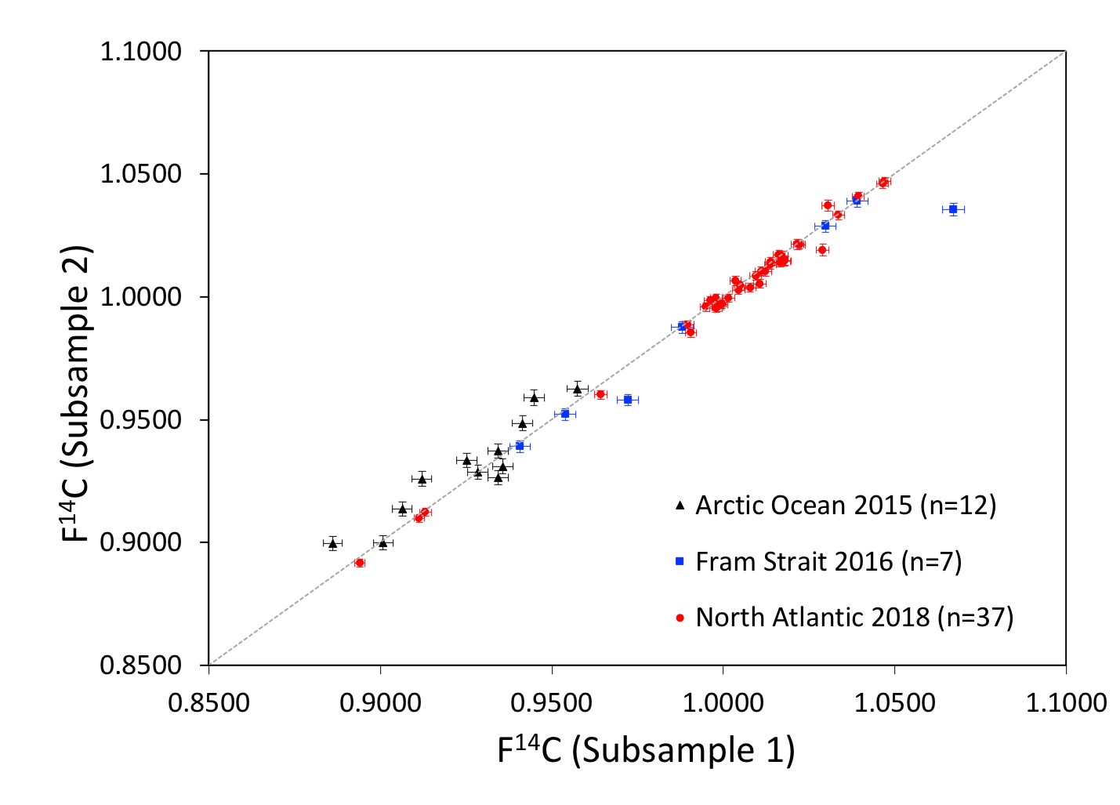
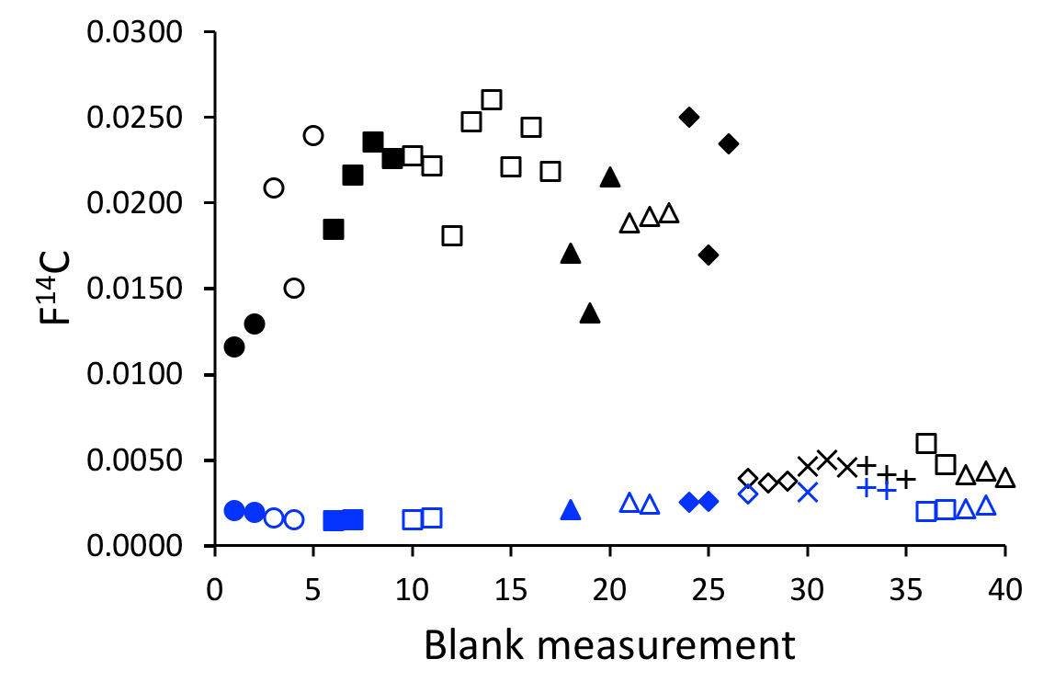
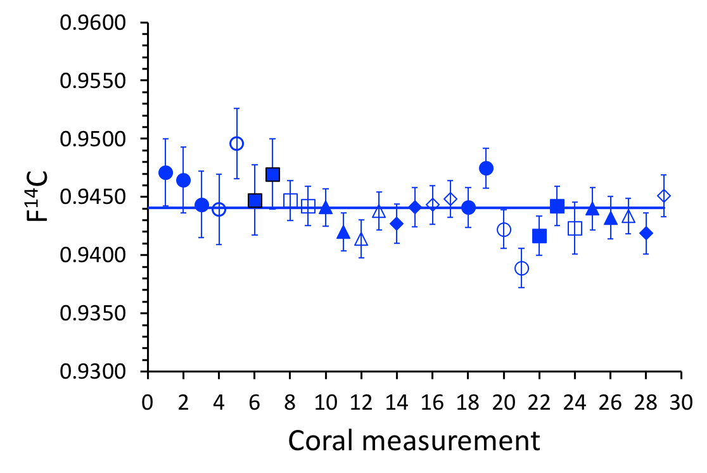
Quality control of the optimized method
Background correction
Accuracy
Reproducibility
Two types of blanks: Pthalic Anhydride combusted in EA (combustion blank) and IAEA C1 in deionized water (process blank). After cleaning of deionized water (blue arrow), both blanks displayed similar values. Thus, combustion blank was used for background correction.
A coral standard was used as a reference material with a nominal value of 0.9447 ± 0.0002. It was prepared similar to process blank and extracted and graphitized following the method used for seawater samples. The obtained mean value agreed within 1 sigma with the nominal value.
Seawater taken in the Arctic Ocean (n=12), Fram Strait (n=7) and North Atlantic (n=37) was used. Each seawater sample was separated into two subsamples. Reproducibility improved due to optimization of the method between subsets of data, from 2016 to 2018.
Initially, blank magnitude and variability
caused by deionized water
Process Blank
Comb. Blank
Figures based on Casacuberta, N., et al. Radiocarbon, 62, 1, 2020. DOI: https://doi.org/10.1017/RDC.2019.87
D3343 | EGU2020-3581
Casacuberta etal. | 3

Slide 5
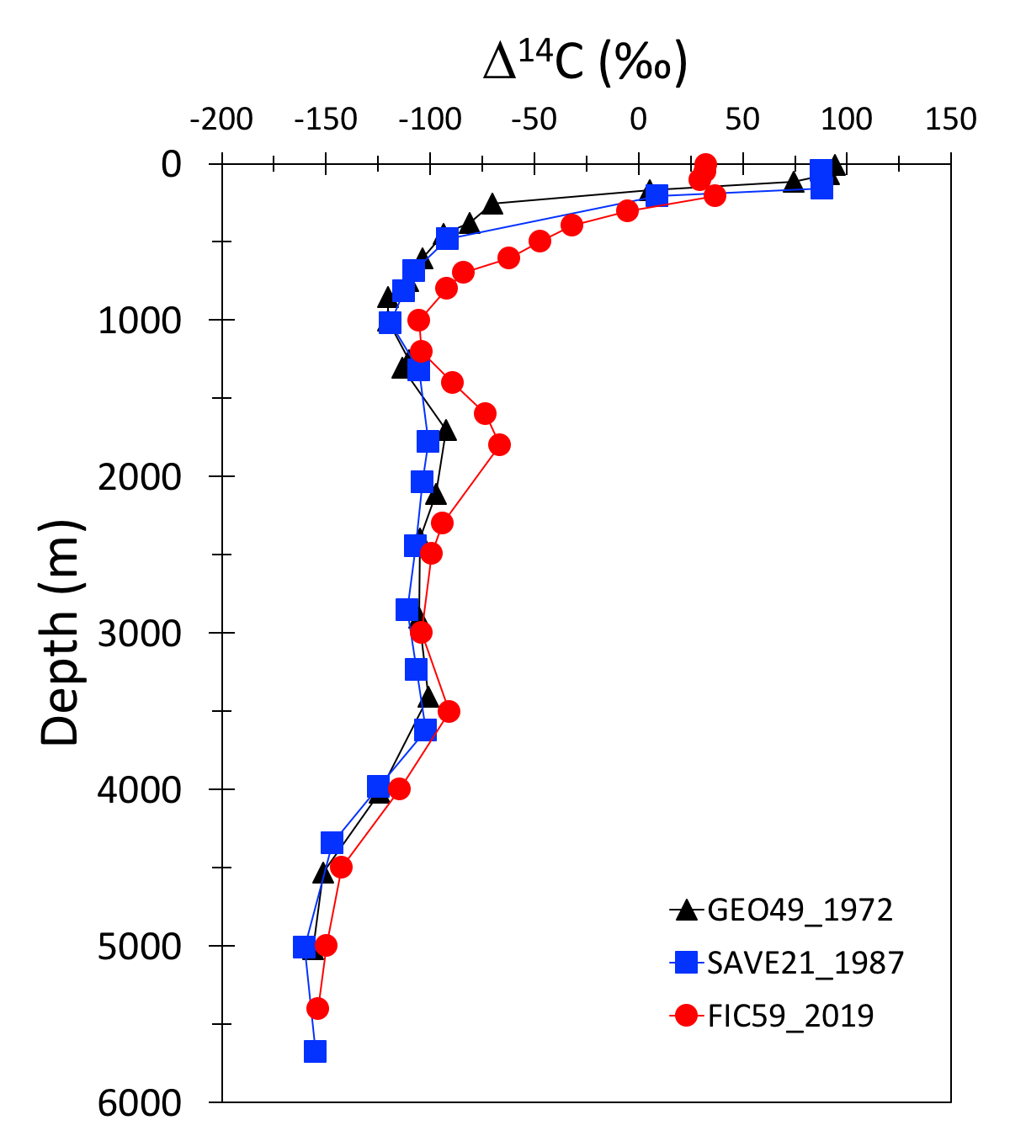
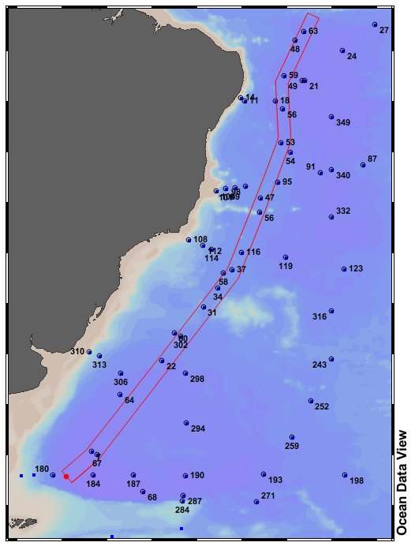
Depth-profile of ¹⁴C
METHOD OPTIMIZATION
Sample volume: 200 L, 60 mL
Precision: larger than 4 ‰, better than 2 ‰
Sample preparation: several hours-days per sample, 4 h for 7 samples in a row
Sample measurement: duplicate beta counting for > 15 h, AMS - 40 sample/day
1
3
2
OCEANOGRAPHIC FEATURES
Input of bomb-¹⁴C after 1960s, and air-sea exchange and vertical transport by 2019
Interior ventilation by northern waters, signal increasing due to bomb-¹⁴C transient
Advection of Southern/Antarctic origin waters, slight increase in ¹⁴C
2
GEOSECS_1972
SAVE_1989
3
2019
2019 data: unpublished, LIP, ETH Zurich.
D3343 | EGU2020-3581
Casacuberta etal. | 4

Slide 6
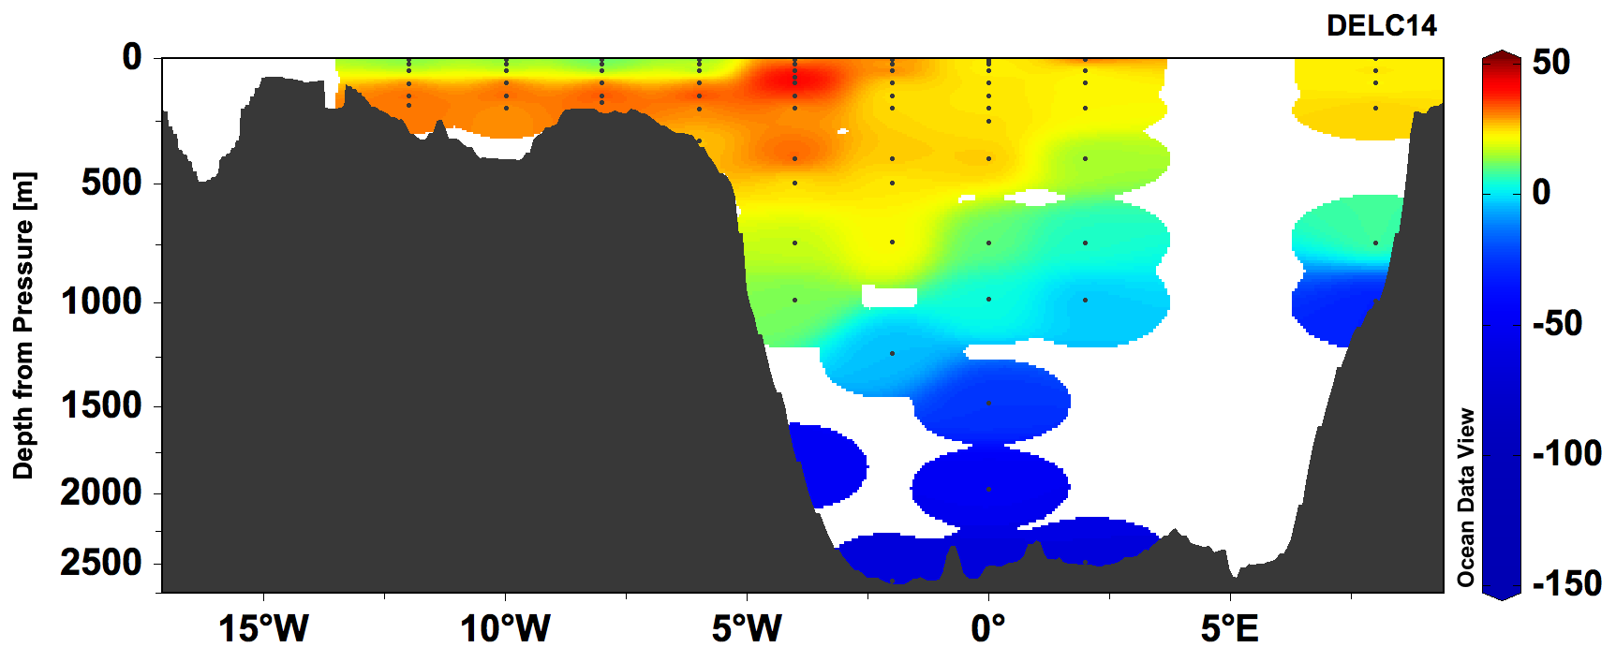
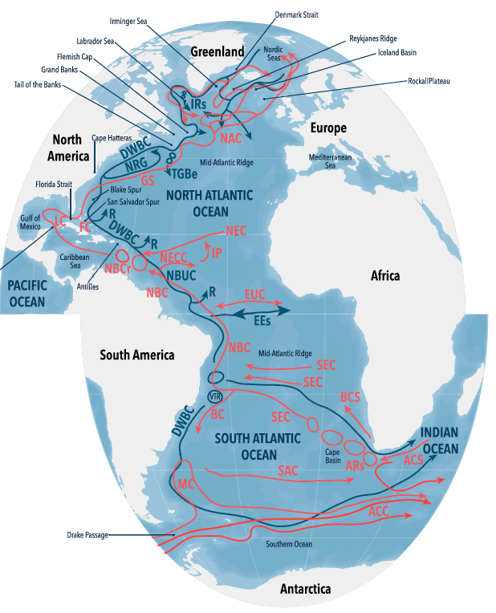
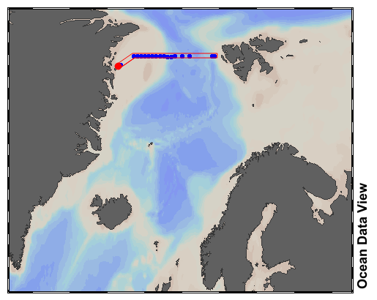
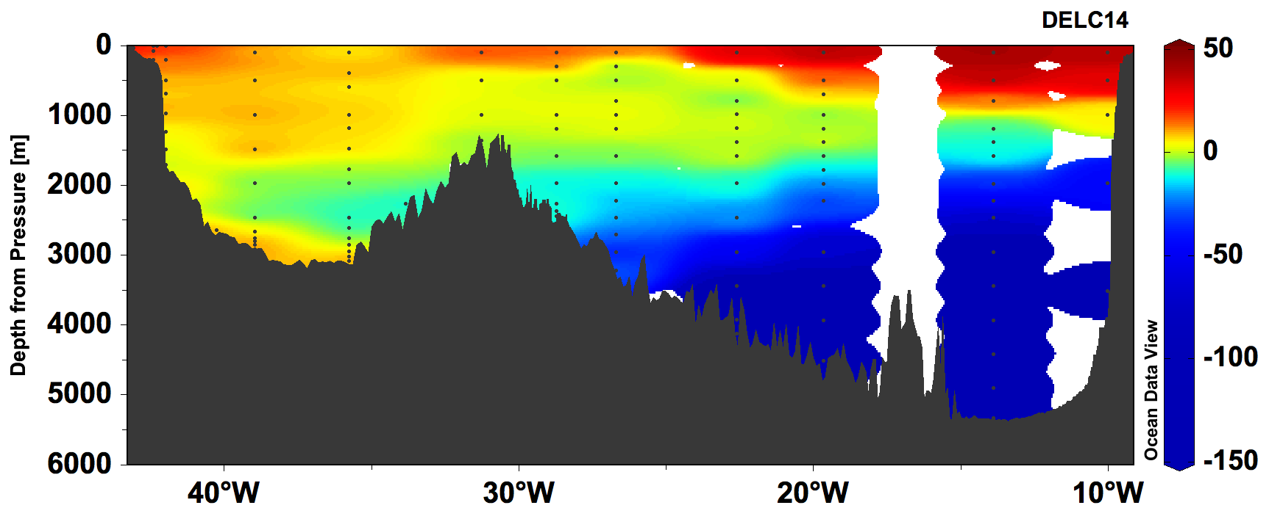
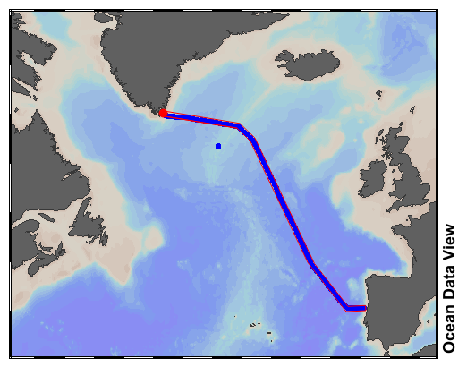
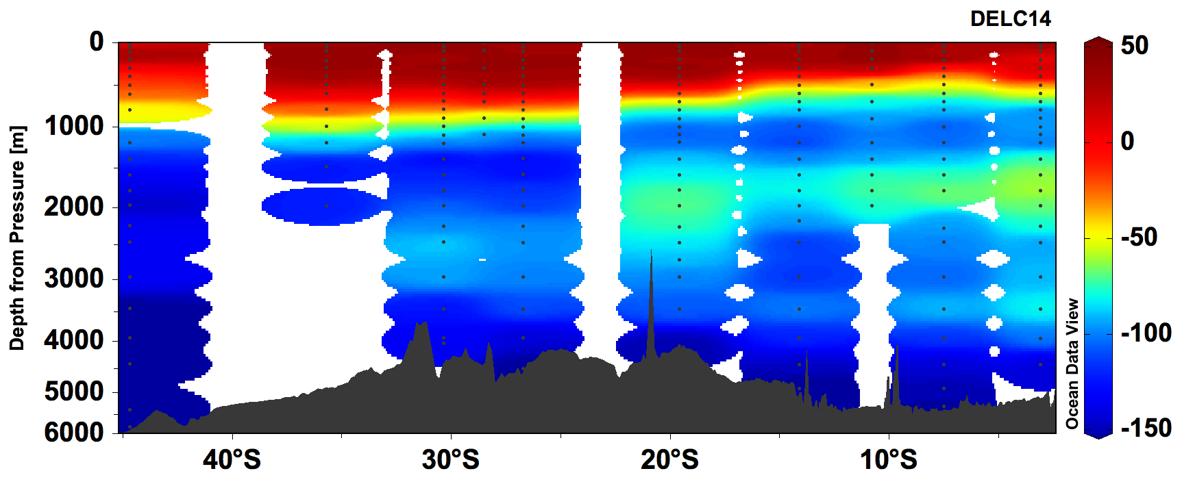
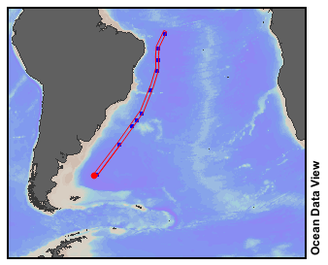
Zonal distribution of ¹⁴C
1
Δ¹⁴C (‰)
Fram Strait 2018
2
Greenland
2
Polar surface water
Waters of Atlantic Origin
Deep waters of Arctic Origin
Subtropical waters (NAC)
Labrador Sea Water
Nordic Overflow
Large portion of Antarctic waters
Subtropical Atlantic Central Water
Upper North Atlantic Deep Water
Lower North Atlantic Deep Water
Depth (m)
2
3
Δ¹⁴C (‰)
4
Subpolar North Atlantic 2018
5
5
5
Depth (m)
6
Irminger Sea
7
7
Δ¹⁴C (‰)
8
8
Southwestern Atlantic 2019
Depth (m)
9
9
10
Bower, A., et al. JGR Oceans, 124, 1, 2020.
DOI: https://doi.org/10.1029/2019JC015014
D3343 | EGU2020-3581
Unpublished data, LIP, ETH Zurich.
Casacuberta etal. | 5

Slide 7
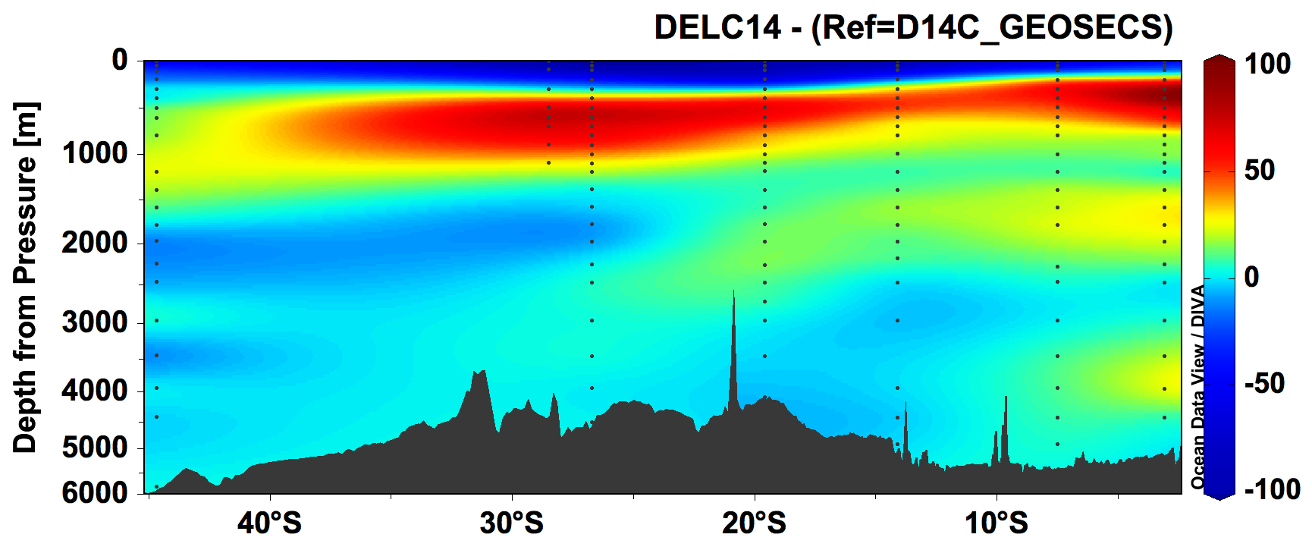
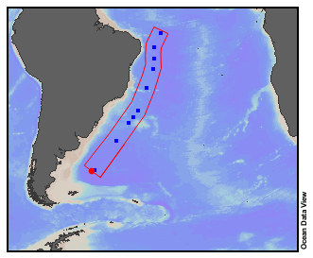
Summary
Outlook
New method to extract CO₂ and measure 14C in DIC of seawater
  Contamination minimized, blanks pose no issue, method is accurate and precise
  Automated extraction and graphitization coupled in a single line
  Reduced sample volume from 250 mL to about 60 mL
  Precision improved from about 3 ‰ to better than 2 ‰
  Fast, allowing sample throughput of 21 samples per day
  First data are oceanographically consistent
Use temporal evolution of ¹⁴C to estimate advection, diffusion, etc.
Combination with other transient tracers (e.g. ¹²⁹I, ²³⁶U and ³⁹Ar) for studying circulation processes on timescales of years to millennia
Reveal interior ventilation pathways and timescales of water in Atlantic Ocean (¹⁴C, ¹²⁹I and ²³⁶U). ETH Zurich Career Seed Grant (SEED-06 19-2)
Provide new constraints on upwelling rates in the Atlantic Ocean (observations and modelling of ¹⁴C)
Diff. 2019-1972 of Δ¹⁴C (‰)
Depth (m)
D3343 | EGU2020-3581
Casacuberta etal. | 6

Slide 8
Acknowledgements
Thank you for your virtual attention!
Thanks to chief scientists, colleagues, captain and crew members involved in the sampling during the three expeditions in the Arctic Ocean, Fram Strait and North Atlantic Ocean
N. Casacuberta’ s research was supported by the Swiss National Science Foundation (AMBIZIONE PZ00P2_154805)
M. Castrillejo’ s research was supported by the ETH Zurich Postdoctoral Fellowship (17-2-FEL-30), co-funded by the Marie Curie Actions for People COFUND Program, and the ETH Career Seed Grant (SEED-06 19-2).
A.-M. Wefing received funding from the ETH-Zurich Doctoral grant ETH-06 16-1.
Additional funds were provided by the Laboratory of Ion Beam Physics and its consortium partners (EAWAG, EMPA and PSI).
D3343 | EGU2020-3581
Casacuberta etal. | 7

