Slide 1


Overall Summary
Emergency
Department
mineral
dust
+
Metals
(insoluble)
pH 1 to 2
pH 1 to 2
Fe₂O₃
Time
Fe₂O₃
internally
mixed
H⁺
H⁺
WS Fe
Toxicity
WS Fe
SO₄²⁻
SO₄²⁻
WS Fe
SO₂/SO₄²⁻
LWC
LWC
oxidative stress
Cardiovascular
Visits
Fine PM must be very acidic to dissolve Fe in reasonable time
Epi Study in Atlanta
SO2 scrubbers installed: Sulfate drops, pH constant, LWC drops, total Fe constant, WS Fe drops, WS Fe/Total Fe drops
Sulfate (and PM2.5) mass linked to adverse health through a complex process, but WS Fe the causative agent
A mechanism explaining sulfate, strong acidity, or secondary species links to health effects reported in many past epi studies?
A demonstration of air pollutant → health-effect complexity
  An example, of unintended consequence (benefit) of coal-fired EGU SO₂ reduction

Slide 2
Iron in Soils and Road Dust is Modulated by Coal-Fired Power Plant Sulfur Making Toxic PM2.5
Rodney Weber, Yuhan Yang, Jenny Wong, Jim Mulholland, Ted Russell
Georgia Tech
Thanos Nenes
EPF Lausanne

Slide 3
Outline
We will show that sulfate from coal fired power plants can be linked to aerosol toxicity and adverse health effects through complex atmospheric chemical processes.
Summary:
Emergency
Department
Dust & Brakes
Metals
(insoluble)
pH 1 to 2
pH 1 to 2
Fe₂O₃
Time
Fe₂O₃
Epi Stuy
internally
mixed
H⁺
H⁺
WS Fe
Toxicity
WS Fe
SO₄²⁻
SO₄²⁻
WS Fe
SO₂/SO₄²⁻
liquid water
liquid water
oxidative stress
Cardiovascular
Visits
fine PM

Slide 4
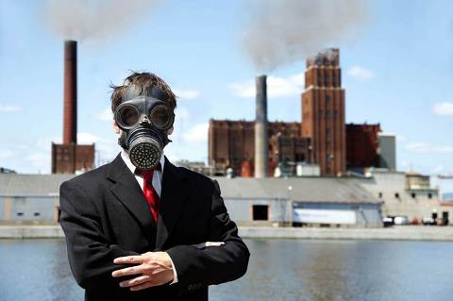
Background: Aerosols and adverse health effects
PM_{2.5} is a complex chemical mixture that evolves with age.
A small mass fraction or particle characteristic may drive most health effects, such as:
    Metals
    Strong acidity (H⁺)
    Incomplete combustion species (soot, PAHs, quinones…)
What emissions should be controlled, what is the aerosol toxicity in the future?

Slide 5
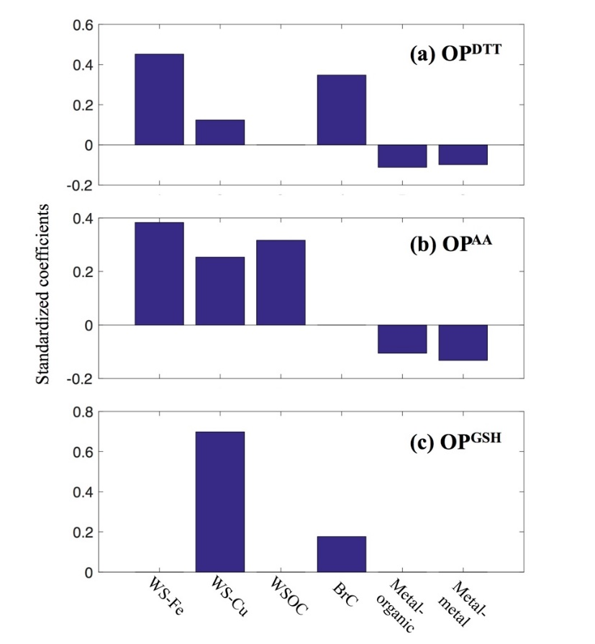
Background: Aerosols and adverse health effects
Relative importance of PM species contributing to particle Oxidative Potential
Oxidative stress/inflammation, a plausible biological mechanism for aerosol toxicity.
Involves redox imbalance due to catalytic in vivo:
  Loss of physiological reductants
  Generation of strong oxidants
  Can explain wide range of effects, cardiovascular, respiratory, dementia…
coefficients from standardized multivariant regression
assay
aerosol
Adapted from Lakey et al., Sci. Reports 2016
Red⁻
Red•
Cycling, small mass can have large effect
Species involved in redox reactions that may play a large role:
  Quinones
  Transition metal ions (TMIs)
soluble Fe and Cu
From Dong Gao PhD Thesis. GIT 2019
Notes:
The standardized coefficient of a specific component indicates the estimated change in an OP measure for every one-unit increase in component. The higher the absolute value of the standardized coefficient, the stronger the effect of the PM species on the OP measure.
Standardized linear regression. Standardization is a process that involves subtracting an individual value by the population mean and then dividing by the population standard deviation. In linear regression this results in predictors that have a mean of 0 and a standard deviation of 1.

Slide 6
Background: Aerosols and adverse health effects
Autonomic nervous system
Biological Pathways linking PM with Cardiovascular Disease (CVD)
→ Transition metal ions (eg, WS_Fe) are linked to oxidative stress, which is linked to CVD
Brook et al. Circulation 121, 2010

Slide 7
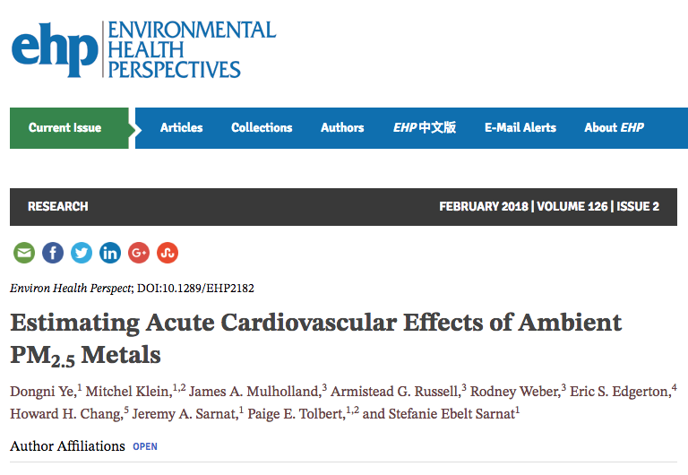
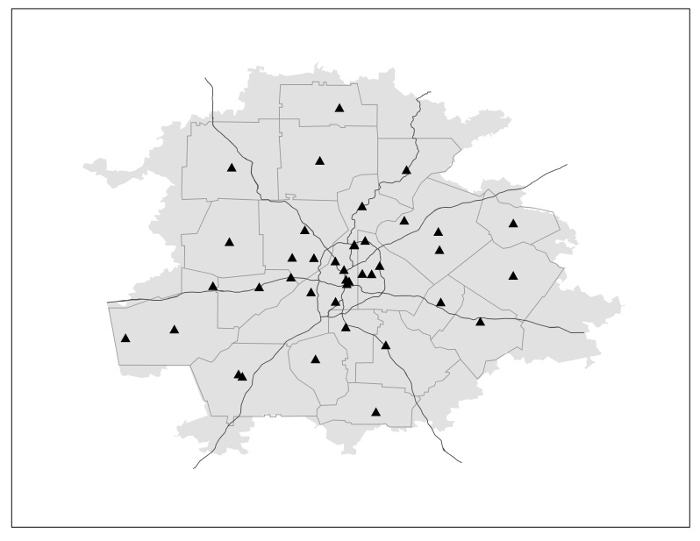
Background: Soluble Iron in Atlanta and Cardiovascular Effects: An Epidemiology Study
Cardiovascular Hospital ED visits for 5-county (yellow) Atlanta region
hospitals
Study Period: 1998 – 2013 (~15 years)
N = 3,303 days for air quality and health data
Total 426,252 CV visits at all hospitals
Air quality data from SEARCH JST site in Atlanta

Slide 8
Background: Soluble Iron in Atlanta and Cardiovascular Effects
Epidemiological Study Results: Data 1998 - 2013
Risk Ratios for single pollutant models
95% confidence intervals
WS Fe highest RR
RR and CI > 1
WS-Fe highest RR
persists in 2-pollutant models (remove co-variability)
RR > 1 = adverse effect
RR = 1 = no effect
RR < 1 = good effect
CV effects most strongly linked to water-soluble Fe
(other TMI may be important, but often below LOD)
What is the source of WS Fe?

Slide 9
Results: Sources of Insoluble and soluble Fe in Atlanta? (PMF)
Insoluble Fe sources (WI_Fe = Fe - WS_Fe)
WS Fe
Secondary Species
47%
39%
Mineral Dust
12%
Biomass Burning
9%
14%
Biomass Burning
Mineral Dust
49%
32%
Road Dust; Tire/Brake Wear
Road Dust; Tire/Brake Wear
Fang et al, Atmos. Chem Phys. 2015
Insoluble forms of Fe are mainly dust, whereas, large fraction of Water-Soluble Fe are linked to secondary processes

Slide 10
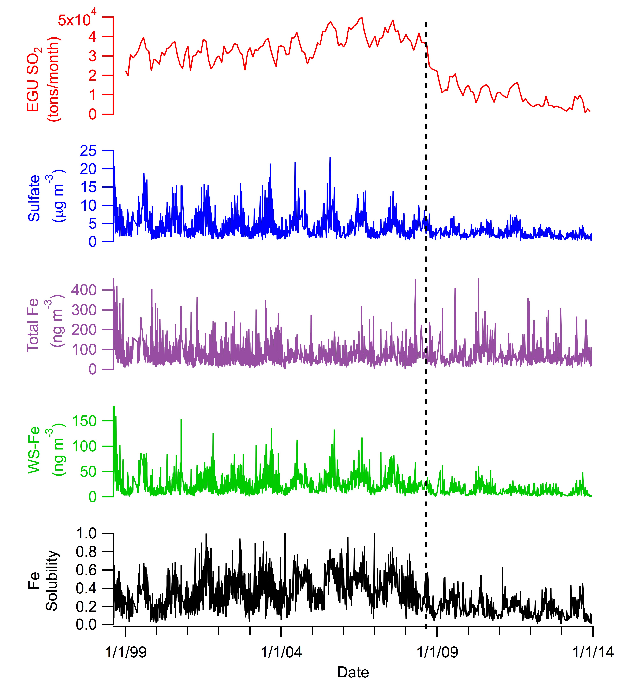
Results: Data from the 1998-2013 Epi Study in Atlanta
SO₂ emissions, PM_{2.5} Fe, Sulfate and Water-Soluble Fe, and WS_Fe/Fe at JST
Coal fired Bowen plant SO₂ scrubbers are online
WS_Fe correlation (Pearson r) with:
Total Fe | r = 0.63
Sulfate | r = 0.66
p<0.05

Slide 11
What happened near end of 2008 in SE US?
Bowen: Rome Georgia,
2006 3rd largest EGU in US
Coal fired.
SO₂ drop near end of 2008
epi study period

Slide 12
Before/After Bowen SO₂ Scrubbers: Similar Changes at Other Sites Throughout the Southeast
Percentage Change at JST After Bowen SO₂ Scrubbers
Sulfate: 49 % drop
Total Fe: 4 % drop
Proportional drop in Sulfate and WS_Fe & Fe Solubility
WS_Fe: 50 % drop
WS_Fe/Fe: 48 % drop

Slide 13
How is sulfate linked to WS_Fe? One way is Acid Dissolution
But the process is slow, it takes time
Explains observed levels of WS_Cu and WS_Fe
Copper
Copper acid dissolution at pH < 5.5
Cu
Iron
Fe
Iron acid dissolution at pH < 3
Birmilli et al.

Slide 14
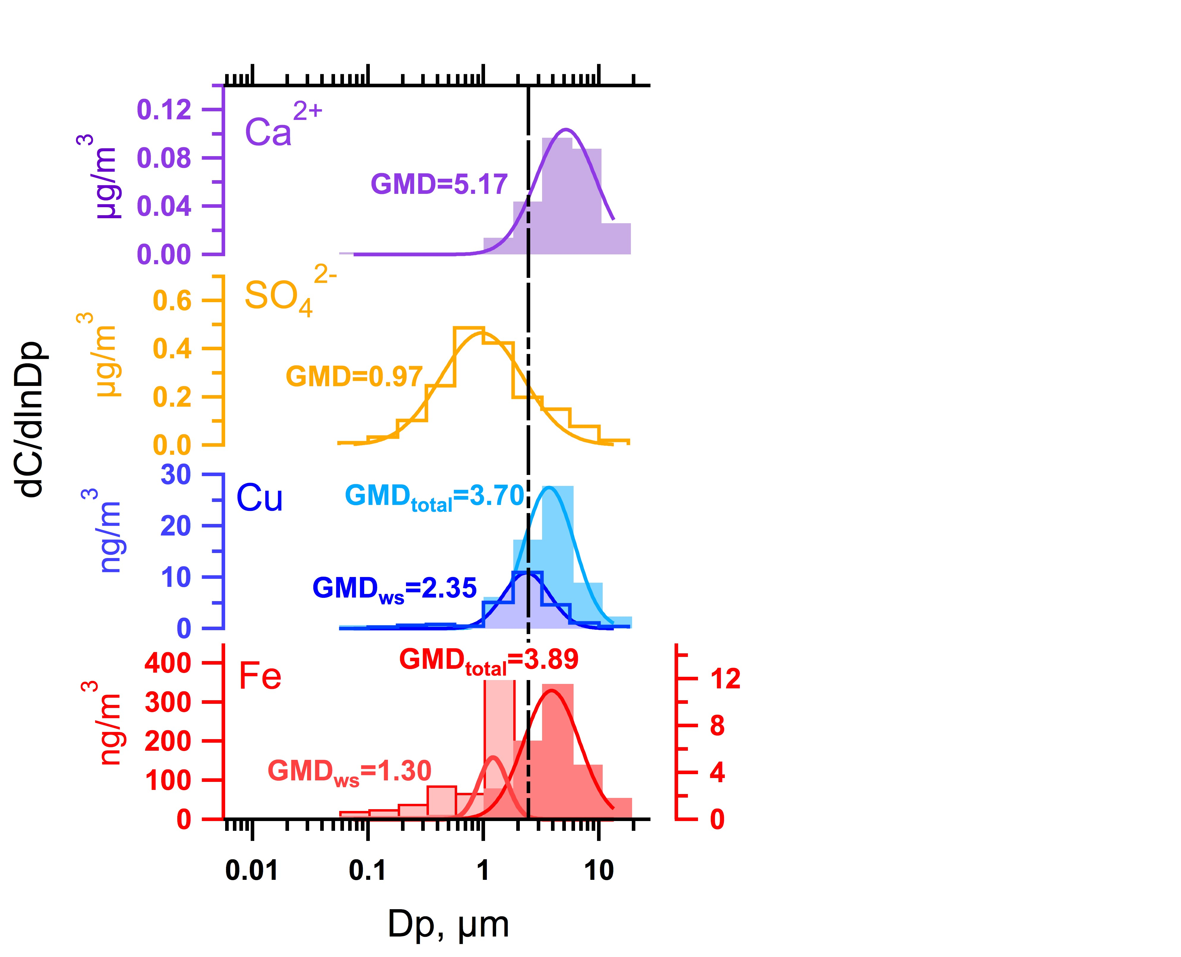
Role of sulfate: Metal Dissolution by Acidic Aerosol in Atlanta
From MOUDI samples
2.5 µm
ISORROPIA-predicted
WS-copper as an example
Acid buffering by NVCs
Emitted insoluble metals in coarse mode.
Acidic PM₁ due to presence of sulfate and few NVCs.
Acid
Elemental Cu
WS Cu
Cu becomes soluble by acid dissociation.
Fang et al, ES&T 2017
Iron more difficult to dissolve than Cu
WS Fe
Single particle analysis (XANES spectroscopy) shows Atlanta WS Fe and WS Cu internally mixed with S.
  (Oakes et al., ES&T 2012) (Longo et al., Atmos Chem Phys 2016)

Slide 15
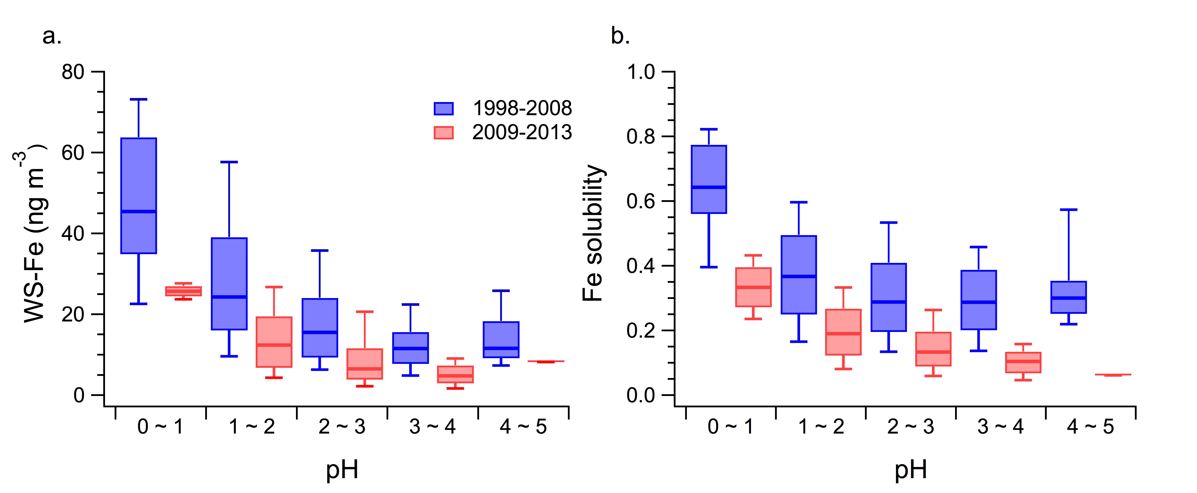
How is sulfate linked to WS_Fe: Acid Dissolution ?
PM_{2.5} pH determined by thermodynamic model, ISORROPIA
From our Epi-study data set, WS-Fe Concentration and fraction of Fe that is water soluble increases with lower pH (ie, approx. pH < 3)
Similar results seen in Toronto,
Tao & Murphy, 2019

Slide 16
What about pH and LWC ?
Percentage Change at JST After Bowen SO₂ Scrubbers
Sulfate: 49 % drop
Fe: 4 % drop
WS_Fe: 50 % drop
WS_Fe/Fe: 48 % drop
pH: ~1 to 3 % drop
Proportional drop in particle liquid water content, pH is always low, but small change
LWC: 39 % drop

Slide 17
Conceptual View: pH is low, but particle liquid water content (LWC) drives variability
Acidity (pH) remains largely constant, LWC (reaction media) varies with sulfate
→ WS_Fe varies with LWC

Slide 18
One Implication: PM_{2.5} mass and WS_Fe are correlated, but WS_Fe Mass Fraction is Low
r = 0.67
slope = 1.57 x 10⁻³ = 0.15 %
(WS_Fe/PM_{2.5} mass ratio)
Eg, Toxic, but small mass component of PM_{2.5} could drive epi associations between PM_{2.5} mass and health endpoints

Slide 19
Summary
Example of PM_{2.5} toxicity driven by secondary processing
(similar processes for other transition metals)
Emergency
Department
Metals
(insoluble)
pH 1 to 2
pH 1 to 2
Fe₂O₃
Time
Fe₂O₃
internally
mixed
H⁺
H⁺
WS Fe
Toxicity
WS Fe
SO₄²⁻
SO₄²⁻
WS Fe
SO₂/SO₄²⁻
LWC
LWC
oxidative stress
Cardiovascular
Visits
Fine PM must be very acidic to dissolve Fe in reasonable time
A mechanism explaining sulfate, strong acidity, or secondary species links to health effects reported in many past epi studies?
A demonstration of air pollutant → health-effect complexity
  An example, of unintended consequence (benefit) of coal-fired EGU SO₂ reduction

Slide 20


R835882
The contents are solely the responsibility of the grantee and do not necessarily represent the official views of the US EPA. Further, US EPA does not endorse the purchase of any commercial products or services mentioned in the work.
All data were from the SEARCH network, PI Eric Edgerton, and supported by the Southern Company/Georgia Power

