Slide 1

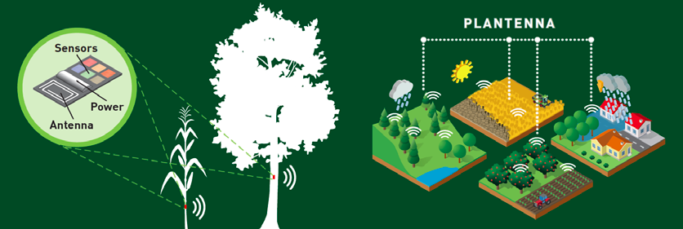

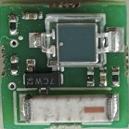
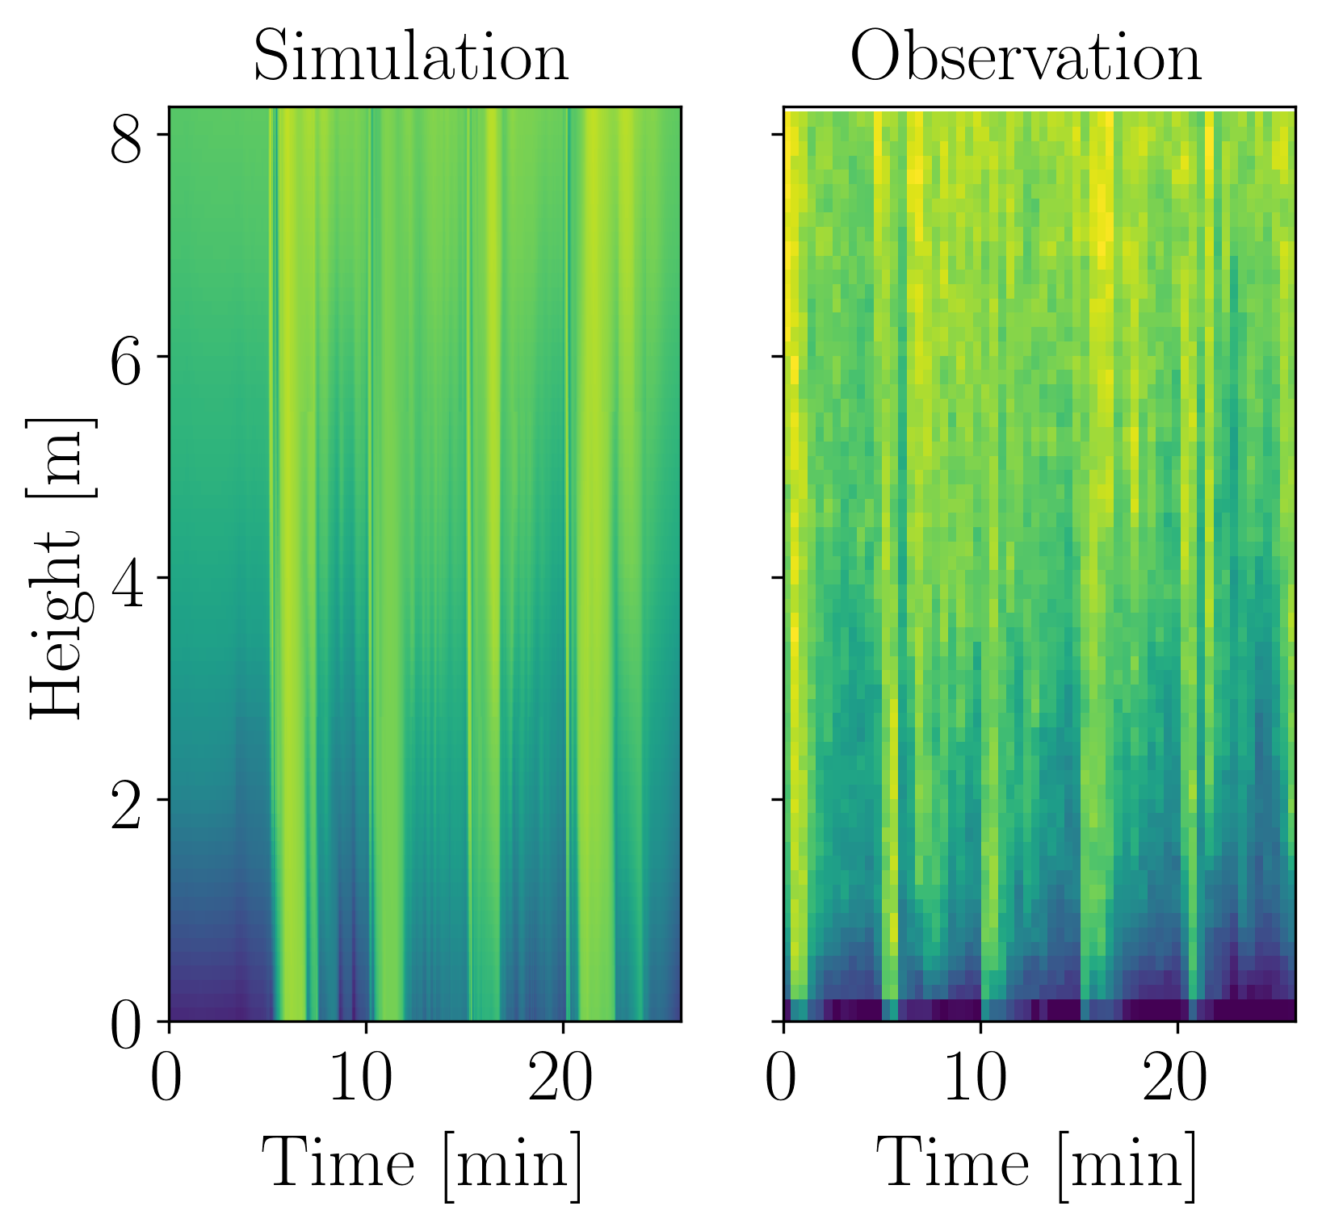
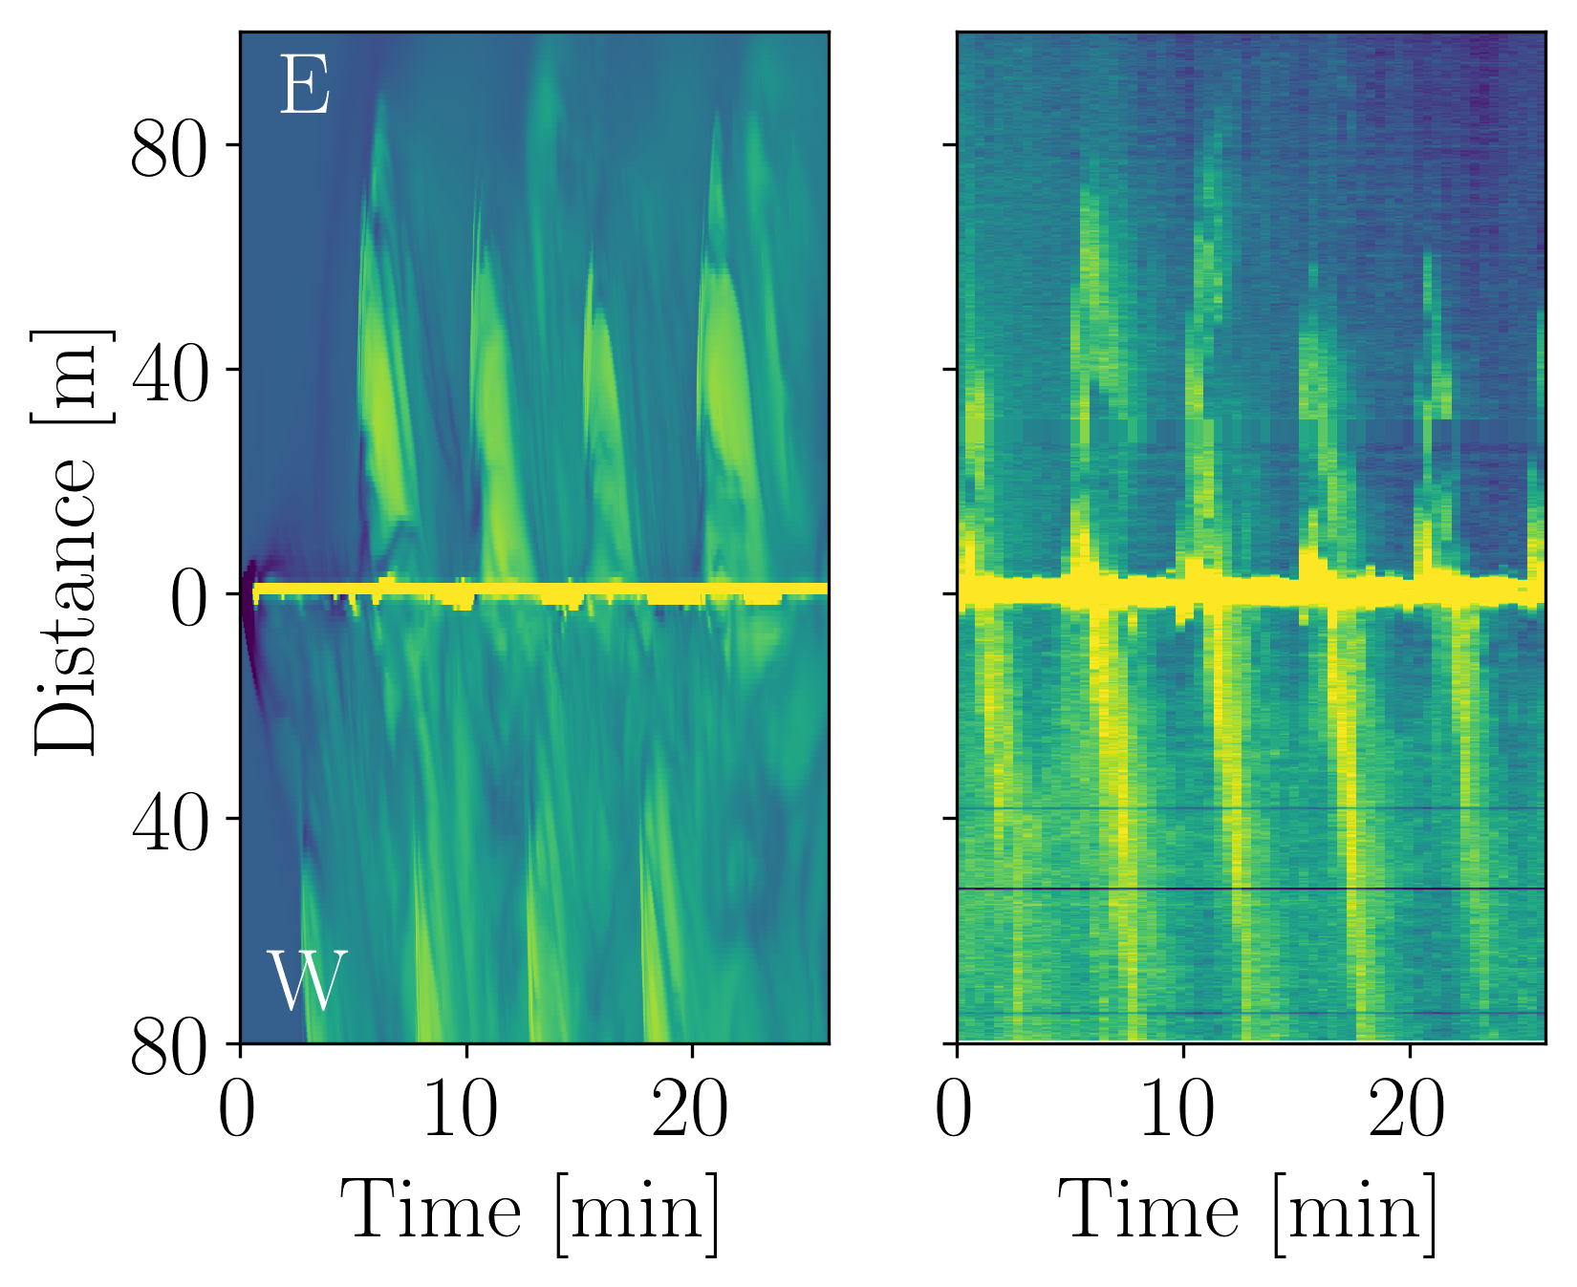
PLANTENNA: 3D-sensor networks monitoring plant environment.
An application for fruit frost protection
Plantenna: 4 NL Universities, 20+ researchers: developing miniature, low-cost, autonomous sensors that measure environmental and in-plant variables at unprecedented resolution
Low-cost, miniature “plug-and-forget” sensors:
Autonomous wrt energy and data communication
Application fruit frost protection: High-density temperature profiles: temperature measurement every 15-50 cm (click links for more more info and animated temperature and turbulence fluxes).
Marie-Claire Ten Veldhuis, Bas van de Wiel, Qinwen Fan and Peter Steeneken
Contact: j.a.e.tenveldhuis@tudelft.nl (Fruitfrost), q.fan@tudelft.nl (Sensortech)

Slide 2
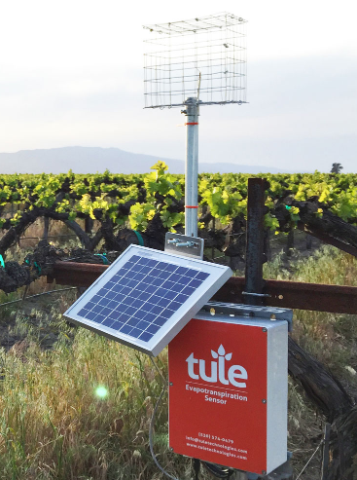
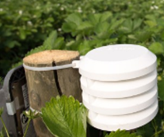
Current solutions versus our proposal
Costly
Price (>100 EURO)
Installation cost
Low-cost
CMOS based: < 5 EURO
Easy installation
Size: 0.5 cm
Contact: Dr. Qinwen Fan q.fan@tudelft.nl

Slide 3
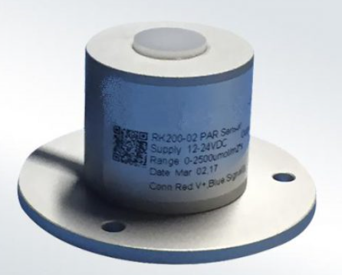
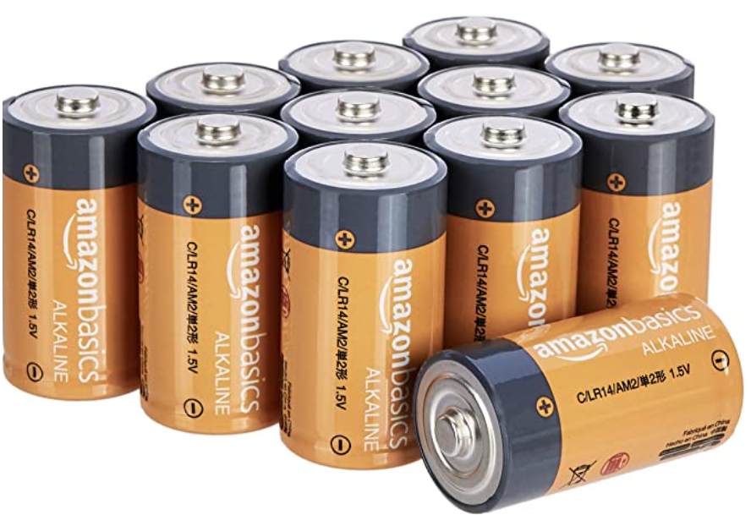
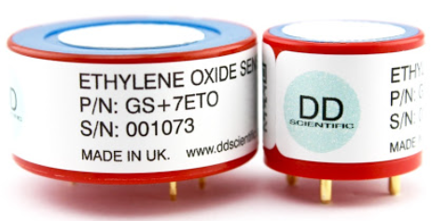
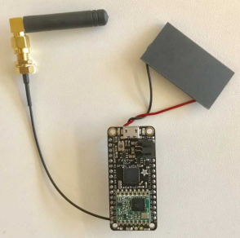
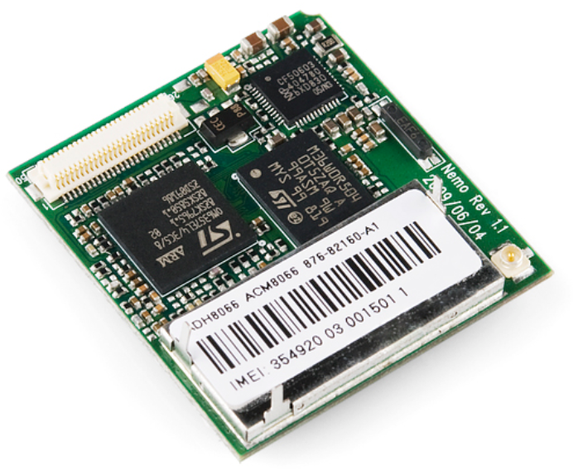
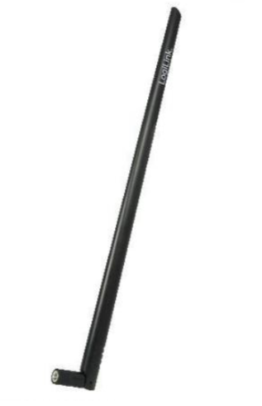
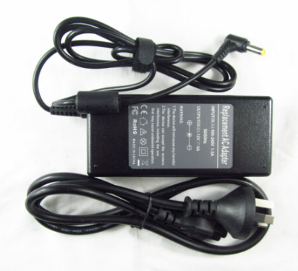
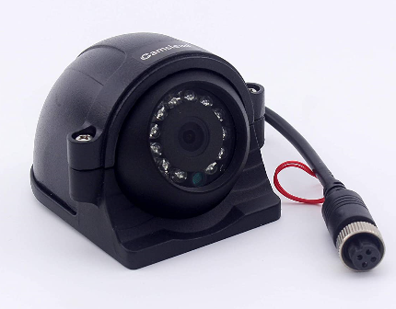
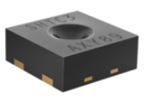
Background: Components of a Typical Sensor System
Power Sensors Electronics Antenna System assembly
Contact: Dr. Qinwen Fan q.fan@tudelft.nl

Slide 4
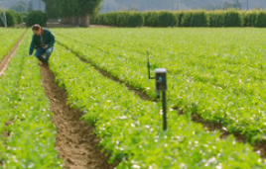
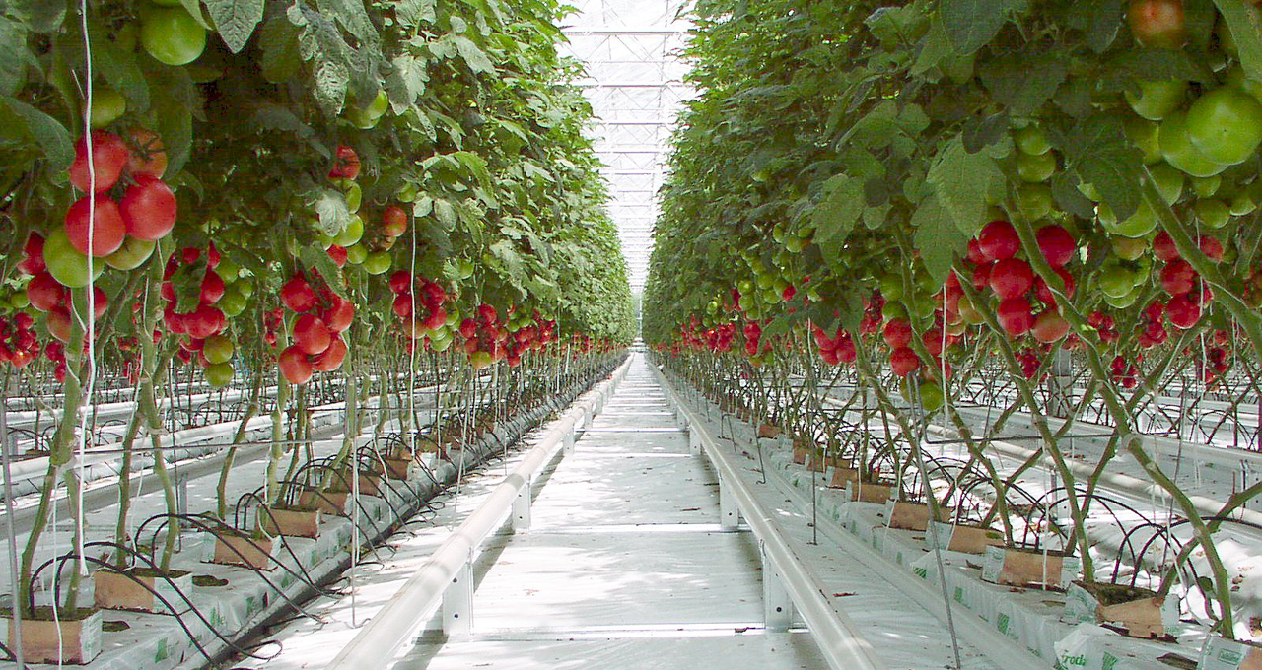
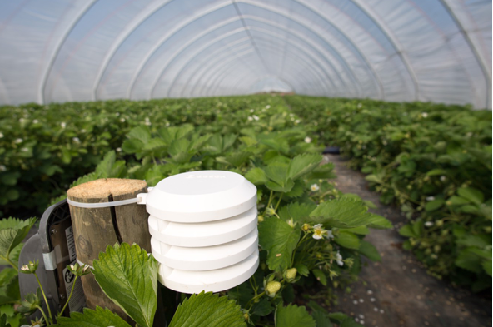
Current solutions versus our proposal
Coarse data
One sensor per large area
Does not track (near-)plant conditions
Limited location
To-the-point data
Sensor per plant
Tracks plant logistic
Flexible location
Contact: Dr. Qinwen Fan q.fan@tudelft.nl

Slide 5
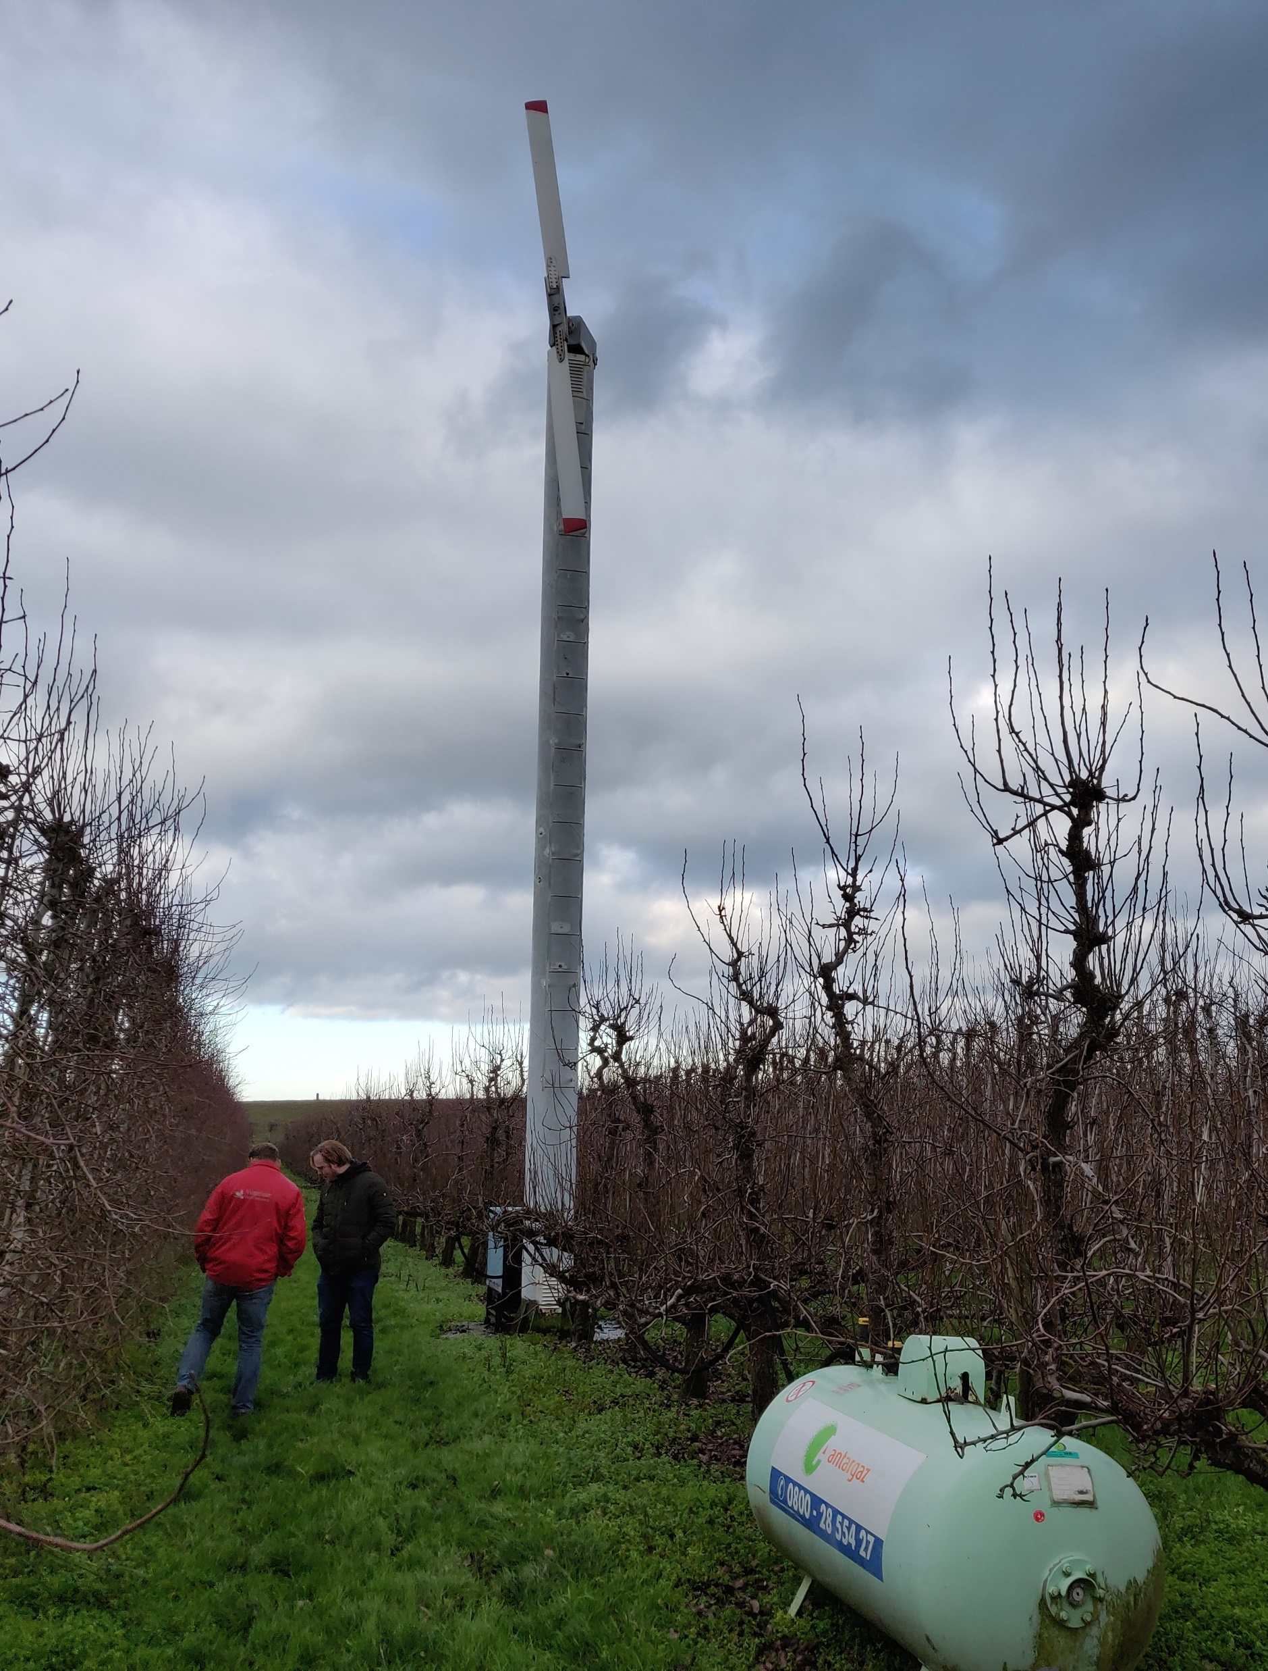
“Clarity on Fruit Frost”
Understanding night frost spatial variability at 15-50 cm resolution.
Test effect of mitigation measures: wind machine
Engine heat
130 kW
10.5 m hub height
5 min rotation time
7ᵒ tilt angle
Contact: Dr. Marie-Claire ten Veldhuis (j.a.e.tenveldhuis@tudelft.nl)

Slide 6

Movie: Impression field experiment: fruit farm and wind machine operation

Slide 7
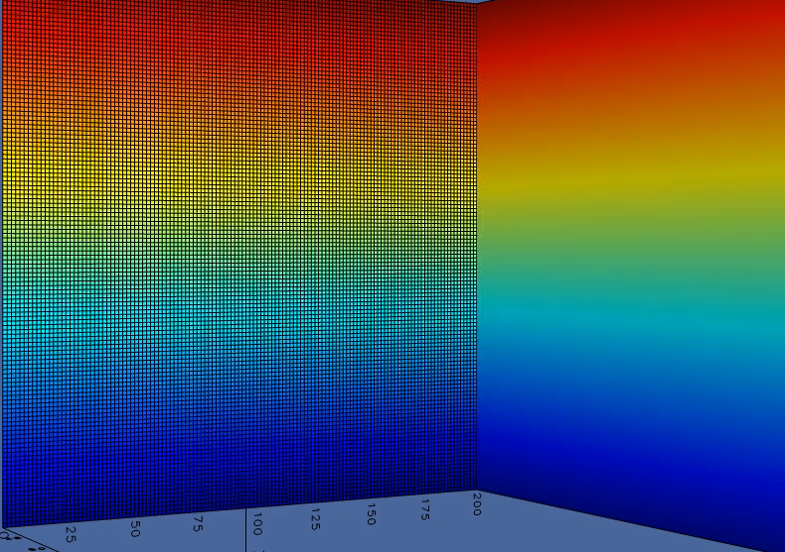
Simulations wind machine turbulence and thermal effect
Animated turbulence vortices induced by wind machine
Animated temperature change induced by wind machine operation
In house Adaptive grid code BASILISK (Courtesy: Van Hooft)

Slide 8
Next steps (5 year Research Grant):
3 PhD’s in Atmospheric, Hydrological Sciences, Sensor Technology)
Groups: Ten Veldhuis, Makinwa, Fan & Van de Wiel
Goals:
Physics: test and improve efficiency multiple mitigation measures
Technology: Towards practical decision tool for farmers: real time quantification 3D frost field (T=0 surface), using fully autonomous, wireless sensor networks

