Slide 1
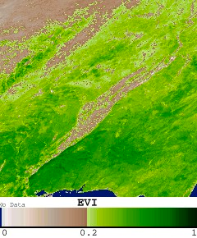
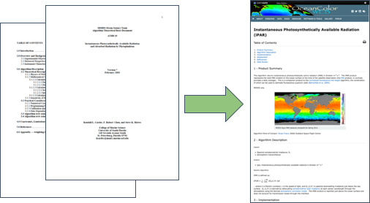
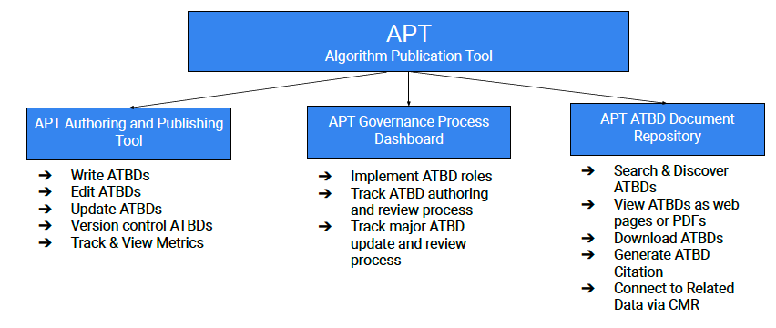
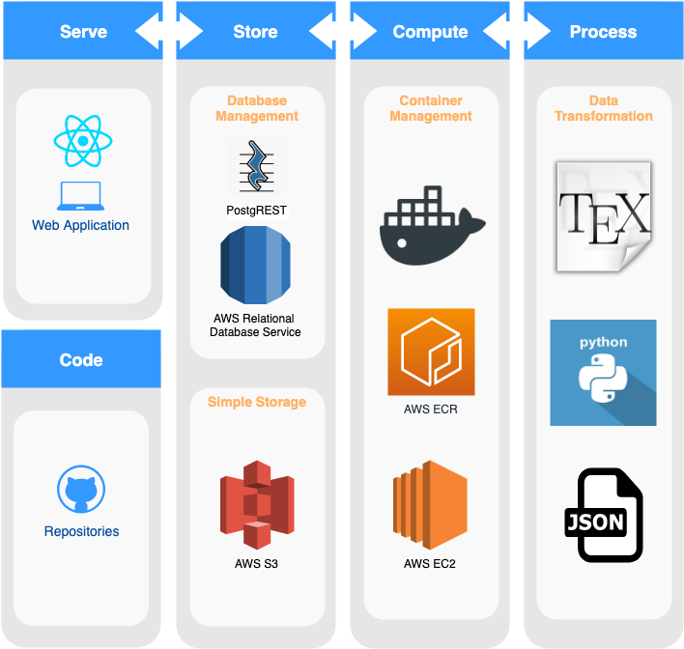
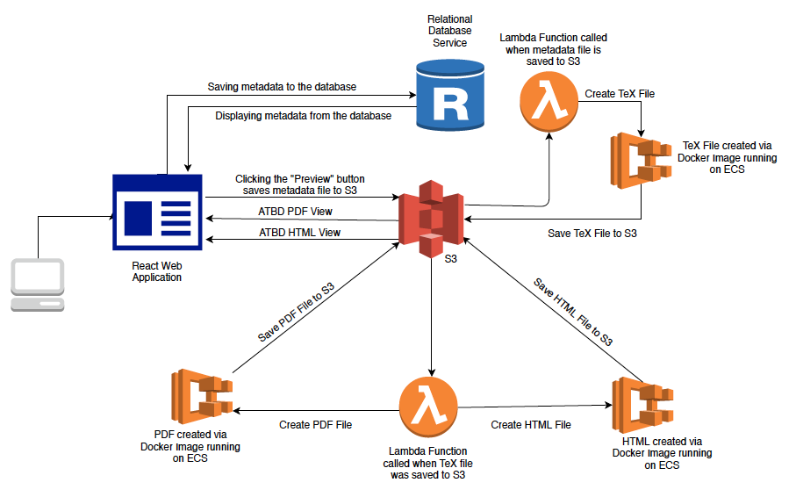
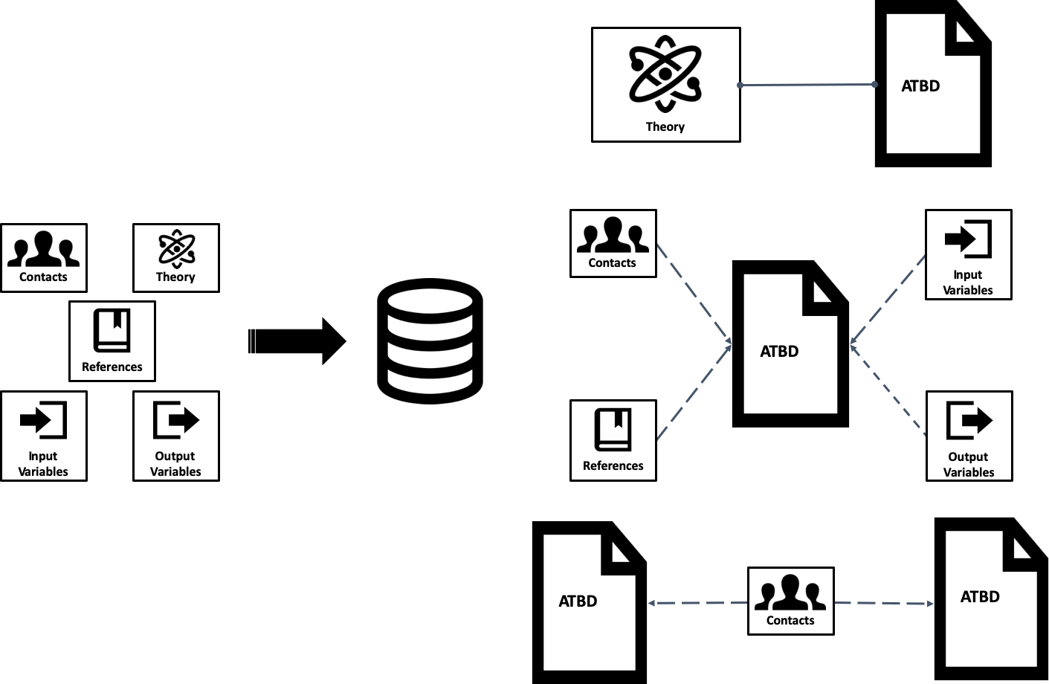
Ensuring Scientific Reproducibility within the Earth Observation Community: Standardized Algorithm Documentation for Improved Scientific Data Understanding
Aaron Kaulfus¹ , Kaylin Bugbee¹, Alyssa Harris², Rahul Ramachandran³, Sean Harkins², Sean Bailey⁴, Aimee Barciauskas², Deborah Smith¹
¹University of Alabama in Huntsville, ²Development Seed, ³NASA Marshall Space Flight Center, ⁴NASA Goddard Space Flight Center
Introduction
What is The Algorithm Publication Tool?
Long-term Vision
Algorithm Theoretical Basis Documents, or ATBDs, describe the physical theory, mathematical procedures, and assumptions made for developing scientific algorithms that convert radiances received by remote sensing instruments into geophysical quantities
ATBDs are essential to:
Ensuring reproducible science by documenting key scientific assumptions made during data generation
Describing calibration and validation processes needed for data product development
Promoting understanding and proper use of Earth observation data
To address ATBD challenges, the IMPACT group is developing the Algorithm Publication Tool (APT). The APT is a cloud-based tool to:
Standardize ATBDs
Streamline the authoring process
Enhance ATBD search and discovery
The APT Prototype efforts have largely focused on the development of the information model and implementation of the authoring tool. Full implementation requires the inclusion of robust functionality for both end science users and document stewards including:
End Science Users
A centralized repository for consistent search and discovery of documents and content contained within the document.
An access API with GET capabilities in support of machine readability
Document Stewards
Established ATBD requirements for authors and ATBD stewardship
The ability to track the authoring progress, review the content, and approve ATBD publication.
Tools to monitor access and use of ATBDs.
The APT provides ATBDs as dynamic, machine-readable, easily modified documents that connect software, data and other supporting resources to improve transparency and promote scientific reproducibility.
Example image of a derived data product: MODIS/Terra Vegetation Indices 16-Day L3 500m SIN Grid. April 9, 2020, EVI index over the southern United States.
APT Prototype
To modernize ATBDs as dynamic, machine-readable documents, the APT stores ATBD content, not as a document, but as metadata. In order to store content as metadata, the APT team developed both a standardized ATBD template and a supporting metadata model. The template and metadata model was developed based on a review of Earth observation community algorithm documentation and encompasses:
Traditional metadata - or descriptors of the document itself, and
ATBD content as metadata - the core information needed to standardize and simplify the content which describes how data is generated
ATBDs are required for every NASA Earth Observing System (EOS) instrument product. However there are challenges in both the production and use of these documents.
Organizational challenges:
No standard template, content requirements, or review procedures
An ATBD may address multiple products or a product may be addressed by multiple ATBDs
Difficult for scientists to know if all document requirements have been met
Variable content review and verification results in inconsistent quality
Inconsistent structure and information across ATBDs provides a challenge for users
ATBD stewardship activities are variable – should be treated as first class research objects
No central repository for search and discovery
Documents are delivered to archival centers for preservation and distribution
It is important for data distribution velocity and science reproducibility that discovery of ATBDs be consistent and efficient
Technical challenges:
Documents are difficult to update or maintain
Data and associated algorithms may change rapidly and documents must be easily updated to reflect advancements in data processing
The update process is coupled with challenges associated with organizational content and review processes
Limited ability for users to efficiently and effectively search through ATBD content
Often available as PDFs; not search engine optimized or machine readable
Not consistently referenced in a dataset’s metadata
This rich information model is implemented in an AWS relational database which stores the ATBD content provided by users.
A user-friendly interface walks ATBD authors through each section of the standardized ATBD template. The APT interface also leverages Latex as a typesetting service to support the generation of rich content required for scientific writing including building equations and tables, using complex mathematical symbols, and inserting figures.
Discussion
Despite taking significant steps in standardizing ATBDs, there remains a number of challenges in achieving open and modernized documentation.
Versioning for dynamic documentation
Need community standards for applying version identifiers to documents
Persistent identifiers (e.g. DOI) must be appropriately applied
Central Repository Robustness
For a centralized repository to be of use to the user community, existing NASA ATBDs should be incorporated for completeness
All versions of ATBDs should be inserted in the tool, be subject to long-term maintenance efforts, and made available to the user community
Automated methods may be leveraged to ease the burden of incorporating existing documents into the repository
APT usability
The authoring tool and typesetting interface must accommodate all scientific writing needs and must not be a barrier to tool use
The implemented governance and review plan must be comprehensive, entirely inclusive in the tool, but not overly burdensome
Integration with existing (meta)data resources
The tool should promote an interconnected and open data ecosystem with intelligent connections to (meta)data
The tool should be flexible to an evolving documentation vision in an increasingly interconnected data ecosystem.
APT High Level Architecture
Prototype development has focused on ease of use by implementing:
Equation writing and in-line validation
UIs for constructing tables and inserting figures
Bibtex support for reference management
Reuse of content enabled by the database implementation
Contact: ak0033@uah.edu
APT Implementation Workflow
From the APT database, both PDF and HTML versions of the document are generated on demand and accessible through the web application.
Notes:
https://e4ftl01.cr.usgs.gov//WORKING/BRWS/Browse.001/2020.04.09/BROWSE.MOD13A1.A2020081.h10v05.006.2020100121117.1.jpg?_ga=2.261862856.437943505.1587585815-1285959778.1543339390

