Slide 1
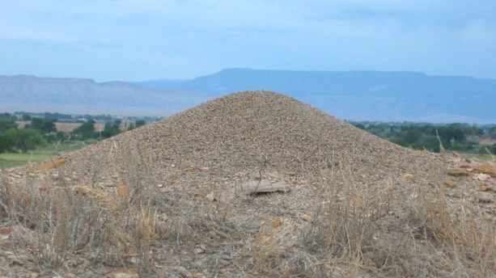
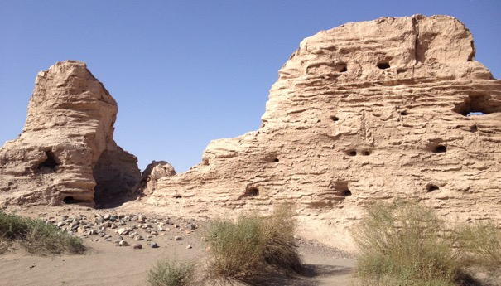
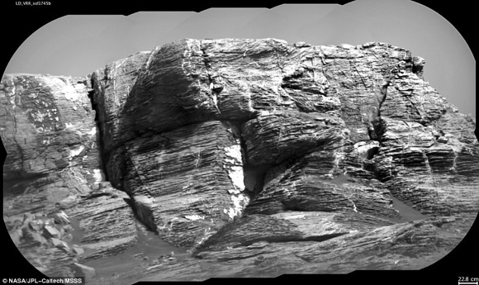
Biogeomorphological research frontiers: From ant mounds to Mars
A six minute ‘taster’ presentation
Heather A Viles
University of Oxford
@Geodiverse
Oxford Resilient Buildings & Landscapes Lab
Notes:
Image credits:
https://www.antwiki.org/wiki/File:Pogo_occidentalis_nest.jpg
Pogonomyrmex occidentalis Nest, High desert, 8 miles north of Fruita, Colorado. 2006 Photo by David Lubertazzi
Ruins of Suoyang Ancient City, Gansu Province, China (Photo by H Viles)
Composite of 10 ChemCam Remote micro-imager images from Curiosity Rover, Mars, 2017, @NASA/JPL-CalTech MSSS

Slide 2
Biogeomorphology as ‘frontier research’
Javier Rey, Director of Fundacion General CSIC says frontier research:
Addresses scientific controversies
Focuses on hard-to-answer questions
Employs atypical methods and concepts
Is paradigm changing
Has a high risk of failure
Viles, H 2019 Biogeomorphology: Past, present and future Geomorphology

Slide 3
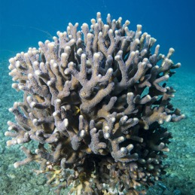
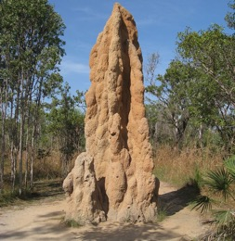
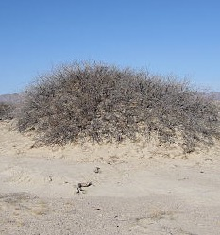
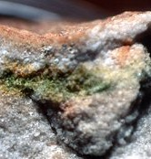
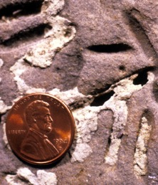
Biogeomorphology ‘in a nut shell’
Landforms
Adapted from: Viles, 2019 and Corenblit et al., 2019
abiotic
biogenic
*aka Bioprotection
autogenic
allogenic
Bioconstruction
Bioconstruction
Biostabilisation*
Bioweathering
Bioerosion
Bioturbation
living dead active passive

Slide 4
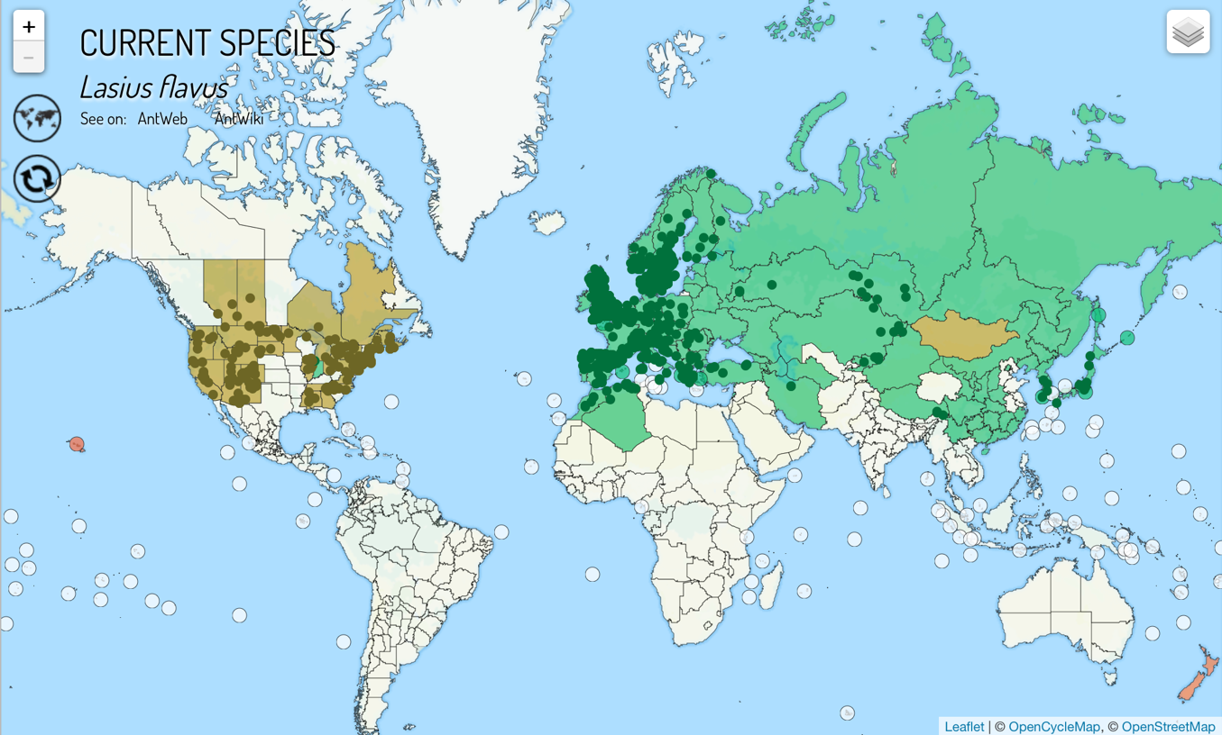
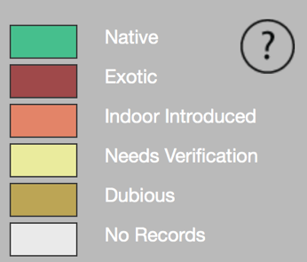
Ant biogeomorphology: scaling it up
Goudie and Viles (forthcoming…)
Source: Antmaps

Slide 5
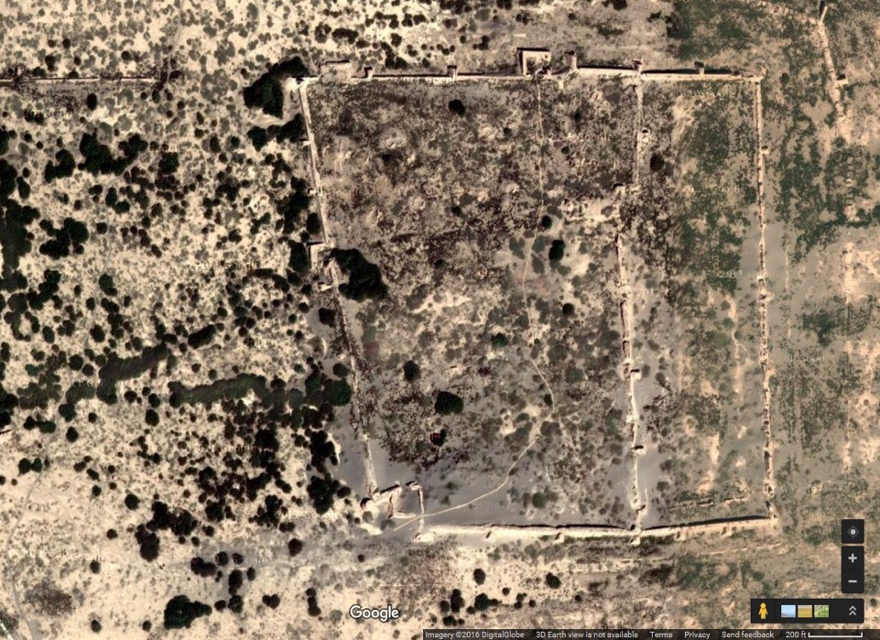
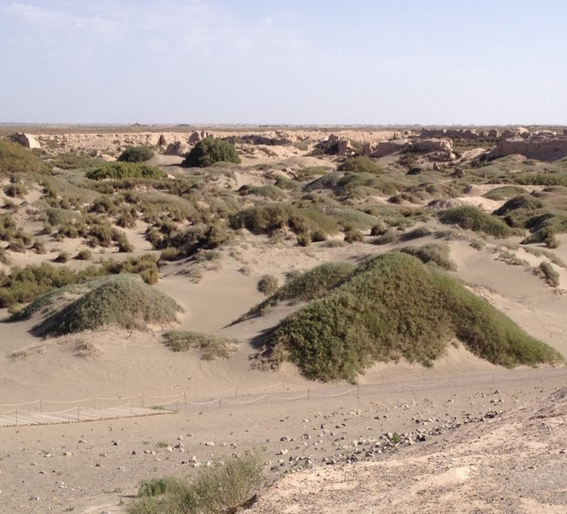
Modelling nature-based solutions for heritage
Suoyang ancient city, Gansu Province, NW China
What is the future for our earthen heritage? Modelling the risk of environmentally-driven deterioration at sites located in dryland areas
Jennifer Richards et al EGU Display and Earth Surface Processes and Landforms (accepted)

Slide 6
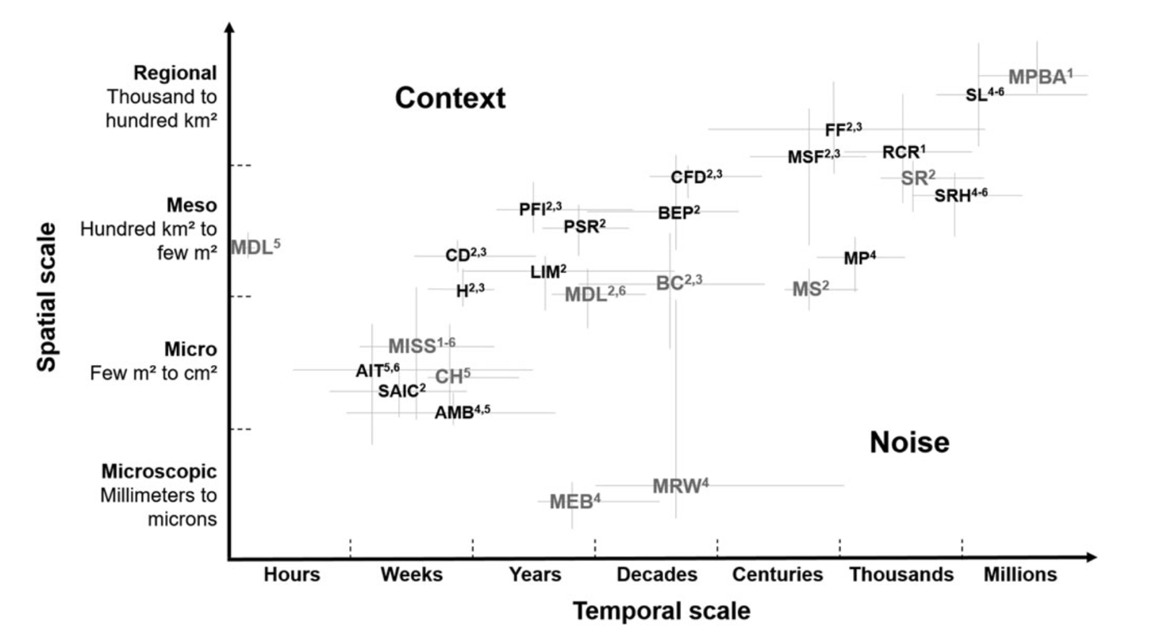
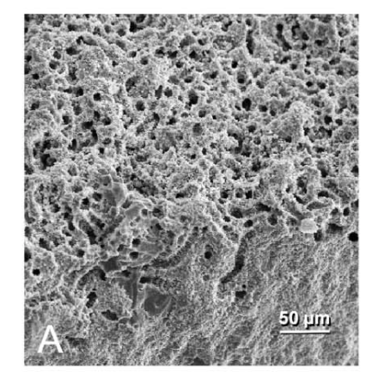
Searching for microbial biosignatures on Mars
Image: Palinska et al (2017) Geomicrobiology
Corenblit, D et al (2019) The search for a signature of life on Mars: A biogeomorphological approach. Astrobiology

Slide 7
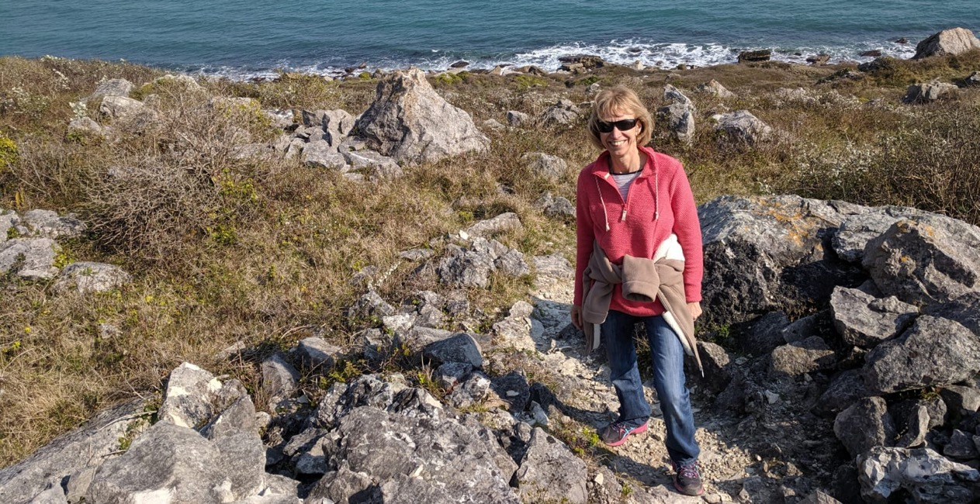
Thanks for listening
I hope this brief ‘taster’ presentation raises some questions and issues for further discussion…
Acknowledgements
Thanks to Dov Corenblit, Andrew Goudie, Jennifer Richards and many other colleagues and friends who have worked with me on biogeomorphological topics over the years…
Thanks to EPSRC, the Getty Trust and the Royal Society for supporting the work at Suoyang.

