Slide 1
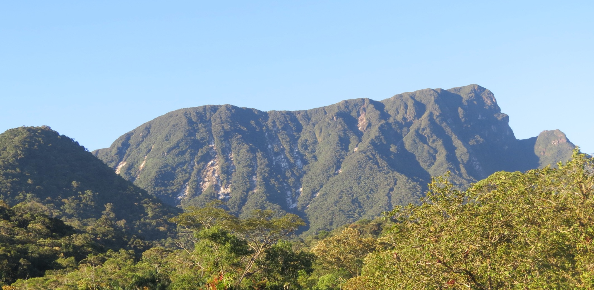
Victor Carvalho Cabral^{1,2}, Fernando Mazo D'Affonseca², Marcelo Fischer Gramani³, Agostinho Tadashi Ogura³, Claudia Santos Corrêa¹,
Carolina Martinez Mendoza⁴, Vinicius Veloso¹ and Fábio Vieira Reis¹
¹ São Paulo State University - UNESP, Brazil
³ Institute for Technological Research - IPT, Brazil
² University of Tübingen, Germany
⁴ Universidad del Norte, Colombia
Magnitude estimation of a landslide-triggered debris flow at Serra do Mar, Brazil
1

Slide 2
Outline
Introduction
The February 2017 debris flow
Material and methods
Magnitude estimation
Conclusion
2
Magnitude estimation of a landslide-triggered debris flow at Serra do Mar

Slide 3
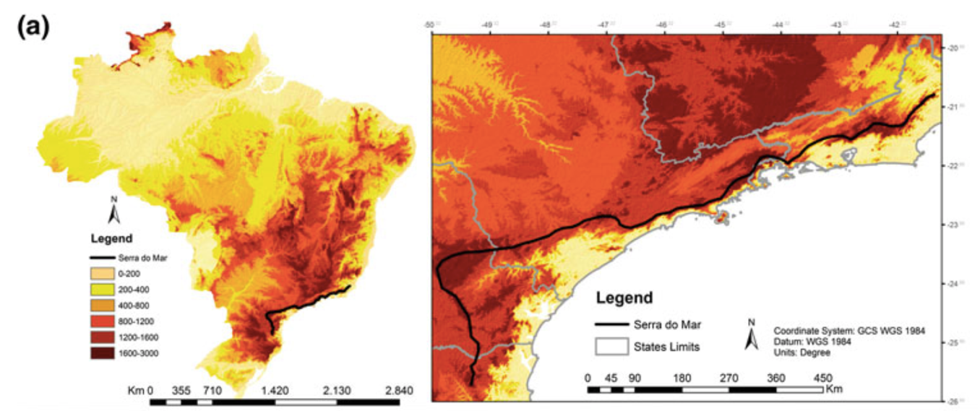
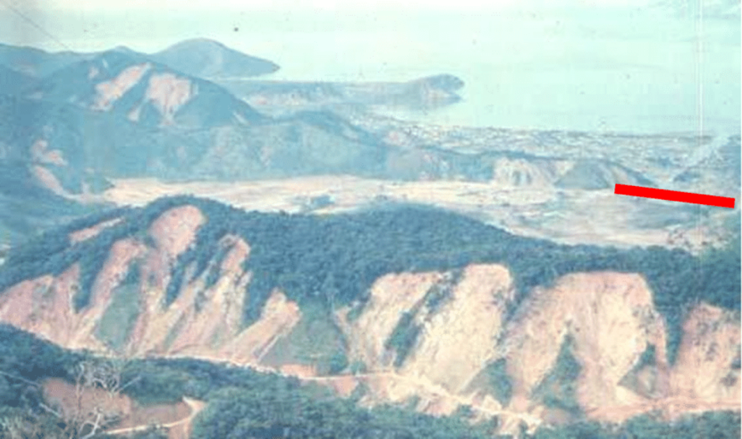
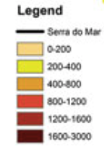
Introduction The Debris Flow Material and Methods Results Conclusion
Serra do Mar is a mountain range that stretches for more than 1,500 km, at the Brazilian coast. Due to the steep slopes and high rainfall rate, it is the main site of debris-flow initiation in Brazil. Over 4,000 debris-flow related fatalities were recorded in the last 100 years from 22 fatal events in Brazil (Kobiyama et al., 2015), 95% of which were concentrated at Serra do Mar.
Caraguatatuba, 1967
Widespread landslides (> 1,500) triggered a debris flow
at the Santo Antonio catchment
Vieira and Gramani (2015)
3
Magnitude estimation of a landslide-triggered debris flow at Serra do Mar

Slide 4
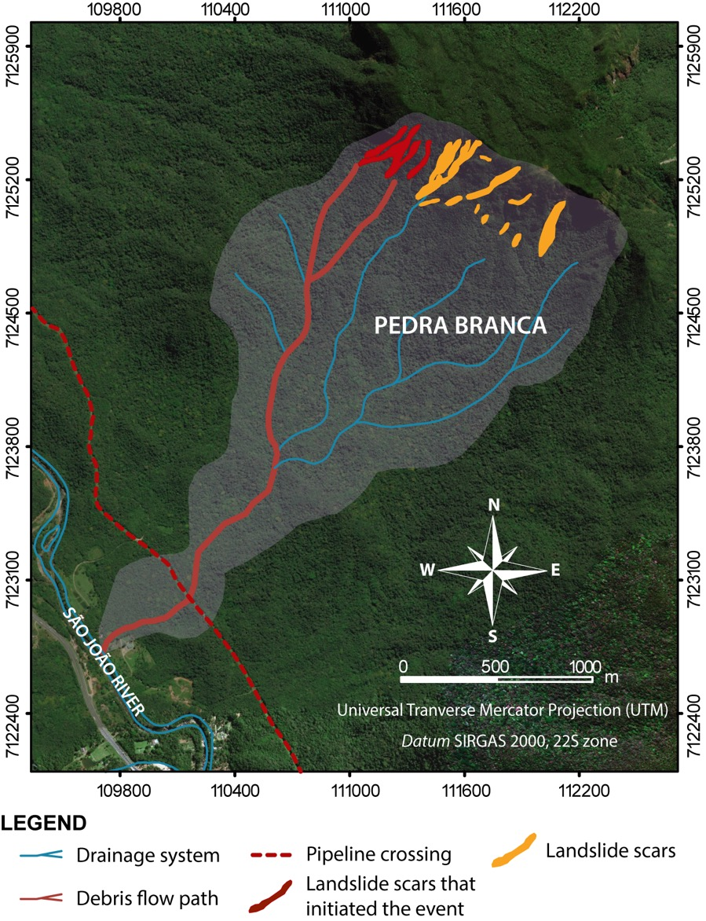
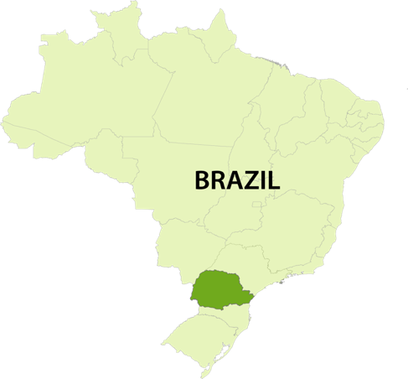
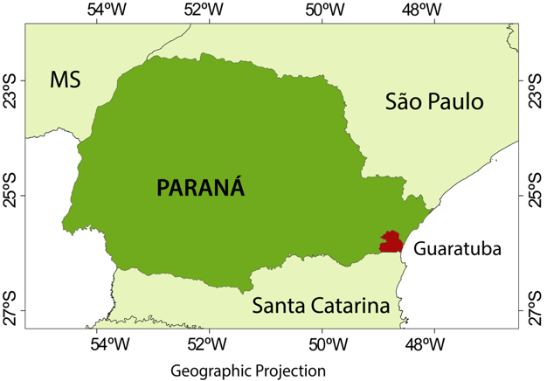
Introduction The Debris Flow Material and Methods Results Conclusion
On the night of February 11, 2017, a debris flow occurred at the Pedra Branca catchment (Serra do Mar), destroying small farms at the outlet region and affecting oil pipelines that cross the catchment.
Cabral et al. (in prep)
The debris flow was initiated by landslides, triggered by a 200 mm rainfall in 5 h (80 mm h⁻¹ peak rainfall).
OBJECTIVE: Estimate the magnitude (i.e. the total volume of debris transported) based on the geomorphological characteristics of the debris flow.
4
Magnitude estimation of a landslide-triggered debris flow at Serra do Mar

Slide 5
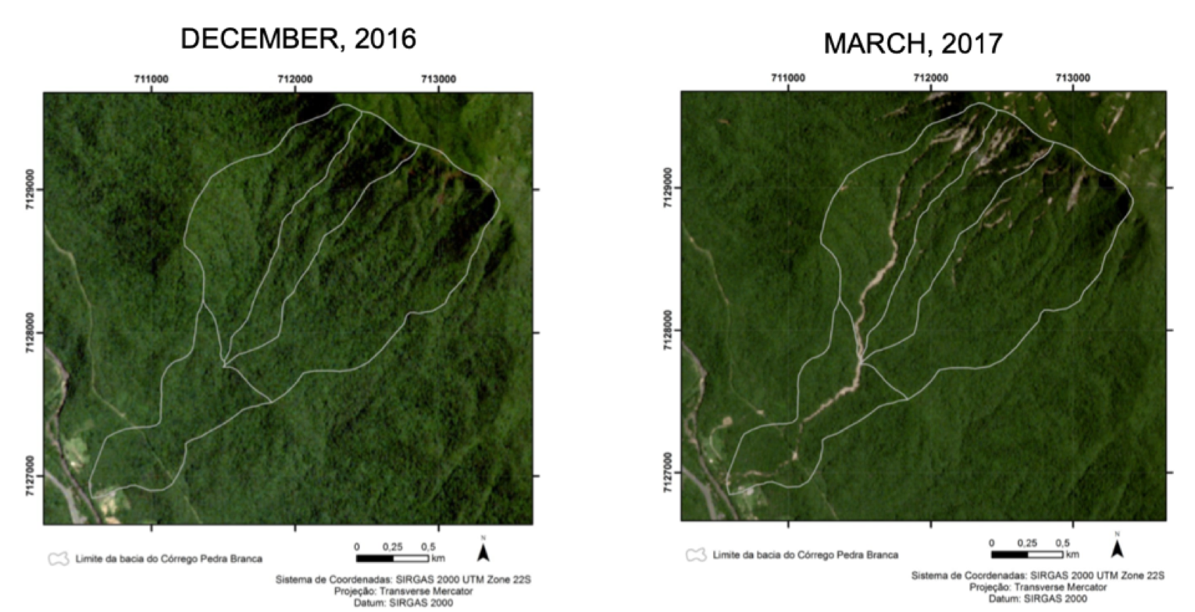
Introduction The Debris Flow Material and Methods Results Conclusion
Before and after the debris flow
Geomorphometric parameters of the
Pedra Branca catchment
Watershed area | 3.43 km²
Maximum elevation | 1,060 m a.s.l.
Outlet elevation | 100 m a.s.l.
Average slope | 16.8º
Channel lenght | 3,100 m
Slope at the initiation area | 34º
Slope at the outlet region | 4º
Avg channel slope (º) | 10º
Sentinel-3 aerial photographs
5
Magnitude estimation of a landslide-triggered debris flow at Serra do Mar

Slide 6
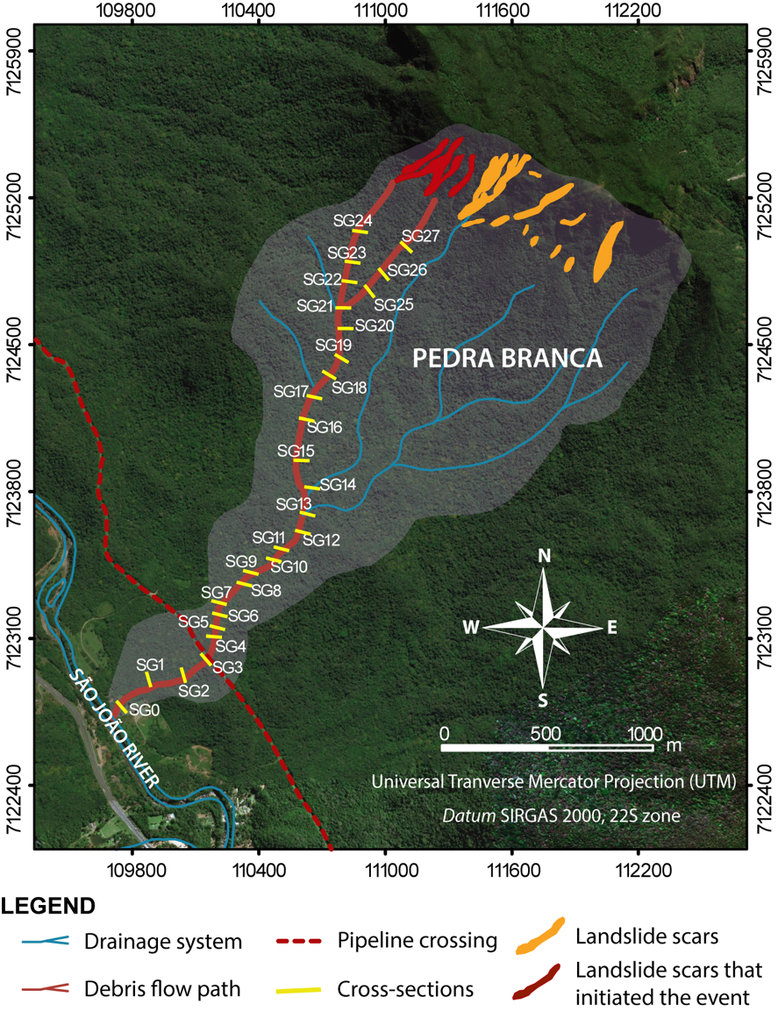
Introduction The Debris Flow Material and Methods Results Conclusion
A systematic post-event terrestrial investigation, using cross-sections, and the acquisition of high-resolution aerial photographs, using aerial unmanned vehicle (UAV), were conducted to characterise the source area, transport path and deposits of the debris flow.
Cabral et al. (in prep)
Location of cross-sections
The Magnitude (Vt) is based on the landslides volume (Vi) that initiated the event, the volume of material entrained (Ve) by the flow and the volume deposited (Vd) along its path (Jakob, 2005):
$$V_{t}=V_{i}+V_{e}−V_{d}$$
6
Magnitude estimation of a landslide-triggered debris flow at Serra do Mar

Slide 7
Introduction The Debris Flow Material and Methods Results Conclusion
Vi was estimated using the equation:
Where Ai is the landslides area and e the average depth of the landslides (estimated using the aerial photographs from the UAV survey).
The calculation of on-channel debris volume (Vd) is based on the areas of accumulation (Ad) delimitated with ortophotos and on the depth of deposits (ed) described in the cross-sections:
Similarly, the entrained volume (Ve) is based on the identification of entrainment areas (Ae) with ortophotos and the entrainment depth (ee) documented in cross-sections:
$$V_{i}=Ai.e$$
$$V_{d}=∑(A_{d}∗e_{d})$$
$$V_{e}=∑(A_{e}∗e_{e})$$
7
Magnitude estimation of a landslide-triggered debris flow at Serra do Mar

Slide 8
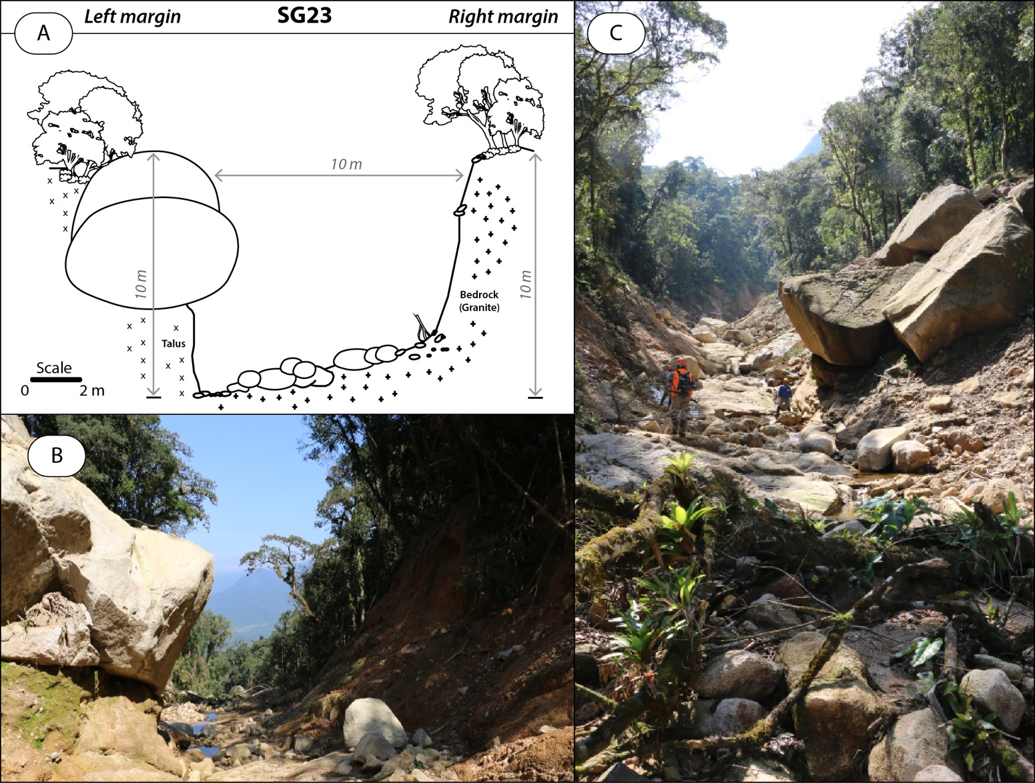
Introduction The Debris Flow Material and Methods Results Conclusion
Cross-sections
Constructed perpendicular to the channel, considering:
Post-event channel width;
Erosion depths;
On-channel deposits dimension (depth, width);
Flow height evidences also documented.
Longitudinal profile of the channel with cross-sections
Cabral et al. (in prep)
8
Magnitude estimation of a landslide-triggered debris flow at Serra do Mar

Slide 9
Introduction The Debris Flow Material and Methods Results Conclusion
1
3
2
Cabral et al. (in prep)
Overview of Pedra Branca
Landslides that initiated the event
Landslide scar | Area (m²) | Depth (m) | Volume (m³)
1 | 22,497 | 1 | 22,497
2 | 7,573 | 1 | 7,573
3 | 5,776 | 1 | 5,776
TOTAL: |  |  | 35,846
The three landslide that initiated the event contributed with approximately 35,846 m³ of material
9
Magnitude estimation of a landslide-triggered debris flow at Serra do Mar

Slide 10
Introduction The Debris Flow Material and Methods Results Conclusion
Channel-bed incision and bank erosion (Ve) provided most of the sediments, estimated at ca. 121,037 m³.
Debris deposits (Vd) have a combined volume of 26,688 m³.
Cabral et al. (in prep)
The Magnitude is estimated at 120,195 m³
10
Magnitude estimation of a landslide-triggered debris flow at Serra do Mar

Slide 11
Introduction The Debris Flow Material and Methods Results Conclusion
11
Magnitude estimation of a landslide-triggered debris flow at Serra do Mar

Slide 12
Introduction The Debris Flow Material and Methods Results Conclusion
The February 2017 debris flow mobilised approximately 120,000 m³ - Size class 5 (Jakob, 2005b)
Entrainment significantly increased the total magnitude of the event, representing more than 75% of sediment input.
It was a large magnitude debris flow, damming several parts of the river, incisively eroding riverbed and parts of forest along its path and damaging infrastructures.
The characterisation of debris flow dynamics and magnitude estimations of recent events are pathways for stronger hazard assessments and mass movements monitoring. Knowledge of the expected intervals of occurrence is fundamental, thus studies focusing on the frequency of debris flows using dating techniques are recommended.
12
Magnitude estimation of a landslide-triggered debris flow at Serra do Mar

Slide 13
REFERENCES
Jakob, M. (2005a). Debris-flow hazard analysis. In: Jakob, M. and Hungr, O. (Eds.). Debris-Flow Hazards and Related Phenomena. Springer-Verlag, Berlin, pp. 411–443.
Jakob, M. (2005b). A size classification for debris flows. Engineering Geology, 79, pp. 151–161.
Kobiyama, M., Michel, G., Engster, E. and Paixão, M. (2015). Historical analyses of debris flow disaster occurrences and of their scientific investigation in Brazil. Labor e Engenho, 9(4), p.76.
Vieira, B.C and Gramani, M.F. (2015). Serra do Mar: the most tormented relief in Brazil. In: B.C. Vieira et al. (Eds.), Landscapes and Landforms of Brazil - World Geomorphological Landscapes. Springer, Berlin, Germany.
13
Magnitude estimation of a landslide-triggered debris flow at Serra do Mar

