Slide 1

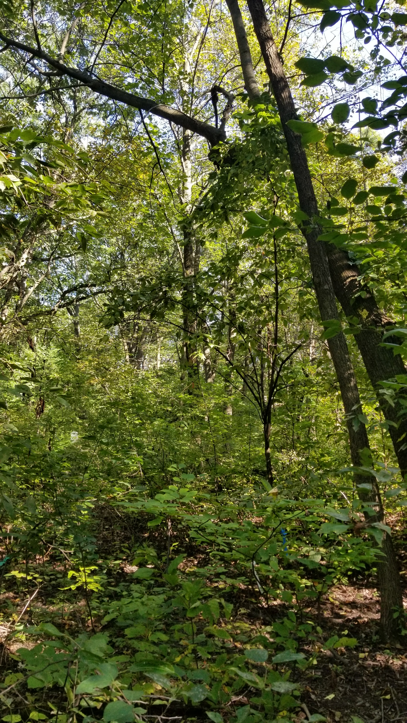
Combining in-situ observations and high resolution Venμs-data to monitor shrub & tree phenology
Alison Donnelly, Rong Yu and Chloe Rehberg
Geography Department, University of Wisconsin-Milwaukee, USA

Slide 2
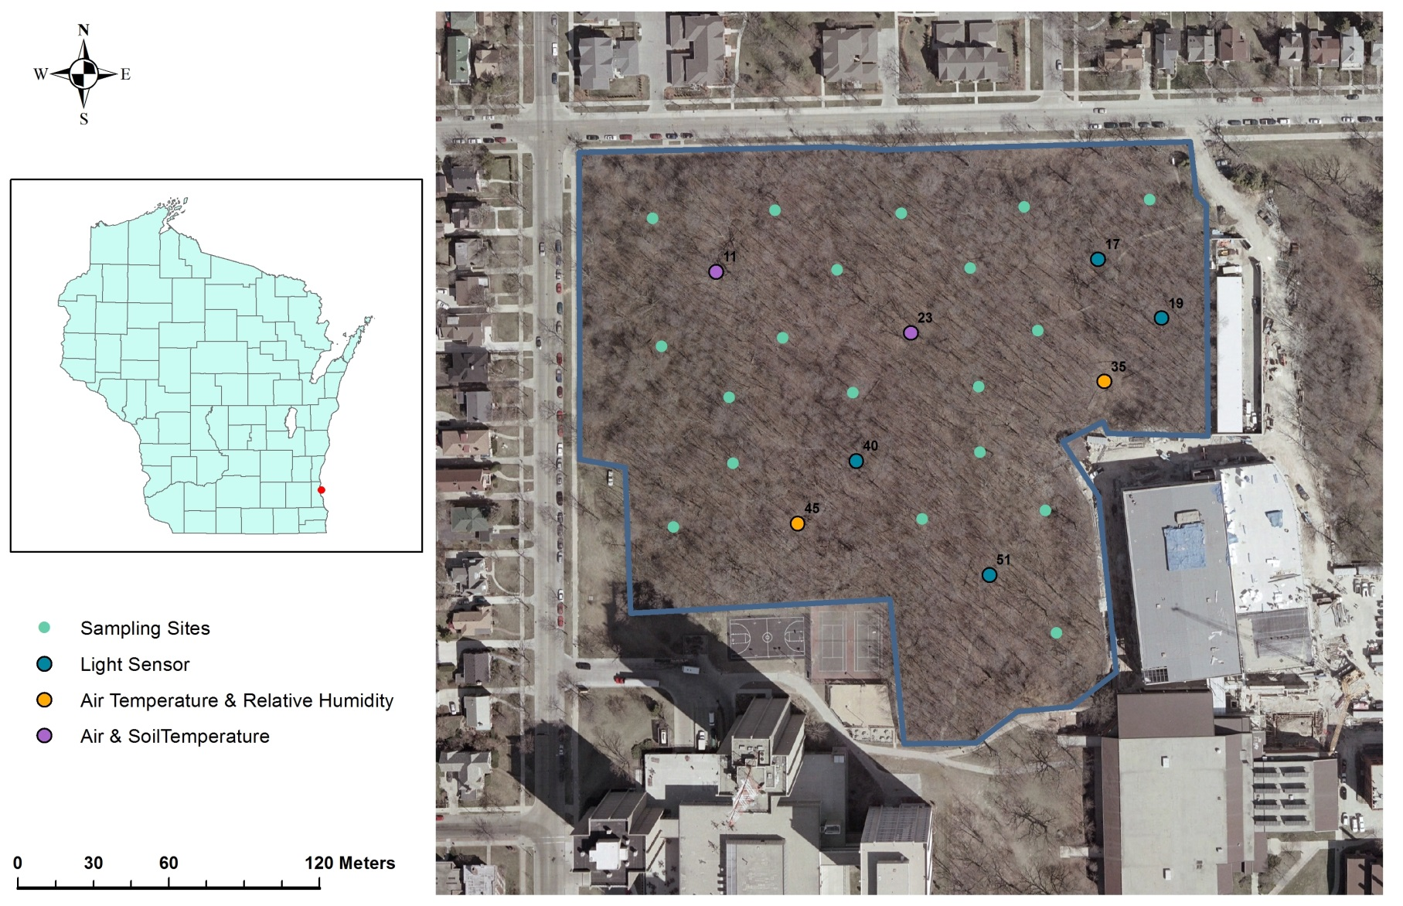
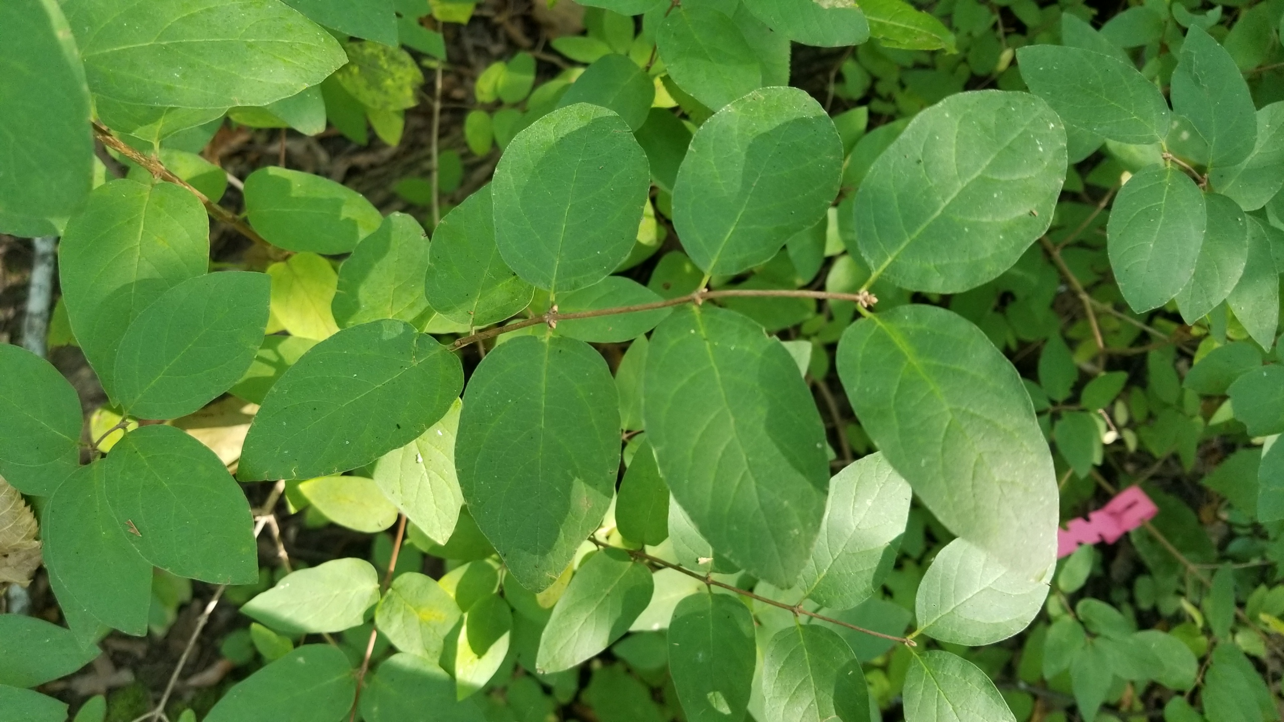
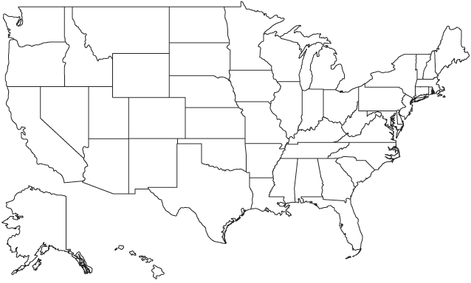
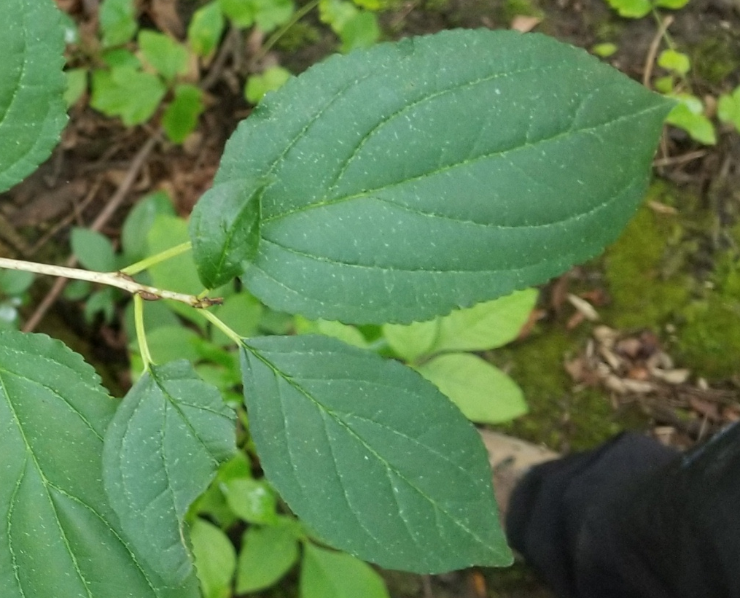
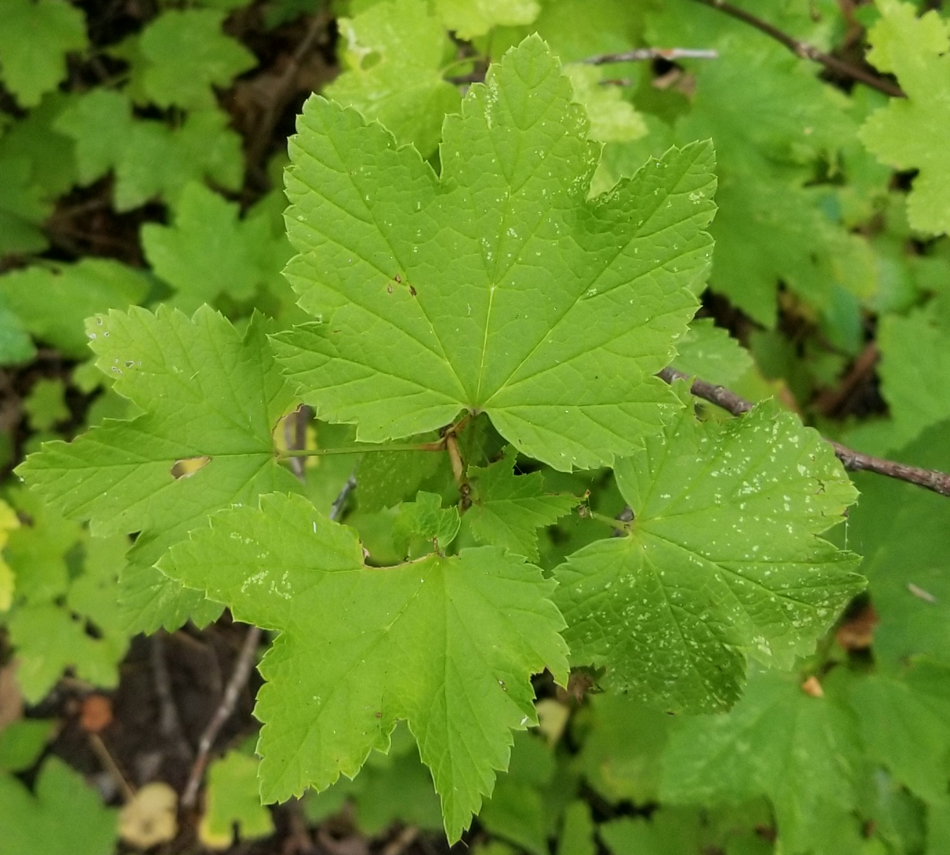
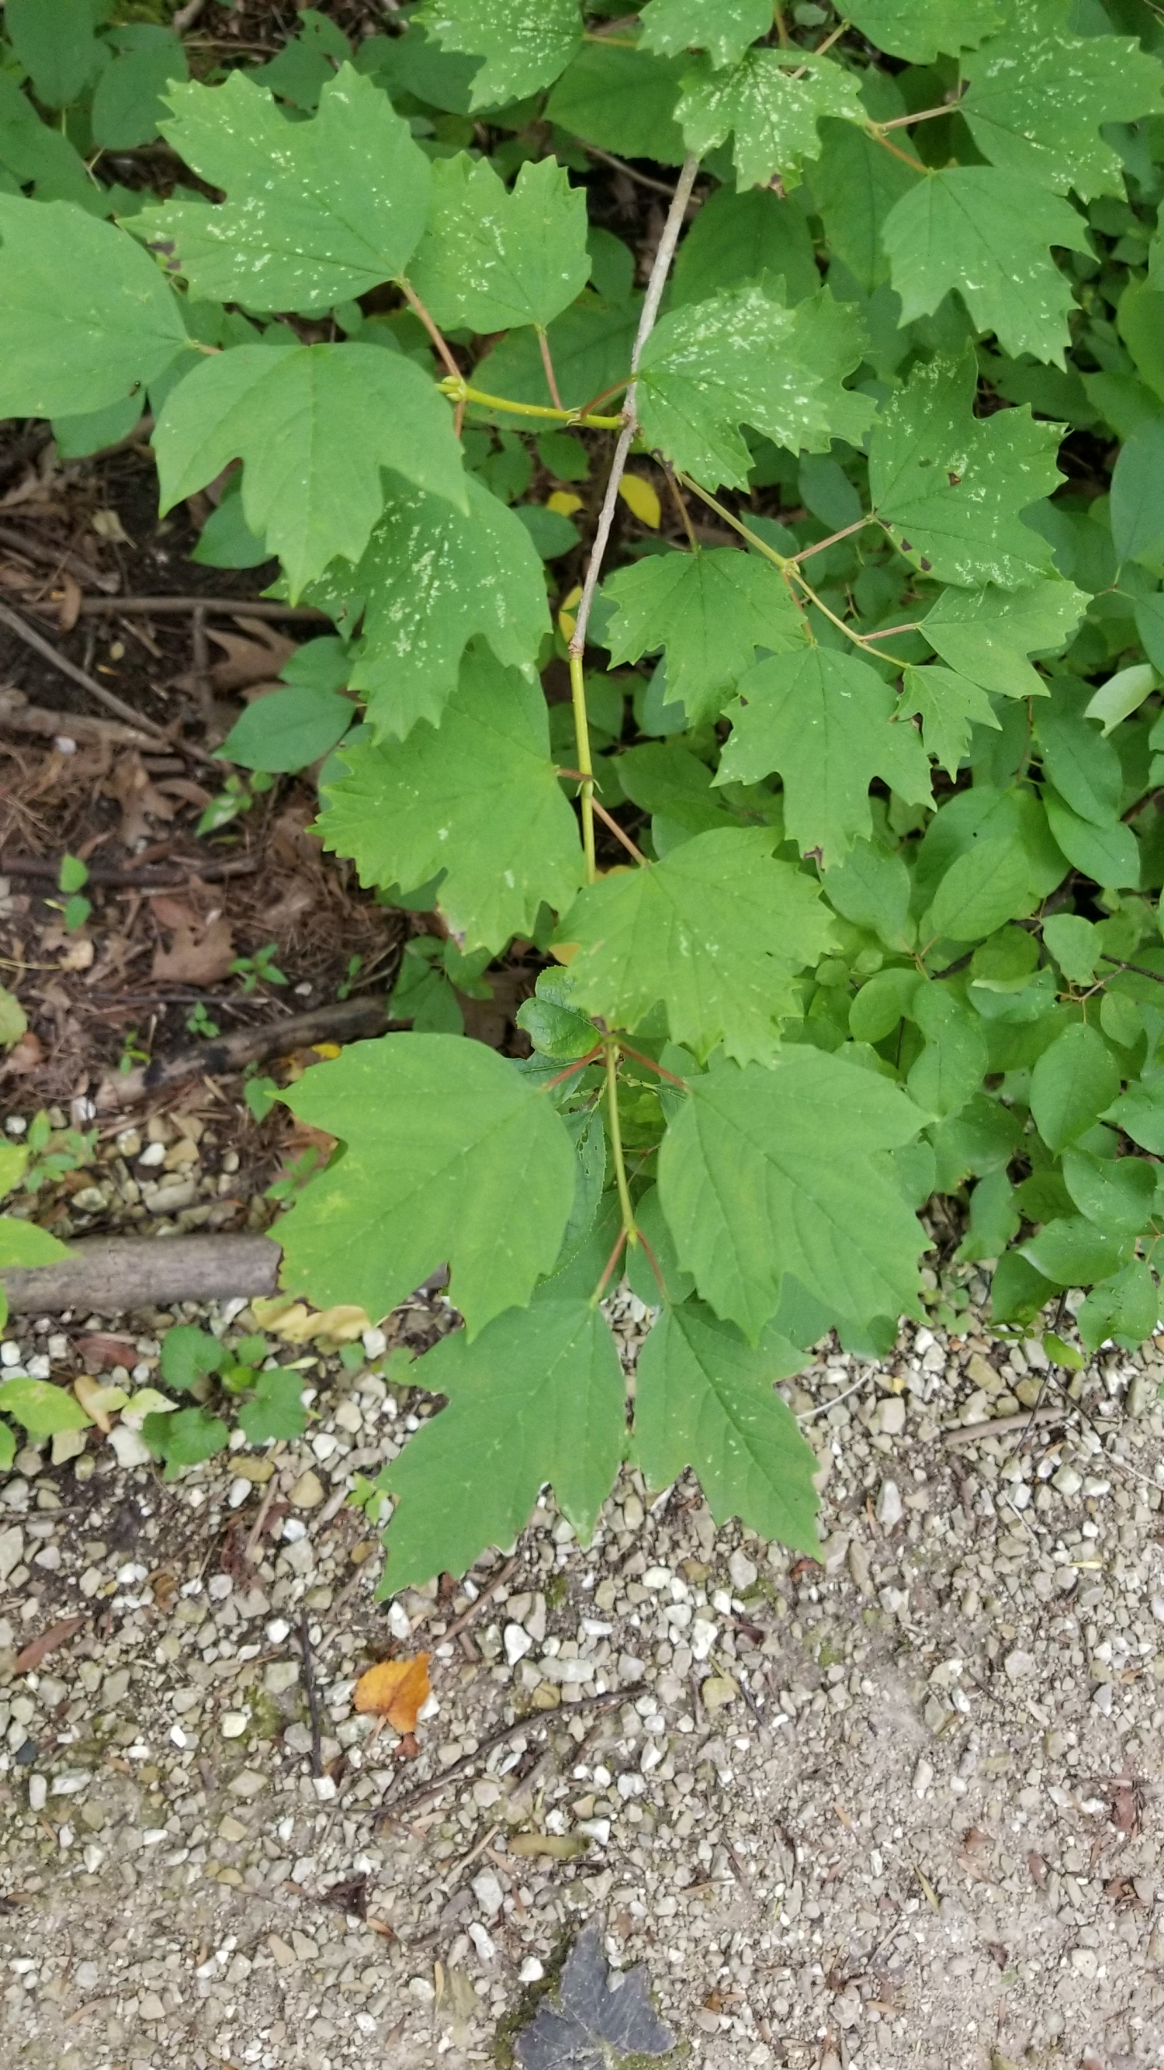
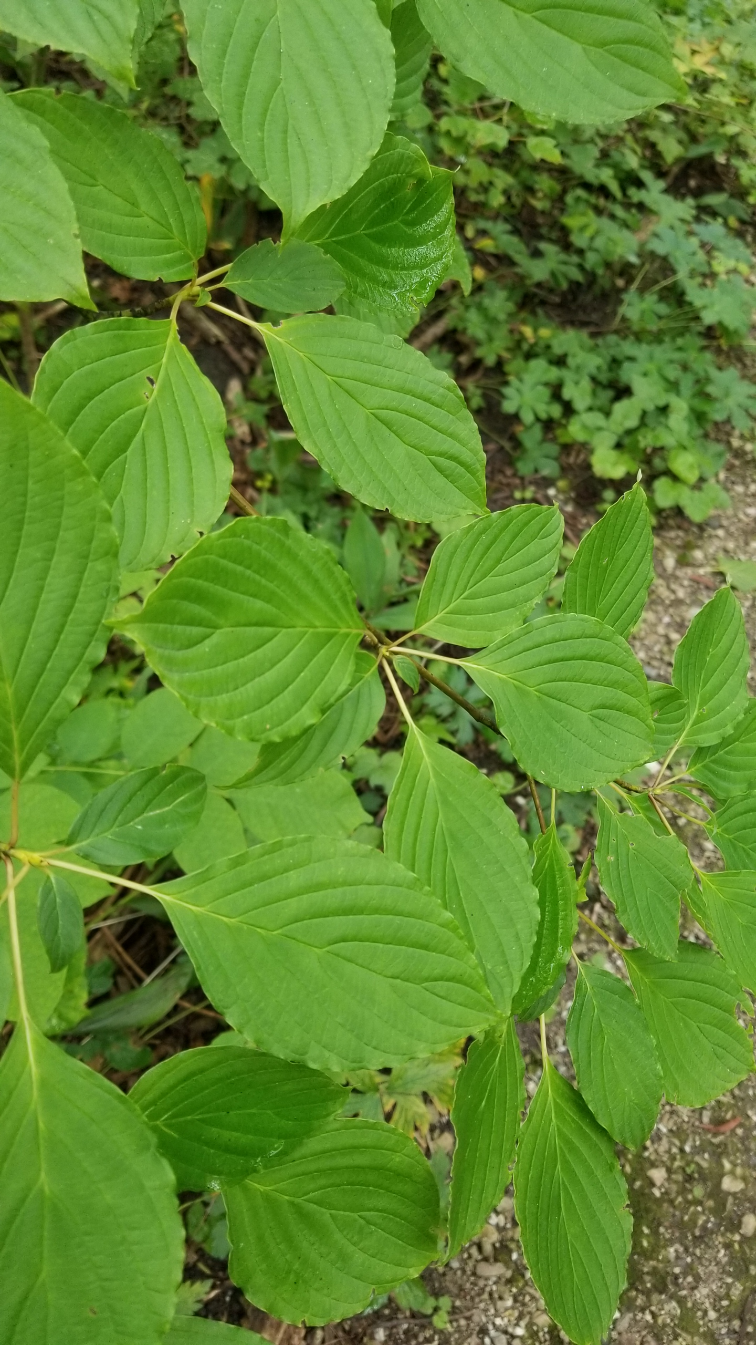
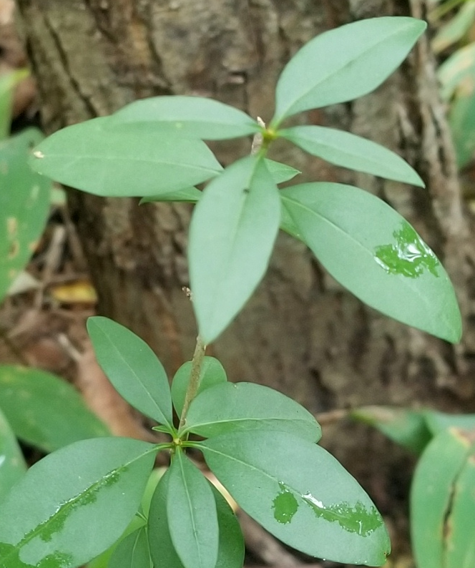
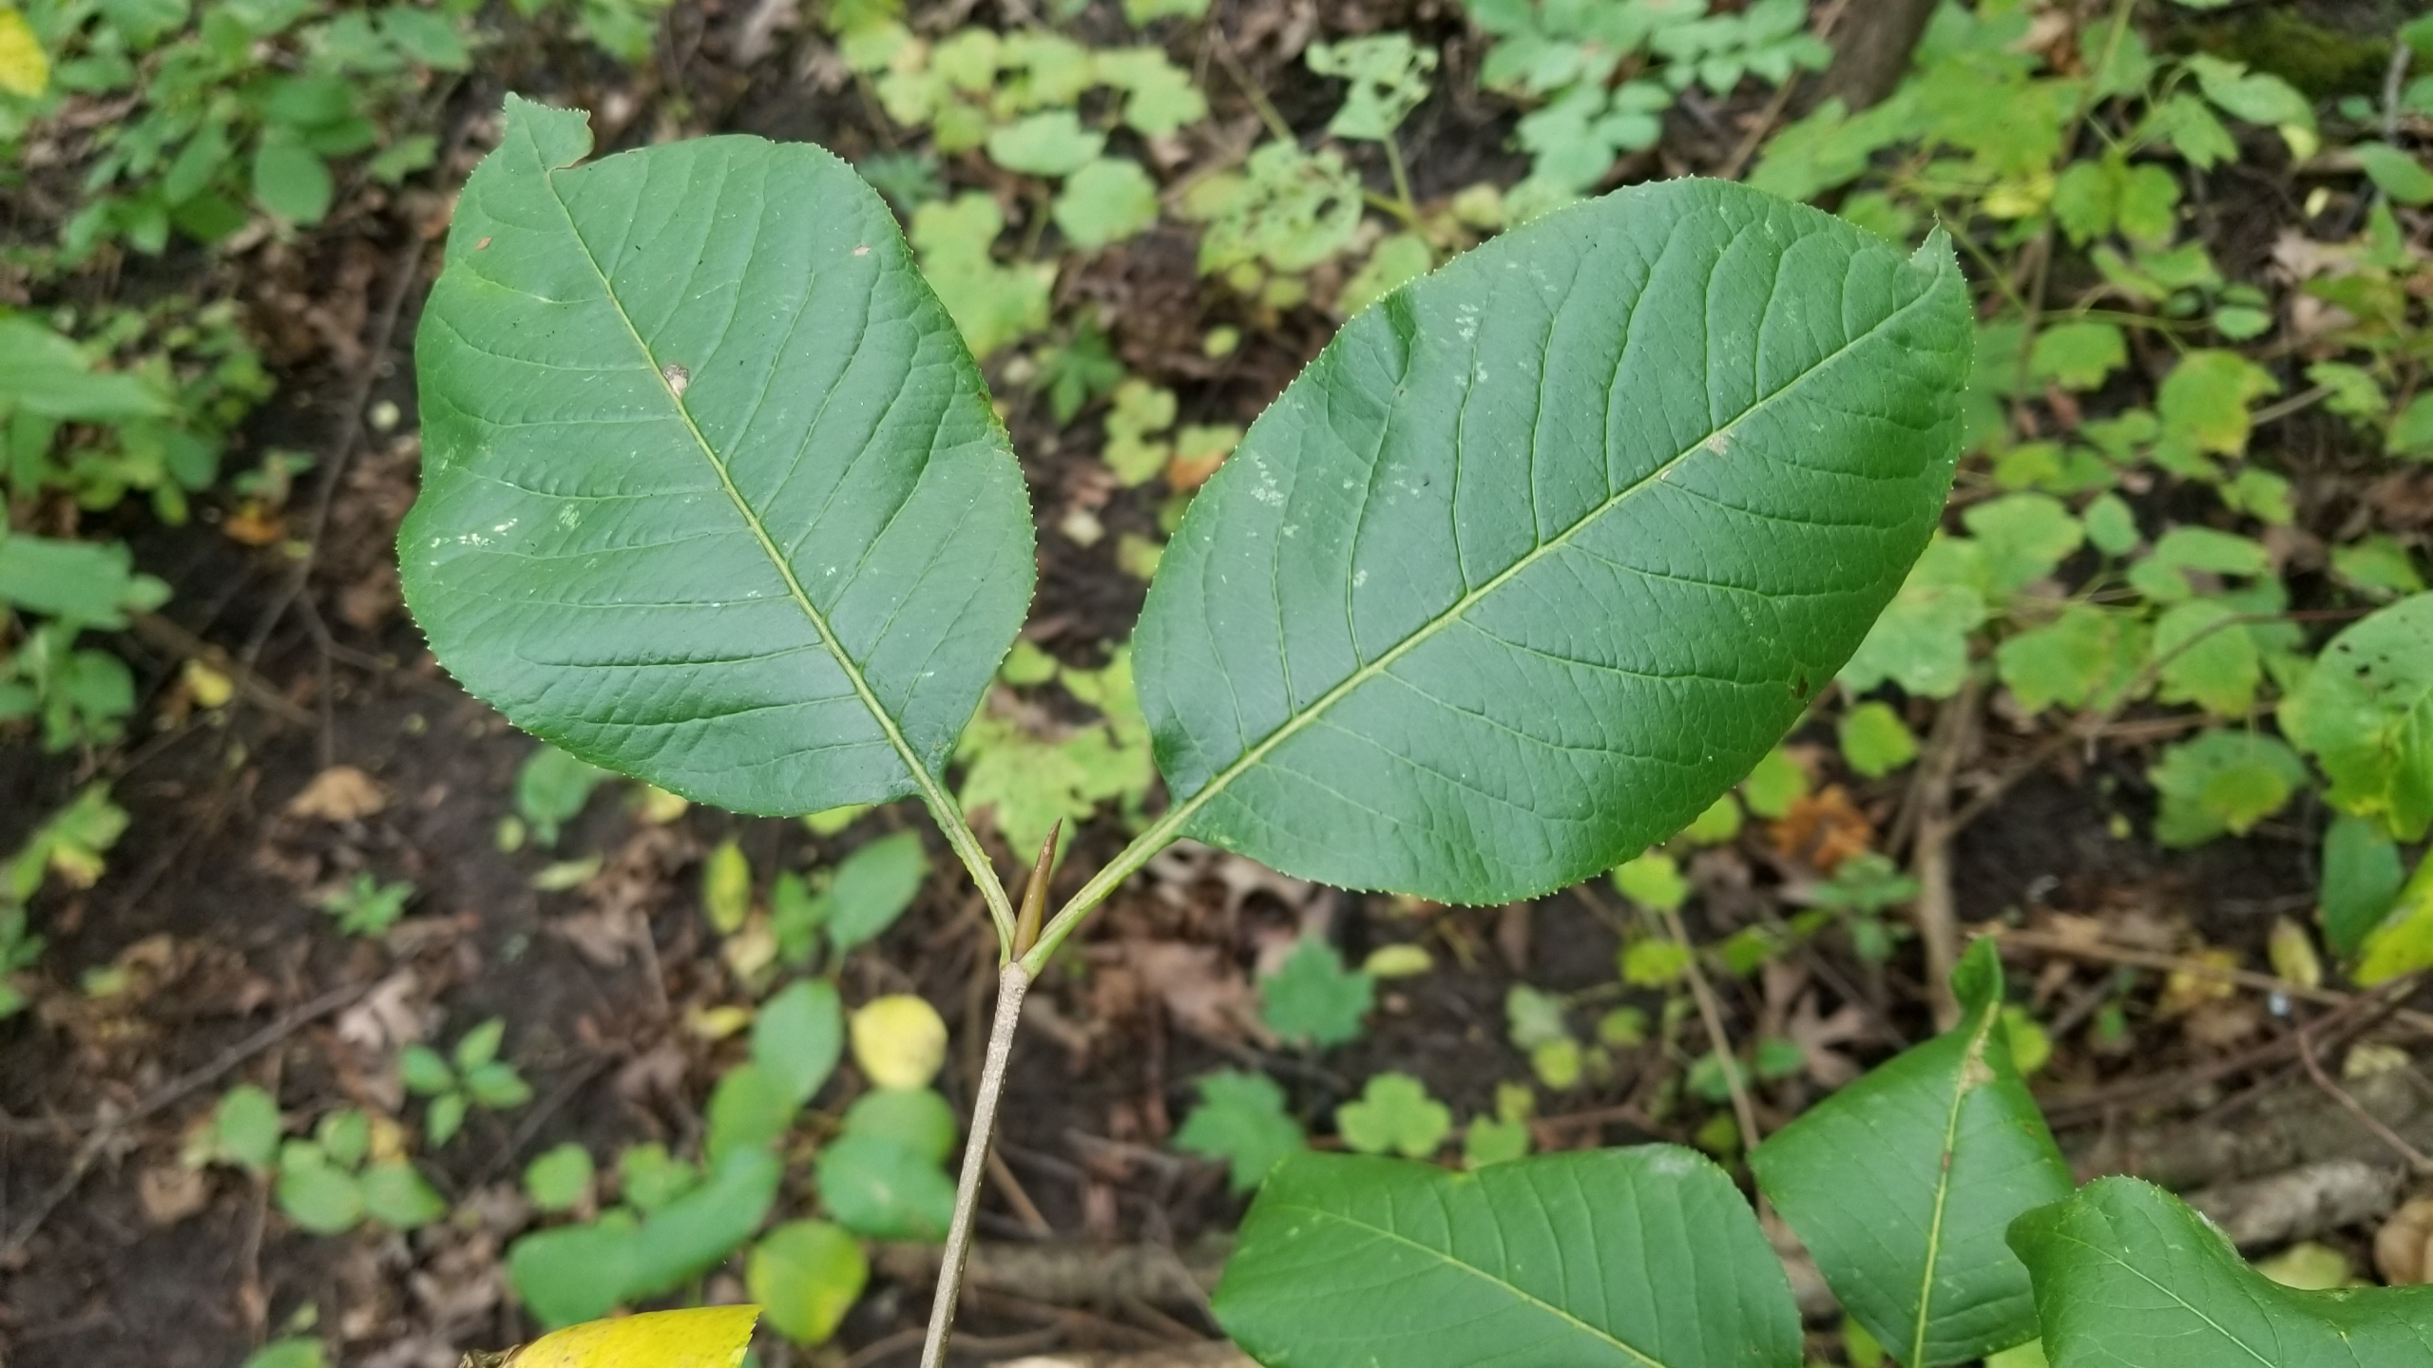
In situ observations
Lonicera morrowii
Honeysuckle
Trees and shrubs
  Budburst, leaf-out, leaf colour, leaf fall
  Every other day
  Native (5 spps) and non-native (3 spps) shrubs
  White oak (Quercus alba), Red oak (Quercus rubra), basswood (Tilia americana) and ash (Fraxinus spp.)
Rhamnus cathartica
Buckthorn
Ribes americanum
Wild currant
Viburnum acerifolium
Maple leaf viburnum
Viburnum lentago
Nannyberry
Cornus alterniflora
Pagoda dogwood
Ligustrum vulgare
European privet
2

Slide 3
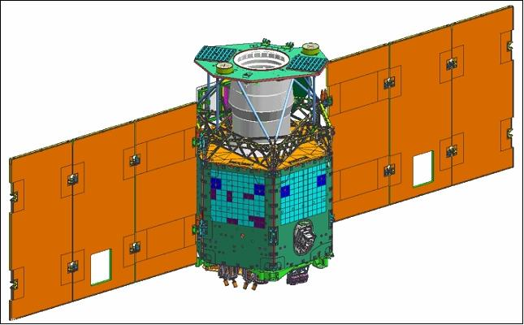
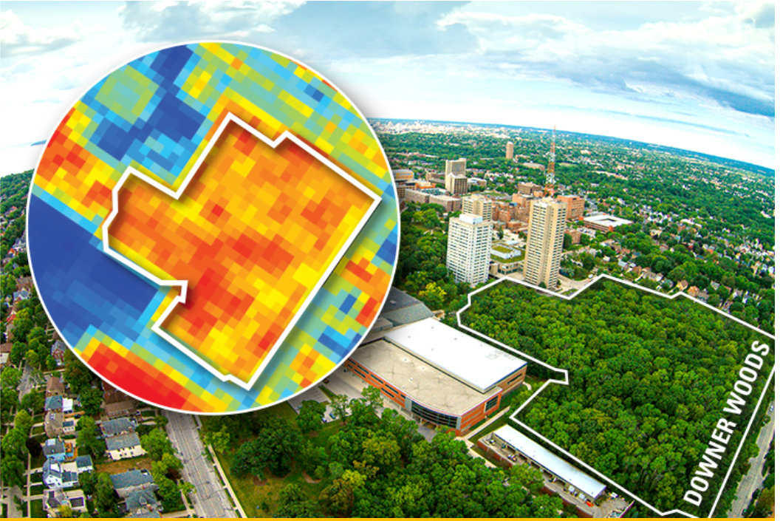
  Vegetation and Environment monitoring on a New Micro-Satellite (VENμS)
Joint Israeli-French collaboration
  ISA $20M and CNES $13M
  Vegetation and Environment monitoring on a New Micro-Satellite (VENμS)
Launched 1st August 2017, Guiana
  Mission duration 3.5 years
  Orbit altitude 720km will drop to 410km in 2020
  Near polar sun-synchronous orbit
  12 spectral bands – in visible and near-infrared
  2-day revisit time, 5-10m resolution
  ~120 special interest sites
Satellite | Spatial resolution | Temporal resolution | Coverage | Temporal extent
VENµS | 5-10m | 2 days | ~120 sites | late 2017 -
MODIS | 250m-1km | 1 day | global | 2000 -
VIIRS | 750m | 1 day | global | 2012 -
AVHRR | 1-8km | 1-8 days | global | 1981 -
LandSat | 30m | 16 days | global | 1972 -
3

Slide 4
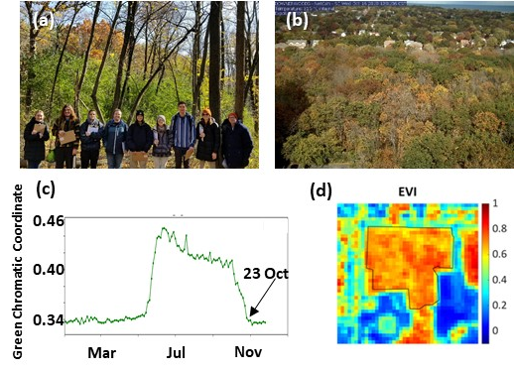
Range of methods to determine phenology
Downer Woods on 23 October 2019
View angle – very different
  (a) direct observation – individual trees and shrubs
    Budburst, leaf-out, leaf colour and leaf fall (0 – 90%)
  (b) PhenoCam image – every 30 minutes
  (c) Green Chromatic Coordinate (greenness) – time series
  (d) VENμS - greenness
    Spring – maximum rate of greenness increase (SOS), peak greenness (EOS)
    Autumn - start of greenness decrease (SOA) and minimum greenness (EOA)
Matching RS and in situ phenometrics!

Slide 5
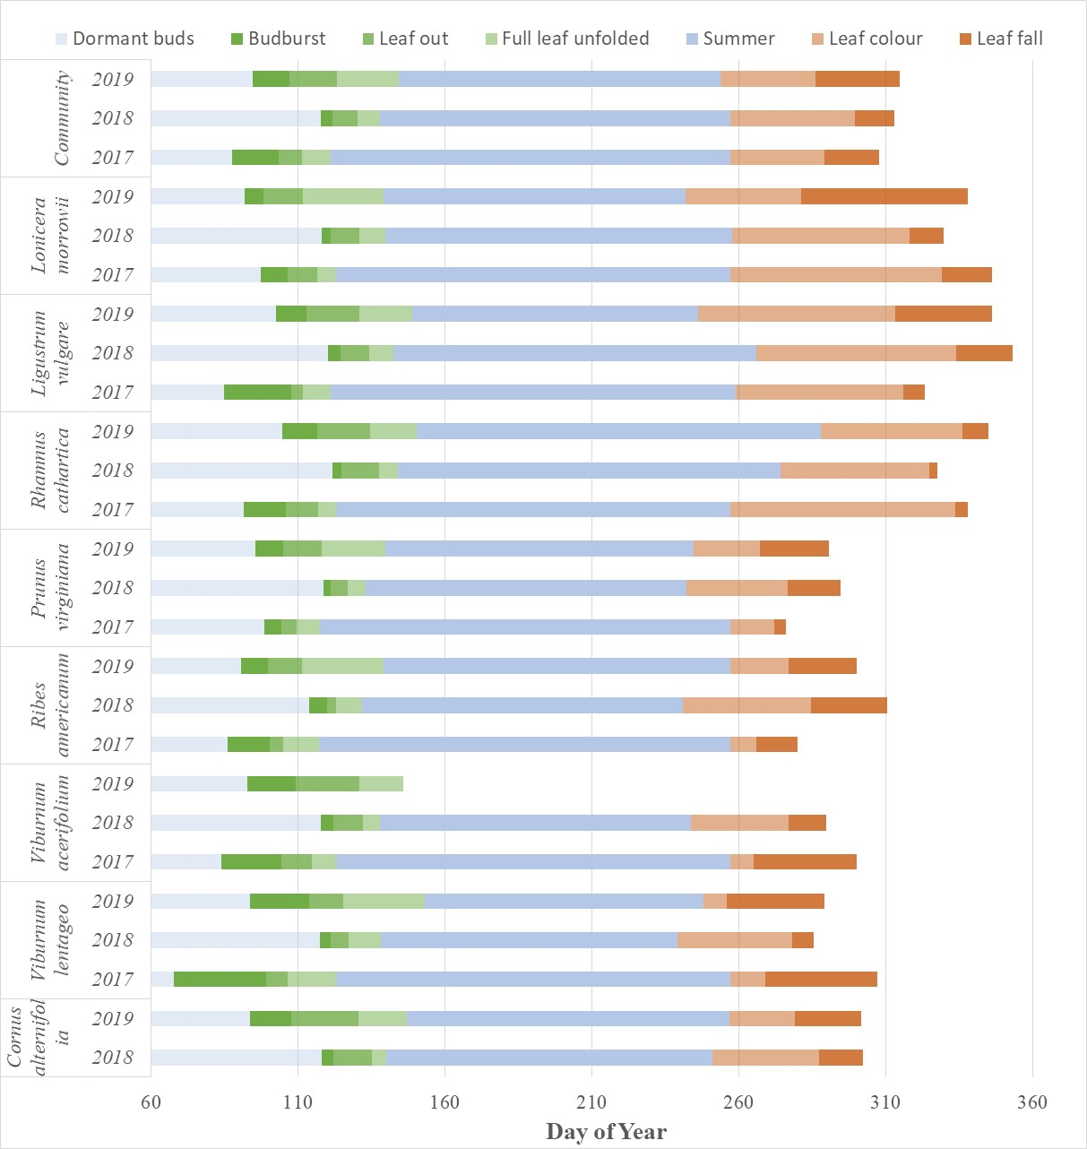
In situ phenology
Shrub community
  Late spring green-up faster (20 vs 33 DAYS)
Non-native species
  Leaf out (DOY 103 vs 99) later than natives
  Reach full leaf faster (DOY 31 vs 34) than natives
  Leaf fall (DOY 336 vs 291) later than natives
Native species
  Leaf fall starts earlier (DOY 263 vs 283)
  Shorter autumn season (40 vs 71 DAYS)
Tree phenology (data not shown)
  Starts 2 weeks later and finishes one month earlier
  Spring lasts 3 weeks and autumn 4 weeks
Non-native shrubs
Native shrubs
Apr 20
Sept 20
5

Slide 6
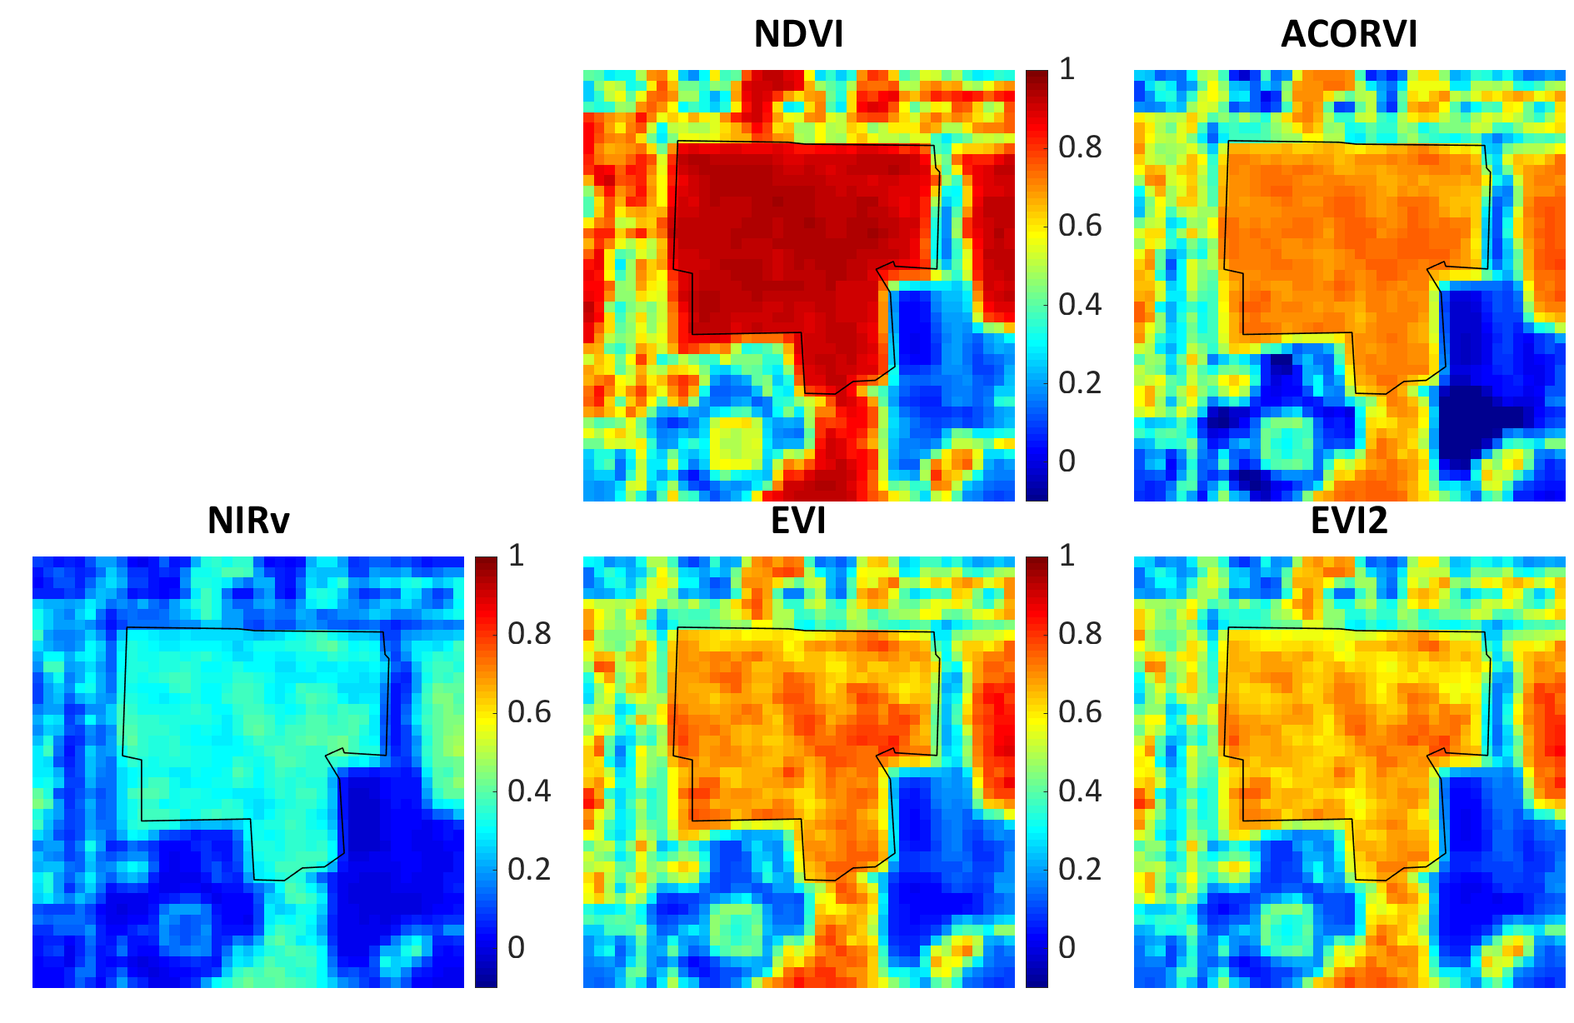
Venμs Vegetation indices
All VIs calculated using Red & NIR bands with EVI2 using an additional blue band
6

Slide 7
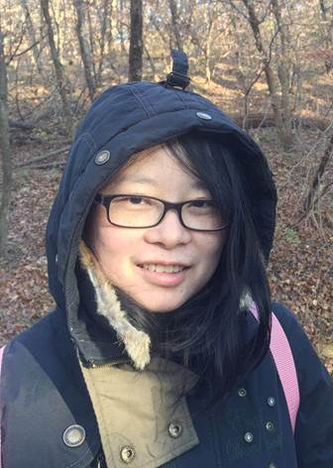
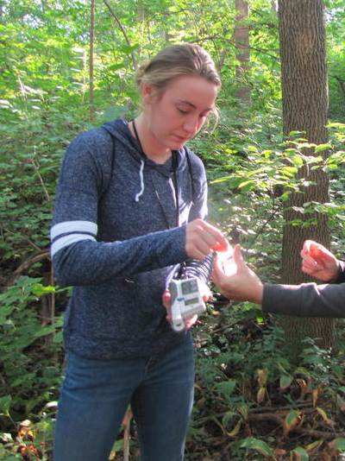
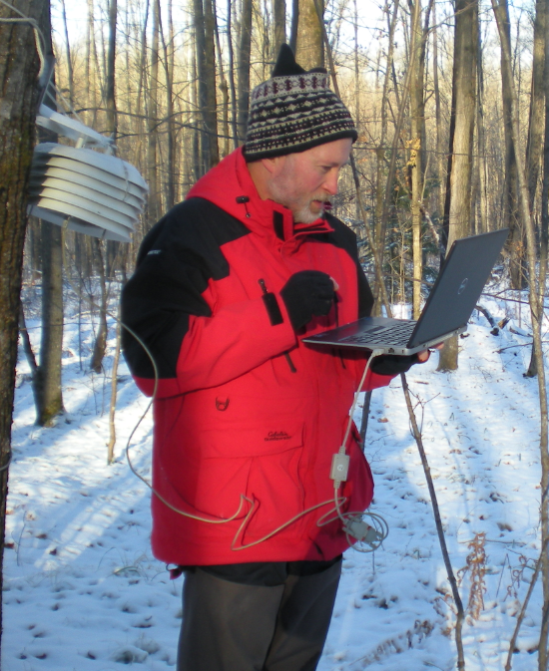
Summary & Acknowledgements
Shrubs extend growing season of temperate deciduous forest
Non-native vs native
  Invasive species strategies leaf-out later, progress faster
  Leaf fall later – competitive advantage over natives
VENμS data looks promising
  Data gaps challenging
  Comparison with MODIS and PhenoCam
This work is supported by a Research Growth Initiative grant (101x368) from the University of Wisconsin-Milwaukee, USA
Rong Yu
Chloe Rehberg
Thanks for your attention!
Any questions?
Mark Schwartz
7

