Slide 1




National Observatory of Athens (NOA)
Current sheets, magnetic islands and associated particle acceleration in the solar wind as observed by Ulysses near the ecliptic plane
Olga E. Malandraki¹, Olga Khabarova², Roberto Bruno³, Gary P. Zank⁴ and the ISSI team-405
¹National Observatory of Athens, IAASARS, Greece
²Heliophysical Laboratory, IZMIRAN, Moscow, Russia
³IAPS-INAF, Roma, Italy
⁴CSPAR, and Department of Space Science, University of Alabama in Huntsville, Huntsville, AL 35805, USA
Notes:
ISSI team – 405 led by Antonella Greco (Calabria) and Olga Khabarova (IZMIRAN)

Slide 2
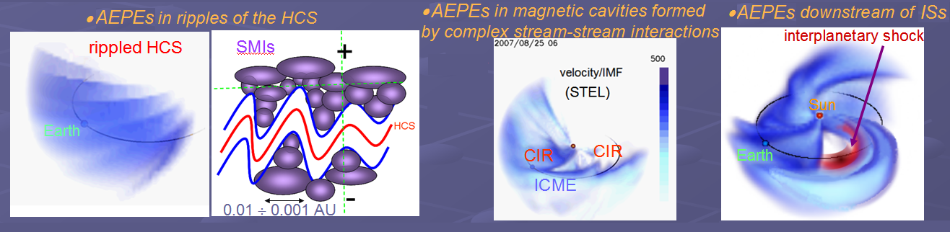

- energetic particles- magnetic cavities – magnetic islands
New paradigm
- pre-acceleration via magnetic reconnection at current sheets or other mechanisms of particle acceleration +
additional acceleration of energetic particles in magnetically confined areas filled with dynamically evolving small-scale magnetic islands (l ~ 0.001AU-0.01AU).
confinement of magnetic islands in magnetic cavities
Zank et al., ApJ, 2014, 2015; le Roux et al., ApJ, 2015, 2016;
Khabarova et al., ApJ, 2015, 2016, 2017; Khabarova & Zank, ApJ 2017;
Khabarova et al. 2018; Zhao et al. ApJ, 2018; Adhikari et al. ApJ, 2019
Notes:
Recent studies of particle acceleration in the heliosphere have revealed a new mechanism that can locally energize particles up to several MeV/nuc.
There are numerous theory and simulation papers (Guo et al. 2014, 2015, 2016a, 2016b, Li et al. 2017, 2018a, 2018b, Du et al. 2018, Zank et al. 2014, 2015, le Roux et al. 2016, 2018, Mingalev et al. 2019) as well as observational papers (Khabarova et al. 2015, 2016, Khabarova & Zank, 2017, Zhao et al. 2018) supporting in detail the mechanism of particle energization by processes occurring in dynamical magnetic islands as a particle acceleration process, which is discussed in this paper.
The so-called AEPEs have been observed in….

Slide 3
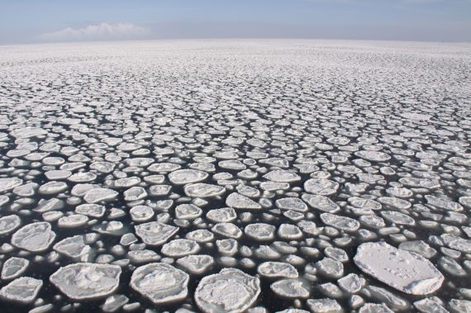
- energetic particles- magnetic cavities – magnetic islands
Particle energization by reconnecting magnetic islands :
Wei et al. 2000; Cargill et al. 2006; Drake et al. 2006, 2013; Pritchett 2006, 2007, 2008; Oka et al. 2010; Hoshino 2012; Guo 2014; Montag et al. 2017; X.Lit et al. 2018
Magnetic island contraction and merging can accelerate particles
The dominant charged particle energization processes are
the electric field induced by magnetic
island merging,
magnetic island contraction.
In both cases, the magnetic island topology ensures that charged particles are trapped in regions where they can experience repeated interactions with either the induced electric field or contracting magnetic islands.
Zank et al., 2014, 2015;
le Roux et al. 2015, 2016; 2017
Greco et al. 2010, Planet. Space Sci., 58
Matthaeus, Ambrosiano, Goldstein, 1984, PhRvL, 53, 1449
Notes:
A new mechanism that can energize particles up to several MeV/nuc locally in the solar wind has been introduced by Zank et al. le Roux et al.

Slide 4
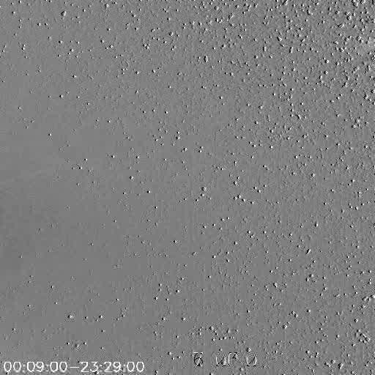
Magnetic cavities formed due to unstable streaming from a long-lived coronal hole
Khabarova, Zank, Li, Malandraki et al, ApJ, 2016
Notes:
Khabarova and co-workers have presented evidence that Magnetic cavities formed due to unstable…. In May 2007. This video shows observations from the Heliospheric Imager 1 onboard STB showing the evolution of a swirl-like structure on 2007 May 28-29

Slide 5
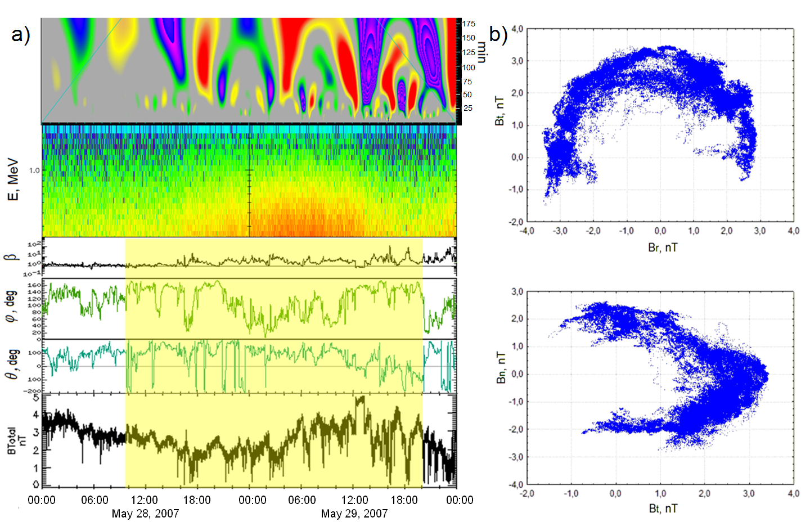
Magnetic cavity formed due to unstable streaming from a long-lived coronal hole + magnetic islands (l~0.001-0.01 AU)
Khabarova, Zank, Li, Malandraki et al, ApJ, 2016
Notes:
They found that the occurrence of magnetic islands in the region between two streams from the same coronal hole corresponds to the appearance of quasi-stable variations of the IMF strength in a range from 20minuts to 2 hr as seen in the results of Fourier analysis shown. The ion intensity increase shown in the second panel inside the yellow highlighted area, coincides with the detection of quasi-stable structures having typical sizes of small-scale magnetic islands as observed by STA. The rotation of the IMF vector inside numerous magnetic islands can be seen from the behaviour of the cone and clock IMF angles.

Slide 6
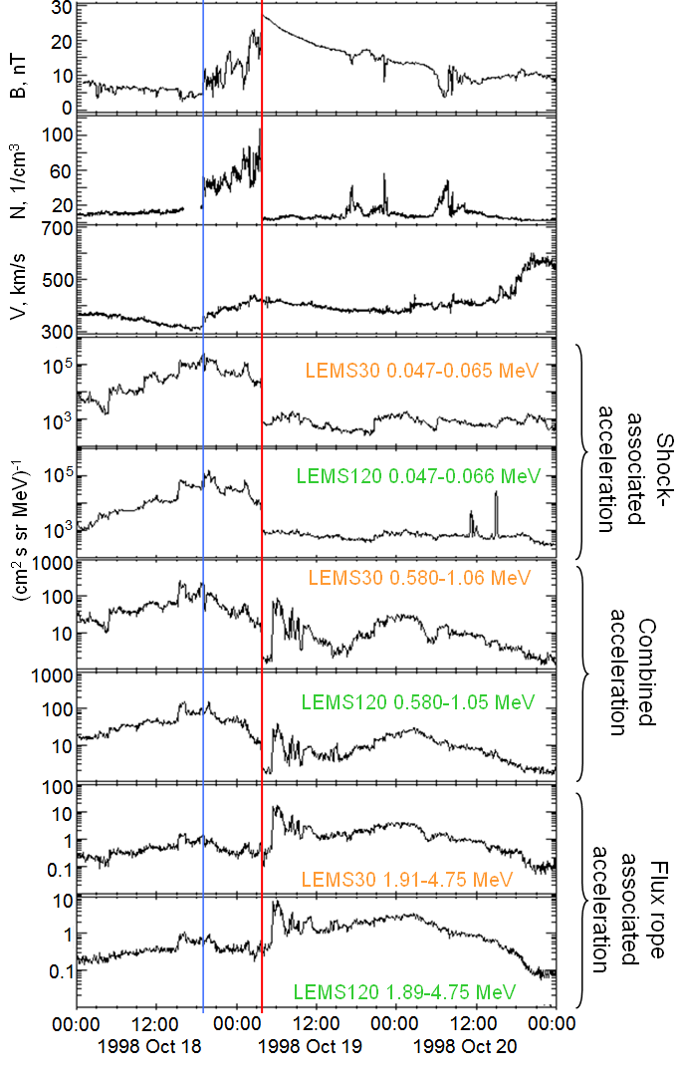
The shock (blue line) accelerates particles effectively up to hundreds of keV.
Dynamical magnetic islands accelerate particles up to 5 MeV.
There is an energy range in
which both sources contribute.
Different mechanisms of particle acceleration can act simultaneously and interplay in the solar wind
Khabarova & Zank, ApJ, 2017
Notes:
K&Z, 2017 have presented evidence for the possibility of different mechanisms of particle acceleration acting simultaneously and interplay in the solar wind, in terms of Diffusive shock acceleration and particle acceleration by dynamical magnetic islands up to 5 MeV.

Slide 7
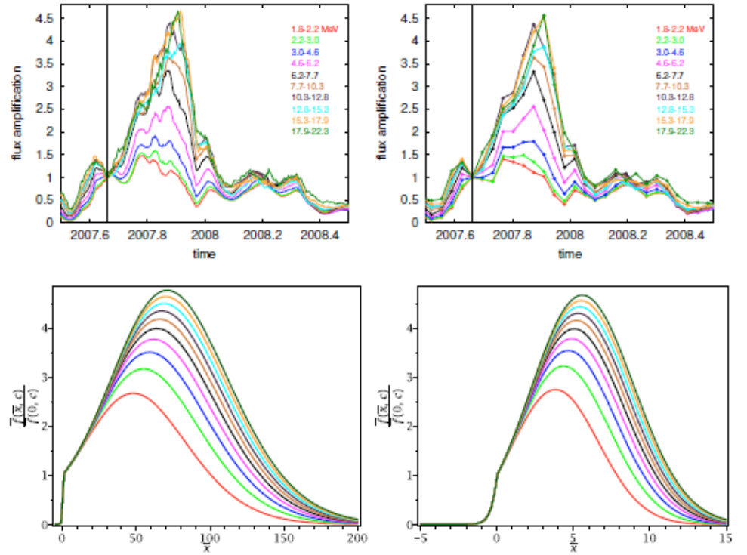
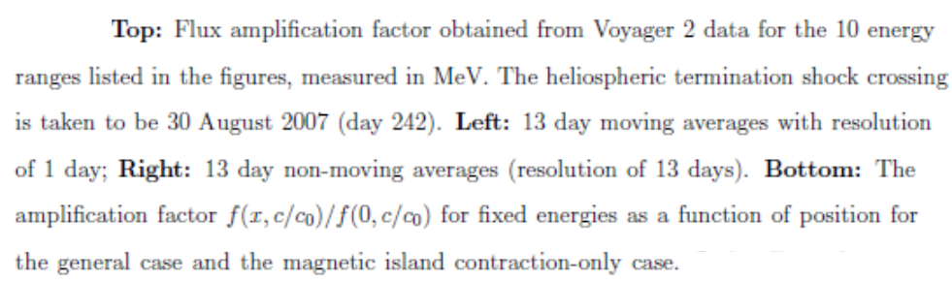
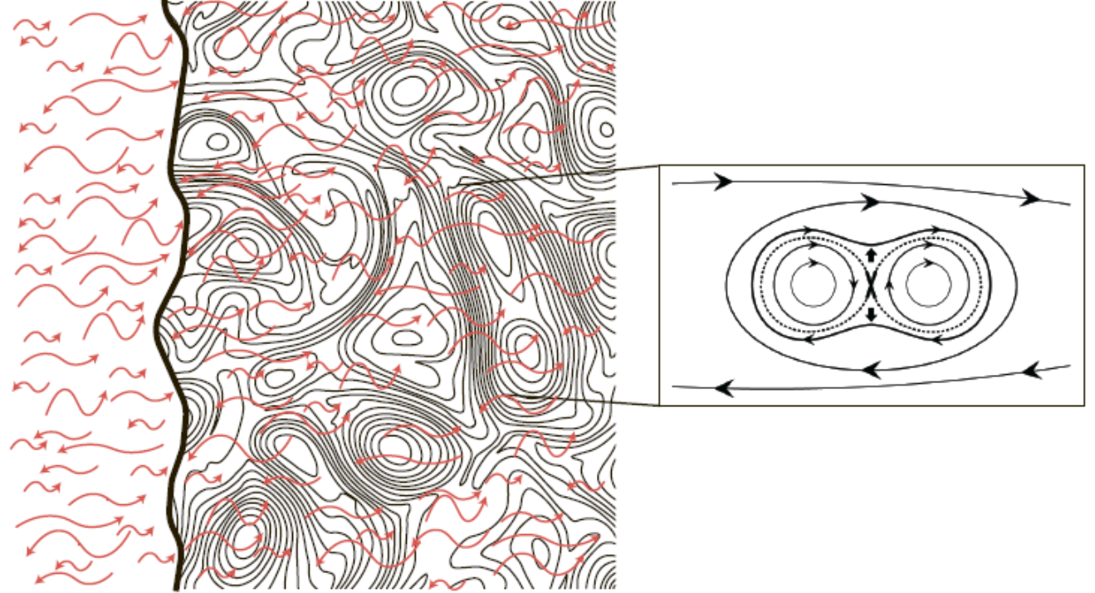
Acceleration in dynamical magnetic islands can be combined with the diffusive shock acceleration mechanism
HTS
HTS
Zank et al. (2015): The energetic particle intensity profile observed by Voyager 2 DS of the heliospheric termination shock (84 AU) appears to support a particle acceleration mechanism that combines both DSA and magnetic-island-reconnection-related processes.

Slide 8

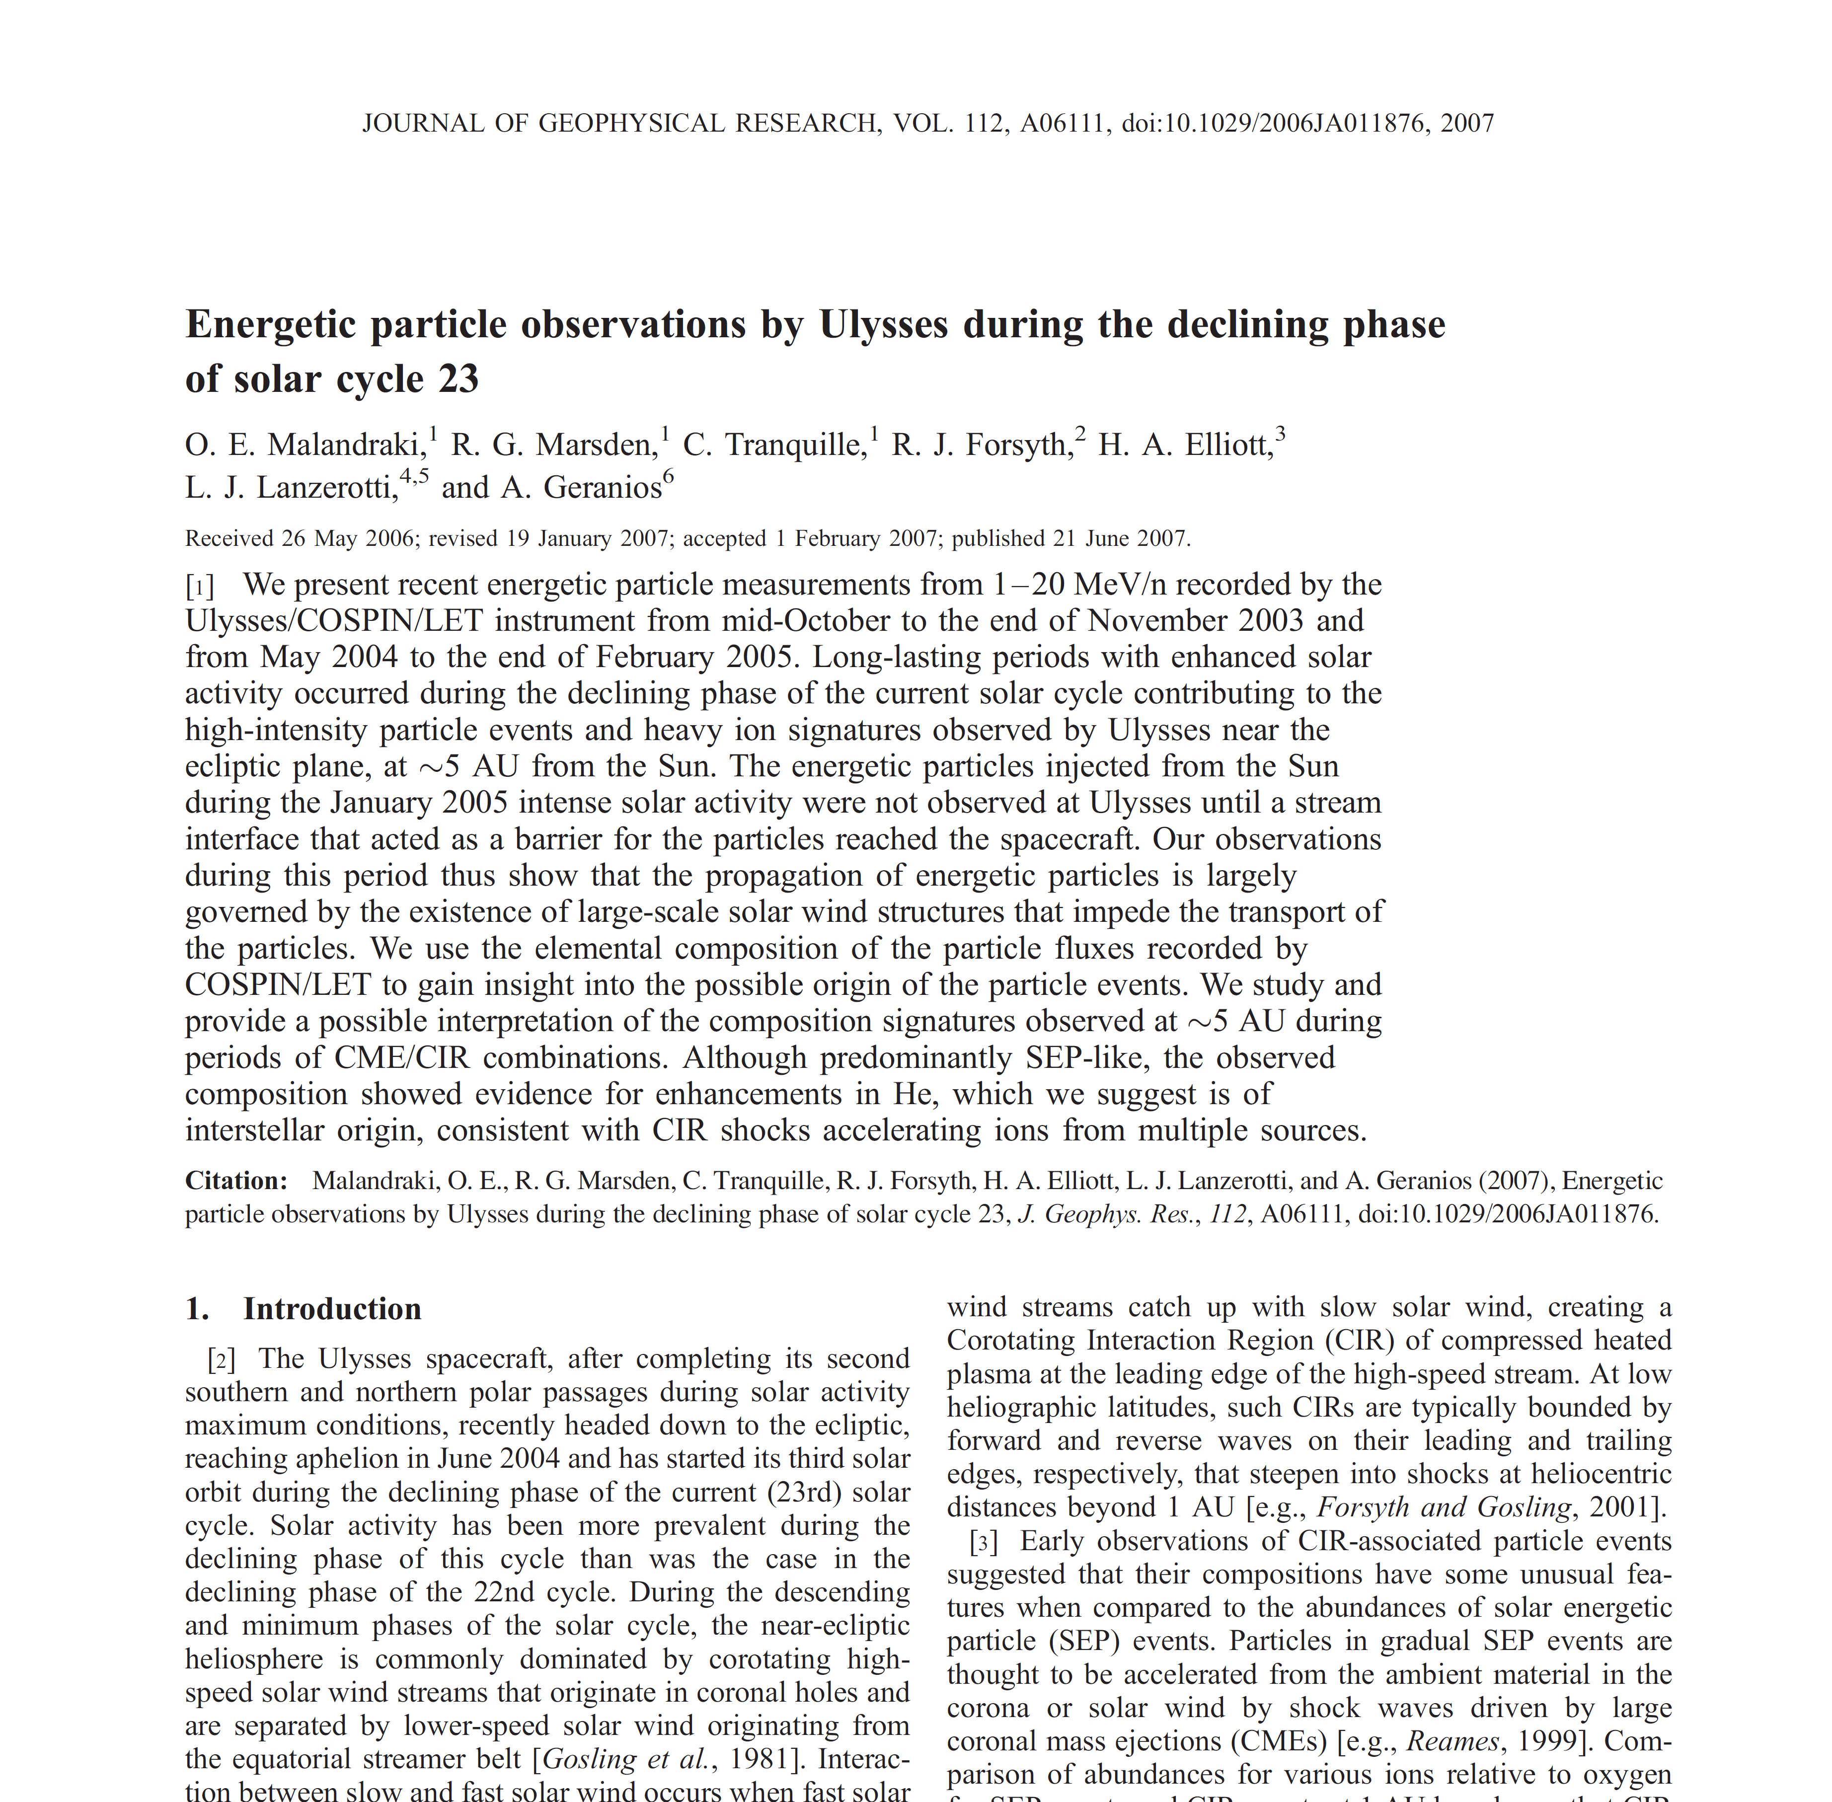
Notes:
Within ISSI I coined the idea and we have re-visited the study of the Jan 2005 event previously studied from the high-energy perspective by the COSPIN/LET onboard Ulysses and and published in the Malandraki et al. 2007 paper. (SHOW slide with the front page of the paper) Ulysses in the ecliptic plane near Jupiter’s orbit at 5.3 AU in January 2005. We revisited the event by studying the lower energy ion observations by the HI-SCALE experiment onboard Ulysses.

Slide 9
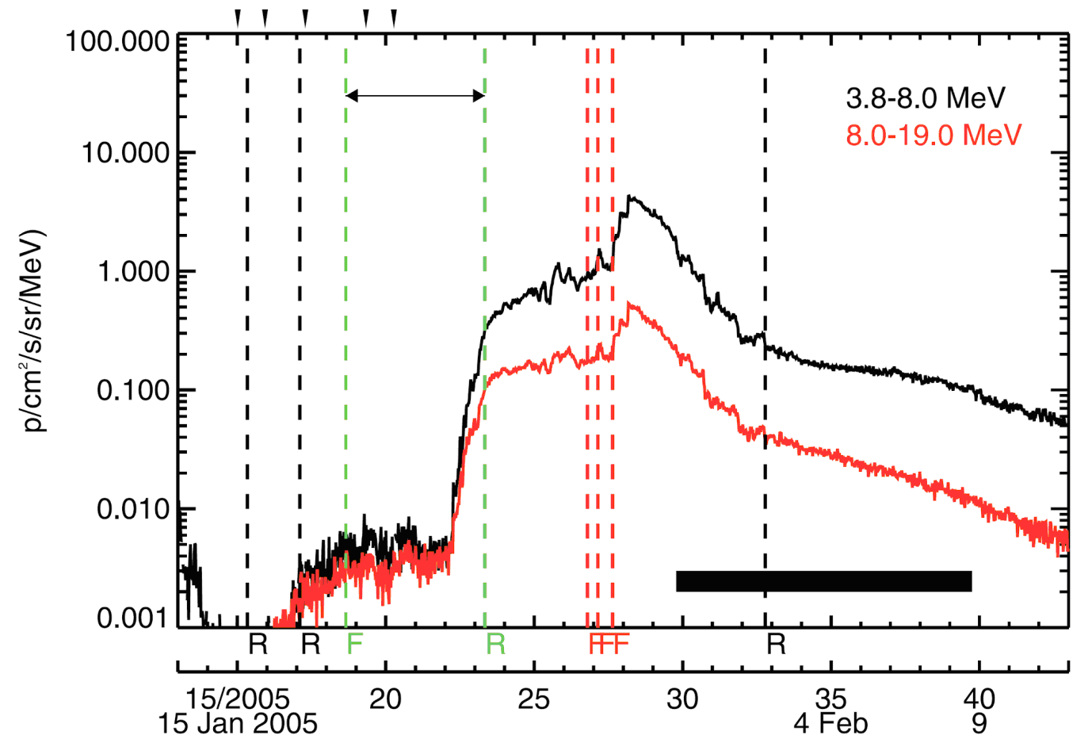
Ulysses/COSPIN/LET observations – Jan 2005, Helioradius~5.3 AU
Malandraki, Marsden et al. 2007
Energetic particle observations in the 3.8-19 MeV energy range as measured by the COSPIN/LET instrument onboard Ulysses
EP not observed until a stream interface (associated with a preceding CIR- green) that acted as a barrier reached the spacecraft
Malandraki et al. 2007: The ICME transient material observed by Ulysses on days 29-39, 2005, (horizontal solid bar) due to Ulysses being in a favorable position to detect a system of solar wind transient flows resulting from the interaction and coalescence of a series of unusually fast halo CMEs ejected from the Sun during 15-20 Jan, 2005 (AR 10720).
3 FS and a later RS were observed in association with the ICME/CIR interaction
Notes:
In Figure 3, a view from the north ecliptic pole in a coordinate system fixed with respect to the Sun-Earth line is presented showing the positions of Earth and the Ulysses spacecraft projected onto the ecliptic at the times indicated during the period for days 1–52, 2005.
….culminating with the one of the fastest halo CMEs that was ejected on 20 Jan 2005.
Individual transient solar wind disturbances resulting from multiple CMEs at the Sun tend to coalesce to form larger, more complex structures (e.g. Richardson et al., 2005; Jian et al. 2011) by the time they reach 5 AU. If at the same time, the background solar wind is dominated by a more or less regular pattern of fast and slow streams that form SIRs, CIRs, or some form of shear layers (e.g. Forsyth and Marsch, 1999, and references therein; Gosling and Pizzo, 1999; Gosling et al., 2001; Bisi et al., 2010, and references therein), the result is often the formation of so-called compound streams (e.g. Burlaga et al., 1986).

Slide 10
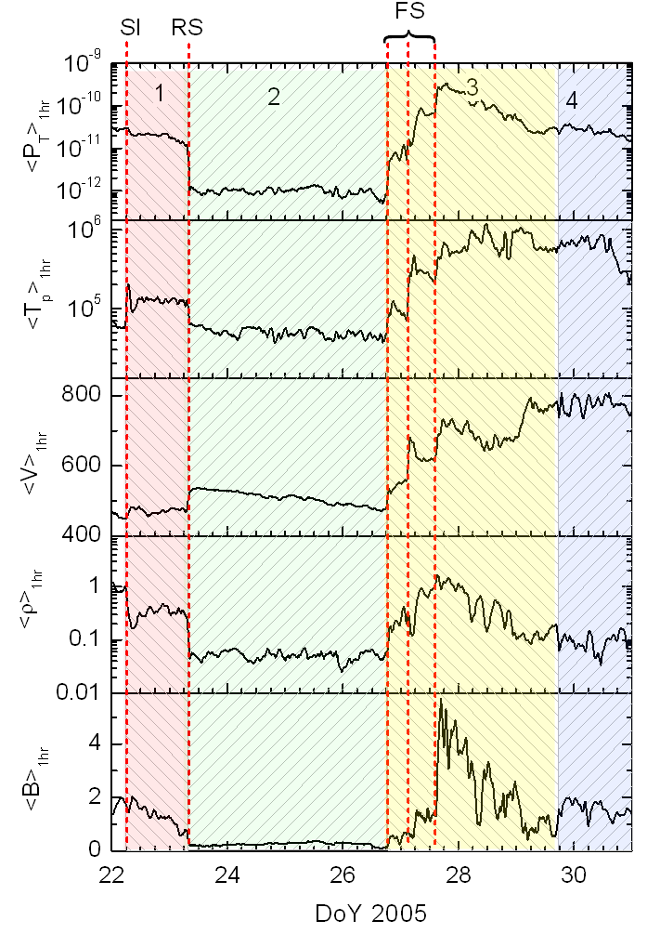
Variations in the IMF and plasma parameters by Ulysses – Jan 2005
Regions 1,2 and 4 characterized by the presence of Pressure Balanced Structures, as shown by the constant value of the total pressure (top panel)
Region 1: interval between SI and RS
Region 2: a quiet interval between the CIR and the ICME (from the RS to the 1st of the 3 FSs)
Region 3: an ICME merged sheath
Region 4: ICME main body
Malandraki, Khabarova, Bruno,
Zank et al., ApJ, 2019
Notes:
From top to bottom we show average values, computed on a 1hr scale, starting from the original data that we re-sampled with a sampling time of 8 min. Shown from top to bottom are total pressure P_{T} (magnetic plus kinetic), proton temperature T_{P}, solar wind speed V, proton number density ρ and magnetic field intensity B, respectively. Vertical dashed lines indicate, from left to right, the location of the stream interface (SI), the reverse shock (RS) and the three ICME driven forward shocks FS, corresponding to the sketch of Figure 3c. SI is the Stream Interface of the CIR bounded by the two green dashed vertical lines in Figure 2.
These regions are easily identified by the behavior of the parameters shown in the various panels. ….

Slide 11
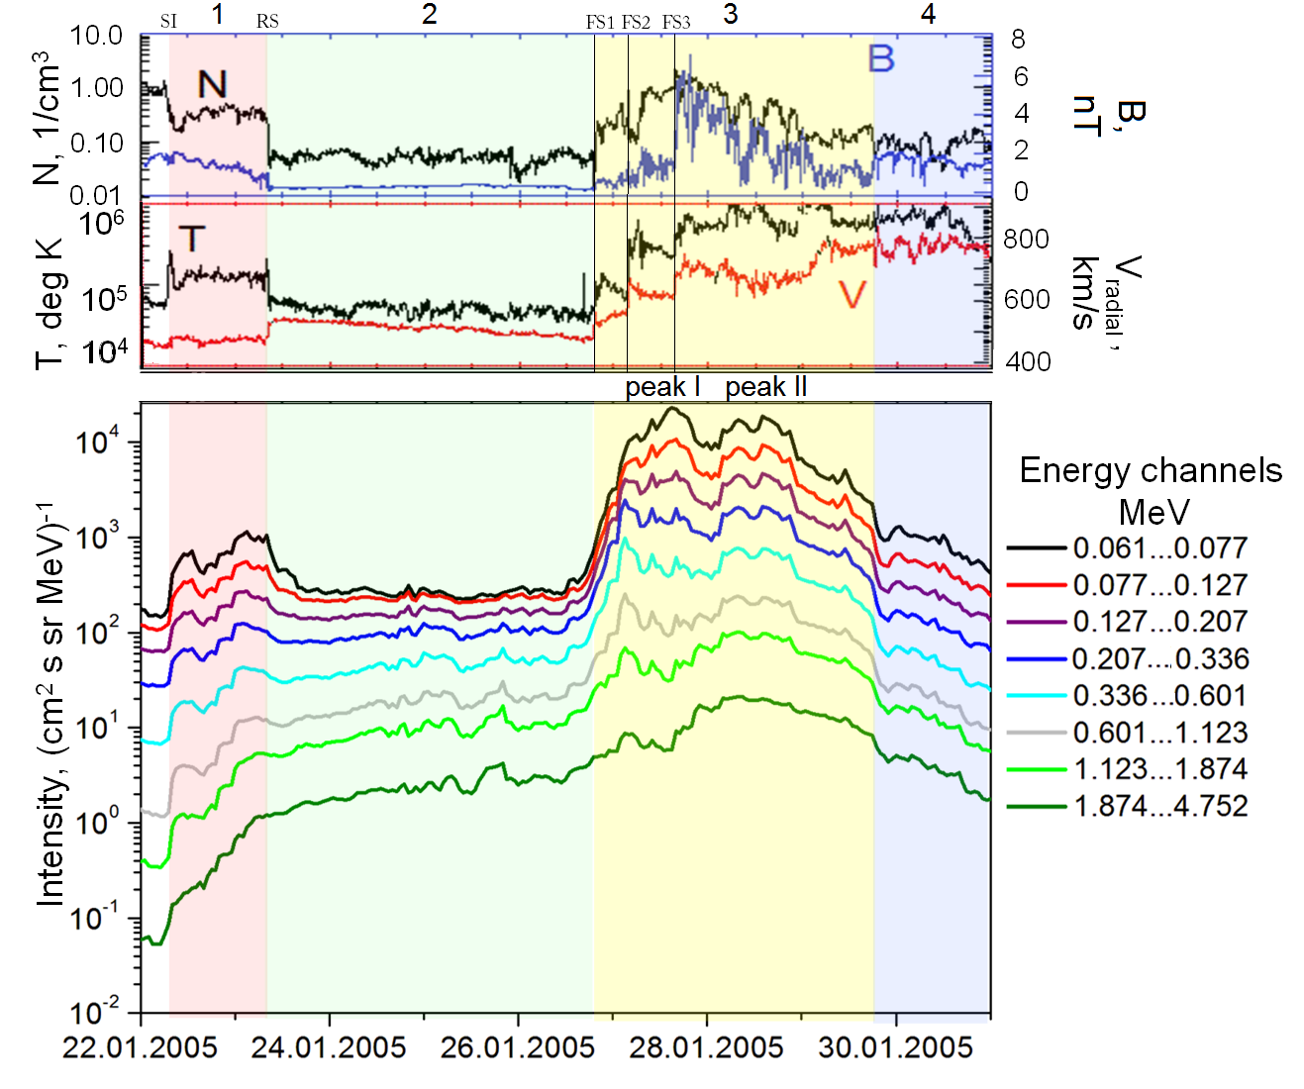
Energetic particle observations by Ulysses/HI-SCALE
Malandraki, Khabarova, Bruno, Zank et al., ApJ., 2019
HI-SCALE/ LEMS120 telescope: Two main peaks observed up to 1MeV: smaller double peak associated with CIR R1 & higher double peak observed within R3
Noteworthy: lower energy ions behave almost independently of higher energy-ions (compare black and green curves)
Abrupt enhancement of the lower-energy (0.061-0.601 MeV) ion intensities is observed at the passage of the SI. At the passage of the RS, a more gradual decrease is observed in the lower-energy ion flux profiles, with the intensity levels getting back to nearly pre-event levels exhibiting a plateau thereafter, within R2.
Ulysses/HI-SCALE
Energetic ions of higher-energy intensities (from 0.601 MeV to 4.752 MeV), as observed in R1 and R2, have typical SEP characteristic profiles in a similar way as shown in Malandraki et al. (2007).

Slide 12
Energetic particle observations by Ulysses/HI-SCALE
Malandraki, Khabarova, Bruno, Zank et al., ApJ, 2019
Lower-energy ion flux enhancements observed in R1 are definitely not related to the SEP propagation
They are not totally due to the RS either, because there are two peaks within the region and none of those is observed to have a maximum coinciding with the shock position
They apparently become accelerated inside R1 by different and independent mechanisms, one of which is of a local origin – quite possibly determined by the existence of magnetic islands inside R1
Ulysses/HI-SCALE
Are those extra peaks far downstream of ISs (PEAK II) related to DSA only or there is also another origin for these energetic particle enhancements?

Slide 13
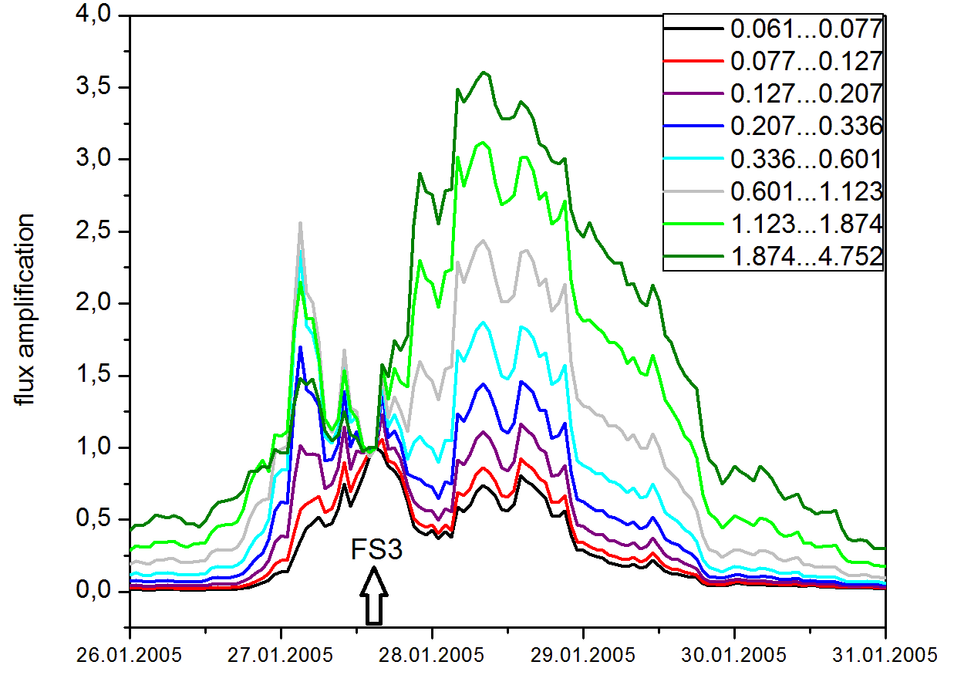
Evidence for the existence of Magnetic islands
Energetic particle observations by Ulysses/HI-SCALE
Ulysses/HI-SCALE
Flux amplification calculated for the 8 HI-SCALE/ LEMS120 telescope channels
Zero point corresponds to the last shock (FS3) position
In the case of pure DSA the flux amplification should be 1 DS of the Shock
The existence of a prominent peak far behind the shock is a signature of some unaccounted processes that accelerated particles occurring within ICME sheath
The order of the curves with higher energies on the top ⇒ signature of particle acceleration proposed by Zank et al. 2014: energization of ions by dynamical magnetic islands
Therefore, Peak II a result of local dynamical processes
Malandraki, Khabarova, Bruno,
Zank et al., ApJ, 2019

Slide 14
Evidence for the existence of Magnetic islands (cntd.)
Energetic particle observations by Ulysses/HI-SCALE
A clear anti-correlation between the density and the IMF strength present in R1 and R3
Anti-correlated pulses of N and B especially well-pronounced in R3
This is one of the signatures for the occurrence of Magnetic Islands (Cartwright & Moldwin, 2010; Khabarova et al. 2015)
Ulysses/HI-SCALE
Malandraki, Khabarova, Bruno, Zank et al., ApJ, 2019

Slide 15
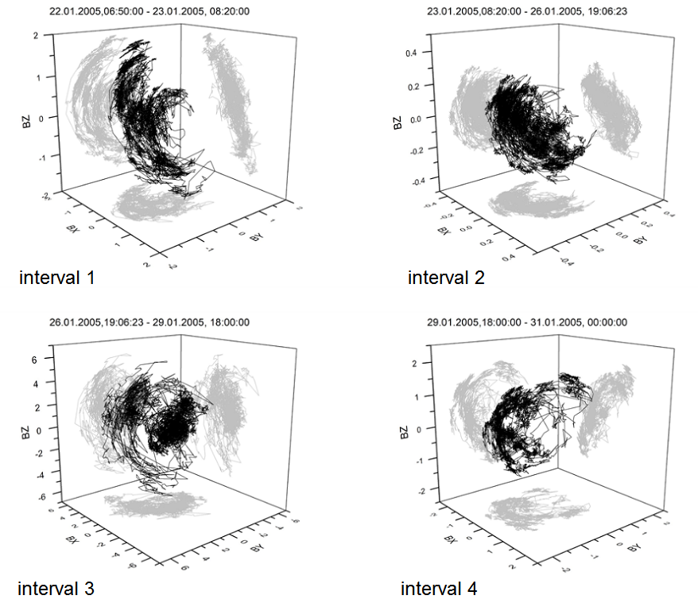
Evidence for the existence of Magnetic islands (cntd.)
Location of the tip of the magnetic field vector (hodograms) in the RTN reference system for each of our 4 time intervals
Intervals 2 and 4 do not show large amplitude arches like intervals 1 & 3
Therefore, signatures of magnetric islands occur mainly in intervals 1 and 3
Malandraki, Khabarova, Bruno, Zank et al., ApJ, 2019

Slide 16
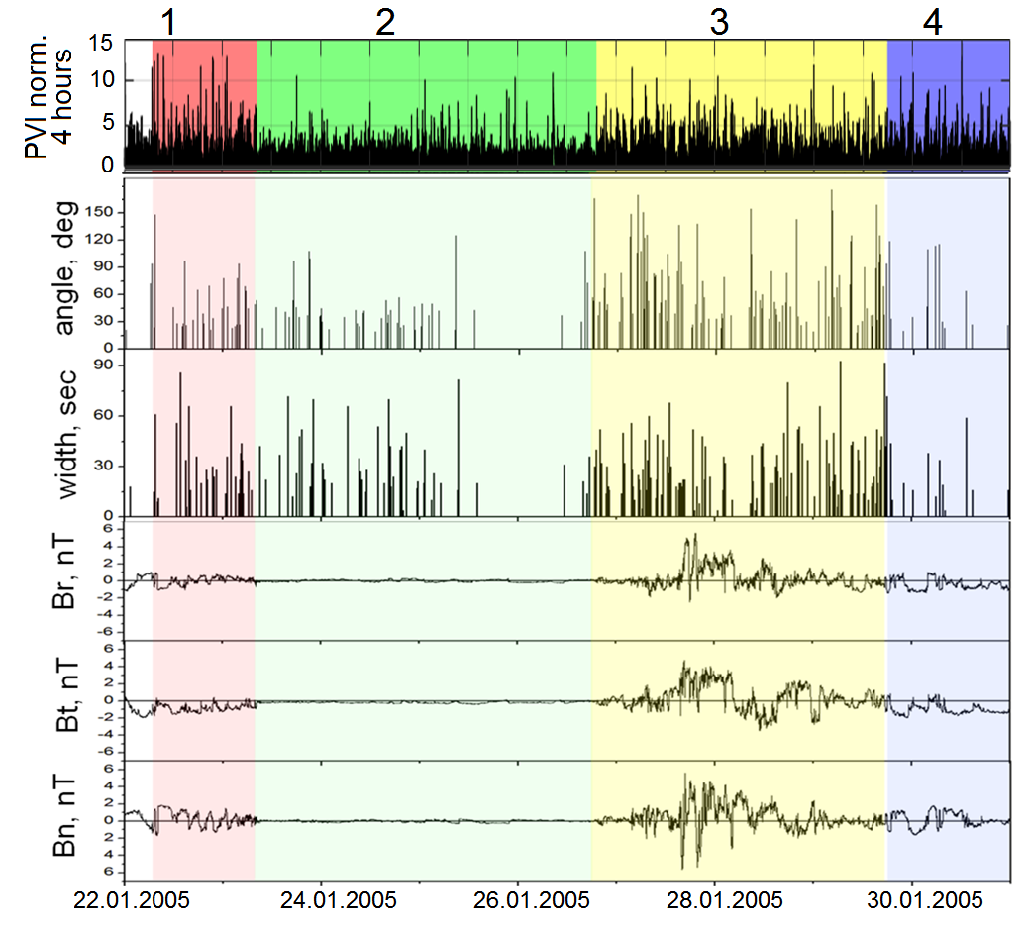
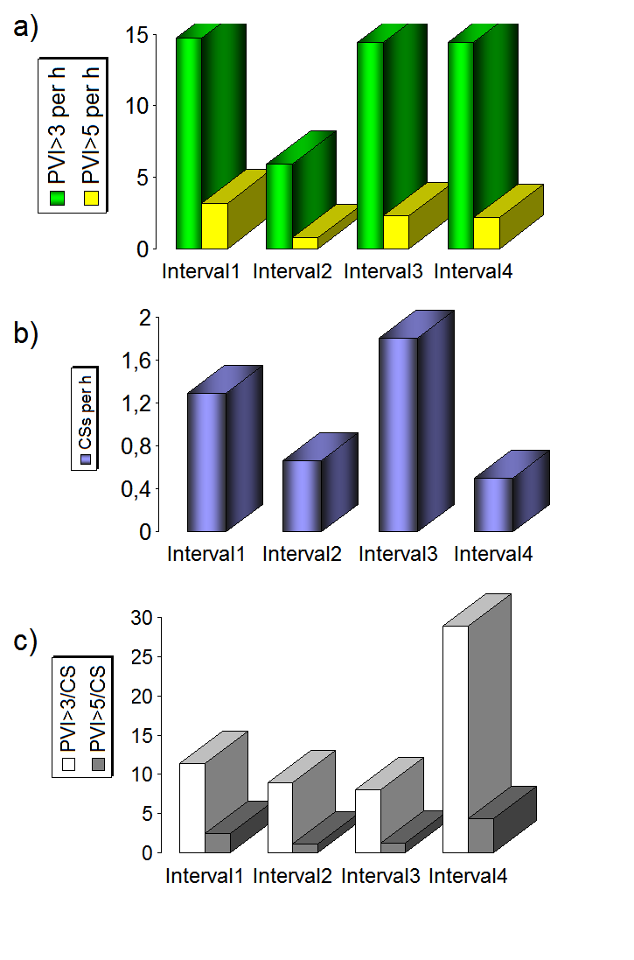
Evidence for the existence of Magnetic islands (cntd.)
Signature of the presence of small-scale MIs: observations of Current Sheets (CSs) separating them
PVI method: top panel shows the presence of coherent structures of all possible origins (Greco et al. 2018)
No big difference between the 4R
Only CSs characteristics derived from the CS identification method by Li 2008 ⇒ the occurrence rate of CSs in R1 and R3 higher than in other regions
CS angles larger in R3 ⇒ larger changes in the local IMF direction
CS occurrence rate calculated: The number of CSs per hour is much higher with R1 and R3
Malandraki, Khabarova, Bruno,
Zank et al., ApJ, 2019

Slide 17
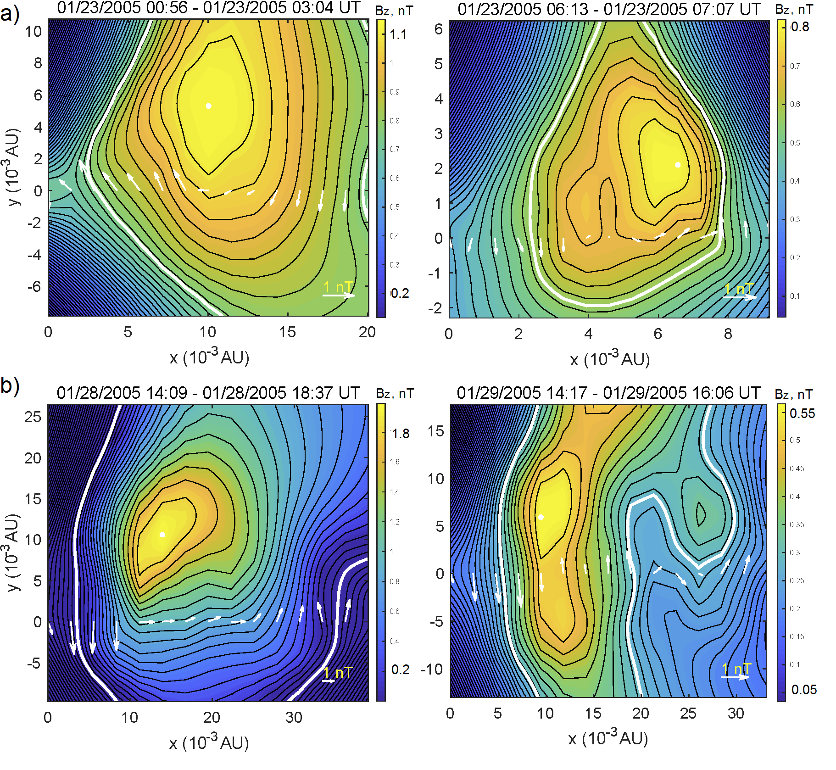
Evidence for the existence of Magnetic islands (cntd.)
Malandraki, Khabarova, Bruno, Zank et al., ApJ, 2019
Additional analysis to confirm the presence of well-shaped MIs within the Rs
Grad-Shafranov reconstruction of the spatial profile of local magnetic fields applied to the solar wind allows finding a form and specific properties of MIs (Zheng & Hu, 2018)
Randomly selected ΜΙs observed within R1 and R3
In each plot: White arrows: the magnetic field vector along the s/c path, Black contours: the isopotential lines of the potential vector A, white dot: mazximum of the Bz component of the IMF
Left panels: relatively large-scale single islands
Right panels: smaller-scale MIs with clear signatures of their dynamical interaction with surrounding islands and formation of small-scale CSs between them

Slide 18
Malandraki, Khabarova, Bruno,
Zank et al., ApJ, 2019
Key results of the study
Energetic ion flux enhancements in lower energy channels have a profile considerably different from higher energy channels. We conclude that energetic particle flux enhancements up to ~0.6 MeV are mostly determined by local particle acceleration occurring in Rs filled with small-scale MIs and CSs
We prove that the variations in the IMF observed in these regions are not associated with Alfvenic fluctuations; therefore the corresponding AEPEs cannot be explained simply by a wave activity or large-scale turbulence
The number of CSs is predominantly higher in Rs where the AEPEs are observed, and the IMF vector rotates in the same Rs
The restoration of the IMF profile with the G-S technique also shows small-scale MIs in the regions
We found the AEPEs DS of the merged ICME shock are characterized by the flux amplification exceeding 1, which points to the existence of a mechanism of particle acceleration apart from DSA
We conclude that local particle acceleration in the regions is governed not only by shocks by also by dynamical MIs and stochastically reconnecting CSs
We thus show that local coherent structures in the solar wind such as magnetic islands and current sheets may not only modulate time-intensity profiles of energetic ion flux but also effectively contribute to particle acceleration in the heliosphere.

Slide 19

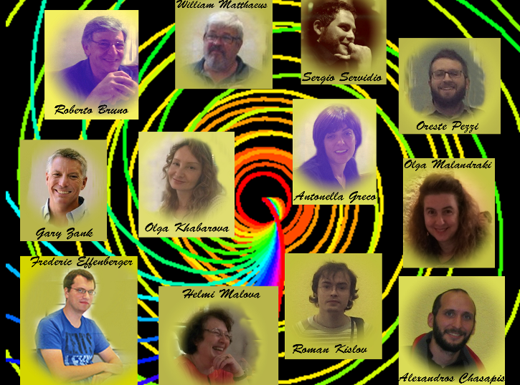
Thank you for your attention!
ISSI international team 405
Yours,
ISSI international team 405
http://www.issibern.ch/teams/structpartaccel

Slide 20
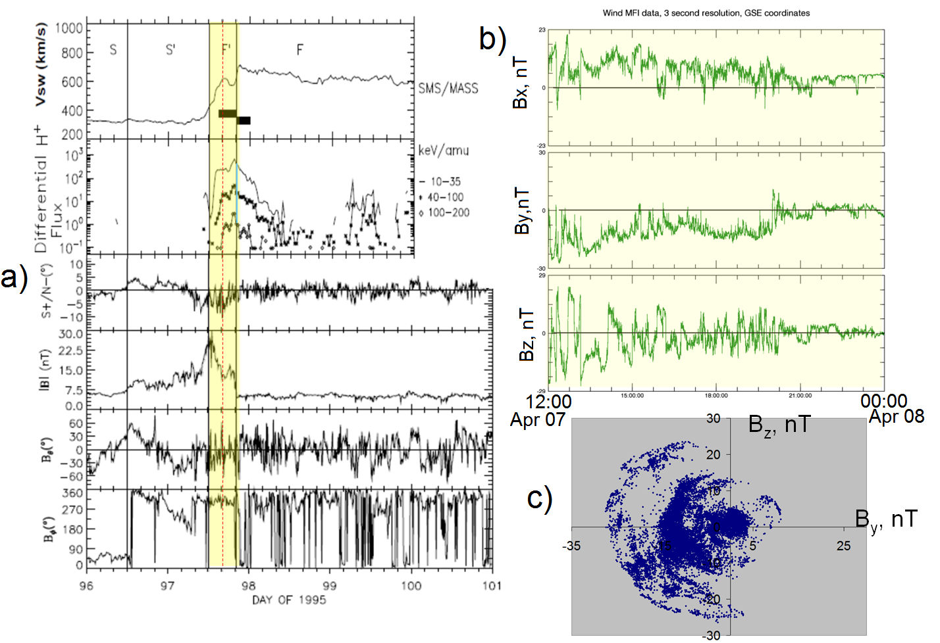
Figure 1. Additional analysis of the IMF variations in region 1 of CIR1 previously discussed by Chotoo et al. 2000. a) Yellow stripe (to the left with regard to the shock) indicates the interval within which an AEPE is observed, and the red dash line shows the crossing of the strongest current sheet within turbulent region 1 downstream of the RS ; b) Variations in the three IMF components in the interval of interest; c) The corresponding rotation of the IMF vector in the Bz-By plane within region 1.

