Slide 1
Theory of low temperature deuteric oxidation and fracturing of titanomagnetite grains of ocean floor basalts
GO “BOROK” Russian Academy of Sciences
NNTU, Trondheim, Norway
Valera Shcherbakov and Karl Fabian
Geophys. J. Int. (2020) 221, 2104–2112
EGU General Assembly 2020

Slide 2
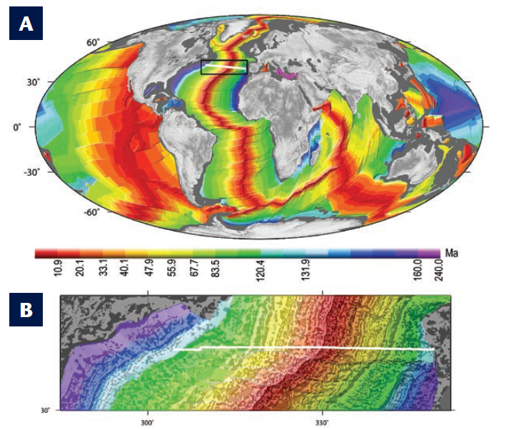
Magnetization patterns of ocean floor basalts provide a detailed picture of the plate tectonic motions and of the geomagnetic field reversals over the last 180 Ma.
The primary NRM of
ocean floor basalts
is carried by
titanomagnetites (TM)
Fe_{3-x}Ti_{x}O₄ with T_{C}  200°C.
This implies that the natural cooling rate is sufficiently high to prevent immediate oxidation of the fresh TM grains during the initial cooling.

Slide 3

Titanomagnetite grains undergo low-temperature oxidation after initial cooling. This process is suspected to control the long-term variations of NRM-intensity across the ocean floor.
The oxidation process is quantified by the oxidation parameter z so that primary TM transforms to non-stoichiometric cation-deficient solid solution Fe_{3-x-z/3}Ti_{x}_{z/3}O₄ where sign means vacancy.
In an oxidizing environment, the process of oxidation in TM grains proceeds by inward diffusion of vacancies. The corresponding diffusion coefficient D(z) for magnetite decreases with increasing degree z (Gillot, 1978). A detailed study of oxidation kinetics of TM grains with sizes of about 300 nm and various compositions x performed by Gapeev and Gribov, 1990 confirmed the same trend for TM. They found a substantial increase of activation energy E with z corresponding to a decrease of D(z) by a several orders of magnitude hypothesize that partial ordering of vacancies severely hinders further diffusion.
Here we develop a theoretical framework to solve the diffusion process with strong D(z) dependence. Based on this theoretical approach, we discuss an explanation for the observed evolution of NRM intensity and degree of oxidation z with age of the oceanic crust.

Slide 4

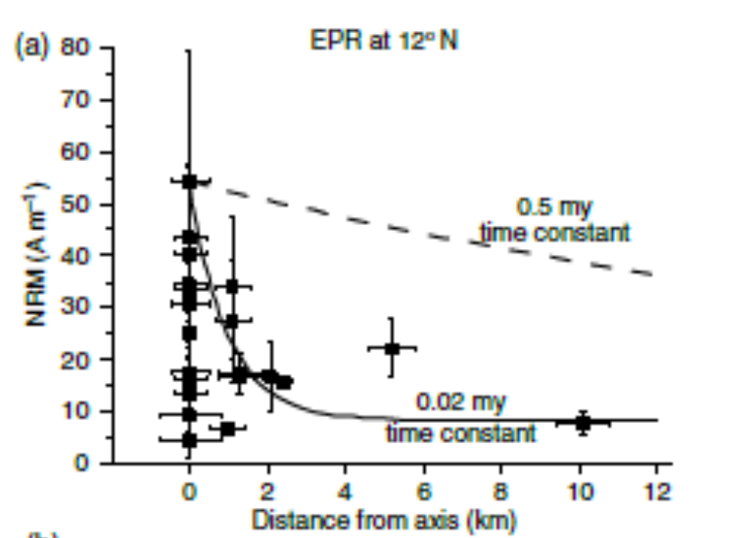
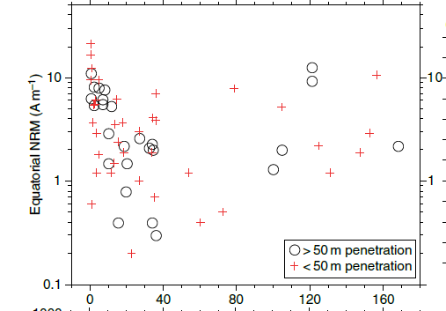
Remanence acquisition at the ocean floor
(By Johnson and Pariso, 1993, Gee and Kent, 2007)
There is a substantial fourfold decrease in mean NRM intensity from the axial zone to older sites (right diagram).
But otherwise there is no an obvious age-dependent trend in the NRM values (left diagram)

Slide 5
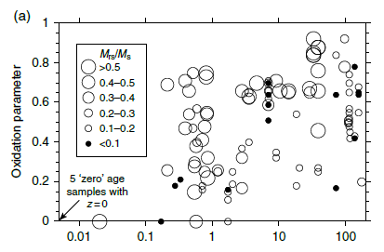
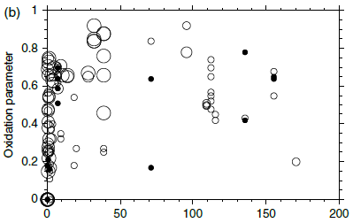
The rapid decrease in NRM is consistent with an initial, very quick increase in alteration such that z values up to 0.8 occur in basalts less than 1 My old, as suggested by Bleil and Petersen , 1983. Much less convincing is any systematic long-term trend because although values of $ greater than 0.8 do tend to occur in samples older than about 30 Ma, the oldest sample measured (Hole 801C, 169 Ma) has a z value of only 0.2. Thus, while low-temperature alteration evidently can occur rapidly, the extrusive layer is not uniformly oxidized even for the oldest seafloor (Gee and Kent, 2007).
Age, Ma. Left, linear scale. Right, logarithmic scale

Slide 6

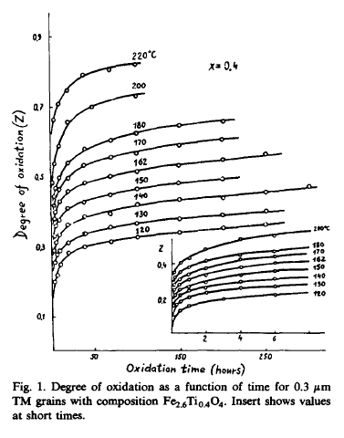
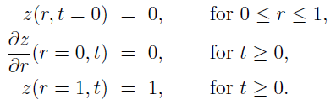

Diffusion equation
for oxidation of a titanomagnetite sphere
New problem:
Diffusion constant decreases with increasing oxidation degree z
=> Stiff differential equation that is numerically almost intractable!
Gapeev and Gribov, 1990

Slide 7
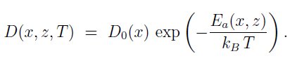




Diffusion time scales
Two limiting time scales for z=0 and z=1:
fast diffusion at low z
slow diffusion at high z

Slide 8

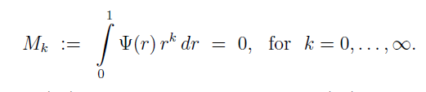

Solving the diffusion equation by the method of moments
Vanishes for solution z(r,t)
All moments vanish !
Get an extremely good approximation by setting
and solve only the three 'simple' differential equations
M₀=0, M₁=0, M₂=0
to find A(t), B(t) and m(t)

Slide 9
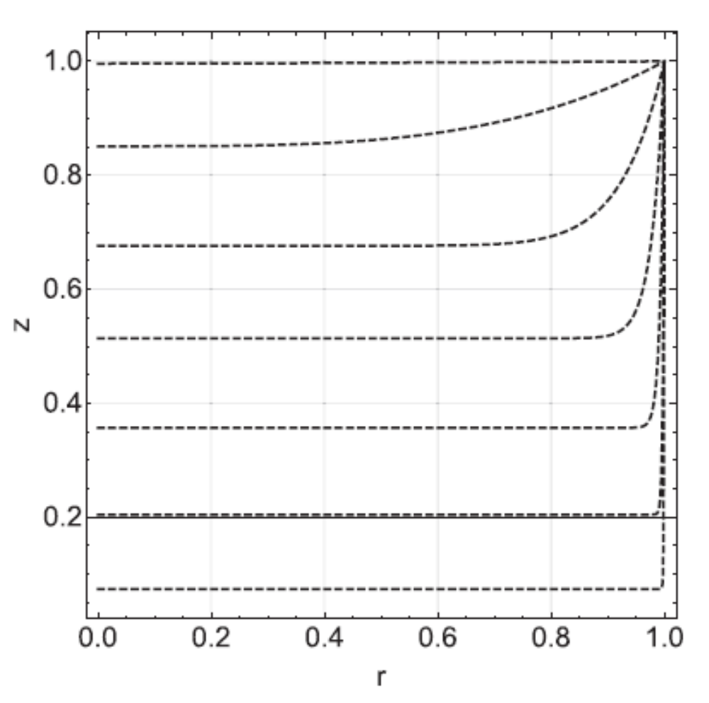
An example of solving the diffusion equation by the method of moments
Vacancy concentration z as a function of relative radius r at different times ₁/₀ = 10^{k} for k = 0,…,6 from bottom to top. Calculations were performed for ₁/₀ = 310⁶.

Slide 10
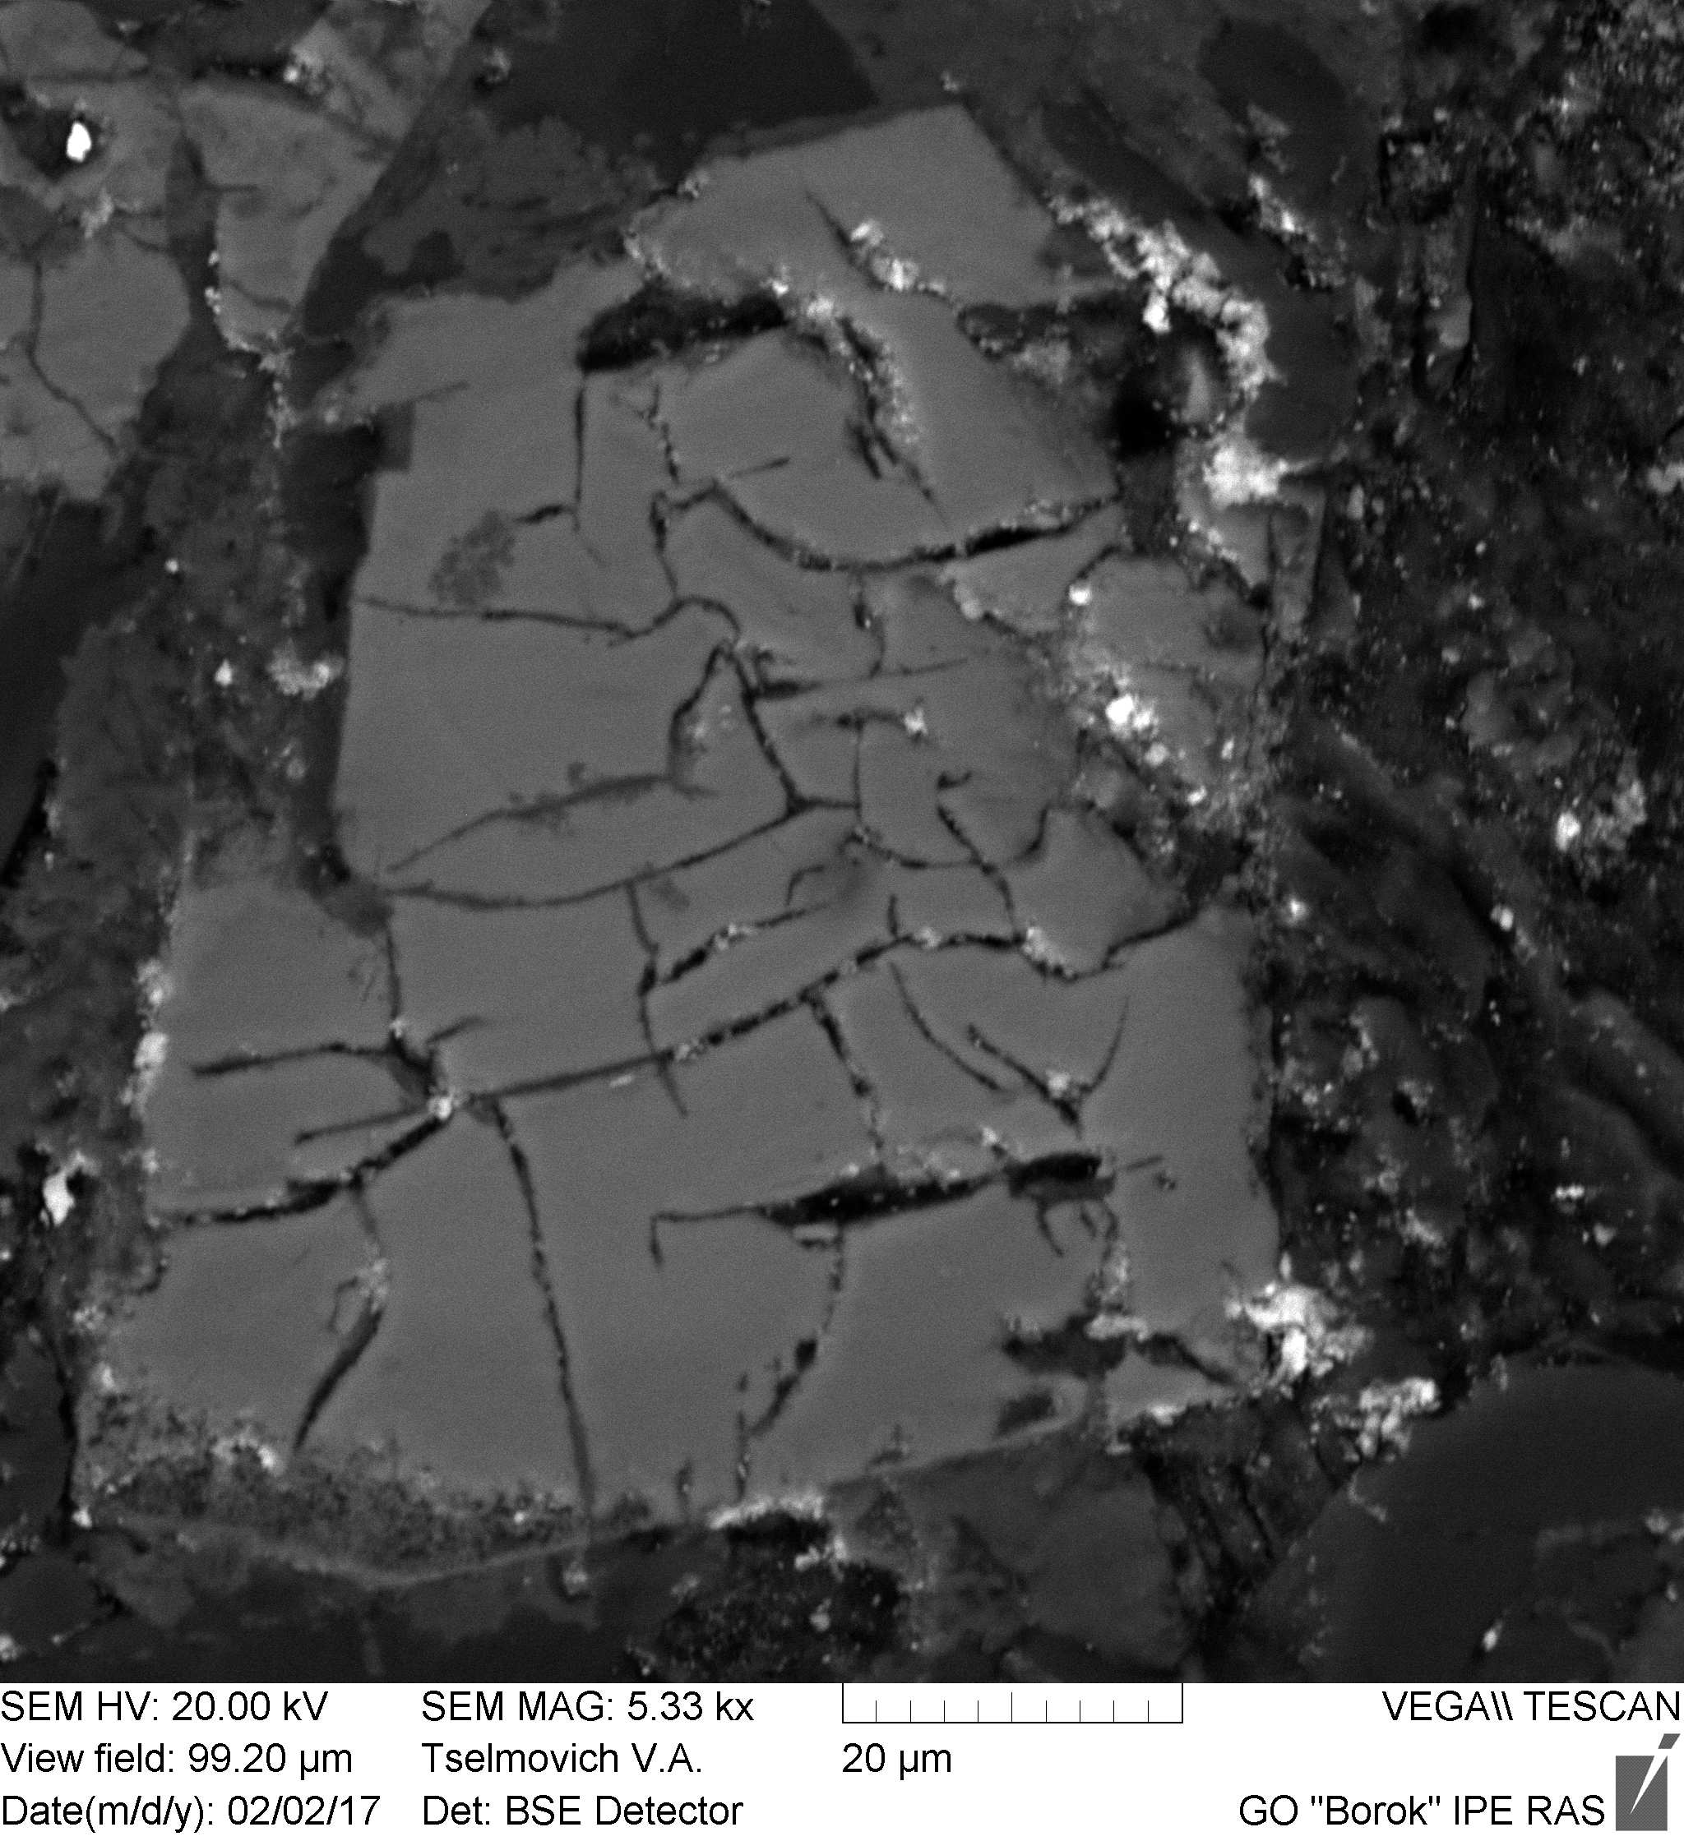
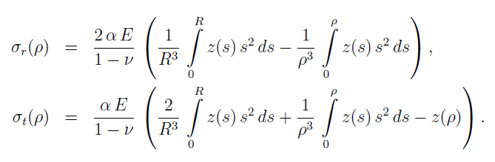


Highly inhomogeneous oxidation profiles naturally generate strong stresses related to oxidation and may lead to fracturing of coarse grains. Such the fracturing was indeed discovered in marine basalts in grains with sizes  5 µm or more (Petersen and Vali, 1987). An example of such the fracturing is shown on the left photo
The oxidation profile z(r) defines
tangential and radial stress fields
Equivalent to thermal stresses:
Timoshenko and Goodier, Theory of elasticity, 1951, p.416

Slide 11
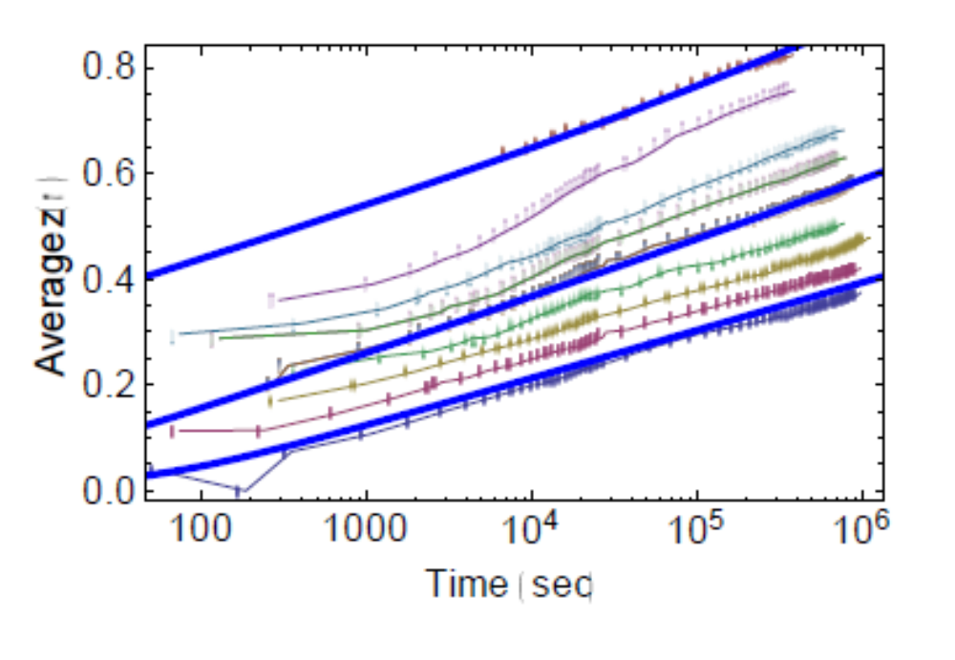
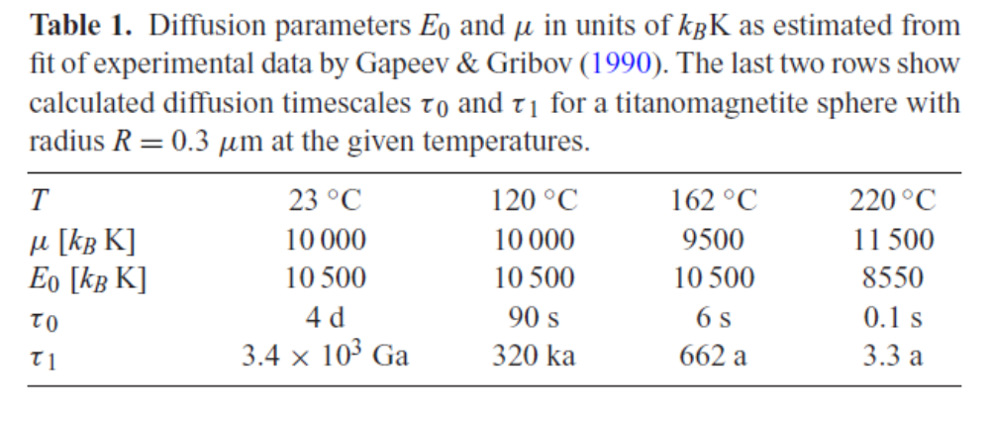
To calculate stresses, we need first of all to know the diffusion coefficient as a function of x, z and T. In our model it is defined by the activation energy E₀ and the parameter µ. They can be estimated from the experimental data by Gapeev and Gribov on oxidation degree z as a function of time for different temperatures (symbols). Thick lines are fits by the method of moments. For the sake of simplicity only fits for the temperatures T = 120, 162 and 220 ◦C are shown. The needed experimental parameters inferred from the fits are listed in Table 1.

Slide 12
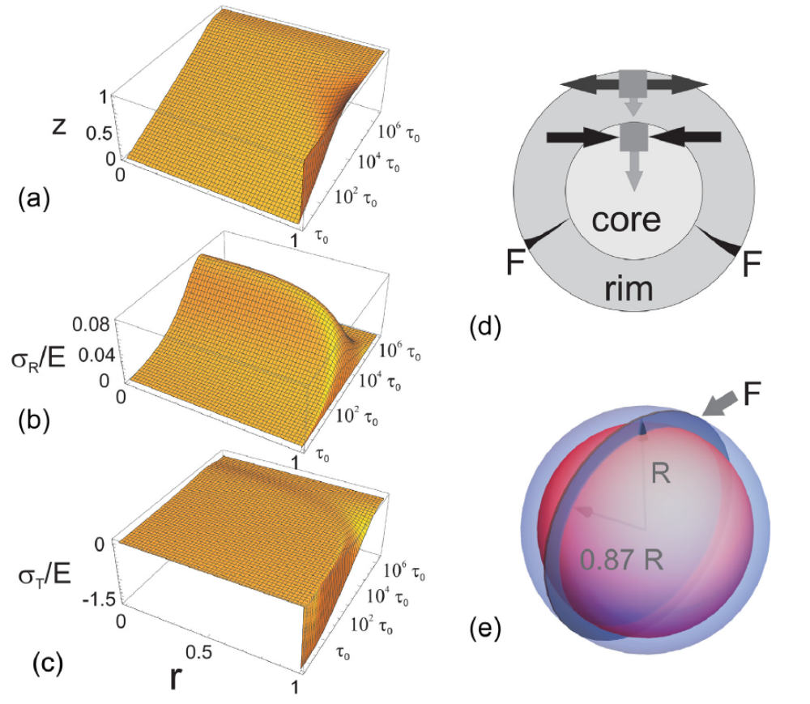
Having the diffusion parameters in hands, we can draw the degree of oxidation and stresses as functions of time and normalized radius
(a) Modelled diffusion profile z(r,t) in a TM sphere with ₁/₀ = 310⁶. Centre and surface of the sphere correspond to r = 0 and r = 1, respectively.
Tangential (b) and radial (c) stresses as a function of time and radius.
(d) Sketches the geometry of radial and tangential stress in a spherical TM particle with strongly oxidized rim and less oxidized core.
(e) Fractures F can form spontaneously only if the release of elastic energy is larger than the surface energy of the newly formed fracture.

Slide 13
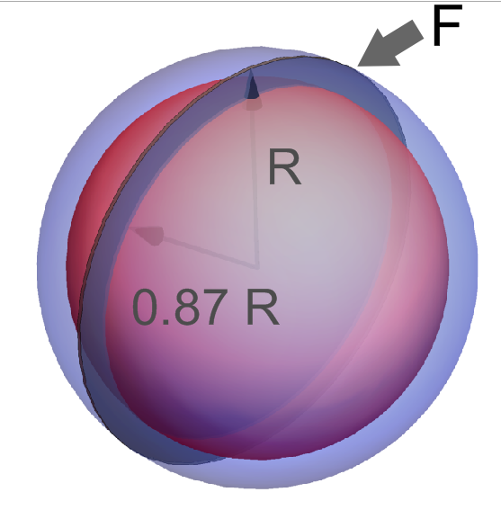
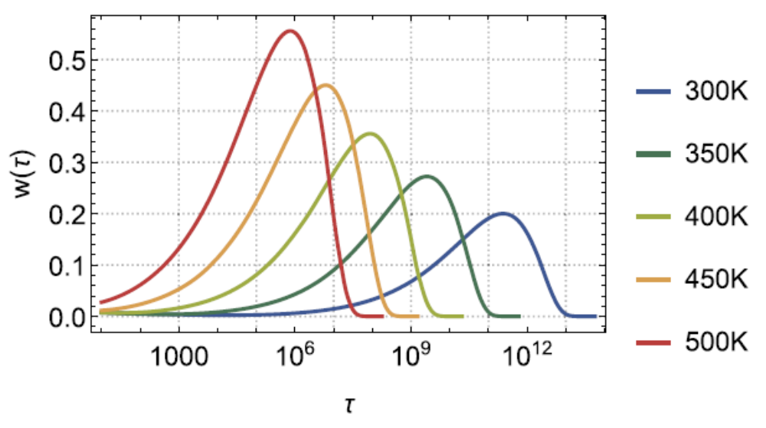
The total elastic energy density
W_{E} = (4R³/3)•E•w
E is the Young’s modul, w is the normalized elastic energy.
Below is the temporal evolution of w (in units of 10⁻⁶, t is in sec). Calculations are carried out for the indicated temperatures using the parameters  =9500 and E₀ = 10500
Surface energy
Ws = 2 a² needed to create a fracture.
A is the depth of the rim.
Fracturing condition:
W_{E} > Ws, or
R > Rc = 2R³•E•w_{max}/ 3a²
At a  R/10 it gives
Rc < 12 μm at 300 K to
Rc < 4.4 μm at 500K
These values agree with the experimental data

Slide 14
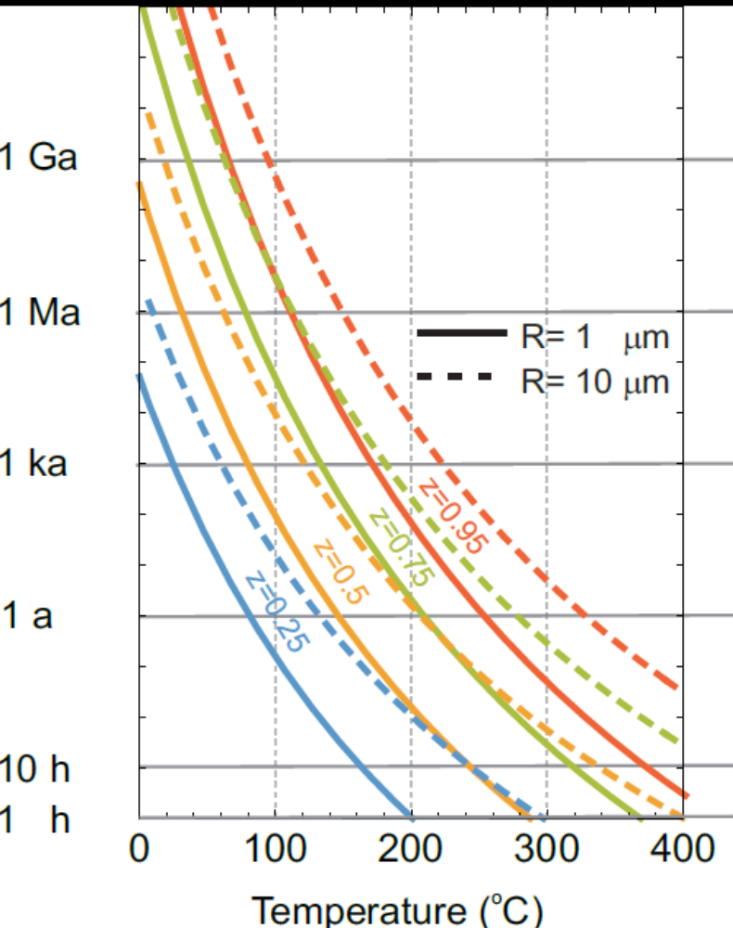
Fracture formation in grains larger than Rc increases the surface through which Fe2+-ions migrate outwards and accelerates deeper oxidation. Self-propagating surface fractures divide large grains into blocks that oxidize separately, and thus reduce the effective size of cracked grains to less than ∼20 μm. Accordingly, grain sizes <20 μm will dominate the average oxidation degree z(t) of ocean-ﬂoor basalts. As is seen from the Figure below, the observed dispersion of the oxidation parameter z in ocean ﬂoor basalts of similar age most likely reﬂects local variability of hydrothermal heating together with grain size variation.
It is well-known that on a laboratory timescale of <1 h oxidation of TM grains requires temperatures of about 200–400 C. The curves plotted in the Figure explain this observation. As follows from this diagram, at a timescale of 1 h single-phase oxidation up to a degree of z≈0.5 develops in spheres with radius of 1–10 μm between 300◦C and 400 C. Lower oxidation temperatures require smaller average grain sizes. The diagram also shows that for R ≤ 1μm complete oxidation is reached within a few hours at 400 C, while for R =10 μm it requires at least several weeks.
High degrees of oxidation z ≥ 0.8 are needed for the formation of exsolution lamellae during high-temperature oxidation. The generation of such oxidation degrees during relatively fast laboratory thermal treatment is experimentally well known to require heating to 400–500 C. This can now be explained by the self-inhibitory character of vacancy diffusion into the interior of coarse grains as predicted by our model.

Slide 15
CONCLUSIONS.
A quantitative model of oxidation of titanomagnetite as vacancy-diffusion process with a diffusion coefﬁcient is constructed that itself depends on oxidation degree.
The result shows that the oxidation process is governed by two widely different timescales. On the short timescale, the strong decrease of the diffusion coefﬁcient with degree of oxidation causes the formation of a thin highly oxidized rim at the grain surface which slows down core oxidation to the much longer second timescale.
The new quantitative model allows to calculate the evolution of the full stress tensor inside individual grains and to estimate the critical grain size for crack formation to be about 10 μm.
Based on experimental data, the dependence of the two timescales on radius and temperature could be derived. These data suggest that observed oxidation of titanomagnetites in ocean-floor basalts during the first million years to oxidation degrees of z  0.8 requires local hydrothermal heating to 100-150 C, while low oxidation degrees in very old ocean-floor basalts indicate large grain size and absence of hydrothermal activity.
The fourfold very rapid decay of the intensity of natural remanent magnetization of the oceanic crust during the first 40 ka is explained by magnetization deflection through the formation of high stress during the fast initial stage of single-phase oxidation in grains below the critical cracking size, and by fracture formation and concurrent domain state changes in grains larger than the critical fracture size.

