Slide 1
Biomass burning declines lead to large net reductions in NO₂ concentrations over north equatorial Africa in spite of growing fossil fuel emissions
NASA
Larry C. Price
Jonathan E. Hickman^{1*}, Niels Andela², Money Ossohou³, Corinne Galy-Lacaux⁴, Kostas Tsigaridis^{5,1}, Susanne E. Bauer¹
¹NASA-Goddard Institute for Space Studies, ²NASA-GSFC, ³Université Félix Houphouët-Boigny, ⁴CNRS, ⁵Columbia University
NASA

Slide 2
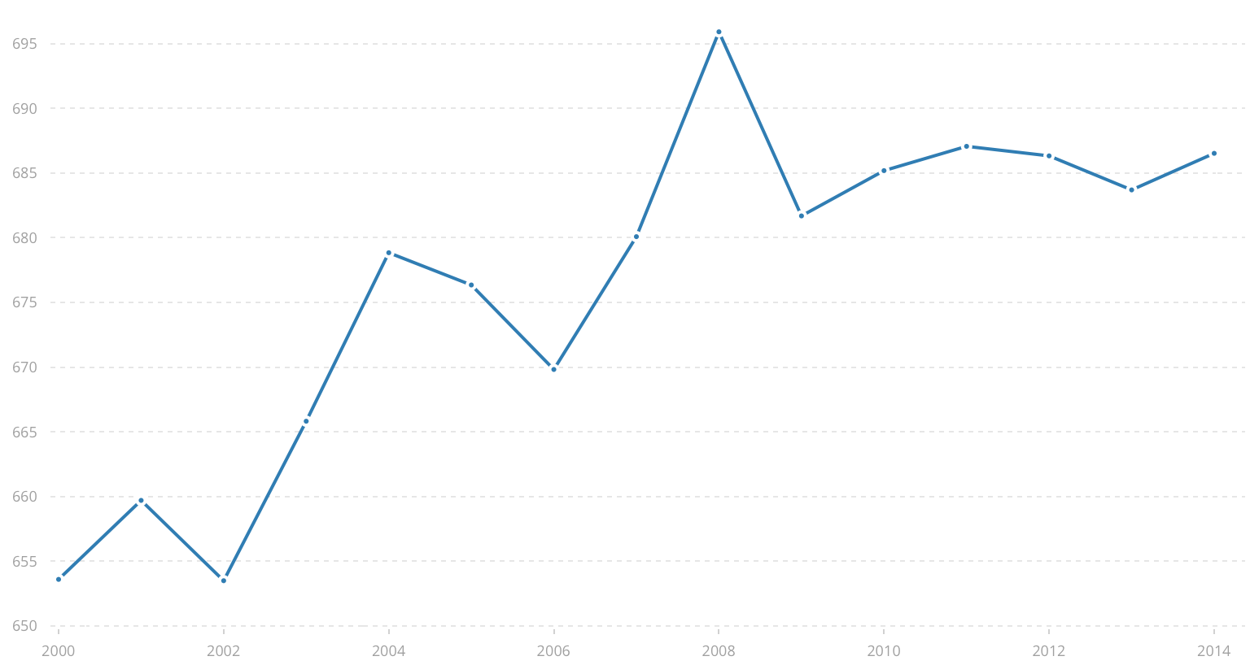
The Environmental Kuznets Curve: As countries grow economically, pollution tends to increase with increasing GDP up to an inflection point. But in sub-Saharan Africa, biomass burning—one of the largest sources of NO2 pollution—has declined steadily during the 21st century as energy use has increased
Environmental Kuznets Curve
Sub-Saharan Africa
Energy use (kg oil equivalent per capita)
pollution
Burned area
Per capita income
Time (since 1998)
U.S. Energy Information Agency (2019) International Energy Statistics Database. Available at: https://www.eia.gov/beta/international/ [Accessed March 1, 2019]
After Andela et al. 2017, Science 356: 1356-1362

Slide 3
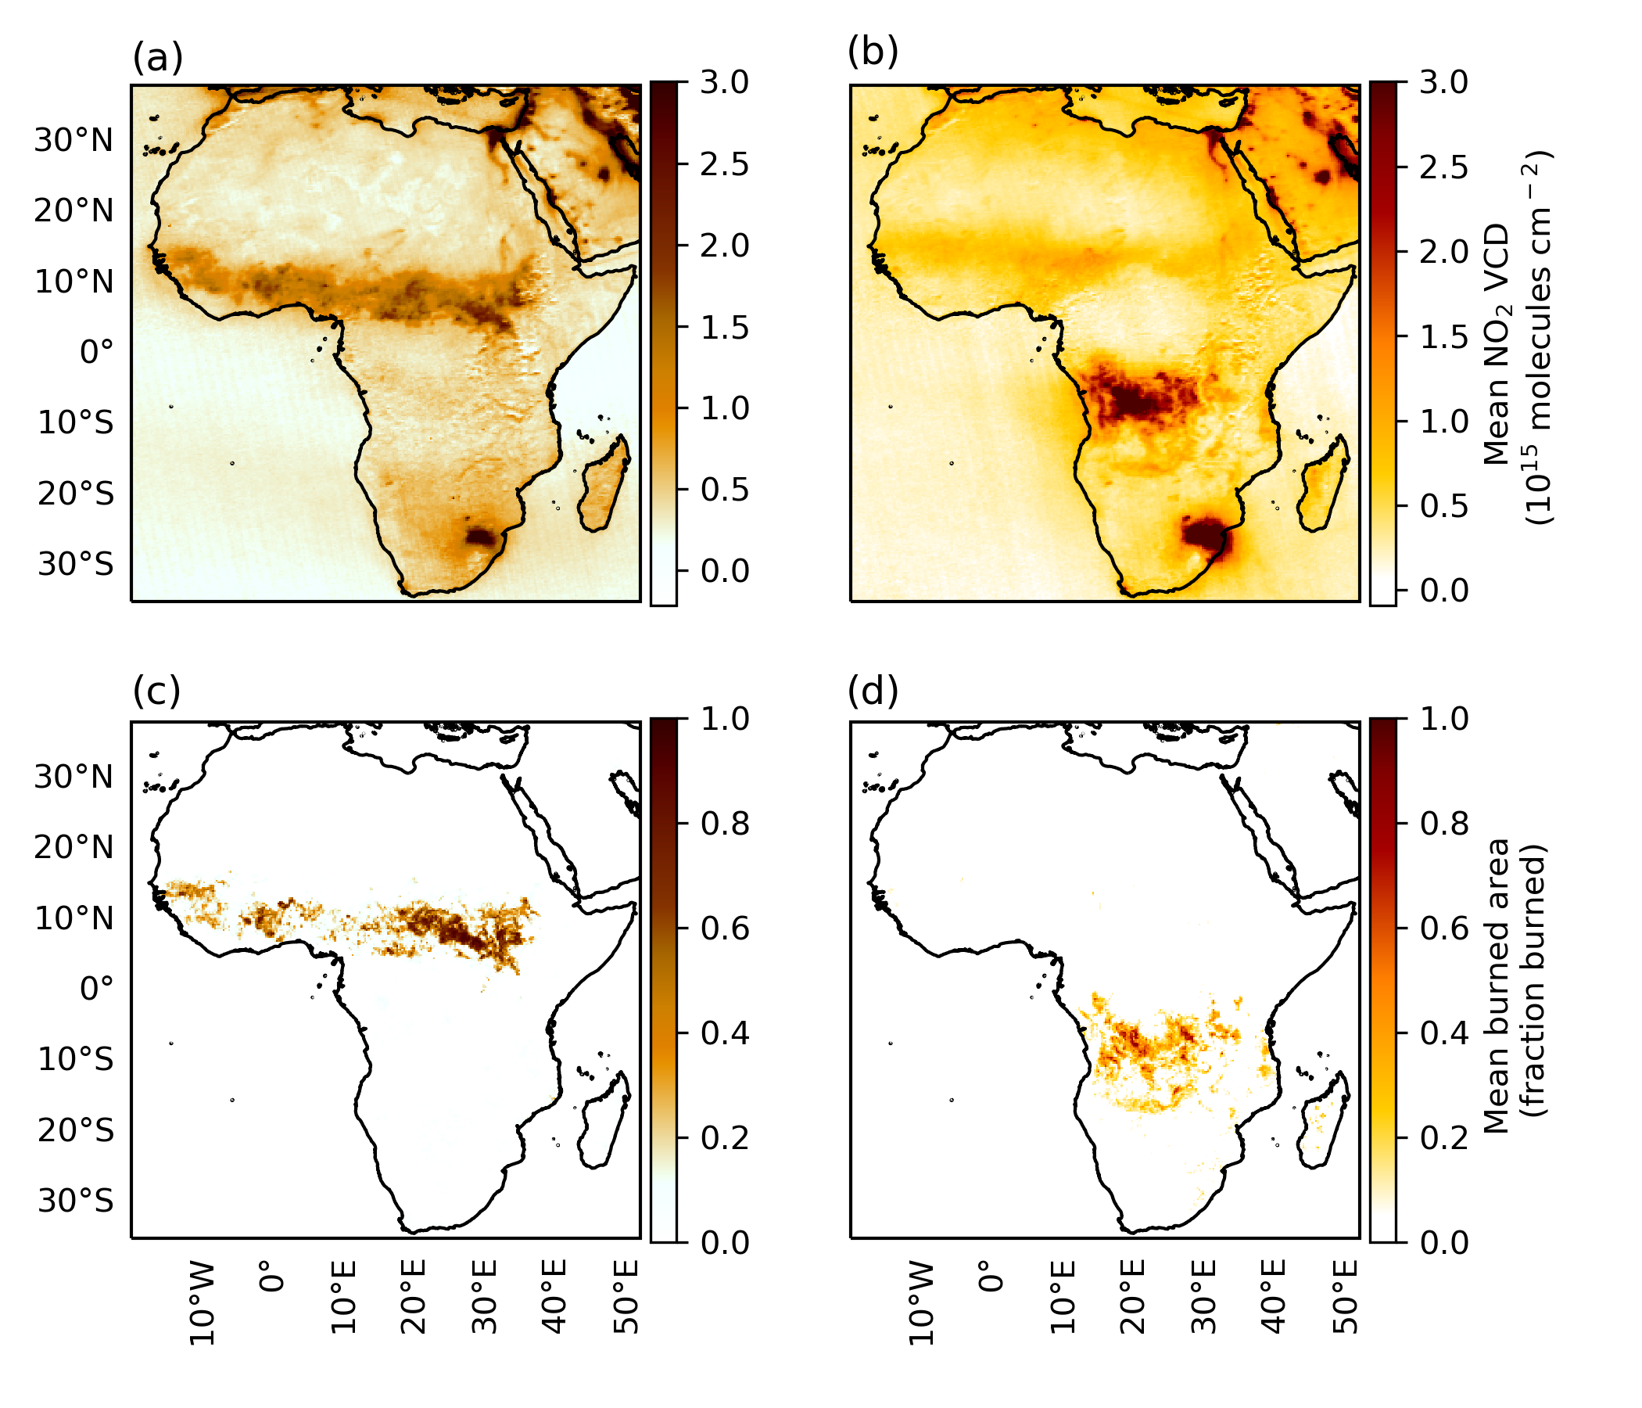
Biomass burning has a distinct seasonality, and a clear influence on tropospheric NO₂ concentrations
NDJF
MJJA
Means of NO₂ vertical column densities from the Ozone Monitoring Instrument (OMI) and burned area from the Moderate Resolution Imaging Spectroradiometer (MODIS) for the northern and southern biomass burning seasons for 2005 through 2017
NO₂ VCDs
Burned area

Slide 4
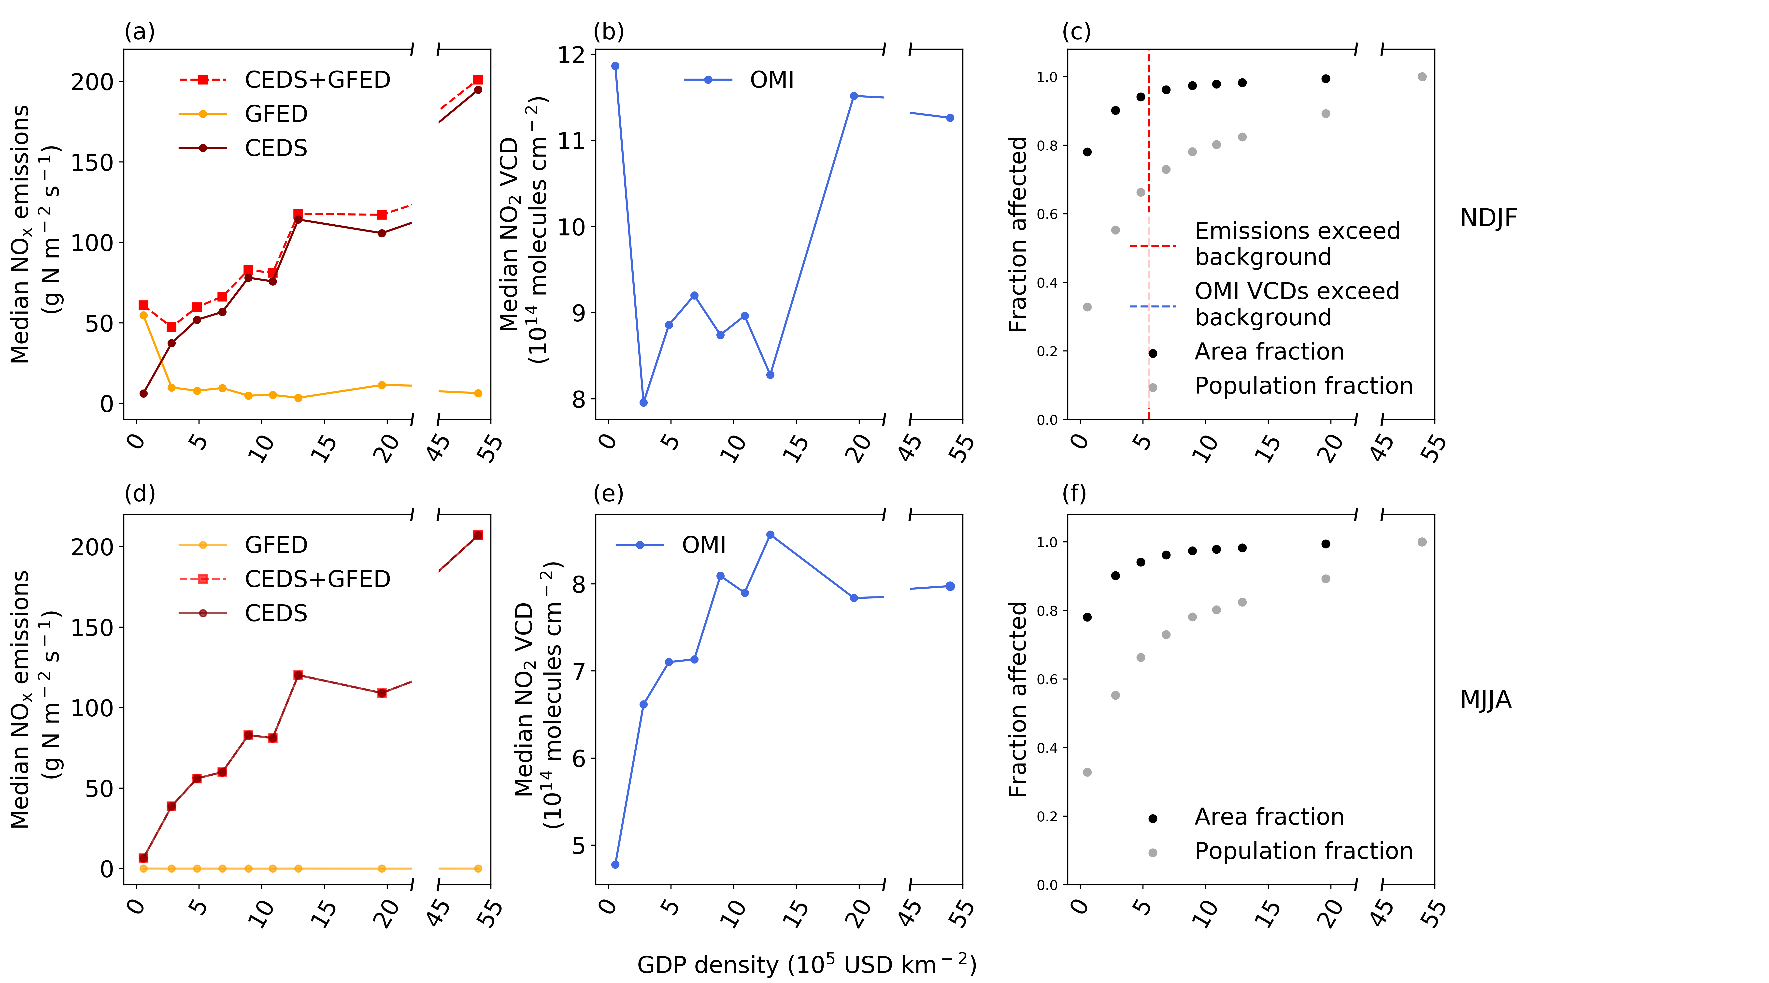
Population effects on biomass burning are the predominant factor influencing NO₂ concentrations over the biomass burning regions of Africa
Northern biomass burning region
but its relative importance differs between satellite observations and inventories
Southern biomass burning region

Slide 5
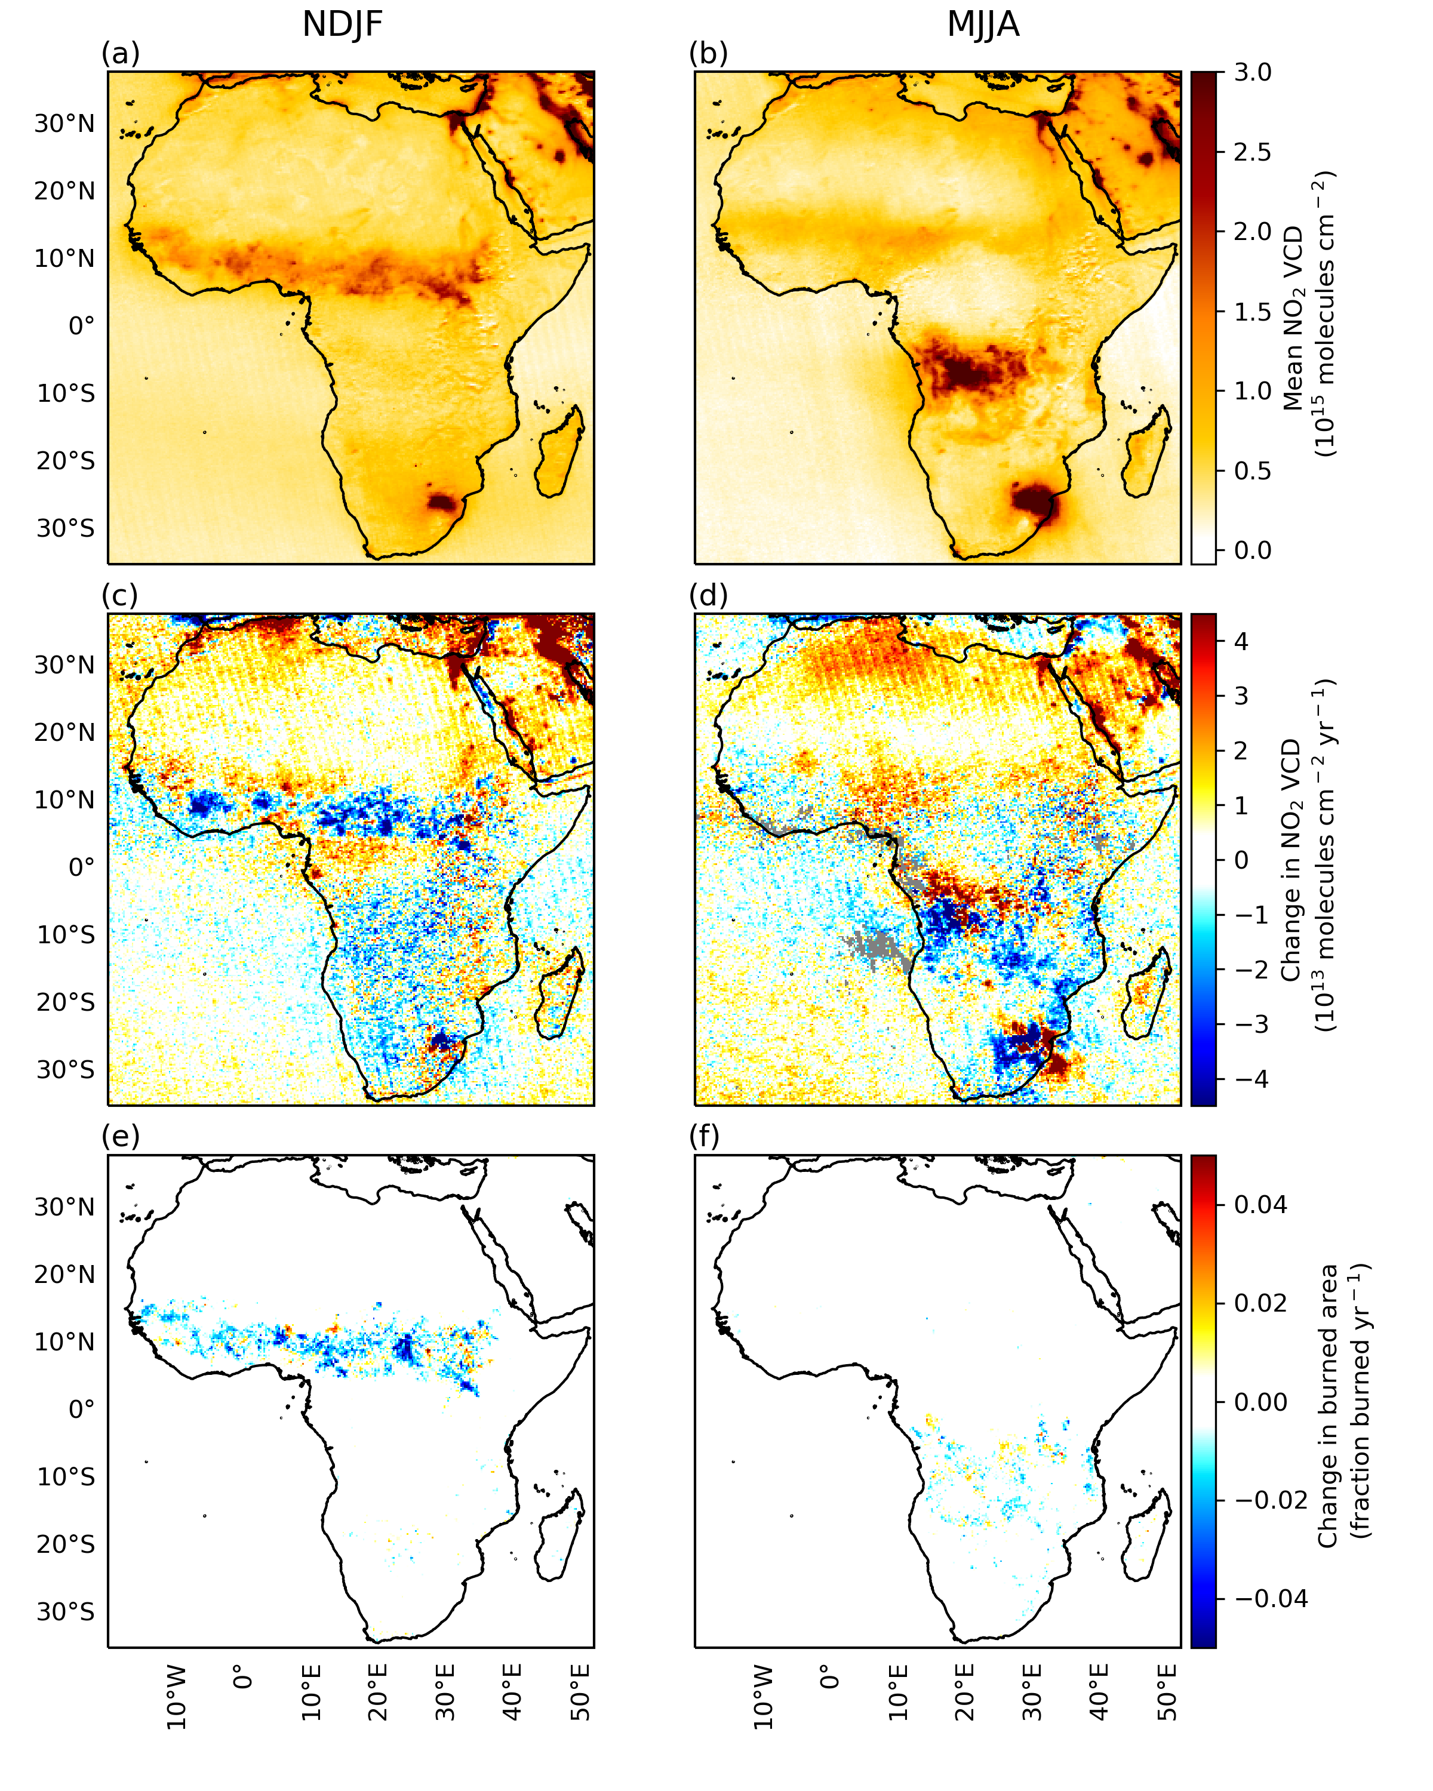
Pronounced trends in burned area and NO₂ VCDs from 2005 through 2017
NDJF
MJJA
NO₂ VCDs decreases on the order of 0.5% yr⁻¹ in N. hemisphere for NDJF
Correspond to decreases in burned area

Slide 6
Relative contributions of fossil fuel (from the Community Emissions Database System (CEDS) inventory) and biomass burning emissions to NO₂ trends, 2005-2014

Slide 7
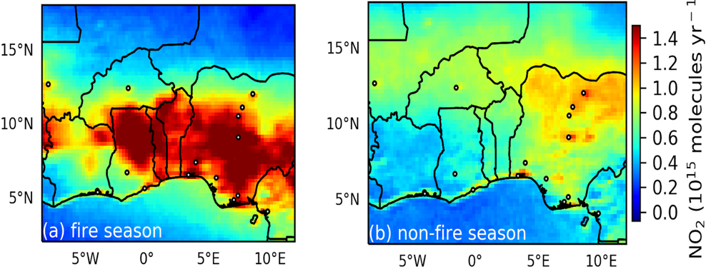
Conclusions
Evidence for population density-dependent controls over NO₂ concentrations in Africa’s biomass burning regions
- mitigation of air pollution through fire suppression
- Improvements are offset by fossil fuel emissions at high population densities
Socio-economic development has led to decreases in NO₂ across much of Africa’s northern biomass burning region, counter to expectations under the Environmental Kuznets Curve
(

