Slide 1
Distribution and cause and cause analysis of typical soil microorganisms in alpine region
Jianwei Wang
Institution: China Institute of Water Resources and Hydropower Research
Department: Department of Water Resources

Slide 2
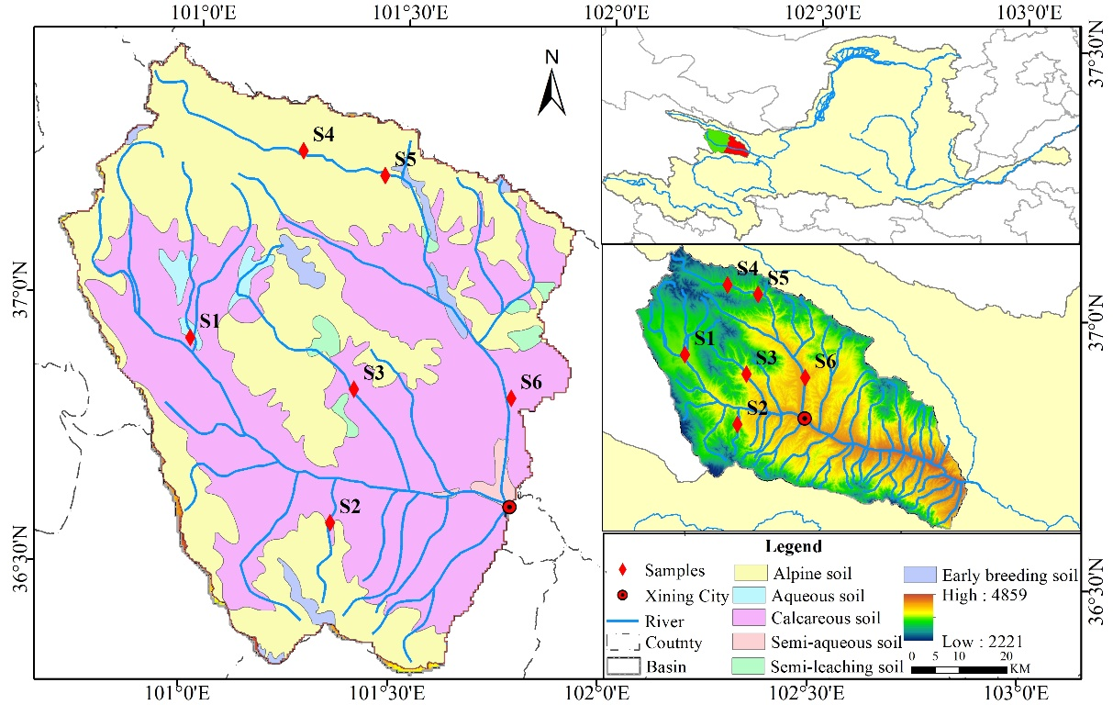
Location
Soil type: calcareous soil(49.3%) alpine soil(45.5%) aqueous soil(1.1%)

Slide 3
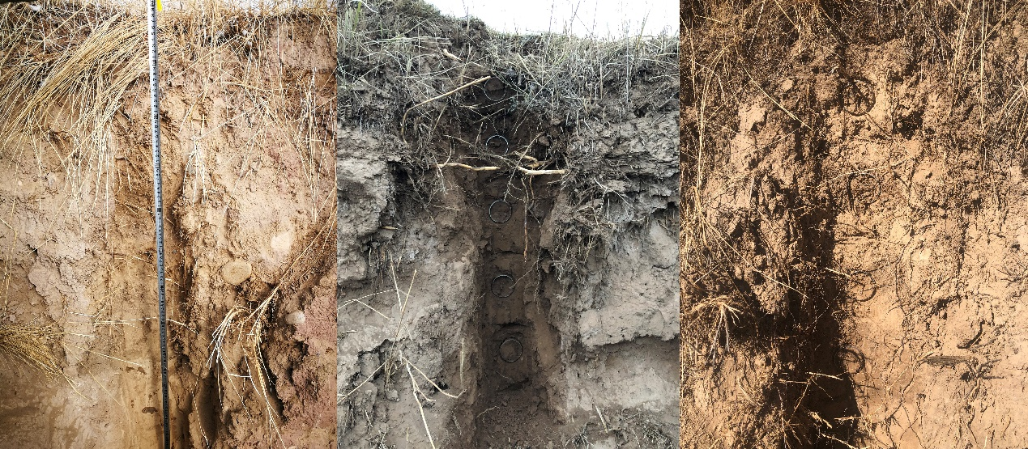
Sample
Aqueous soil Calcareous soil Alpine soil

Slide 4
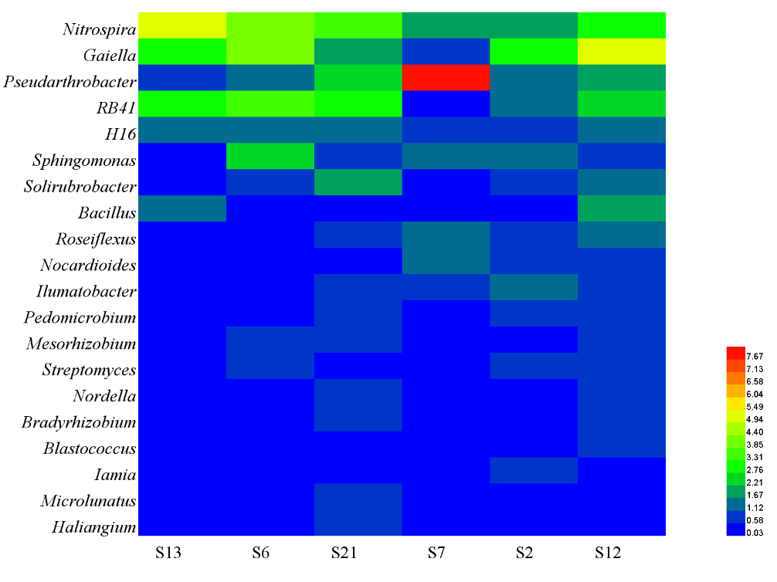
Results
 | pH | OMG | TP | TN | slope | Elevation
Nitrospira | -0.406 | 0.237 | -0.394 | 0.175 | .866* | -.816*
Bacillus | -0.421 | 0.059 | -0.296 | 0.042 | 0.587 | -0.094
Nocardioides | 0.092 | 0.263 | 0.388 | 0.32 | -0.583 | 0.775
Bradyrhizobium | 0.484 | -.879* | 0.389 | -.835* | -0.739 | 0.286

Slide 5
Conclusion
Nitrospira and Gaiella were the main microorganism;
Negative correlation between Bradyrhizobium and soil TN;
Negative correlation between Nitrospira and Nocardioides.

Slide 6
Thank You !

