Slide 1

Electron- and ion-scale, nested magnetic cavities: Manifestation of cross-scale theta-pinches in space plasmas
Jing-Huan Li¹⁺, Fan Yang¹⁺, Xu-Zhi Zhou^{1*}, Qiu-Gang Zong^{1*},
Anton V. Artemyev², Robert Rankin³, Quanqi Shi⁴,
Shutao Yao⁴, Han Liu¹, Jiansen He¹, Zuyin Pu¹, Chijie Xiao⁵,
Ji Liu⁶, Craig Pollock⁷, Guan Le⁸, and James L. Burch⁹
Notes:
1

Slide 2
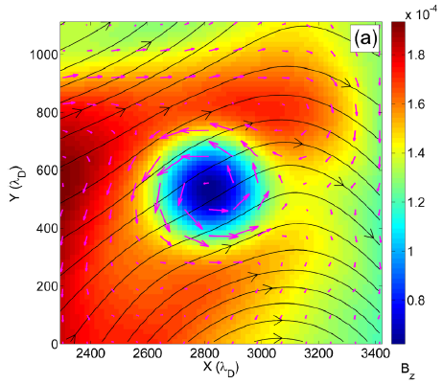
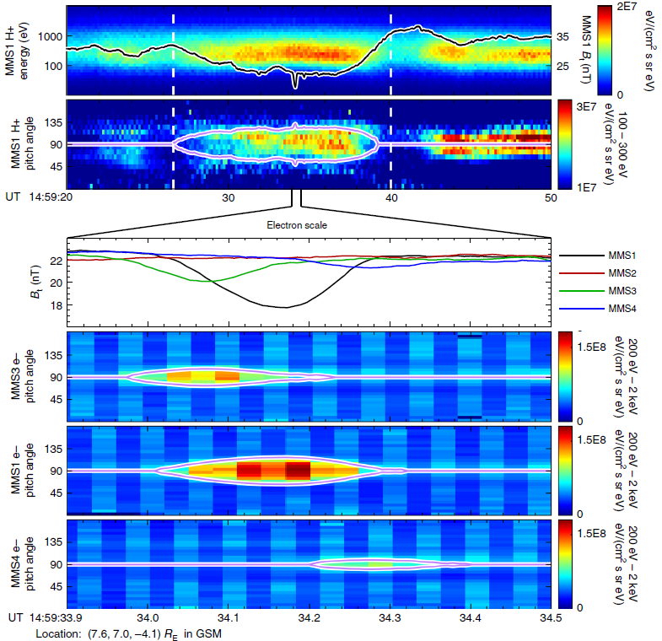
Introduction to magnetic cavities
PIC simulations
Observations from MMS
[Haynes et al., 2015]
[Liu et al., 2019]

Slide 3
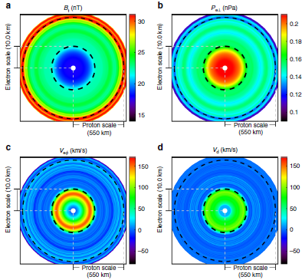
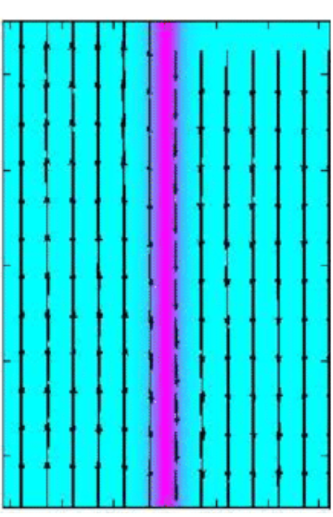
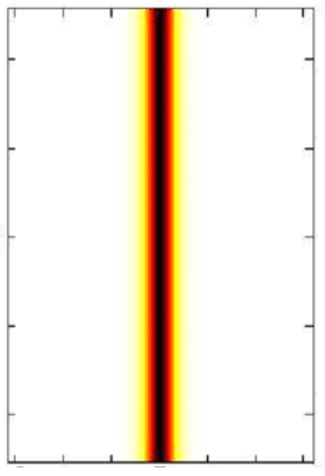
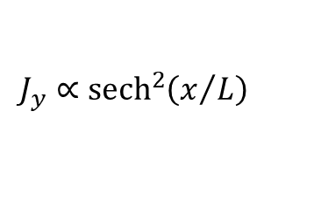
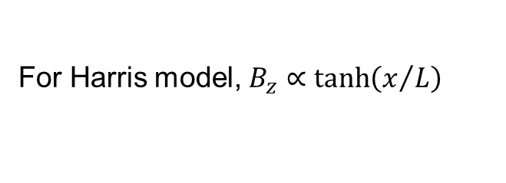
Analogy: magnetic cavities & current sheets
Magnetic cavities:
Current sheets:
n
J_{y}
For Harris model, $B_{z}∝\tanh\left(x/L\right)$
$$J_{y}∝{sech}^{2}\left(x/L\right)$$
in cylindrical coordinates
Magnetic field in z direction
Velocity & Current in phi direction
Gradients in r direction
in Cartesian coordinates
Magnetic field in z direction
Velocity & Current in y direction
Gradients in x direction

Slide 4
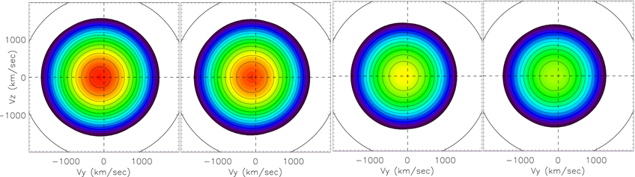
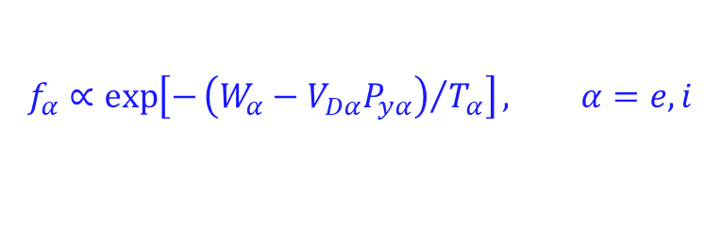
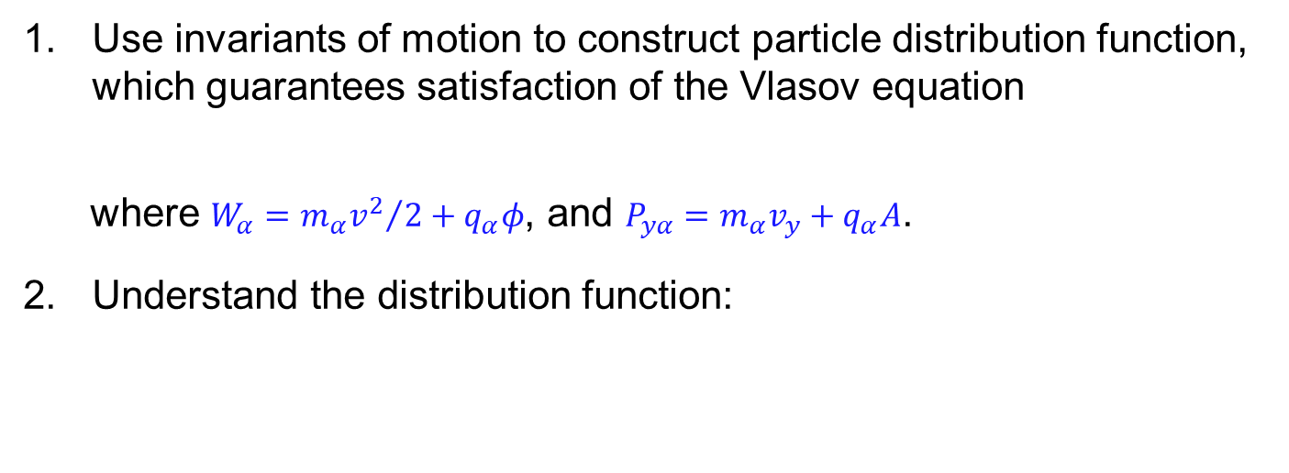
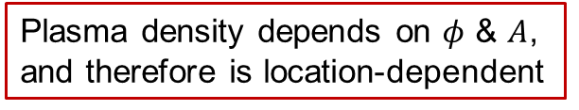
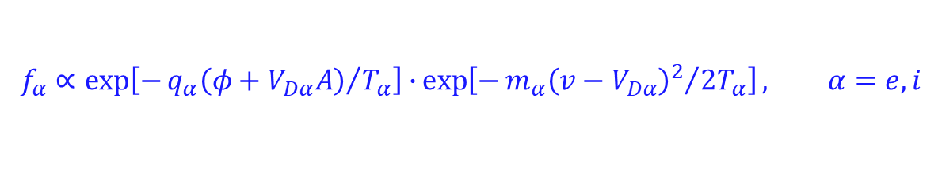
Current sheet construction
Use invariants of motion to construct particle distribution function, which guarantees satisfaction of the Vlasov equation
where $W_{α}={m_{α}v^{2}}/2+q_{α}φ$, and $P_{yα}=m_{α}v_{y}+q_{α}A$.
Understand the distribution function:
$$f_{α}∝\exp\left[−{\left(W_{α}−V_{Dα}P_{yα}\right)}/{T_{α}}\right], α=e,i$$
$$f_{α}∝\exp\left[−{q_{α}\left(φ+V_{Dα}A\right)}/{T_{α}}\right]∙\exp\left[−{m_{α}{\left(v−V_{Dα}\right)}^{2}}/{2T_{α}}\right], α=e,i$$
Plasma density depends on $φ$ & $A$, and therefore is location-dependent
Particle distributions are always Maxwellian, with a location-independent velocity shift in y
Sample particle
distributions at various locations

Slide 5
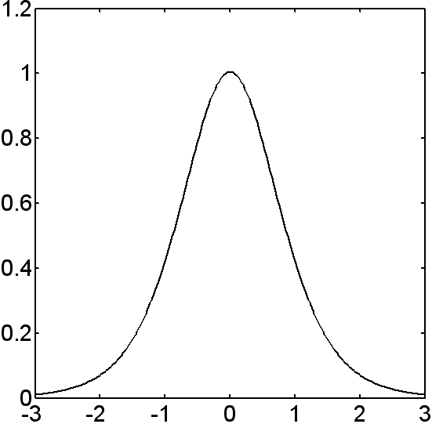
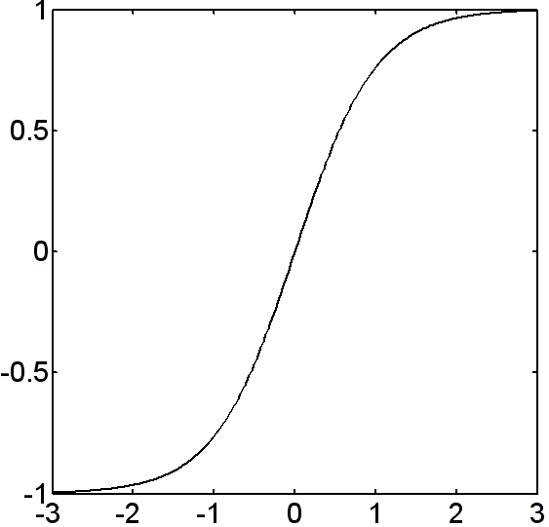
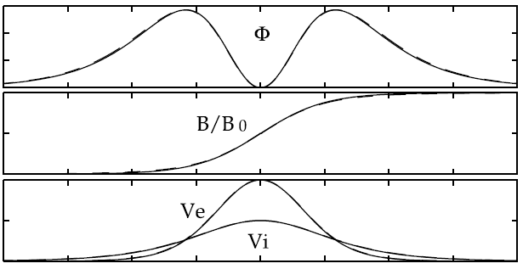
Current sheet construction
Substitute particle distributions into Maxwell equations, to derive self-consistent solutions of the current sheet
Cross-scale current sheets can be constructed by having multiple ion or electron components
The Harris [1961] solution:
Density & Current Profiles
Magnetic Field Profile
[Yoon & Lui, 2004]

Slide 6
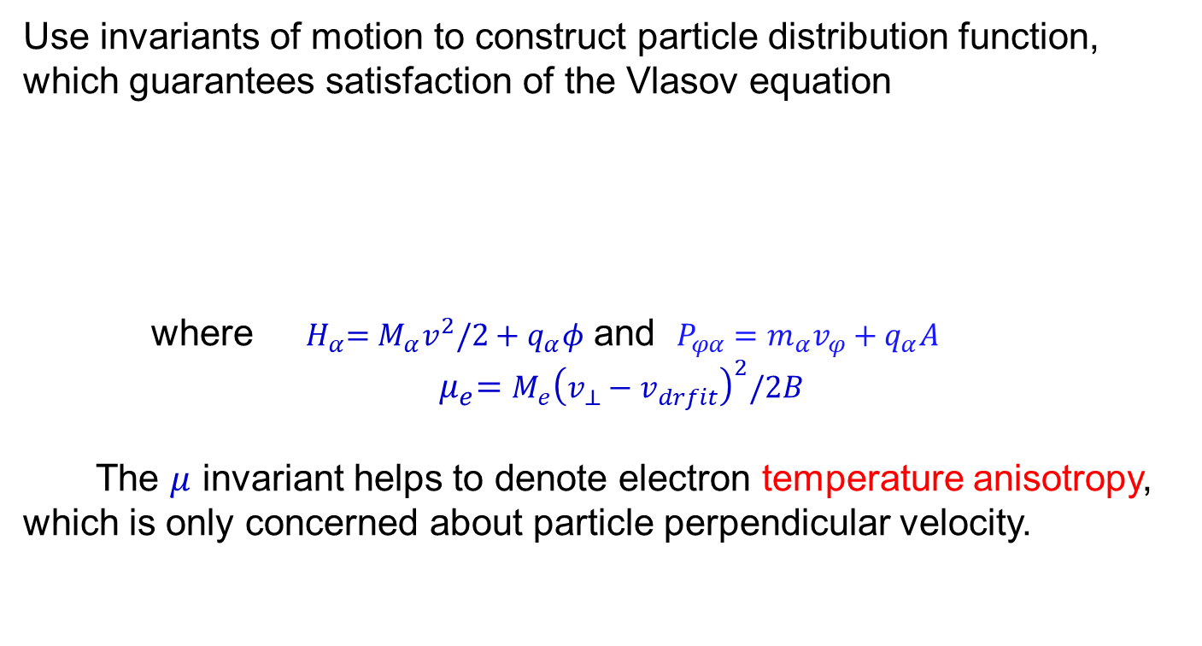
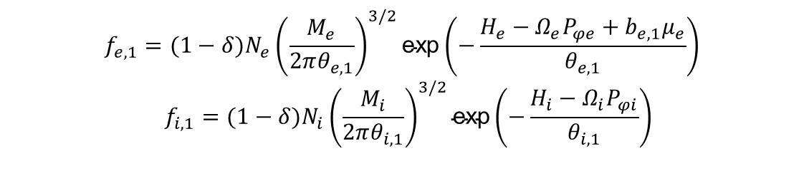
Magnetic cavity construction
Similar approach carried out in cylindrical coordinates
Use invariants of motion to construct particle distribution function, which guarantees satisfaction of the Vlasov equation
where ${ H}_{α}=M_{α}v^{2}/2+q_{α}φ$ and $P_{φα}=m_{α}v_{φ}+q_{α}A$
$${ μ}_{e}=M_{e}{\left(v_{⊥}−v_{drfit}\right)}^{2}/2B$$
The $μ$ invariant helps to denote electron temperature anisotropy, which is only concerned about particle perpendicular velocity.
$$f_{e,1}=(1−δ)N_{e}{\left(\frac{M_{e}}{2πθ_{e,1}}\right)}^{3/2}\text{exp}\left(−\frac{H_{e}−Ω_{e}P_{φe}+b_{e,1}μ_{e}}{θ_{e,1}}\right)$$
$$f_{i,1}=(1−δ)N_{i}{\left(\frac{M_{i}}{2πθ_{i,1}}\right)}^{3/2}\text{exp}\left(−\frac{H_{i}−Ω_{i}P_{φi}}{θ_{i,1}}\right)$$

Slide 7
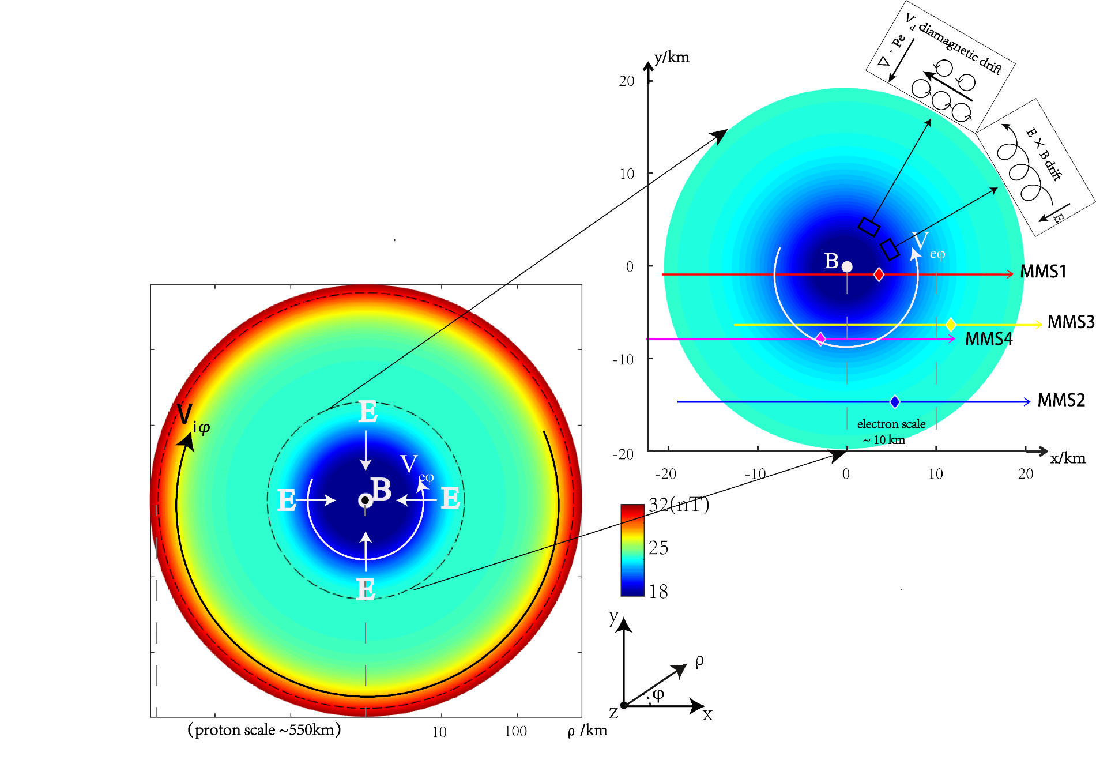
Sketch of the nested magnetic cavities

Slide 8
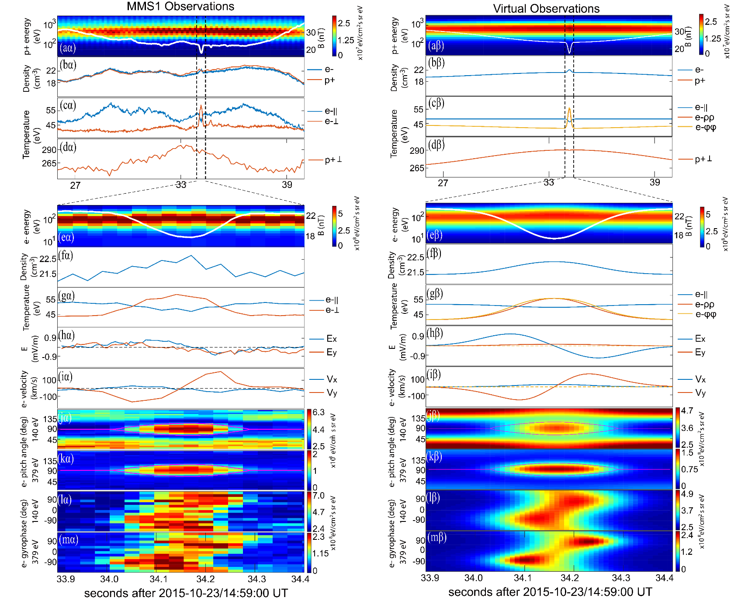
Magnetic cavity reconstruction
Parameters selected via a best fit to MMS1 data

Slide 9
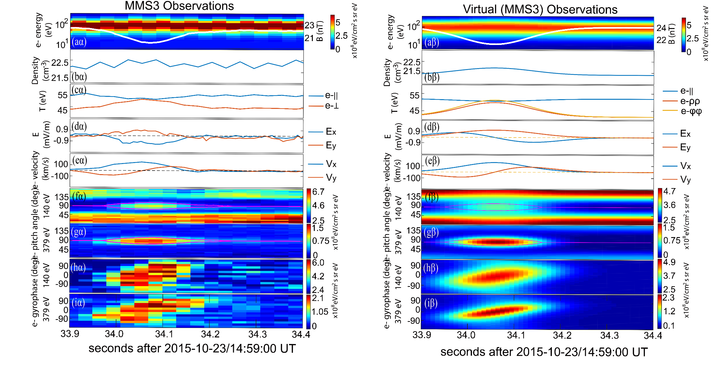
Model Validation
Based on same parameters, compare model with MMS3 data
MMS3 observations
Reconstructed cavity

Slide 10
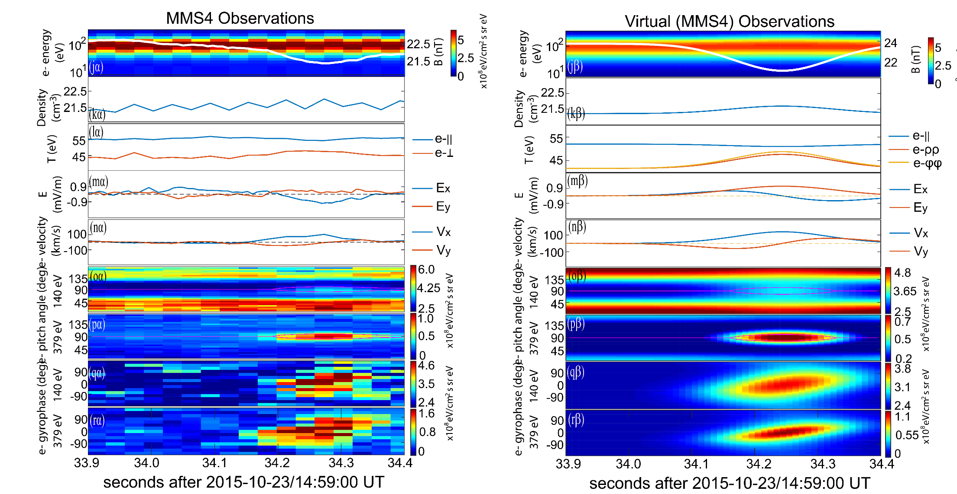
Model Validation
Based on same parameters, compare model with MMS4 data

Slide 11
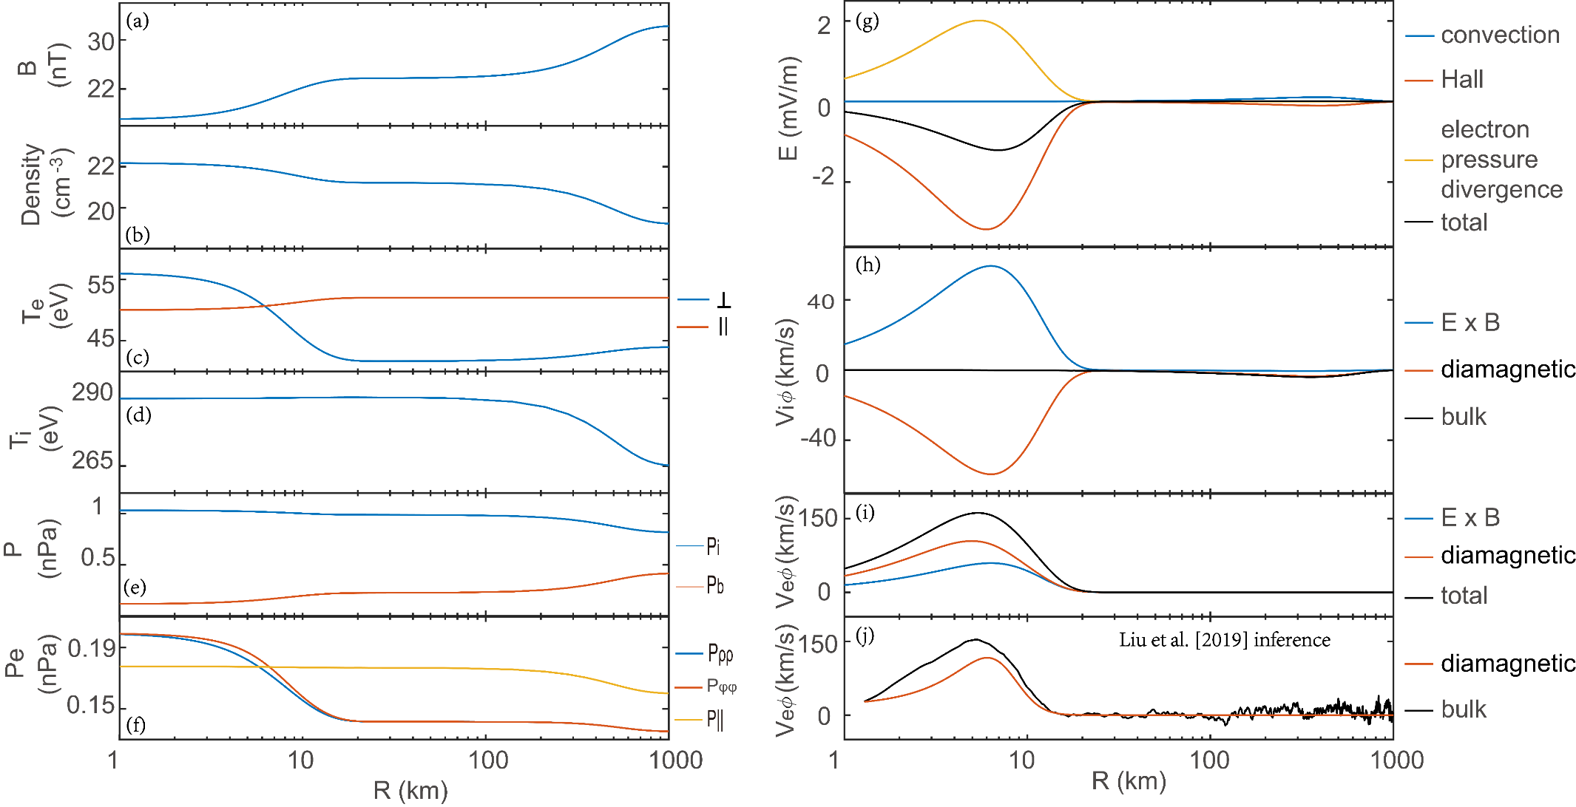
Model profiles

Slide 12
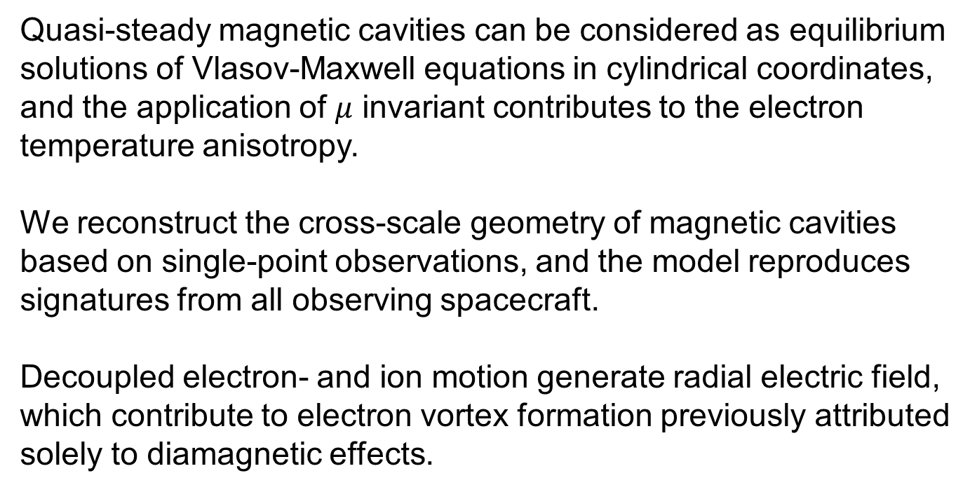
Summary
Quasi-steady magnetic cavities can be considered as equilibrium solutions of Vlasov-Maxwell equations in cylindrical coordinates, and the application of $μ$ invariant contributes to the electron temperature anisotropy.
We reconstruct the cross-scale geometry of magnetic cavities based on single-point observations, and the model reproduces signatures from all observing spacecraft.
Decoupled electron- and ion motion generate radial electric field, which contribute to electron vortex formation previously attributed solely to diamagnetic effects.
Thank you!

