Slide 1
The forced response of Asian Summer Monsoon precipitation during the past 1500 years: based on the CESM
WANG Zhiyuan, WANG Jianglin, JIA Jia, LIU Jian
E-mail: wzhy@zjnu.edu.cn

Slide 2
Motivation
The intensity of Asian Summer Monsoon (ASM) rainfall could affect the lives and human activities of 60% of populations across all over the world.
However, the characteristics and drivers of the ASM at decadal to centennial timescales are still unclear.
To study the mechanisms and impacts of the decadal to centennial ASM variabilities, climate diagnosis with simulation is essential.

Slide 3
Scientific questions
What are the spatial-temporal characteristics of the ASM rainfall on the decadal to centennial timescales and its corresponding influence of the ASM precipitation?
What factors are responsible for the spatial-temporal variations of the forced ASM precipitation?

Slide 4
Model and experimental design
The CESM (version 1.0) is a state-of-the-art earth system model that was developed by the National Center for Atmospheric Research (NCAR).
CAM4
POP2
CLM4
CPL7
CISM
CICE4
Configurations of the CESM in this study

Slide 5
Details of experimental design
Number | Name |  | Forcings (A.D. ) |  |  |  |  | Years
 | Full name | Abbreviation | TSI | VOL | GHGs | LULC | Orb
1 | Control run | CTRL | 1850 | 1850 | 1850 | 1850 | 1990 | 1-2000
2 | Full forced run | ALLR | √ | √ | √ | √ | √ | 1-2000
3 | Natural forced run | NAT | √ | √ | 1850 | 1850 | 1990 | 1-2000
4 | Anthropogenic forced run | ANTH | 1850 | 1850 | √ | √ | 1990 | 1-2000

Slide 6
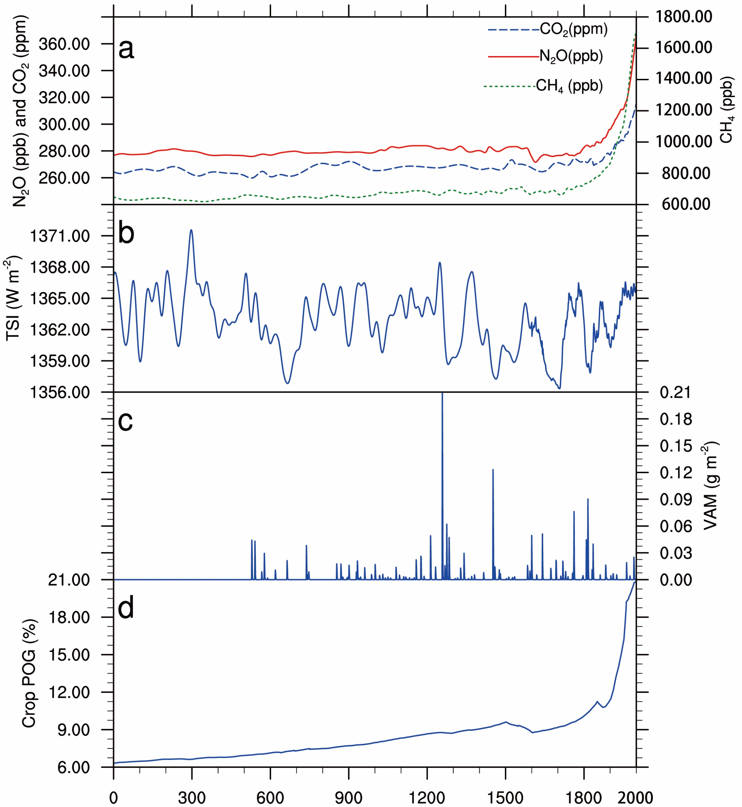
External forcing reconstructions used in the simulations
(a) The concentration of CO₂ (blue line), N₂O (blue dash line), CH₄ (red dash line) from the reconstructions of ice cores (MacFarling et al. 2006). (b) Total solar irradiance data from Shapiro et al. (2011). (c) Global volcanic sulfate aerosol masses injection over the past 1500 years from Gao et al. (2008). (d) Percentage of global landmass from Kaplan et al. (2011)

Slide 7
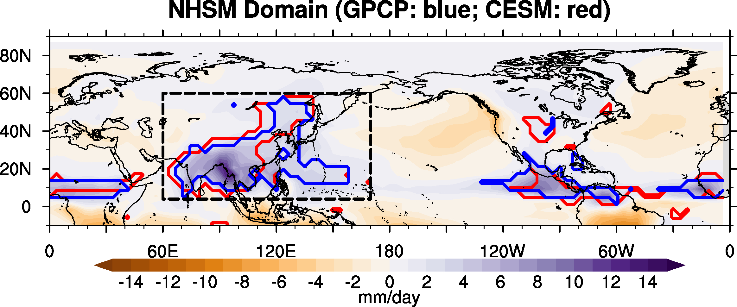
ASM domain in this study (dash black line)
Northern Hemisphere Summer Monsoon (NHSM) domain. The observed NHSM precipitation domains and the counterparts simulated are denoted by thick blue and red lines, respectively. The Asian summer monsoons (ASM) domains are emphasized by the dash black line. The NHSM precipitation domains outlined by the thick lines are defined by local summer-minus-winter precipitation rate exceeding 2.0 mm/day and the local summer precipitation exceeding 55% of the annual total by Wang and Ding (2008). The data are derived from the GPCP and ALLR precipitation between 1979 and 2000.

Slide 8
The multidecadal-scale variations of the (a) Northern Hemisphere surface temperature (NHST) and (b) Asian summer monsoon index (ASMI). The red, black, blue, and green lines represent results from the ALLR, CTRL, NAT, and ATNH, respectively. The grey dash lines represent ±1.5 times of the standard deviation of those derived fromof the CTRL. The smoothed curves are 31-yr running mean.

Slide 9
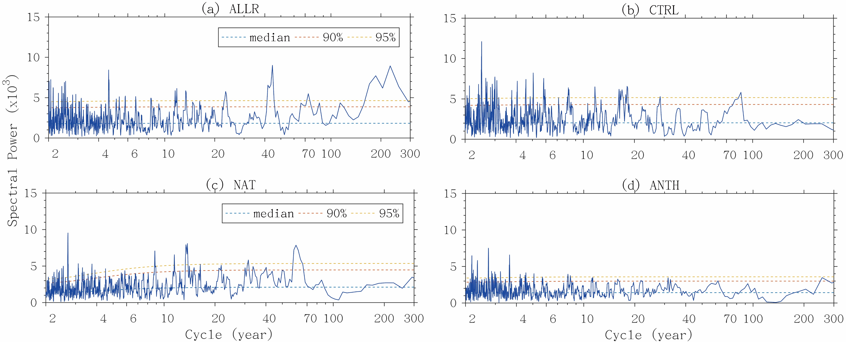
Multi-tape method (MTM) spectral analysis of the annual ASMI over the past 1500 years

Slide 10
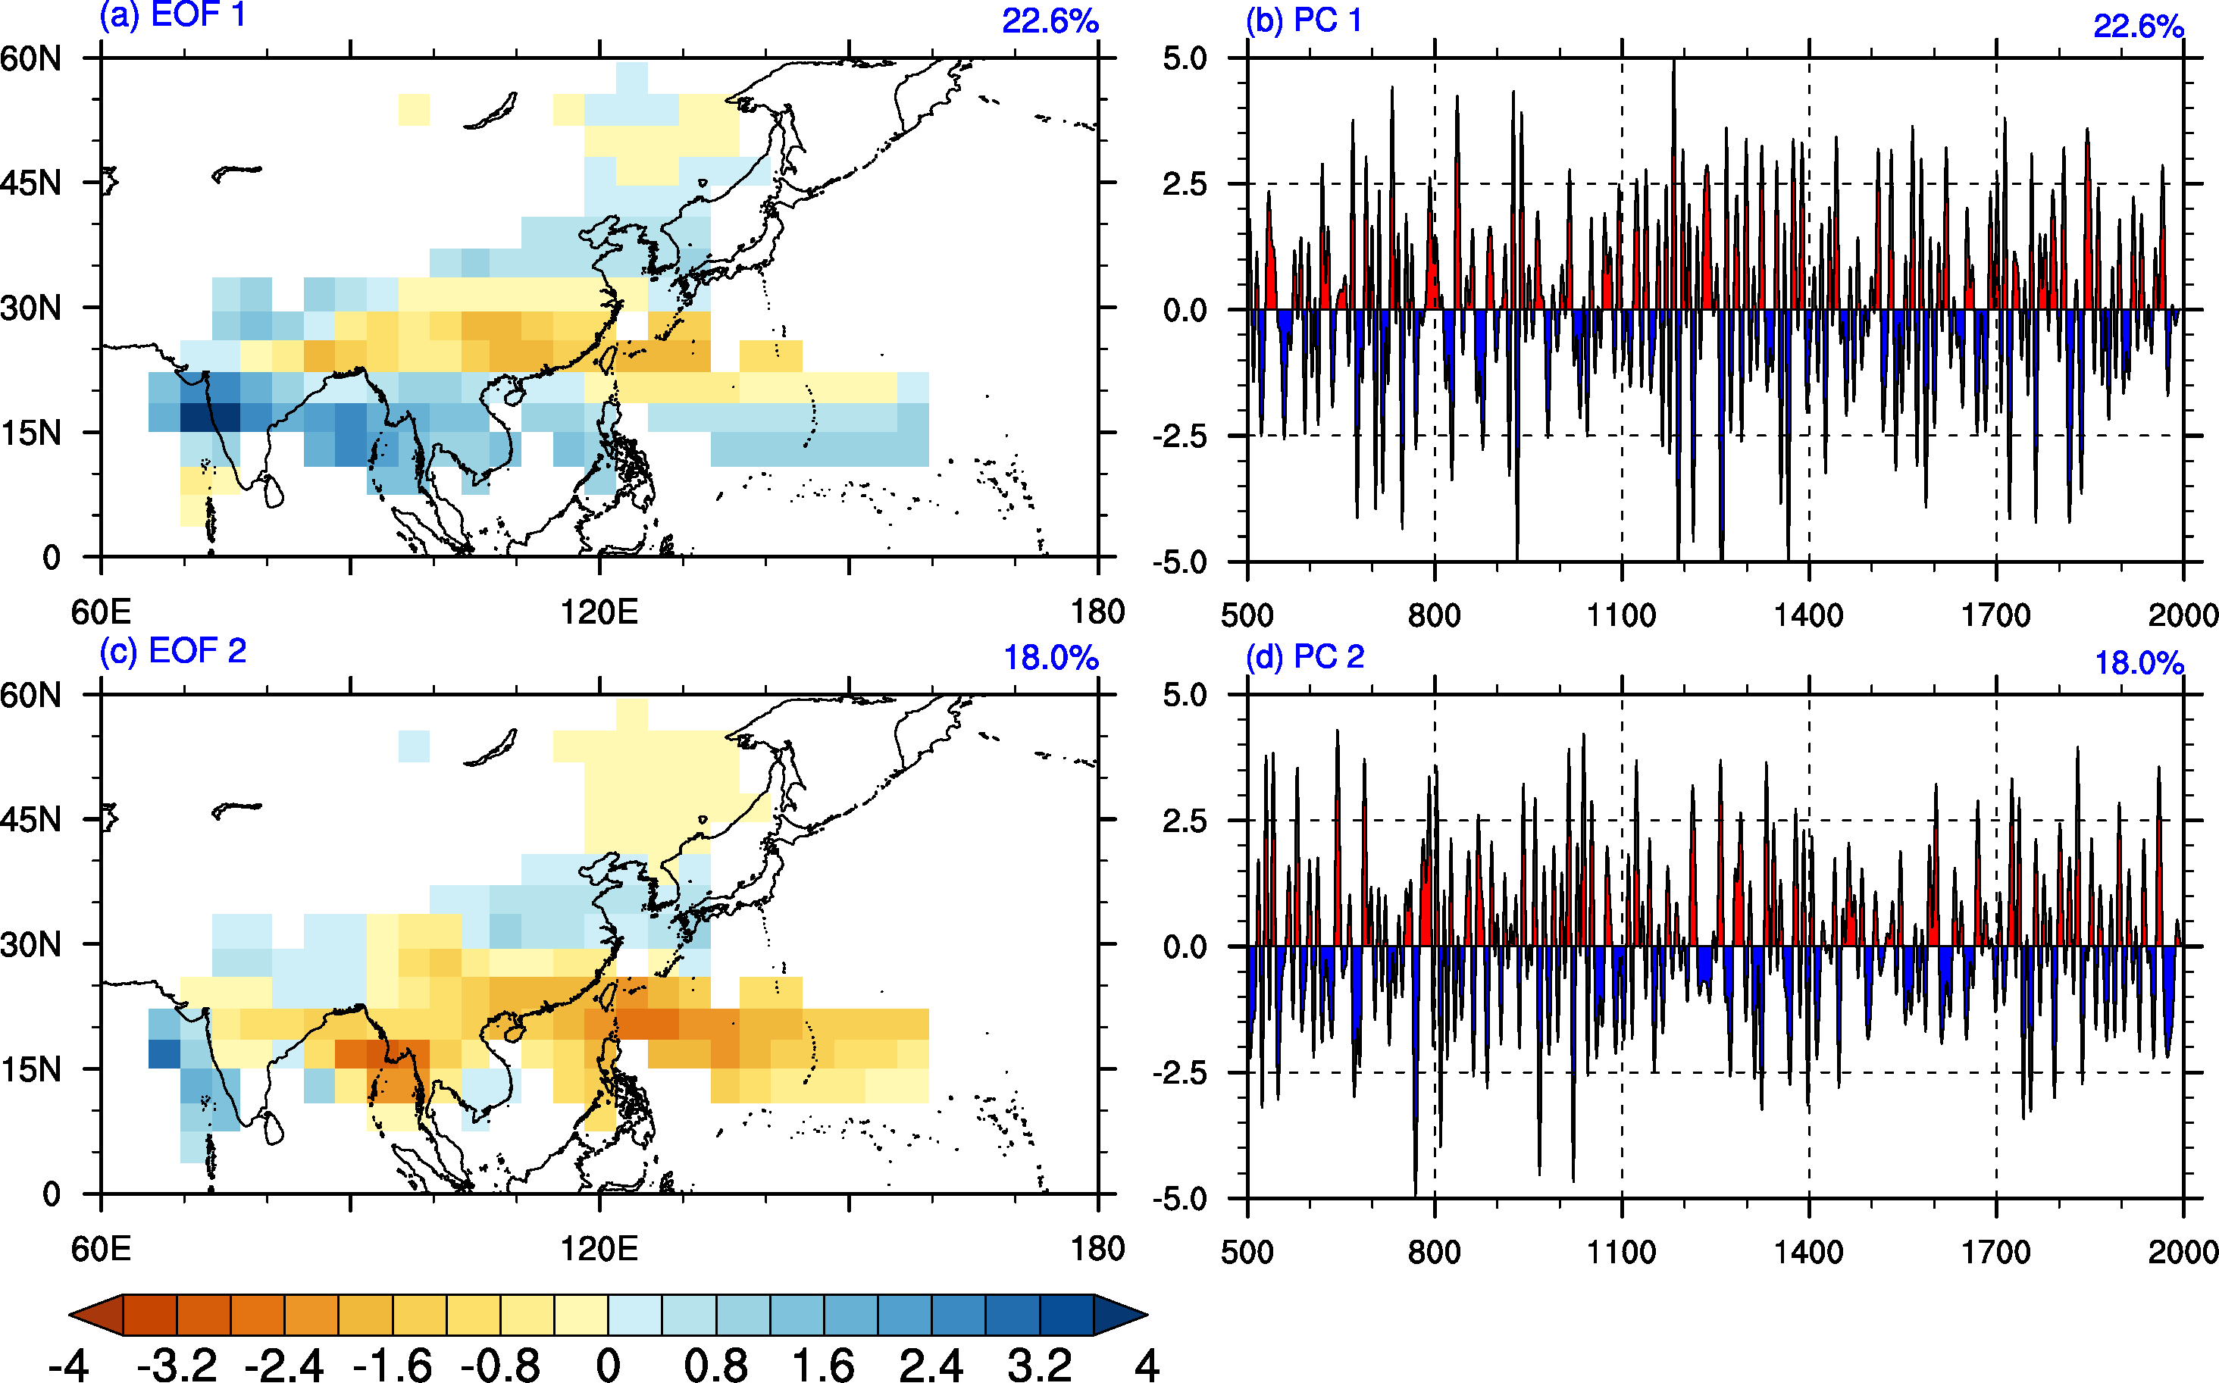
The first two EOF modes of the ASM variation over the past 1500 years. The figure shows the spatial structure (a, c) and the corresponding principal component (PC) of the leading EOF mode (b, d). The fractions on the top right of the panel denote the fractional variances. The data derived from the ALLR were band-pass filtered to extract the frequencies at 10-100 years.

Slide 11
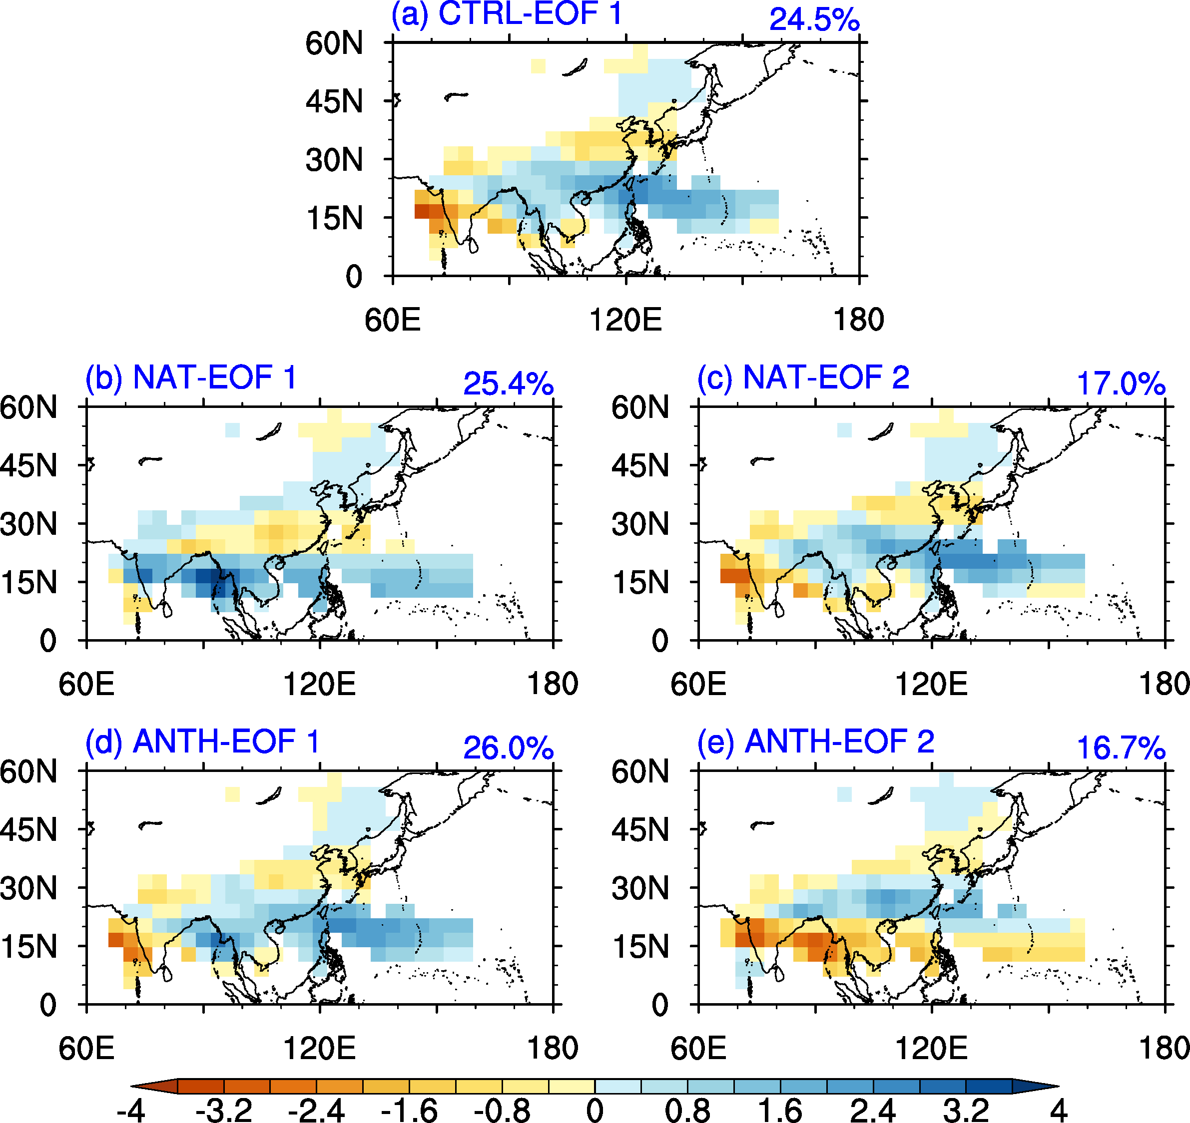
The EOF spatial patterns of the ASM precipitation variations over the past 1500 years. (a) Leading EOF mode from the CTRL; (b) and (c) the first two EOF modes from the NAT; (d) and (e) the first two EOF modes from the ANTH. The fractions on the top right of the panel denote the fractional variances. The data were processed, by applying a 10-100-yr band-pass filter.
Spatial Correlations
ALL-EOF1 | NAT-EOF1 | 0.83
CTRL-EOF1 | NAT-EOF2 | 0.98
CTRL-EOF1 | ANTH-EOF1 | 0.92
CTRL-EOF1 | ALL-EOF2 | -0.86

Slide 12
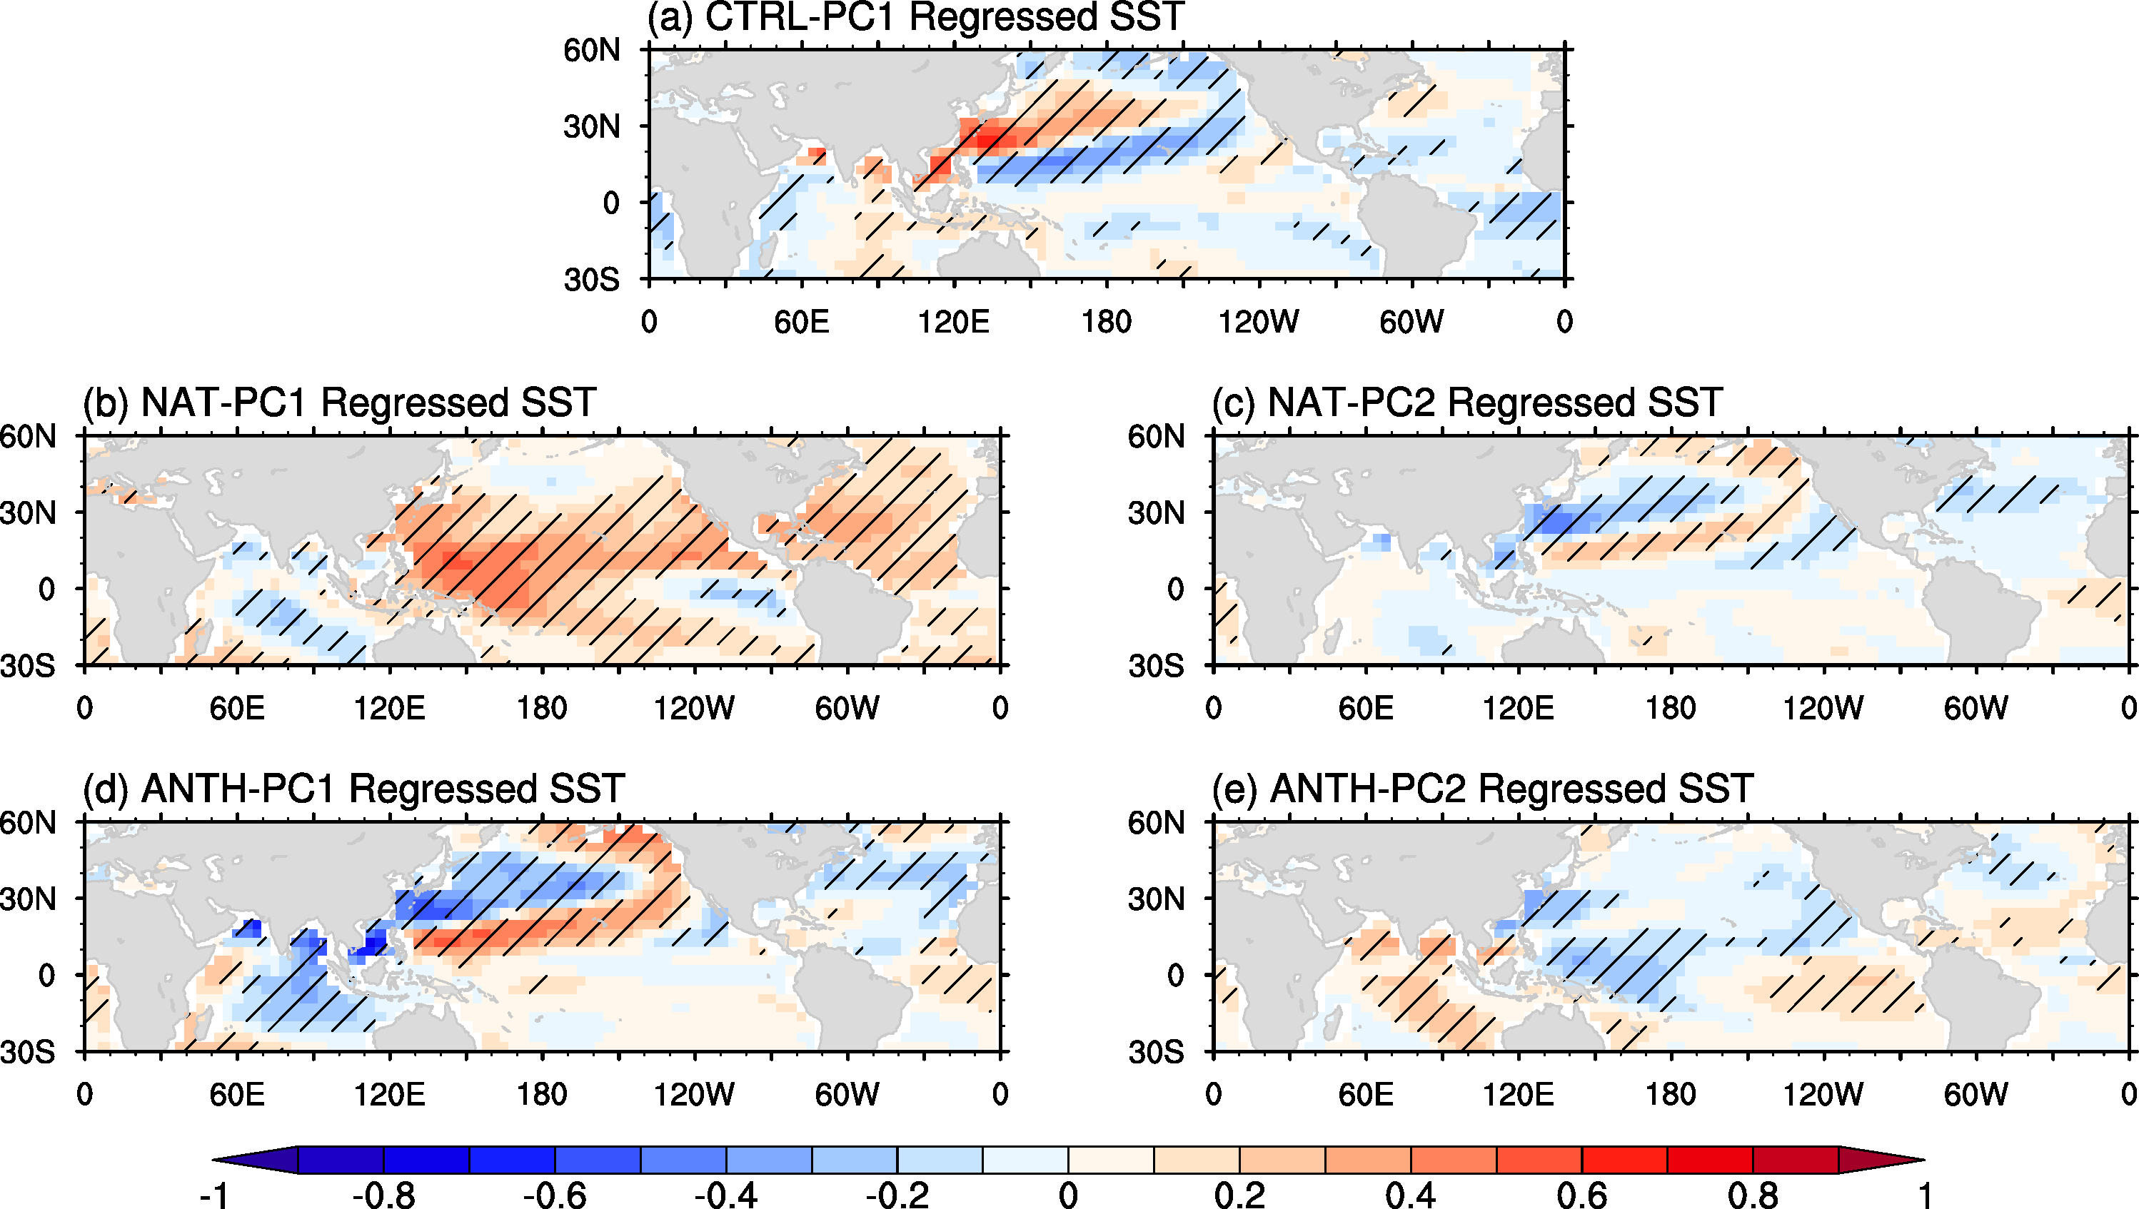
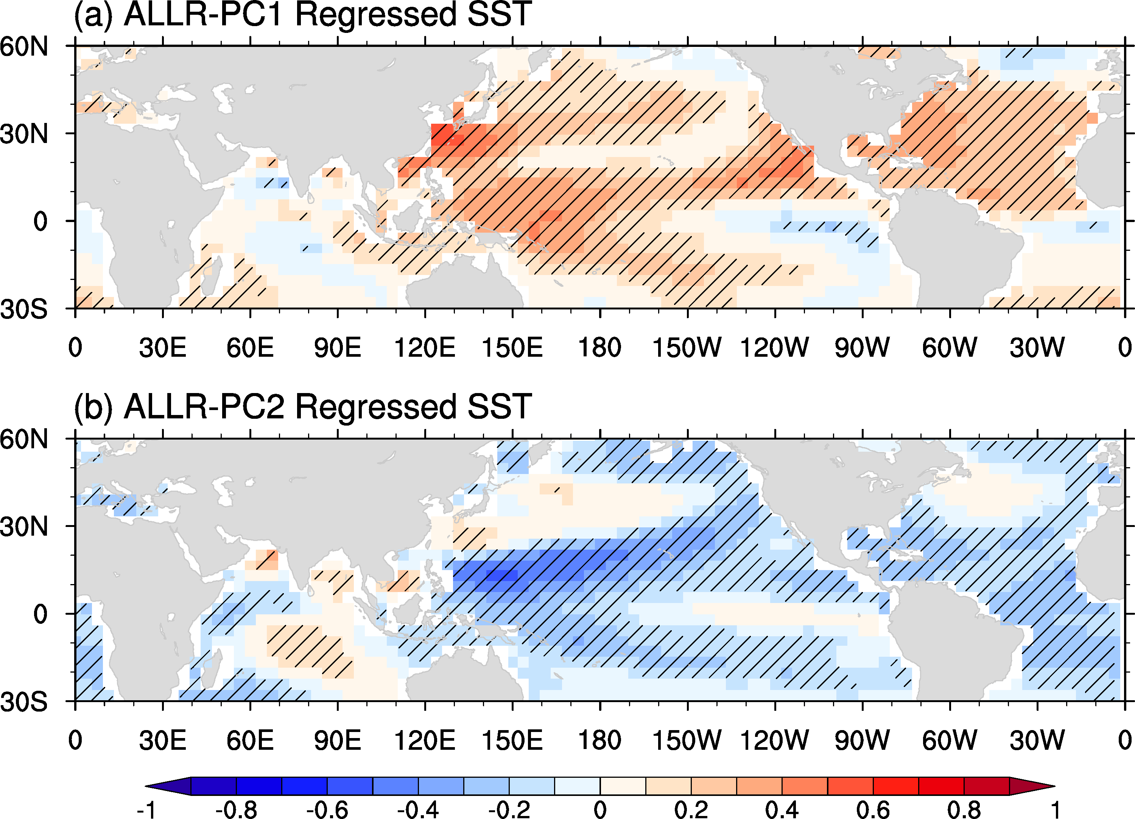
Regressed summer SST patterns onto (a) ALLR-PC1 and (b) ALLR-PC2 over the past 1500 years. Black slash denotes values passing a 10% significance level.
Regressed summer SST patterns onto (a) CTRL-PC1, (b) NAT-PC1, (c) NAT-PC2, (d) ANTH-PC1 and (e) ANTH-PC2 over the past 1500 years. Black slash denotes values passing a 10% significance level.

Slide 13
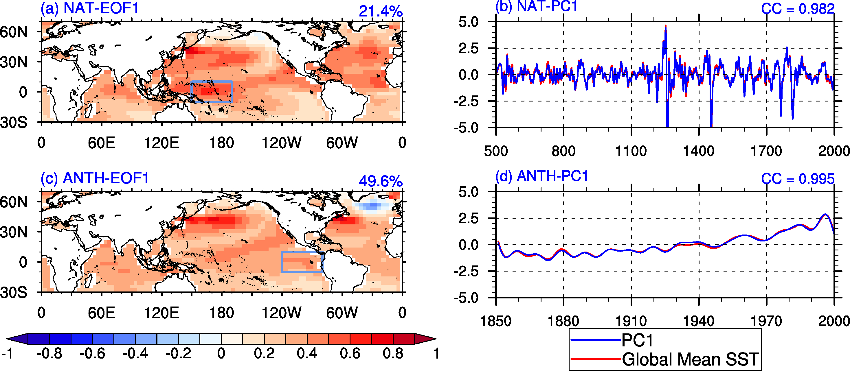
The leading spatial structures and corresponding PCs derived from the NAT over the past 1500 years (a, b) and the ANTH over the past 150 years (c, d). The fractions on the top right of the panel (a) and (c) denote the fractional variances; the values on the top right of the panel (b) and (d) denote the correlation coefficients. The red line and blue line on the panel (b) and (d) represent the PC1 and Global mean SSTs, respectively. The data derived from the NAT were processed by applying a 10-100-yr band-pass filtering; the data for the ANTH were processed by applying 10-yr low-pass filter.

Slide 14
Concluding remarks
Based on our simulated results, the variation of the ASMI shows significant 2-9, ~15, ~25, ~40, ~ 70, and ~220 years periodicities in the ALLR. Some periodicities, such as 2-9, ~15 and ~25, are also observed in the CTRL.
The spatial pattern of the first leading EOF mode of ASM precipitation derived from the ALLR on decadal to centennial timescales is the forced mode and exhibits an meridional spatial ‘tripole’ pattern, which shows a sign of rainfall anomalies over Northern China and most tropical areas of Asian with an opposite sign over the mid-latitude of EASM fields as a broad corridor extending from the Tibetan, crossing southern China, and stretching to Taiwan province.
The dominant forced mode of ASM precipitation on decadal to centennial timescales is mainly affected by natural forcing over the past 1500 years. Under the natural forcing, the considerable warming (cooling) over the western tropical Pacific enhances (reduces) the SST gradient change in the tropical Pacific, and modifying the ASM precipitation distribution.

