Slide 1
A Comparative Study of Entropy-based Methods for Optimal Design of Streamgauge Monitoring Networks Vijay Sreeparvathy¹, V.V. Srinivas² ^{1,2} Department of Civil Engineering, Indian Institute of Science, Bangalore, India
EGU2020-398

Slide 2
OBJECTIVES
First Objective: to develop a fuzzy entropy based (FEBM) methodology for optimal design of hydrometric network. Potential of the developed methodology is demonstrated over conventional Shannon entropy based methodology (SEBM) and its related theoretical improvement EEBM (exponential entropy-based methodology) by application to hydrometric network in Mahanadi basin of India, which is frequently prone to floods.
Second objective: to investigate the effect of various bin size estimation rules on Shannon and exponential entropy estimates and identify if the estimates obtained using any of the rules closely resemble fuzzy entropy estimates. The effect of entropy estimation method and bin size estimation rule was examined on prioritization of stations for data collection, identification of stream gauge deficit zones, and design of optimal hydrometric network in Mahanadi river basin.
Third objective: to evaluate adequacy of stream gauge networks in sixteen river basins of peninsular India (covering 0.64 million km²) using the proposed methodology to get a glimpse of the scenario of hydrometric networks in those basins.

Slide 3
Background on Entropy approaches
Entropy of a system is generally defined as a measure of inherent disorderness within the system
Advantage of entropy approach in design of hydrometric monitoring networks:
Assessment of non-linear relationship between variables
Unbiased estimation of network performance
Flexibility to simultaneously consider each station’s individual information gain and mutual information transfer between the stations in the network
Can be better tailored to specific application or optimisation could be based on the requirement without compromising on the information gain from each station
Flexibility to accommodate the rising demand for additional stations
Capability to consider user specific criteria to meet various demands in the design of optimal monitoring network using multi-objective optimisation
Limitations of conventional Shannon entropy approach are
Formal form is computationally intensive
If uniform probability distribution is considered to determine probability required for estimation of entropy, Shannon’s entropy does not have a fixed upper bound.
Discretization of streamflow data into bins to calculate probability could lead to information loss which in turn has implications on the calculated entropy estimates.
Quantising (binning) of continuous variables leads to different results
Difficult to benchmark
Data intensive
Shannon entropy is not defined in all limits.

Slide 4
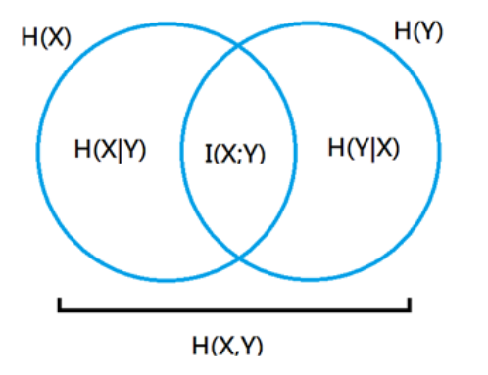
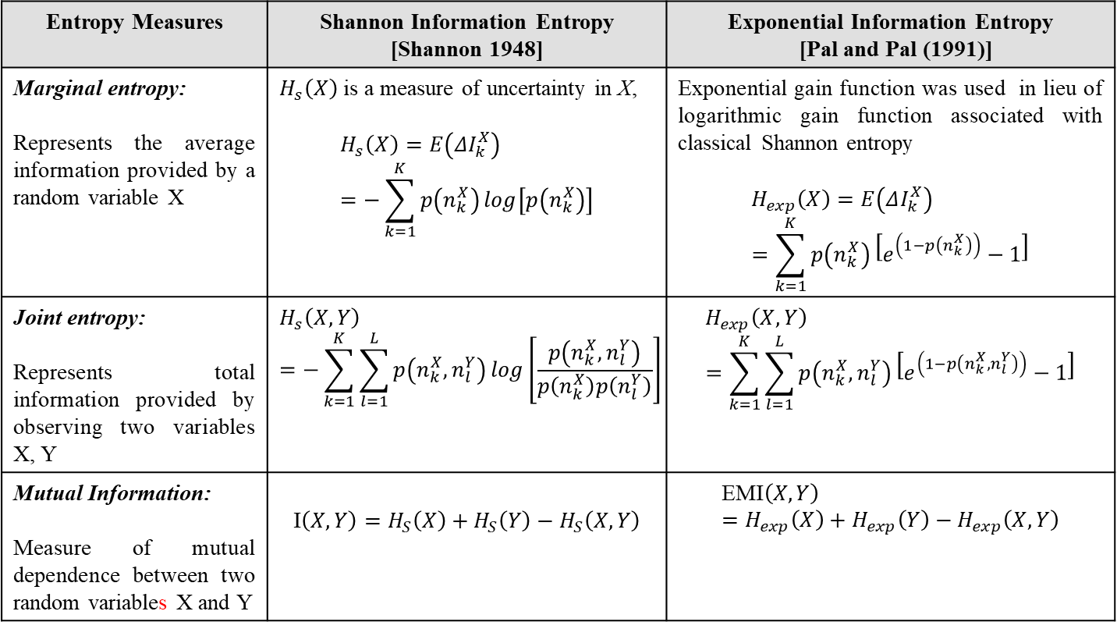
Background on Entropy theory
For Shannon entropy as
$p\left(n_{k}^{X}\right)→0$, $ΔI_{k}^{X}→∞$ and $H_{s}\left(X\right)→∞$
$p\left(n_{k}^{X}\right)=0$, $ΔI_{k}^{X}$ and $H_{s}\left(X\right)$ are not defined
$p\left(n_{k}^{X}\right)→1$, $ΔI_{k}^{X}→0$ and $H_{s}\left(X\right)→0$
$p\left(n_{k}^{X}\right)=1$, $ΔI_{k}^{X}=0$ and $H_{s}\left(X\right)=0$
This implies that upper bound of Shannon entropy is not well-defined when $p\left(n_{k}^{X}\right)→0$ or $p\left(n_{k}^{X}\right)=0$
In Shannon theory, the measure of gain in information is taken as 1/$p\left(n_{k}^{X}\right)$. But statistically information gain can be better represented by (1-$p\left(n_{k}^{X}\right)$) than 1/$p\left(n_{k}^{X}\right)$
Hence $ΔI_{k}^{X}=\log\left[1−p\left(n_{k}^{X}\right)\right]$
Then $ΔI_{k}^{X}$<0 or increases with $p\left(n_{k}^{X}\right)$ which is unappealing.
Hence exponential function of (1-$p\left(n_{k}^{X}\right)$) would alleviate the difficulty.
Entropy Measures | Shannon Information Entropy [Shannon 1948] | Exponential Information Entropy [Pal and Pal (1991)]
Marginal entropy: Represents the average information provided by a random variable X | $H_{s}\left(X\right)$ is a measure of uncertainty in X, $$H_{s}\left(X\right)=E\left(ΔI_{k}^{X}\right)=−\sum_{k=1}^{K}{p\left(n_{k}^{X}\right)\log\left[p\left(n_{k}^{X}\right)\right]}$$ | Exponential gain function was used in lieu of logarithmic gain function associated with classical Shannon entropy $$H_{exp}\left(X\right)=E\left(ΔI_{k}^{X}\right)=\sum_{k=1}^{K}{p\left(n_{k}^{X}\right)}\left[e^{\left(1−p\left(n_{k}^{X}\right)\right)}−1\right]$$
Joint entropy: Represents total information provided by observing two variables X, Y | $$H_{s}\left(X,Y\right)=−\sum_{k=1}^{K}{\sum_{l=1}^{L}{p\left(n_{k}^{X},n_{l}^{Y}\right)\log\left[\frac{p\left(n_{k}^{X},n_{l}^{Y}\right)}{p\left(n_{k}^{X}\right)p\left(n_{l}^{Y}\right)}\right]}}$$ | $$H_{exp}\left(X,Y\right)=\sum_{k=1}^{K}{\sum_{l=1}^{L}{p\left(n_{k}^{X},n_{l}^{Y}\right)}\left[e^{\left(1−p\left(n_{k}^{X},n_{l}^{Y}\right)\right)}−1\right]}$$
Mutual Information: Measure of mutual dependence between two random variables X and Y | $$\text{I}\left(X,Y\right)=H_{S}\left(X\right)+H_{S}\left(Y\right)−H_{S}\left(X,Y\right)$$ | $$\text{EMI}\left(X,Y\right)=H_{exp}\left(X\right)+H_{exp}\left(Y\right)−H_{exp}\left(X,Y\right)$$

Slide 5
Background on Proposed Fuzzy entropy theory
Entropy Measures | Proposed Fuzzy information entropy for design of hydrometric network [Yu. et. al., 2011]
Marginal entropy: Represents the average information provided by a random variable X | where $F_{X}$ represents the fuzzy attribute set which has a fuzzy equivalence relation $R_{F_{X}}$ with $X$ $$H_{F}\left(X\right)=\frac{1}{n}\sum_{i=1}^{n}{\log\left(\frac{\left|{\left[x_{i}\right]}_{R_{F_{X}}}\right|}{n}\right)}=\frac{1}{n}\sum_{i=1}^{n}{\log\left(\frac{\sum_{j=1}^{n}{r_{ij}^{X}}}{n}\right)}$$ Relation Matrix, $M\left(R_{F_{X}}\right)=\left[\begin{matrix}r_{11}^{X} & r_{12}^{X} & ⋯ & r_{1n}^{X} \\ r_{21}^{X} & r_{22}^{X} & ⋯ & r_{2n}^{X} \\ ⋮ & ⋮ & ⋮ & ⋮ \\ r_{n1}^{X} & r_{n2}^{X} & ⋯ & r_{nn}^{X}\end{matrix}\right]$ where $r_{ij}^{X}=R_{F_{X}}\left(x_{i},x_{j}\right)=\exp\left(−\frac{\left|x_{i}−x_{j}\right|}{2}\right) i,j=1,…,n$
Joint entropy ($H_{F}$): Represents total information provided by observing two variables X, Y | $$H_{F}\left(X,Y\right)=H_{F}\left(R_{F_{X}}{,}R_{F_{Y}}\right)=−\frac{1}{n}\sum_{i=1}^{n}{\log{\frac{\left|{\left[x_{i}\right]}_{R_{F_{X}}}\right|∩\left|{\left[y_{i}\right]}_{R_{F_{Y}}}\right|}{n}}}$$ In order to compute $\left|{\left[x_{i}\right]}_{R_{F_{X}}}\right|∩\left|{\left[y_{i}\right]}_{R_{F_{Y}}}\right|$, intersection of the relation matrices $M\left(R_{F_{X}}\right)$ and $M\left(R_{F_{Y}}\right)$ corresponding to X and Y is determined as, $$M\left(R_{F_{X}}\right)∩M\left(R_{F_{Y}}\right)=\left[\begin{matrix}r_{11}^{X} & r_{12}^{X} & ⋯ & r_{1n}^{X} \\ r_{21}^{X} & r_{22}^{X} & ⋯ & r_{2n}^{X} \\ ⋮ & ⋮ & ⋮ & ⋮ \\ r_{n1}^{X} & r_{n2}^{X} & ⋯ & r_{nn}^{X}\end{matrix}\right]∩\left[\begin{matrix}r_{11}^{Y} & r_{12}^{Y} & ⋯ & r_{1n}^{Y} \\ r_{21}^{Y} & r_{22}^{Y} & ⋯ & r_{2n}^{Y} \\ ⋮ & ⋮ & ⋮ & ⋮ \\ r_{n1}^{Y} & r_{n2}^{Y} & ⋯ & r_{nn}^{Y}\end{matrix}\right] \\ =\left[\begin{matrix}r_{11}^{X,Y} & r_{12}^{X,Y} & ⋯ & r_{1n}^{X,Y} \\ r_{21}^{X,Y} & r_{22}^{X,Y} & ⋯ & r_{2n}^{X,Y} \\ ⋮ & ⋮ & ⋮ & ⋮ \\ r_{n1}^{X,Y} & r_{n2}^{X,Y} & ⋯ & r_{nn}^{X,Y}\end{matrix}\right]$$
Mutual Information (MI): Measure of mutual dependence between two random variable X and Y | $$\text{FMI}\left(X,Y\right)=H_{F}\left(X\right)+H_{F}\left(Y\right)−H_{F}\left(X,Y\right)$$
directly compute MI between numerical and fuzzy variables based on a relation matrix
for discrete variables, a crisp equivalence relation matrix can be computed from data and entropy can be estimated
fuzzy information entropy is directly calculated for variables without discretisation of data points
The potential of fuzzy entropy measures is yet to be explored in the field of hydrology

Slide 6
Background on Bin size discretisation methods
discretization of data points is essential to compute the entropy estimates in the case of both Shannon and exponential entropy methods, as the underlying distribution of flow data is unknown.
discretization is quite challenging as no best bin size estimate exists, and different bin sizes can reveal different features of the data.
too small bin width may lead to a histogram that is overly rough, whereas too large bin width results in smooth histogram when compared to the true probability density function (PDF). An increase in roughness causes the variance of estimated PDF to be too high, whereas increase in smoothness results in a significant amount of bias.
various bin size determination rules/ formulae considered in the study to fix the optimal bin width are
(ii) Sturge’s rule
(iii) Scott’s rule
(i) Freedman–Diaconis rule
(iv)Rice rule
Bin size determination methods
(ix) Shimazaki and Shinomoto rule
(v) Doane’s formula
(viii) Knuth’s rule
(vi) Bendat and Piersol formula
(vii) Cochran’s formula

Slide 7
Proposed Methodology
Ranking stream gauges in the existing hydrometric network based on their importance
Observations of streamflows at existing stations in river basin
Identifying stream gauge deficient zones (if any)
Estimating entropy measures for existing stations:
Marginal entropy
Joint Entropy
Mutual Information
Calculating the number of additional stations required based on WMO guidelines for physiographic units
Is WMO minimum requirement met?
Spatial information data:
Land-use/land-cover, soils
Climate data: Rainfall, temperature, wind speed, relative humidity, solar radiation
Identifying potential locations of additional stations by delineating sub-basins
Yes
No
Hydrometric network is deemed adequate
DEM data
Simulating flows at the potential locations using SWAT
Development of Hydrologic model (SWAT)
Estimating entropy measures for potential stations using the simulated flows
Optimising hydrometric network using NSGA II

Slide 8
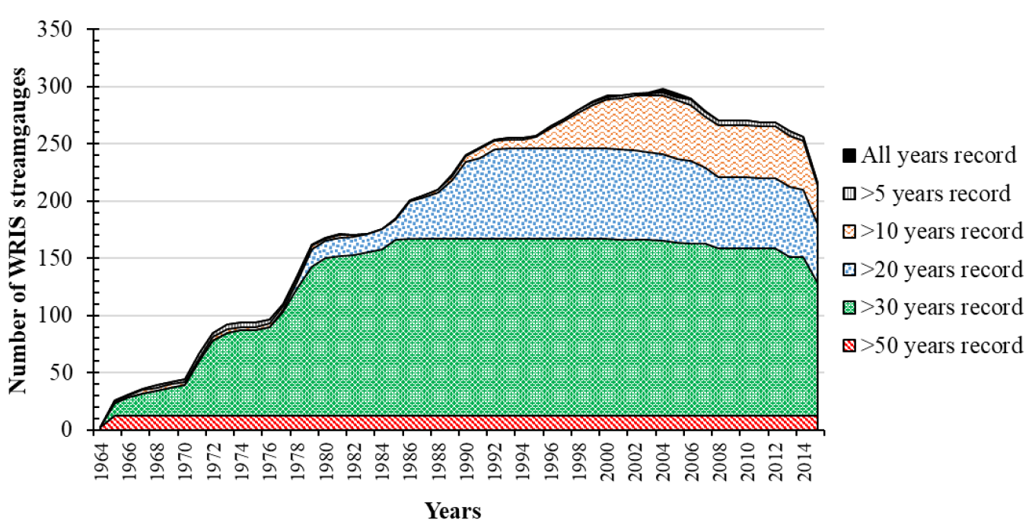
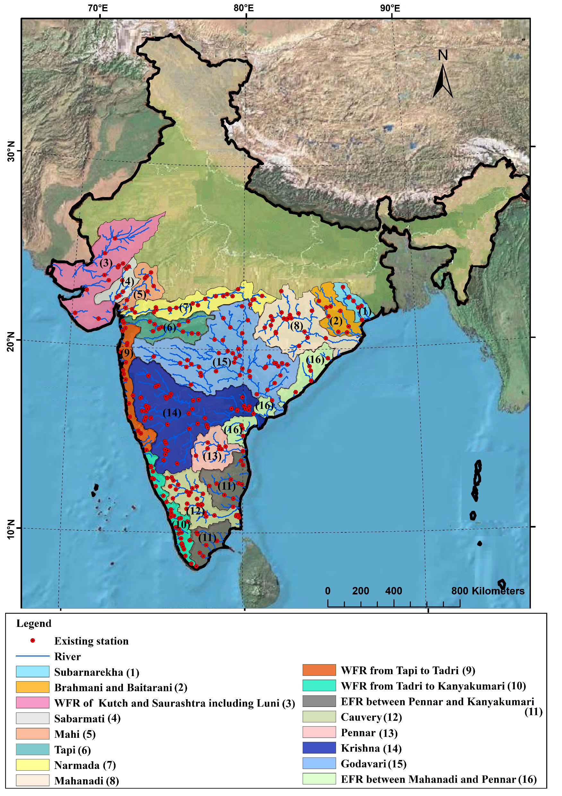
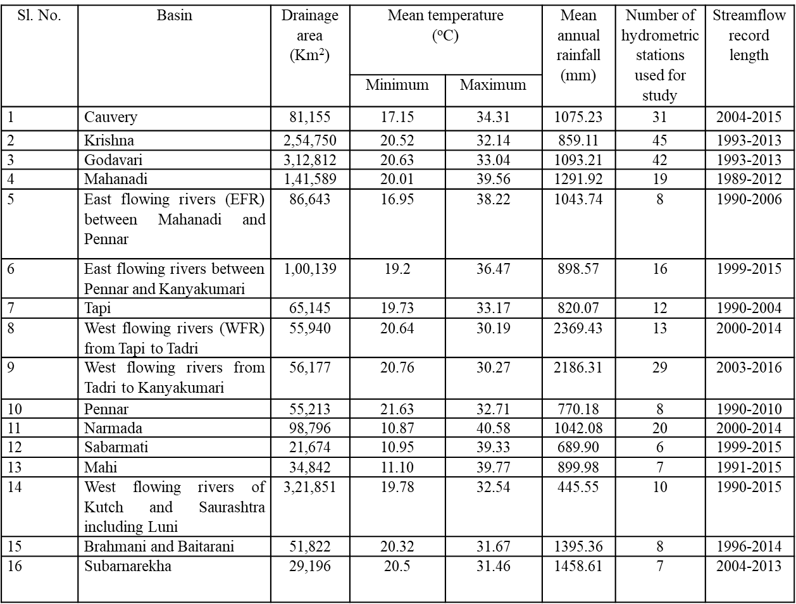
Study area
Fig. 1.: The scenario of records for stream gauge stations available in 16 basins considered over peninsular India
Fig. 2: Locations of stream gauges considered in different basins of peninsular India for the study

Slide 9
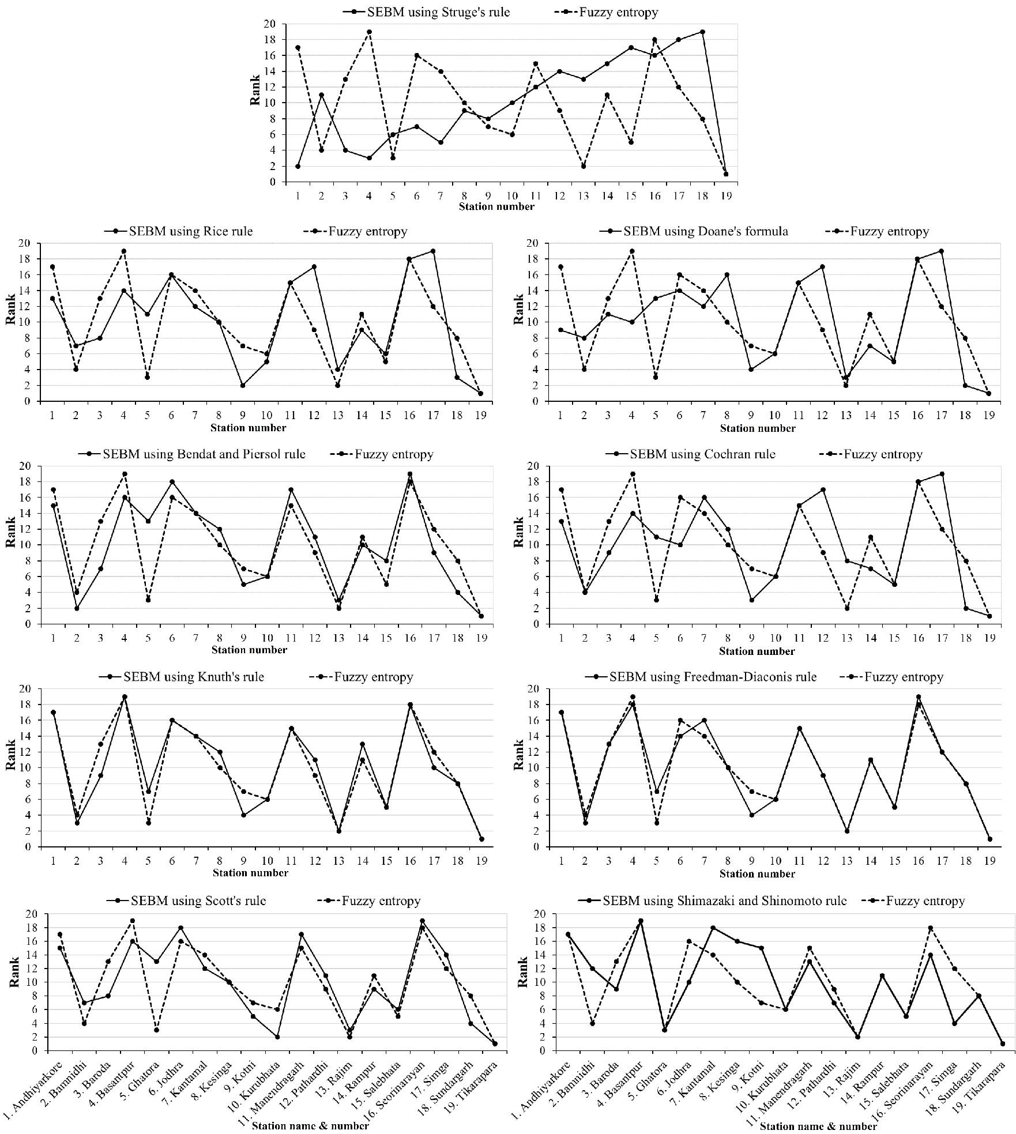
Prioritizing stations in the existing hydrometric network of Mahanadi basin
Fig. 3. Comparison of station priority ranks in Mahanadi basin determined using Fuzzy and Shannon entropy-based method considering nine bin size determination rules/formula).
(X axis: Rank; Y axis: Station name)

Slide 10
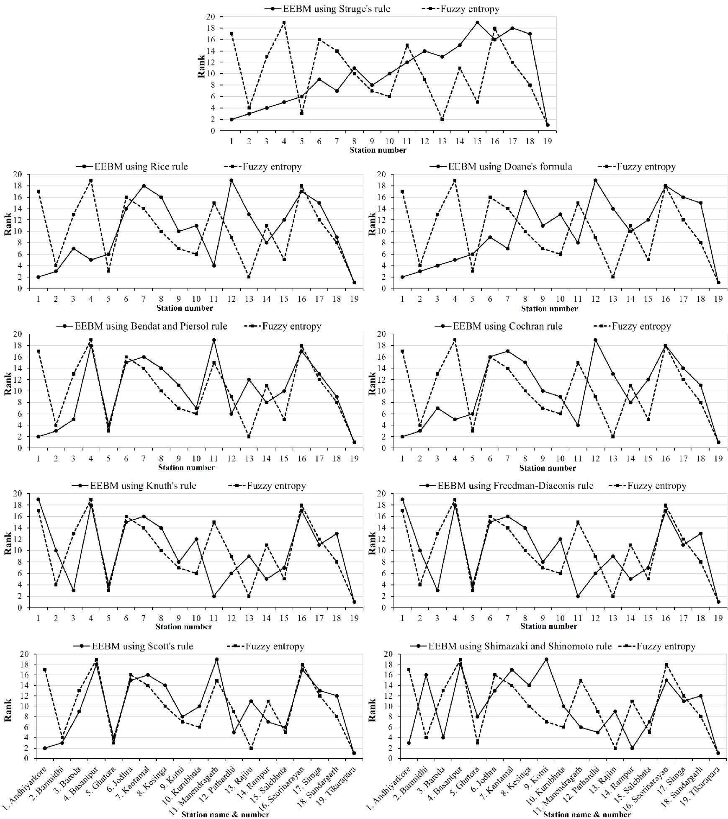
Prioritizing stations in the existing hydrometric network of Mahanadi basin
Fig. 4. Comparison of station priority ranks in Mahanadi basin determined using Fuzzy and Exponential entropy-based method considering nine bin size determination rules/formula).
(X axis: Rank; Y axis: Station name)

Slide 11
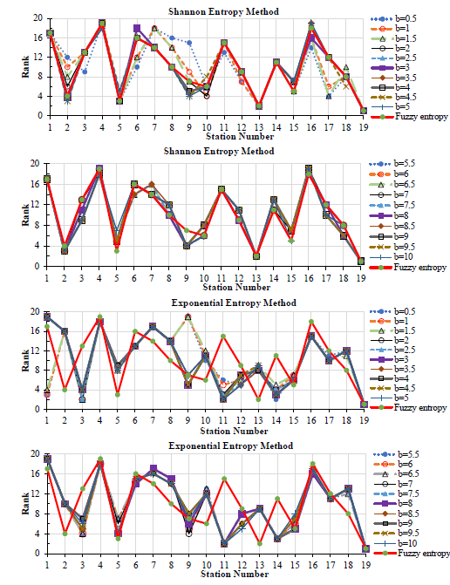
Prioritizing stations in the existing hydrometric network of Mahanadi basin
Fig. 5. Comparison of station priority ranks determined using Fuzzy entropy method with those determined using Shannon and exponential entropy methods considering different arbitrary values for bin size (b).

Slide 12
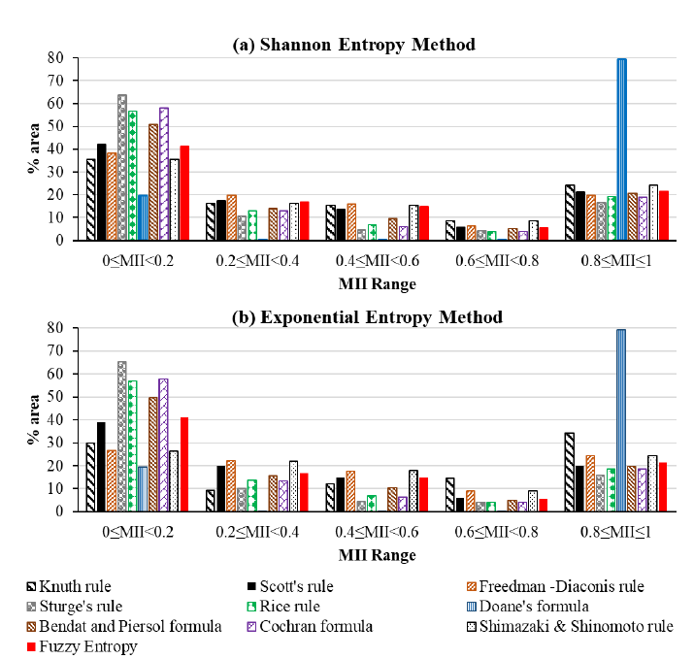
Identification of stream gauge deficit zones in Mahanadi basin
Fig. 6. Estimates of PBA-MII (percentage of the basin area falling in different MII zones) obtained using Shannon and exponential entropy methods considering nine bin size determination rules/formulae are compared with the estimates based on fuzzy entropy method.

Slide 13
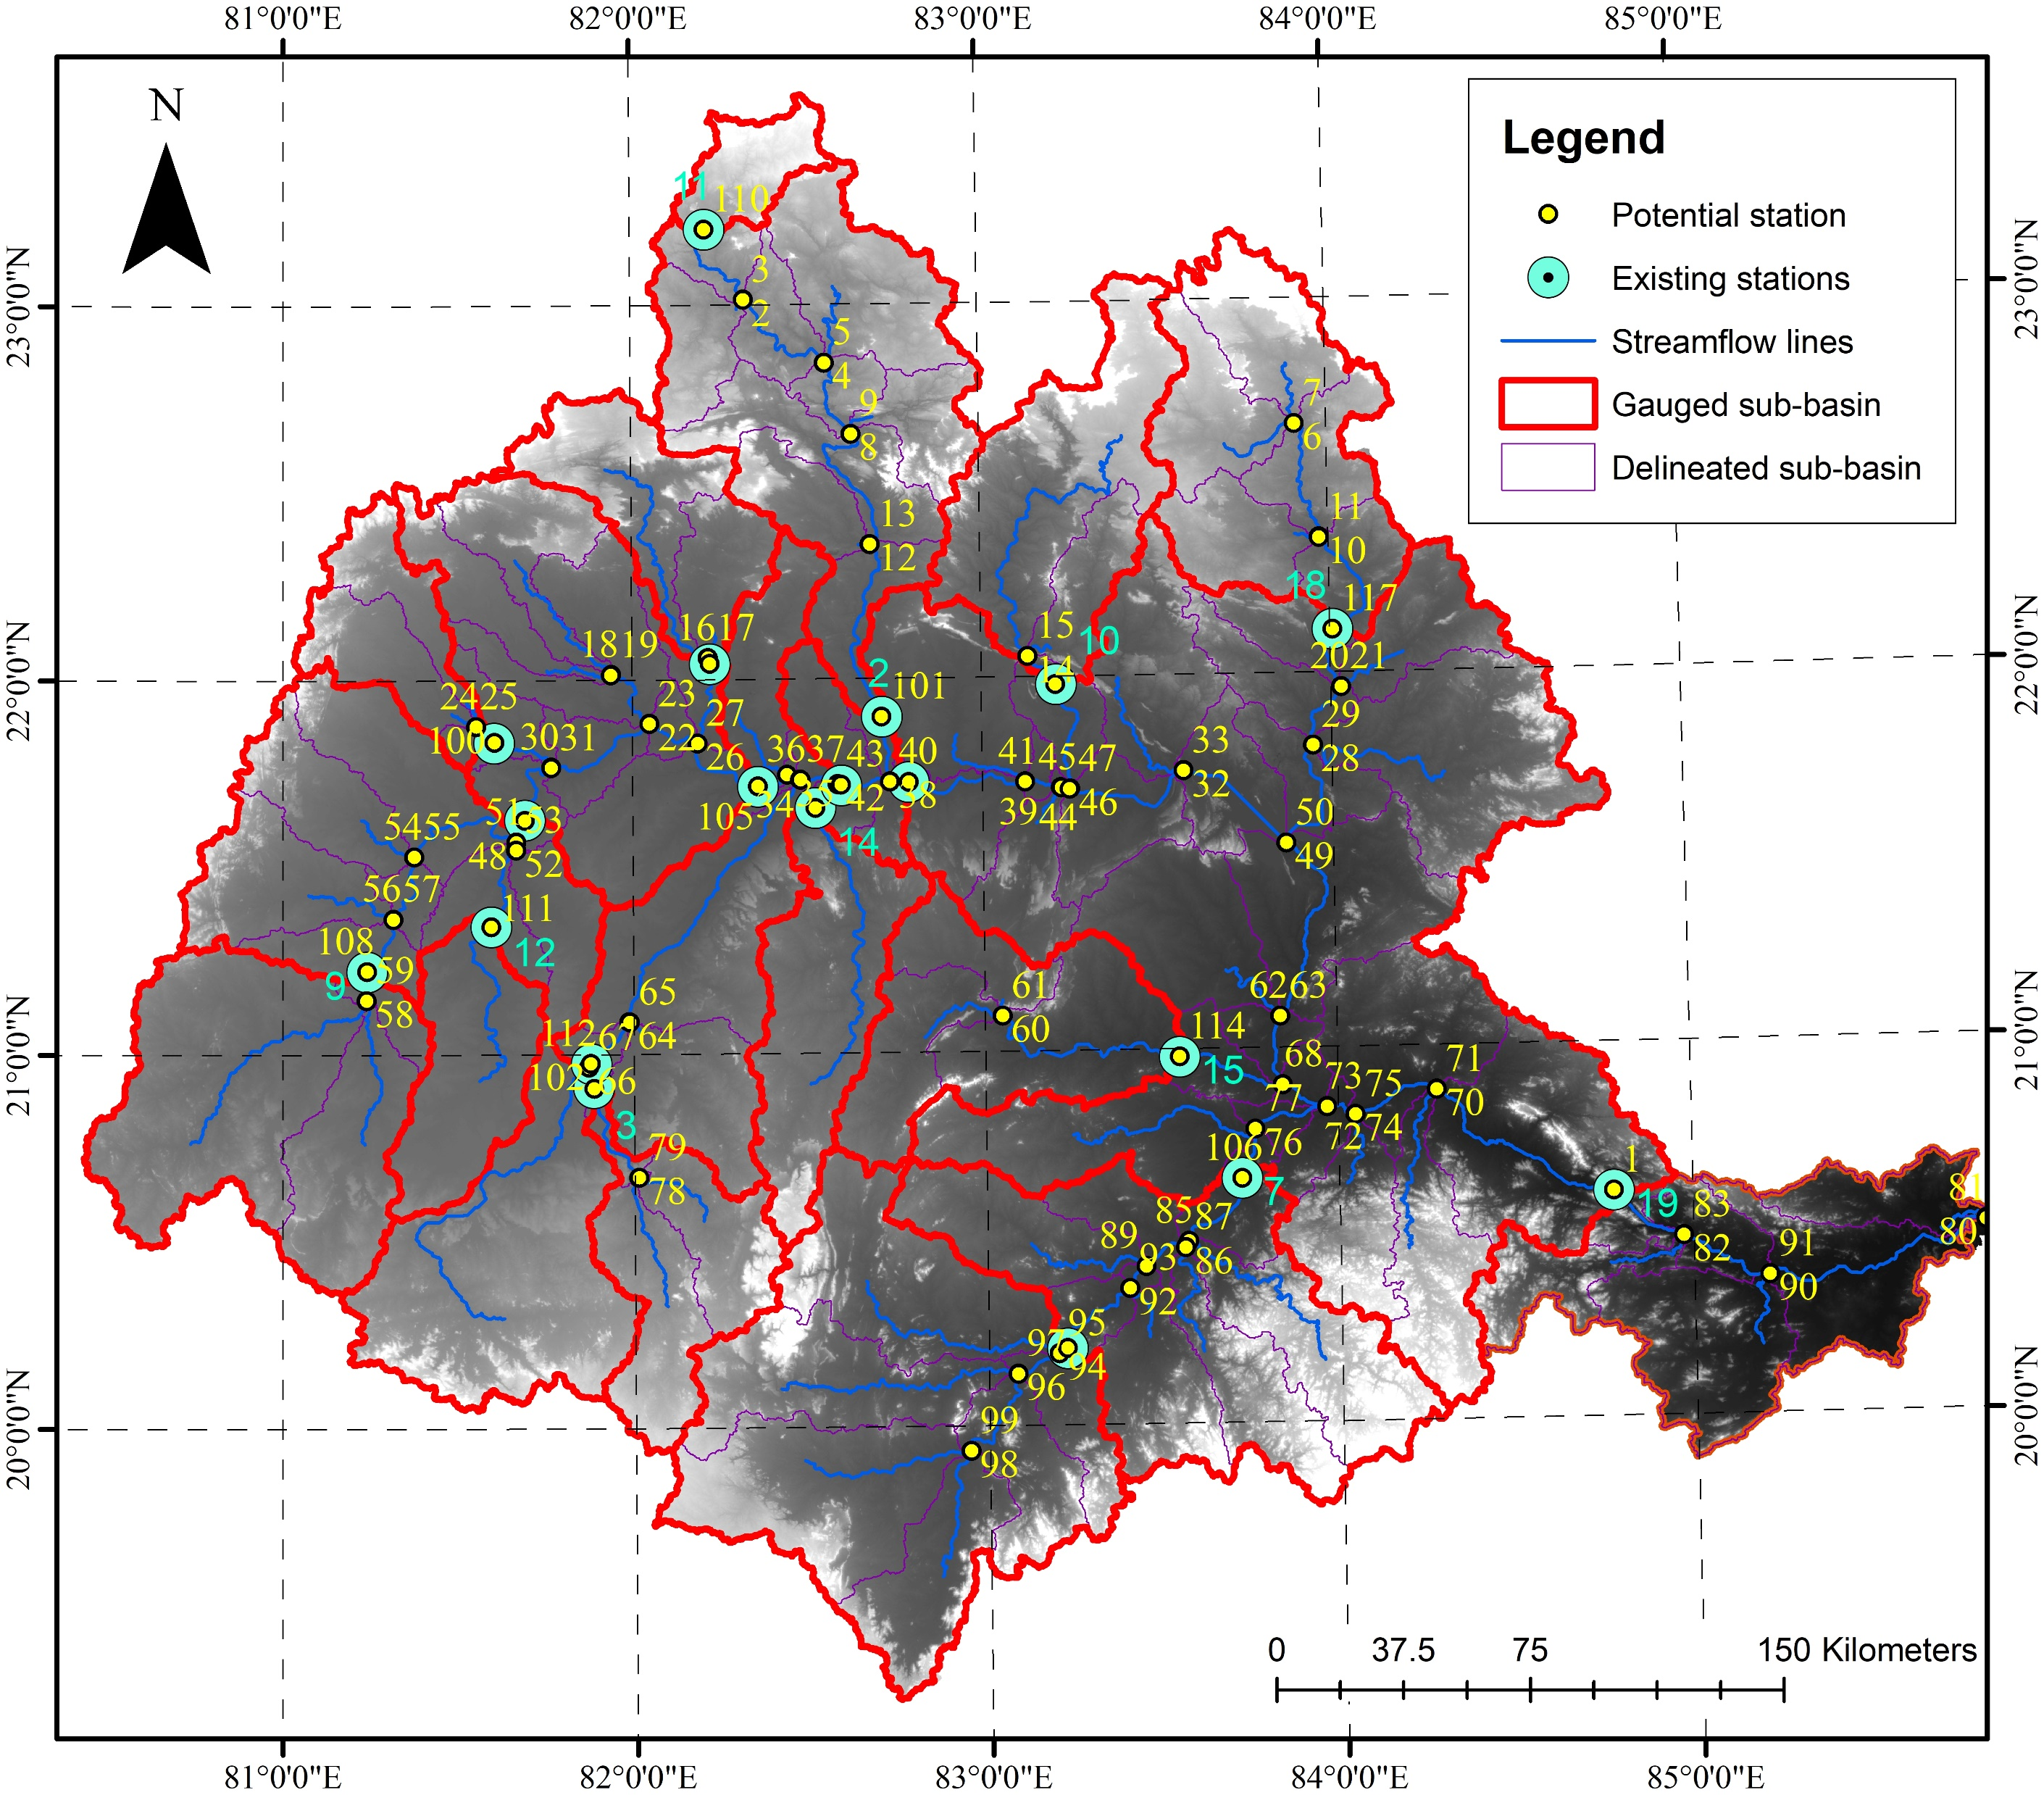
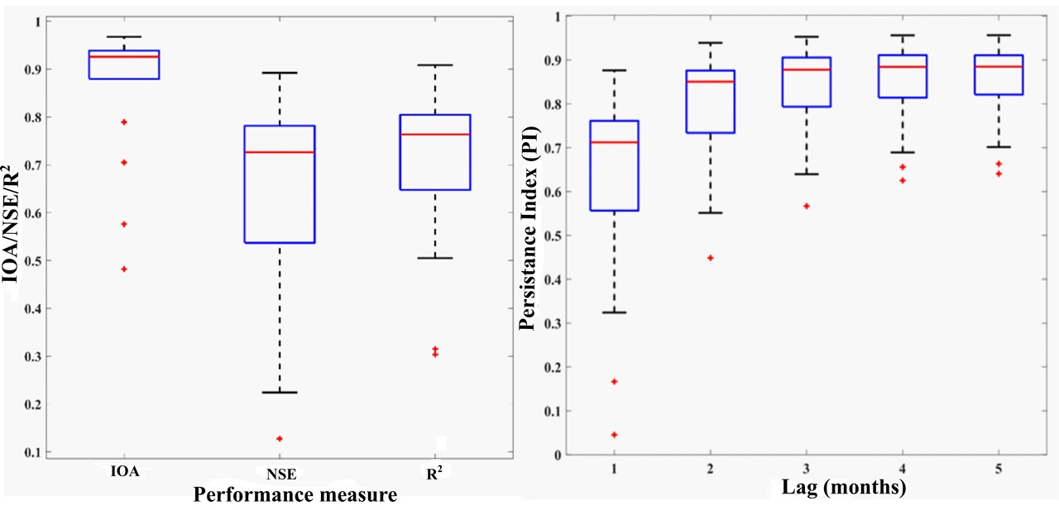
Estimation of streamflow at potential gauge locations using SWAT
Minimum requirements as per WMO guidelines: 83 stations
Existing number of stations: 19
Threshold area chosen for delineating sub-basins: 0.64% of the basin area (1,41,589 km²)
Total sub-basins yielded from delineation: 98
Total 117 potential locations including the existing stations
Fig. 7. Performance of the calibrated SWAT model. IOA: Index of Agreement; NSE: Nash-Sutcliffe efficiency; R²: coefficient of determination, PI: Persistence Index.
Figure 8: Possible potential location of stations for effective monitoring of streamflow

Slide 14
Optimisation of hydrometric network using NSGA-II optimisation algorithm considering FEBM, EEBM and SEBM
Shannon Entropy
Details of NSGA-II output | Freedman–Diaconis rule | Sturge’s rule | Scott’s rule | Rice rule | Doane’s formula | Bendat and Piersol formula | Cochran’s formula | Knuth’s rule
Number of pareto-optimal solutions | 116 | 202 | 123 | 219 | 136 | 145 | 232 | 116
Total number of optimal stations | 76 | 65 | 61 | 62 | 64 | 59 | 61 | 72
Total number of optimal stations matching with fuzzy optimal stations | 56 | 46 | 42 | 44 | 46 | 37 | 43 | 52
Exponential Entropy
Details of NSGA-II output | Freedman–Diaconis rule | Sturge’s rule | Scott’s rule | Rice rule | Doane’s formula | Bendat and Piersol formula | Cochran’s formula | Knuth’s rule
Number of pareto-optimal solutions | 58 | Nil* | Nil* | 28 | Nil* | 41 | 24 | 54
Total number of optimal stations | 69 | Nil* | Nil* | 73 | Nil* | 78 | 79 | 68
Total number of optimal stations matching with fuzzy optimal stations | 51 | Nil* | Nil* | 50 | Nil* | 52 | 53 | 44
Fuzzy Entropy
Number of pareto-optimal solutions | 102
Total Number of optimal stations | 66
*failed to produce pareto-optimal solution in multi-objective optimization

Slide 15
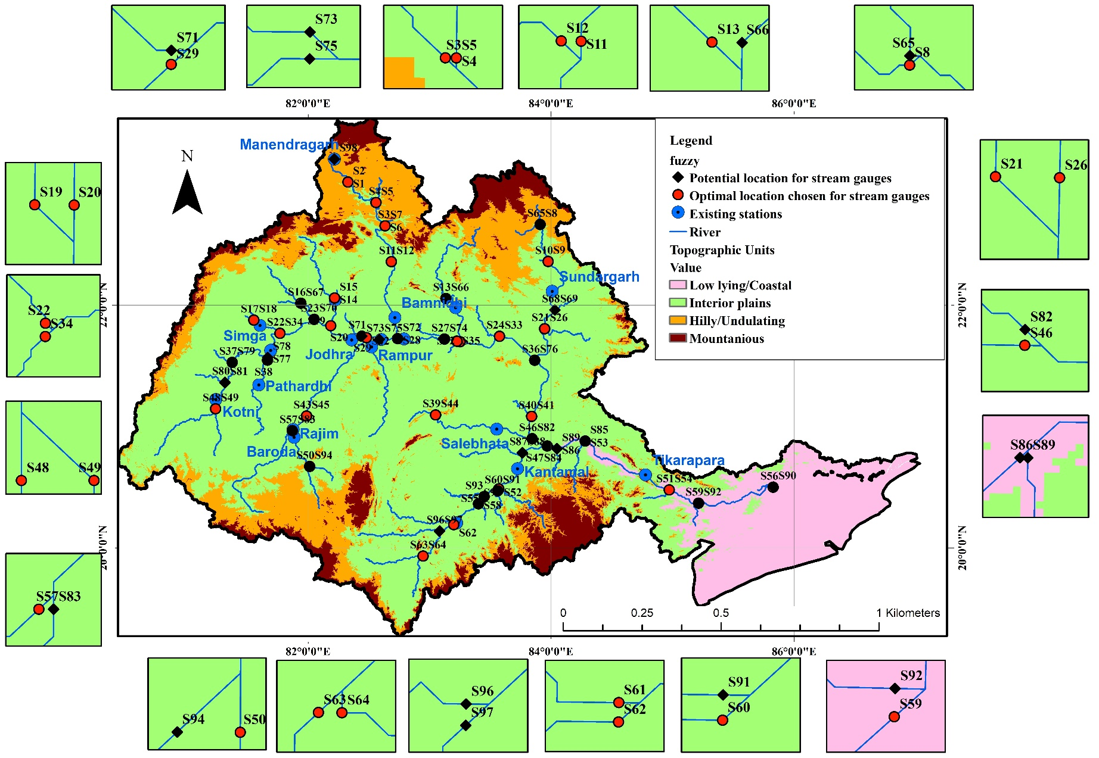
Optimisation of hydrometric network using NSGA-II optimisation algorithm considering proposed FEBM
Fig. 9. The optimised hydrometric network in Mahanadi basin.

Slide 16
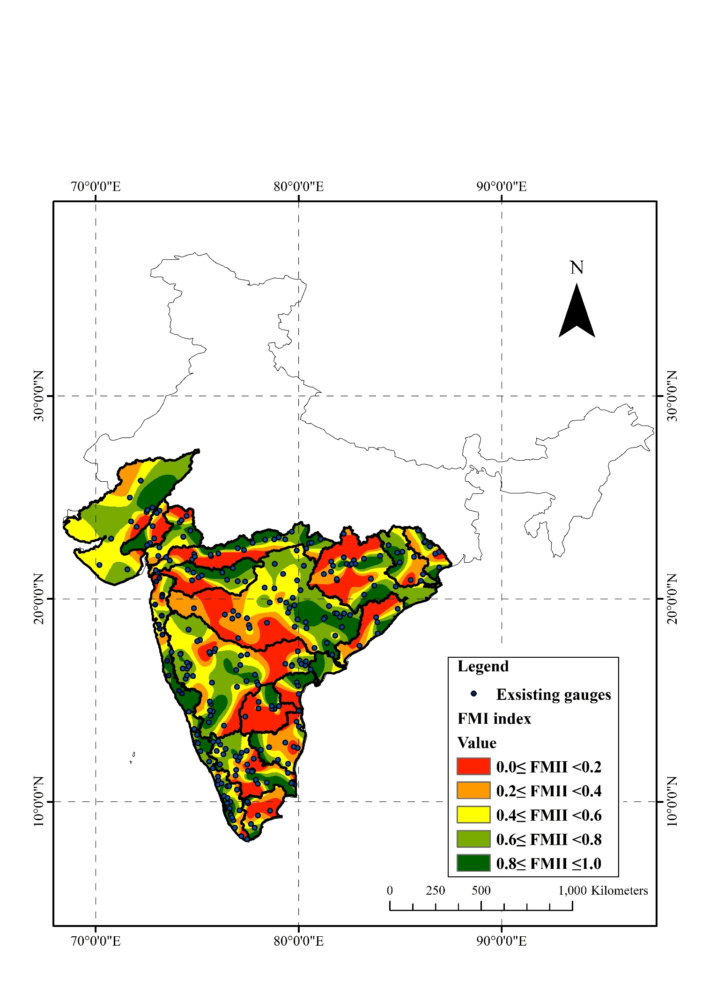
Assessment of adequacy of existing streamgauge network in 16 river basins of Peninsular India
Sl. No. | Basin | Area of basin (in %) classified based on physiography as |  |  |  | Minimum number of gauges as per WMO [2008] and existing number of gauges
 |  | Coastal region | Interior plains | Hilly/ Undulating region | Mount ainous region
1 | Cauvery | 14.13 | 30.15 | 6.11 | 49.62 | 69 (31)
2 | Krishna | 2.79 | 17.41 | 45.57 | 34.23 | 180 (45)
3 | Godavari | 2.14 | 44.21 | 34.22 | 19.42 | 194 (42)
4 | Mahanadi | 10.95 | 63.57 | 17.07 | 8.41 | 83 (19)
5 | East flowing rivers between Mahanadi and Pennar | 50.70 | 32.26 | 7.55 | 9.49 | 46 (8)
6 | East flowing rivers between Pennar and Kanyakumari | 44.84 | 31.55 | 8.05 | 15.56 | 52 (16)
7 | Tapi | 2.51 | 62.05 | 21.98 | 13.46 | 40 (12)
8 | West flowing rivers from Tapi to Tadri | 42.10 | 34.34 | 15.47 | 8.09 | 30 (13)
9 | West flowing rivers from Tadri to Kanyakumari | 49.21 | 23.33 | 7.53 | 19.92 | 31 (29)
10 | Pennar | 5.19 | 45.77 | 25.05 | 23.99 | 38 (8)
11 | Narmada | 5.84 | 50.26 | 27.51 | 16.39 | 62 (20)
12 | Sabarmati | 48.75 | 40.16 | 5.95 | 5.14 | 16 (6)
13 | Mahi | 25.91 | 52.24 | 21.01 | 0.85 | 23 (7)
14 | West flowing rivers of Kutch and Saurashtra including Luni | 51.52 | 45.07 | 2.92 | 0.49 | 95 (10)
15 | Brahmani and Baitarani | 14.30 | 41.85 | 24.83 | 19.02 | 31 (8)
16 | Subarnarekha | 35.96 | 46.11 | 10.17 | 7.75 | 17 (7)
Fig. 10. Spatial variability of fuzzy mutual information index for 16 river basins in Peninsular India. Ranges are given for FMI index values to classify an area as highly deficit, deficit, average, above average, or excess in terms of stream gauges.
FMI index range | Zones
0≤ FMII <0.2 | highly deficient zone
0.2≤ FMII <0.4 | deficient zone
0.4≤ FMII <0.6 | average zone
0.6≤ FMII< 0.8 | above average zone
0.8≤ FMII ≤1 | excess zone

Slide 17
Summary and Conclusion
Advantage in using FEBM (in lieu of SEBM and EEBM) for design of hydrometric network was demonstrated through a case study on Mahanadi basin in India, by considering various bin size estimation methods/rules with the latter two methods.
The proposed FEBM overcomes problems/artefacts of SEBM and EEBM with regard to the choice of bin size and its effect on discretisation of data and estimates of entropy measures/indices
Priority ranks assigned to stream gauge stations in Mahanadi basin using FEBM were compared with those obtained with Shannon entropy method. The ranks were more comparable for SEEs (Shannon entropy estimates) obtained for arbitrarily chosen bin widths of 2 m³/s (k = 6948), 2.5 m³/s (k = 5558), and 4 m³/s (k = 3474). They were fairly comparable when SEEs were determined using Freedman-Diaconis rule and Knuth’s rule, and least comparable when SEEs were determined using Shrug’s rule.
SEBM, EEBM and FEBM were considered to determine stream gauge deficit zones in Mahanadi basin. The zones resulting from SEE obtained with Freedman-Diaconis rule and from EEE (Exponential entropy estimates) obtained with Scot’s rule resembled the zones formed using the fuzzy entropy estimates (FEE). Overall, uncertainty in percentage of the basin area classified into different MII zones is less with SEBM than with the EEBM.
The NSGA-II optimisation carried out with different entropy methods and nine bins size estimation rules to obtain optimal location for new gauges indicated that the number of pareto optimal solutions as well as the number of optimal number of stations vary with chosen entropy method and bin size.
Case study performed on 16 river basins in peninsular India using FEBM concluded that the stream gauge networks are inadequate for effective monitoring of flows and there is a need for their expansion
the methodology could be readily considered for the evaluation of networks monitoring other hydro-meteorological (e.g., precipitation, temperature) and hydrological (e.g., groundwater) variables, and water quality parameters

Slide 18
REFERENCE
Related publication:
Sreeparvathy, V. and Srinivas, V.V., A Fuzzy Entropy Approach for Design of Hydrometric Monitoring Networks. Journal of Hydrology, Volume 586 p.124797, July 2020.

