Slide 1
Flash Size and Within-flash Time Evolution of Cloud-top Optical Emissions
Ken Cummins & Daile Zhang
See Zhang and Cummins, JGR, 2020 (open access link)

Slide 2
Two Topic Areas
Evaluate flash detection capabilities of the Geostationary Lightning Mapper (GLM) on GOES-East
Study/explain the GLM findings related to flash size and duration using the Lightning Imaging Sensor on TRMM

Slide 3
Purposes of the GLM Study
Evaluate GLM performance as a function of 3-dimensional flash extent using high-performance VHF lightning mapping systems (LMA and MERLIN – LMA is used in this study)
Evaluate GLM to determine its suitability for launch support, particularly for large distant thunderstorms that are not well-characterized by the local LLS systems

Slide 4
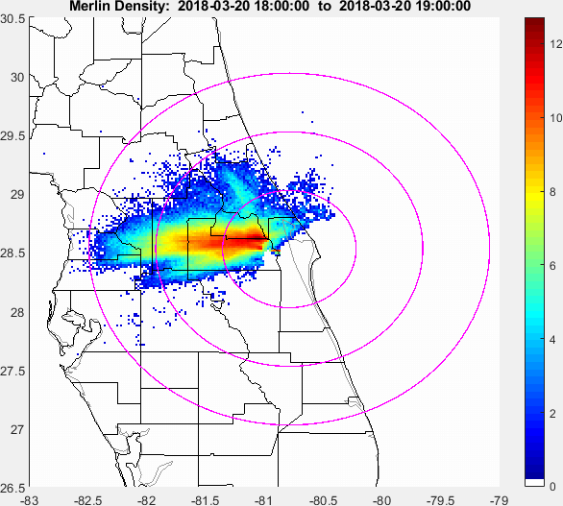
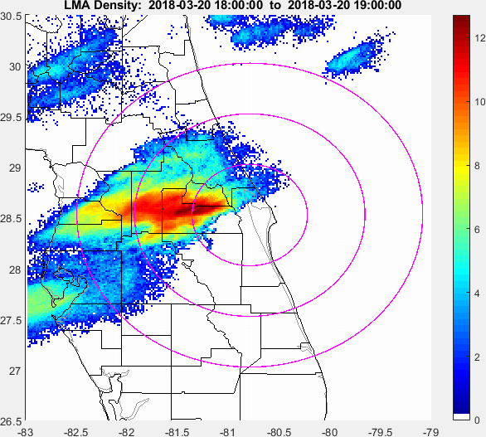
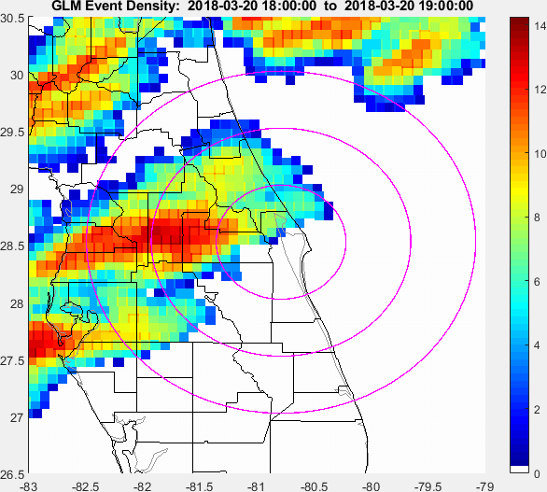
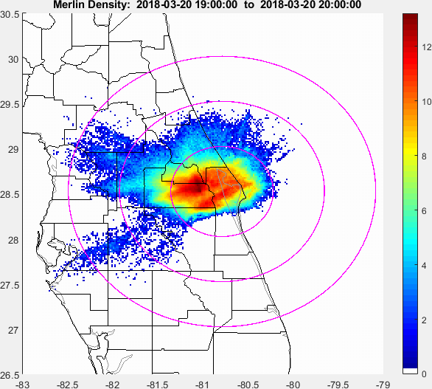
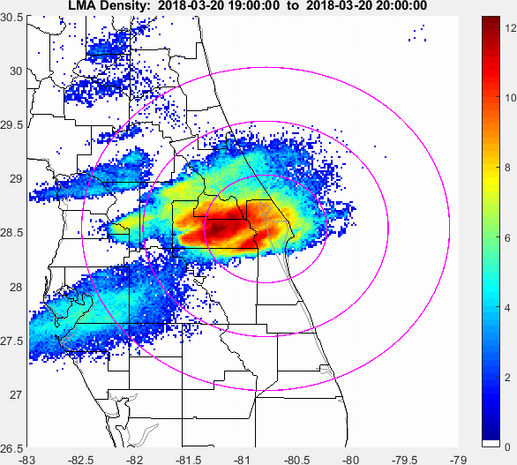
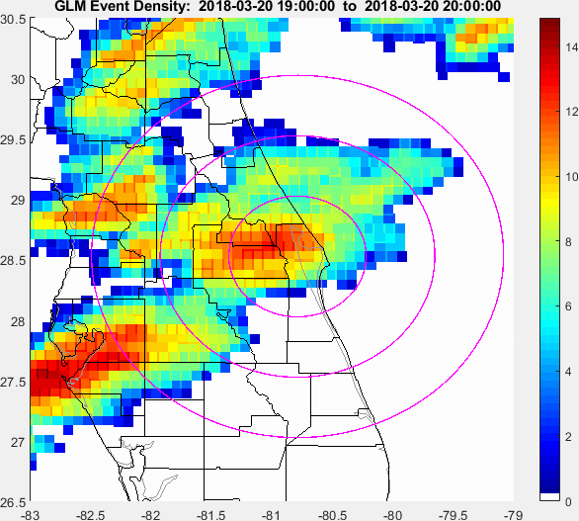
Lightning Mapping Coverage for GLM, MERLIN, and LMA
MERLIN KSC LMA GOES-16 GLM
March 20, 2018 18-19 UTC
Plan view of lightning “source densities” for three systems looking at the same storm in central Florida between 18:00 and19:00 on March 20th, 2018. Color scale is log2 of the source counts.
March 20, 2018 19-20 UTC
Notes:
MERLIN is a VHF interferometer network (Vaisala) operated by the Air Force, for KSC operations
The KSC LMA sensors are deployed to provide good coverage within ~ 100 km of KSC.
This is a research system, and is NOT maintained for operational use.
GLM clearly provides the most-complete situational awareness, with uniform coverage “everywhere”

Slide 5
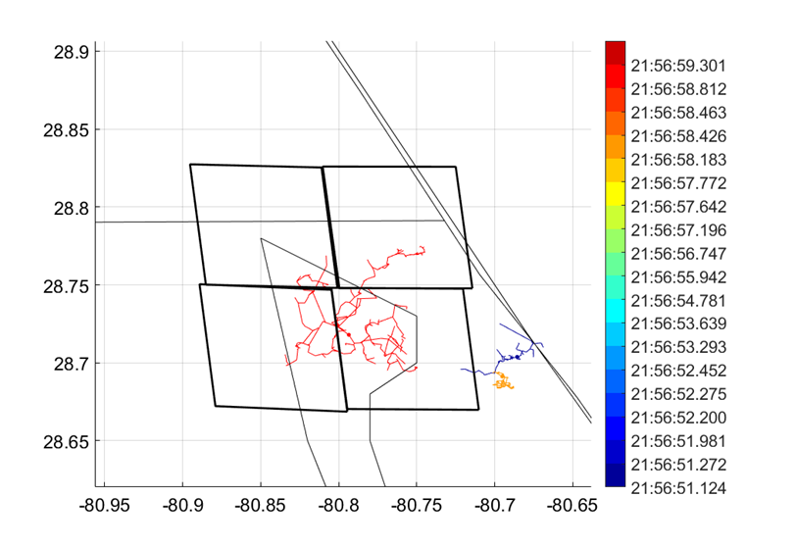
Technical Approach
Conceptual Bases:
LMA can be relied-upon to
determine the start and minimal duration of a flash
define the set of possible 3-dimensional paths for higher-current processes
High-current processes can occur well after channel development depicted by LMA (so time coincidence requirements are very loose)
Plan view of three LMA flashes at Kennedy Space Center during 21:56:50 to 21:57:00 on March 20th, 2018, colored by start-of-flash time. The black squares outline the GLM pixels associated with the large (red) flash. The other two (smaller) flashes were not reported by GLM

Slide 6
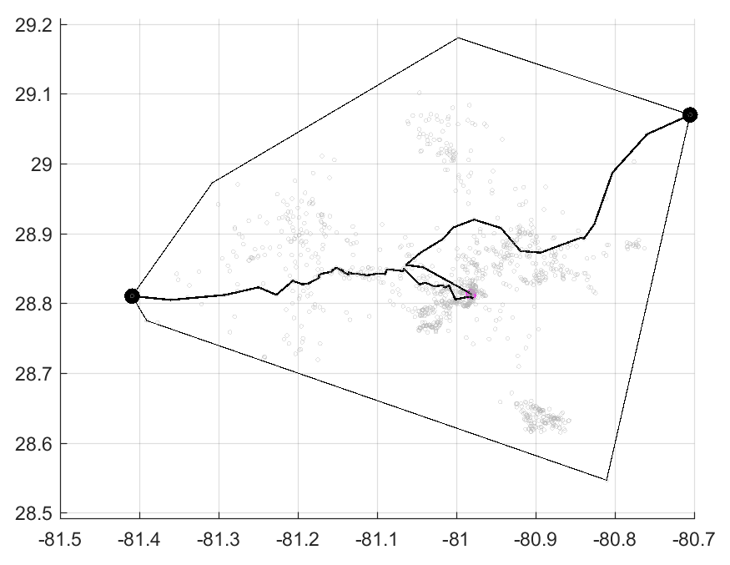
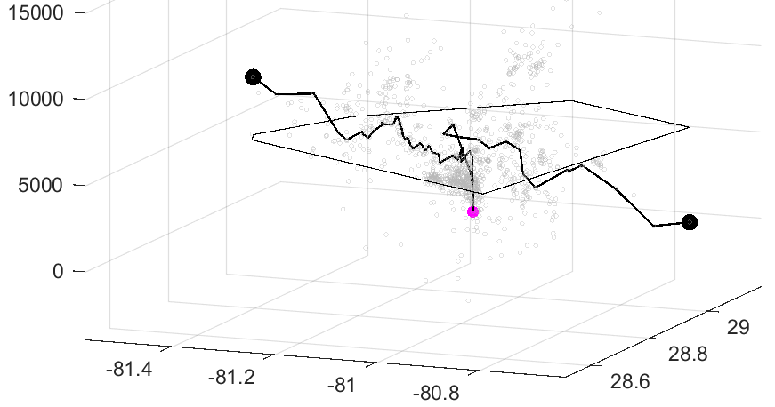
Technical Approach (cont.)
Characterize LMA flashes in terms of:
Duration
Area (convex hull)
Horizontal Extent (Major Axis)
Main Channel Length
Horizontal Extent
Major Axis
Main Channel Length
2D View
Convex Hull
3D View
Flash Origin

Slide 7
Technical Approach (cont.)
Evaluate GLM Flash DE as a function of LMA flash parameters
Evaluate diurnal variation of DE vs. flash “size”
Analysis Period:
March 20, 2018 through February 27, 2019 (one full year)
~250,000 LMA flashes on 22 storm days

Slide 8
March 20, 2018 “canonical anvil lightning case”
Notes:
Forward anvil clouds (this case) and trailing stratiform regions associated with distant thunderstorms pose a launch risk. However, local lightning mapping systems may not be able to capture the complete situation. GLM has the potential to provide the missing lightning-mapping information regarding anvil and stratiform flashes

Slide 9
Late-storm Anvil Flashes on March 20, 2018
Plan view of several LMA flashes at Kennedy Space Center between 18:03:30 and 18:04:00 on March 20th, 2018, colored by start-of-flash time. The black squares outline the GLM pixels associated with the displayed flashes.
Plan view of several LMA flashes at Kennedy Space Center between 18:11:30 to 18:12:00 on March 20th, 2018, colored by start-of-flash time. The black squares outline the GLM pixels associated with the displayed flashes.
Notes:
Each flash is a different color
Note imperfect detection by GLM of some smaller flashes
GLM shows good mapping of horizontally extensive flashes, but it does not always map the distal ends of long flashes

Slide 10
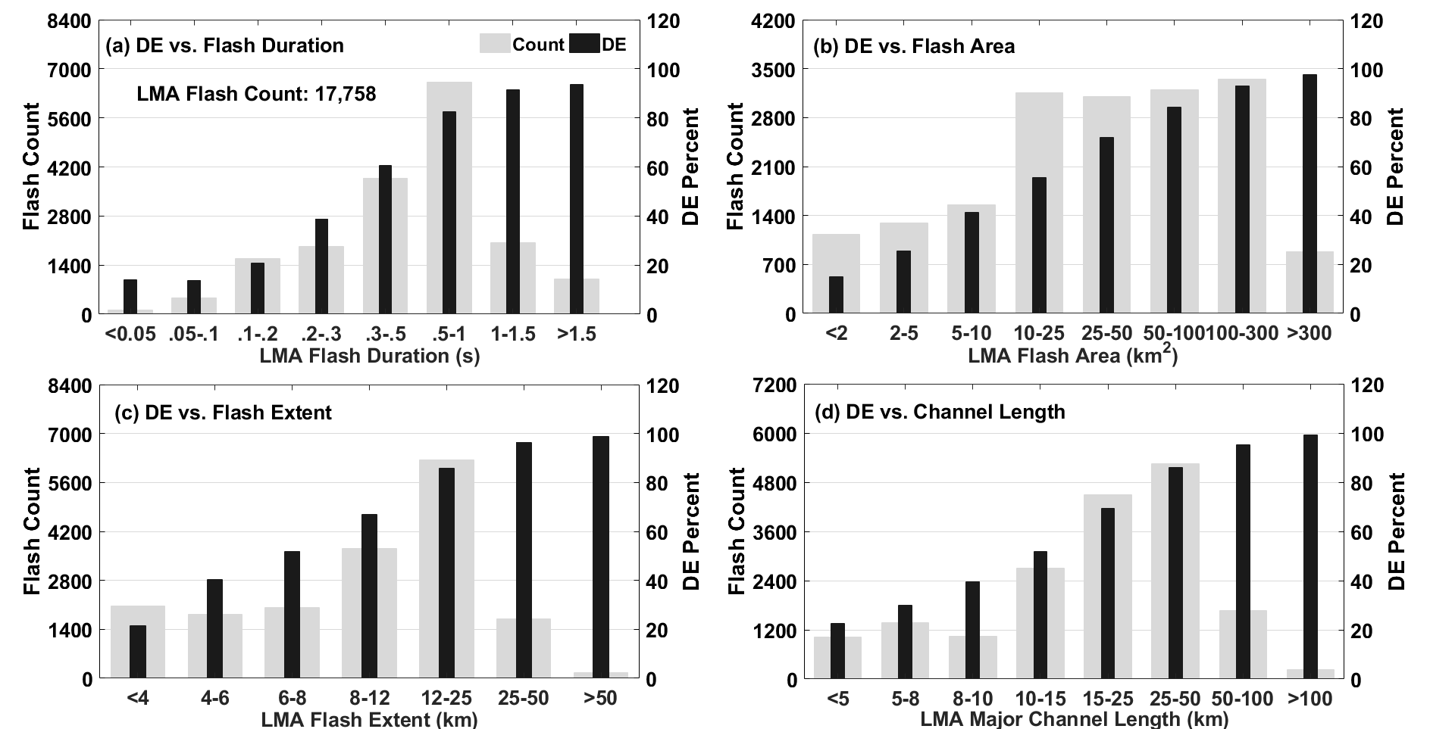
GLM Detection Efficiencies vs. Flash Parameters
18:00 – 19:59 on March 20th, 2018
GLM flash detection efficiency (DE, black bars) during 18:00 – 19:59 on March 20th, 2018 with respect to flash duration (top left), flash area (top right), flash extent (bottom left) and channel length (bottom right). The number of flashes are shown as wide grey bars.
Notes:
Four flash-size parameters
Ranges fo parameters values
Shows counts and percentage detected by GLM

Slide 11
Overall Analysis Summary
22 storm days (25 storm cases) from March 20, 2018 through February 27, 2019
Overall Flash DE: 73.8%
IC Flashes: 71.8%
CG Flashes: 86.5%
Short Flashes (<8 km): 40.4%
Long Flashes (>50 km): 96.3%
Night DE: 10-20% better
Average Detection Lag from start-of-flash
~100 ms overall
~38 ms at night
 |  | GLM DE Relative to LMA
Date | LMA Flash Count | Overall | IC | CG | 5-8 km | 15-25 km | 50-100 km
03/20/18 | 51,849 | 71.7 | 69.5 | 85.9 | 39.7 | 75 | 95.3
04/07/18 | 6,040 | 67 | 65.3 | 75.7 | 34.5 | 59.5 | 93.9
04/10/18 | 36,732 | 60.8 | 59.5 | 67.3 | 21.9 | 59.7 | 90.9
04/11/18 | 2,413 | 86.4 | 85.1 | 89.2 | 56 | 77.6 | 96.6
04/23/18 | 11,564 | 63.6 | 59.7 | 84 | 15.8 | 69 | 95.1
05/15/18 | 31,030 | 74.7 | 73.4 | 82.5 | 45.3 | 80.1 | 95.4
05/31/18 | 13,920 | 59.8 | 56.4 | 88 | 18.2 | 64.2 | 94.5
06/04/18 | 522 | 74.9 | 73.2 | 93.2 | 35.7 | 87.8 | 96.2
06/06/18 | 21,402 | 67.7 | 65.4 | 80 | 24.5 | 72.5 | 95.2
07/18/18 | 10,495 | 65.9 | 60.8 | 82.9 | 27.8 | 69.3 | 95
08/10/18 | 1,652 | 50.8 | 44.2 | 83.6 | 20.8 | 56.1 | 90.3
08/23/18 | 16,822 | 67 | 63.1 | 85 | 32.6 | 75.6 | 92.8
09/19/18 | 11,547 | 71.2 | 69.5 | 84.7 | 38.1 | 84.4 | 96.2
11/12/18 | 507 | 94.7 | 94.2 | 99.2 | 66.7 | 96.3 | 100
11/23/18 | 3,210 | 74.2 | 73.6 | 100 | 39.7 | 91.9 | 100
12/03/18 | 6,523 | 77 | 76 | 88.9 | 40.8 | 91.2 | 99.4
12/15/18 | 647 | 88.4 | 86.7 | 95.4 | 42.9 | 91.5 | 100
12/20/18 | 5,337 | 64.4 | 63.7 | 72.4 | 32.1 | 73.1 | 98.5
01/24/19 | 1,287 | 91.8 | 91.6 | 94.5 | 62.2 | 91.2 | 100
02/12/19 | 4,919 | 84.3 | 83.8 | 91.2 | 52 | 93 | 99.8
02/13/19 | 2,261 | 98.3 | 98.3 | 98.9 | 92.3 | 98.8 | 100
02/27/19 | 527 | 85.2 | 83.3 | 100 | 72.4 | 80.8 | 100
Total | 241,206 | 73.8 | 71.8 | 86.5 | 40.4 | 77.8 | 96.3
Summary of GLM detection efficiencies relative to LMA in the 22 storm days at KSC in 2018 and 2019. Nighttime observations are highlighted in gray.

Slide 12
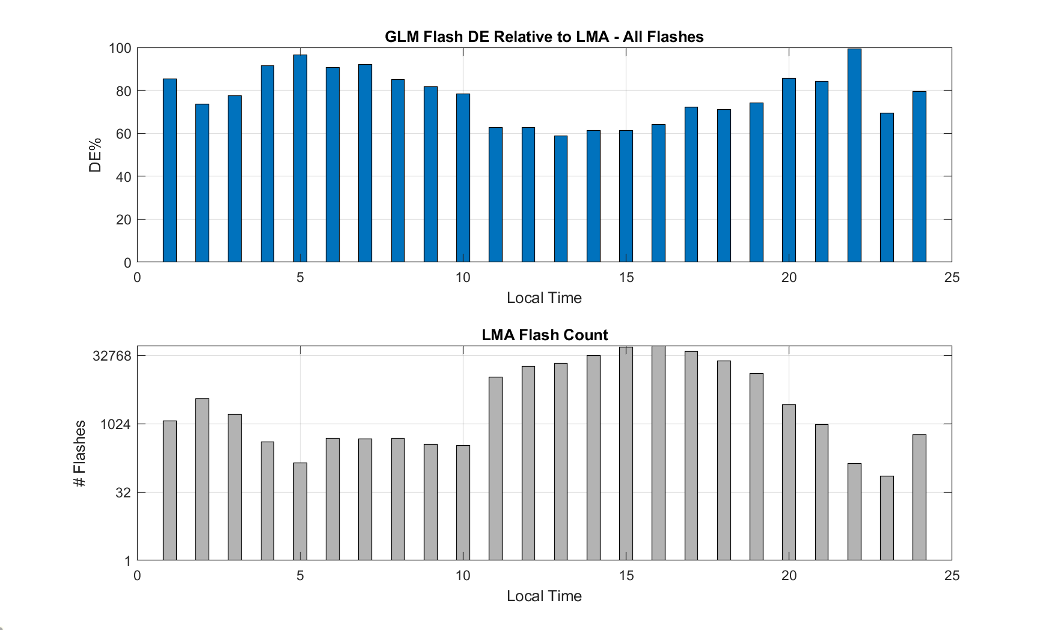
Full-year Diurnal DE for GLM
Long Flashes
Modest diurnal variation
All Flashes
~25% diurnal variation for GLM
Many-more daytime flashes
Note log scale
Notes:
Note the flash counts are small (~100) for hours 5, 22, and 23

Slide 13
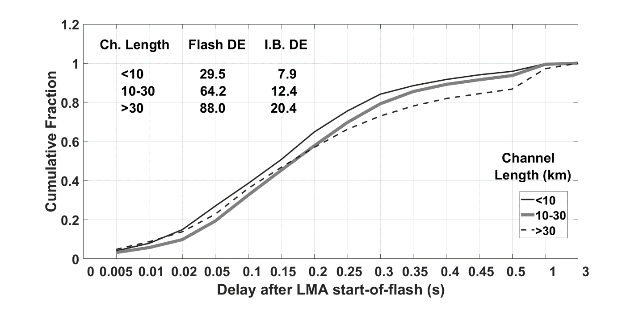
GLM DE vs. Latency after Initial Breakdown
Cumulative fraction of the GLM flash latency after the LMA-reported start-of-flashes for various ranges of channel lengths. The table indicates the flash DE and DE for initial breakdown (I.B. DE) for the same ranges of channel lengths.
Notes:
Somewhat complicated figure because the datasets for each range of channel lengths is only the GLM-reported flashes, and is used to normalize the cumulative distributions. The table is required for a full understanding.
The fraction of reported flashes increases with channel length (29.5 to 88%), but the time-lags for the reported flashes does not seem to depend on flash size (channel length).

Slide 14
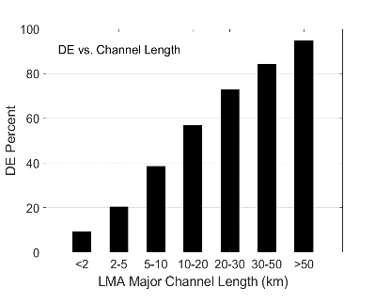
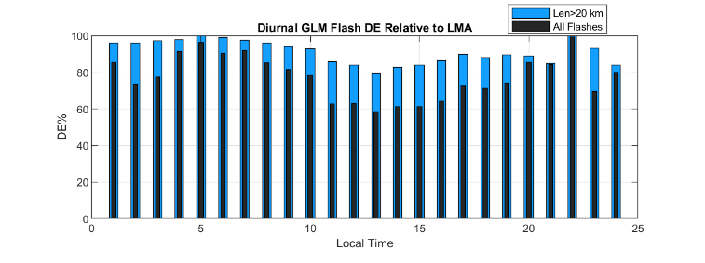
Summary – GLM Performance
Mean daily flash DE ~74% (higher at night; better for CG)
Larger flash and/or longer flash => higher DE
Well-suited to support LLCC interpretation for anvil and stratiform cases (~95% DE for long flashes)
Diurnal DE variations are smaller for larger flashes
Late detection of flashes (frequently misses Initial Breaksown)
What is at the root of these GLM behaviors?
Let’s look at LIS…
12

Slide 15
Part 2
Study/explain the GLM findings related to flash size and duration (discussed above) using the Lightning Imaging Sensor on TRMM

Slide 16
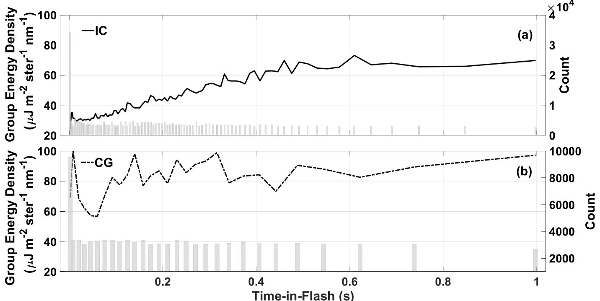
Flash Time Evolution of Group Energy Density
TRMM LIS June-July-August 2013 over CONUS
LIS flash time evolution of mean group area in intra-cloud flashes (solid, top) and cloud-to-ground (dash-dotted, bottom) within the NLDN coverage during 2013 JJA. The sampling intervals are longer as time-in-flash increases, due to the smaller number of longer-duration flashes. The grey bars are the count (shown on the right) in the bins. Note that the data were cut off at one second in the figures due to the small number of flashes longer than one second.
Notes:
The flash start-times are the times of the first LIS report in each flash. It is likely that LIS misses initial breakdown in some of the flashes, so the true “Time-in-Flash” is likely somewhat longer, and findings will be somewhat “smeared” in time. Given the nature of the time variations for IC flashes, this does not impact the interpretation of the findings.

Slide 17
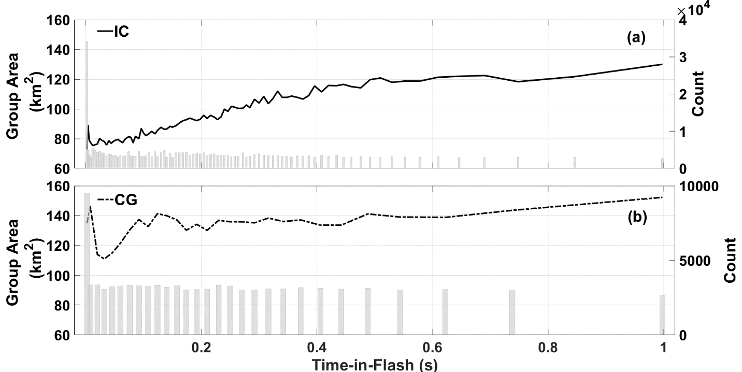
Flash Time Evolution of Group Area
TRMM LIS June-July-August 2013 over CONUS
Same as for previous slide, but for group area

Slide 18
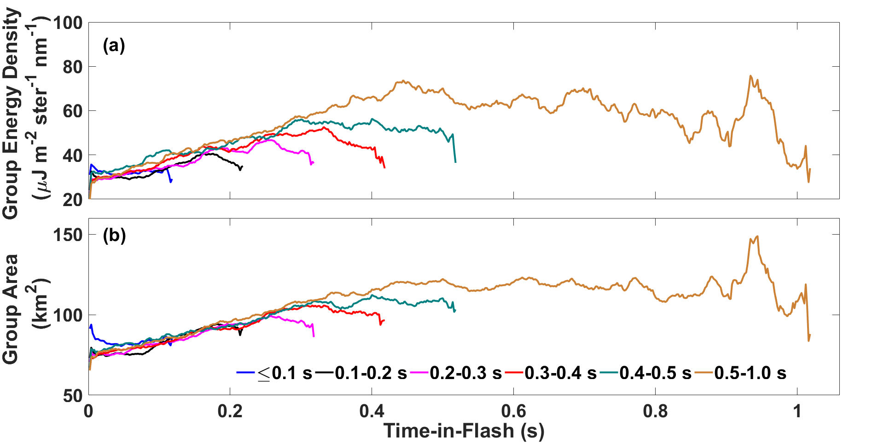
Flash Time Evolution for Different Flash Durations
TRMM LIS June-July-August 2013 over CONUS
Time evolution of mean group energy density (a) and group area (b) for different durations of LIS IC flashes
Both group energy and area strongly depend on time-in-flash
Note late-in-flash fall-off of energy density and area

Slide 19
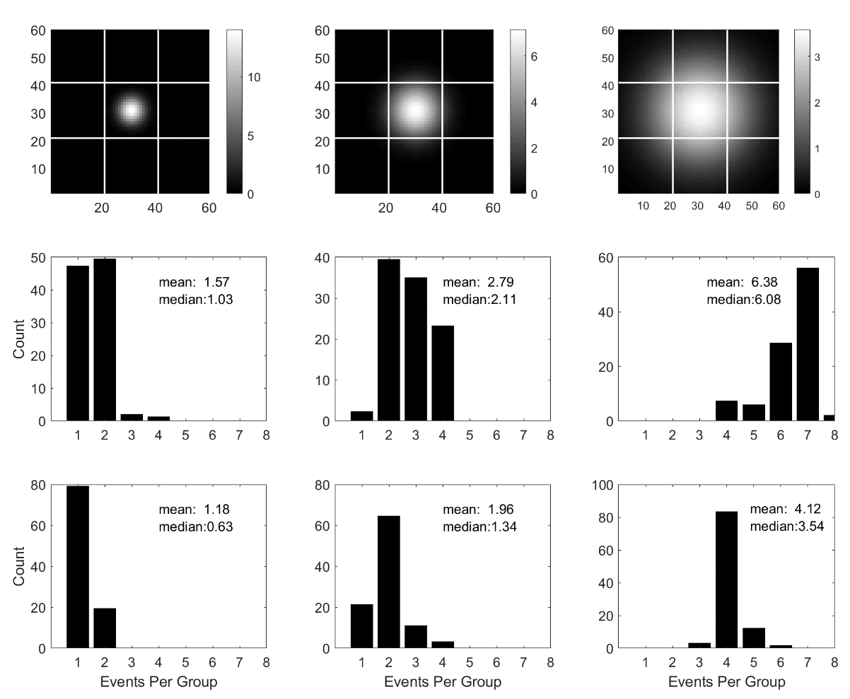
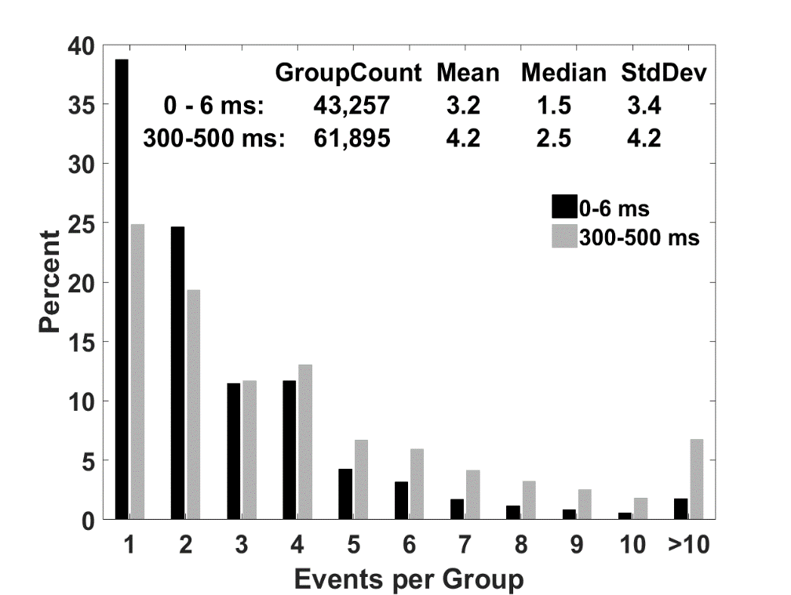
Modeling to Assess Cloud-top Source Size
The only way to get a large percentage of single-event groups is to have optical sources smaller than a LIS pixel
Observed Events per Group
Low Thresh.
High Thresh.
See Zhang and Cummins (2020) JGR for details
Notes:
Results from the light source modeling using a 10x10 LIS pixel array. The top panels are the modeled three sizes of light sources in the central 9 LIS pixels. The middle (bottom) panels are the LIS population histogram of the number of events exceeded a low (high) threshold of 158 (316) J.
The histograms represent that fraction of the time that specific numbers of events-per-group are reported, assuming random (“uniform”) spatial location of the optical source.

Slide 20
Comparing LIS & GLM – Group Cloud-top Energy
$$LIS Group Cloudtop Energy≅\frac{πΔλA\hat{ξ}}{n} = \frac{2.86A\hat{ξ}}{n}$$
$$GLM Group Cloudtop Energy≅\frac{4A\hat{q}}{n\overline{Δw}D2} = \frac{6.61A\hat{q}}{n}$$
n: the number of events (pixels) in the group A: the group area in km²
$\hat{ξ}$: LIS group radiance in µJ m⁻² ster⁻¹ nm⁻¹ $\hat{q}$: GLM intercepted energy in femtojoules
$Δλ$: spectral bandwidth $\overline{Δw}:mean pixel solid angle$ $D:$ sensor entrance pupil diameter
Notes:
Convert LIS and GLM energy-related values to a common framework: Cloud-top optical energy

Slide 21
Minimum Single-pixel Cloud-top Energy
$$E=\frac{2.86\hat{ξ}A}{n}=2.86\left(3.6\right)\left(4×4\right)=164 J$$
LIS
v
2.9-3.6 µJ/m²/ster/nm
$$E=\frac{6.61A\hat{q}}{n}=6.61\left(8×8\right)\left(1.0\right)=423 J$$
GLM
Relative Energy Threshold (GLM/LIS): 423/164 = 2.58
($∴TRMM LIS reported lower energy SMALL cloudtop sources$)
See Zhang and Cummins (2020) JGR for details
Notes:
“Small” means optical sources that fit within a LIS pixel

Slide 22
Min. Single-pixel Cloud-top Energy Density
$${\overline{E}}_{dens}≅\frac{2.86\hat{ξ}}{n}=2.86\left(3.6\right)=10.25 J/{km}^{2}$$
LIS
v
2.9-3.6 µJ/m²/ster/nm
$${\overline{E}}_{dens}≅\frac{6.61\hat{q}}{n}=6.61\left(1.0\right)=6.6 J/{km}^{2}$$
GLM
Relative Energy Density Threshold (GLM/LIS): 6.6/10.25 = 0.64
($∴GLM reports lower energy density LARGE cloudtop sources$)
See Zhang and Cummins (2020) JGR for details
Notes:
“Large” means optical sources large enough to fill a GLM pixel

Slide 23
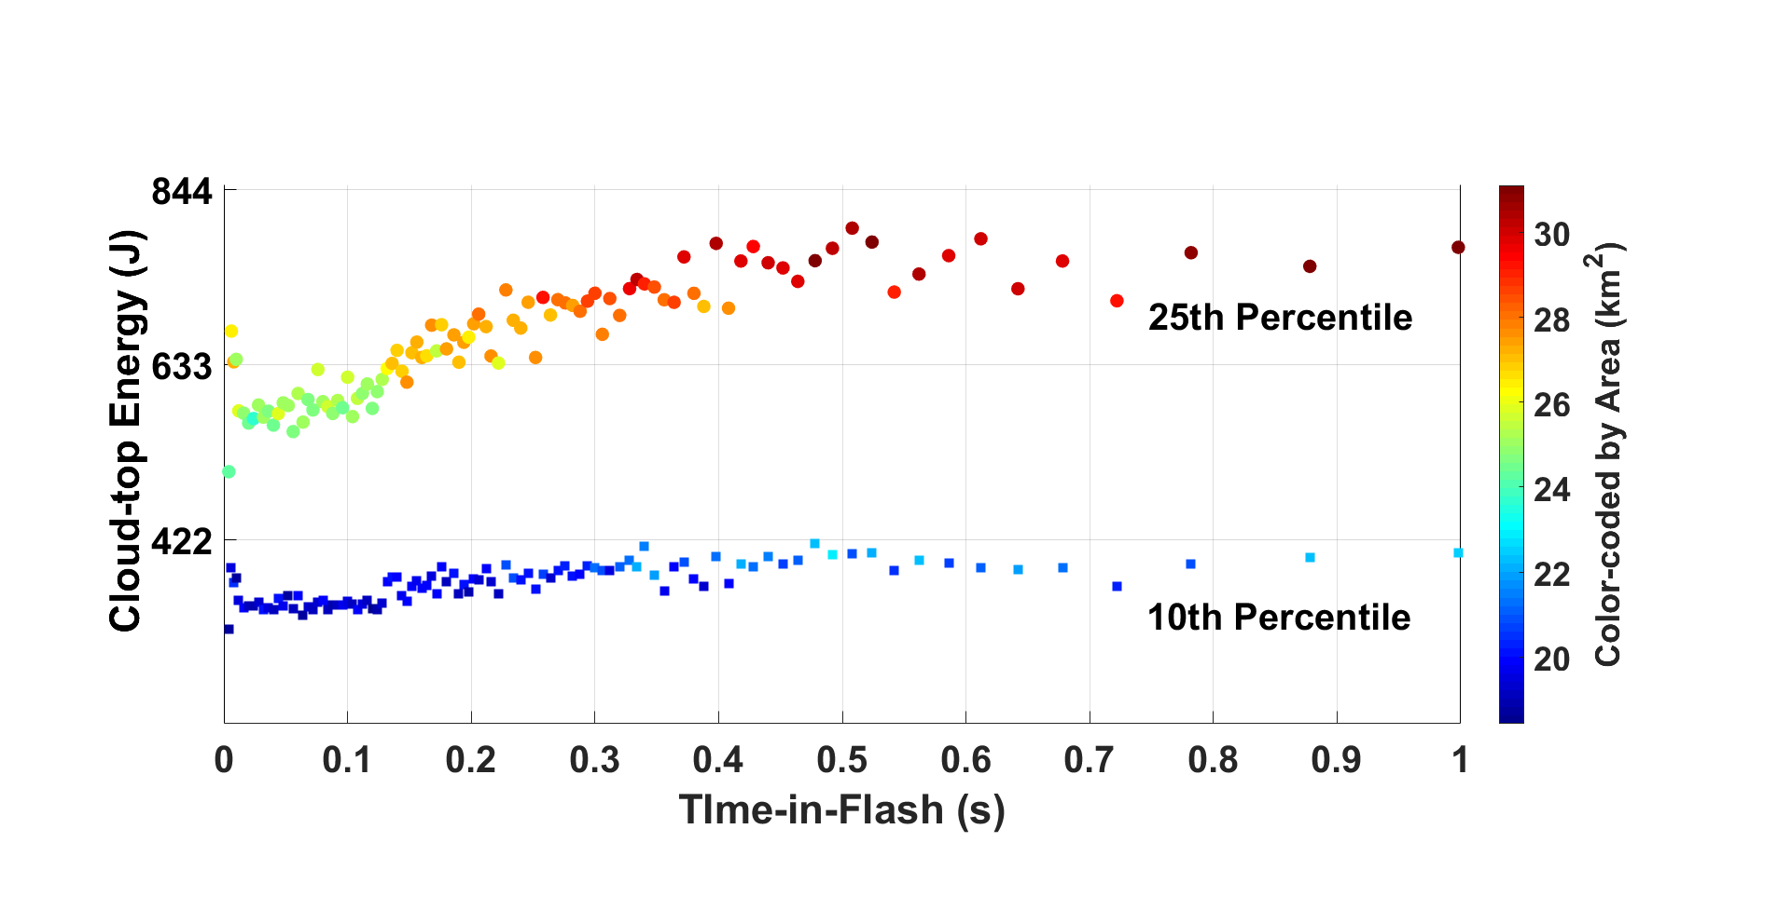
Flash Time Evolution of Group Cloud-top Energy
Time evolution of group cloud-top energy (Joules) in the 10th and 25th percentiles, color-coded by the group area for LIS IC flashes. The black line shows the best-case GLM nighttime threshold, which is 423 J.
GLM best-case cloud-top energy threshold
Notes:
These findings show:
The reason for the delay of flash detection by GLM
That there are many small optical sources produced by lightning that will not be reported by GLM
It will be important to provide the lowest possible detection threshold for optical sources from space

Slide 24
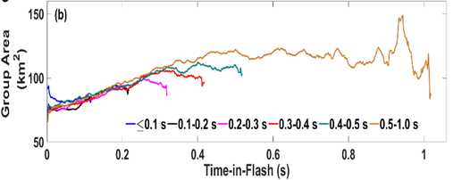
Overall Summary
Mean daily flash DE ~74% (higher at night; better for CG!!)
Larger flash and/or longer flash => higher DE (20% to ~100%)
This is because:
MANY optical sources have energies below GLM threshold, and are much smaller than a GLM pixel, particularly early in IC flashes
GLM sometimes misses extensive channels in long flashes
Possibly due to smaller and dimmer optical emissions late in the flash
Does NOT fail to detect these flashes!
LIS and GLM Cloud-top Thresholds are COMPLICATED
LIS is better at low-energy SMALL optical sources
GLM is better at low energy density LARGE optical sources

Slide 25
Backup Slides

Slide 26
Technical Approach
Employ the KSC LMA as the Reference LLS
3D mapping of channels and branches
Good performance beyond 100 km from KSC
~10-20m 2D location accuracy
~50-100m vertical accuracy
Detection “almost all” flashes

Slide 27
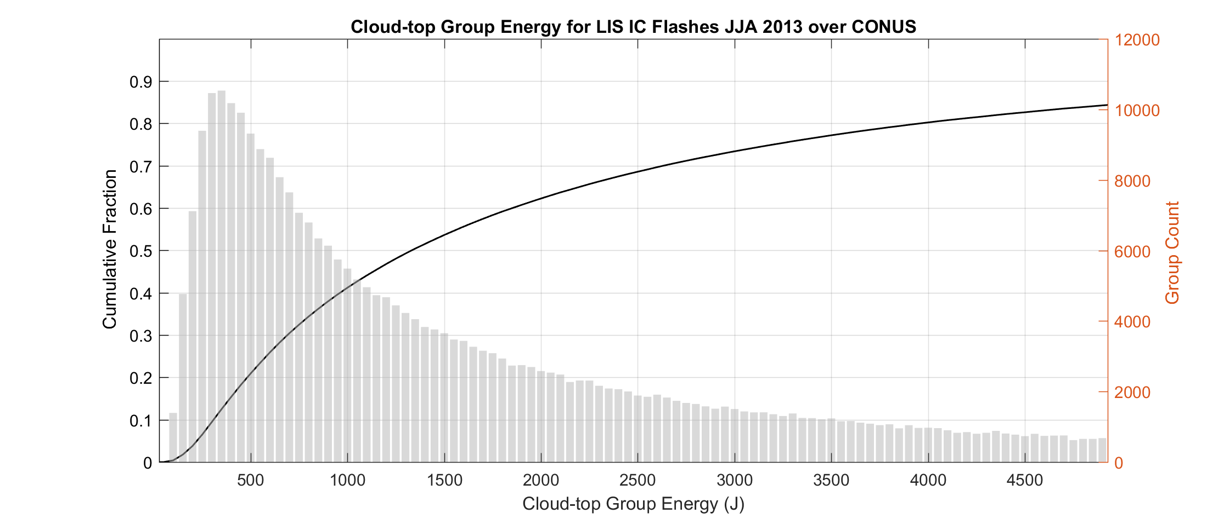
Distribution of Cloud-top Group Energies
For the population of small sources, with the assumption that all the light is within a single pixel
Best Threshold
Best COLMA Threshold

Slide 28
Cloud-top detection animation: small source
Small source with steadily decreasing energy (brightness, for a fixed-size source)
E = 500 J (LIS & GLM detection)
LIS pixel
GLM pixel

Slide 29
Cloud-top detection animation: small source
Small source with steadily decreasing energy (brightness, for a fixed-size source)
E = 250 J (Only LIS detection)
LIS pixel
GLM pixel

Slide 30
Cloud-top detection animation: small source
Small source with steadily decreasing energy (brightness, for a fixed-size source)
E = 125 J (no detection)
LIS pixel
GLM pixel

Slide 31
Cloud-top detection animation: large source
Large source with FIXED energy density, thus steadily decreasing energy as the size decreases
E_{dens} = 11 J/km² (LIS & GLM detection)
(per-pixel energies are 4x4x11 = 176J for LIS and 8x8x11 = 704J for GLM, and both are above threshold
LIS pixel
GLM pixel

Slide 32
Cloud-top detection animation: large source
Large source with FIXED energy density, thus steadily decreasing energy as the size decreases
E_{dens} = 11 J/km² (3 LIS & GLM detection)
(one LIS pixel is partially illuminated so the energy is below that pixel’s threshold)
LIS pixel
GLM pixel

Slide 33
Cloud-top detection animation: large source
Large source with FIXED energy density, thus steadily decreasing energy as the size decreases
E_{dens} = 10 J/km² (Only GLM detection)
(energy density is above the GLM threshold of 6.6 J/km², but below the LIS threshold of 10.25 J/km²)
LIS pixel
GLM pixel

Slide 34
Cloud-top detection animation: large source
Large source with FIXED energy density, thus steadily decreasing energy as the size decreases
E_{dens} = 10 J/km² (Only GLM detection)
(total energy is above the GLM threshold of 423J due to the large size of the uniform-density source
(~55 km² * 10 J/km² = 550J)
LIS pixel
GLM pixel

Slide 35
Cloud-top detection animation: large source
Large source with FIXED energy density, thus steadily decreasing energy as the size decreases
E_{dens} = 10 J/km² (No detection)
(total energy is below the GLM threshold of 423J due to the smaller size of the uniform-density source
LIS pixel
GLM pixel

