Slide 1
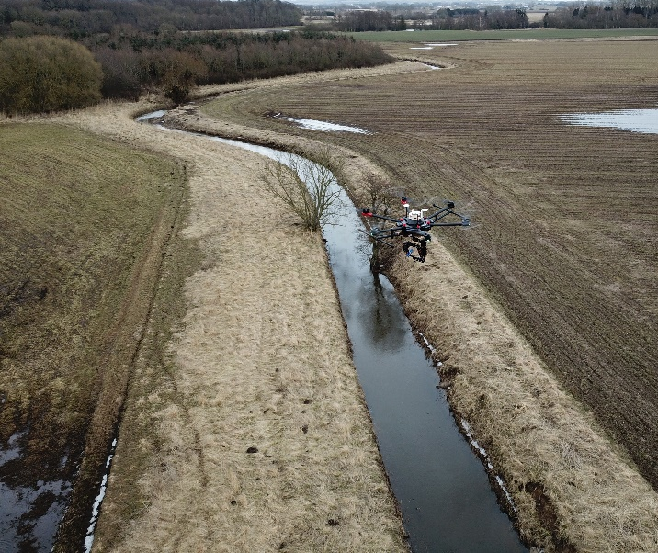
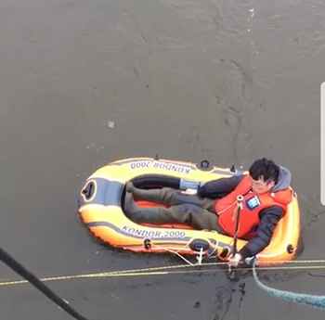
An airborne contactless method to jointly estimate discharge and Manning’s roughness in rivers and streams
Filippo Bandiniª, Beat Lüthi^{b}, Salvador Peña-Haro^{b}, Jun Liuª, Peter Bauer-Gottweinª
ªDepartment of Environmental Engineering, Technical University of Denmark, 2800 Kgs. Lyngby, Denmark
^{b}Photrack AG: Flow Measurements, Ankerstrasse 16a, 8004 Zürich, Switzerland
Research outcome of Riverscapes project, funded by Innovation Fund Denmark
Contactless discharge observations
In-situ discharge observations
VS

Slide 2
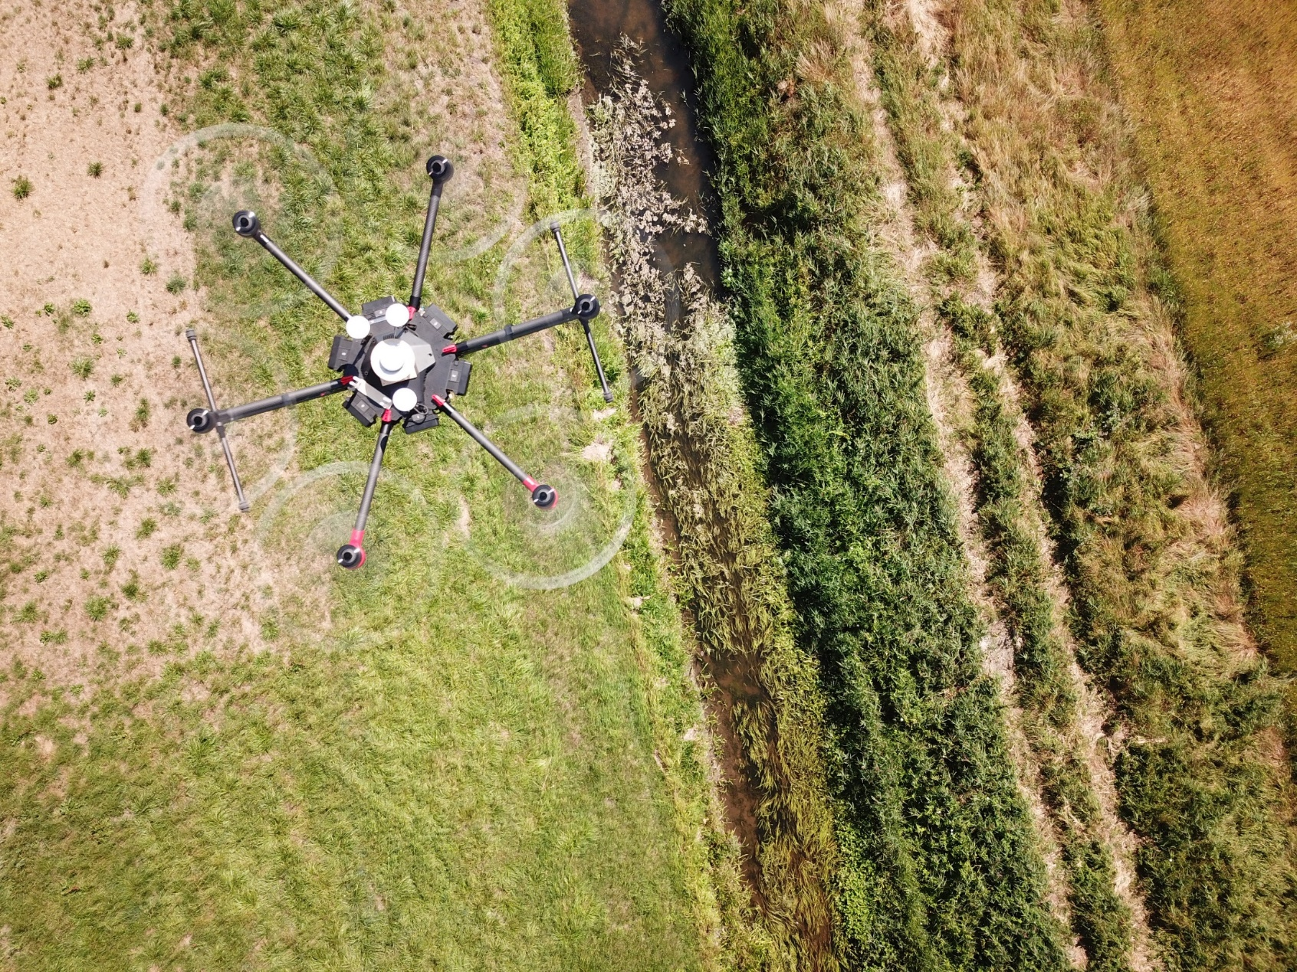
Research aim
Principal idea:
Develop an efficient, reliable, and contactless method to estimate discharge of stream and rivers, by exploiting measurements of:
Water depth
Water surface velocity
Water surface slope
Water surface elevation
retrieved by Unmanned Aerial Vehicles (UAVs)

Slide 3
The UAV-borne payload
The UAV-borne payload consists of:
A GoPro camera
A radar sensor with full waveform¹
A 3-axis gimbal (Gremsy gimbal) to stabilize and nadir-orient sensors
A tethered-sonar²
An accurate differential Global Navigation Satellite System (GNSS)
An accurate Inertial Measurement Unit (IMU)
A single-board computer (BeagleBone Black) to syncronize and save observations of all sensors
¹Bandini, F. et al. (2020). Unmanned Aerial System (UAS) observations of water surface elevation in a small stream: Comparison of radar altimetry, LIDAR and photogrammetry techniques. Remote Sensing of Environment. https://doi.org/10.1016/j.rse.2019.111487
² Bandini, F., Olesen, D., Jakobsen, J., Kittel, C. M. M., Wang, S., Garcia, M., & Bauer-Gottwein, P. (2018). Technical note: Bathymetry observations of inland water bodies using a tethered single-beam sonar controlled by an unmanned aerial vehicle. Hydrology and Earth System Sciences, 22(8), 4165–4181. https://doi.org/10.5194/hess-22-4165-2018

Slide 4
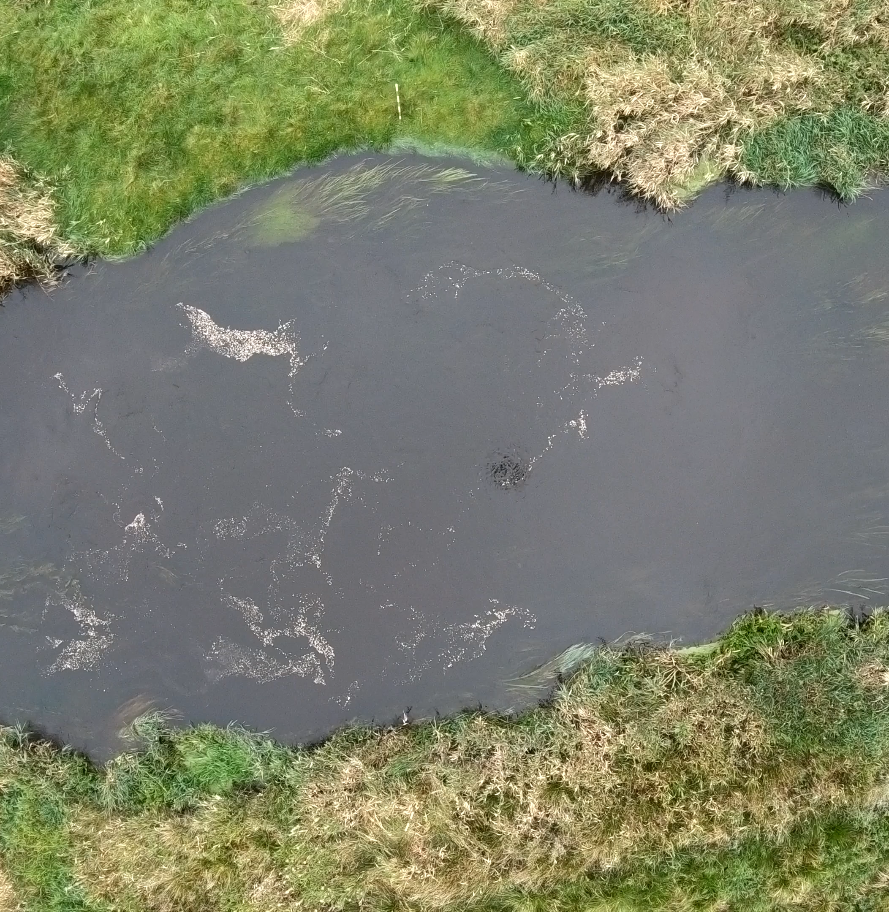
Drone-borne discharge estimation
UAV-borne high-resolution video of the water surface
Video stabilization (high and low frequency vibrations)
Correction of lens distortion and ortho-rectification
of video frames
Image analysis using cross-correlation techniques
Water depth
Water surface 2D velocity field
1D velocity profile
across XS
From surface velocity to mean vertical velocity
Discharge

Slide 5
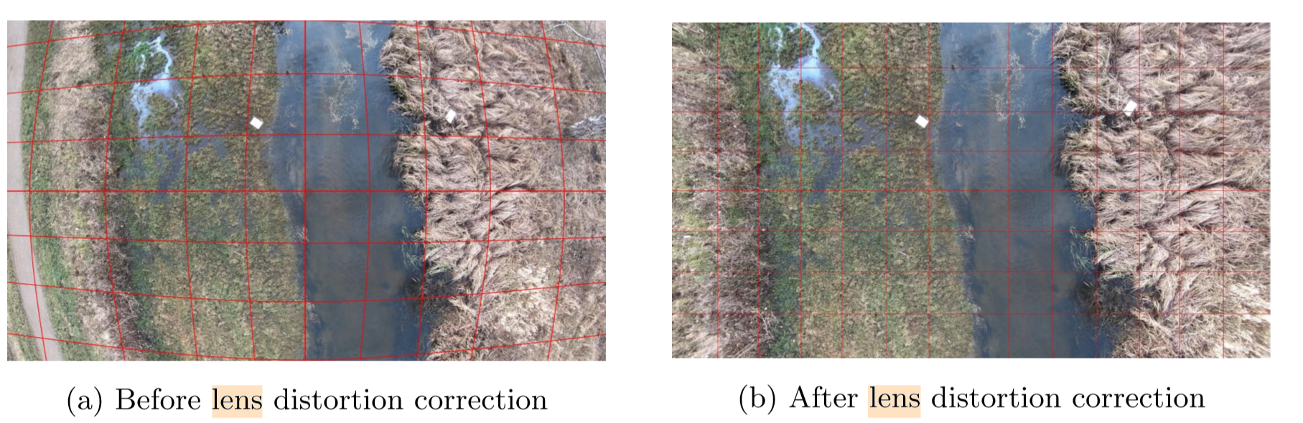
UAV-borne high-resolution video of the water surface
GoPro camera (e.g. Hero versions) can take high-resolution videos: 4K resolution, 30 Hz frame rate
The gimbal ensures that the camera is nadir looking and removes low frequency vibrations
The acquired video can be further stabilized with a Matlab script, developed by Photrack
GoPro shows deep lens distortion. Camera intrinsic parameters, which are retrieved with standard camera calibration methods, can be used to correct distortion. Thus a Matlab script was created to undistort the video frames

Slide 6
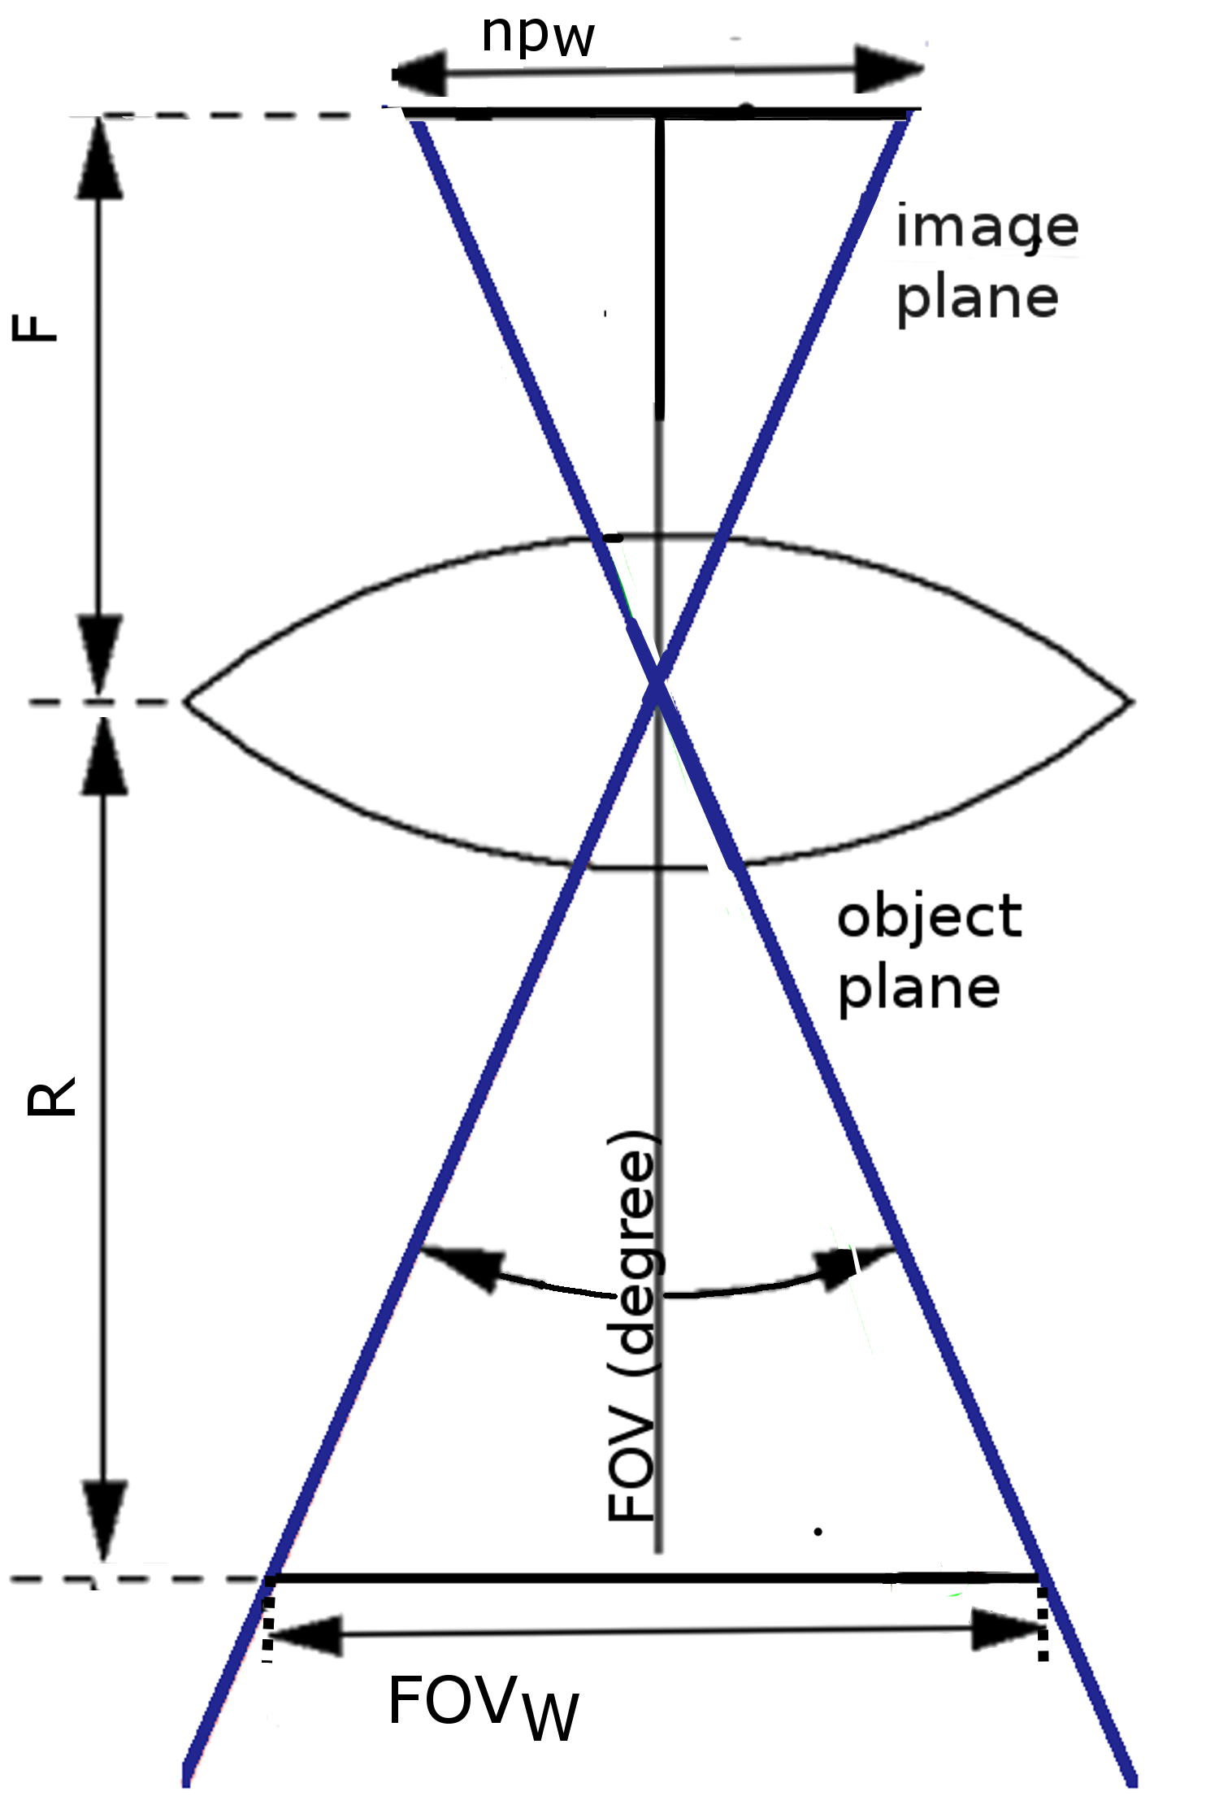
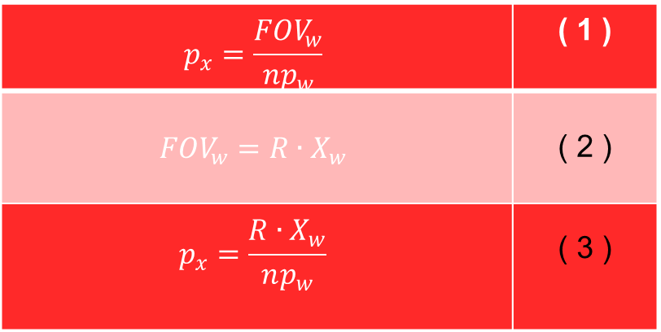
Conversion from pixel unit into metric unit
Pixel units need to be converted into metric units. Our innovative method does not require any Ground Control Point
Our method is based on a camera pinhole model, in which the range from the pinhole to the water surface is measured by the onboard radar sensor. The method relies of the 3 equations:
  Equation (1) shows that the horizontal width (p_{x}) of each pixel in metric units can be expressed as the full width of the FOV in meters (FOV_{w}) divided by the total amount of pixels over the width of the frame np_{w} (3840 for 4K resol.).
  Equation (2) shows that FOV_{w} depends on the range R and several camera settings and characteristics, most importantly the focal length and the sensor size, which were combined into one empirical variable X_{w} (which could be approximated as the ratio between horizontal width of the sensor and focal length).
  Combining the two equations shows that p_{x} is a function of the object distance, X_{w} and np_{w}, as shown in (3).
$$p_{x}=\frac{{FOV}_{w}}{{np}_{w}}$$ | ( 1 )
$${FOV}_{w}=R∙X_{w}$$ | ( 2 )
$$p_{x}=\frac{R∙X_{w}}{np_{w}}$$ | ( 3 )

Slide 7
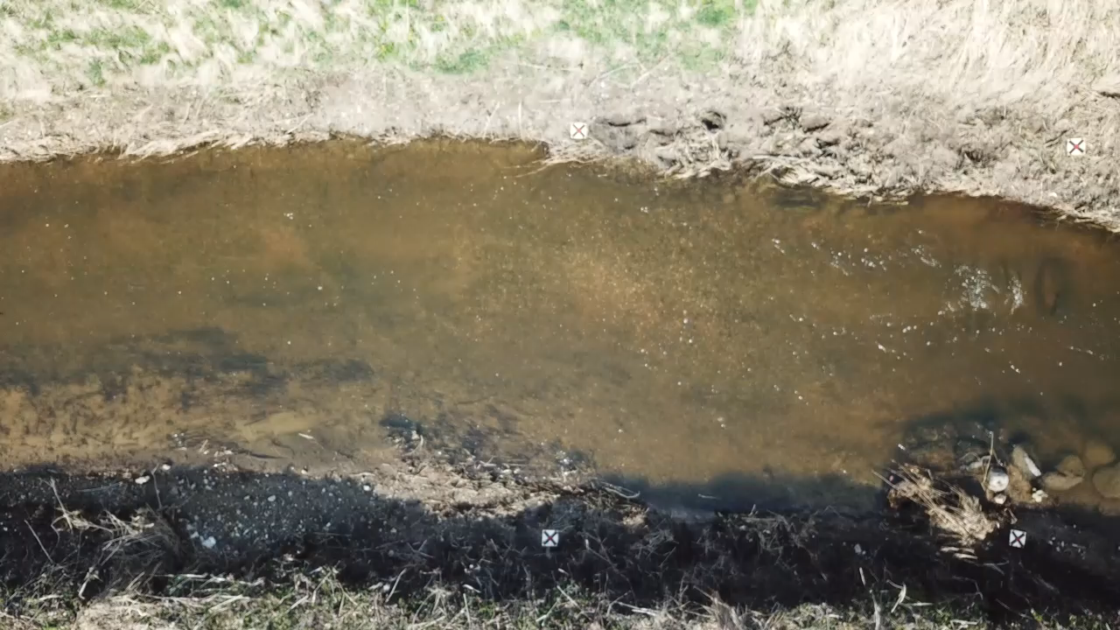
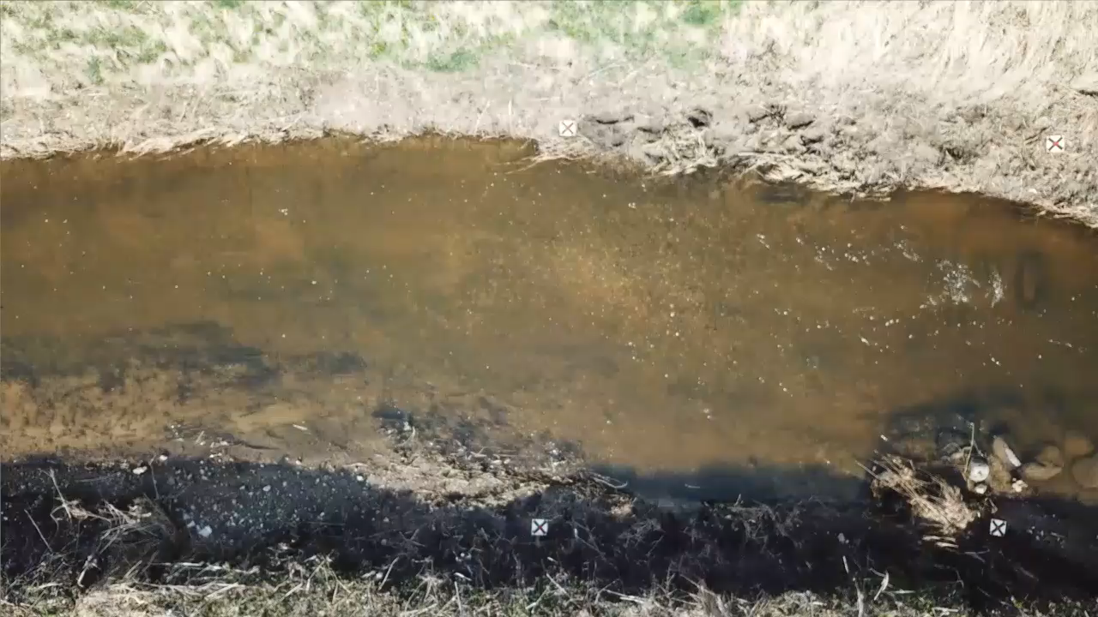
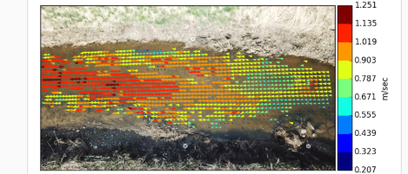
Image analysis cross correlation techniques
Different software can be used to estimate the velocity field with image analysis techniques such as Particle Image Velocimetry (PIV). For example, we suggest:
PIVlab, open-source MATLAB software. Good results when uniform seeding of the water surface.
SSIVsuite (Photrack), available also as Android App. Works efficiently with good artificial seeding conditions but can estimate the velocity also when no artificial seeding is added to the water surface. In this case it just relies on visible natural floating particles (e.g. foam, material transported by the flow), or visible surface waves and colour differences generated by water flow. http://www.photrack.ch/products.html
Raw video
Stabilized video
Surface velocity field
http://www.photrack.ch/dischargedrone.html
Åmose river, April 2018

Slide 8
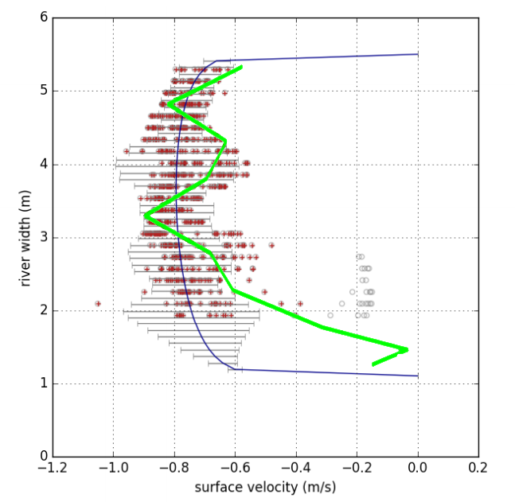
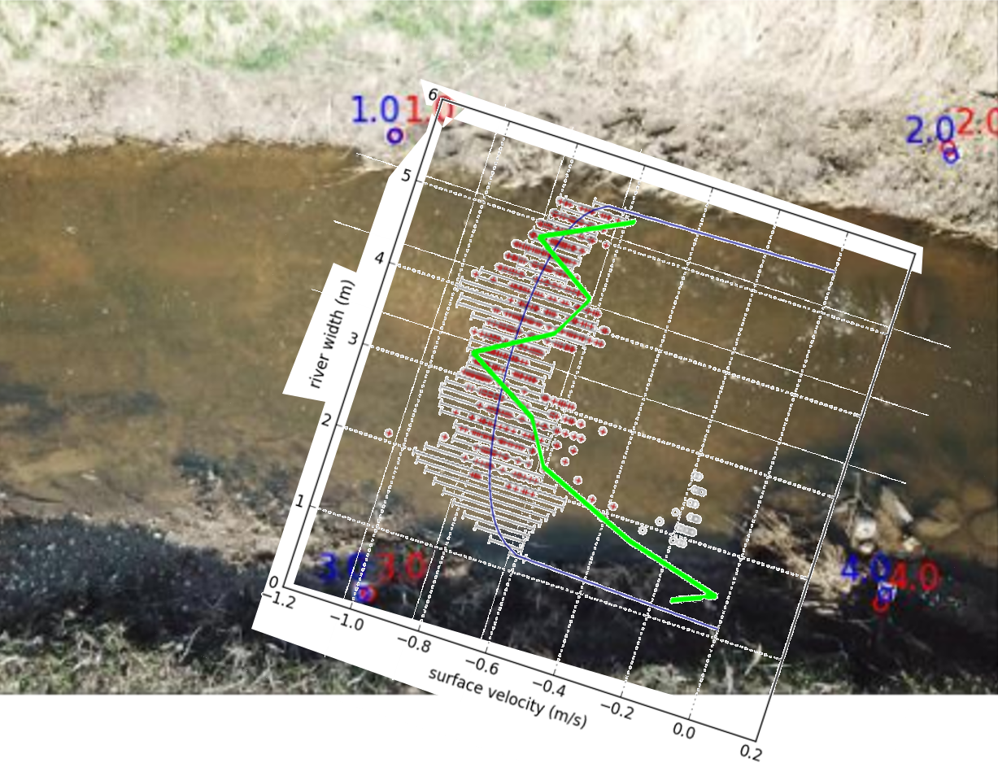
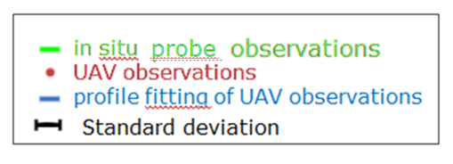
In-situ velocity probe vs UAV-estimates
An example of a UAS-borne surface velocity estimation:
  Good agreement between velocity probe in-situ measurements and UAV water velocity observations
Åmose river, April 2018
Cross section at coordinates 55.567183°, 11.671606° (Lat, Long WGS84)
SSIVsuite
Software
Ground Control Points are used only as validation of the pinhole camera model accuracy,
but are ultimately not needed

Slide 9
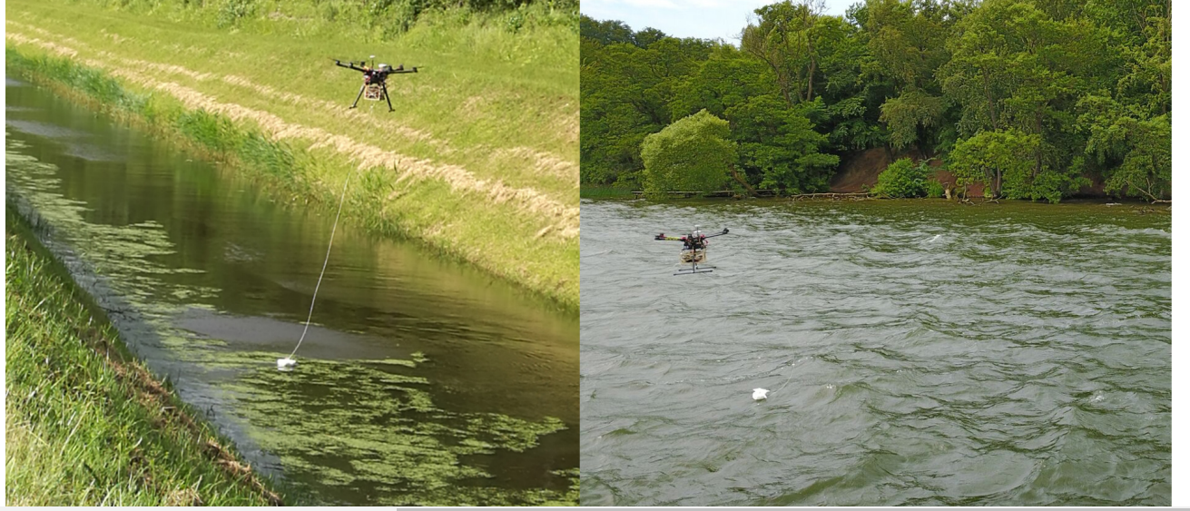
Water depth
A sonar (Deeper PRO+) https://deepersonar.com/uk/en_gb/products/deeper-smart-sonar-pro-plus
can be tethered to the drone to acquire water depth measurements.
Maximum depth: 80 m
Minimum depth: 0.3-0.5 m
Accuracy ∼ 2.1 % of the actual depth
Main limitation: requires wire connection between drone and sonar. Thus only semiautomatic flights can be conducted: flights require operator nearby the platform, Beyond Visual Line Of Sight (BVLOS) not possible, typically requires manual control of the drone
Reference:
Bandini, F. et al. (2018). Technical note: Bathymetry observations of inland water bodies using a tethered single-beam sonar controlled
  by an unmanned aerial vehicle. Hydrology and Earth System Sciences. https://doi.org/10.5194/hess-22-4165-2018
Bandini, F. et al.(2018). Unmanned aerial vehicle observations of water surface elevation and bathymetry in the cenotes and lagoons of the Yucatan Peninsula, Mexico. Hydrogeology Journal. https://doi.org/10.1007/s10040-018-1755-9

Slide 10
From surface velocity to mean vertical velocity.
Can water surface slope help?
The Water Surface slope is measured by the onboard radar + precise GNSS system¹
The slope observations from WSE can be used to improve Manning number (M) estimate.
Manning number is important to convert from surface velocity into mean velocity velocity.
WSE slope (S_{w})
measured with UAV observations
¹Bandini, F. et al. (2020). Unmanned Aerial System (UAS) observations of water surface elevation in a small stream: Comparison of radar altimetry, LIDAR and photogrammetry techniques. Remote Sensing of Environment. https://doi.org/10.1016/j.rse.2019.111487

Slide 11



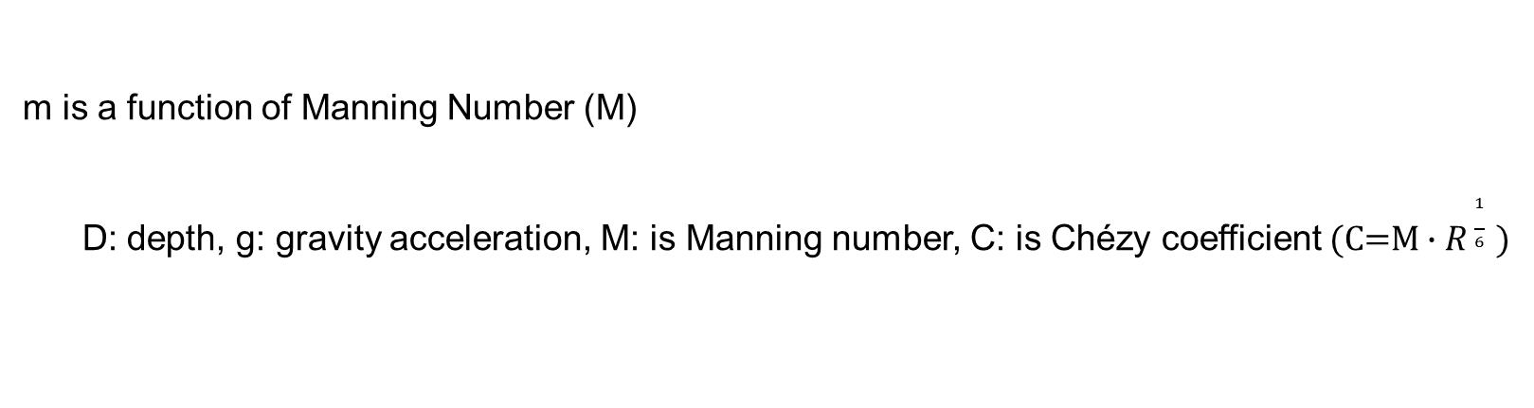

ISO-Standards (EN ISO 748:2007):
From surface velocity to vertical velocity
$\overline{v}=\left(\frac{m}{m+1}\right)∙v_{surf}$
Mean vertical velocity ($\overline{v}$) estimated from integration of power law
m is a function of Manning Number (M)
D: depth, g: gravity acceleration, M: is Manning number, C: is Chézy coefficient (C=M $∙R\frac{1}{6} )$

Slide 12
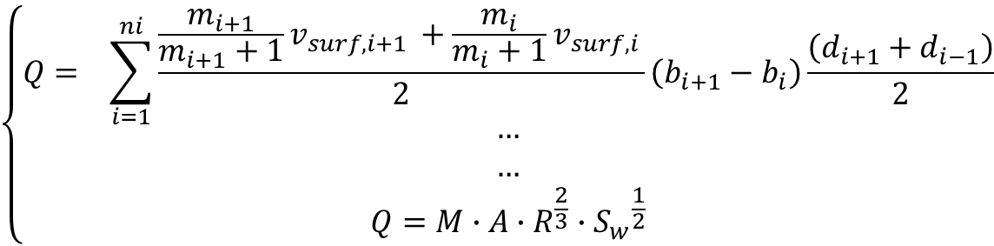
A system of 2 unknowns and 2 main equations
2 unknowns: Q (discharge) and M (Manning number)
Equations: Manning formula and ISO equations to compute mean velocity and discharge
$$\left\{\begin{aligned}Q= \sum_{i=1}^{ni}{\frac{\frac{m_{i+1}}{m_{i+1}+1}v_{surf,i+1 }+\frac{m_{i}}{m_{i}+1}v_{surf,i }}{2}\left(b_{i+1}−b_{i}\right)\frac{\left(d_{i+1}+d_{i−1}\right)}{2}} \\ … \\ … \\ Q=M∙A∙R^{\frac{2}{3}}{∙S_{w}}^{\frac{1}{2}}\end{aligned}\right.$$
ISO equations for computing i) discharge with mid-section method and ii) for computing mean vertical velocity from surface velocity
Manning Equation
Holds for uniform flow
Measured variables:
  ni (number of discretization nodes at which velocity is measured)
  b_{i} (width of each cross section interval),
  d_{i} (depth of each cross section interval, meas. by tethered sonar),
  A (flow area meas. by tethered sonar),
  R (hydraulic radius meas. by tethered sonar),
  S_{w} (slope meas. by radar).
  v_{surf} (surface velocity meas. with PIV technique),
Estimated variables:
M (Manning number) / m (velocity roughness factor)
Q (discharge)

Slide 13
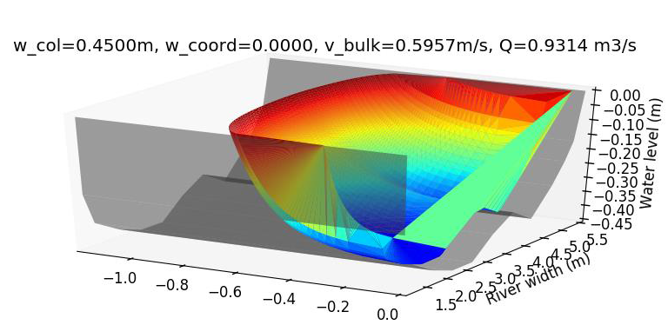
Discharge estimation
An example of a UAS-borne discharge estimation:
Measurements retrieved in the stream Åmose Å (April 2018).
UAV-estimate of discharge was estimated as 931 l/s,
In-situ measured discharge was 830 l/s,
UAV-estimate of Manning number was as 39.5 m^{1/3}/s,
In-situ measured Manning number was 35.2 m^{1/3}/s.

Slide 14
Results
Our method was evaluated at different cross sections of 6 different Danish streams, at a total of approximately 30 sites. This measurements were during different hydrological conditions, with flow conditions vary from a few l/s to a few m³/s, and different aquatic vegetation density conditions.
The method relying on the pinhole camera model proved reliable. When compared to 4 Ground Control Points, the mean absolute errors are less than 3% in the conversion from pixel into metric unit.
Water surface velocity is typically estimated with a mean absolute error of 0.1 m/s for velocities in the range 0-1 m/s. The largest errors typically occur at the lower velocities, when seeding conditions are not optimal. High wind conditions and insufficient seeding are the most critical factor affecting accuracy.
Discharge estimated with our system of equations method results in a accuracy of ca. 15-20%. No significant correlation was found between hydrological conditions and discharge accuracy, only a weak correlation between accuracy and flow magnitude.
Our system of equations method allows us to jointly estimate discharge and Manning number. Manning number estimates also showed to be accurate when compared to in-situ Manning number observations

Slide 15
Thanks for your attention
Would you like to receive more info?
Contact the authors or
Or
Please hold on:
  A paper regarding this workflow was recently submitted to Water Resources Research

