Slide 1
2020 European General Assembly “Vienna”, 4-8 May, 2020
Using a boundary-corrected wavelet transform coupled with machine learning and hybrid deep learning approaches for multi-step water level forecasting in Lakes Michigan and Ontario
Rahim Barzegar^{1,2}, Jan Adamowski¹, John Quilty³, Mohammad Taghi Aalami²
¹Department of Bioresource Engineering, McGill University, 21111 Lakeshore, Ste Anne de Bellevue, Quebec, H9X 3V9, Canada
²Department of Water Resources Management, Faculty of Civil Engineering, University of Tabriz
³Department of Civil and Environmental Engineering, University of Waterloo, 200 University Avenue West, Waterloo, Ontario, N2L 3G1, Canada
Notes:
1
For details please refer to the mentioned references.
For questions and comments you can contact us at rahim.barzegar@mail.mcgill.ca

Slide 2
Objectives
Applying machine learning (ML) (i.e., random forest (RF) and support vector regression (SVR)) and hybrid convolutional neural network (CNN)-long-short term memory (LSTM) deep learning (DL) models for multi-step (i.e., one-, two- and three-monthly step ahead) water level (WL) forecasting in the Great Lakes (Michigan and Ontario).
Integrating the boundary corrected (BC) maximal overlap discrete wavelet transform (MODWT) with SVR, RF, and CNN-LSTM models to improve the performance of the individual models.
Notes:
For questions and comments you can contact us at rahim.barzegar@mail.mcgill.ca

Slide 3
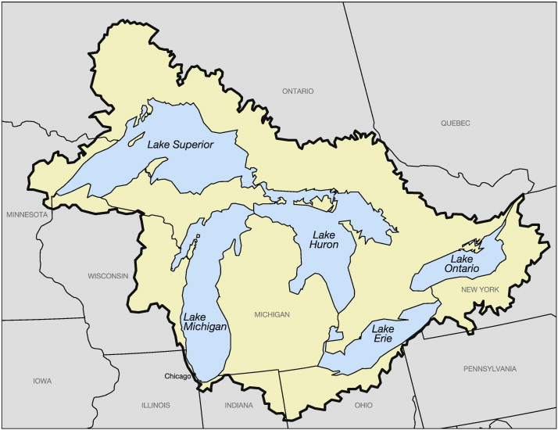
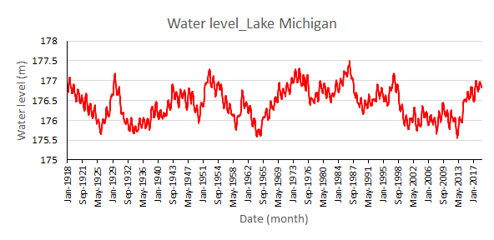
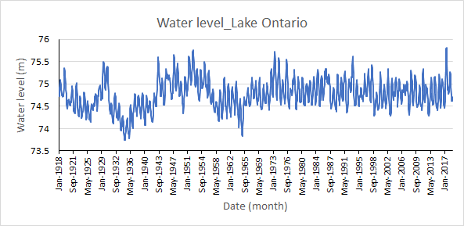
Study cases and data
The data in this study are water level time series of two North-American Great Lakes, namely, Lake Ontario in Canada and Lake Michigan in the United States.
The lake’s WL data were obtained from the National Oceanic and Atmospheric Administration’s (NOAA) National Ocean Services database.
Notes:
The lake’s WL data were obtained from the National Oceanic and Atmospheric Administration’s (NOAA) National Ocean Services database. The monthly WLs were measured from January 1918 to December 2018. The WL measurements for Lake Ontario ranged between 73.74 and 75.81 m, with a mean value of 74.76 m. For the Lake Michigan, the monthly WLs varied between 175.57 and 177.50 (with a mean and standard deviation of 176.42 and 0.39 m).

Slide 4
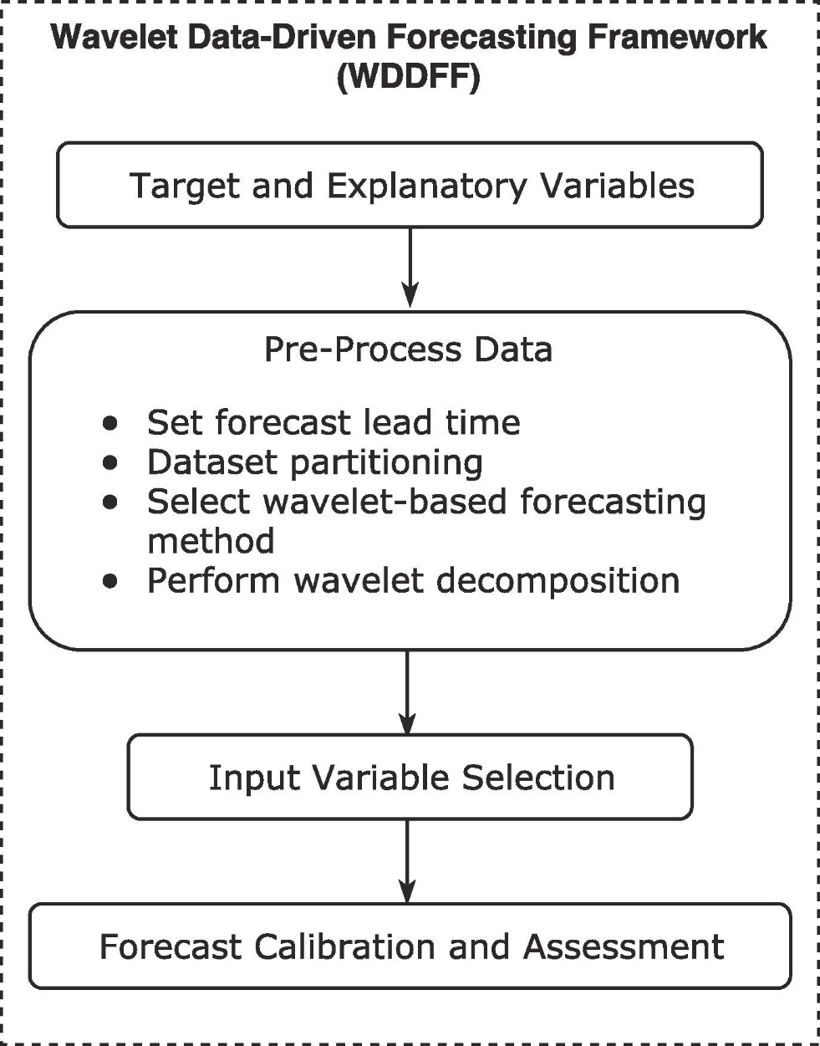
Methodology
Table 1 Selected input variables using particle swarm search technique for different step ahead WL forecasting in Lakes Ontario and Michigan
Lake | Target | Input variables
Ontario | WL (t+1) | WL (t), WL (t-10)
 | WL (t+2) | WL (t), WL (t-9)
 | WL (t+3) | WL (t), WL (t-8)
Michigan | WL (t+1) | WL (t), WL (t-1), WL(t-9)
 | WL (t+2) | WL (t), WL (t-10)
 | WL (t+3) | WL (t), WL (t-8)
Wavelet-based ML model framework (adopted from Quilty and Adamowski, (2018))
Notes:
To develop the singular machine learning models (e.g. SVR and RF), potential lag times of WL up to 12 months were considered and input variable selection based on particle swarm optimization search (PSOS) technique (Table 1) was used to select the best input variables for modeling. For developing standalone ML and deep learning (DL) models, the dataset was portioned into training (70%) and validation (30%) subsets.
WA-based ML models were developed based on the Wavelet Data-Driven Forecasting Framework (WDDFF) as proposed in Quilty and Adamowski (2018). For developing wavelet-based ML models (e.g. WA-SVR and WA-RF), forecast lead time (e.g. t+1, t+2 and t+3) were set on the target variable and then wavelet decomposition decomposed WL (t) at different levels with different wavelet families [(Daubechies (db), Haar, Symlets (sym), Fejer-Korovkin (fk), and Coiflets (Coif)]. Lagged time series of decomposed series up to 12 months as potential explanatory variables were used where PSOS selected suitable explanatory variables for developing the models. The maximal overlap discrete wavelet transform was applied for decomposing the input variables. Since the wavelet-decomposed data is affected by “boundary conditions” (see details in Quilty and Adamowski, 2018), it was necessary to remove the first 𝐿_{𝐽} wavelet and scaling coefficients (see Section 2.4) affected by BC due to the selected wavelet filter length (𝐿) and decomposition level (𝐽) at the beginning of the decomposed data. The number of BC-effected coefficients that were removed from the beginning of the target and input variables in all models (𝐿_{f}) was determined according to (Quilty and Adamowski, 2018):
𝐿_{f} = (2^{𝐽𝑚𝑎𝑥} ‒ 1) (𝐿 ‒ 1) + 1
In this study, 𝐽𝑚𝑎𝑥 and 𝐿 were set between 1 to 10 to find the best 𝐽𝑚𝑎𝑥 and 𝐿 in different ML and DL models.

Slide 5
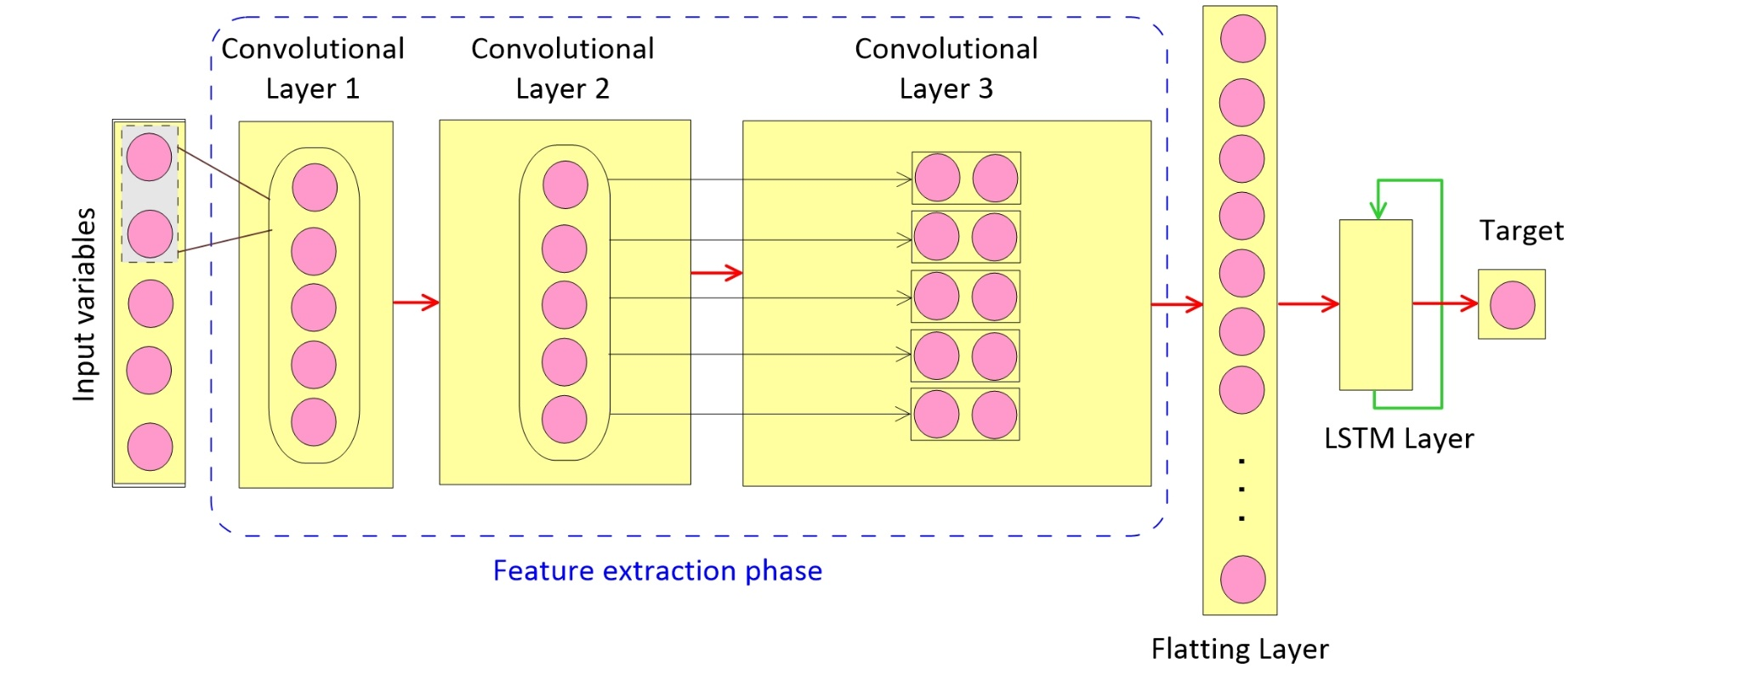
Methodology
Fig 3. The structure of the developed hybrid CNN-LSTM model
Notes:
In this study, the integration of convolutional neural networks and long-short term memory networks as a hybrid CNN-LSTM DL neural network is designed for the time series forecasting. In this way, CNN extracts local trend features and the same features of time series that appear at different times and then LSTM captures long-term dependencies and learns the sequential correlations (Barzegar et al., 2020).
To develop DL models, input series should be served to the DL model as a sequential series and input variable selection process is not needed. Therefore, for developing standalone CNN-LSTM model, water levels up to 12 lags [WL (t),…,WL(t-1)] were served as the inputs of the DL models. The structure of the models and optimum values of different models’ parameters were selected through a grid search process. The structure of the CNN-LSTM model is plotted in Fig 3. For more details, please refer to Barzegar et al., (2020).

Slide 6
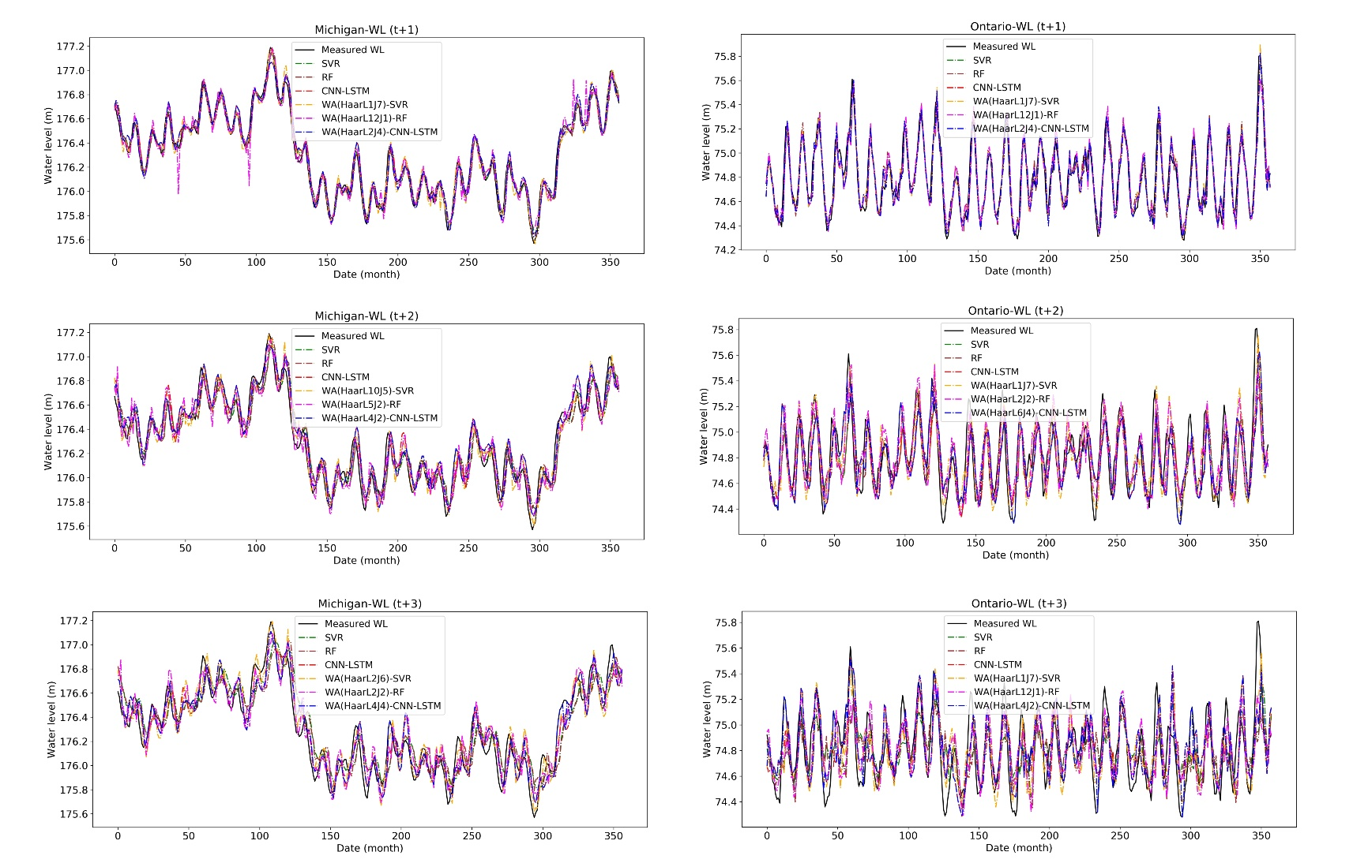
Results
Lake Ontario
 | Model | RMSE | MAE | NSC | r
WL(t+1) | SVR | 0.067 | 0.230 | 0.962 | 0.981
 | RF | 0.069 | 0.234 | 0.959 | 0.979
 | CNN-LSTM | 0.064 | 0.229 | 0.965 | 0.984
WL(t+2) | SVR | 0.117 | 0.306 | 0.883 | 0.940
 | RF | 0.121 | 0.311 | 0.875 | 0.936
 | CNN-LSTM | 0.098 | 0.283 | 0.918 | 0.963
WL(t+3) | SVR | 0.155 | 0.35 | 0.797 | 0.895
 | RF | 0.158 | 0.355 | 0.789 | 0.889
 | CNN-LSTM | 0.119 | 0.313 | 0.88 | 0.939
WL(t+1) | WA-SVR | 0.050 | 0.197 | 0.979 | 0.990
 | WA-RF | 0.073 | 0.226 | 0.955 | 0.978
 | WA-CNN-LSTM | 0.041 | 0.195 | 0.981 | 0.994
WL(t+2) | WA-SVR | 0.077 | 0.250 | 0.950 | 0.975
 | WA-RF | 0.094 | 0.276 | 0.926 | 0.962
 | WA-CNN-LSTM | 0.750 | 0.231 | 0.970 | 0.986
WL(t+3) | WA-SVR | 0.105 | 0.294 | 0.906 | 0.953
 | WA-RF | 0.123 | 0.317 | 0.872 | 0.934
 | WA-CNN-LSTM | 0.081 | 0.271 | 0.923 | 0.978
Lake Michigan
 | Model | RMSE | MAE | NSC | r
WL(t+1) | SVR | 0.091 | 0.263 | 0.892 | 0.946
 | RF | 0.099 | 0.278 | 0.872 | 0.934
 | CNN-LSTM | 0.091 | 0.267 | 0.892 | 0.946
WL(t+2) | SVR | 0.202 | 0.403 | 0.465 | 0.690
 | RF | 0.202 | 0.406 | 0.465 | 0.688
 | CNN-LSTM | 0.202 | 0.403 | 0.465 | 0.690
WL(t+3) | SVR | 0.226 | 0.420 | 0.328 | 0.575
 | RF | 0.231 | 0.424 | 0.295 | 0.552
 | CNN-LSTM | 0.202 | 0.405 | 0.463 | 0.692
WL(t+1) | WA-SVR | 0.086 | 0.257 | 0.904 | 0.951
 | WA-RF | 0.102 | 0.282 | 0.865 | 0.931
 | WA-CNN-LSTM | 0.062 | 0.232 | 0.925 | 0.962
WL(t+2) | WA-SVR | 0.147 | 0.334 | 0.718 | 0.851
 | WA-RF | 0.162 | 0.359 | 0.654 | 0.813
 | WA-CNN-LSTM | 0.131 | 0.311 | 0.816 | 0.872
WL(t+3) | WA-SVR | 0.188 | 0.386 | 0.535 | 0.740
 | WA-RF | 0.199 | 0.396 | 0.481 | 0.700
 | WA-CNN-LSTM | 0.171 | 0.372 | 0.586 | 0.781
Fig 4. Measured vs. forecasted multi-step water levels in Lakes Ontario and Michigan
Notes:
Performance of the developed models indicates that hybrid CNN-LSTM DL model outperforms the ML (SVR and RF) models. Wavelet based ML and DL models performs better than standalone ML and DL models. Note that for the Wavelet based models, results of the best performed waveles are given here.

Slide 7
Conclusions
Of the ML models, the SVR outperformed RF while the DL models outperformed the ML models for each forecast lead time (one-, two-, and three-step(s) ahead).
Results from this case study indicate that not all wavelet families and decomposition levels perform equally and in some cases, the wavelet-based models do not improve performance over the non-wavelet-based models. However, the BC-MODWT-CNN-LSTM using suitable mother wavelets (e.g., Haar) outperforms the individual ML and BC-MODWT-ML-based models.
More accurate forecasts were obtained for Lake Michigan although the performance in both Great Lakes was accurate.
The outcomes of this research indicate that the BC-MODWT-CNN-LSTM model is a promising tool for generating accurate WL forecasts.

Slide 8
References
Quilty, J., & Adamowski, J. (2018). Addressing the incorrect usage of wavelet-based hydrological and water resources forecasting models for real-world applications with best practices and a new forecasting framework. Journal of hydrology, 563, 336-353.
Barzegar, R., Aalami, M. T., & Adamowski, J. (2020). Short-term water quality variable prediction using a hybrid CNN–LSTM deep learning model. Stochastic Environmental Research and Risk Assessment, 1-19.

Slide 9
Question?
Notes:
For details please refer to the mentioned references.
For questions and comments you can contact us at rahim.barzegar@mail.mcgill.ca

