Slide 1





Heritage Stones: Global relevance vis-à-vis architectonic heritage
The Granite of Pena, the Building Stone of the Most Important Buildings of the Twentieth Century in Vila Real (Northern Portugal)
Dr. David Martín Freire-Lista
Dr. Luís Sousa
Dr. Martinho Lourenço
General
Assembly
2020
European Geosciences Union

Slide 2
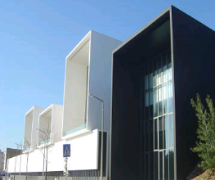
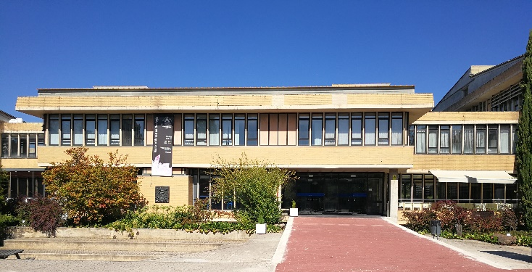

INTRODUCTION
MATERIALS & METHODS
RESULTS
CONCLUSIONS
Geosciences center
University of Coimbra
University of Tras-os-Montes e Alto Douro
Geology deparment
2020
General
Assembly

Slide 3
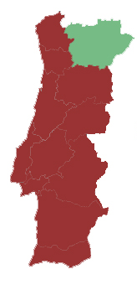
INTRODUCTION
MATERIALS & METHODS
RESULTS
CONCLUSIONS
Vila Real
2020
General
Assembly

Slide 4
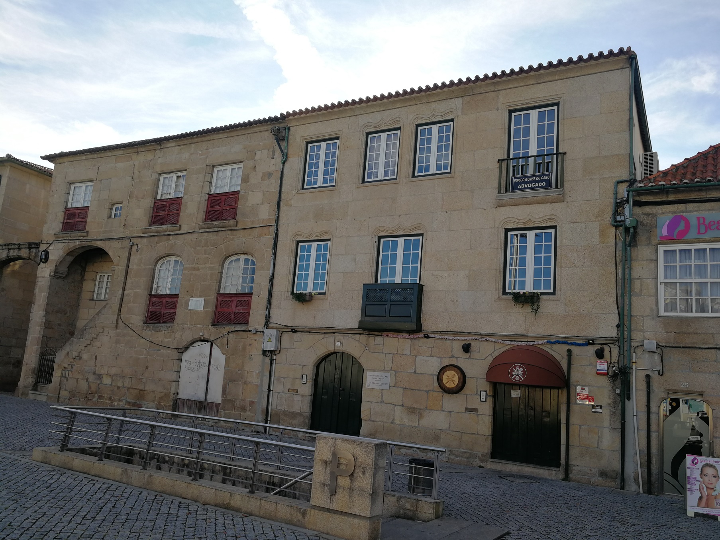
INTRODUCTION
MATERIALS & METHODS
RESULTS
CONCLUSIONS
Diogo Cão House , 15th century

Slide 5
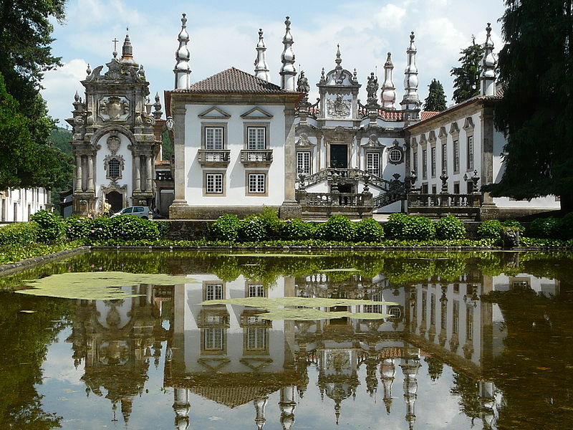
INTRODUCTION
MATERIALS & METHODS
RESULTS
CONCLUSIONS
Mateus Palace, 18 th century

Slide 6
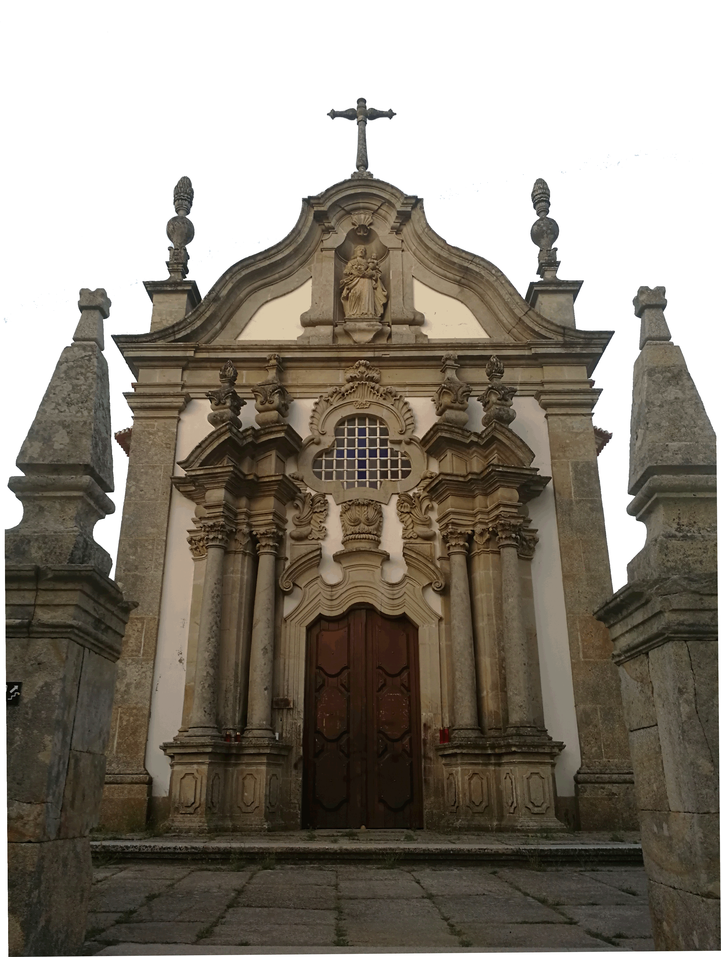
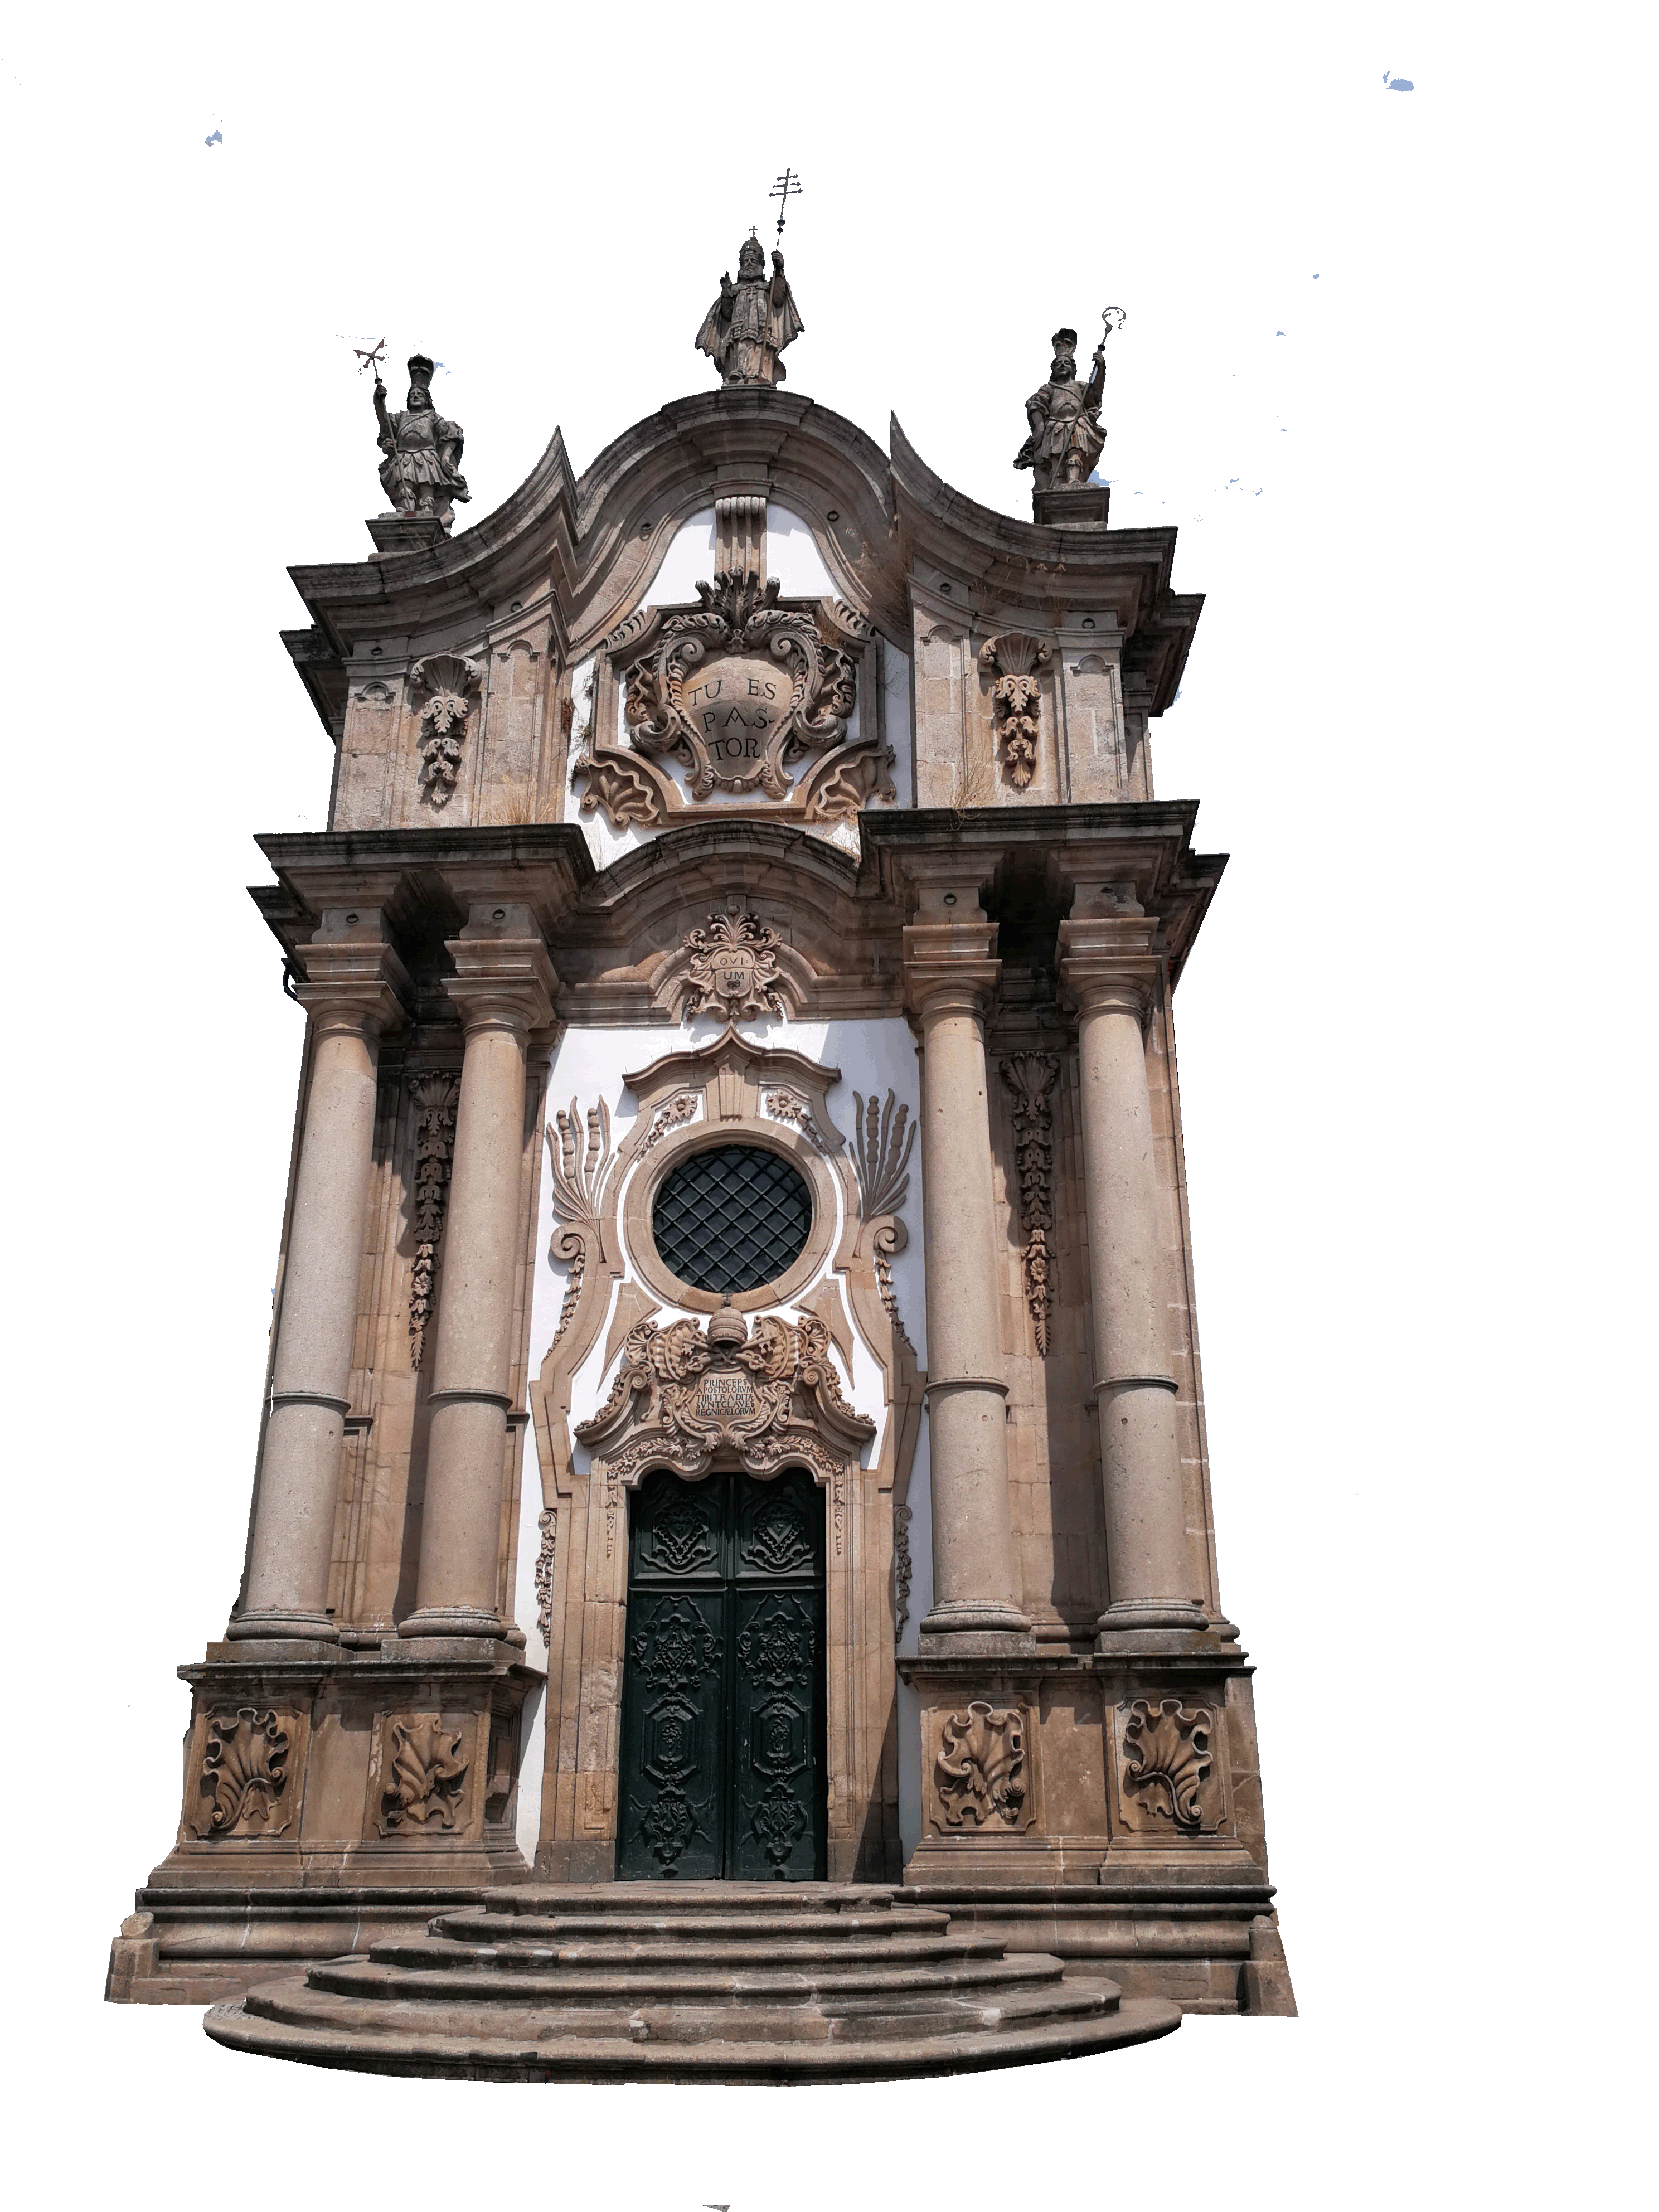
INTRODUCTION
MATERIALS & METHODS
RESULTS
CONCLUSIONS
São Paulo Church, 18 th century
Nossa Senhora da Pena Sanctuary, 18th century

Slide 7
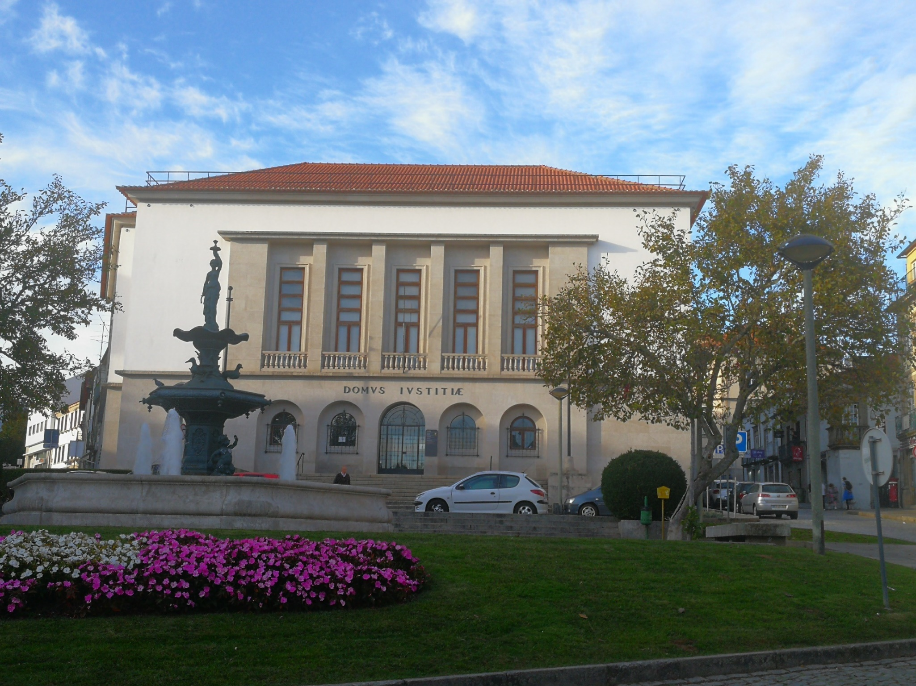
INTRODUCTION
MATERIALS & METHODS
RESULTS
CONCLUSIONS
Justice Court, 20th century

Slide 8
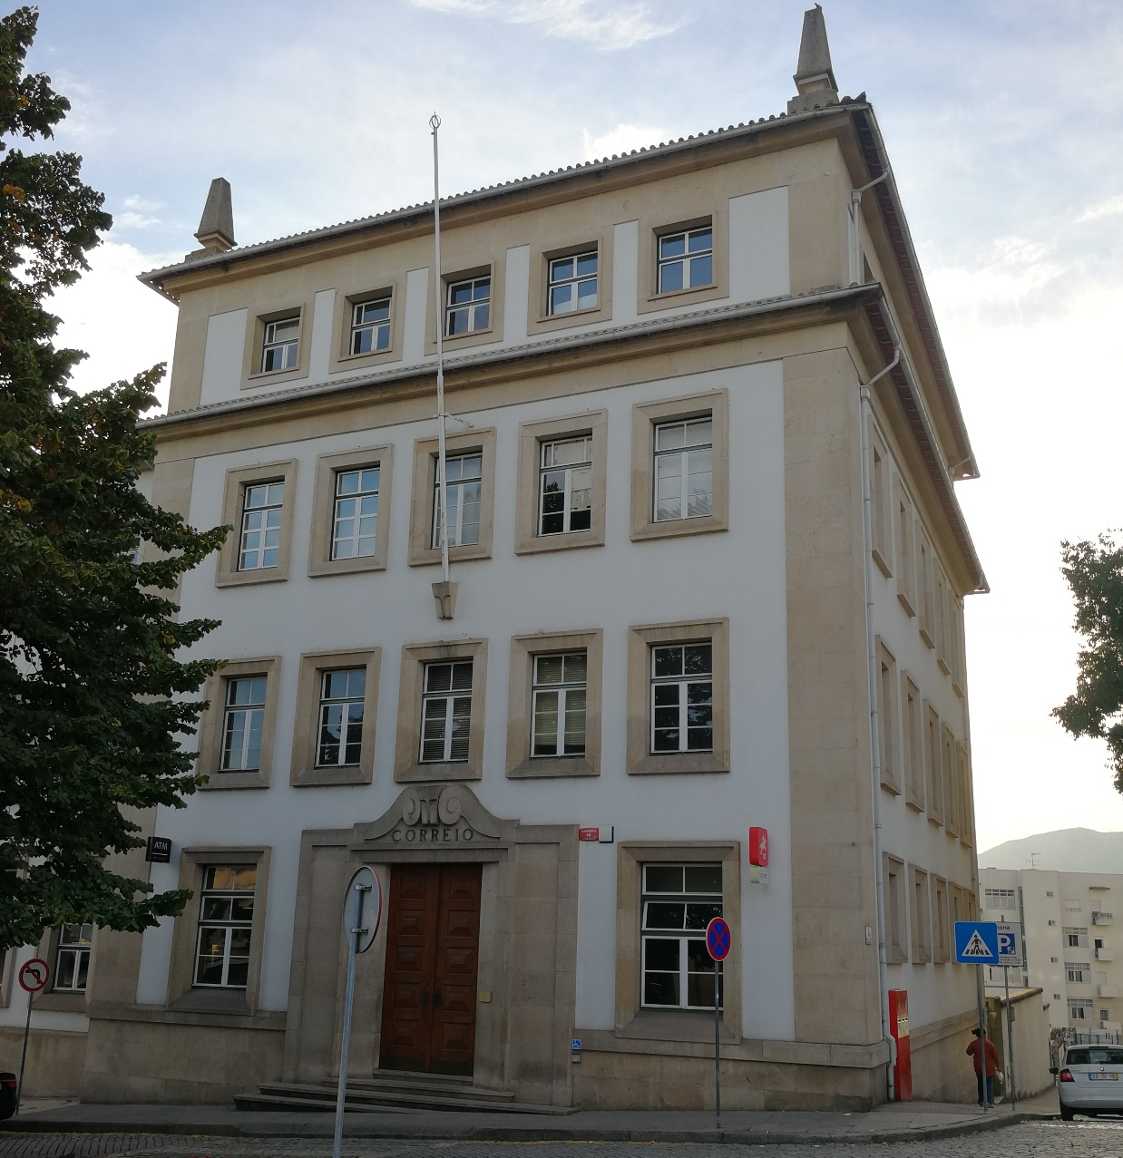
INTRODUCTION
MATERIALS & METHODS
RESULTS
CONCLUSIONS
Post house, 20th century
2020
General
Assembly

Slide 9
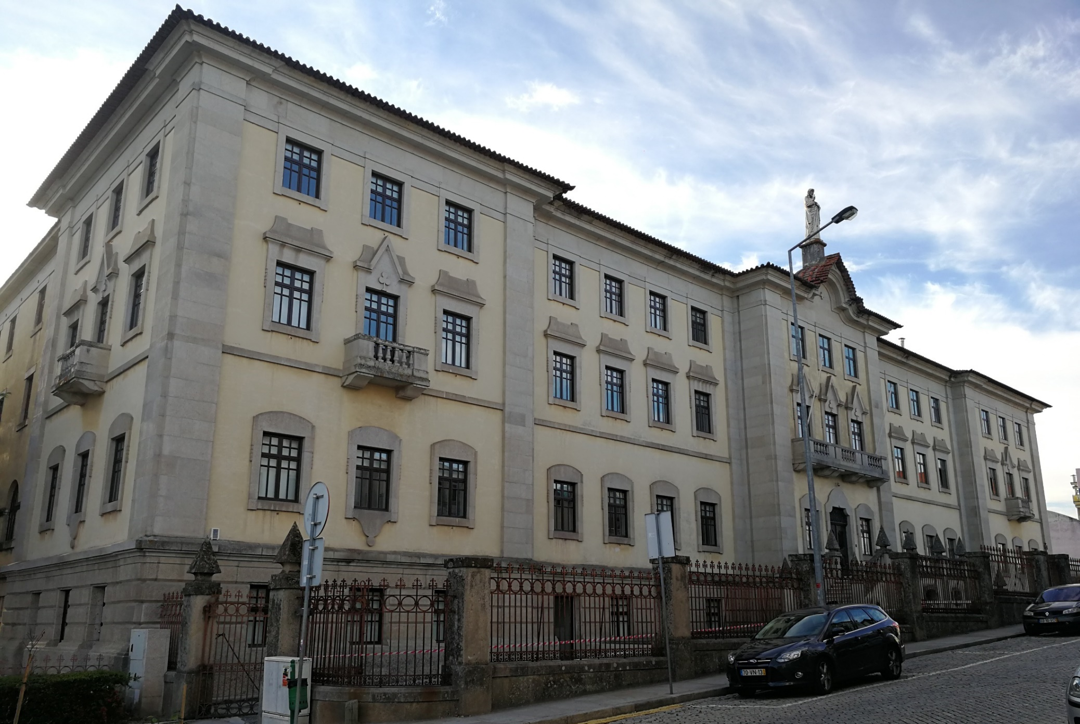
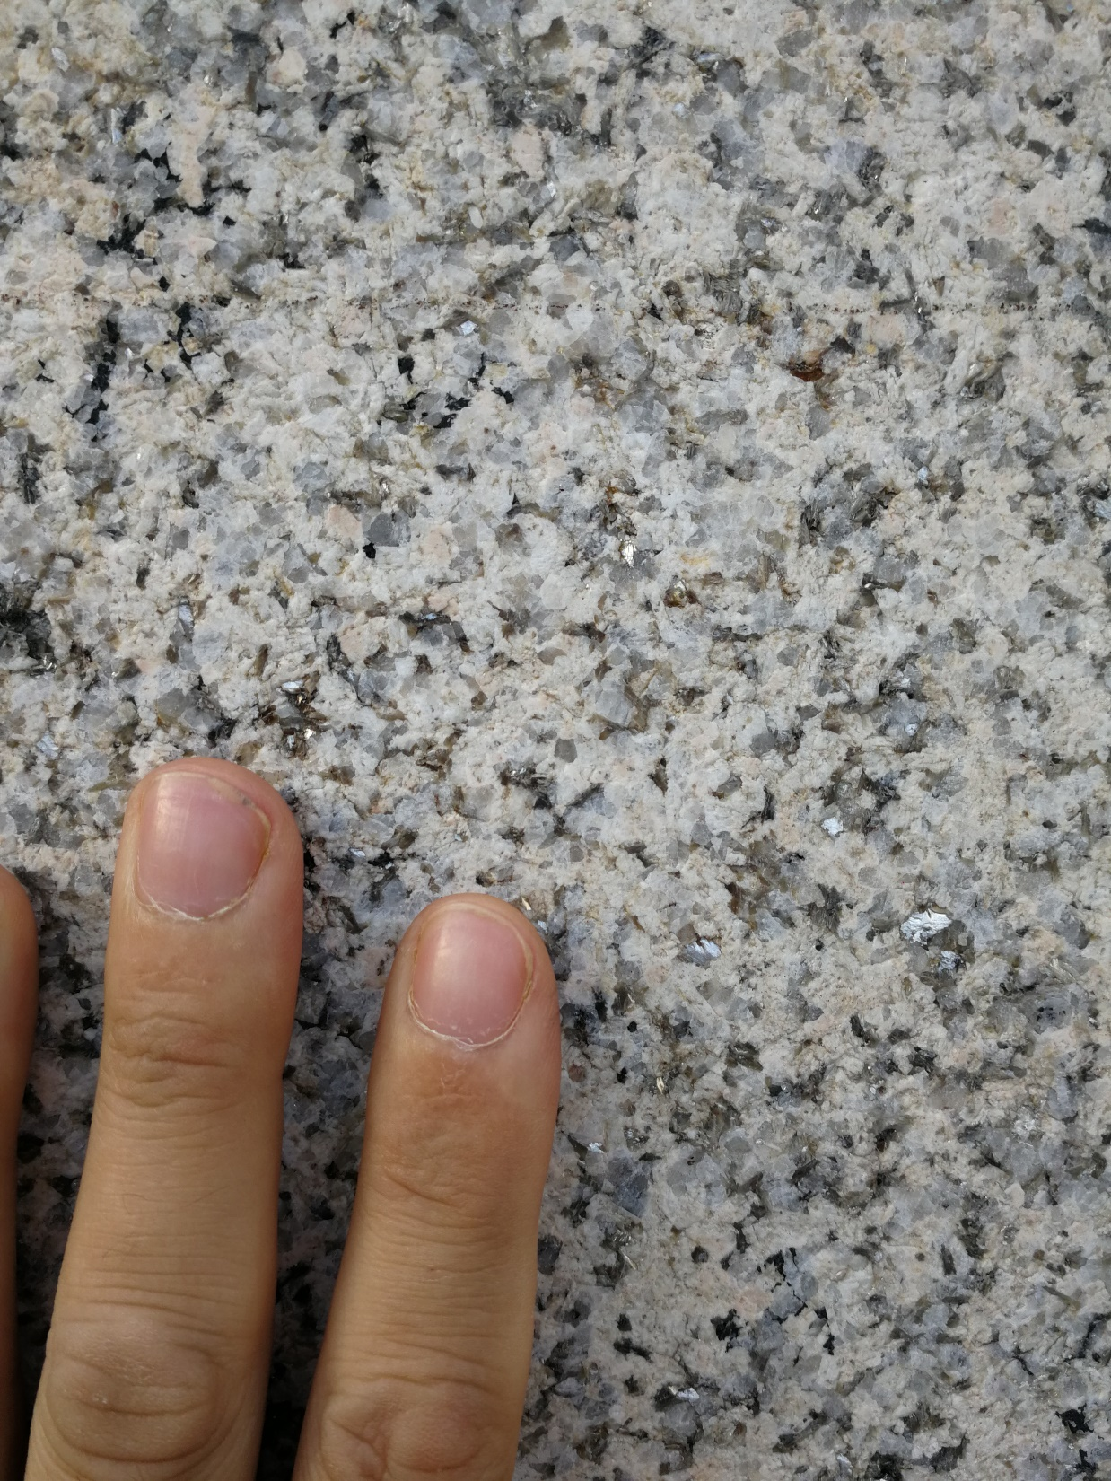
INTRODUCTION
MATERIALS & METHODS
RESULTS
CONCLUSIONS
Seminary, 20th century

Slide 10
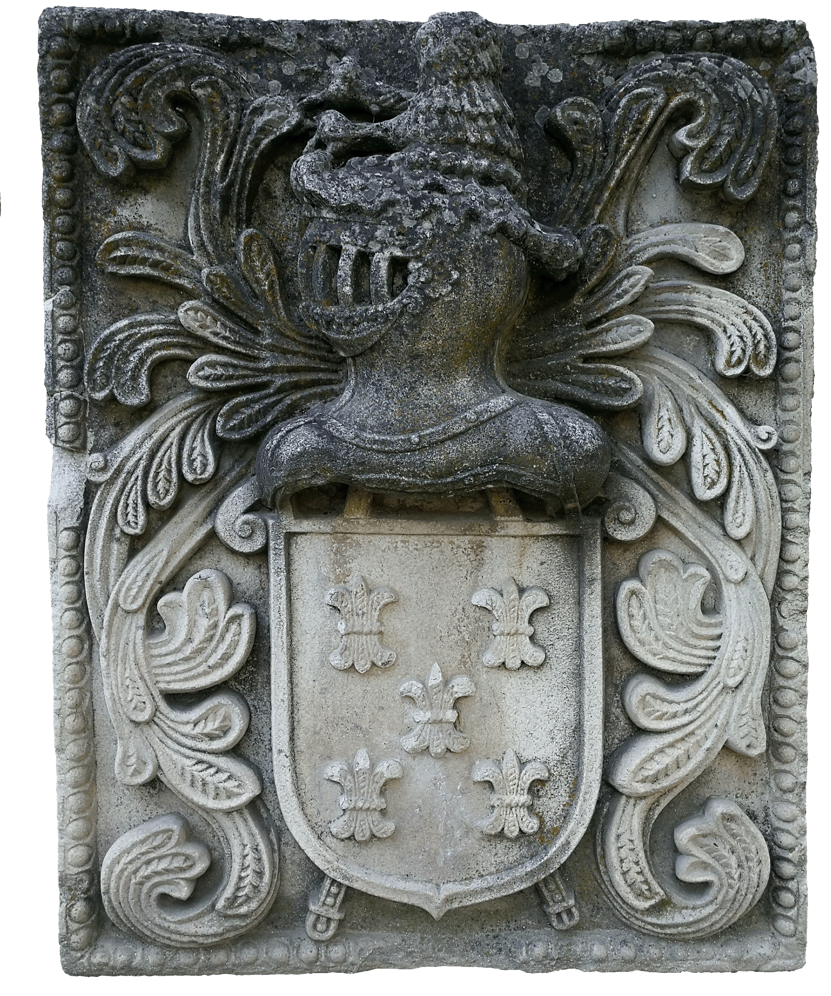
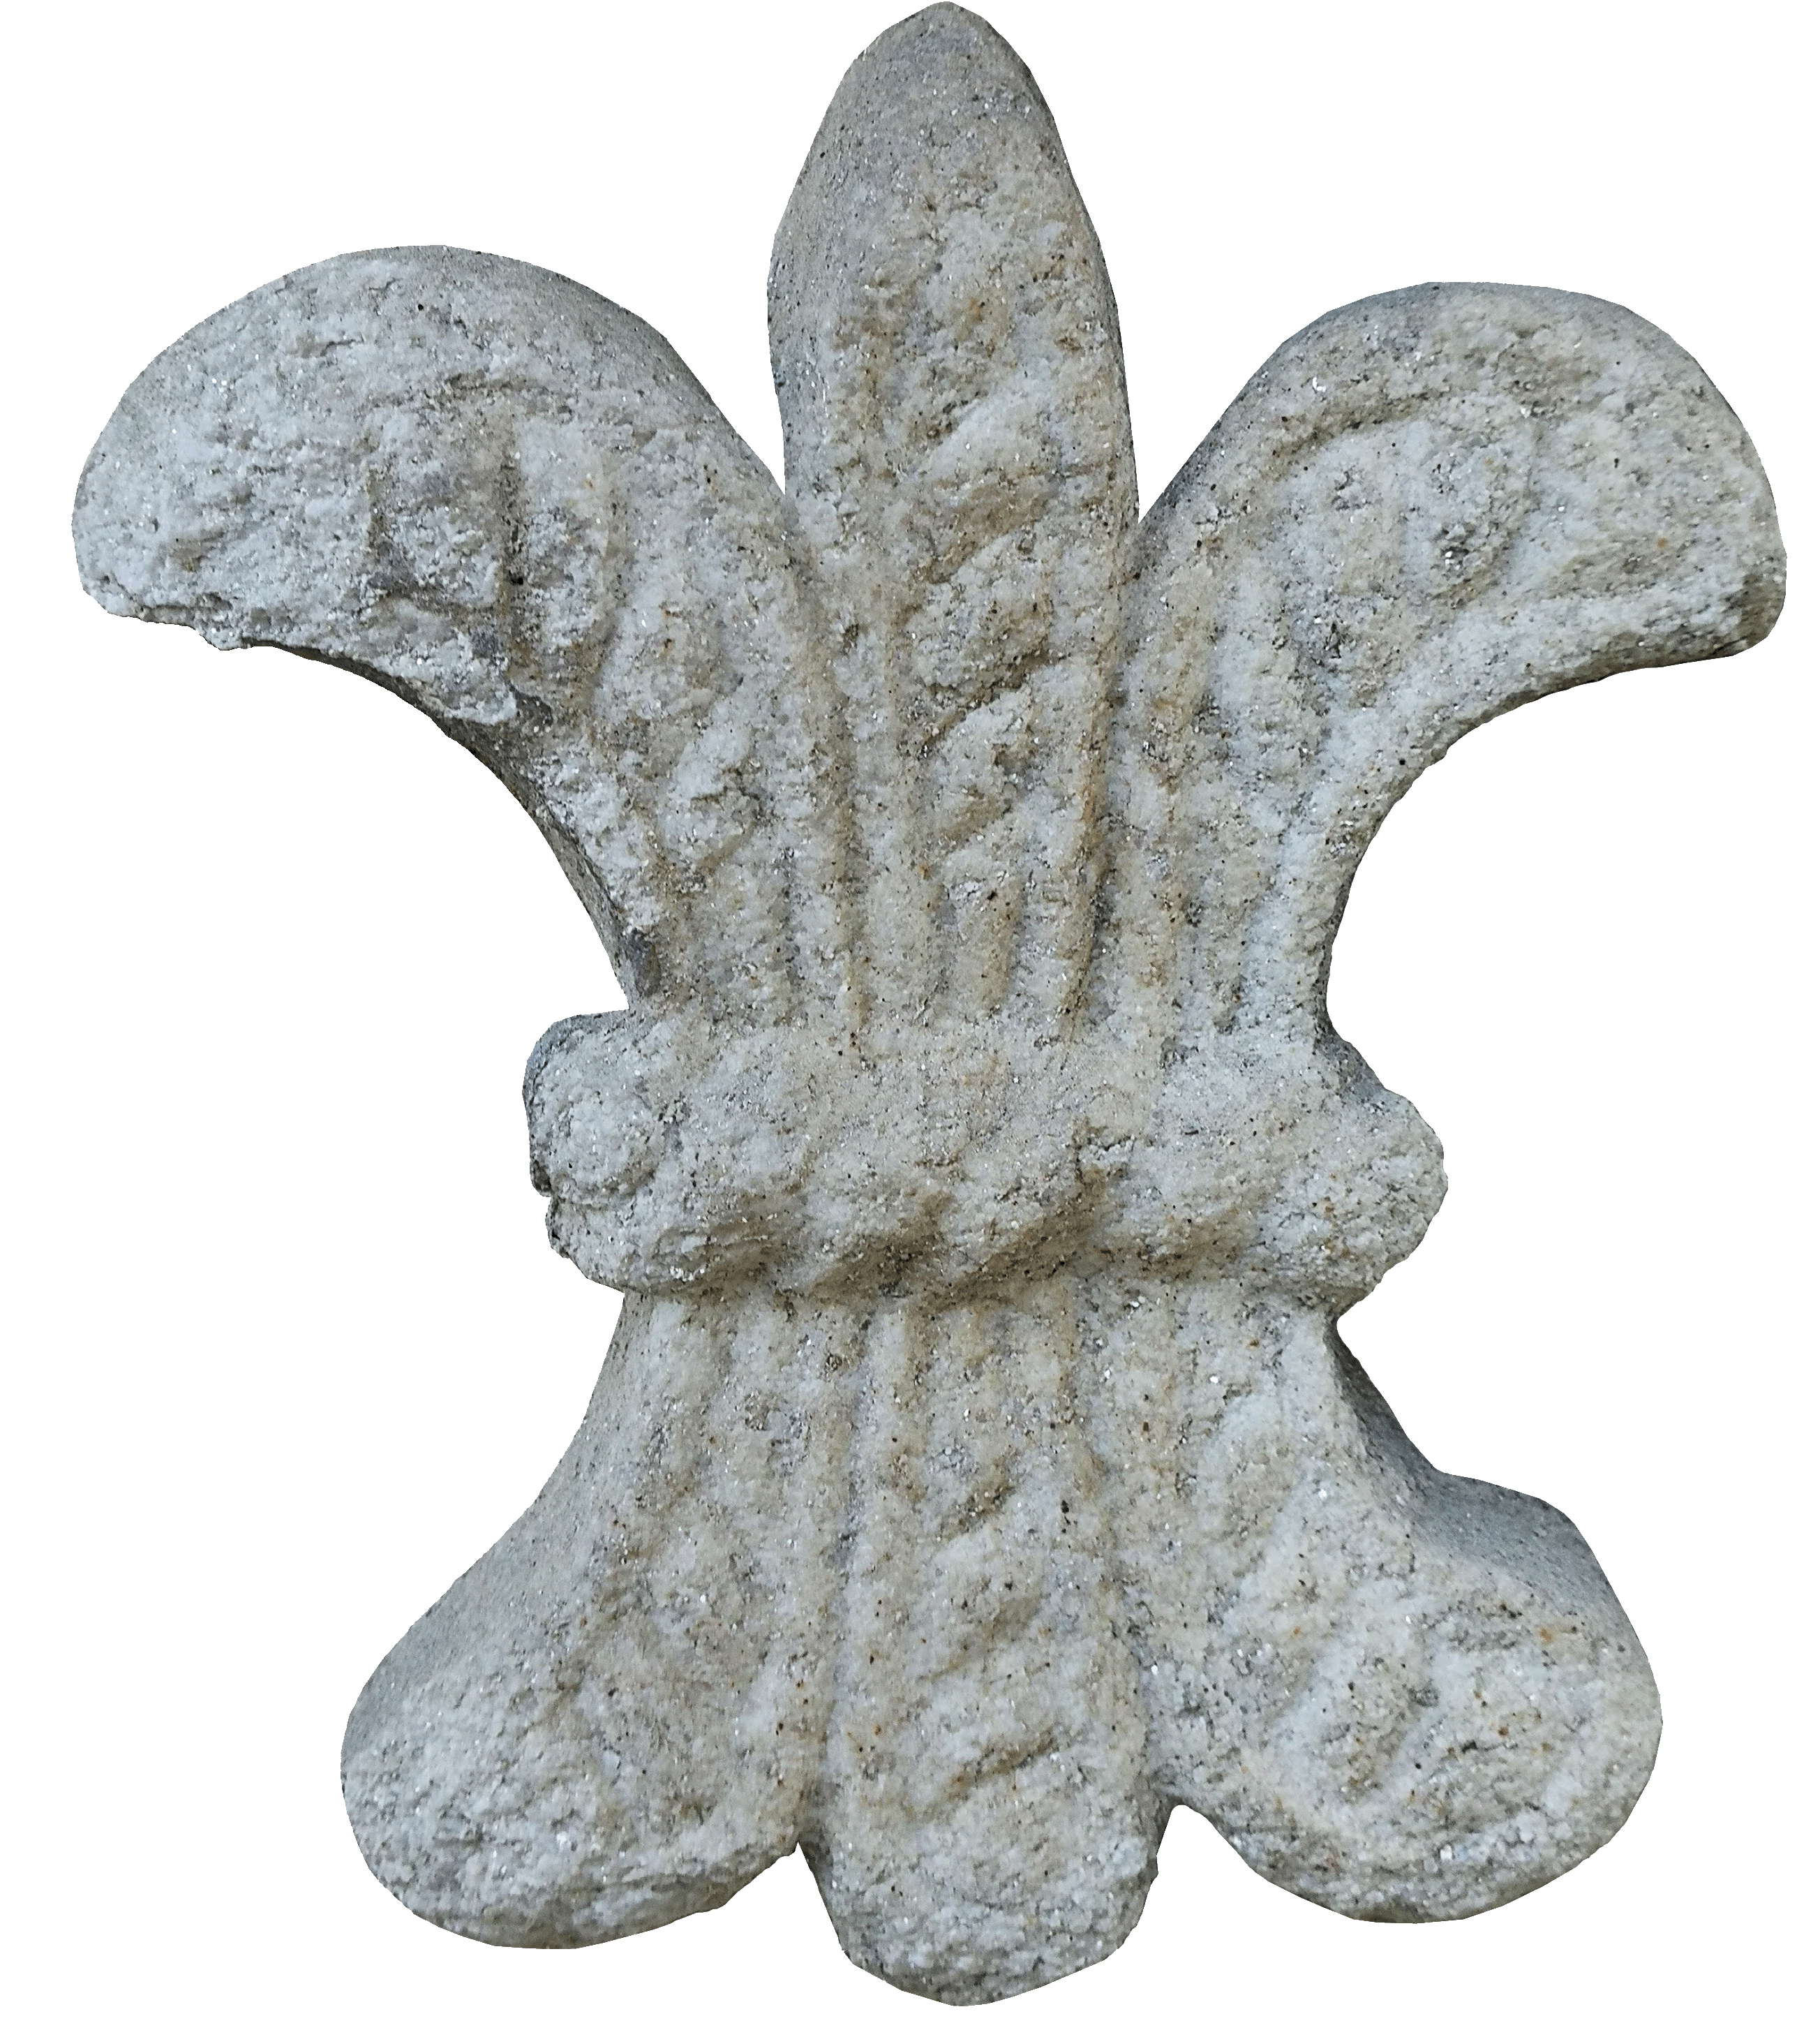
INTRODUCTION
MATERIALS & METHODS
RESULTS
CONCLUSIONS
2020
Coat of arms
0
20
General
Assembly
cm

Slide 11
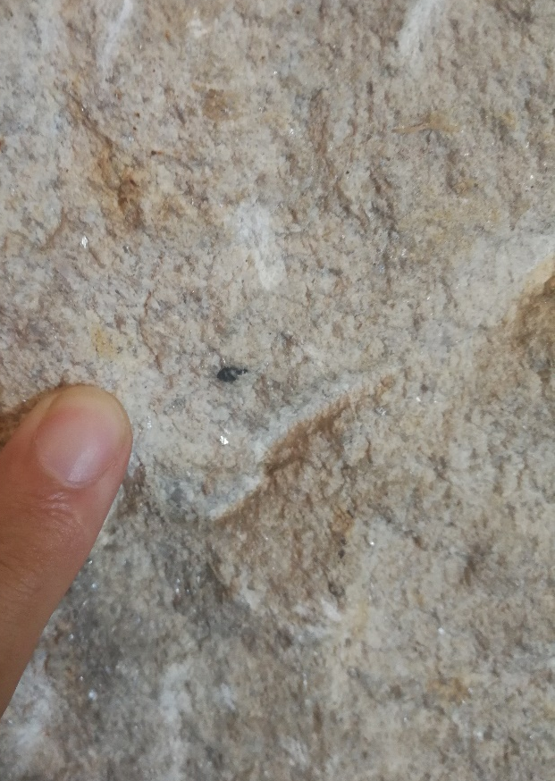
INTRODUCTION
MATERIALS & METHODS
RESULTS
CONCLUSIONS

Slide 12
INTRODUCTION
AIMS
RESULTS
CONCLUSIONS
1 Locate the historical quarries
2 Characterise the extraction area
2.1 Historic quarry modeling
2.2 Cartography of the extraction area
2.3 Volume of extracted granite
3 Characterise the building stones
3.1 Petrographic properties
DECAY
3.2 Mineralogical composition (XRD)
3.3 Petrophysical properties
3.3.1 Hydric properties
3.3.2 Ultrasound pulse velocity
3.3.3 Colour
2020
General
Assembly

Slide 13
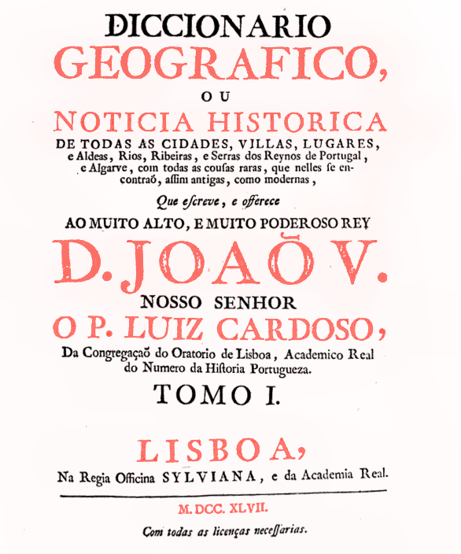
INTRODUCTION
MATERIALS & METHODS
RESULTS
CONCLUSIONS
1 Locate the historical quarries
The Portuguese Geographic Dictionary of 1747 indicates that in Pena, a village near Vila Real city, there is good “Pedra mármore”
2020
General
Assembly
Notes:
Historic building materials were typically near the place where they would be used. The geology of Northern Portugal is broadly composed of metamorphic rocks and granites. Each stone had a use according to its aesthetic and durability characteristics. These materials have created a rich cultural heritage that has been preserved up to this date.
Industrialisation, the development of means of transport and new materials have led to the abandonment of historical quarries, necessary for the conservation of monuments. The location of these quarries allows the creation of open-air museums and walking routes. In addition, the use of their stones for restoration will guarantee the supply for future generations, promoting local employment and the conservation of built heritage, both rural and urban heritage in a specific area.
Documentary search, cartography and petrographic characterisation are necessary to locate the historical quarries of the stones with which monuments have been built. The use of drones together with topographic analyses allows geologists to know the approximate granite volume extracted from the historical quarries, to calculate reserves and to locate granite boulders that can be used in future restorations. The use of analytical techniques, such as petrography, accelerated artificial ageing, ultrasound pulse velocity measurements and spectrophotometry will guarantee the quality, durability and colour of restoration stones. In addition, tourist routes with information panels and QR codes from the historic buildings to the original quarries of their building granites will allow visitors to know about the local heritage, geology and landscape of the area.
The implementation of this project aims at the revitalisation of villages with quarrying tradition and at the sustainable conservation of cultural heritage, inventorying building granites that can be used for restoration and creating a proximity trade. Restoration stones needs will be guaranteed without compromising their supply for future generations.
The period of most intense development of traditional stonework in the Trás-os-Montes area occurred in the 18th century. The Portuguese Geographic Dictionary of 1758 indicates that in Pena, a village near Vila Real city, capital of the homonymous district, there was “pedra mármore”, a leucogranite of fine crystal-size, white colour and with extraordinary petrophysical characteristics. In addition to the discovery of these quarries, an important historical quarry of granite with coarse crystal-size was discovered in the highest mountain of this village, from where an extraordinary panorama of Vila Real city can be admired.
Pena retains numerous vestiges of historical stonework and a profuse use of it. There are numerous door lintels that retain the construction date carved on them, as well as houses with carved ashlars, granite pinnacles, granaries and roadside granite crosses. The lintels and jambs of the doors and windows of its parish church were carved out of “pedra mármore”, while the walls and crosses dating from the 18th century and arranged on its perimeter were built with the coarse crystal-size granite. More recently, the seminary was built with Pena granites. In addition, the court and post office buildings also in Vila Real, were also built with Pena granites.

Slide 14
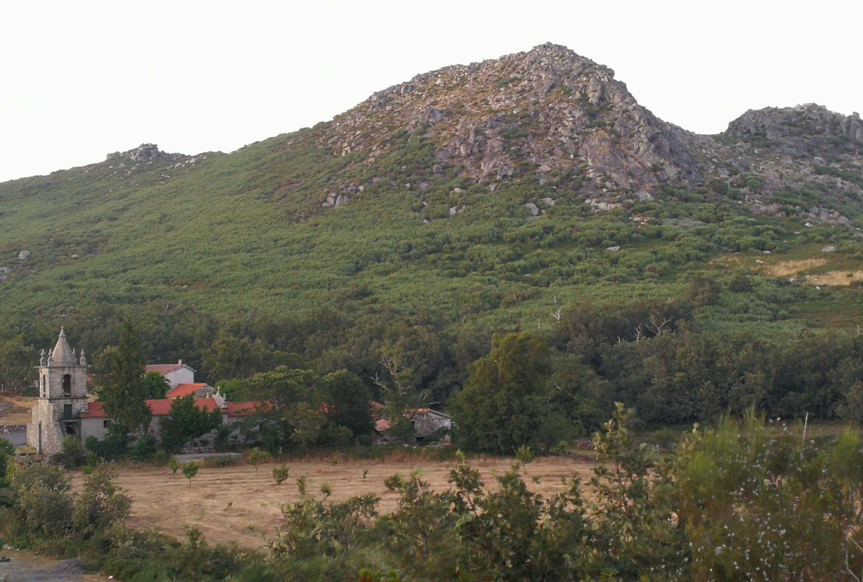
INTRODUCTION
MATERIALS & METHODS
RESULTS
CONCLUSIONS
1 Locate the historical quarries
Picarreira montain
Church of Sao Miguel da Pena

Slide 15
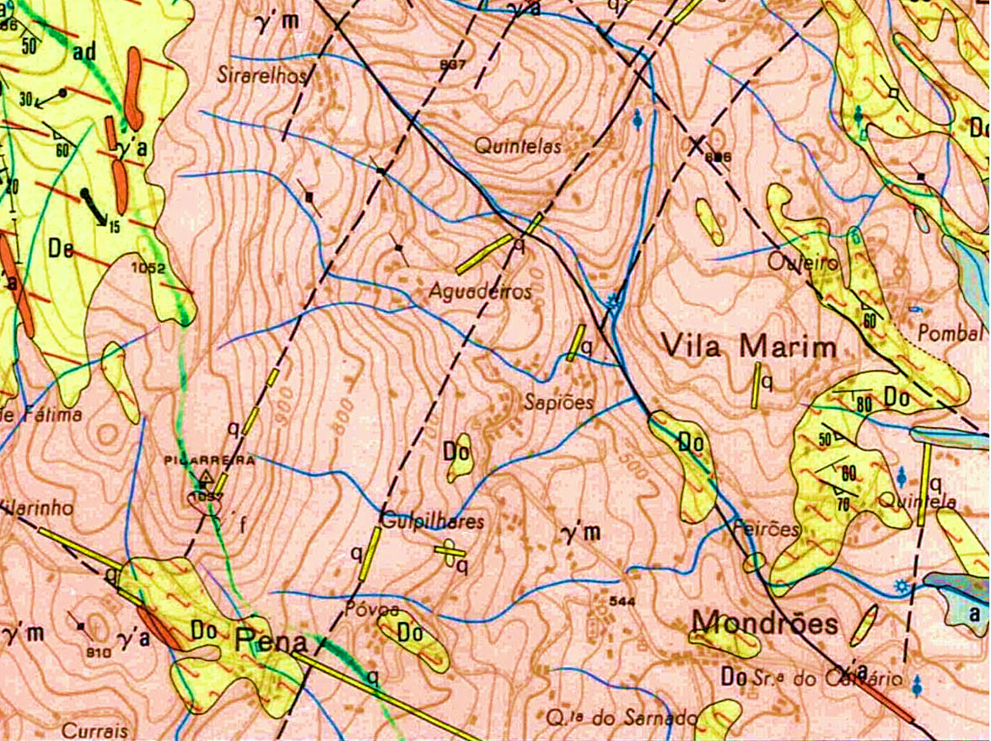
INTRODUCTION
MATERIALS & METHODS
RESULTS
CONCLUSIONS
1 Locate the historical quarries
Vila Real granite
Aplites
Metasedimentary
rocks
0
1
Km
2020
General
Assembly
1:50.000
Notes:
Intrusive rocks

Slide 16
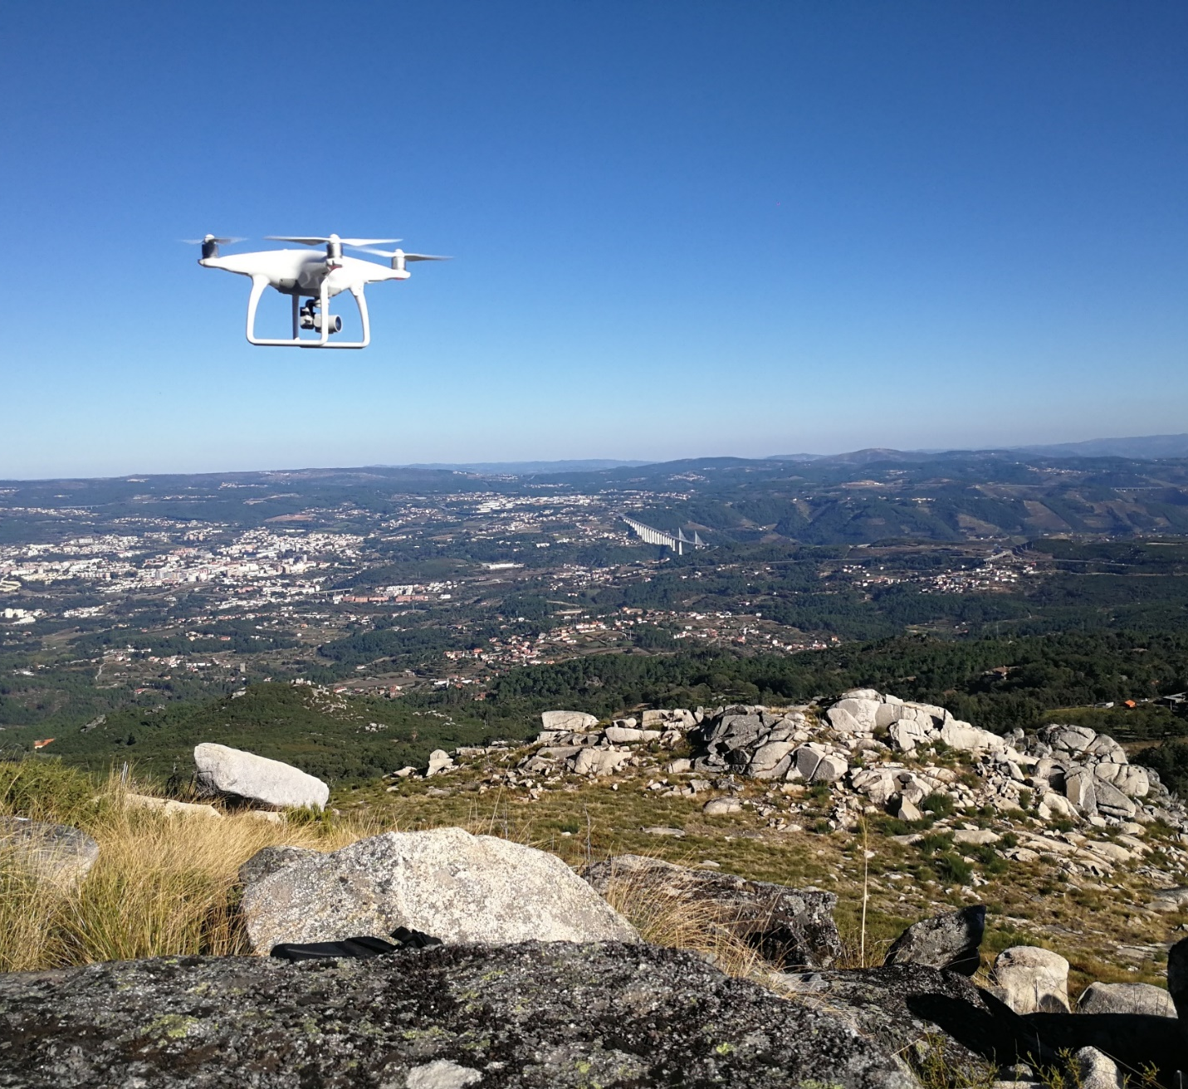
INTRODUCTION
MATERIALS & METHODS
RESULTS
CONCLUSIONS
2 Characterisation of the extraction area
Drone: DJI phantom 4
Flight planning and navigation software: Fix 4D Capture
Coverage: Double mesh
Photo overlay: 80 %
Flight height: 50 meters of the take-off
Model / Photogrammetric Processing: AGISOFT METASHAPE
2020
General
Assembly

Slide 17
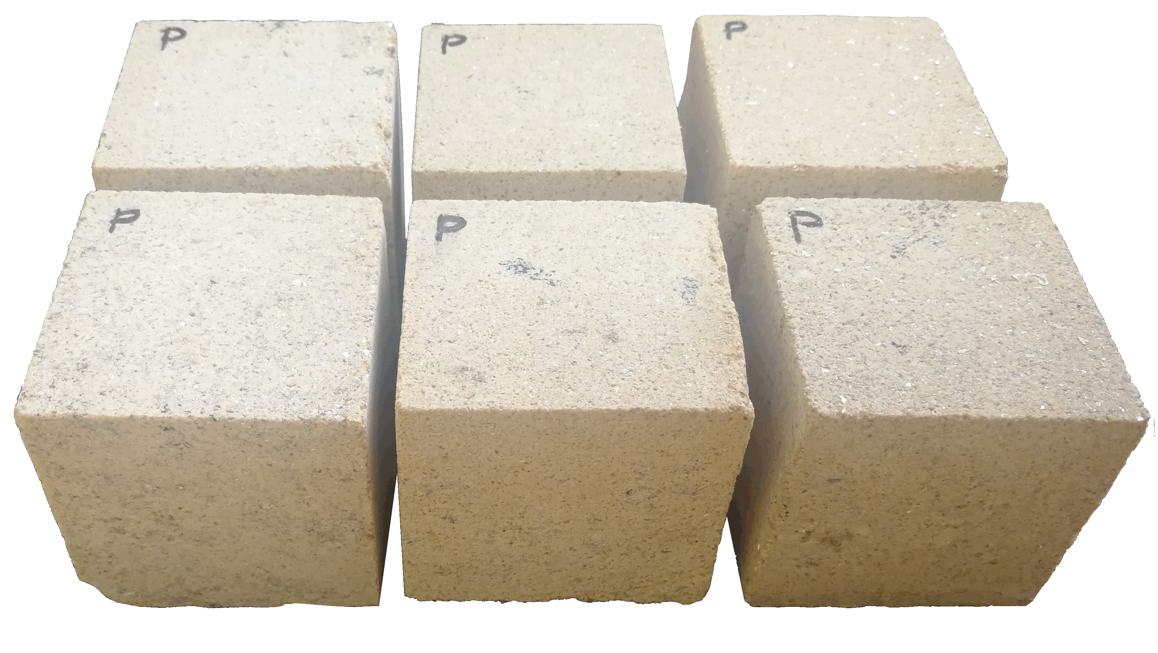
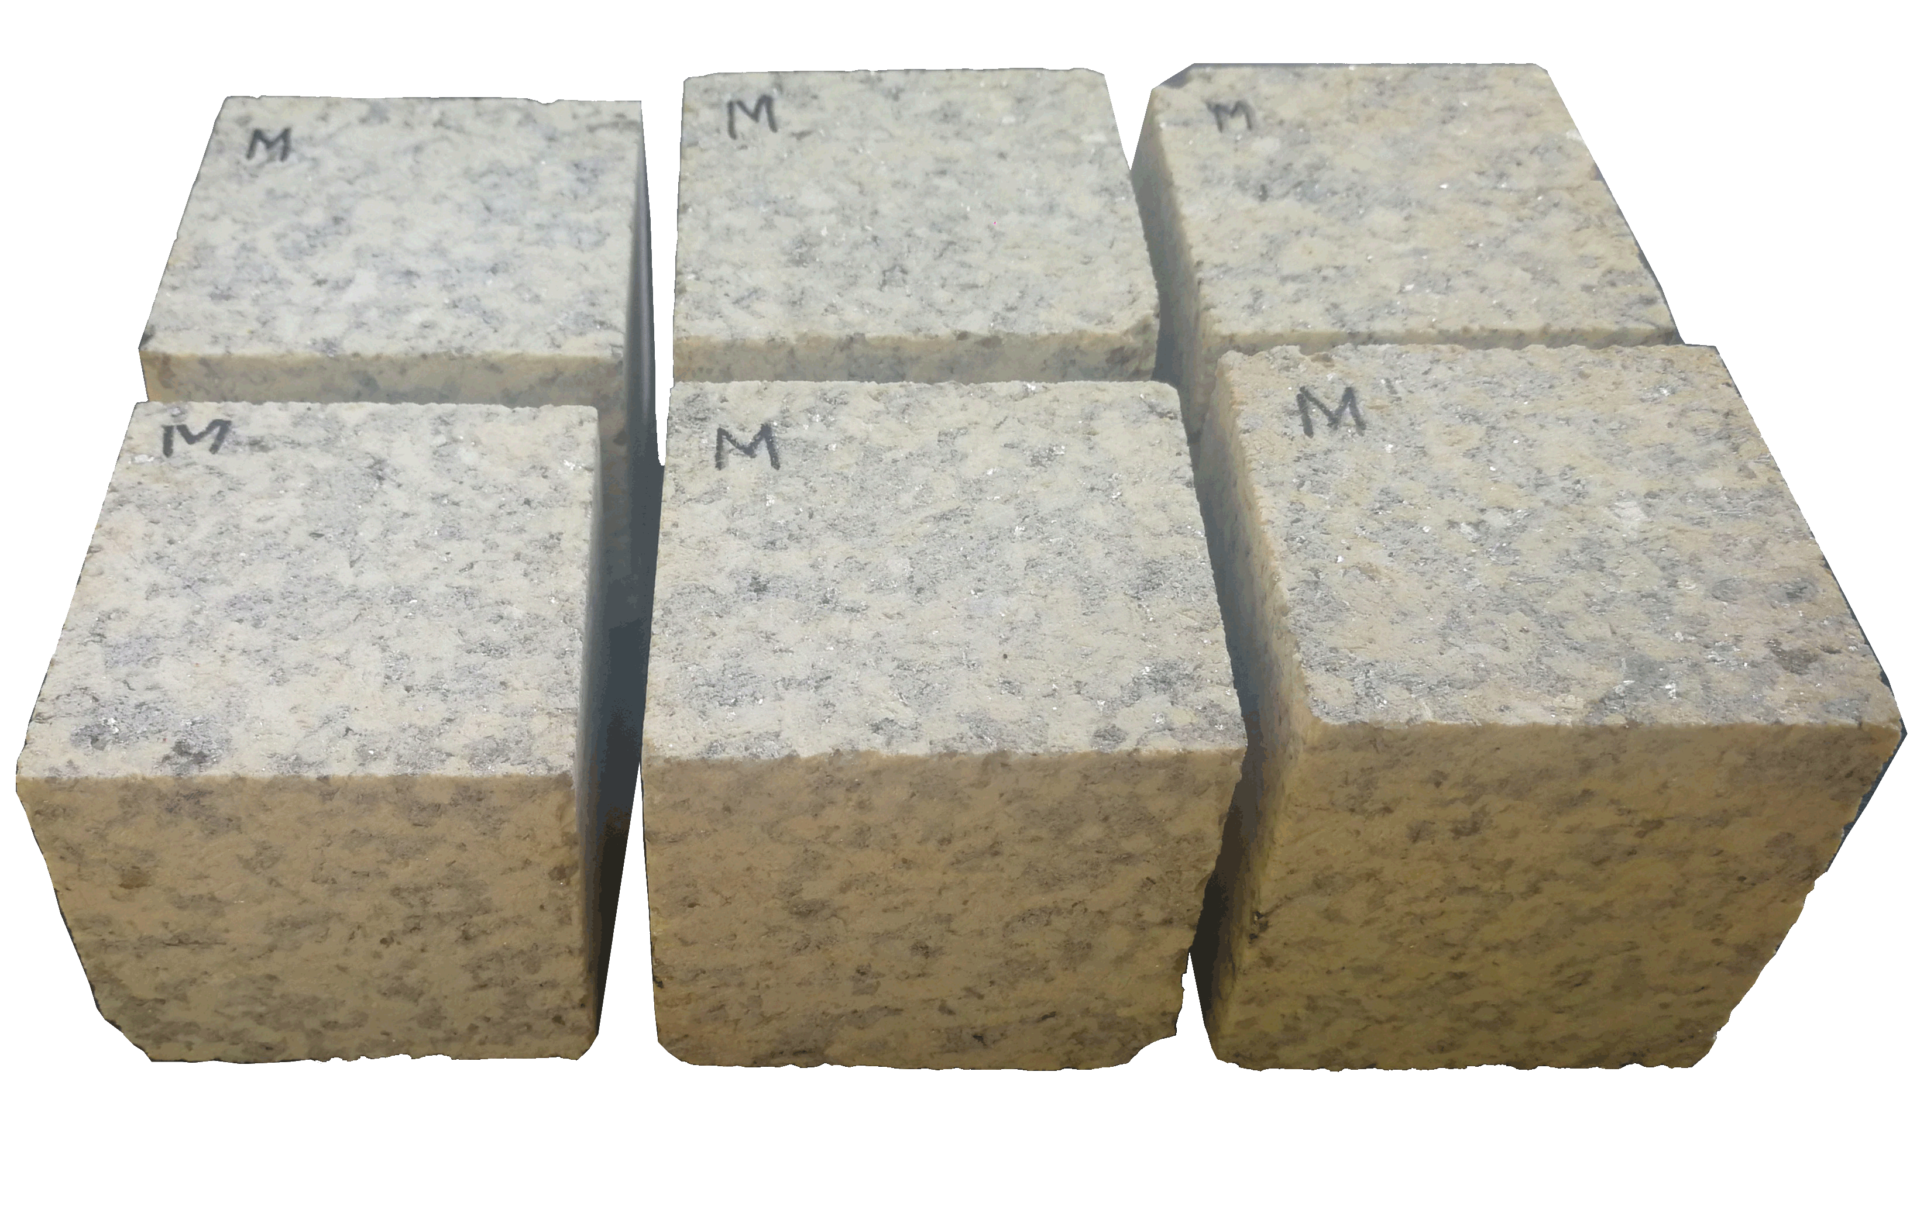
INTRODUCTION
MATERIALS & METHODS
RESULTS
CONCLUSIONS
3.3 Petrophysical properties
3.3.1 Hydric properties
Hydric properties: UNE-EN 1936: 2007
Natural stone test methods.
Bulk density and effective porosity
2020
General
Assembly

Slide 18
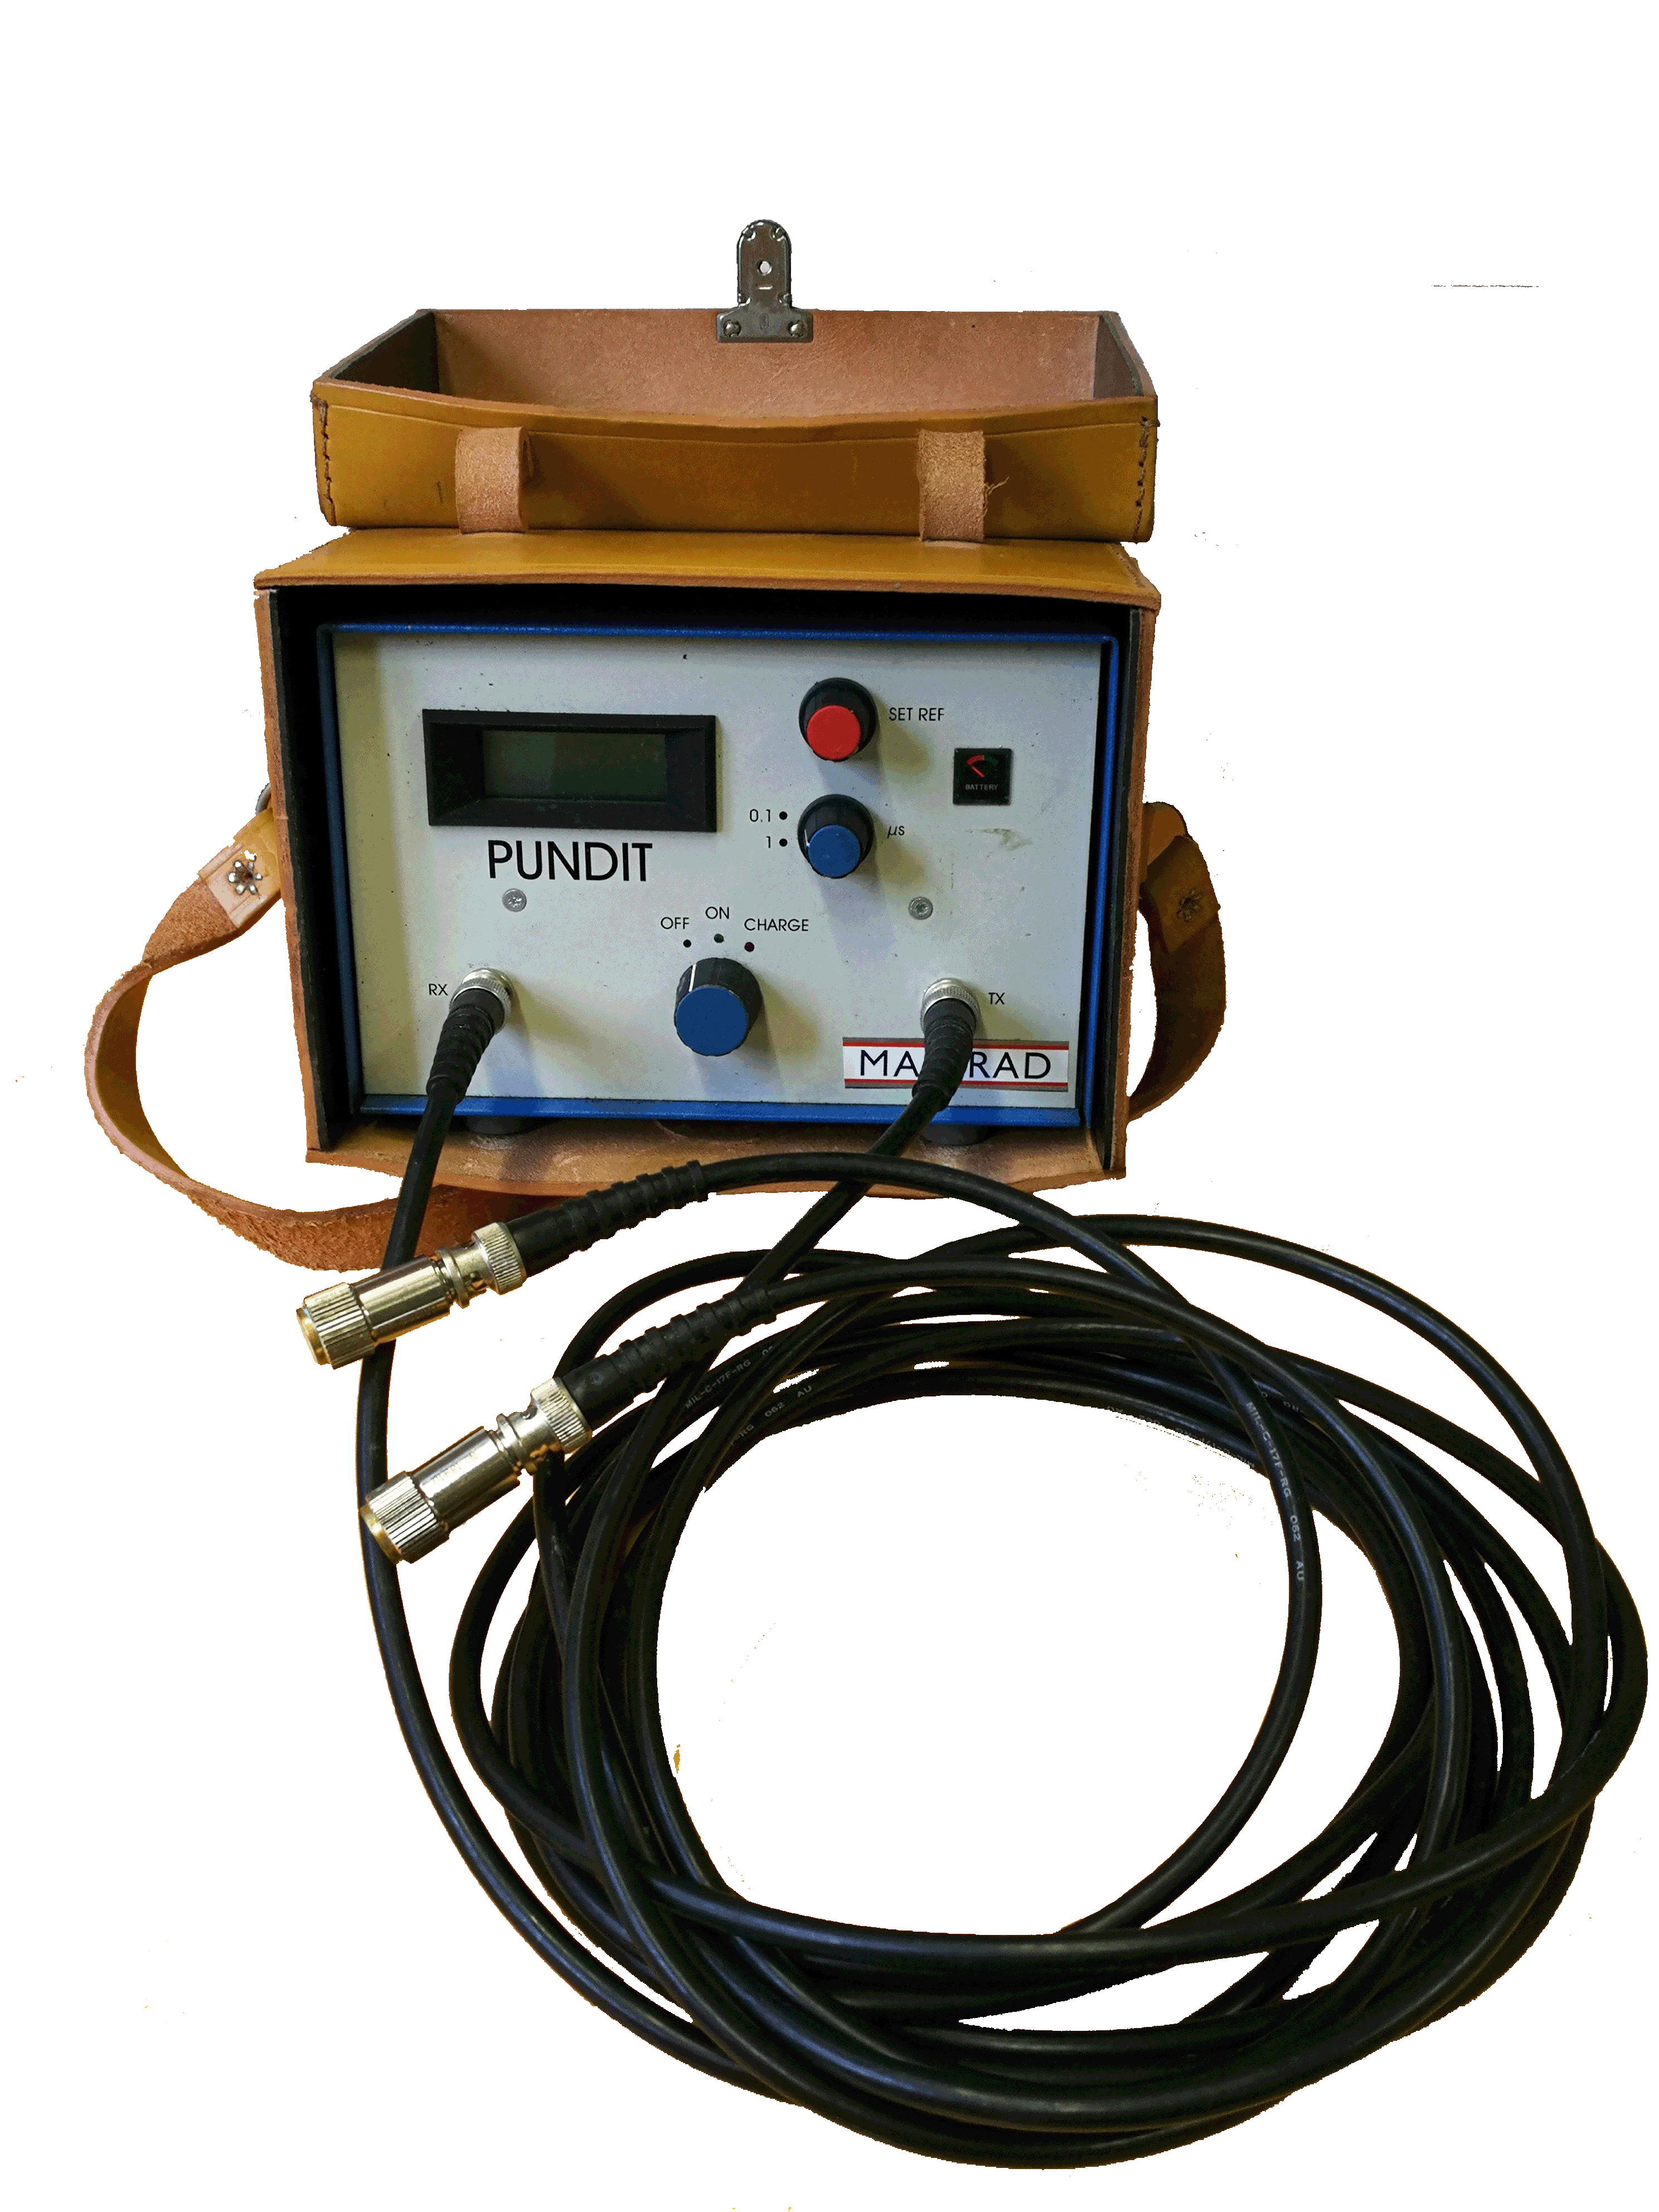
INTRODUCTION
MATERIALS & METHODS
RESULTS
CONCLUSIONS
3.3 Petrophysical properties
3.3.2 Ultrasound pulse velocity
2020
General
Assembly

Slide 19
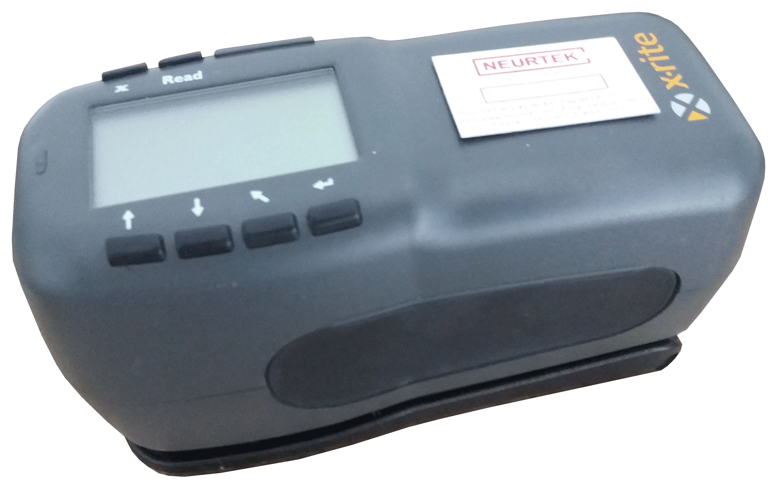
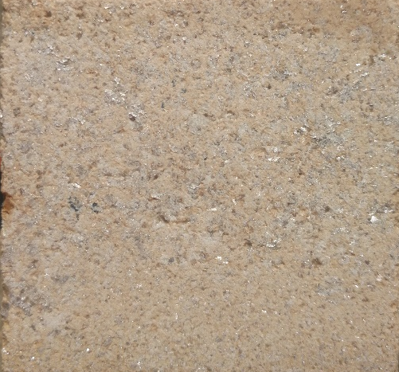
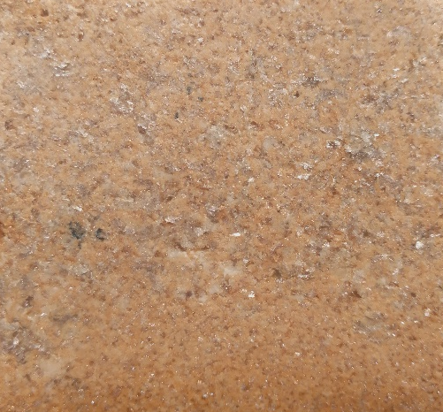
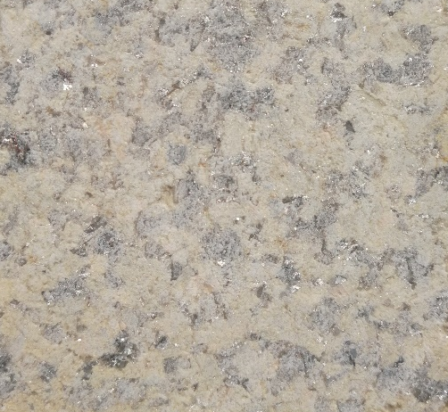
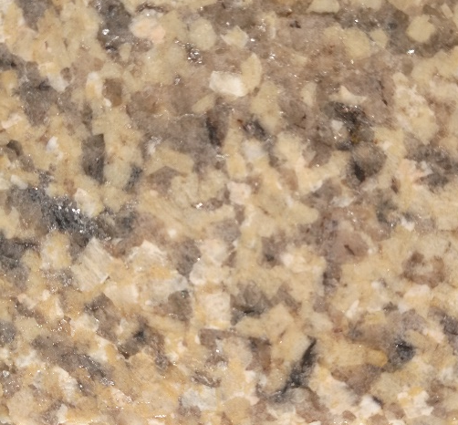
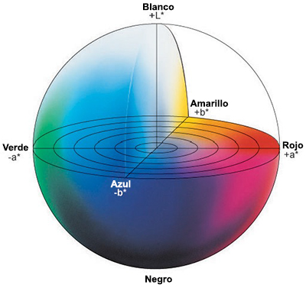
INTRODUCTION
MATERIALS & METHODS
RESULTS
CONCLUSIONS
3.3 Petrophysical properties
3.3.3 Colour
Dry
Wet
X-Rite colorimeter (model 964).
Illuminant: D65
White
Yellow
Green
Red
Blue
2020
General
Assembly
Black
Notes:
X-Rite colorimeter (model 964) (Fig. 6a), with a 45°/0° geometry and specular component included, and by using the D65 illuminant. Considering the polyphasic character and textural heterogeneity of the stones, several shots must be done to get a mean value (Prieto et al. 2010, Urosevic et al. 2010, Sousa and Gonçalves 2012). In this study,
The colour parameters were obtained from the mean value of 20 shots made with the 8 mm aperture.
Colour is expressed using CIE-L*a*b* system, the most widely used to classify the colour without misinterpretations. In the CIE-L*a*b* system, the colour is quantified according to three chromatic coordinates.
The L* parameter represents lightness or luminosity (L*=0, black; L*=100, white).
the a* parameter is the red–green axis (a*>0, red; a*<0, green)
the b* parameter is the yellow–blue axis (b*>0, yellow; b*<0, blue).

Slide 20
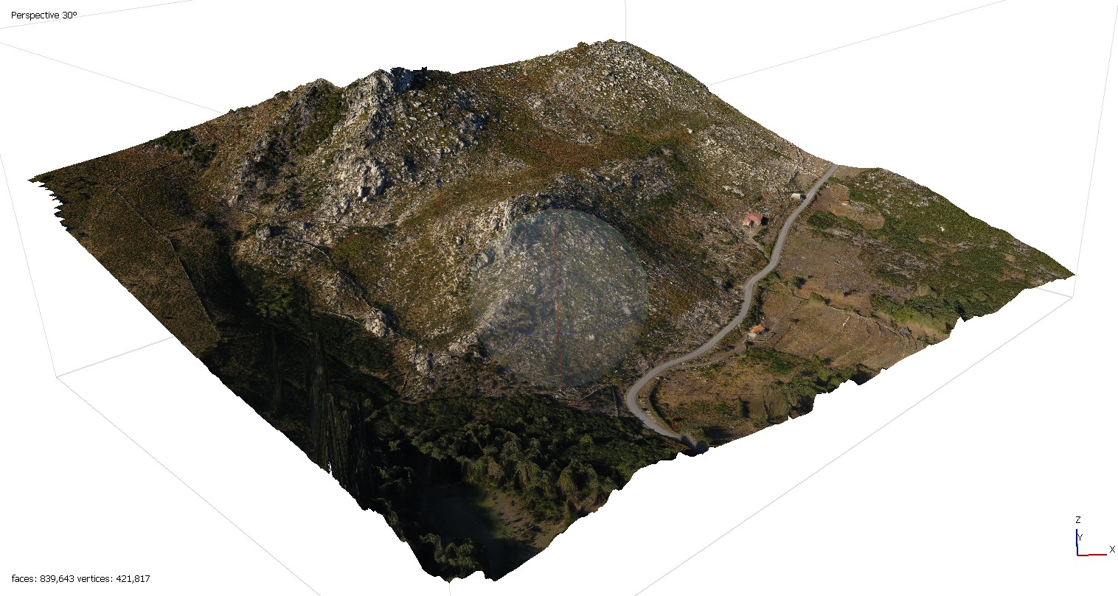
INTRODUCTION
MATERIALS & METHODS
RESULTS
CONCLUSIONS
2 Characterisation of the extraction area
429.2 m
616.2 m
2020
General
Assembly

Slide 21
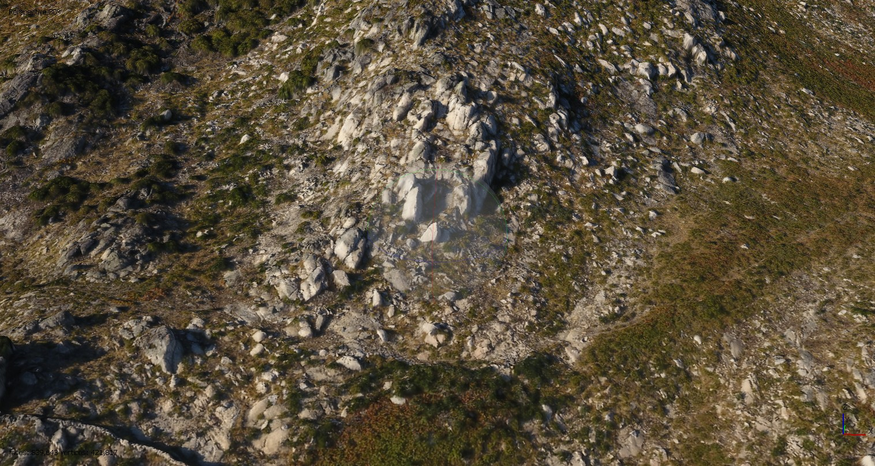
INTRODUCTION
MATERIALS & METHODS
RESULTS
CONCLUSIONS
2 Characterisation of the extraction area
Old road
Stone dumps
Stone stockpile
Extraction Zone

Slide 22
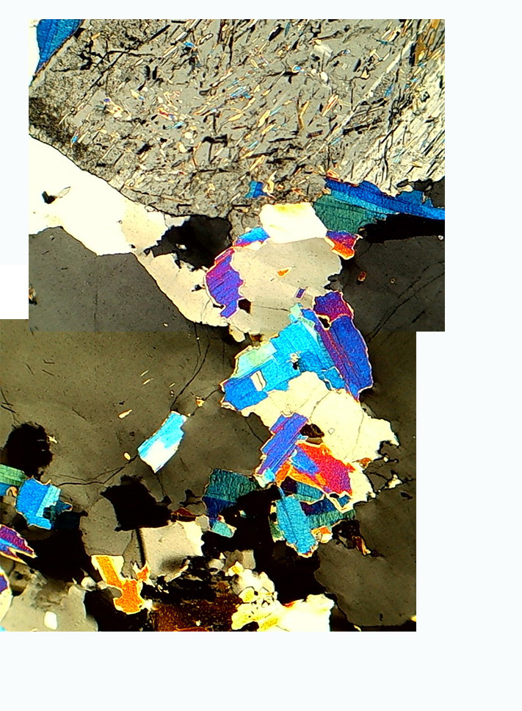
INTRODUCTION
MATERIALS & METHODS
RESULTS
CONCLUSIONS
3.1 Petrographic Properties
Qzt
Mo
Mo
Granite
Qzt
1
Qzt
0
mm
2020
General
Assembly

Slide 23
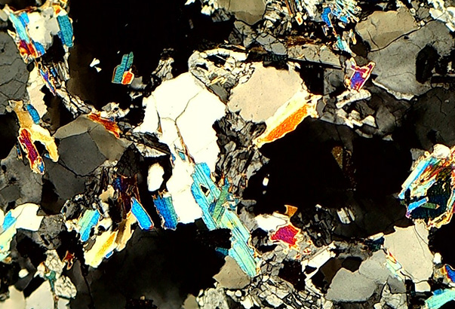
INTRODUCTION
MATERIALS & METHODS
RESULTS
CONCLUSIONS
3.1 Petrographic Properties
Mo
Mo
Qzt
Qzt
Aplite
Qzt
0
1
mm
2020
General
Assembly

Slide 24
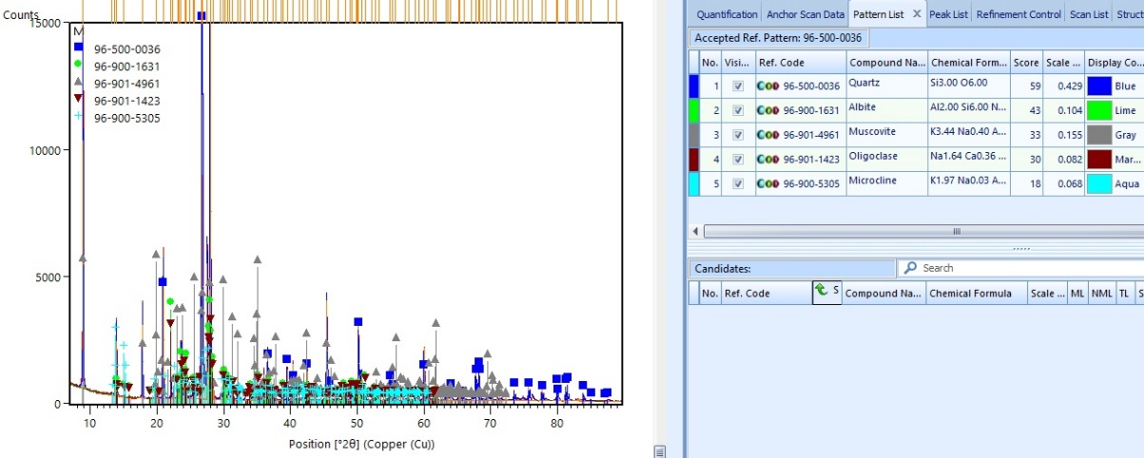
INTRODUCTION
MATERIALS & METHODS
RESULTS
CONCLUSIONS
3.2 Mineralogical Composition (XRD)
Quartz
GRANITE
Albite
Muscovite
Oligoclase
Microcline
2020
General
Assembly

Slide 25
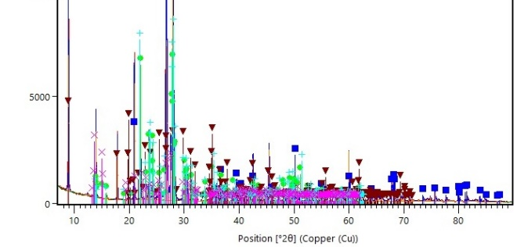
INTRODUCTION
MATERIALS & METHODS
RESULTS
CONCLUSIONS
3.2 Mineralogical Composition (XRD)
Quartz
Albite
Muscovite
APLITE
Oligoclase
Microcline
×
2020
General
Assembly

Slide 26

INTRODUCTION
MATERIALS & METHODS
RESULTS
CONCLUSIONS
3.3 Petrophysical properties
3.3.1 Hydric properties
Granite
Aplite
2020
General
Assembly

Slide 27
INTRODUCTION
MATERIALS & METHODS
RESULTS
CONCLUSIONS
3.3 Petrophysical properties
3.1.2 Ultrasound pulse velocity
 |  | Vp (m/s)
 | Granite | 3978 | ± | 180
 | Aplite | 4567 | ± | 108

Slide 28
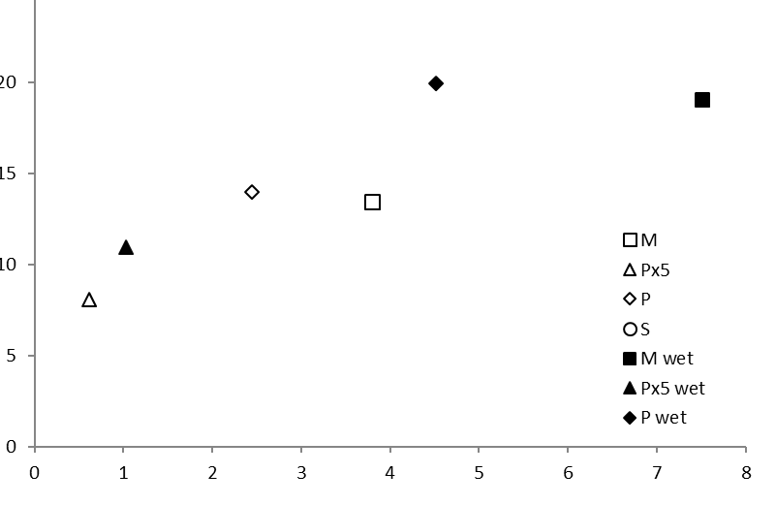
INTRODUCTION
MATERIALS & METHODS
RESULTS
CONCLUSIONS
3.3 Petrophysical properties
3.1.3 Colour
Granite
Aplite
b
Dry |  |  | Wet (1h)
L | a* | b* | L | a* | b*
67.66 | 0.61 | 8.05 | 51.24 | 1.03 | 10.95
63.04 | 3.8 | 13.41 | 42.24 | 7.51 | 19.01
Granite
Aplite
a
2020
General
Assembly

Slide 29
INTRODUCTION
MATERIALS & METHODS
RESULTS
CONCLUSIONS
Two types of igneous stones are the most used in the built heritage of Vila Real: granite and aplite.
The quarries of Pena have supplied building stones for Vila Real heritage buildings.
Both building stones have different petrophysical properties and similar mineralogical composition.
The stone decay will be studied with accelerated artificial aging tests.
2020
General
Assembly

Slide 30
THANK YOU FOR YOUR ATTENTION
Dr. David Martín Freire-Lista
davidfreire@utad.pt
2020
General
Assembly
Heritage Stones: Global relevance vis-à-vis architectonic heritage

