Slide 1
Title: Storage/Release of Geologic Carbon Influenced Pleistocene Glacial/Interglacial Atmospheric pCO₂ Cycles
Lowell Stott, University of Southern California
With, Jun Shao, Katie Harazin, Bryan Davy, Ingo Pecher, Richard Coffin, Ludovic Reass, Jenny Suckale

Slide 2
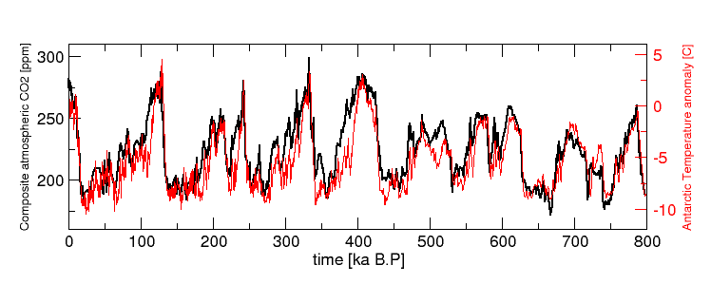
Antarctic Air Temperatures and
Associated Atmospheric CO₂ Variability
If temperatures are linked to atmospheric CO₂ variability, what controls the CO₂ perturbations?
After More than 30 Years of Research the Source of CO₂ and the Mechanism Responsible for its Regulation Remains a Mystery-----A Grand Challenge
Notes:
Here are Earth System has managed to ‘Regulate’ the concentration of atmospheric pCO2 between a very narrow range…..180 and 280ppm.

Slide 3
Prevailing Hypothesis:
Carbon Pump Ocean & Ventilation Change
The prevailing hypothesis to explain the glacial/interglacial pCO₂ variability calls upon ocean-stratification and reduced ventilation of deep waters during glaciations.
In this scenario atmospheric CO₂ is drawn down by the marine biological pump and respired metabolic carbon accumulates in a deep ocean reservoir that remains isolated from the atmosphere.

Slide 4
Prevailing Hypothesis Predicts:
Glacial Ocean
Increased dissolved carbon in Deep Waters of the Pacific
Lower deep water δ¹³C_{DIC} from accumulation of respired carbon
Lower dissolved oxygen concentrations in Pacific Deep Water
Longer deep water residence times and hence, lower Δ¹⁴C
DeGlacial Ocean, Heinrich 1
Rising deep water δ¹³C_{DIC} from ventilation of old respired carbon
Higher dissolved oxygen concentrations in Pacific Deep Water
Shorter deep water residence times in the deglacial ocean and hence, higher deep water Δ¹⁴C

Slide 5
Considerations
Global Carbon Budget Assumes Constant Geologic Carbon Flux on Glacial/Interglacial Timescales
The Ocean Being the Next Largest Reservoir is Assumed to Regulate Atmospheric pCO₂
Production Rate May Remain ~Constant, But Geologic Storage May Not Remain Constant

Slide 6
Testing Prevailing Hypothesis:
Lower Glacial Dissolved O₂?
Recent Studies Estimate 130μmol/kg
Lower Glacial Deep Water [O₂]
Jacobel, A. W. et al. Deep Pacific storage of respired carbon during the last ice age: Perspectives from bottom water oxygen reconstructions. Quaternary Science Reviews, 106065, (2019).
Anderson, R. F. et al. Deep-Sea Oxygen Depletion and Ocean Carbon Sequestration During the Last Ice Age. Global Biogeochemical Cycles 33, 301-317, (2019).
Important!
130μmol/kg lowering of Deep Water O₂
by metabolic carbon respiration
would lower δ¹³C_{DIC} by ~1‰

Slide 7
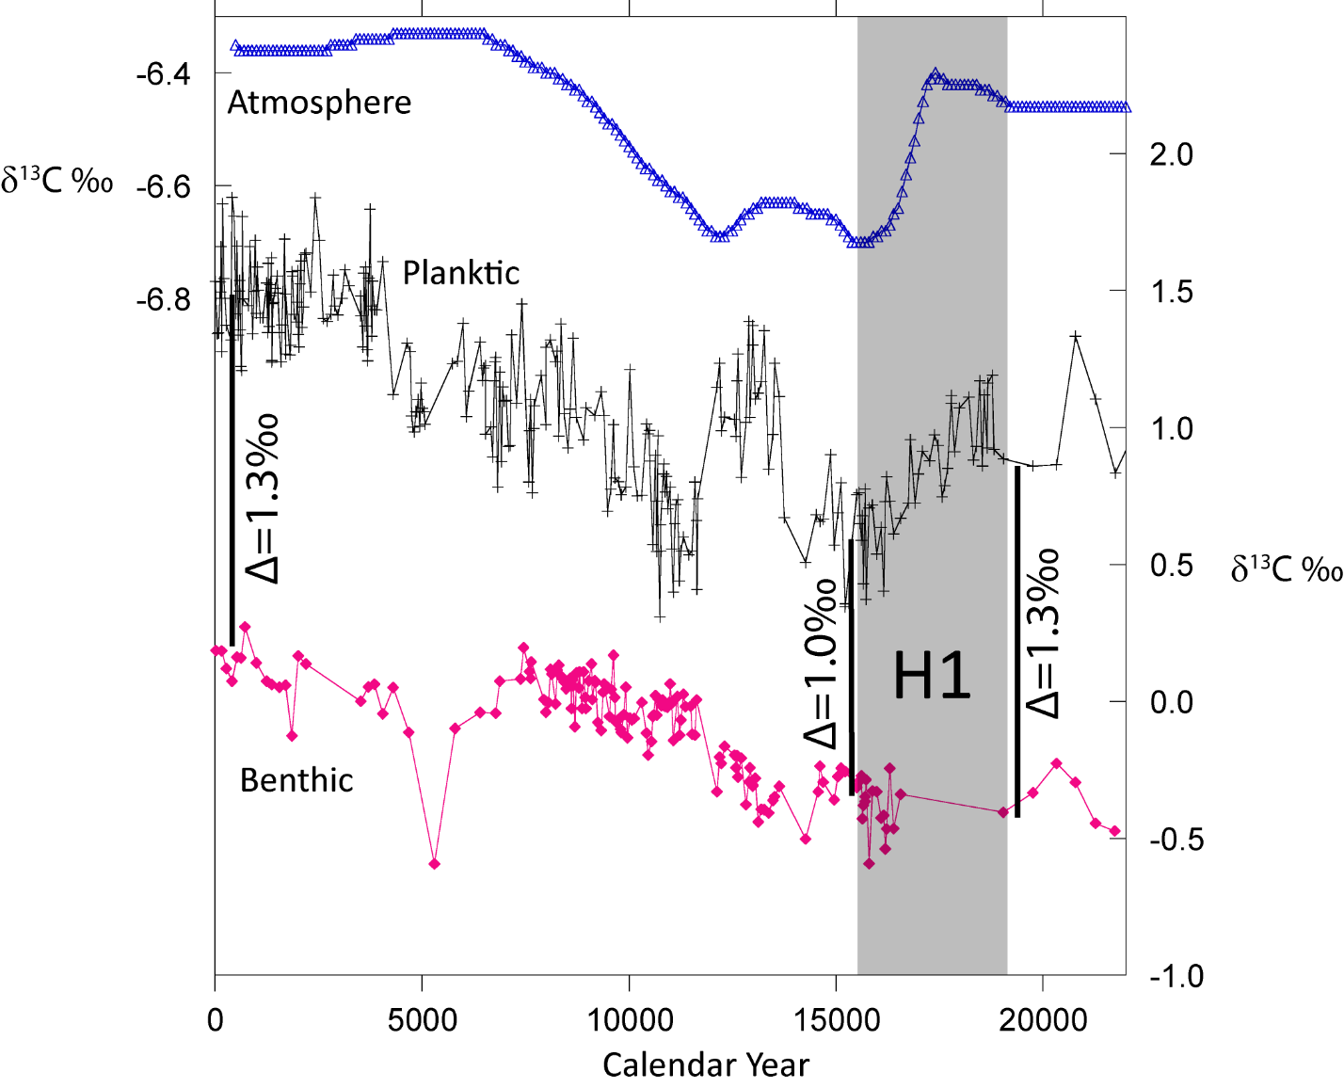
Testing the Prevailing Hypothesis
The record of atmospheric δ¹³C (CO₂), planktic (G. ruber) δ¹³C and benthic (C. mundula) δ¹³C from core MD98-2181 from the western tropical Pacific. All values are plotted relative to the VPDB standard. Located at 2114m water depth, the marine core is bathed today by Pacific Deep Water.
No Net Change
in glacial Deep Water δ¹³C
(relative to surface water)

Slide 8
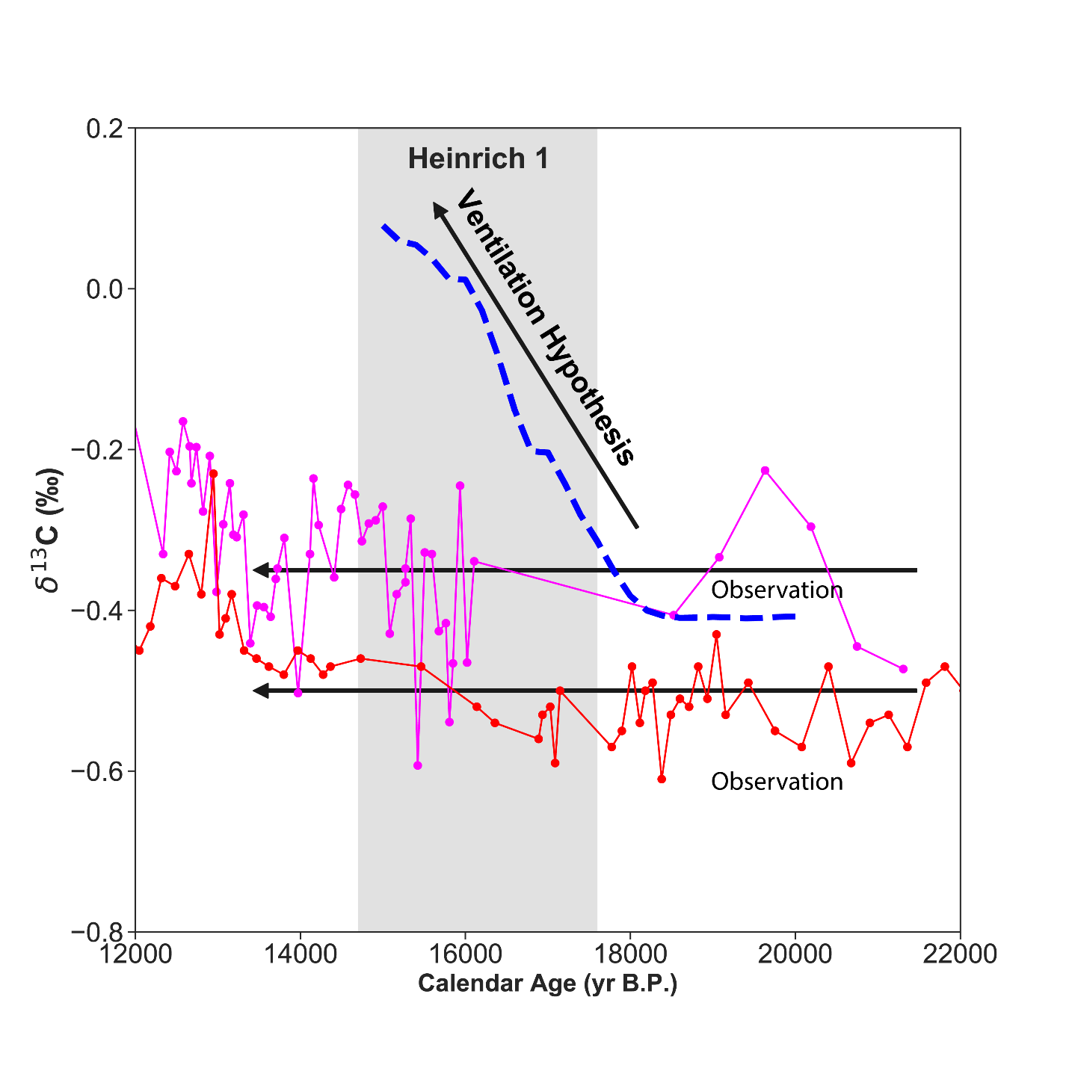
Prevailing Hypothesis predicts increasing Pacific Deep Water δ¹³C during H1
Benthic δ¹³C (Obs) from deep Pacific cores MD98-2181 (magenta, this study) and W8709A-13PC(red)(Lund et al, 2011 and 2013) and the LOVECLIM simulated Deep Pacific δ¹³C_{DIC} response to enhanced ventilation (blue) (Menviel et al., 2018).
No Increase in
Pacific Deep Water
δ¹³C during H1

Slide 9
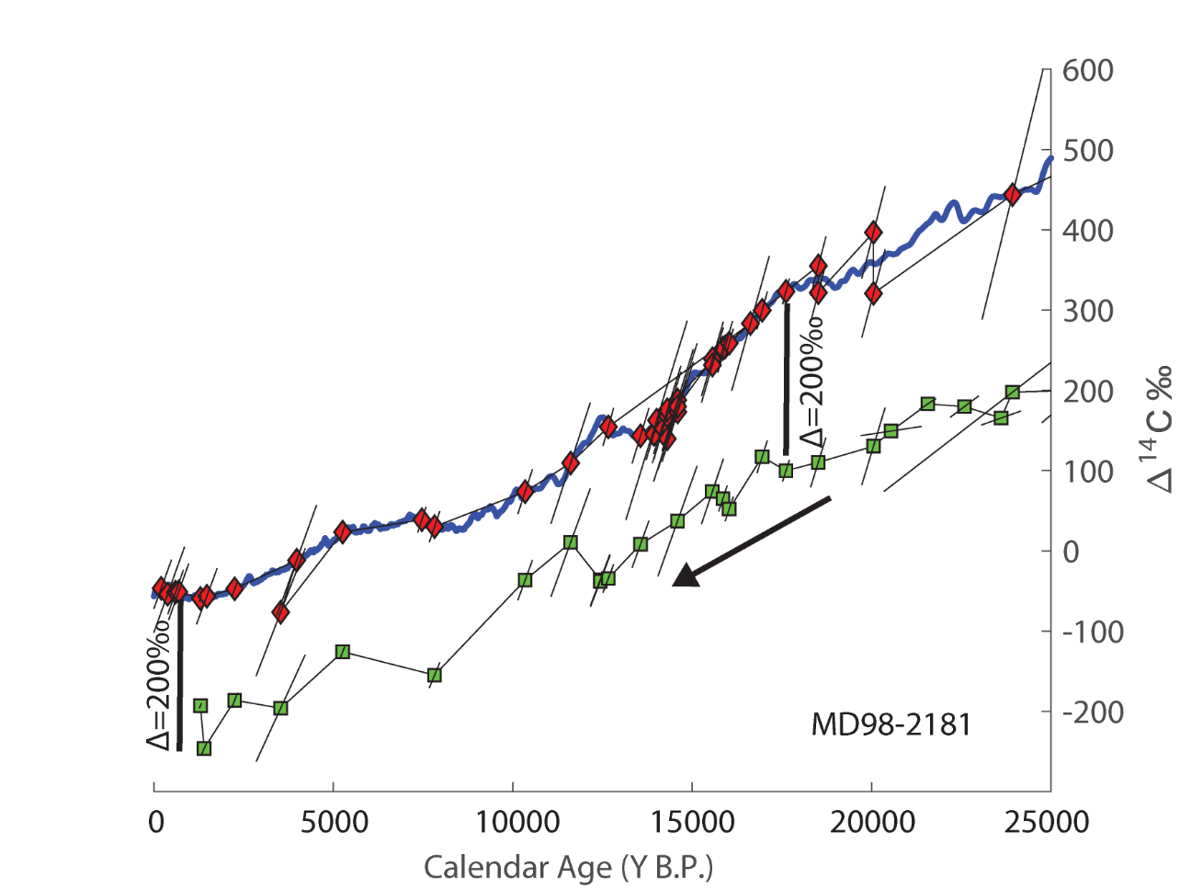
Prevailing Hypothesis Predicts:
Longer Residence Time of Pacific Deep Water
Planktic Δ¹⁴C (red) and benthic Δ¹⁴C (green) from core MD98-2181 with the Marine 13 Δ¹⁴C record (blue). The quivers represent the combined age (horizonal) and radiometric (vertical) uncertainties. The offset between the planktic and benthic Δ¹⁴C values is 200‰ in the Holocene and is similar during the late glacial and early deglacial sections.
No Change in Pacific
Deep Water
Residence Time

Slide 10
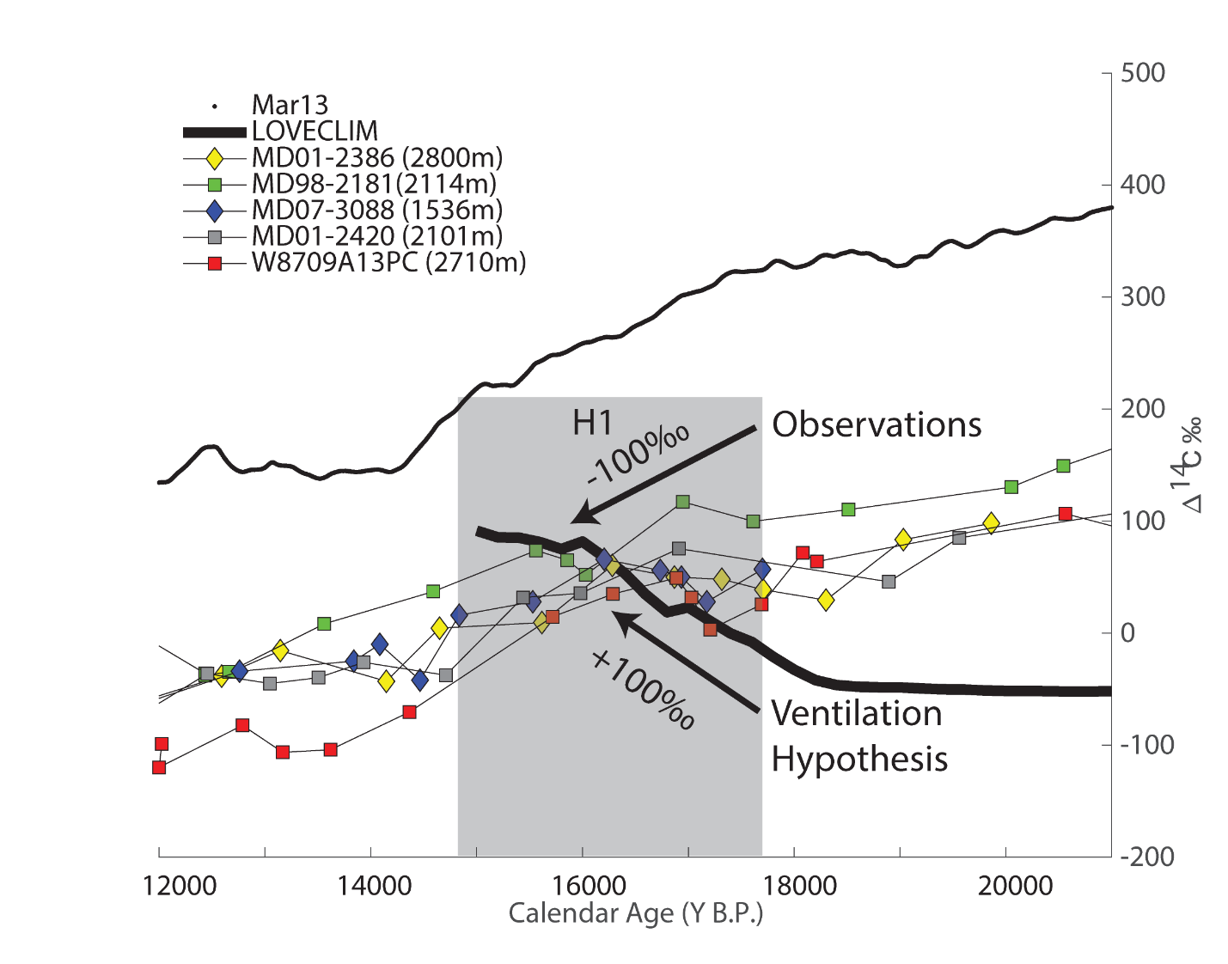
Prevailing Hypothesis Predicts Increasing Δ¹⁴C during H1 as Ocean Ventilation Increases
Benthic Δ¹⁴C from the deep Pacific cores and MAR13 (global surface ocean) Δ¹⁴C. The solid black line is the simulated deep Pacific (130E-130W, 0-50N, 2000-3000m) Δ¹⁴C response to enhanced ventilation during the deglaciation (Menviel et al 2018).
Deep Water Δ¹⁴C
does not increase
During Deglaciation

Slide 11
An Important Clue,
Southon et al., 2012
Radiocarbon History
The Mystery Interval
200º/oo Drop in Δ¹⁴C?

Slide 12
During the Late Glacial and early Deglacial
¹⁴C Production Constant
But Δ¹⁴C decreases
200-250 º/oo
Reimer et al., 2013

Slide 13
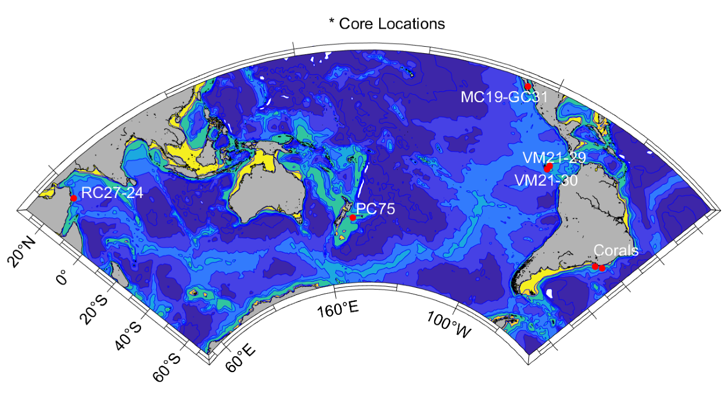
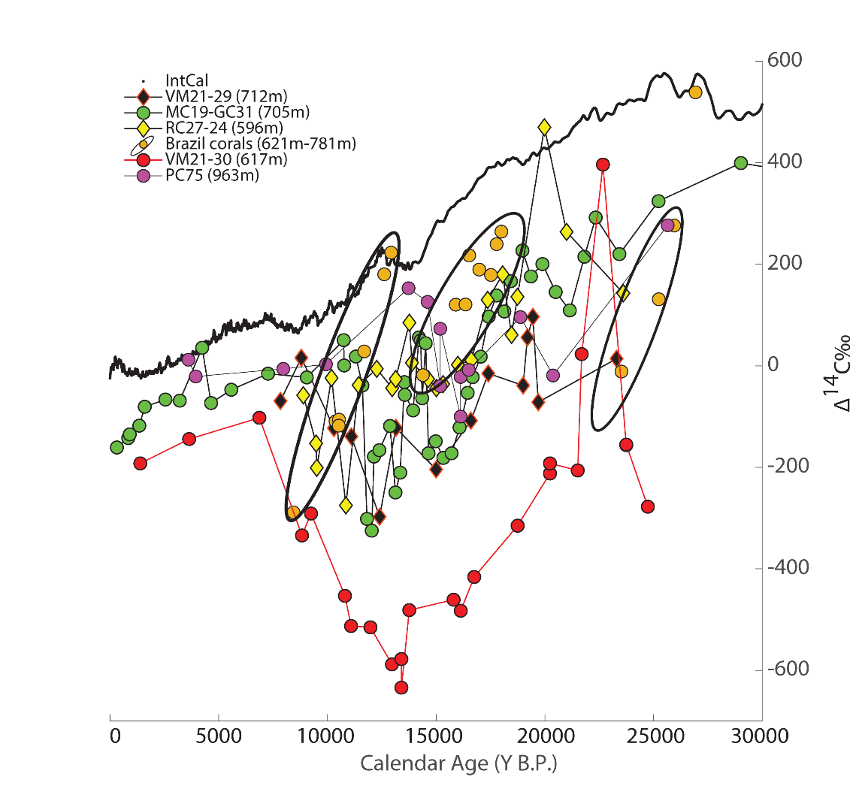
Shallow-Intermediate Depth Sites
Document Large Deglacial Δ¹⁴C excursions
Shallow intermediate depth cores that document large Δ¹⁴C excursions during the last deglaciation. Note the largest offset between the atmosphere (INTCAL) and the intermediate depth ocean is greatest during the deglacial period.

Slide 14
Recent Discoveries
Numerous Sources
of Geologic
Carbon That Are Not
Currently
Included in Marine
Carbon Budgets

Slide 15
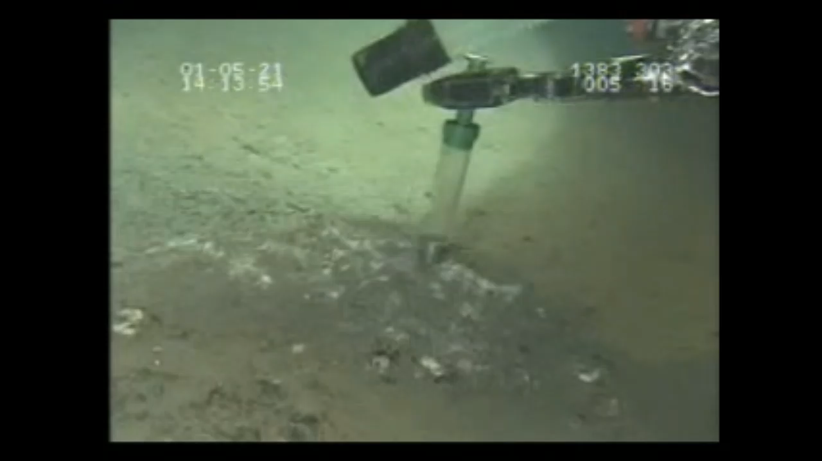
Reservoirs of Liquid/Hydrate CO₂!
Inagaki et al, 2006

Slide 16
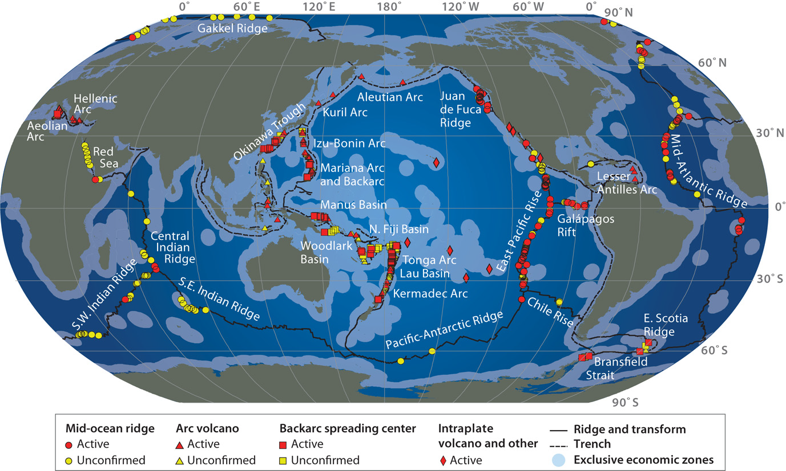
Hydrothermal Systems
Sites of Δ¹⁴C excursions
Map from Hannington et al., 2011

Slide 17
Conclusions
The findings presented here have important implications for the prevailing hypothesis for glacial/interglacial pCO₂ variability and importantly, for the global carbon cycle. We’ve shown that the hypothesis for sequestration of excess respired carbon in the deep sea is not consistent with δ¹³C and Δ¹⁴C data now available.
And the sustained decrease of Δ¹⁴C in the deep Pacific by -100‰ during the first five thousand years of the deglaciation (18-13ka) requires there to have been a large flux of ¹⁴C -depleted carbon into the ocean carbon pool that lowered the entire Pacific Δ¹⁴C. That source of carbon must have come from sites where ¹⁴C-dead carbon accumulates and can be released to the ocean on relatively short time scales. Together with recent discoveries of liquid and hydrate reservoirs of CO₂ accumulating on and near the sea floor these Δ¹⁴C records from continental margin locations indicate there are sources of carbon to the ocean that are not currently included in marine carbon budgets.
With this recognition comes the need to re-evaluate the long-standing view that geologic processes do not influence the global carbon cycle and atmospheric pCO₂ on glacial time scales. This calls for a concerted effort to identify sites where of geologic carbon is stored and can be released on glacial cycle time scales.

