Slide 1
The opposing factors controlling change in warming related future flood extremes
Ashish Sharma
^{a.sharma@unsw.edu.au}
Civil and Environmental Engineering
UNSW, Sydney, AUSTRALIA
http://www.civeng.unsw.edu.au/staff/ashish.sharma
with help from Suresh Hettiarachchi, Conrad Wasko, Seth Westra, Rhys Hardwick Jones, Tom Roderick, Kane Alexander, Sean Ou and many more
Acknowledgements
Australian Research Council
Australian Bureau of Meteorology
Water NSW, Institution of Engineers-Australia

Slide 2
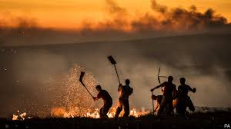
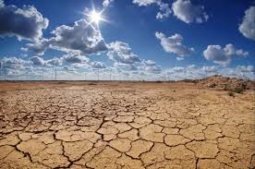
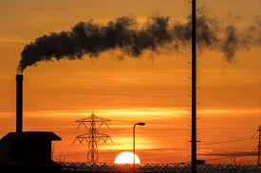
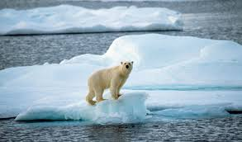
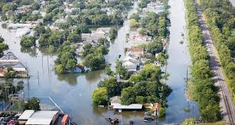
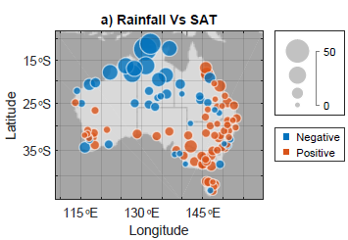
What Really Happens?
P = (Extreme) Precipitation depth
SAT = Surface Air Temperature
$$\frac{∂P}{∂SAT}$$
Roderick, T. P., Wasko, C. & Sharma, A. Atmospheric moisture measurements explain increases in tropical rainfall extremes. Geophysical Research Letters, doi:10.1029/2018GL080833 (2019).

Slide 3
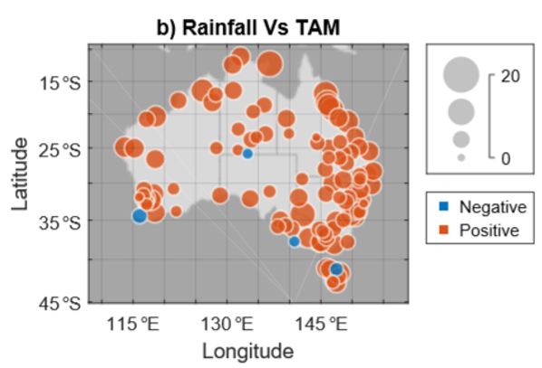
What Really Happens?
P = (Extreme) Precipitation depth
TAM = Total Air Moisture
$$\frac{∂P}{∂TAM}$$
Roderick, T. P., Wasko, C. & Sharma, A. Atmospheric moisture measurements explain increases in tropical rainfall extremes. Geophysical Research Letters, doi:10.1029/2018GL080833 (2019).

Slide 4
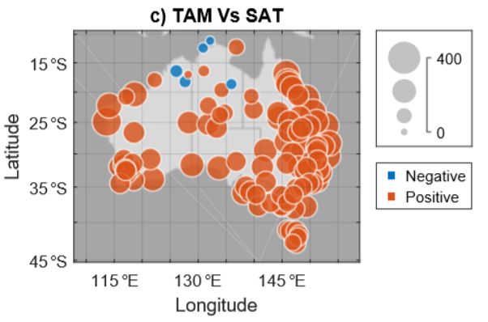
What Really Happens?
TAM = Total Air Moisture
SAT = Surface Air Temperature
$$\frac{∂TAM}{∂SAT}$$
Roderick, T. P., Wasko, C. & Sharma, A. Atmospheric moisture measurements explain increases in tropical rainfall extremes. Geophysical Research Letters, doi:10.1029/2018GL080833 (2019).

Slide 5
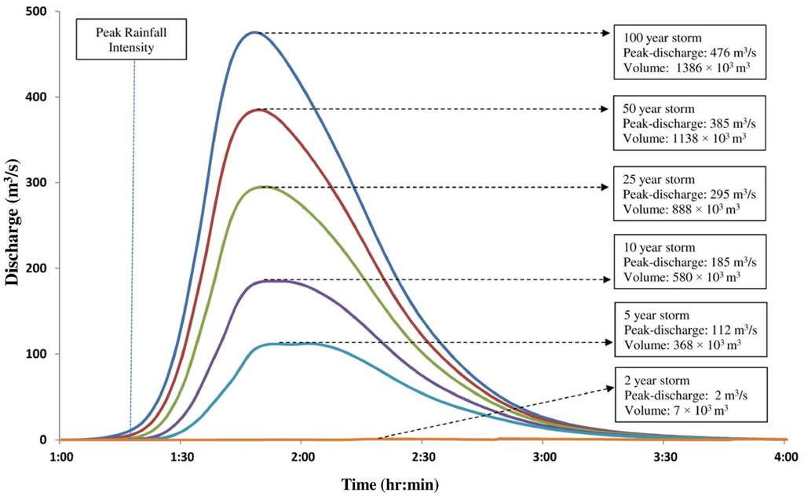
Revisiting Design Flood Estimation
1. Sample of Annual Maximum Precipitation Events
2a. Intensity Frequency Duration (IFD) curves
What happens when temperatures rise?
2b. Design Temporal Patterns
Changed initial conditions
3. Design Flood Hydrograph
Notes:
Floods -> Factoring -> Continuous rainfall simulation

Slide 6
What really happens to Design Storm Events?
Precipitation Intensity
Time
Increase in storm intensity

Slide 7
What really happens to Design Storm Events?
Precipitation Intensity
Time
Increase in storm intensity
Intensification of temporal pattern
Wasko, C. and A. Sharma, Steeper temporal distribution of rain intensity at higher temperatures within Australian storms. Nature Geoscience, 2015. 8(7): p. 527-529.

Slide 8
What really happens to Design Storm Events?
Precipitation Intensity
Time
Sharma, A., C. Wasko, and D.P. Lettenmaier, If Precipitation Extremes Are Increasing, Why Aren't Floods? Water Resources Research, 2018. 54(11): p. 8545-8551.
Increase in storm intensity
Intensification of temporal pattern
Increase in dryness or reduction in excess rainfall

Slide 9
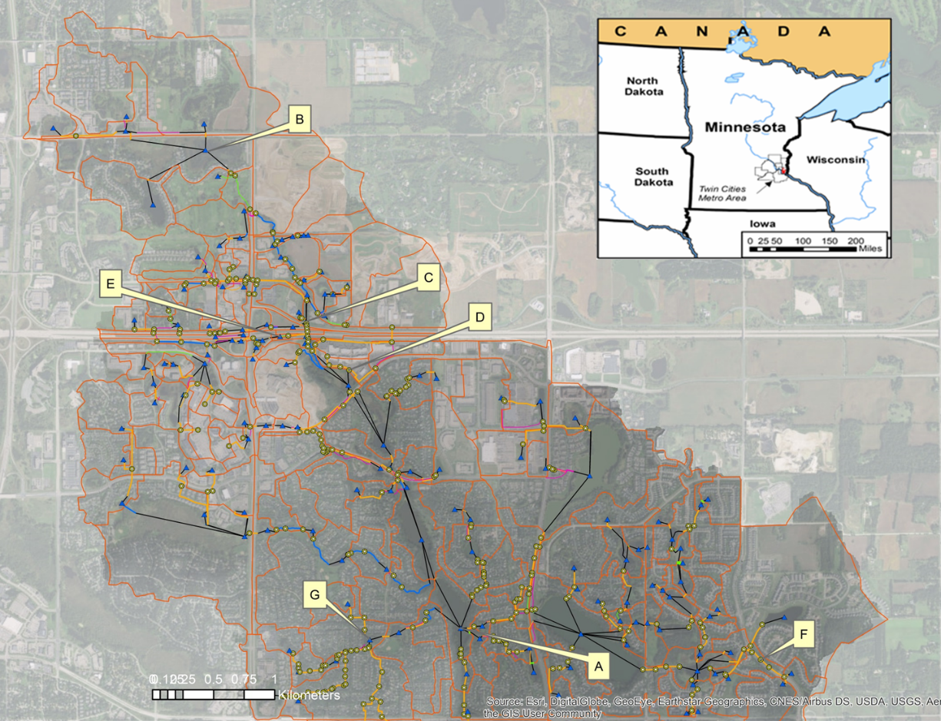
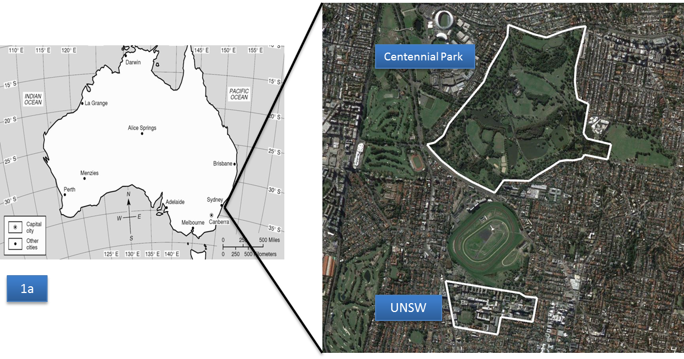
Minneapolis
~25km²
How to assess likely change in urban flooding into the future?
UNSW, Centennial Pk
~1-5km²

Slide 10
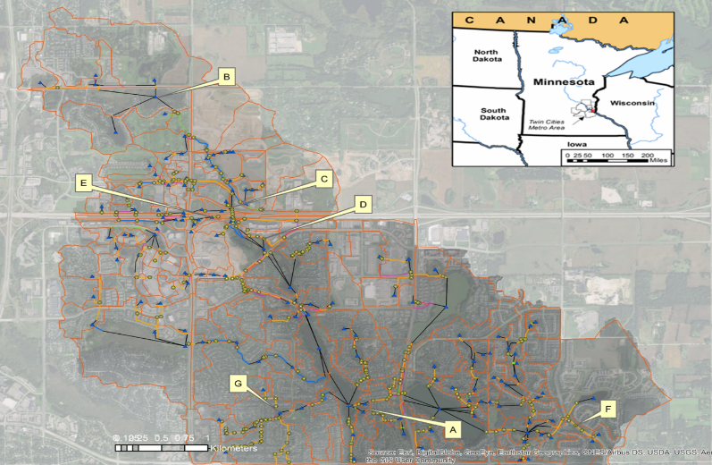
NOAA Atlas 14 Temporal Patterns
Hettiarachchi, S., Wasko, C., and Sharma, A.: Increase in flood risk resulting from climate change in a developed urban watershed – the role of storm temporal patterns, Hydrol. Earth Syst. Sci., 22, 2041-2056, https://doi.org/10.5194/hess-22-2041-2018, 2018.
First Quartile
Precirpitation in/hr
hrs

Slide 11
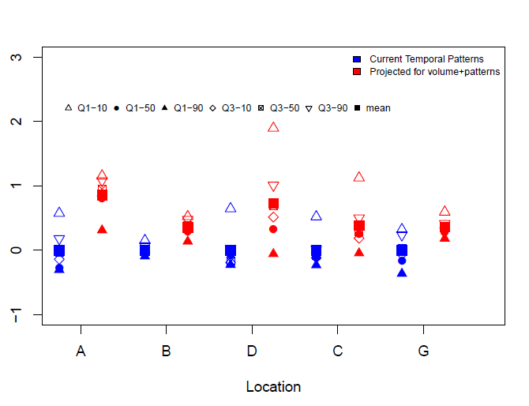
Increase in flood risk when indexed to RCP8.5
Hettiarachchi, S., Wasko, C., and Sharma, A.: Increase in flood risk resulting from climate change in a developed urban watershed – the role of storm temporal patterns, Hydrol. Earth Syst. Sci., 22, 2041-2056, https://doi.org/10.5194/hess-22-2041-2018, 2018.
Normalized flood depth (m)

Slide 12
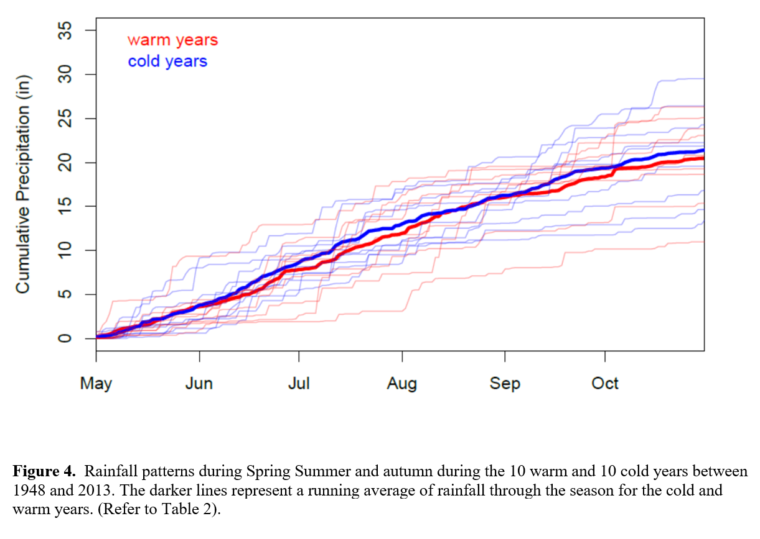
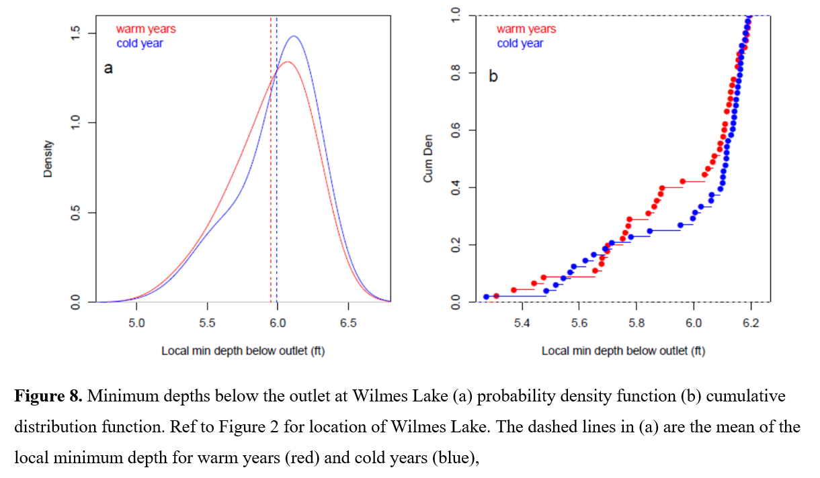
Can changes to design storm capture change when antecedent conditions are important?
Hettiarachchi, S., Wasko, C. & Sharma, A. Can antecedent moisture conditions modulate the increase in flood risk due to climate change in urban catchments? Journal of Hydrology 571, 11-20 (2019).

Slide 13
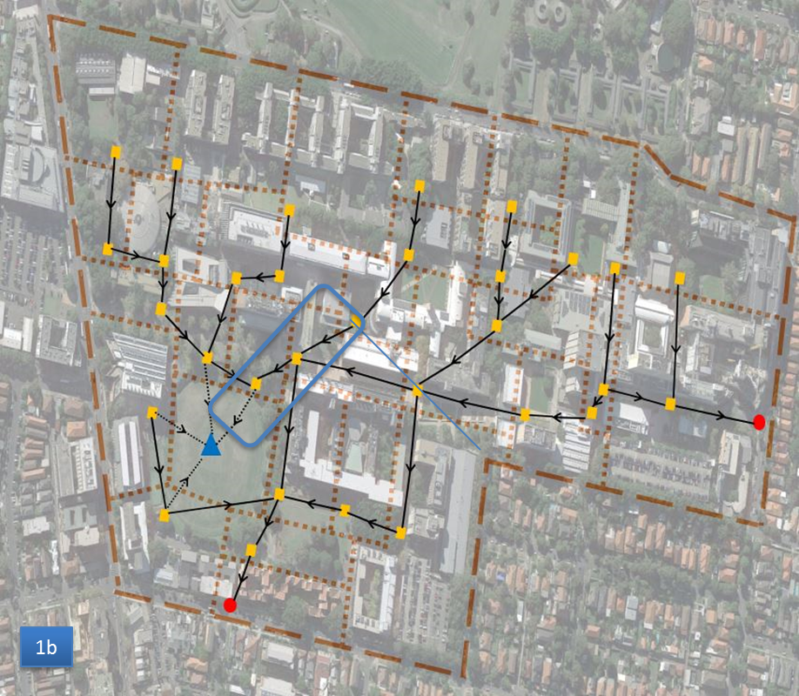
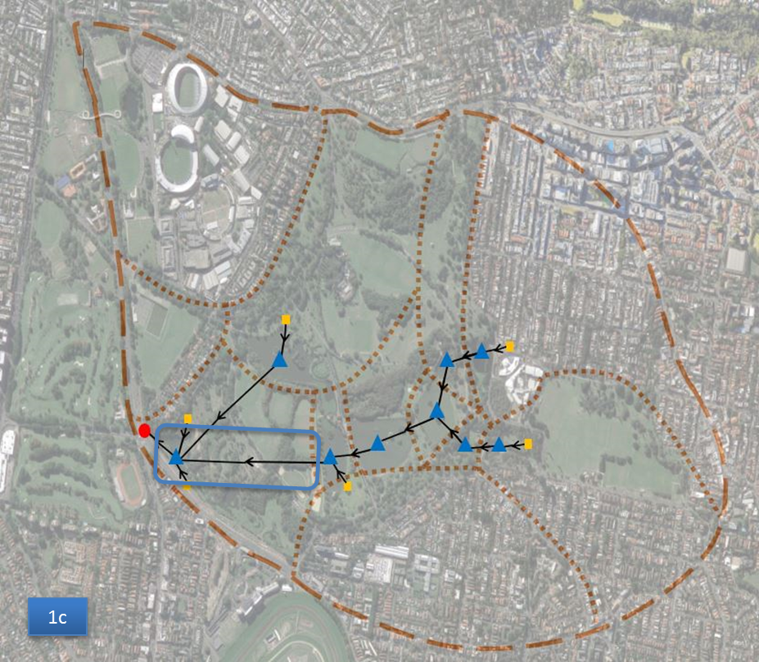
What about smaller spatial scales?
Alexander, K., S. Hettiarachchi, Y. Ou, A. Sharma, Can integrated green spaces and storage facilities absorb the increased risk of flooding due to climate change in developed urban environments? Journal of Hydrology, 2019. 579: p. 124201.

Slide 14
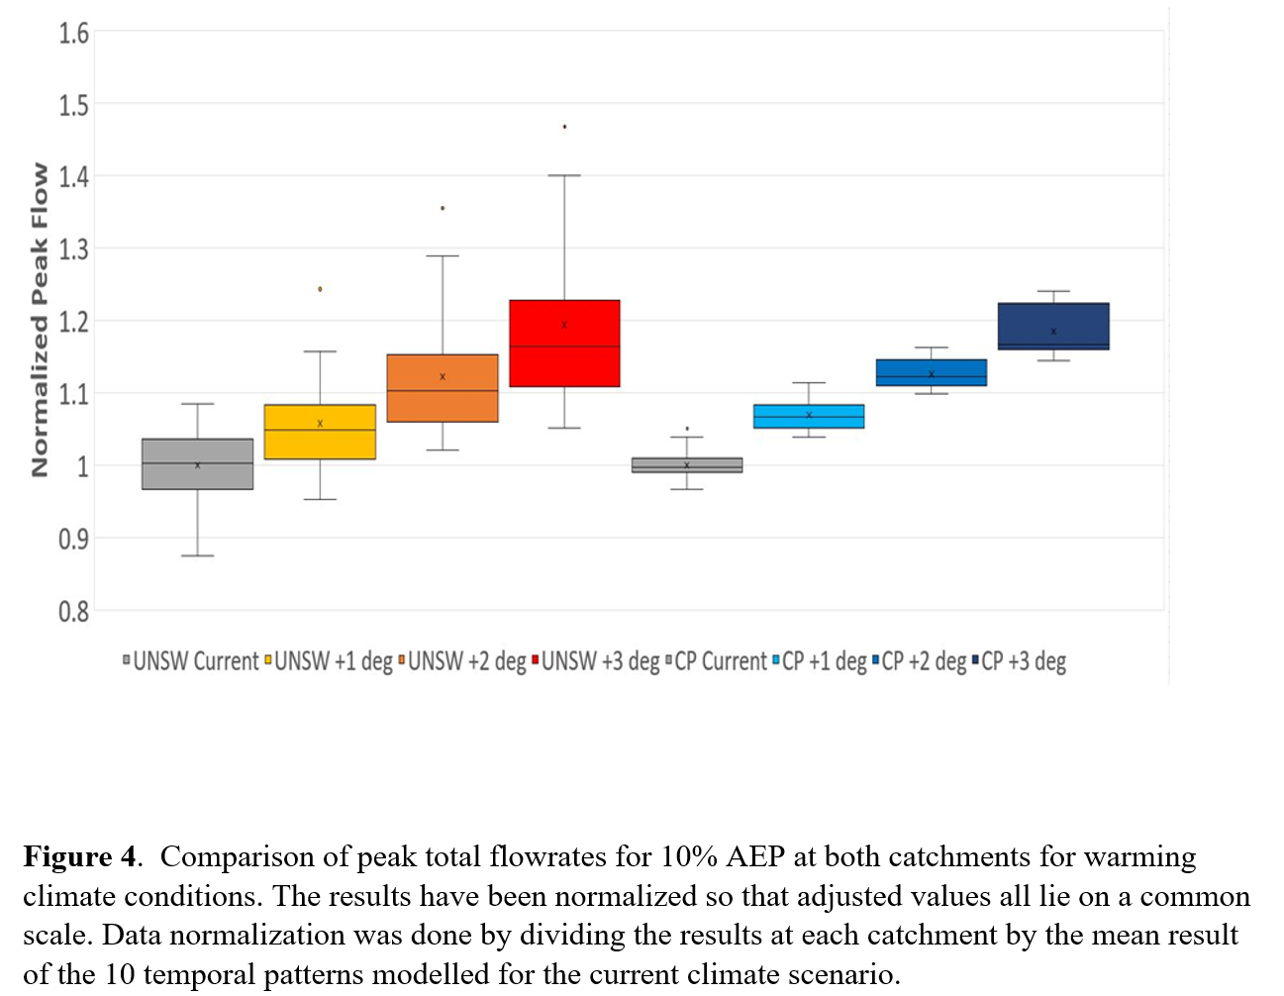
Alexander, K., S. Hettiarachchi, Y. Ou, A. Sharma, Can integrated green spaces and storage facilities absorb the increased risk of flooding due to climate change in developed urban environments? Journal of Hydrology, 2019. 579: p. 124201.

Slide 15
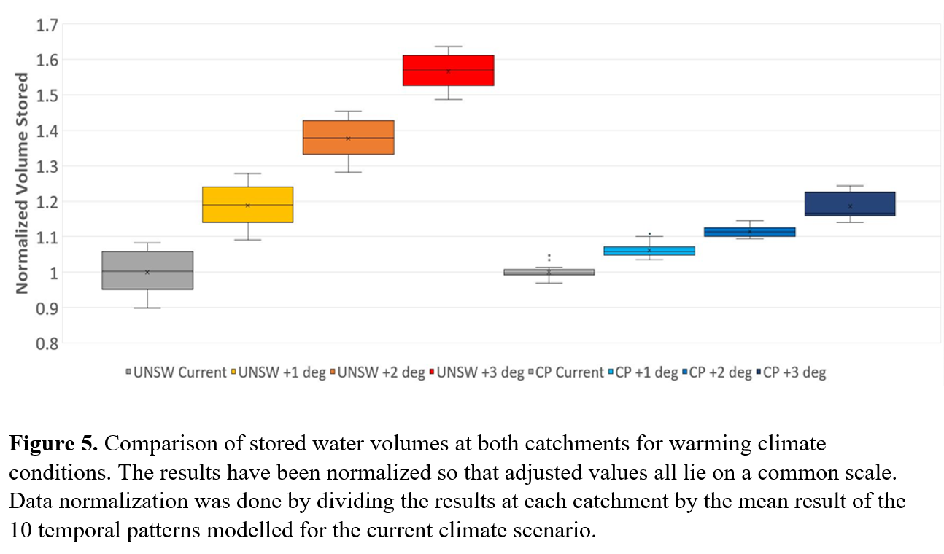

Slide 16
To summarise…
Urban flooding is on the rise, a trend that is likely to continue
Non-urban flooding will increase for rare extremes and smaller catchments
Floods lower for large catchments due to drying soils
BUT – this does not mean cities will universally flood into the future
Strategic mixing of high density and open parkland developments may offer a means on containing increases in frequent or nuisance flood events
Containing rare or extreme flood events is likely to require new stormwater infrastructure

Slide 17
The opposing factors controlling change in warming related future flood extremes
Ashish Sharma
^{a.sharma@unsw.edu.au}
Civil and Environmental Engineering
UNSW, Sydney, AUSTRALIA
http://www.civeng.unsw.edu.au/staff/ashish.sharma
with help from Suresh Hettiarachchi, Conrad Wasko, Seth Westra, Rhys Hardwick Jones, Tom Roderick, Kane Alexander, Sean Ou and many more
Acknowledgements
Australian Research Council
Australian Bureau of Meteorology
Water NSW, Institution of Engineers-Australia

