Slide 1
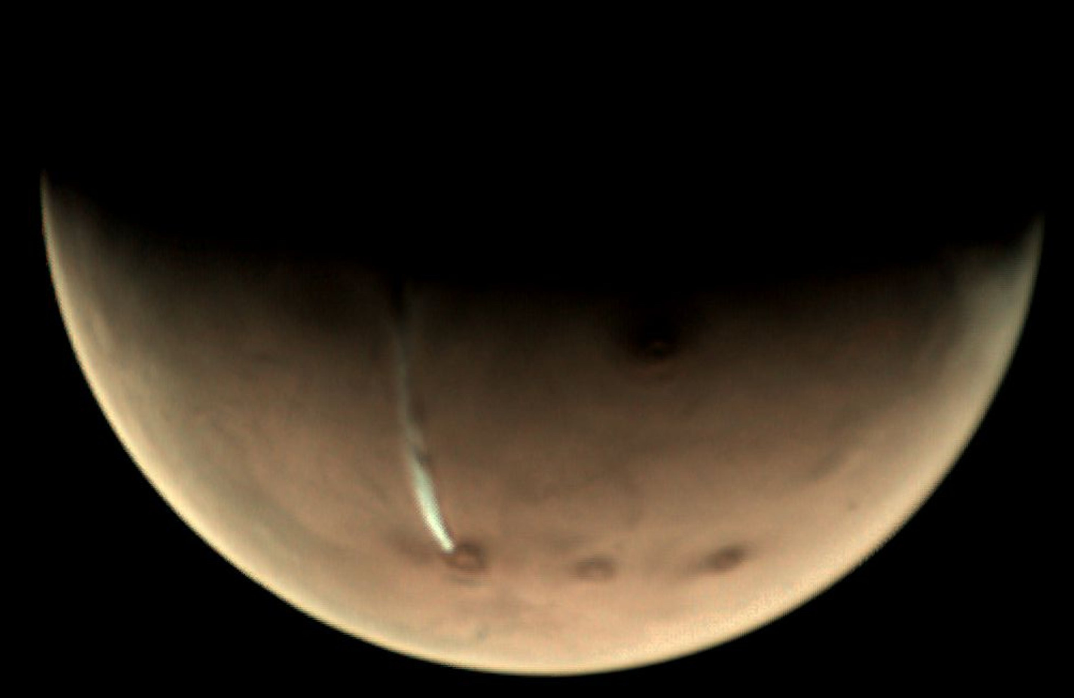
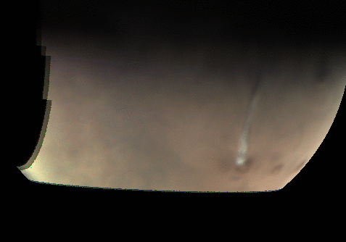
Dynamics of the extremely elongated cloud on Mars Arsia Mons volcano
J. Hernández-Bernal (1,2), A. Sánchez-Lavega (1), T. del Río-Gaztelurrutia (1), E. Ravanis (3), A. Cardesín-Moinelo (3,4), K. Connour (5), D. Tirsch (6),
I. Ordóñez-Etxeberria (1), B. Gondet (7), S. Wood (8), D. Titov (9), N. M. Schneider (5), R. Hueso (1), R. Jaumann (10), E. Hauber (6)
(1) Dpto. Física Aplicada I, EIB, Universidad País Vasco UPV/EHU, Bilbao, Spain, (2) Aula EspaZio Gela, Escuela de Ingeniería de Bilbao, Universidad del País Vasco UPV/EHU, Bilbao, Spain, (3) European Space Agency, ESAC, Madrid, Spain, (4) Instituto de Astrofísica e Ciências do Espaço, Obs. Astronomico de Lisboa, Portugal (5) Laboratory for Atmospheric and Space Physics, University of Colorado, Boulder, USA (6) German Aerospace Center (DLR), Institute of Planetary Research, Berlin, Germany. (7) Institut d’Astrophysique Spatiale, CNRS/University Paris Sud, Orsay, France (8) European Space Agency, ESOC, Darmstadt, Germany (9) European Space Agency, ESTEC, Noordwijk, Netherlands (10) Freie Universitaet Berlin, Institute of Geological Sciences, Berlin, Germany
Hernández-Bernal et al. (2020) An Extremely Elongated Cloud over Arsia Mons Volcano on Mars: Life Cycle. Submitted to JGR.

Slide 2
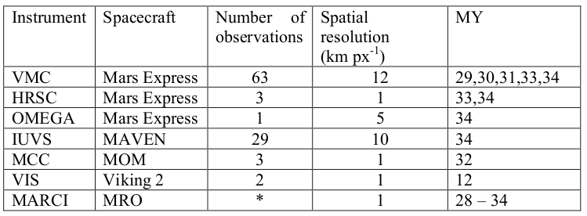
Arsia Mons Elongated Cloud (AMEC)
We observed and extremely Elongated Cloud extending up to 1800 km westward from Arsia Mons following the Global Dust Storm in Martian Year 34 (MY34).
We found a similar cloud in the same season in different years in archive images. Several instrument imaged it: VMC, HRSC, and OMEGA on board Mars Express, IUVS on MAVEN, MCC on MOM, and even Viking 2 orbiter.

Slide 3
Sun-synchronous orbits and Local Time Diversity
Many missions in the last 20 years of Mars exploration were placed in sun-synchronous orbits on the afternoon. This is great for cartography and geology, and provides easily comparable systematic data of atmospheric features.
However, sun-synchronous missions lack of the capability to study a wide diversity of local times, and the dynamics of the Martian atmosphere are very fast. That is why few suitable observations of this cloud are available.
Mars Express, MAVEN, MOM, and TGO are current orbiters in non-sun-synchronous orbits. Vikings were neither sun-synchronous.

Slide 4
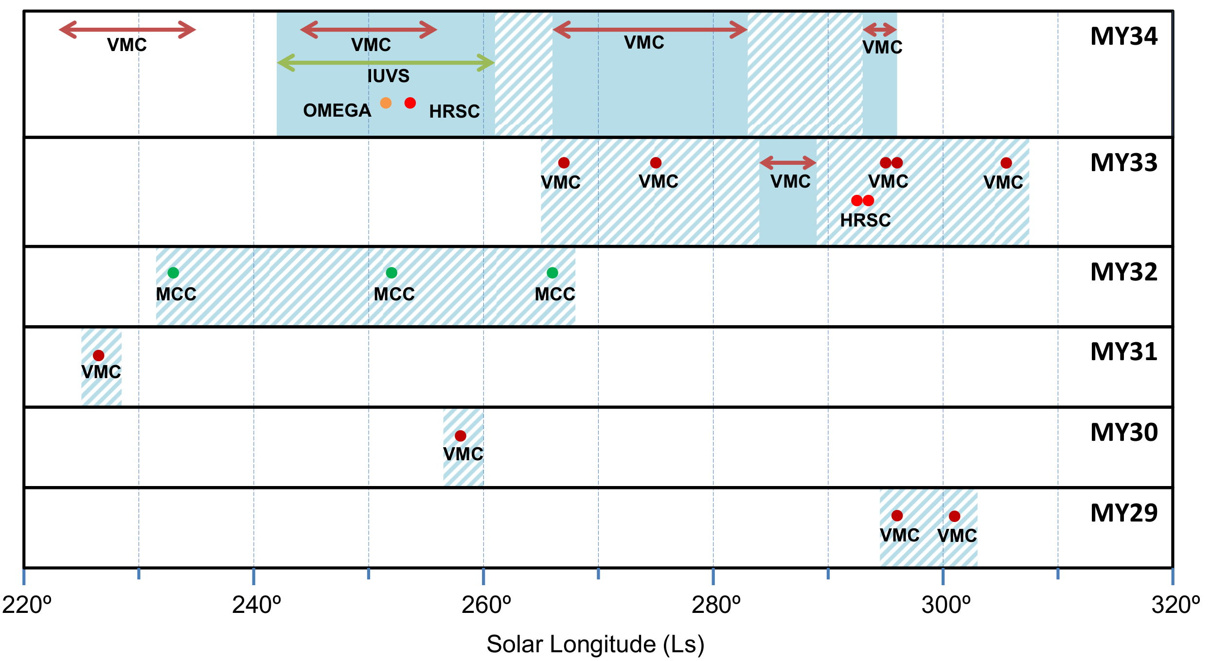
Observations of the AMEC along the years
Instruments:
Mars Express:
VMC
HRSC
OMEGA
MAVEN
IUVS
MOM
MCC
Viking
VIS

Slide 5
Observations of the AMEC along the years
The AMEC phenomenon takes place around the southern solstice (Ls 270º) for a long season.
The AMEC season is not clearly constrained due to the lack of suitable observations.
There were also some observations by Viking 2 orbiter around Ls 300º in MY12.
What means “suitable observations”?
The AMEC exhibits very fast dynamics, it starts at dawn and its expansion phase lasts less than 3 hours (see daily cycle in next slide). By suitable observations we refer to observations in the right Ls and Local Time.

Slide 6
Daily Cycle (As inferred from MY34)

Slide 7
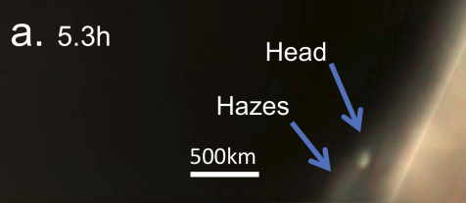
Daily Cycle
Phase 1. Growth in twilight

Slide 8
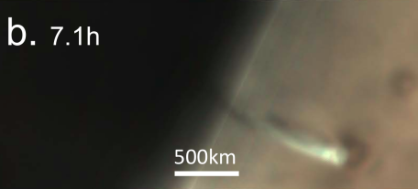
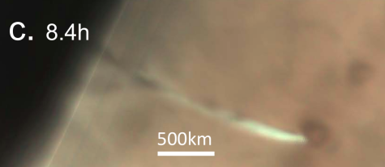
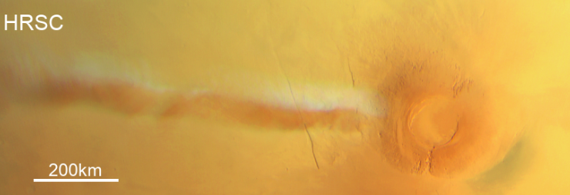
Daily Cycle
Phase 2. Expansion

Slide 9
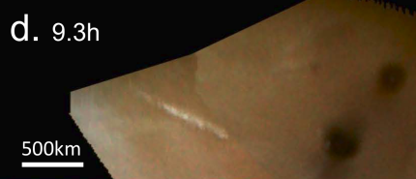
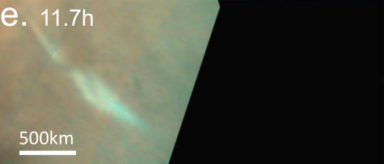
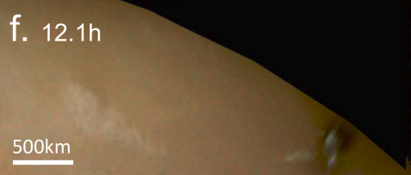
Daily Cycle
Phase 3. Detached

Slide 10
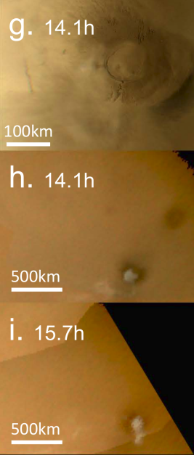
Daily Cycle
Phase 4. Growth of local clouds

Slide 11
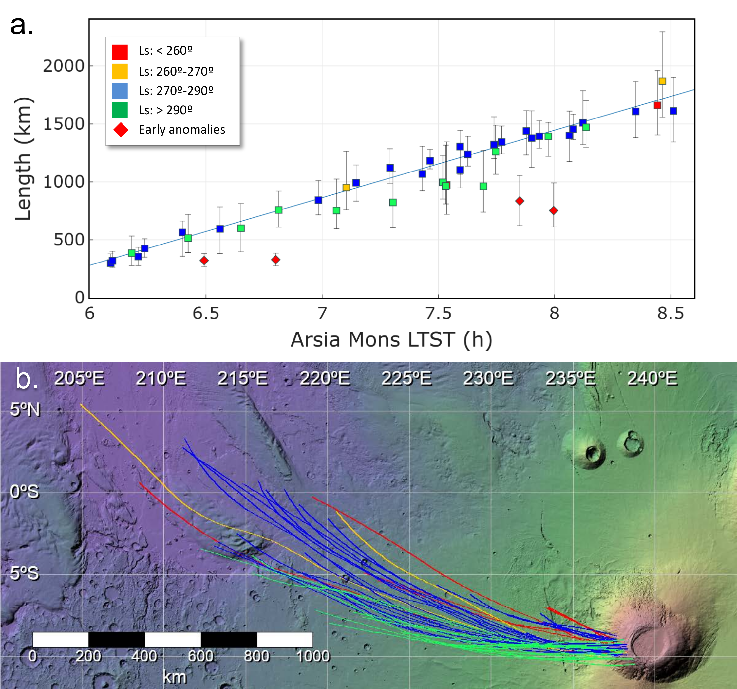
Expansion velocity and length (As inferred from MY34)
The linear fit reveals an expansion velocity of 160 m/s. The maximum observed length was around 1800 km.

Slide 12
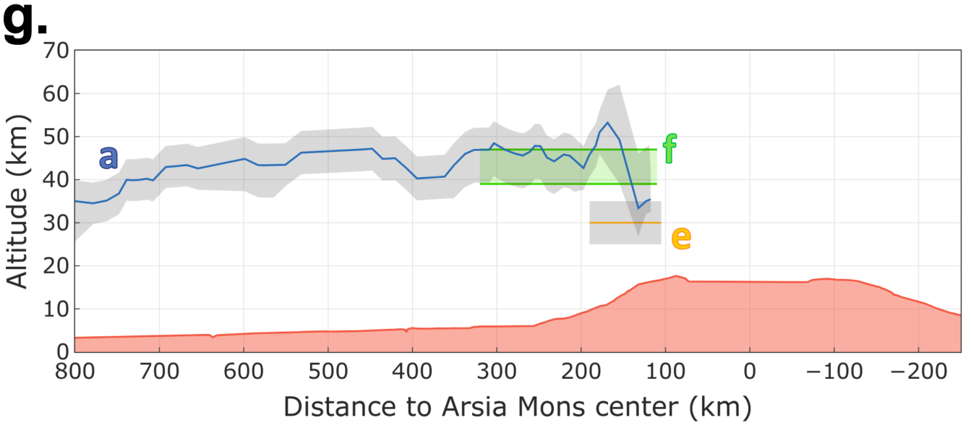
Altitude of the phenomenon
From shadows, limb observations, and twilight observations, we infer an altitude of ~45km (mesosphere) over the areoid, and probably an ascent during twilight.

Slide 13
Interannual variations and effects of the GDS
Several features of the AMEC could be subject of interannual variations.
We are interested in these variations as a possible proxy to the general state of the atmosphere.
Early observations in MY34 were abnormal, maybe because of the effect of the decaying Global Dust Storm (GDS). Also, the AMEC started later.
The AMEC was also abnormal in MY33 compared to other years, with the AMEC shorter and optically thinner.

Slide 14
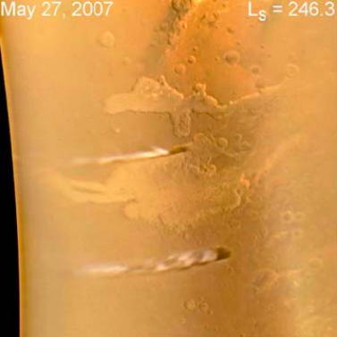
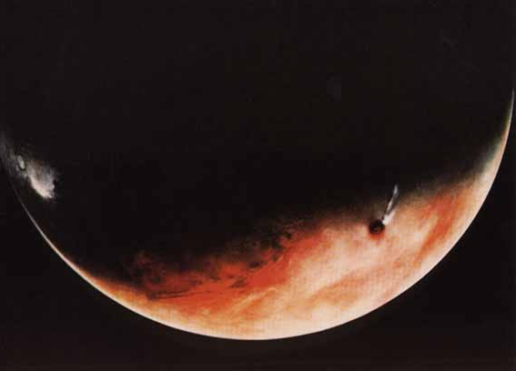
How rare is the AMEC?
Arsia Mons Elongated Cloud
(AMEC)
This work
Ascraeus Mons Elongated Cloud
(AsMEC)
Valles Marineris Cloud Trails
(VMCT)
Clancy et al. (2009)
The AsMEC was originally observed by Viking. Both VMC and IUVS saw it again recently. Are these phenomena related? This will be subject of future work.
Also, there is some evidence of other elongated clouds on Mars, potentially driven by the same mechanism: vertical ascent followed by fast advection in the mesosphere.

Slide 15
Conclusions
The Arsia Mons Elongated Cloud (AMEC) is a previously observed but unnoticed phenomenon consisting in an elongated cloud extending to the west from Arsia Mons, up to 1800 km.
This phenomenon takes place every MY around the southern solstice. And it follows a regular daily cycle, and is only visible in the morning.
It takes place in the mesosphere (45 km over areoid), where fast winds advect it at a high velocity of 160 m/s.
The AMEC is subject of interannual variations that might be a proxy to the general state of the atmosphere. GDS 2018 probably delayed the starting of the phenomenon.
There are other elongated clouds on Mars (Ascraeus Mons, Valles Marineris) that will be subject of future works.
In a future work we will study the AMEC from a theoretical point of view.

Slide 16
Thank you!
Hernández-Bernal et al. (2020) An Extremely Elongated Cloud over Arsia Mons Volcano on Mars: Life Cycle. Submitted to JGR.

