Slide 1
The EGU General Assembly 2020
Simulation of Loess Gully Evolution Based on Geographic Cellular Automata
Lanhua Luo
School of Geography, Nanjing Normal University,
Nanjing, China
Tutor：Prof. Fayuan Li

Slide 2
CONTENTS
1
Introduction
2
Materials and Method
3
Simulation results
4
Discussion
5
Conclusion

Slide 3
Introduction
The EGU General Assembly 2020
The occurrence and development of gullies have an important impact on the development and evolution of modern landforms. Research on the development of gullies is the key to explaining the causes, mechanisms and spatial differentiation of landforms.

Slide 4
Materials and Method
The EGU General Assembly 2020
This study explores the mechanism of the development process of the gully while taking into account the dynamic factors of head-cut erosion. Based on the basic data of the Loess simulation small watershed, the construction of the simulation model of the gully development is constructed and realized. Finally, the model is applied to the evaluation of the Madigou watershed in Suide County, Shaanxi Province. The comparison between the simulated results of model and the measured data is used to verify the validity of the model.

Slide 5
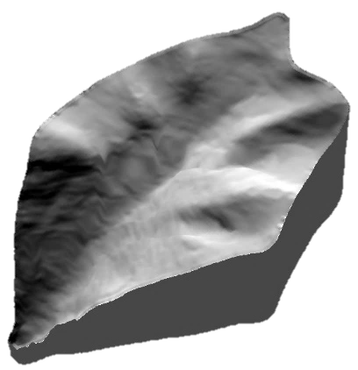
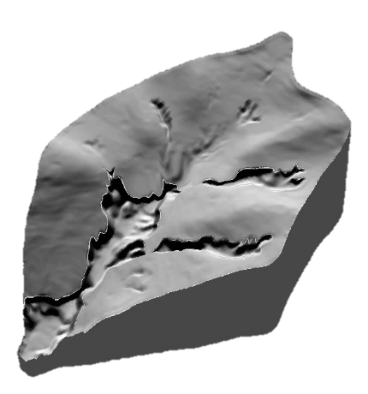
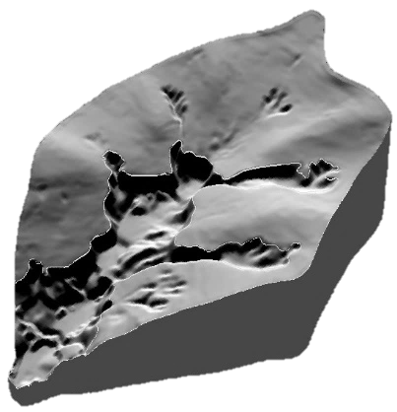
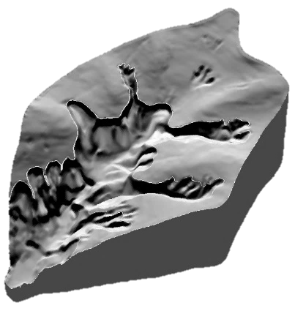
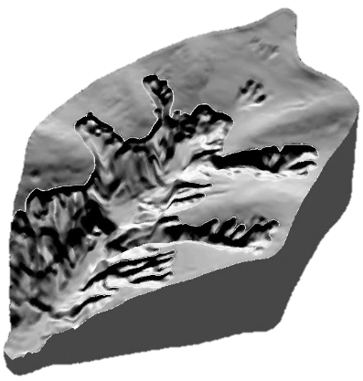
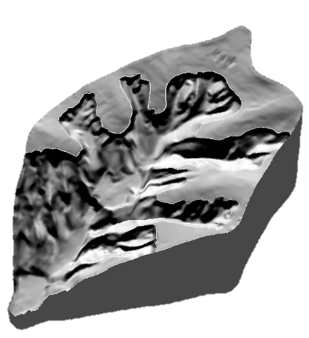
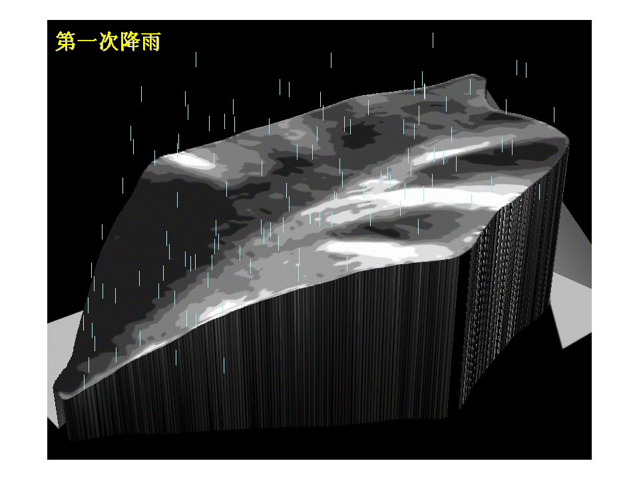
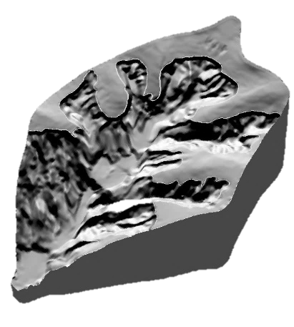
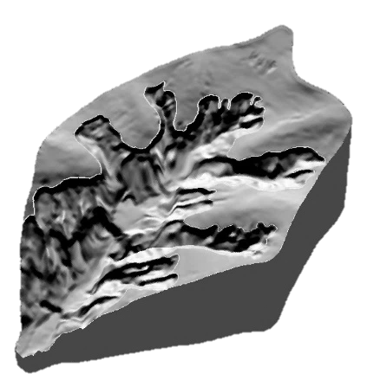
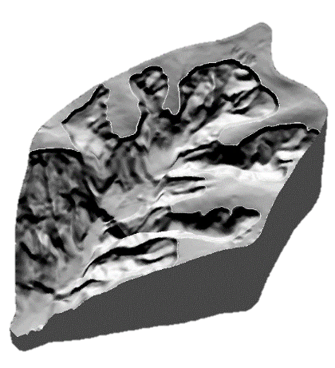
Materials and Method
The EGU General Assembly 2020
Experiment Data-Loess Simulated Small Watershed

Slide 6
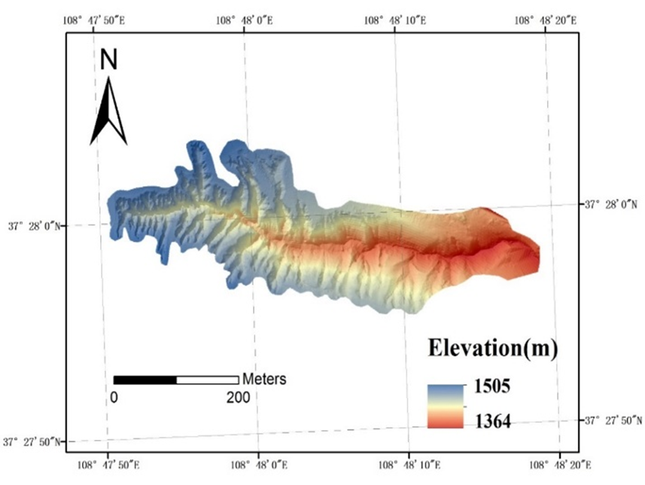
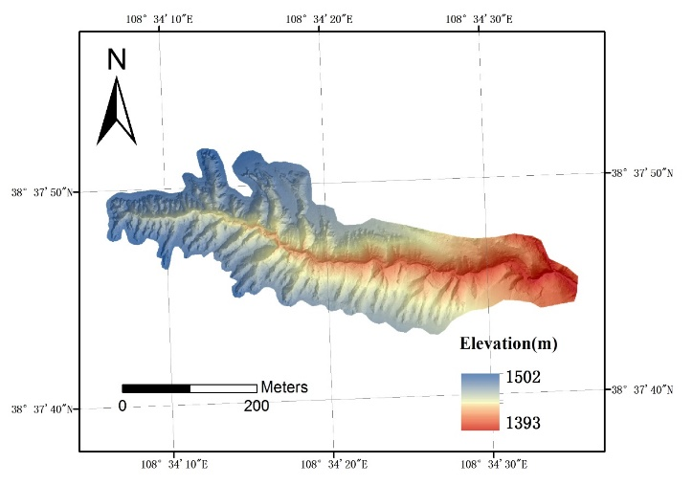
Materials and Method
The EGU General Assembly 2020
Model Validation Data-the Madigou watershed
2014
2018

Slide 7
Materials and Method
The EGU General Assembly 2020
Model construction
Basic model elements
Cell size--two-dimensional square grids
Cell state--evolution of cell
Neighbor--the Mohr-type neighborhood
Transition rules--the rules of gully head region, the rules of water infiltration, flow direction rule, flow rules, and sediment transport rules
Time--1 second

Slide 8
Materials and Method
The EGU General Assembly 2020
Model implementation
The basic framework of the model is constructed by using the 5th and 6th phase of simulation small watershed data for parameter calibration. Input the DEM data of the 5th simulation small watershed, through transition rules setting, complete the simulation process to realize the simulation of the 6th phase. The simulation results are compared with the measured data, and the parameters are adjusted continuously until more satisfactory simulation results are obtained. The simulation of the loess gully evolution is based on the input of the DEM data from the previous simulation small watershed, and the simulated gully evolution simulation model is used to simulate the results of the gully evolution in the latter phase.

Slide 9
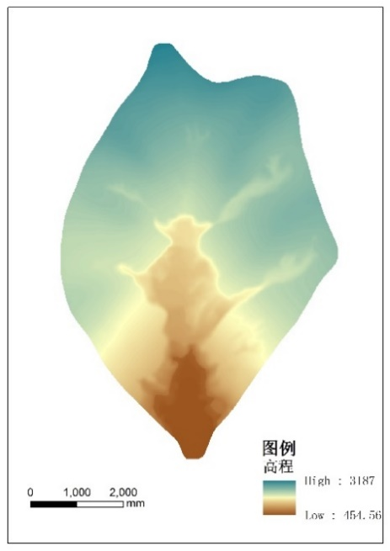
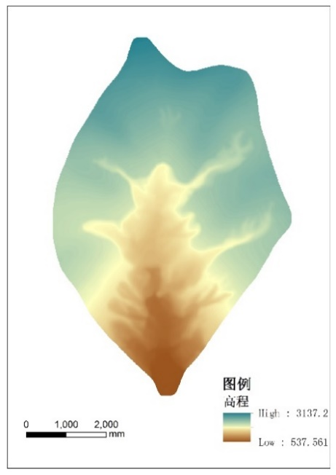
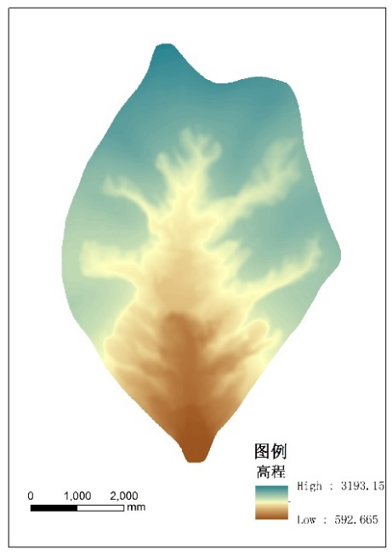
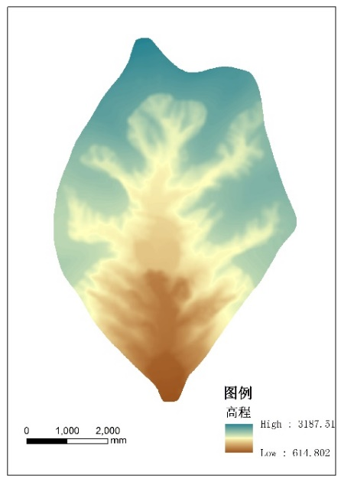
Simulation results
The EGU General Assembly 2020
3rd phase
4thphase
5thphase
6thphase
7thphase
8thphase
9thphase

Slide 10
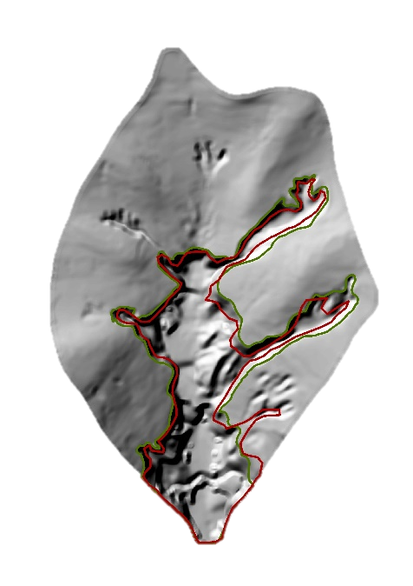
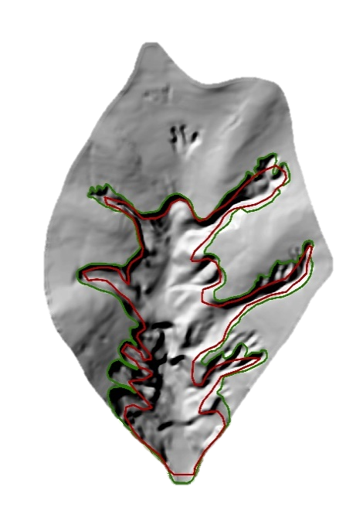
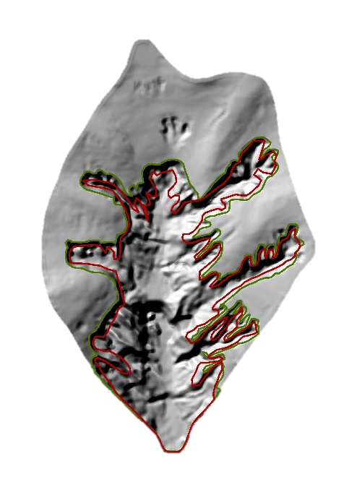
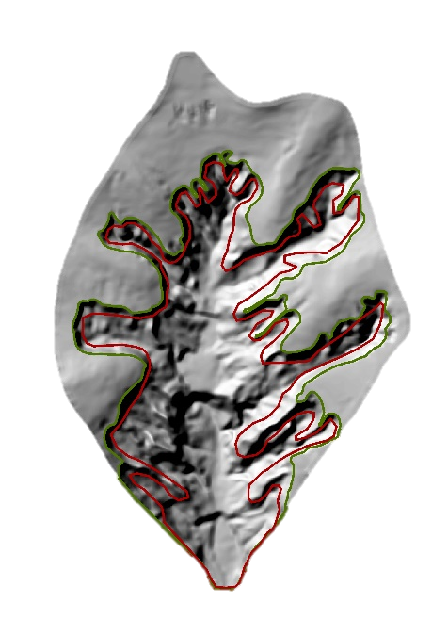
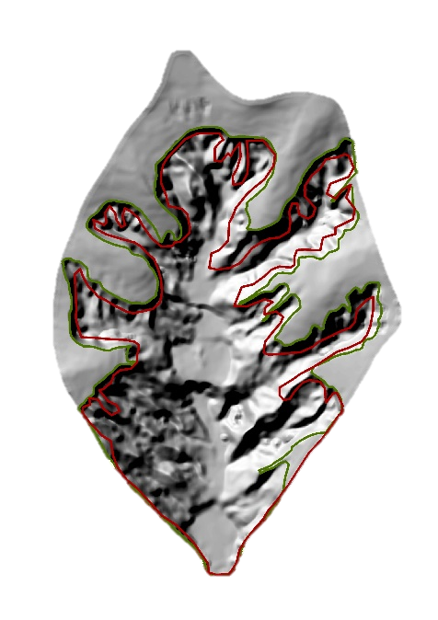
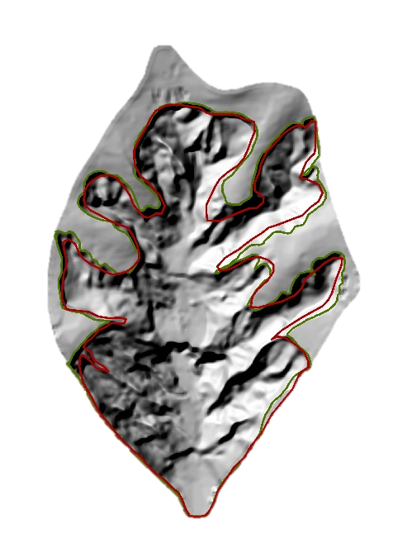
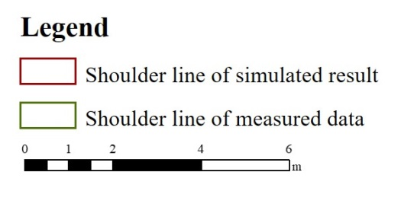
Simulation results
The EGU General Assembly 2020
The negative terrain comparison
3rd phase
4thphase
5thphase
6thphase
7thphase
8thphase
9thphase

Slide 11
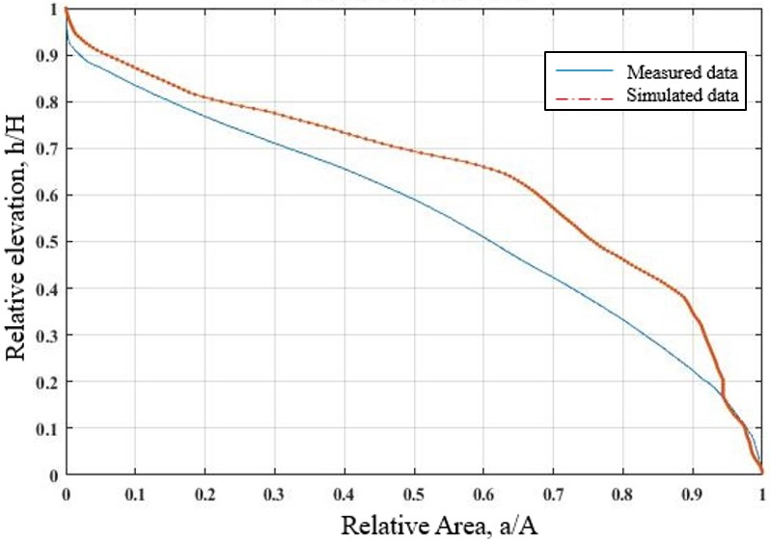
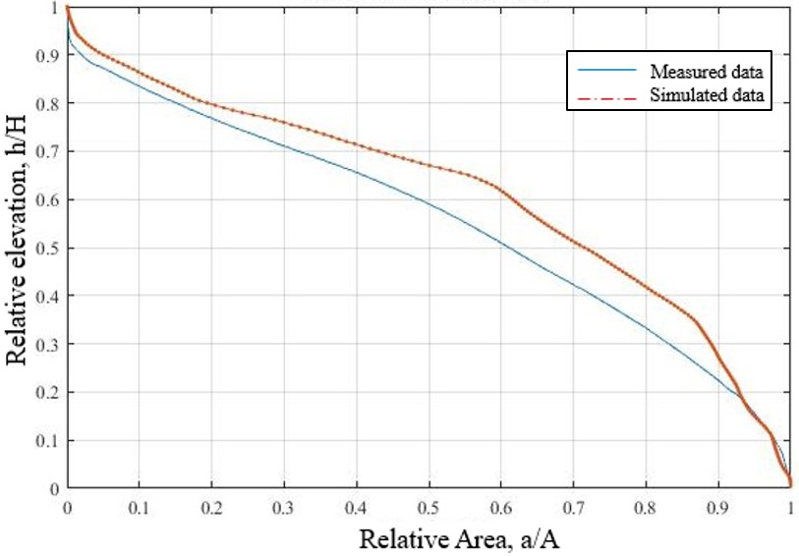
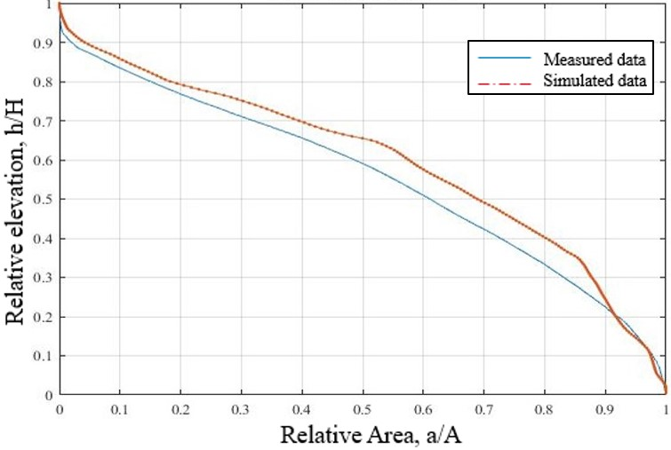
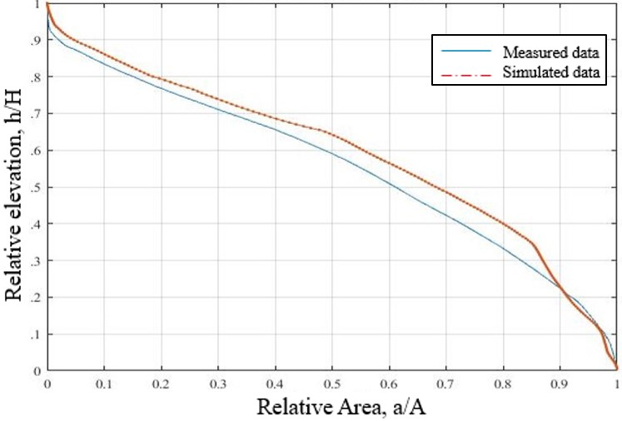
Simulation results
The EGU General Assembly 2020
Hypsometric Integral comparison
3rd phase
4thphase
5thphase
6thphase

Slide 12
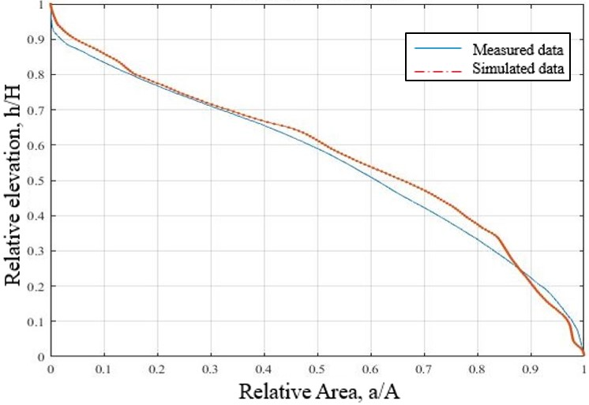
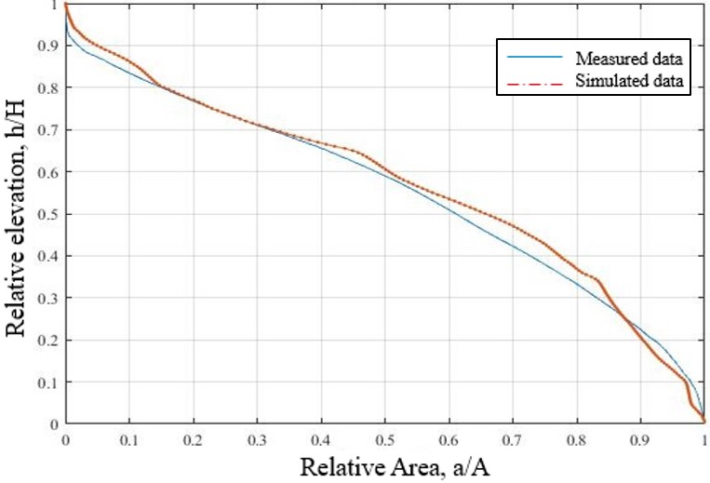
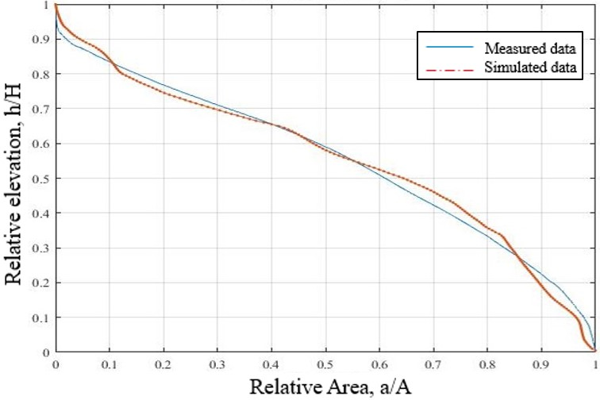
Simulation results
The EGU General Assembly 2020
Hypsometric Integral comparison
7thphase
8thphase
9thphase
Table. The HI value of the simulated results and the measured results of small watershed.
HI value | 3rd phase | 4th phase | 5th phase | 6th phase | 7th phase | 8th phase | 9th phase
Simulated results | 0.6391 | 0.6107 | 0.5952 | 0.5884 | 0.5705 | 0.5675 | 0.5526
Measured data | 0.6254 | 0.6097 | 0.5914 | 0.5877 | 0.5698 | 0.564 | 0.5533
Difference value | 0.0137 | 0.001 | 0.0038 | 0.0007 | 0.0007 | 0.0035 | -0.0007

Slide 13
Discussion
The EGU General Assembly 2020
Model validation
Based on the 2014 DEM data of the Madigou watershed as the initial data input of the model simulation, the development of the valley was simulated to obtain the DEM data simulated in 2018.

Slide 14
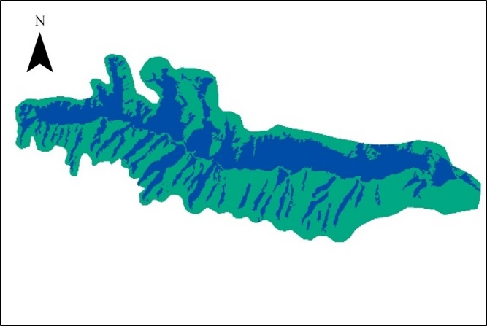
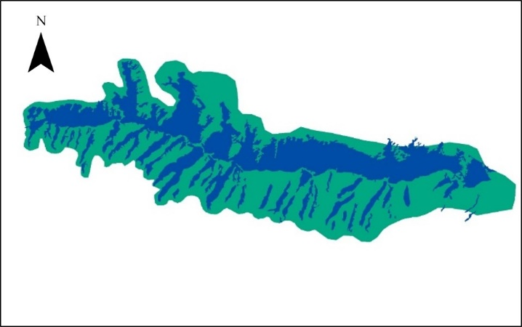
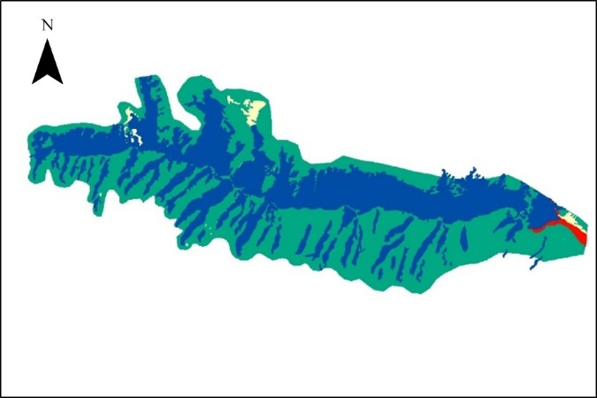
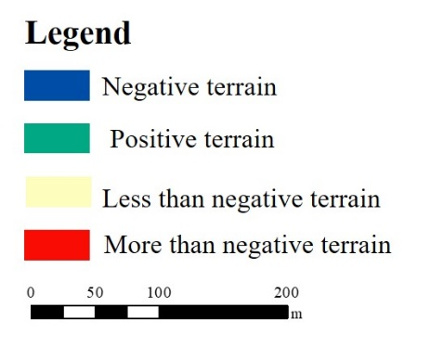
Discussion
The EGU General Assembly 2020
Model validation
(a) Positive and negative terrain of simulation results
(b) Positive and negative terrain of measured results
(c) Overlay map of positive and negative terrain correlation between simulated and measured data

Slide 15
Conclusion
The EGU General Assembly 2020
Based on the small simulated Loess watershed and the mechanism of the development process of gullies, the parameters and transition rules of Geographic Cellular Automata were defined, and the evolution model of Loess gullies based on Geographic Cellular Automata was constructed to simulate the dynamic process of Loess gully development.

Slide 16
The EGU General Assembly 2020
Thank you!

