Slide 1


“Global Heritage Stone Resource”
Activities in Germany
Angela Ehling
Wien 2020

Slide 2
International Union of Geological Sciences (IUGS)
Commission for Geoheritage
Heritage Stones Subcommission (HSS)
Board: Lola Pereira, Björn Schouenborg, Barry Cooper, Brian R. Pratt, Piero Primavori, Gurmeet Kaur
+ Advisory Panel (11 persons )
2017
in dialog with UNESCO
and the connected advisory boards
IUNC (International Union for Conservation of Nature)
ICOMOS (International Council on Monuments and Sites)
ICCROM (International Centre for the Study of the Preservation and Restoration of Cultural Property )

Slide 3
Definitions
A Global Heritage Stone Resource (GHSR) ) is a designated natural stone
that has achieved an important use over a significant historical period with due recognition in human culture.
A Global Heritage Stone Province (GHSP) is a designated area
where two or more GHSRs are associated in close geographic proximity and by their common geology.

Slide 4
Aim of the “Global Heritage Stone Resource” designation:
  Promoting increased community, national and international awareness of natural stone
  and its widespread utilisation in human culture.
  Gaining additional professional recognition for, and understanding of natural stone amongst
  professional workers, primarily in geology, engineering, architecture and stone/building conservation.
  Highlighting the significant positive attributes of natural stone in terms of sustainability and regional economic development.
  Encouraging proper management of well known existing natural stone extraction operations
in order to ensure future availability and utilisation.
  Enhancing international co-operation in the research and utilisation ofn atural stone resources
as building material, sculptural/decorative material and as a tourism product.

Slide 5
Guidance for GHSR recognition
GHSR may be recognised if the natural stone under consideration has most of the following attributes:
  Historic use for a period of at least 50 years.
  Wide-ranging geographic application.
  Utilisation in significant public or industrial projects.
  Common recognition as a cultural icon, potentially including association with national identity
  or a significant individual contribution to architecture.
  Ongoing availability of material for quarrying.
  Potential benefits (cultural, scientific, architectural, environmental) arising from GHSR designation.

Slide 6
procedure
Scientific publication about a natural stone in epeer-reviewed journal
Annual call to applicate a nomination to the corresponding members
Review form
Decision by the board
Publication of the designation within the IUGS Newsletter and the HSTG Circular

Slide 7
91 natural stones from 27 states have been registered
designated
Portland Stone / GB
Carrara Marmor Provinz / Italien
Hallandia Gneis / Schweden
Larvikit Blue Pearl / Norwegen
Kalkstein Petit Granite / Belgien
Villamayor Sandstein
Estremoz Marmor / Spanien
Podpec Kalkstein / Slowenien
Lede Stone / Belgien
publicated
Sydney Sandstone / Australien
Sandstein Pietra Serena / Italien
Granit Rosa Beta / Italien
Lioz Kalkstein / Portugal
Arrabida Breccia / Portugal
Colmenar Kalkstein / Spanien
Granit Piedra Pajarilla / Spanien
Serpentinit Sierra Nevada / Spanien
Älvdalen Porphyr / Schweden
Kolmarden Serpentin-Marmor / Schweden
Kalkstein Bath Stone / GB
Kalkstein Purbeck Stone / GB
Tennessee „Marble“ / USA
Globigerinen-Kalkstein / Malta
Registrated applications (examples)
Solnhofener Kalkstein / D, Öland Limestone, Bohus und Vanga- Granite / S, ArmenianTuff, Adneter Rotscheck / A, Minas Gerais Slate / BR,
Thassos Marble / GR, Hungarian Travertine, Rosso di Verona, Trani, RomanTravertine / I, Shirataki Obsidian / Japan, Otta Phyllit,
Fauske Marble / N, 8 granites and limestones from Spain

Slide 8
Activities in Germany
Foundation of a national GHSR-team at 03.07.2018 in Würzburg
Board: Dr. A. Ehling (BGR Berlin), speaker of the team
Dr. F. Häfner (Budenheim b. Mainz, Rh-Pf)
Dr. L. Katzschmann (TLUG, Weimar, Thuringia)
R. Krug (DNV, Würzburg)
Dr. K. Poschlod (LfU Bayern, Augsburg)
Prof. Dr. H. Siedel (TU Dresden)
Prof. Dr. E. Stadlbauer (NLD, Hannover)
Dr. W. Wagner (professional journalist Mayen)
Dr. W. Werner (LGRB BW, Freiburg)
Main tasks:
- aktive contacts to the HSS of the IUGS
Initiate and coordinate applications of GHSR-nominations of German natural stones
Public relation
Cooperation with national and international institutions and organisations
(German UNESCO Commission (DUK), ICOMOS-ISCS, ICCROM und IUNC)
→ Press release, information letters to these institutions and organisations

Slide 9
List with potential GHSR-candidates in Germany
Bundesland | Gestein
Niedersachsen | Obernkirchener Sandstein
 | Wesersandstein
 | Bentheimer Sandstein
 | Raseneisenstein
 | Porta-Sandstein
Brandenburg | Findlinge
NRW / HE / RP | "Lahnmarmor"
NRW | Anröchter Stein
 | Baumberger Sandstein
 | Ruhrsandsteine
 | Fredeburger Schiefer
Sachsen | Elbsandstein
 | Rochlitzer Porphyrtuff
 | Lausitzer Granodiorit
 | Zöblitzer Serpentinit
 | "Sächsische Marmore"
Rheinland-Pfalz | Rheinische Basaltlava
 | Eifel-Tuffgesteine
 | Pfälzischer Buntsandstein
 | Moselschiefer
Bayern | Treuchtlinger „Marmor"
 | Fränkischer Muschelkalk
 | Fränkischer Buntsandstein
 | Kösseine - Granit
 | Bayerwald-Granit
 | Suevit
 | Rhätsandstein Solnhofener Kalkstein
Baden-Württemberg | Schwarzwälder Buntsandstein
 | Schilfsandstein
 | Stubensandstein
 | Zwiefalter Travertin
Baden-Württemberg | Schwarzwälder Granit
Hessen | Odenwald-Quarz
Thüringen / BY | Thüringer Dachschiefer
Thüringen | Thür. Rätsandstein
 | Thür. Travertin
 | Saalburger „Marmor“
Thüringen/ST | Muschelkalk
Sachsen-Anhalt | Nebraer Sandstein
 | Brocken-Granit
 | Bernburger Rogenstein

Slide 10
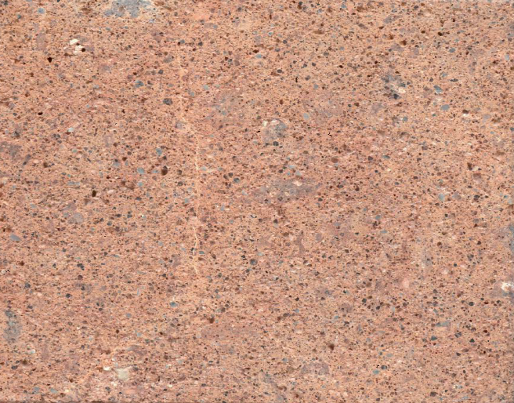
First activities for a GHSR-nomination in Germany
Solnhofen Limestone
Solnhofener Plattenkalk: a heritage stone of international significance from Germany
M. Kölbl-Ebert and B. J. Cooper
Geological Society, London, Special Publications, 486, 9 January 2019, https://doi.org/10.1144/SP486-2017-324
Rochlitzer Porphyrtuff
Siedel, H., Rust, Ma., Goth, K., Krüger, A. & Heidenfelder, W. (2019): Rochlitz porphyry tuff („Rochlitzer Porphyrtuff“):
A candidate for „Global Heritage Stone Resource“ designation from Germany.- Episodes 2019; 42(2): 81-91;
https://doi.org/10.18814/epiiugs/2019/019007
In progess:
Roof slate
Basaltlava Eifel

Slide 11
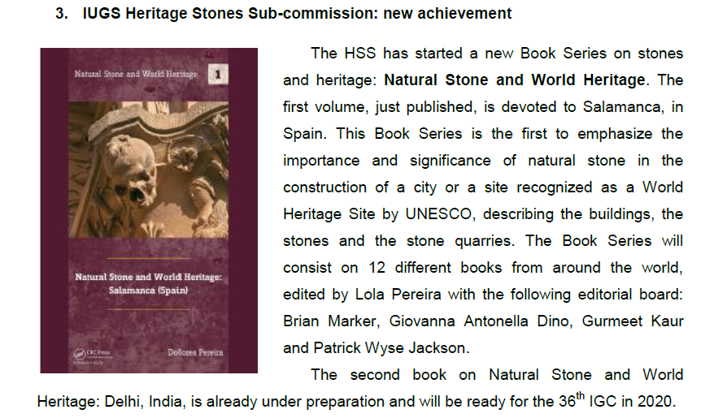
New IUGS-publications on „Natural Stones and Heritage“
volume 1: Stones of Salamanca (2018)
volume 2 : Stones in New Delhi (2020)
volume 3: Natural Stones at UNESCO-Sites in Germany (2021)

Slide 12

Natural Stone and World Heritage
Natural Stones at UNESCO-Sites in Germany (2021)
Introduction
(about 30 UNESCO heritage sites, made with natural stone)
10 UNESCO-Heritage sites in detail
Description of 20 most important natural stones

Slide 13
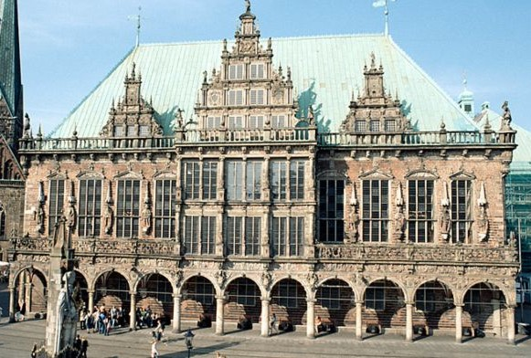
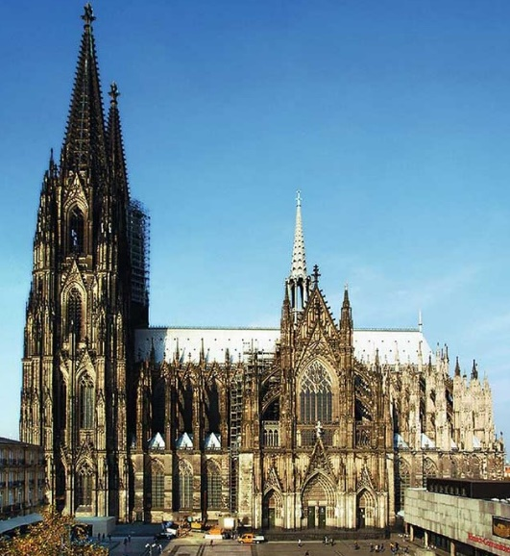
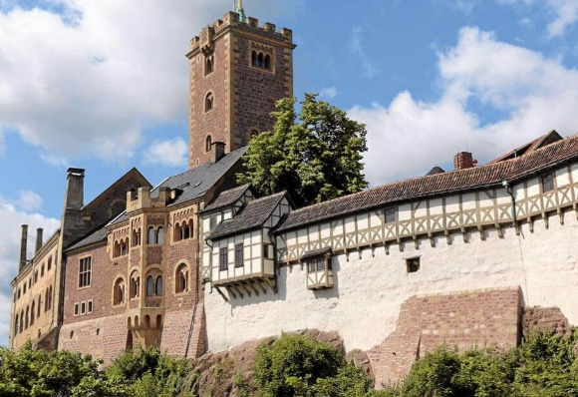

Content
Introduction
 | UNESCO sites in Germany
1 | Bremen town hall and Roland
2 | Berlin Museums Island
3 | Corvey Monastery (Carolingian Westwork)
4 | Köln Cathedral
5 | Kassel Bergpark Wilhelmshöhe
6 | Eisenach Wartburg
7 | Naumburg Cathedral
8 | Roman Trier
9 | Maulbronn Monastery
10 | Regensburg old town
 | Natural Stones at these UNESCO sites
11 | Obernkirchen Sandstone
12 | Elbe Sandstones
13 | Weser Sandstone
14 | Nebra Sandstone
15 | Rhaetian Sandstones Thuringia
16 | Regensburg Grünsandstein
17 | Kylltall Sandstone
18 | Schilfsandstein SW-Germany
19 | Muschelkalk Germany
20 | Jurassic Limestones
21 | Solnhofen Limestone
22 | Coloured “Marbles”
23 | Roof Slates
24 | Rhenish Basaltlava
25 | Rhenish Tuff
26 | Drachenfels Trachyte
27 | Habichtswald Tuff
28 | Bavarian Granites
16 authors

Slide 14
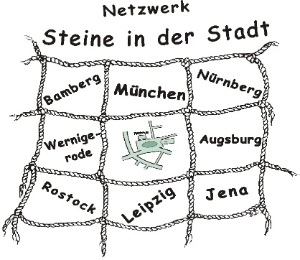
Network „Stones in the city“
Founded 2006 in Berlin
More than 120 participants, mainly in Germany – Geologists, stonecutter, architects, historians, city guides
Annual meetings in different cities with talks, papers and (city) excursions
Collective and single publications
Homepage www.steine-in-der-stadt.de
- a bibliography with about 800 titles regarding stones in the cities worldwide
- online publications, stony object of the month, reviews

Slide 15
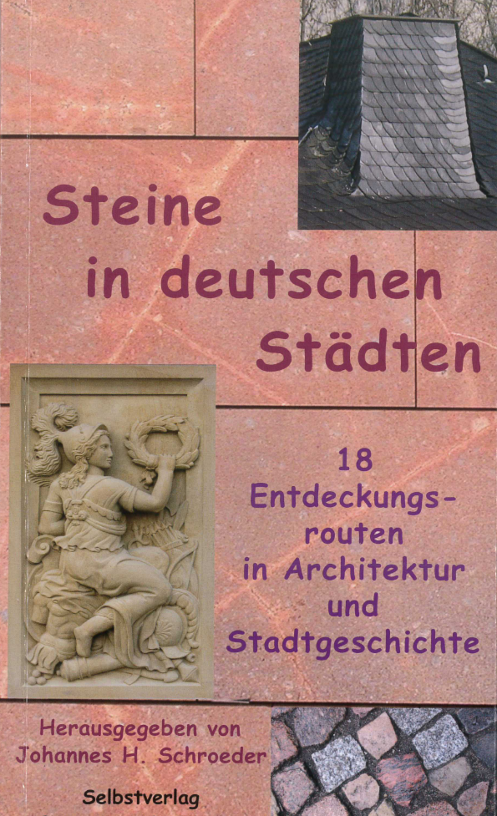
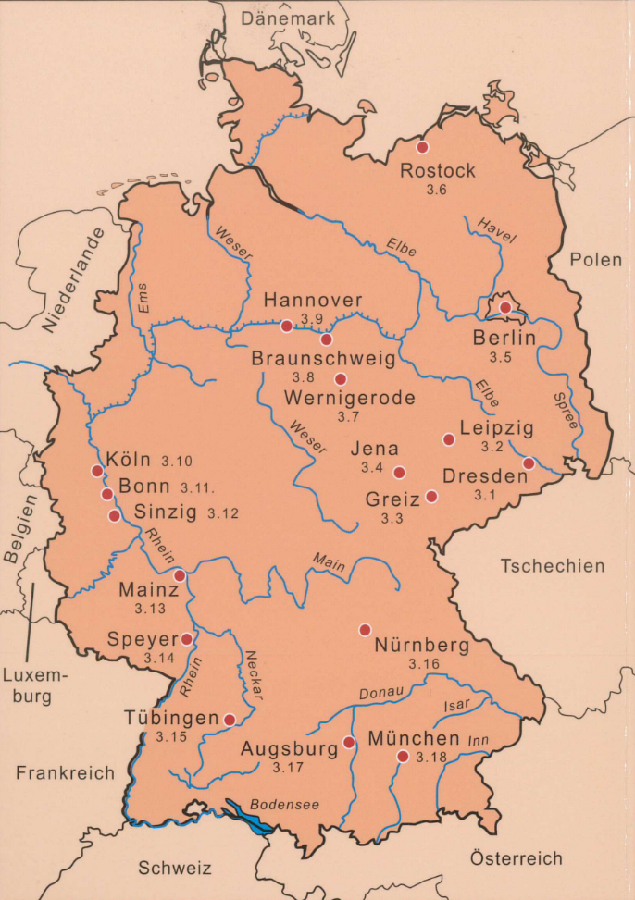
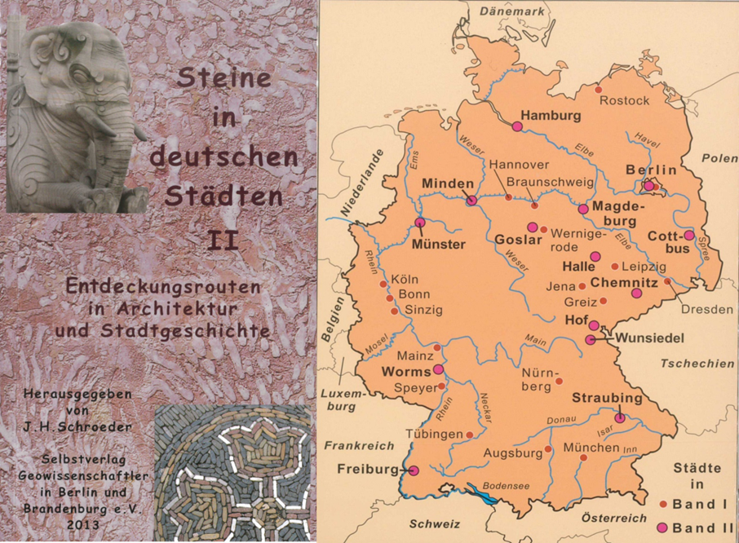
Collective publications
www.steine-in-der-stadt.de

Slide 16
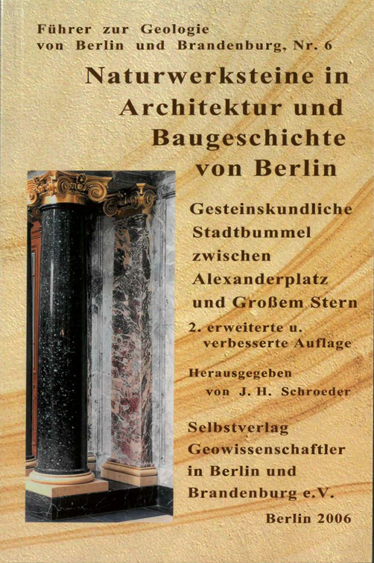
Single publications
examples
www.steine-in-der-stadt.de

Slide 17
Stone of the year
2007 Granit
2008 Sandstein
2009 Basalt
2010 Kalkstein
2011 Tuff
2012 Quarzit
2013 Kaolin
2014 Phonolith
2015 Gneis
2016 Sand
2017 Diabas
2018 Steinkohle
2019 Schiefer
2020 Andesit
Initiative of the BDG ( Union of German Geologists)
In cooperation with the Geological Surveys and stone industry
Public relation with posters, press release, events in quarries,
exhiubitions in museums

Slide 18

Focus on natural stones as an important historical and modern building material
GHSR
Stone of the year
Network
Stones in the city
Geological surveys

Slide 19
Thank you for your attention!
Join us!
www.globalheritagestone.com

