Slide 1

Deducing the role of eolian dust sedimentation during soil forming periods on mineral magnetic records and its implications for paleoclimate reconstructions
Diana Jordanova and Neli Jordanova
National Institute of Geophysics, Geodesy and Geography, Bulgarian Academy of Sciences, Acad. G. Bonchev str., block 3, 1113 Sofia, BULGARIA
diana_jordanova77@abv.bg

Slide 2
THE PROBLEM
Loess-paleosol sequences are widely utilized for reconstructions of past climate and environmental changes during the glacial Pleistocene. Different proxy records are utilized: magnetic susceptibility; chemical weathering indexes; isotopic ratios; biomarkers; pollens; snail and opal phytolith assemblages; soil micromorphologies.
In all records, a basic assumption is the continuity of dust deposition, allowing for complete and uninterrupted recording.
Continuous dust deposition is assumed based on detailed (high resolution) ¹⁴C and OSL/IRSL dating of loess-paleosol sequences for Late Pleistocene, e.g. last 120 ka with possible extensions using method’s modifications up to 350 ka (Buylaert et al., 2012)
Worldwide correlation analyses of deep-sea and terrestrial records of climate change assume straightforward continuous time flow of both archives and try to deduce time lags, inter-relationships and interactions between land and ocean.
HOWEVER:
      No direct evidence for persistence of the same continuous dust deposition regime deeper in time
      Large IRSL error estimates for older units, reaching tens of thousands of years
      Soil development on loess can proceed until mature stage within some 1000 – 2000 years, well within the error estimates of luminescence dating method itself
      ……..

Slide 3
IMPORTANCE FOR SOIL SCIENCE
Modelling soil formation and soil evolution: currently most of the modelling efforts consider soil formation as downward propagation of weathering reactions, taking into account interactions of inorganic constituents with biological (microbes, vegetation, soil fauna) and atmospheric (CO₂, O₂, CH₄) agents (Brantley et al., 2014). Few studies deal with modelling of soil formation under aeolian additions (Cohen et al., 2015).
Understanding and predicting the effects of climate change and agricultural practices on soil properties and functioning (Brevik, 2013) is critical for ensuring sustainable food security. However, it requires proper identification of all factors affecting the process of soil carbon formation and stabilization. The latter also responds to dynamics in dust cycle among other factors.
Global dust distribution during past climate epochs
Western European sequences reveal that there were no active periglacial dust sources during the time since the last interglacial period (Kemp, 2001; Rousseau et al., 2017).
Recent studies evidence continuing dust deposition during the Holocene for sites from Central and Eastern Europe (Constantin et al., 2019; Varga,2015).

Slide 4
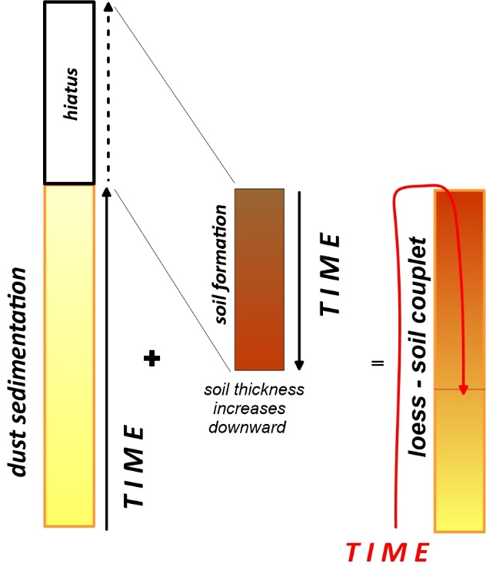
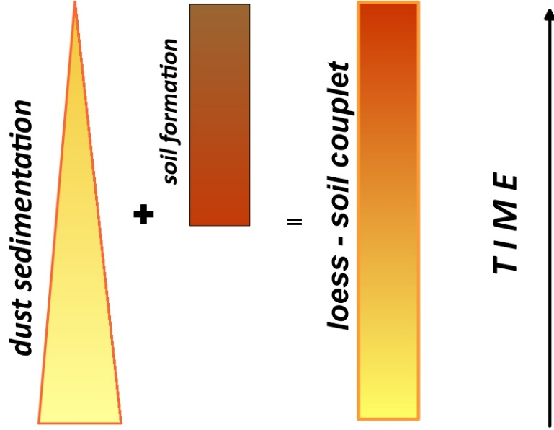
…… AND ENVIRONMENTAL MAGNETISM
Magnetic susceptibility records along loess-paleosol sequences are frequently utilized as sensitive climate proxies assuming quasy-continuous nature of dust sedimentation, thus definitely ascribing certain part of the record to a soil-forming interval (for review - Maher, 2016) (Fig. 1a)
In other cases, some periods of soil formation are considered as hiatuses in the sedimentary records (Rousseau et al., 2017). However, it should be explicitly pointed out that in terms of dust sedimentation there is a hiatus, but at the same time, in terms of temporal evolution of aeolian sediments and pedogenesis, there will be downward soil development. This particular case results in over-writing of the original (initial) loess signal by later soil record on a reverse time scale (Fig.1b).
Accretional soil formation
Bedrock-weathering
soil formation
Fig. 1a
Fig. 1b

Slide 5
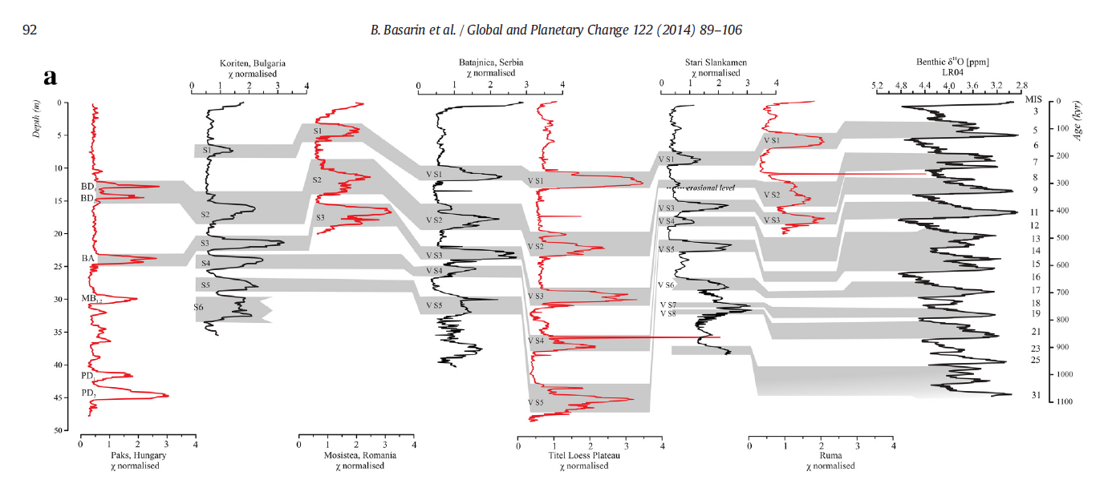
QUESTION: How can we discriminate between the two mechanisms of soil formation and perform correctly depth - time correlation between loess-paleosol record with sedimentary hiatuses during the soil forming periods, and time series of climate change?
From:
B. Basarin et al. / Global and Planetary Change 122 (2014) 89–106
We propose a conceptual framework that uses a combination of magnetic parameters and their variation with depth which could allow for the discrimination of past regimes of eolian dust deposition and soil formation intensities.

Slide 6
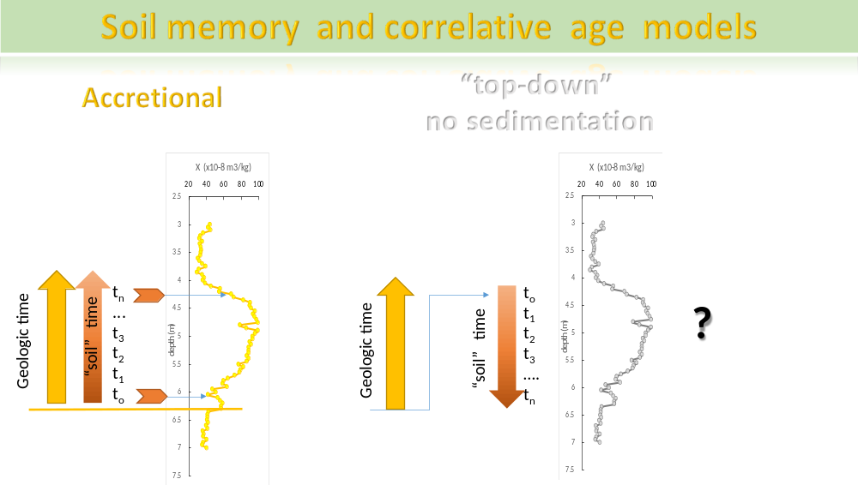

Slide 7
THE NEW CONCEPT
Pedogenic magnetic enhancement is not taken as “stationary state” of a mature soil BUT is considered as a process occurring throughout the entire soil-forming period. This allows to discriminate between different “exposure time” of “in situ” formed iron oxides to soil surface conditions in case of accretional soil formation, or bedrock-weathering soil formation.
We consider the buildup of the soil magnetic signature as a time-dependent evolution of concentration, grain size distribution, stability and reactivity of a continuously evolving iron oxides in the soil system.
The underlying hypothesis is that nucleation and growth of pedogenic strongly magnetic iron oxides are two competing processes during soil evolution with time. Relative importance of the one over the other will depend on the concentration of Fe²⁺ ions in soil solution released as a result of weathering of the lithogenic minerals.
Bedrock-weathering (“top – down”) pedogenesis is realized through downward migration of weathering fronts of the primary minerals in the parent material. As a result, pedogenic minerals form at different soil depths, with the ones found at greater depth (in B-horizons) never experiencing surface (topsoil) conditions. Thus, pedogenic minerals formed from the weathering products at the bottom of the soil collectively are the youngest.
In accretional soils “in situ” formed pedogenic minerals from each soil level experience surface conditions at one point during their life time. This universal history of the magnetic minerals’ evolution at each depth of the soil leads to wide grain size distribution of the pedogenic component, spanning SP-SD-PSD range. Its total amount will depend on the amount and seasonality of precipitation. Another consequence from the surface exposure of each soil level is that pedogenic minerals form at higher soil surface temperatures as compared to lower temperatures at deeper soil.

Slide 8
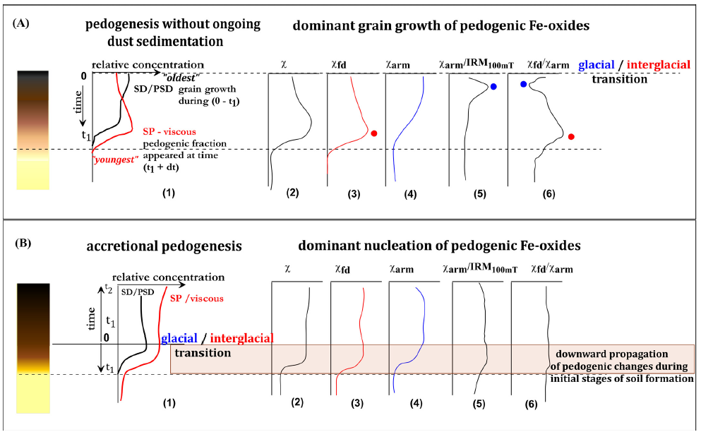
THE EMPIRICAL MODEL
The amount of weatherable minerals (sources of Fe²⁺) decreases exponentially with time ⇒ addition of ions into soil solution decreases, favoring grain growth at the expense of continuous nucleation.
magnetite grains in topsoil grow from SP to SD-PSD sizes ⇒ χ_{arm} increases towards the top and χ_{arm}/IRM_{100mT} peaks there. χ_{fd} has maximum at deeper level, where most recent nucleation occurred.
__________________________________________
Every depth of an accretional soil had formed under similar conditions of high organic content, intense microbial activities, high weathering rates and fa- vorable climate conditions.
This universal history of the magnetic minerals’ evolution at each depth of the soil is expressed by wide grain size distribution of the pedogenic component. Its total amount will depend on the amount and seasonality of precipitation.
χ_{fd}, χ_{arm}, χ - exhibit relative maxima and minima at the same depths
Depth variations in the concentration of the ﬁnest superparamagnetic (SP) and coarser (single/pseudo single domain (SD -PSD)) magnetic grain size fractions together with idealized curves of suggested behavior of magnetic proxy parameters with depth of soil proﬁles developed under different eolian dust sedimentation regimes: A) “top-down”; B) accretional.

Slide 9
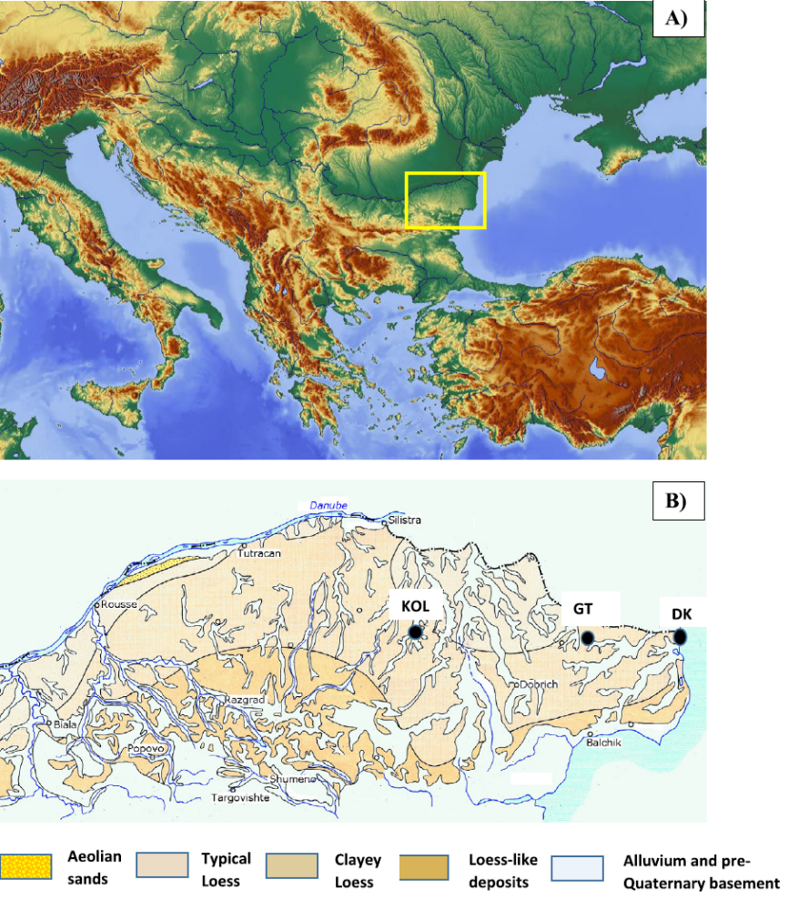
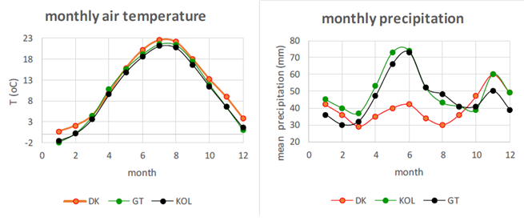
Study area
VERIFICATION OF THE CONCEPT BY MAGNETIC RECORDS ALONG THREE HOLOCENE SOILS FROM BULGARIA
SITES
Holocene soils from:
DK - section Durankulak (Bulgarian Black sea coast) – Calcic Chernozem
GT - section General Toshevo (Dobrogea loess plateau) – Leached Chernozem
KOL – section Kolobar (Ludogorie hilly area) – Luvic Chernozem
Present day climate
site MAT (ºC) MAP (mm)
DK 11.8 480
GT 10.2 556
KOL 10.6 607
Magnetic proxy parameters utilized in the study:
- χ_{fd} – frequency dependent magnetic susceptibility – reflection of the amount of pedogenic superparamagnetic (SP) magnetite (maghemite) (Dearing et al., 1997)
- χ_{arm} – anhysteretic susceptibility – sensitive to the presence of stable single domain (SD) magnetic fraction (Maher, 1988)
- ratio χ_{arm}/IRM_{100mT} – proxy for the presence of true SD particles (Geiss et al., 2008)

Slide 10
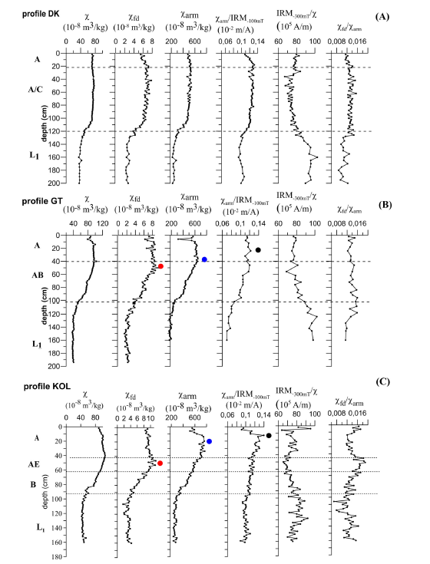
Variations of magnetic parameters with depth in Holocene soils
Examining the behavior of magnetic proxy parameters along depth of the three profiles in light of the proposed conceptual model, we observe:
- parallel changes in χ_{fd}, χ_{arm} and χ_{arm}/IRM_{100mT} with depth for soil profile DK, consistent with an accretional mechanism of soil formation.
- progressively shallower depths of maxima χ_{arm} and χ_{arm}/IRM_{100mT} as compared to depth of maximum χ_{fd} for profiles GT and KOL, consistent with bedrock weathering mechanism of soil formation.

Slide 11
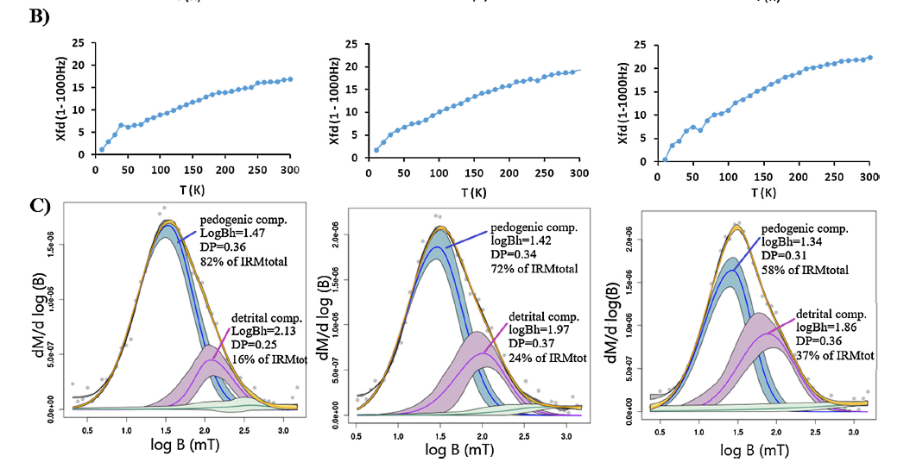
MORE ON MINERALOGY AND MAGNETIC GRAIN SIZE DISTRIBUTIONS (GSD)
samples from depths of maximum χ_{fd}
DK 40
GT 42
KOL 50
Frequency dependent susceptibility calculated as a difference of the measured signal at frequencies of 1Hz and 1000Hz is depicted for the temperature range (10–300 K). The samples show wide spectra of unblocking up to room temperature with slightly more concave shape for sample KOL50. The widest GSD (expressed by DP parameter) can be deduced for sample DK40, representative for accretional soil profile DK.
In the context of the proposed model for “top-down” pedogenesis, at the point of maximum χ_{fd} there should dominate large population of pedogenic SP particles with narrower GSD, and relatively smaller part of SD-PSD pedogenic grains. Such a trend could be deduced from IRM acquisition curves unmixing. Mean coercivity of the pedogenic component in KOL 50 is less than that in DK40 and GT 42, which is consistent with the assumption for a shift towards smaller grain sizes of the pedogenic GSD. Particularly high Bh value of the pedogenic component in DK40 suggests that the strongly magnetic careers are with sizes near true SD threshold or with oxidized surface layer.

Slide 12
Present day climate and soil formation mechanisms at the three sites
The three soil profiles are located at sites with different present day climate conditions. Significantly dryer climate is distinctive for the Black sea cost, where MAP is only 480mm. This factor, combined with the accretional soil forming mechanism at site DK results in lower pedogenic magnetic enhancement.
“maximum absolute magnetic enhancement” for different magnetic grain size fractions:
Δχ_{fd} = χ_{fd} max - χ_{fd} min; (x10⁻⁸ m³/kg) DK 4.6; GT 6.6; KOL 8.4
Δχ_{arm} = χ_{arm} max - χ_{arm} min; (x10⁻⁸ m³/kg) 295 435 499
ΔIRM = IRM _{max} – IRM _{min} (x10⁻³ Am²/kg) 2.1 3.3 4.8
For all three magnetic characteristics DK<GT<KOL ⇒ the highest amount of pedogenic strongly magnetic fractions of SP-SD-PSD magnetic grain sizes is produced in soil proﬁle KOL. However, the depth of this maximum enhancement for each proxy parameter is DIFFERENT.
Pedogenic fraction in accretional soils would possess wider effective magnetic grain size distribution skewed towards larger grain sizes as compared to the GSD of the pedogenic fraction in soils with top-down pedogenesis.

Slide 13
CONCLUSIONS:
✗ Presence or absence of eolian dust sedimentation during soil formation on loess parent material can be deduced from the high-resolution grain-size selective magnetic records along the profiles.
✗ Soil formation taking place at stable landscape conditions without significant additions of eolian dust (“top-down” pedogenesis) show differences in the depths, at which maximum values of the grain-size sensitive magnetic parameters are observed. The maximum value of χ_{fd}, indicative for the dominance of finest SP particles, occurs at deepest level, followed by depth of χ_{arm}maximum, and closest to the surface is obtained the maximum of χ_{arm}/IRM_{100mT} proxy indicative of stable near SD magnetic grains.
✗ Magnetic signature with depth of soils developed under continuous additions of eolian dust during soil-forming period (accretional soils) exhibit parallel variations of the magnetic proxies utilized for characterization of grain size of the pedogenic magnetic component (χ_{fd}, χ_{arm}, χ_{arm}/IRM_{100mT}).
✗ Mean coercivity of the pedogenic component of accretional soils will be higher than that in soils, developed through top-down mechanism at comparable temperature and precipitation regimes.

Slide 14
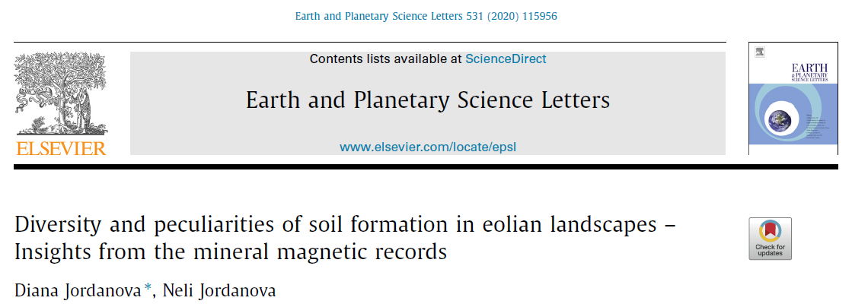
References
Brantley S.L., Lebedeva M., Bazilevskaya E., 2014. Relating Weathering Fronts for Acid Neutralization and Oxidation to pCO2 and pO2. In: Treatise on Geochemistry, 2nd Edition, pp. 327 – 352, Elsevier
Brevik, E.C. 2013. The Potential Impact of Climate Change on Soil Properties and Processes and Corresponding Influence on Food Security. Agriculture, 3, 398-417
Buylaert, J.-P., Jain, M., Murray, A.S., Thomsen, K., Thiel, C., Sohbati, R., 2012. A robust feldspar luminescence dating method for Middle and Late Pleistocene sediments. Boreas 41, 435–451.
Cohen, S., Willgoose, G., Svoray, T., Hancock, G., Sela, S., 2015. The effects of sediment transport, weathering, and aeolian mechanisms on soil evolution. J. Geophys. Res. Earth Surf., 120, 260–274
Constantin, D., Veres, D., Panaiotu, C., Anechitei-Deacua, V., Groza, S.M., Begy, R., Kelemen, S., Buylaert, J.-P., Hambach, U., Markovi´ch, S.B., Gerasimenko, N., Timar-Gabor, A., 2019. Luminescence age constraints on the Pleistocene-Holocene transition recorded in loess sequences across SE Europe. Quat. Geochronol.49, 71–77.
Dearing, J., Bird, P. Dann, R., Benjamin, S., 1997. Secondary ferrimagnetic minerals in Welsh soils: a comparison of mineral magnetic detection methods and implications for mineral formation. Geophys. J. Int., 130, 727-736.
Geiss, C.E., Egli, R., Zanner, C.W., 2008. Direct estimates of pedogenic magnetite as a tool to reconstruct past climates from buried soils. J. Geophys. Res.113, B11102. https://doi .org /10 .1029 /2008JB005669.
Kemp, R.A., 2001. Pedogenic modification of loess: significance for palaeoclimatic reconstructions. Earth-Sci. Rev.54, 145–156.
Maher, B.A., 1988. Magnetic properties of some synthetic sub-micron magnetites. Geophys. J.94, 83–96.
Maher, B.A., 2016. Palaeoclimatic records of the loess/palaeosol sequences of the Chinese Loess Plateau. Quat. Sci. Rev.154, 23–84.
Rousseau, D.-D., Svensson, A., Bigler, M., Sima, A., Steffensen, J.P., Boers, N., 2017. Eurasian contribution to the last glacial dust cycle: how are loess sequences built? Clim. Past13, 1181–1197. https://doi .org /10 .5194 /cp -2017 -67.
Varga, G., 2015. Changing nature of Pleistocene interglacials – is it recorded by paleosoils in Hungary (Central Europe)? Hung. Geogr. Bull.64 (4), 317–326.
This contribution is supported financially by project No КП-06-Н34/2 of the Bulgarian Science Fund

