Slide 1
EGU2020: Sharing Geoscience Online
Session: ITS1.7/SM3.5
Abstract: EGU2020-4594
Disclaimer
The views expressed on this presentation are those of the author and do not necessarily reflect the view of the CTBTO
Estimates of seismo-acoustic transfer functions relevant to CTBT
IMS T-phase stations^{*)}
P.L. Nielsen, M. Zampolli, R. Le Bras and G. Haralabus, CTBTO, Vienna, Austria
J.L. Stevens and J. Hanson, Leidos, San Diego, USA
Peter.Nielsen@ctbto.org
Mario.Zampolli@ctbto.org
Ronan.LeBras@ctbto.org
Georgios.Haralabus@ctbto.org
Pierrick.Mialle@ctbto.org
Jeffry.L.Stevens@leidos.com
Jeffrey.A.Hanson@leidos.com
*Part of the presentation submitted for publication in Pure and Applied Geophysics, Springer Nature:
“Calculation of Hydroacoustic Propagation and Conversion to Seismic Phases at T-Stations” by Jeffry L. Stevens, Jeffrey Hanson, Peter Nielsen, Mario Zampolli, Ronan Le Bras, Georgios Haralabus and Steven M. Day

Slide 2
Outline
Objectives
Canonical Environments
Canonical Solutions
Modeling of Wave Conversion for IMS Hydroacoustic Stations
Comparison to Measurements
Estimates of Transfer Function
Summary

Slide 3
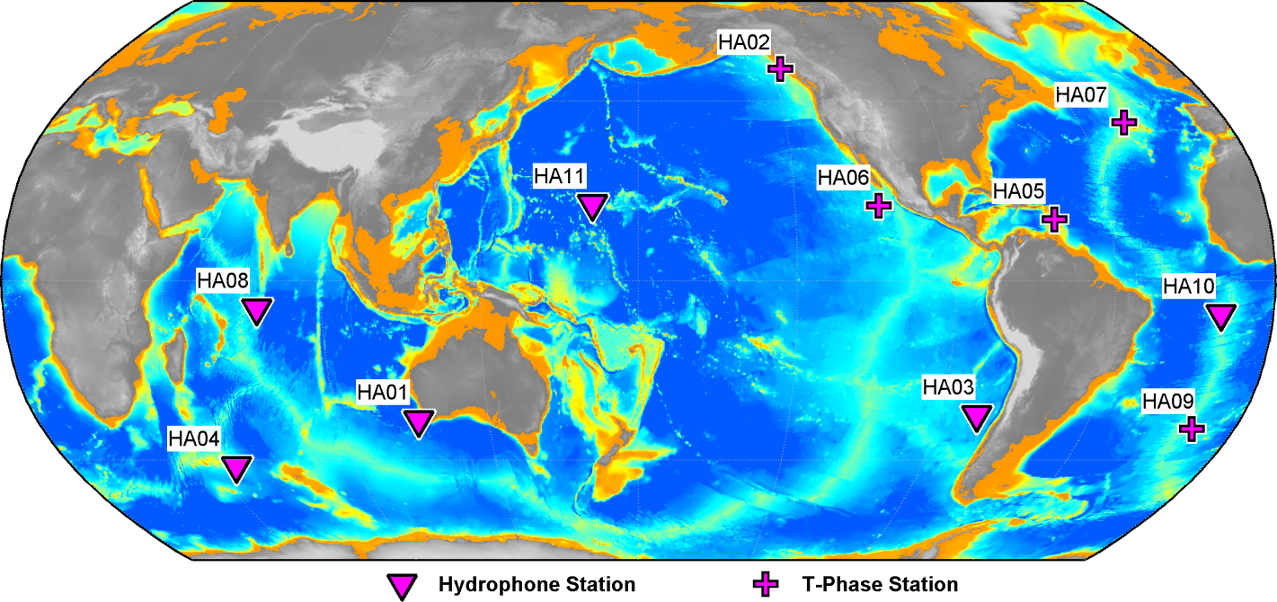
Objectives
Further understand in-water to in-ground phase conversion at T-phase stations to improve detection and classification of in-water events.
Identify canonical environments representative of realistic conditions at hydroacoustic stations.
Collect environmental descriptors relevant for hydroacoustic propagation.
Calculate waveforms at hydroacoustic hydrophones and seismometers.
Model – data comparison.
The IMS hydroacoustic network

Slide 4
Overall Modelling Approach
Hybrid: local model (SPECFEM) for island and surroundings combined with a far-field hydroacoustic propagation model(s) (RAM and KRAKEN)
Spectral Finite Element SPECFEM2D^{1,2}. Two-dimensional time-domain version of the SPECFEM model applied in this project but three-dimensional version exists as well.
SPECFEM2D includes pressure calculations in fluid (ocean) and displacement velocity in elastic media (ground), with attenuation.
In this project SPECFEM2D was combined with the frequency domain ocean acoustic propagation models RAM and KRAKEN, to account for far-field ocean waveguide propagation (coupling to SPECFEM2D by FFT) from the source to the SPECFEM domain.
Calculations of transfer functions simulating observed transfer functions (by Leidos).
¹ Available from https://geodynamics.org/cig/software/specfem2d
² J. Tromp, D. Komatitsch and Q. Liu (2008), “Spectral-Element and Adjoint
Methods in Seismology,” Communications in Computational Physics, 3 (1),
pp. 1-32. ISSN 1815-2406.

Slide 5
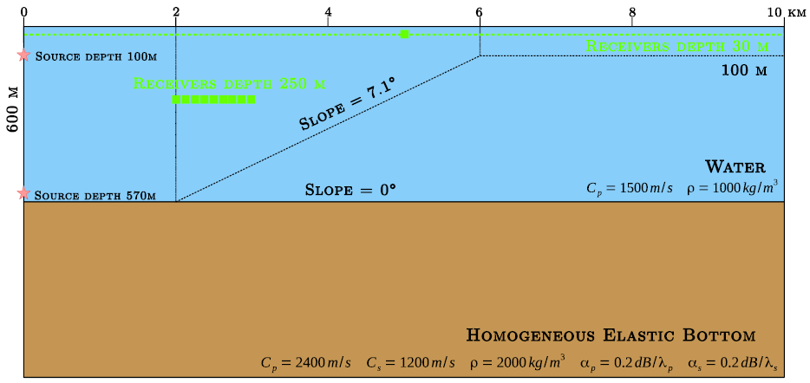
Canonical Environments
Canonical environments are simplified and controlled descriptions of the problem geometry and of the material properties.
Benchmarking case to check SPECFEM2D model setup: Comparison with Bottero et al.¹
¹ A. Bottero, P. Cristini, D. Komatitsch and M. Asch (2016), “An axisymmetric time-domain spectral-element method for full-wave simulations: Application to ocean acoustics. Journal of the Acoustical Society of America 140, 3520, doi: 10.1121/1.4965964.

Slide 6
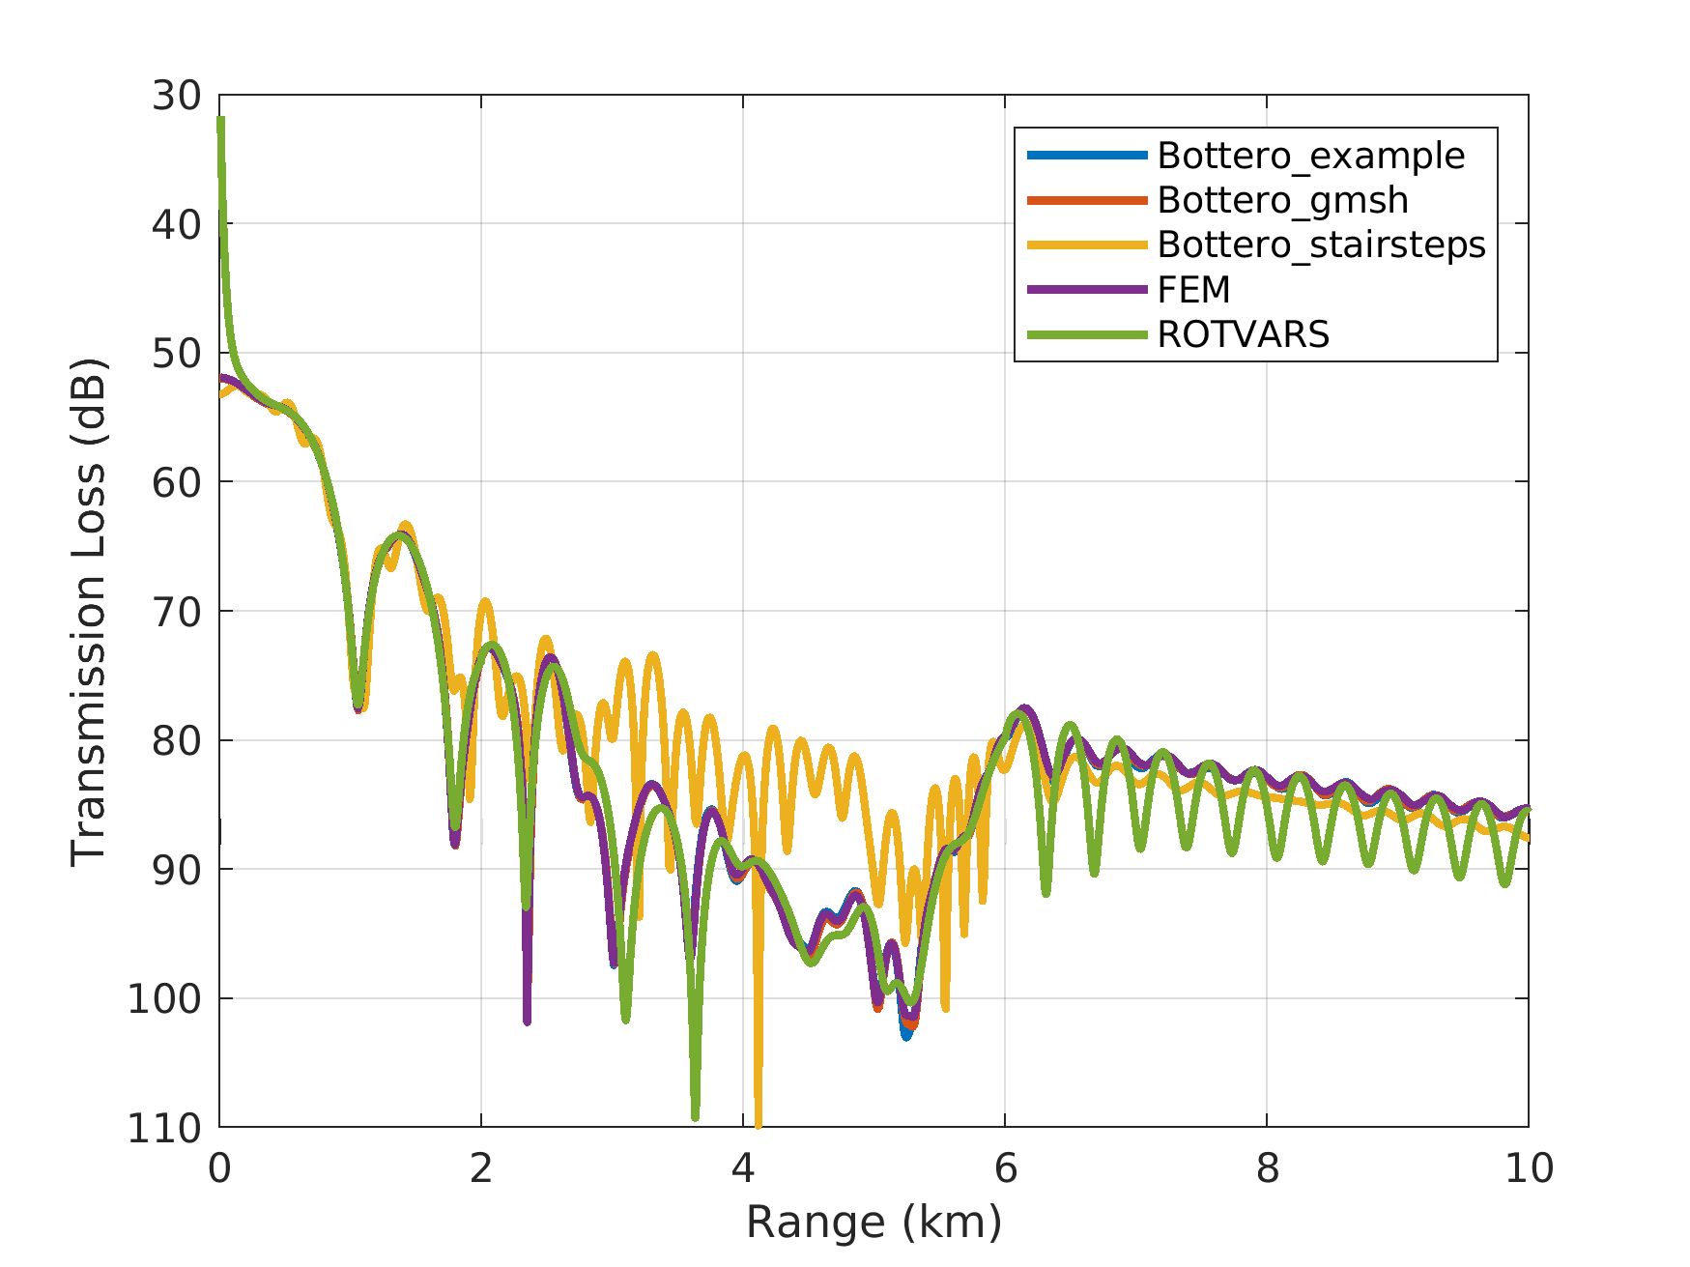
Comparison with Bottero et al. Paper
Source deep
Receiver shallow
With a smooth mesh (Bottero_gmsh), the transmission loss calculated with SPECFEM2D agrees very well with the calculated transmission loss shown in the paper (Bottero_example).
FEM¹ curve is a separate solution from a frequency domain finite element model.
ROTVARS² is an efficient elastic PE model.
This example also shows the importance of modelling the domain with a smooth mesh.
¹ F. B. Jensen, P. L. Nielsen, M. Zampolli, M. D. Collins, and W. L. Siegmann. Benchmarking range-dependent seismo-acoustic propagation problems. In S. M. Jesus and O. C. Rodríguez, editors, Proceedings of 8th ECUA, Carvoeiro, Portugal 45–50 (2006).
² D. A. Outing, W. L. Siegmann, M. D. Collins, and E. K. Westwood. Generalization of the rotated parabolic equation to variable slopes. J. Acoust. Soc. Am. 120, 3534–3538 (2006).

Slide 7
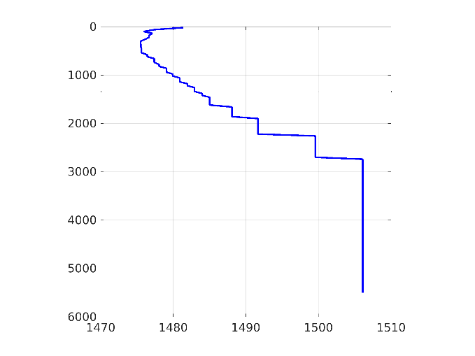
Canonical Environments
Water velocity profile
Canonical environments are simplified and controlled descriptions of the problem geometry and material properties.
The controlling physical factors are in this case:
Sound speed and density in the ocean.
Bathymetry of the ocean bottom.
Material properties (P-velocity, S-velocity and density) of the basement rock for SPECFEM domain.
Material properties and thickness of (fluid) sediment layers.
Sloping Bathymetry
30 degree slope

Slide 8
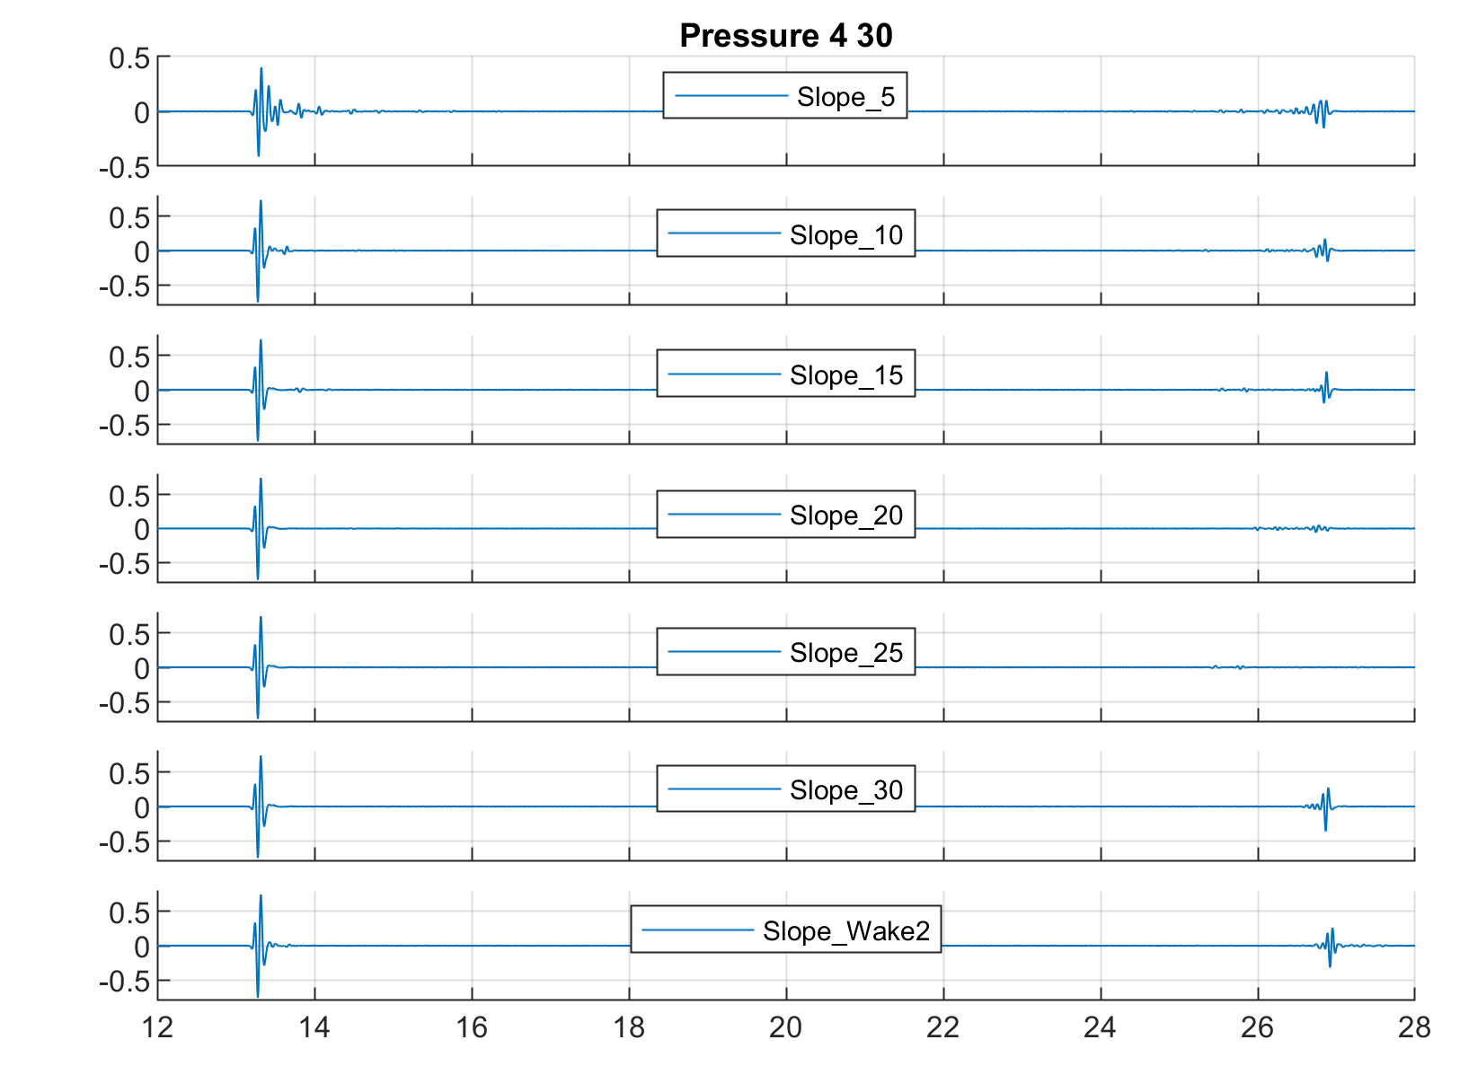
Signal filtered 4-30 Hz
Effect of Sloping Bathymetry -
Waveforms at hydrophone location
Incoming
Backscatter
from slope
The incoming pressure (i.e. propagating in the deep water before the island slope) consistent among all calculations.
Clear differences arise once the waveform interacts with the island bathymetries. Large variability.
Causes of this variability are more complex than slope only.
Pressure
Time (s)

Slide 9
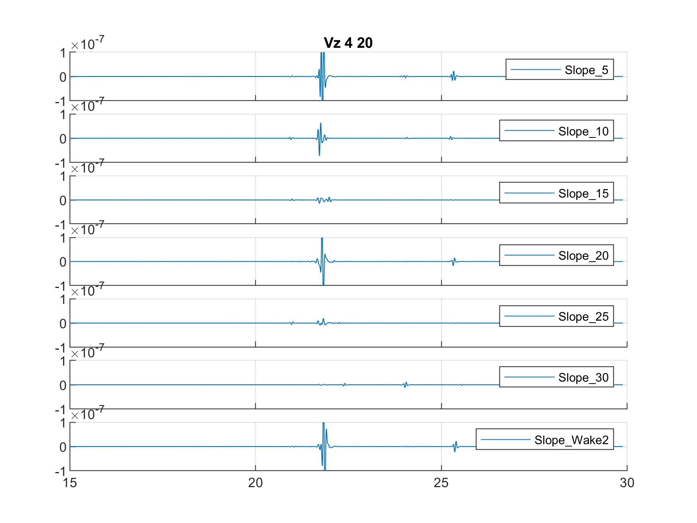
Effect of Sloping Bathymetry -
Waveforms at T-Station 5 km inland
Signal filtered 4-20 Hz
p
surface wave
p
Dependence on slope is very complicated.
The most important factor is the efficiency of surface wave generation when the Hydro phase is converted to T-phase.
p
p
Velocity
p
p
p
Time (s)

Slide 10
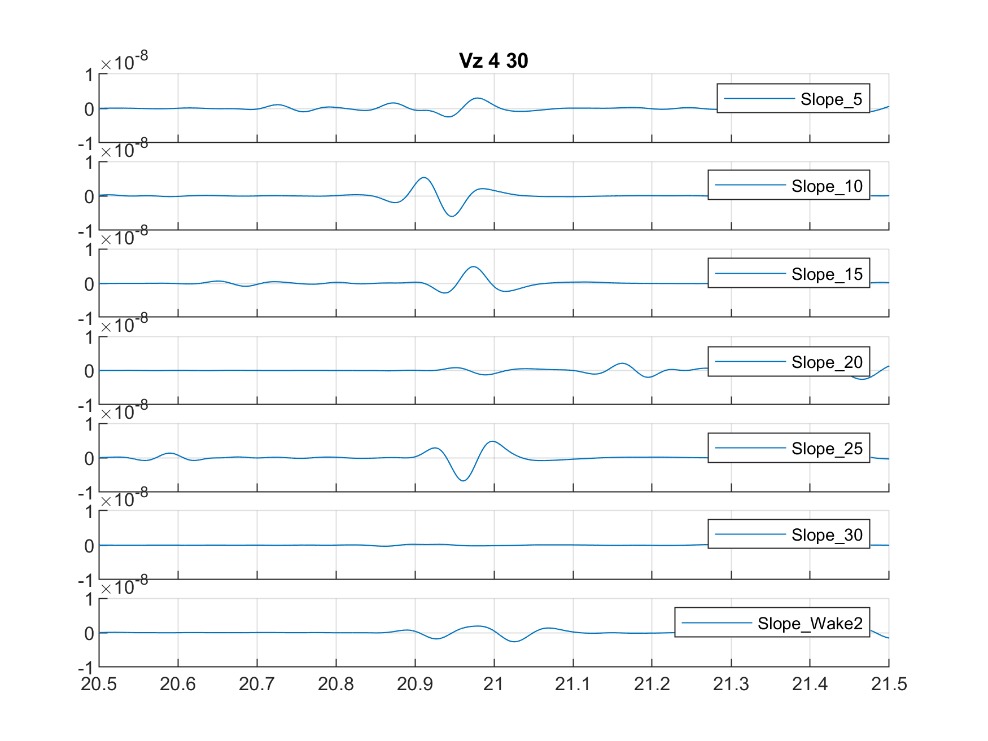
Effect of Sloping Bathymetry -
Waveforms at T-Station 5 km inland
Signal filtered 4-30 Hz, zoom on P wave
Dependence on slope is complicated.
The most important factor is the efficiency of conversion in the direction of the station.
Velocity
Time (s)

Slide 11
Effect of Sloping Bathymetry: Seismic Conversion Process
5 Degree Slope
30 Degree Slope
Movies show the propagating wave from the start of the calculations through 30 seconds

Slide 12
Modelling of Wave Conversion: The IMS Hydroacoustic Network
Calculations for the 5 T-stations (HA02, HA05, HA06, HA07, HA09).
Calculations for 3 hydroacoustic stations which have co-located non-IMS seismometers (HA04, HA10, and HA11).

Slide 13
IMS T-Station Calculations
Example is H06N from a 3000m deep explosion source 500 km to the north
Attenuation was included in this calculation
Orange line is the SPECFEM source input location, where the incoming waves from RAM or KRAKEN are coupled to the SPECFEM2D domain.

Slide 14
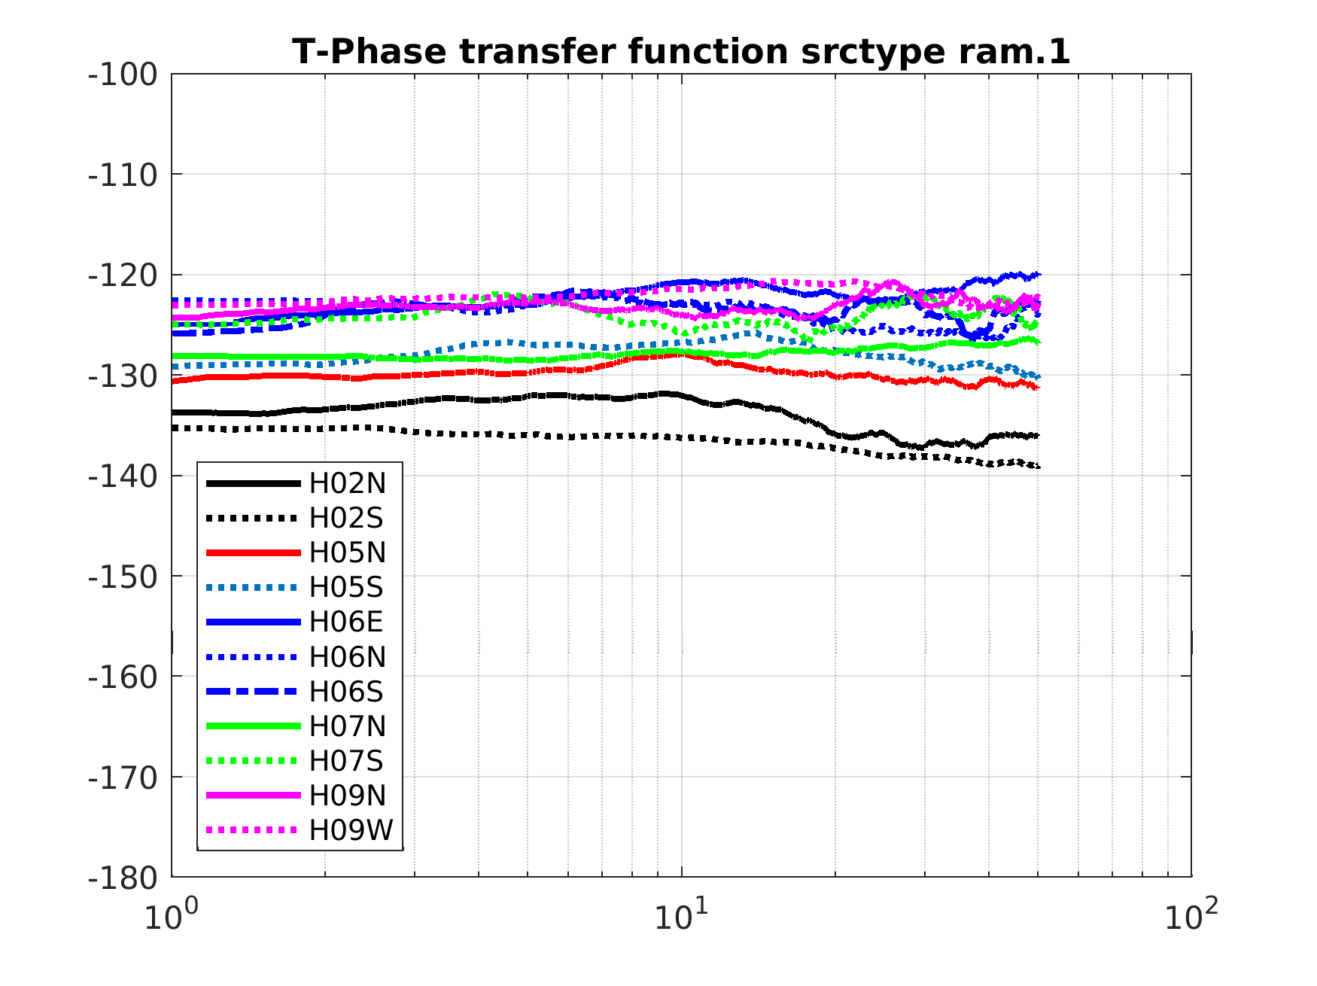
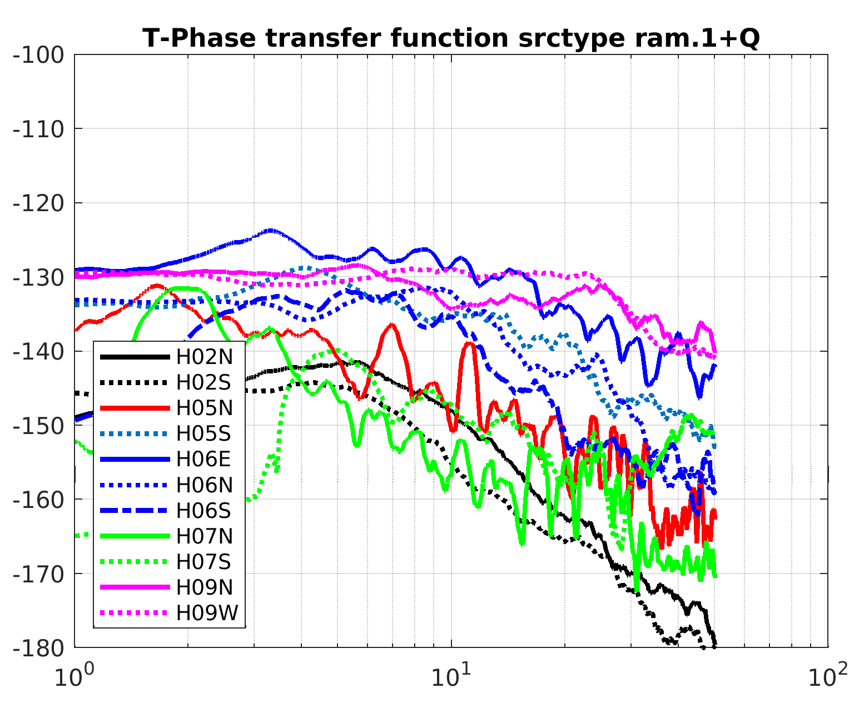
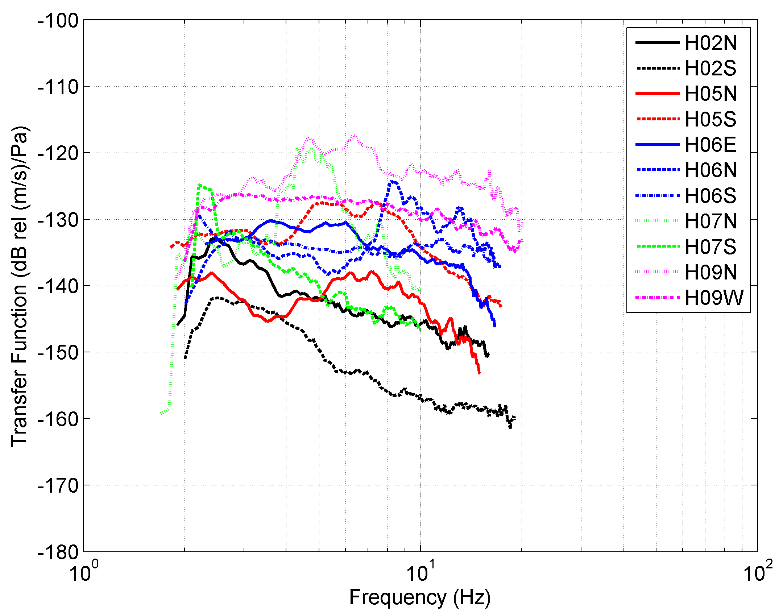
Comparison to Measurements:
smoothed T-Phase Transfer Functions, first rough model data comparison
Calculated without elastic attenuation 2-50 Hz
Calculated with elastic attenuation 2-50 Hz
Observed 2-20 Hz

Slide 15
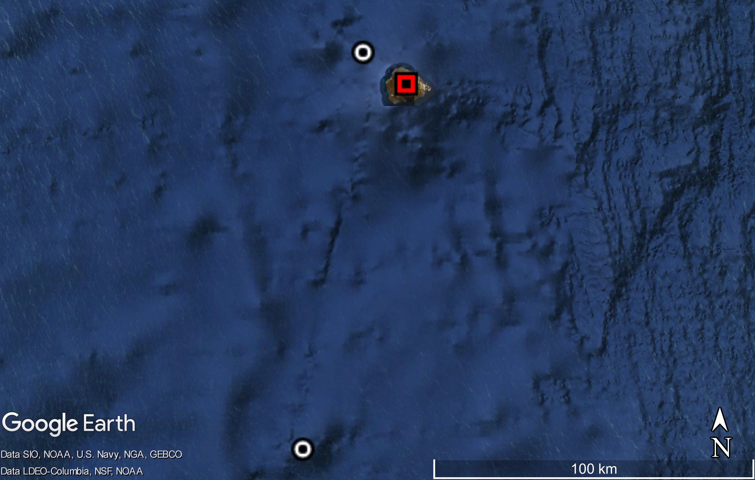
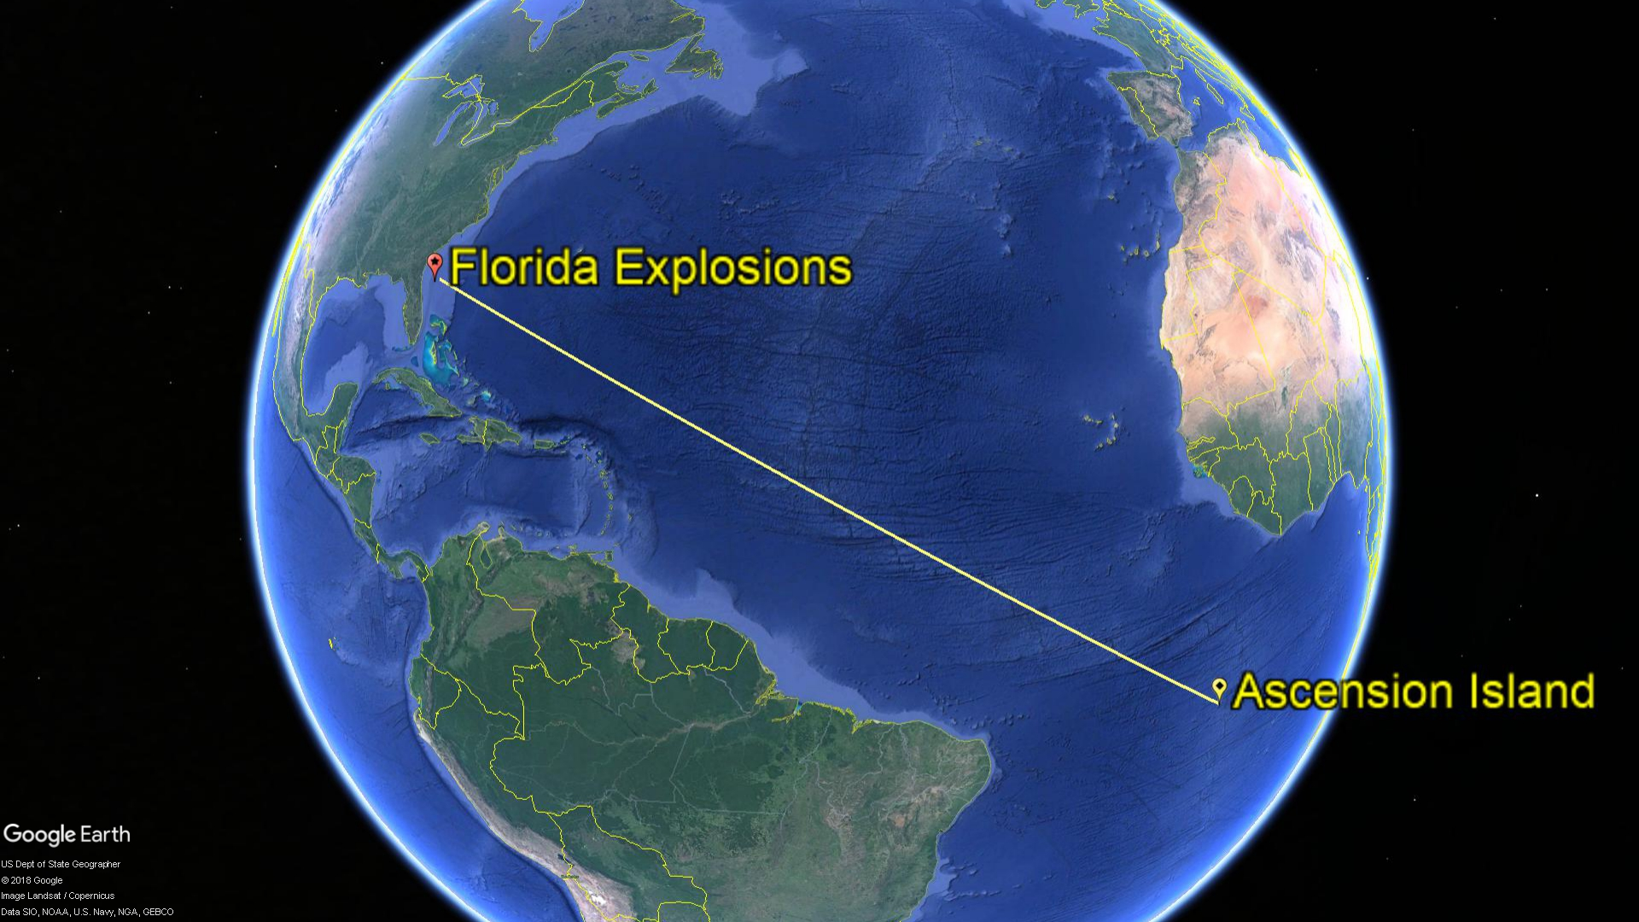
HA10 North triplet
Example: Florida Explosions Recorded at ASCN
Butt Crater seismometer
Ascension Island
Underwater Explosions off the East Coast of Florida¹
5 explosive sources (7 ton TNT equivalent each)
Event | Date | Time | Lat | Lon | m_{b}
1 | 2016/06/10 | 17:10:49 | 29.941 | 79.575 | 3.6
2 | 2016/06/23 | 17:20:00 | 29.948 | 79.479
3 | 2016/07/16 | 20:00:12 | 29.676 | 79.573 | 3.2
4 | 2016/09/04 | 18:29:32 | 30.362 | 79.537 | 3.2
5 | 2016/09/21 | 16:30:55 | 30.173 | 79.568 | 3.3
HA10 South triplet
Geodesic path ~8000 km
¹ R. Heyburn, S. E. J. Nippress and D. Bowers (2016), “Seismic and Hydroacoustic Observations from Underwater Explosions off the East Coast of Florida,” Bull. Seism. Soc. Am., 108 (6), 3612-3624; doi: 10.1785/0120180105.

Slide 16
Example of a calculation for HA10 and the ASCN non-IMS Seismometer

Slide 17
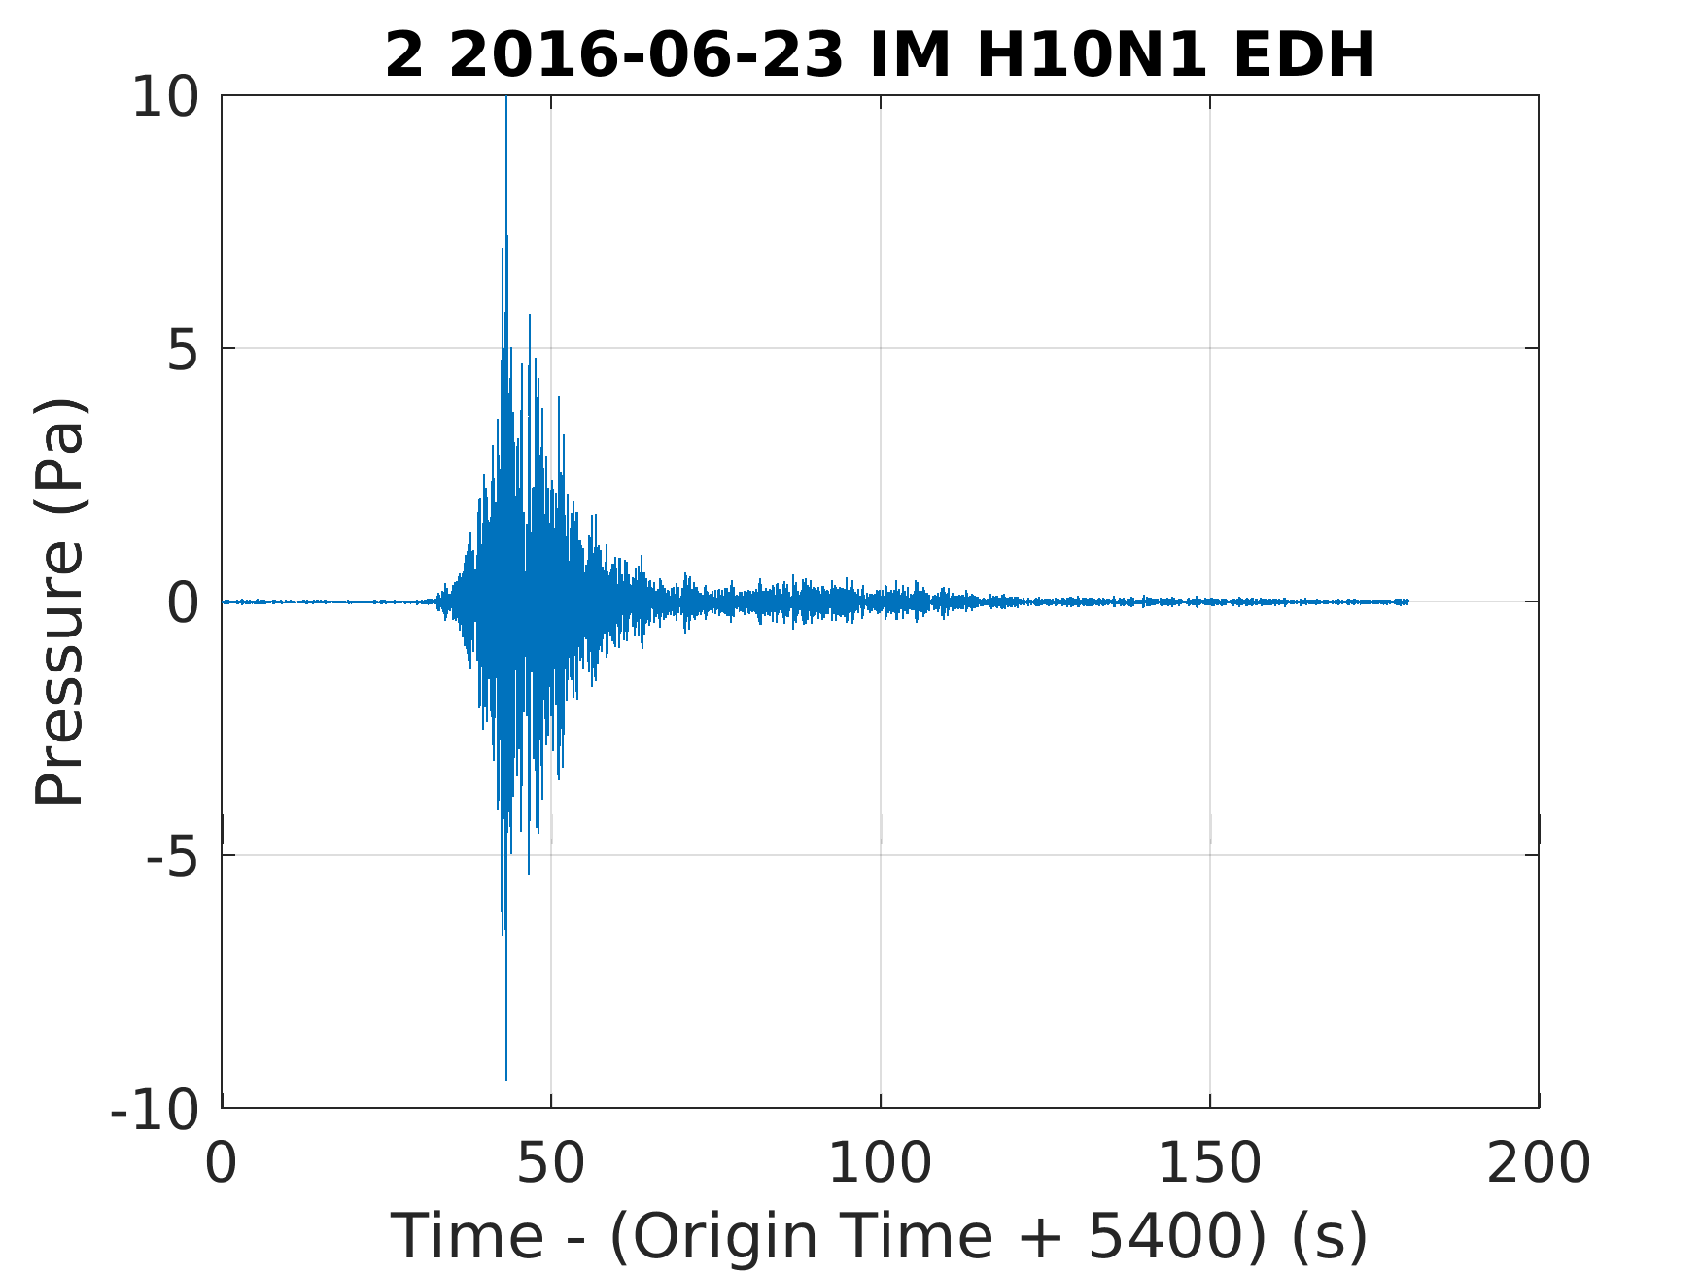
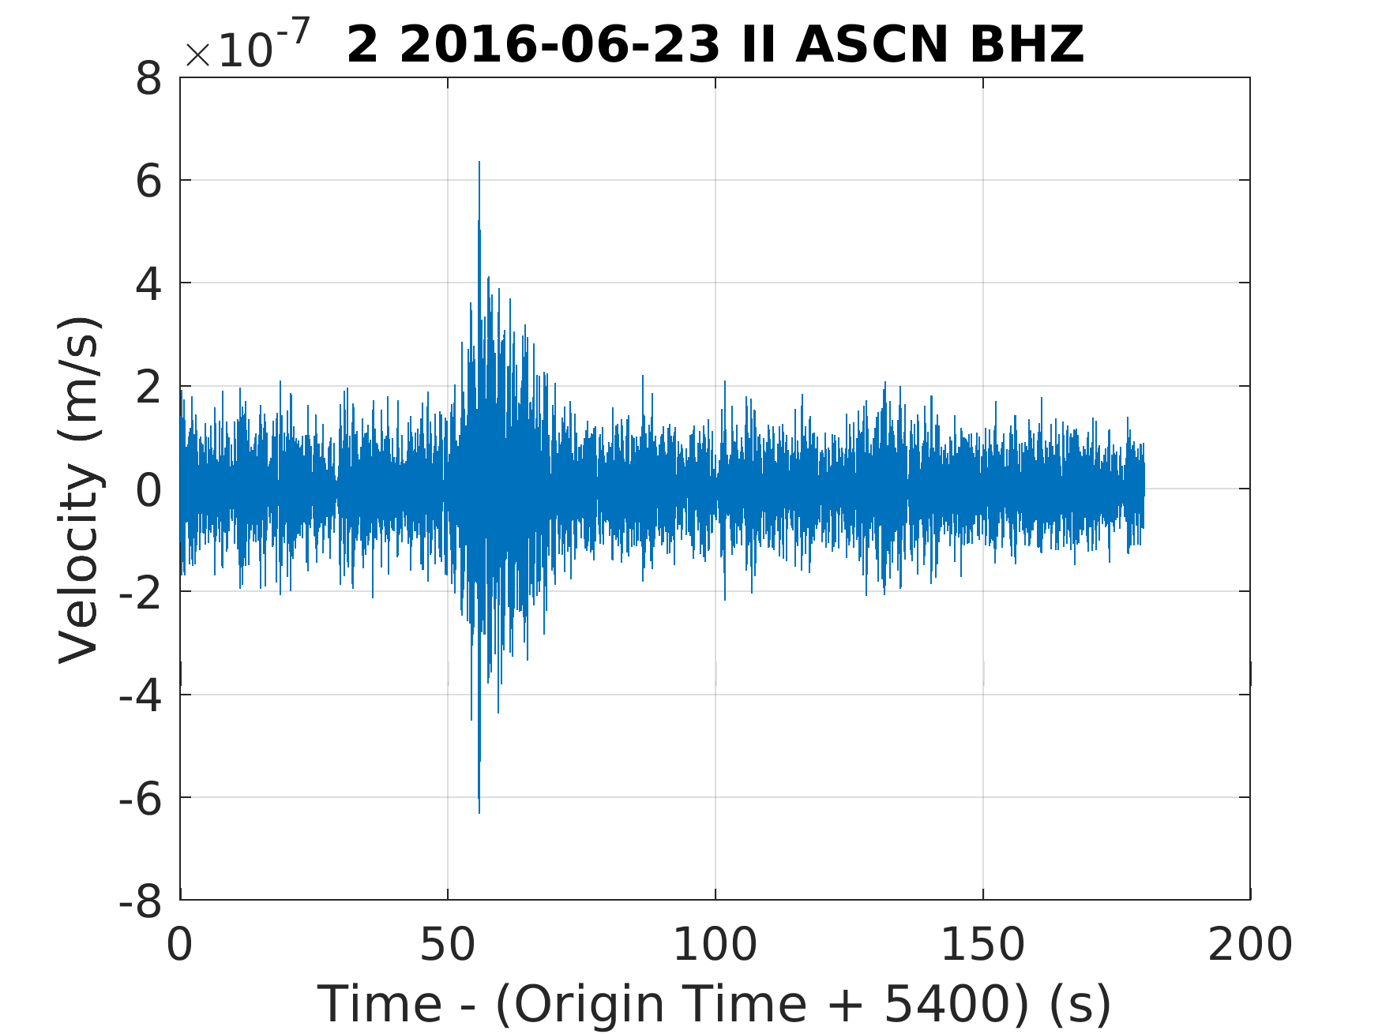
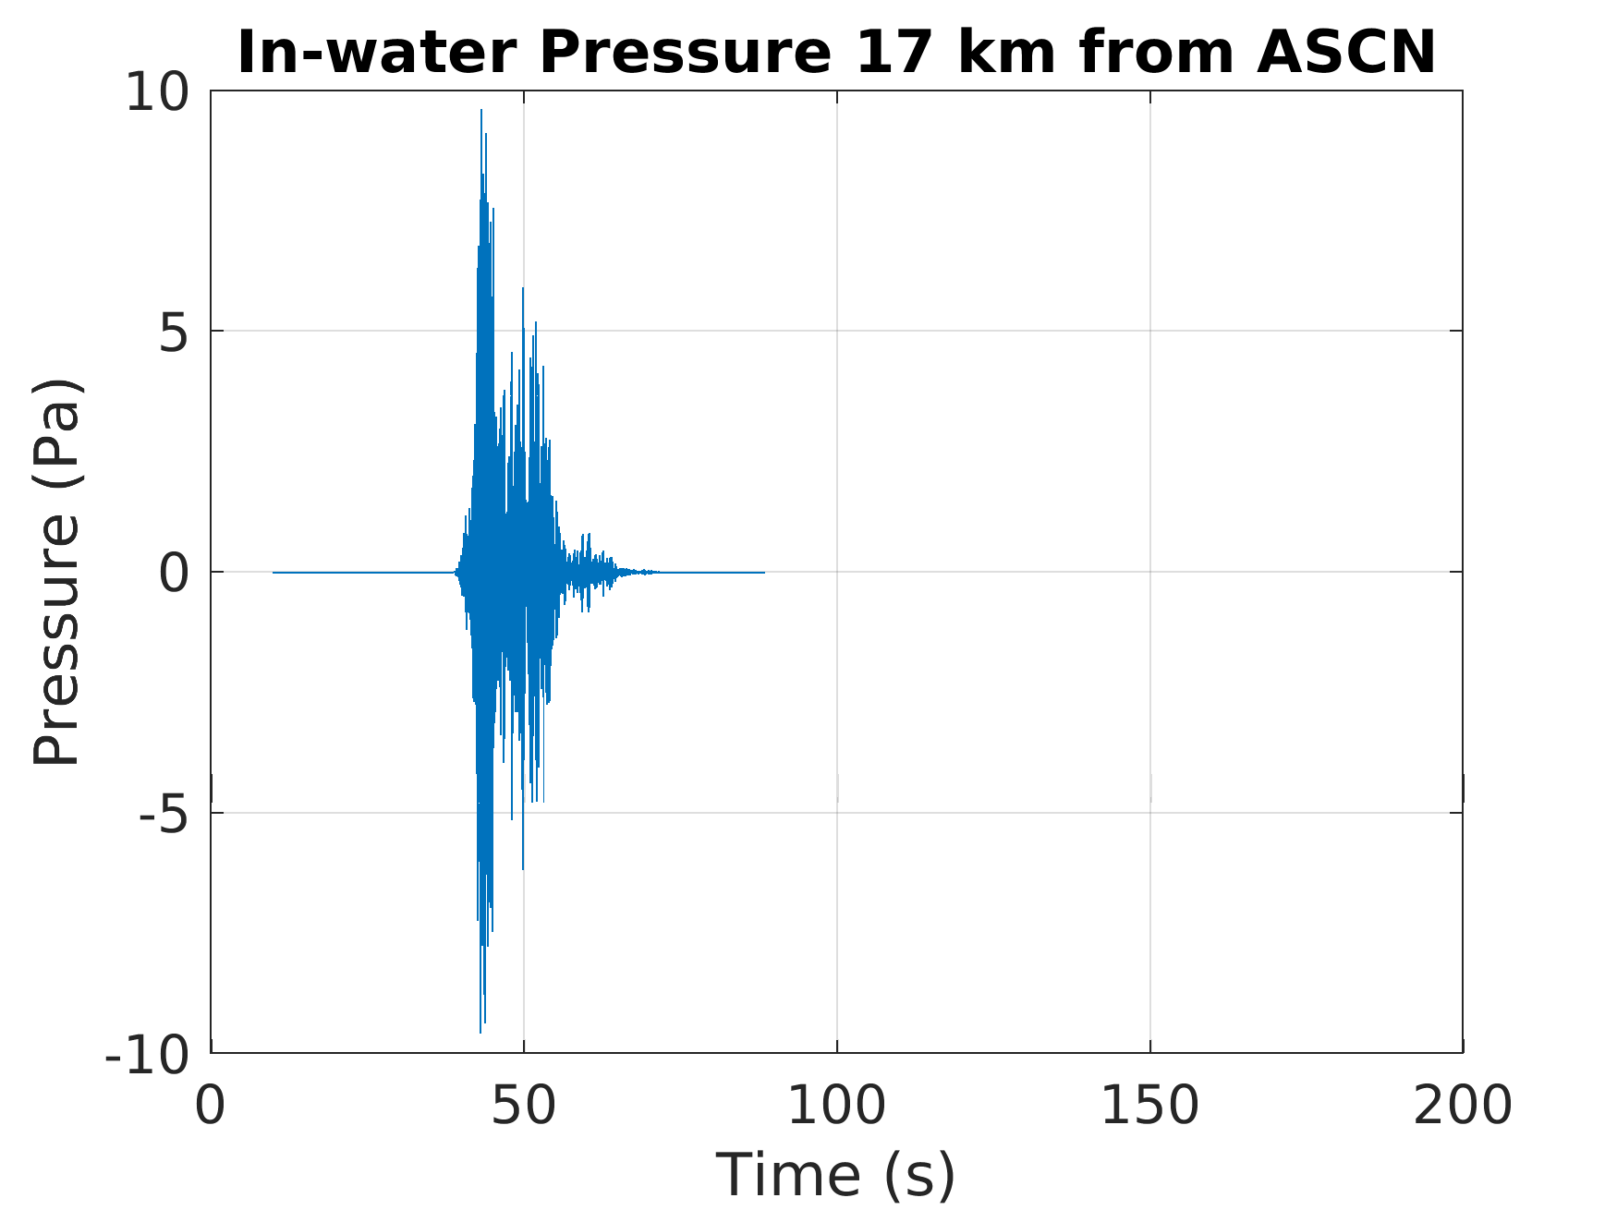
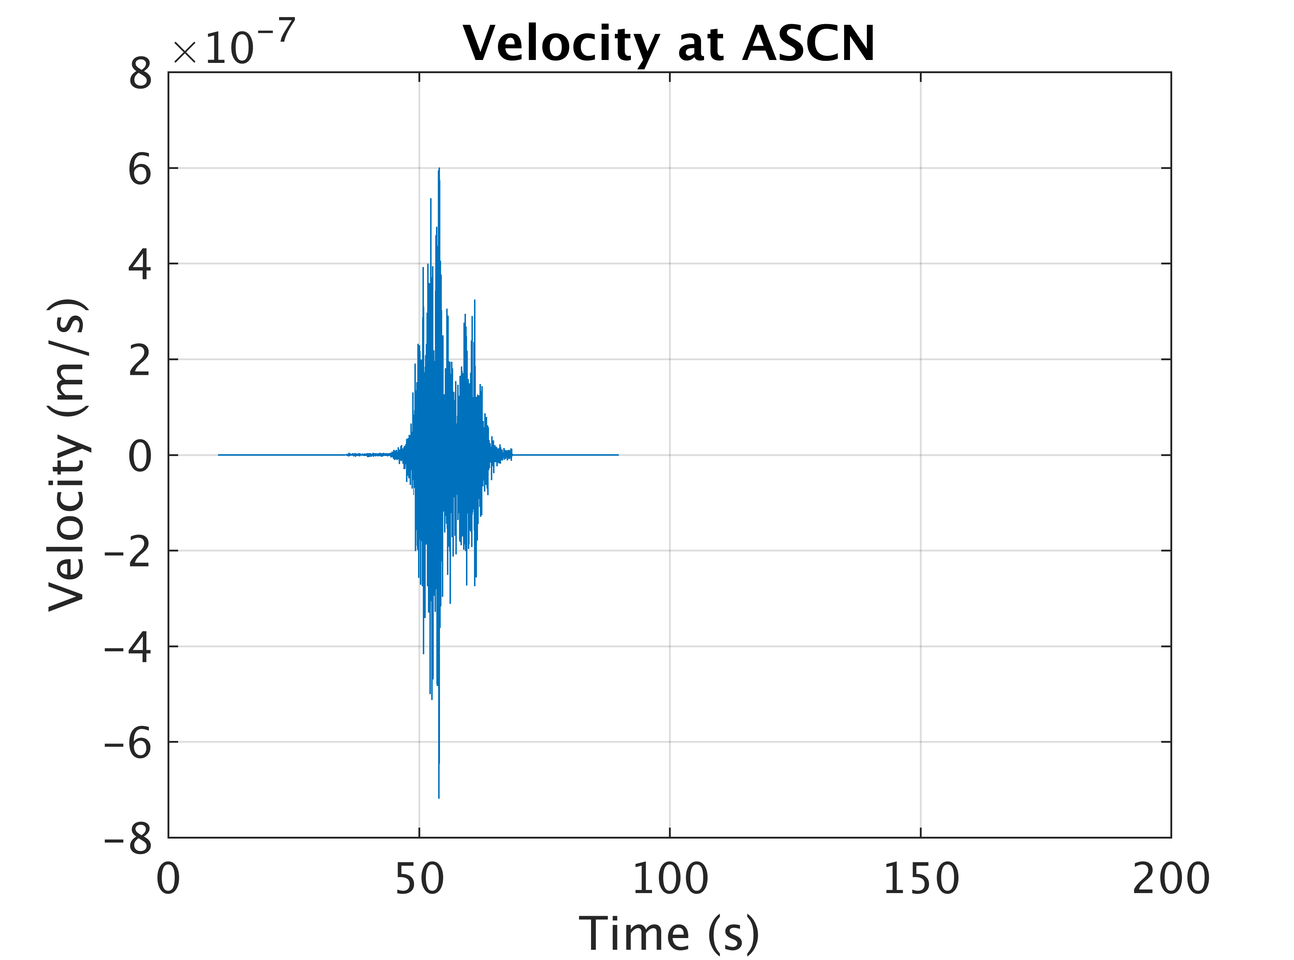
Comparison between Model and Data from Florida Explosions at ASCN
Calculations were initiated at the source location using the PE code RAM.
Then propagated using SPECFEM2D.
Attenuation was included in the SPECFEM2D calculation.
All waveforms filtered 6-10 Hz.
Explosion source function applied.
Correction for system response (hydrophone and seismometer).
Data: Hydro
Data: Seismic
Calculated with RAM
Calculated with SPECFEM2D

Slide 18
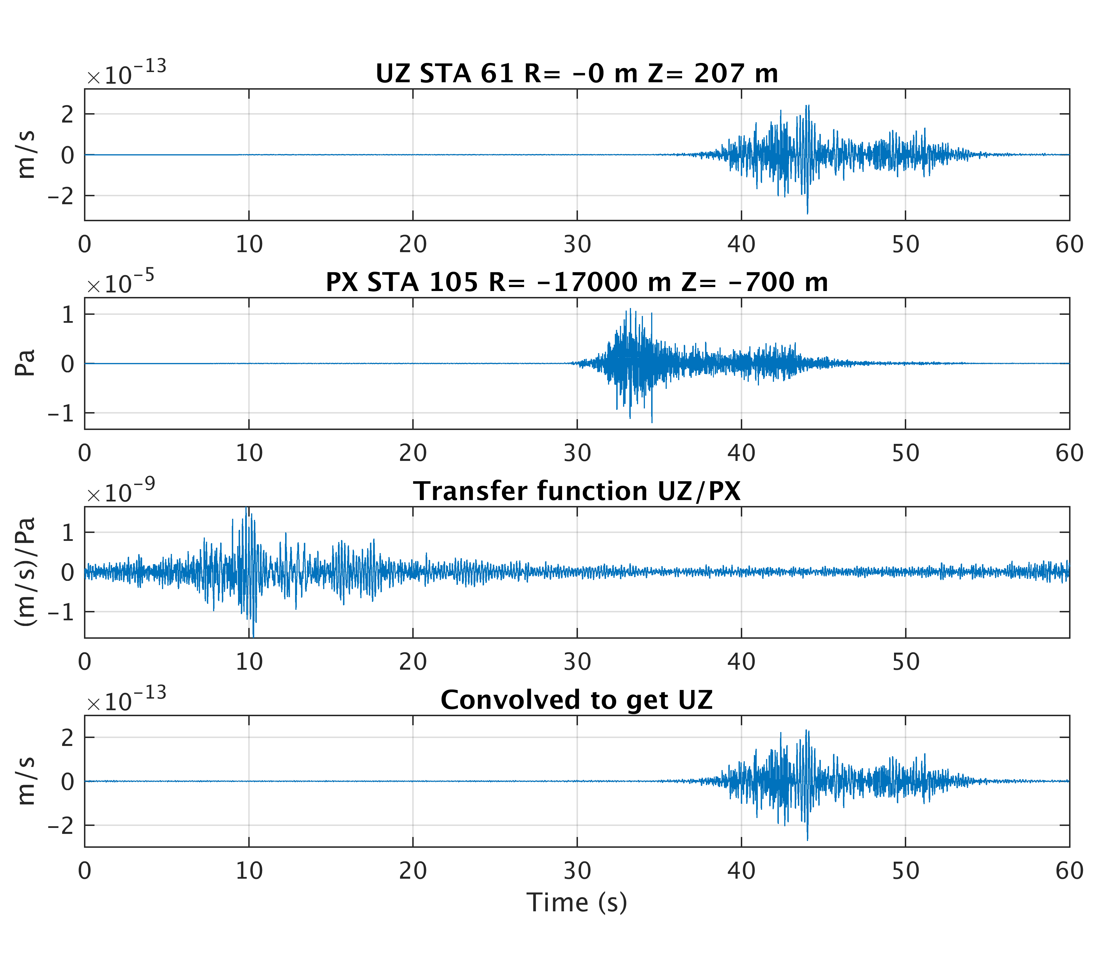
Modelled transfer function ASCN AZ304
Vertical
velocity
modelled directly
T_{model}
Modelled Pressure
u _{model}
p _{model}
T(f) = u(f)/p(f)
Modelled
Transfer
function
Vertical
Velocity estimated from transfer function and model pressure

Slide 19
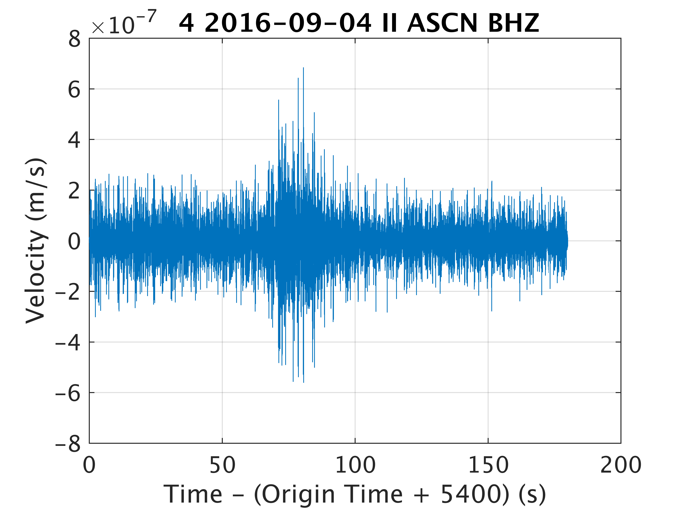
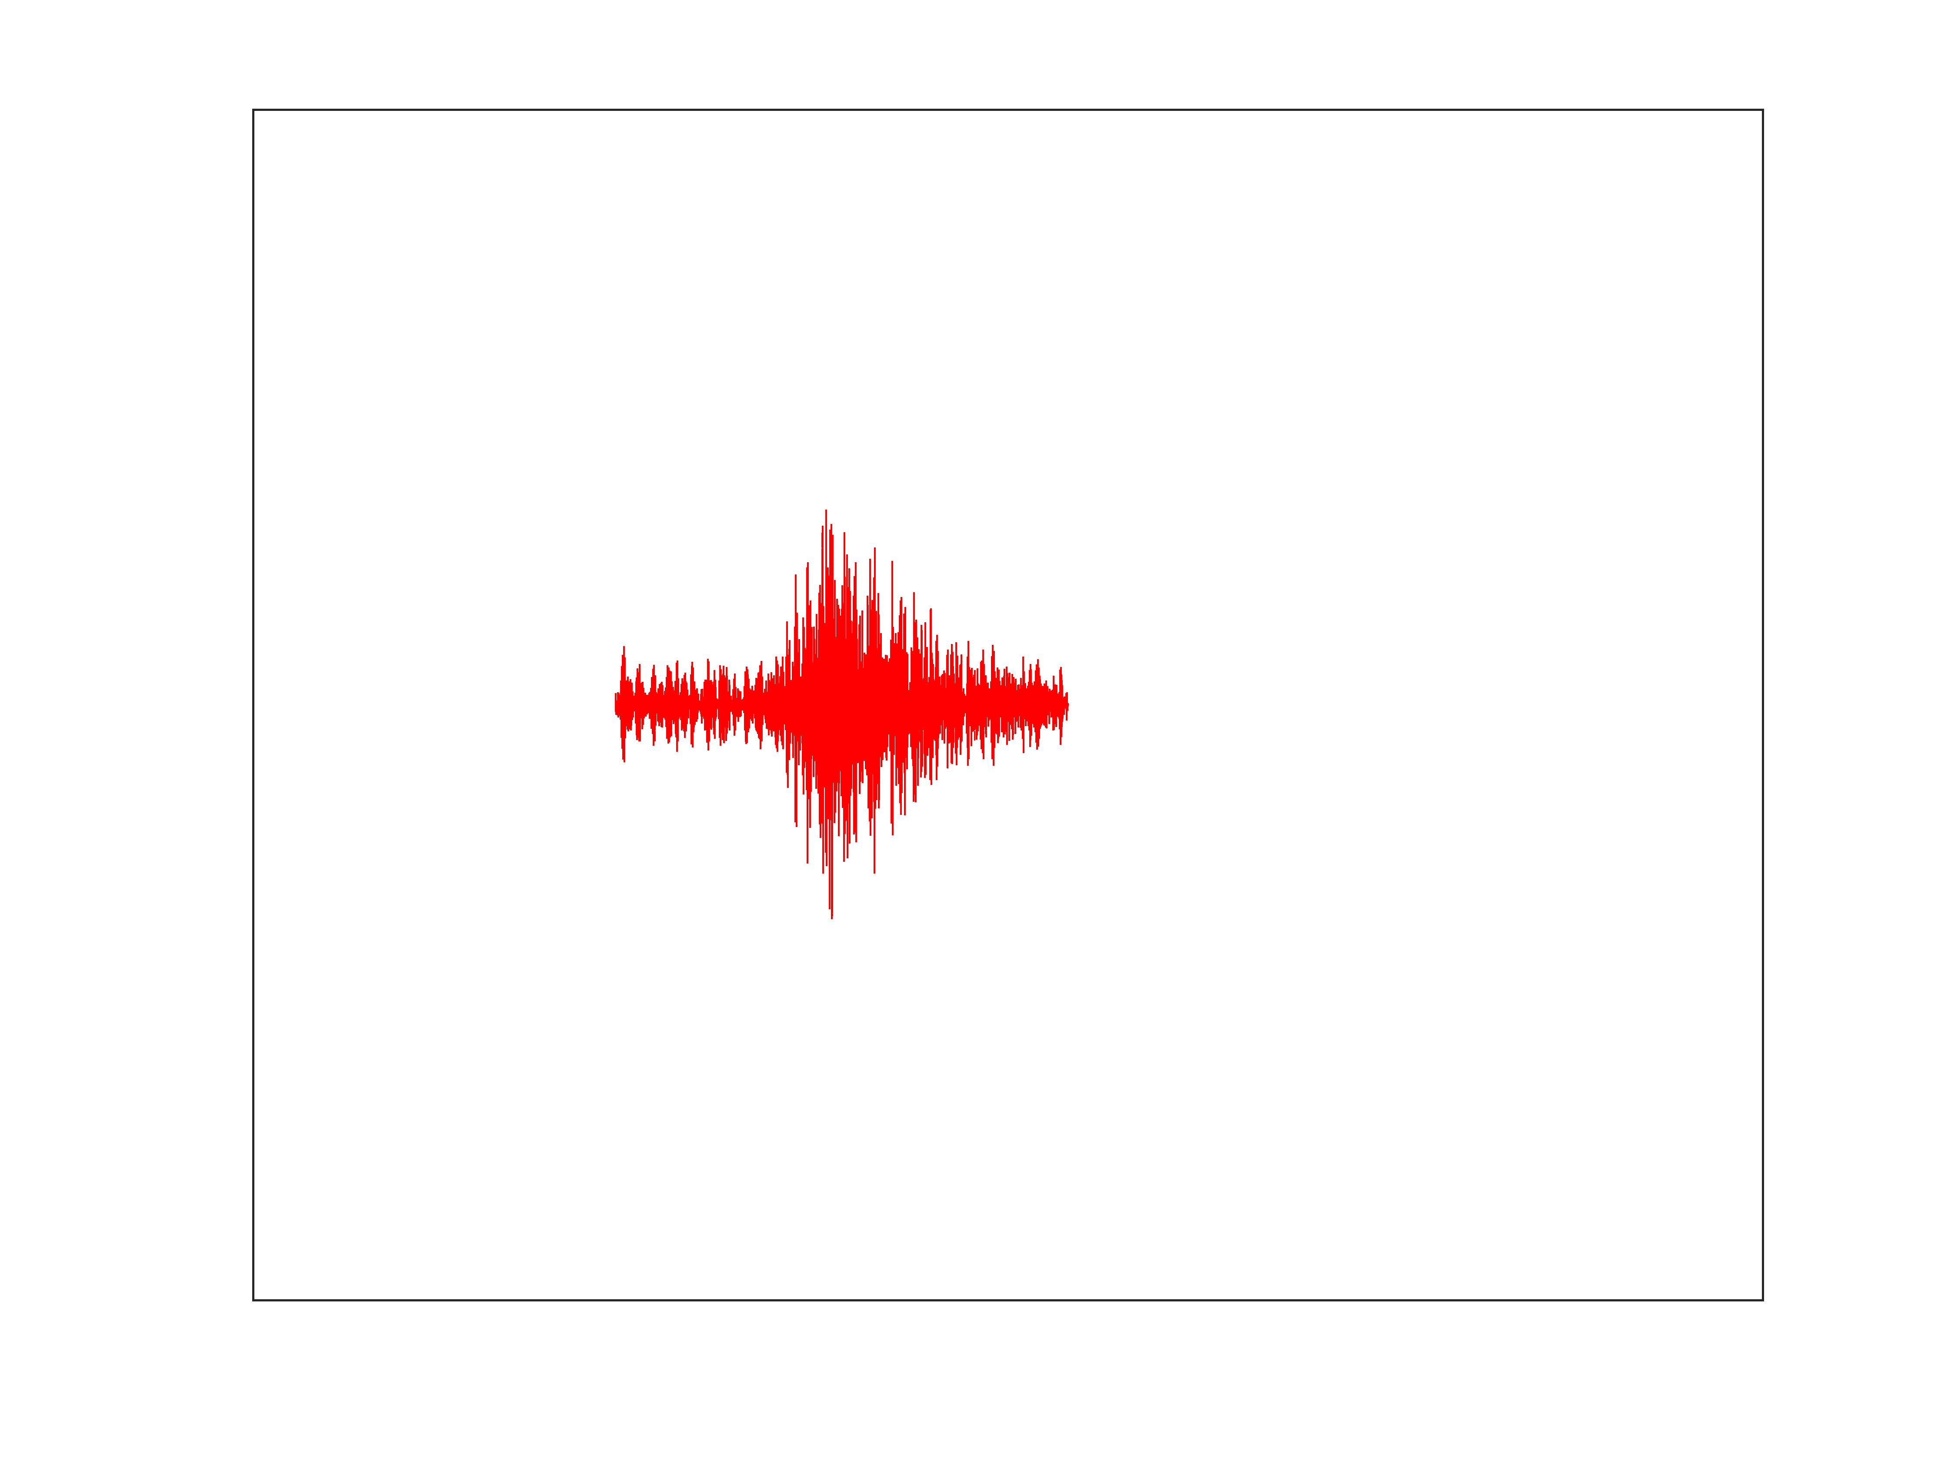
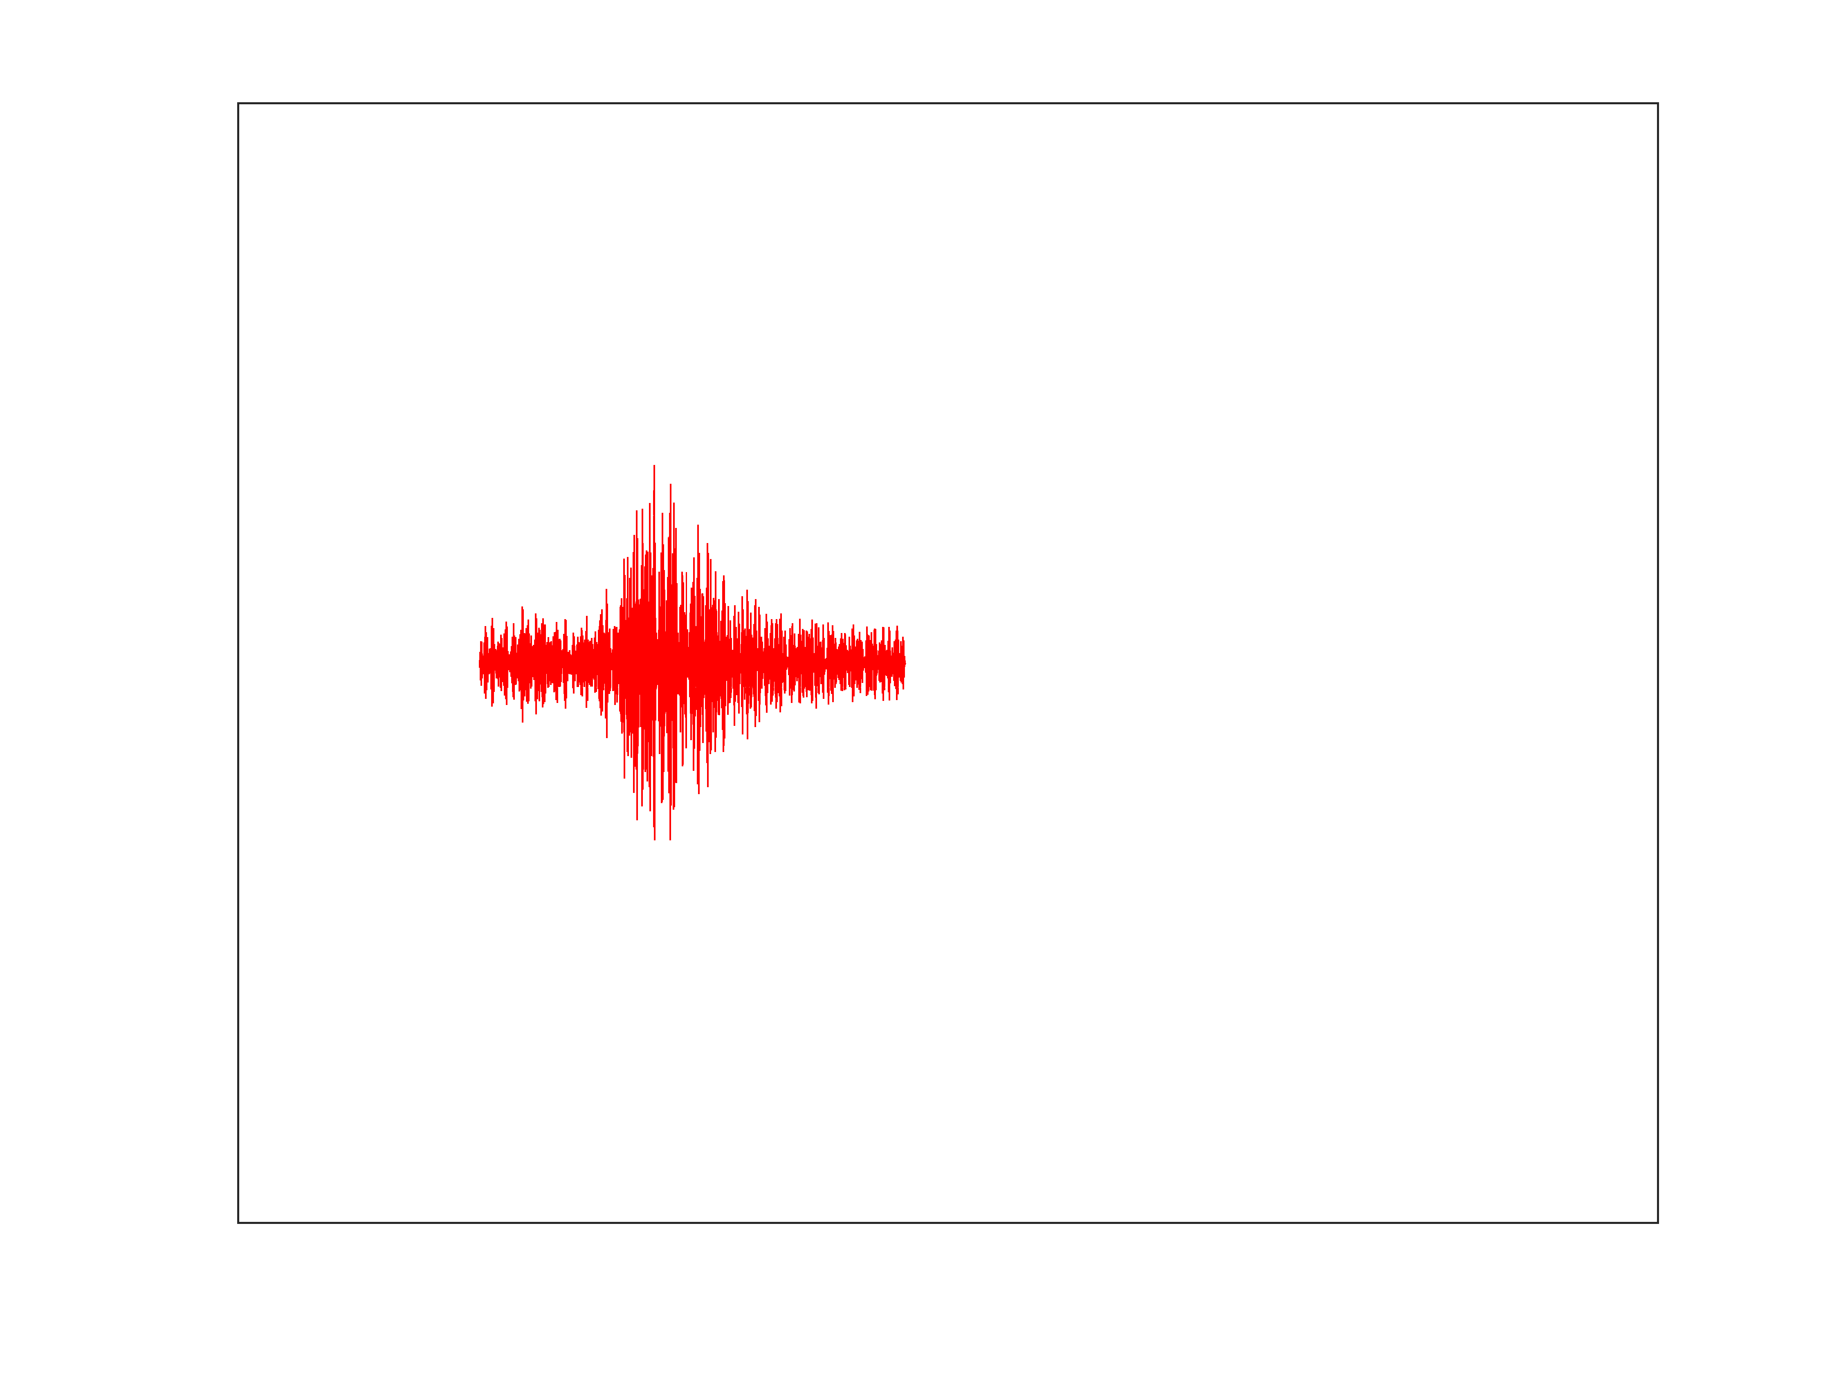
Hydrophone recording (actual data!)
convolved with model Transfer Function
at ASCN AZ304
u_{estim.}(f) = T_{model}(f) p_{data}(f)
T_{model}
u _{estimated}
Measured
Estimated
p _{data}

Slide 20
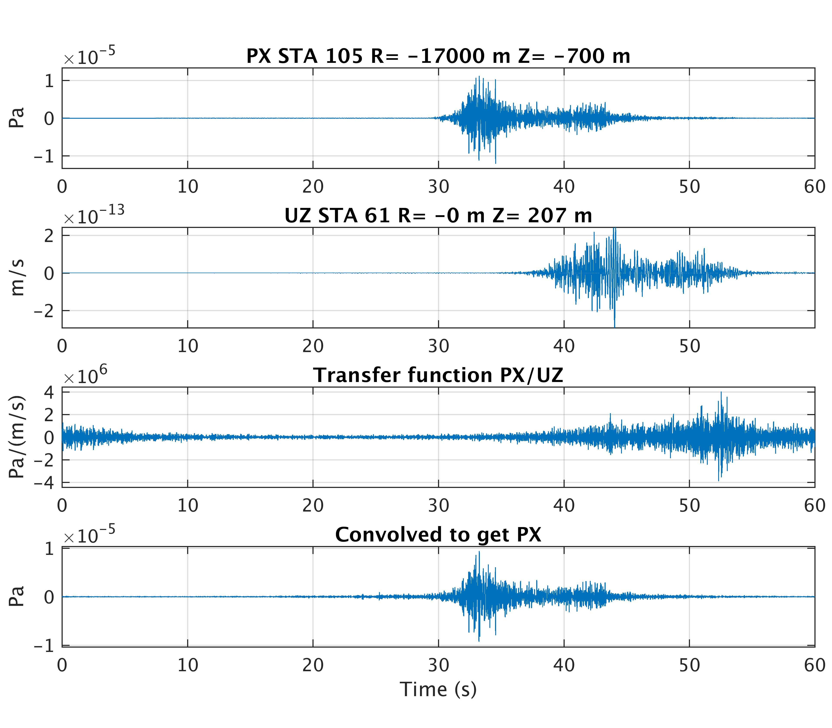
Modelled transfer function ASCN AZ304
Modelled
pressure
Modelled
vertical
velocity
T_{model}
u _{model}
p _{model}
T(f) = p(f)/u(f)
Modelled
transfer
function
Estimated
pressure
from modelled transfer function and modelled velocity

Slide 21
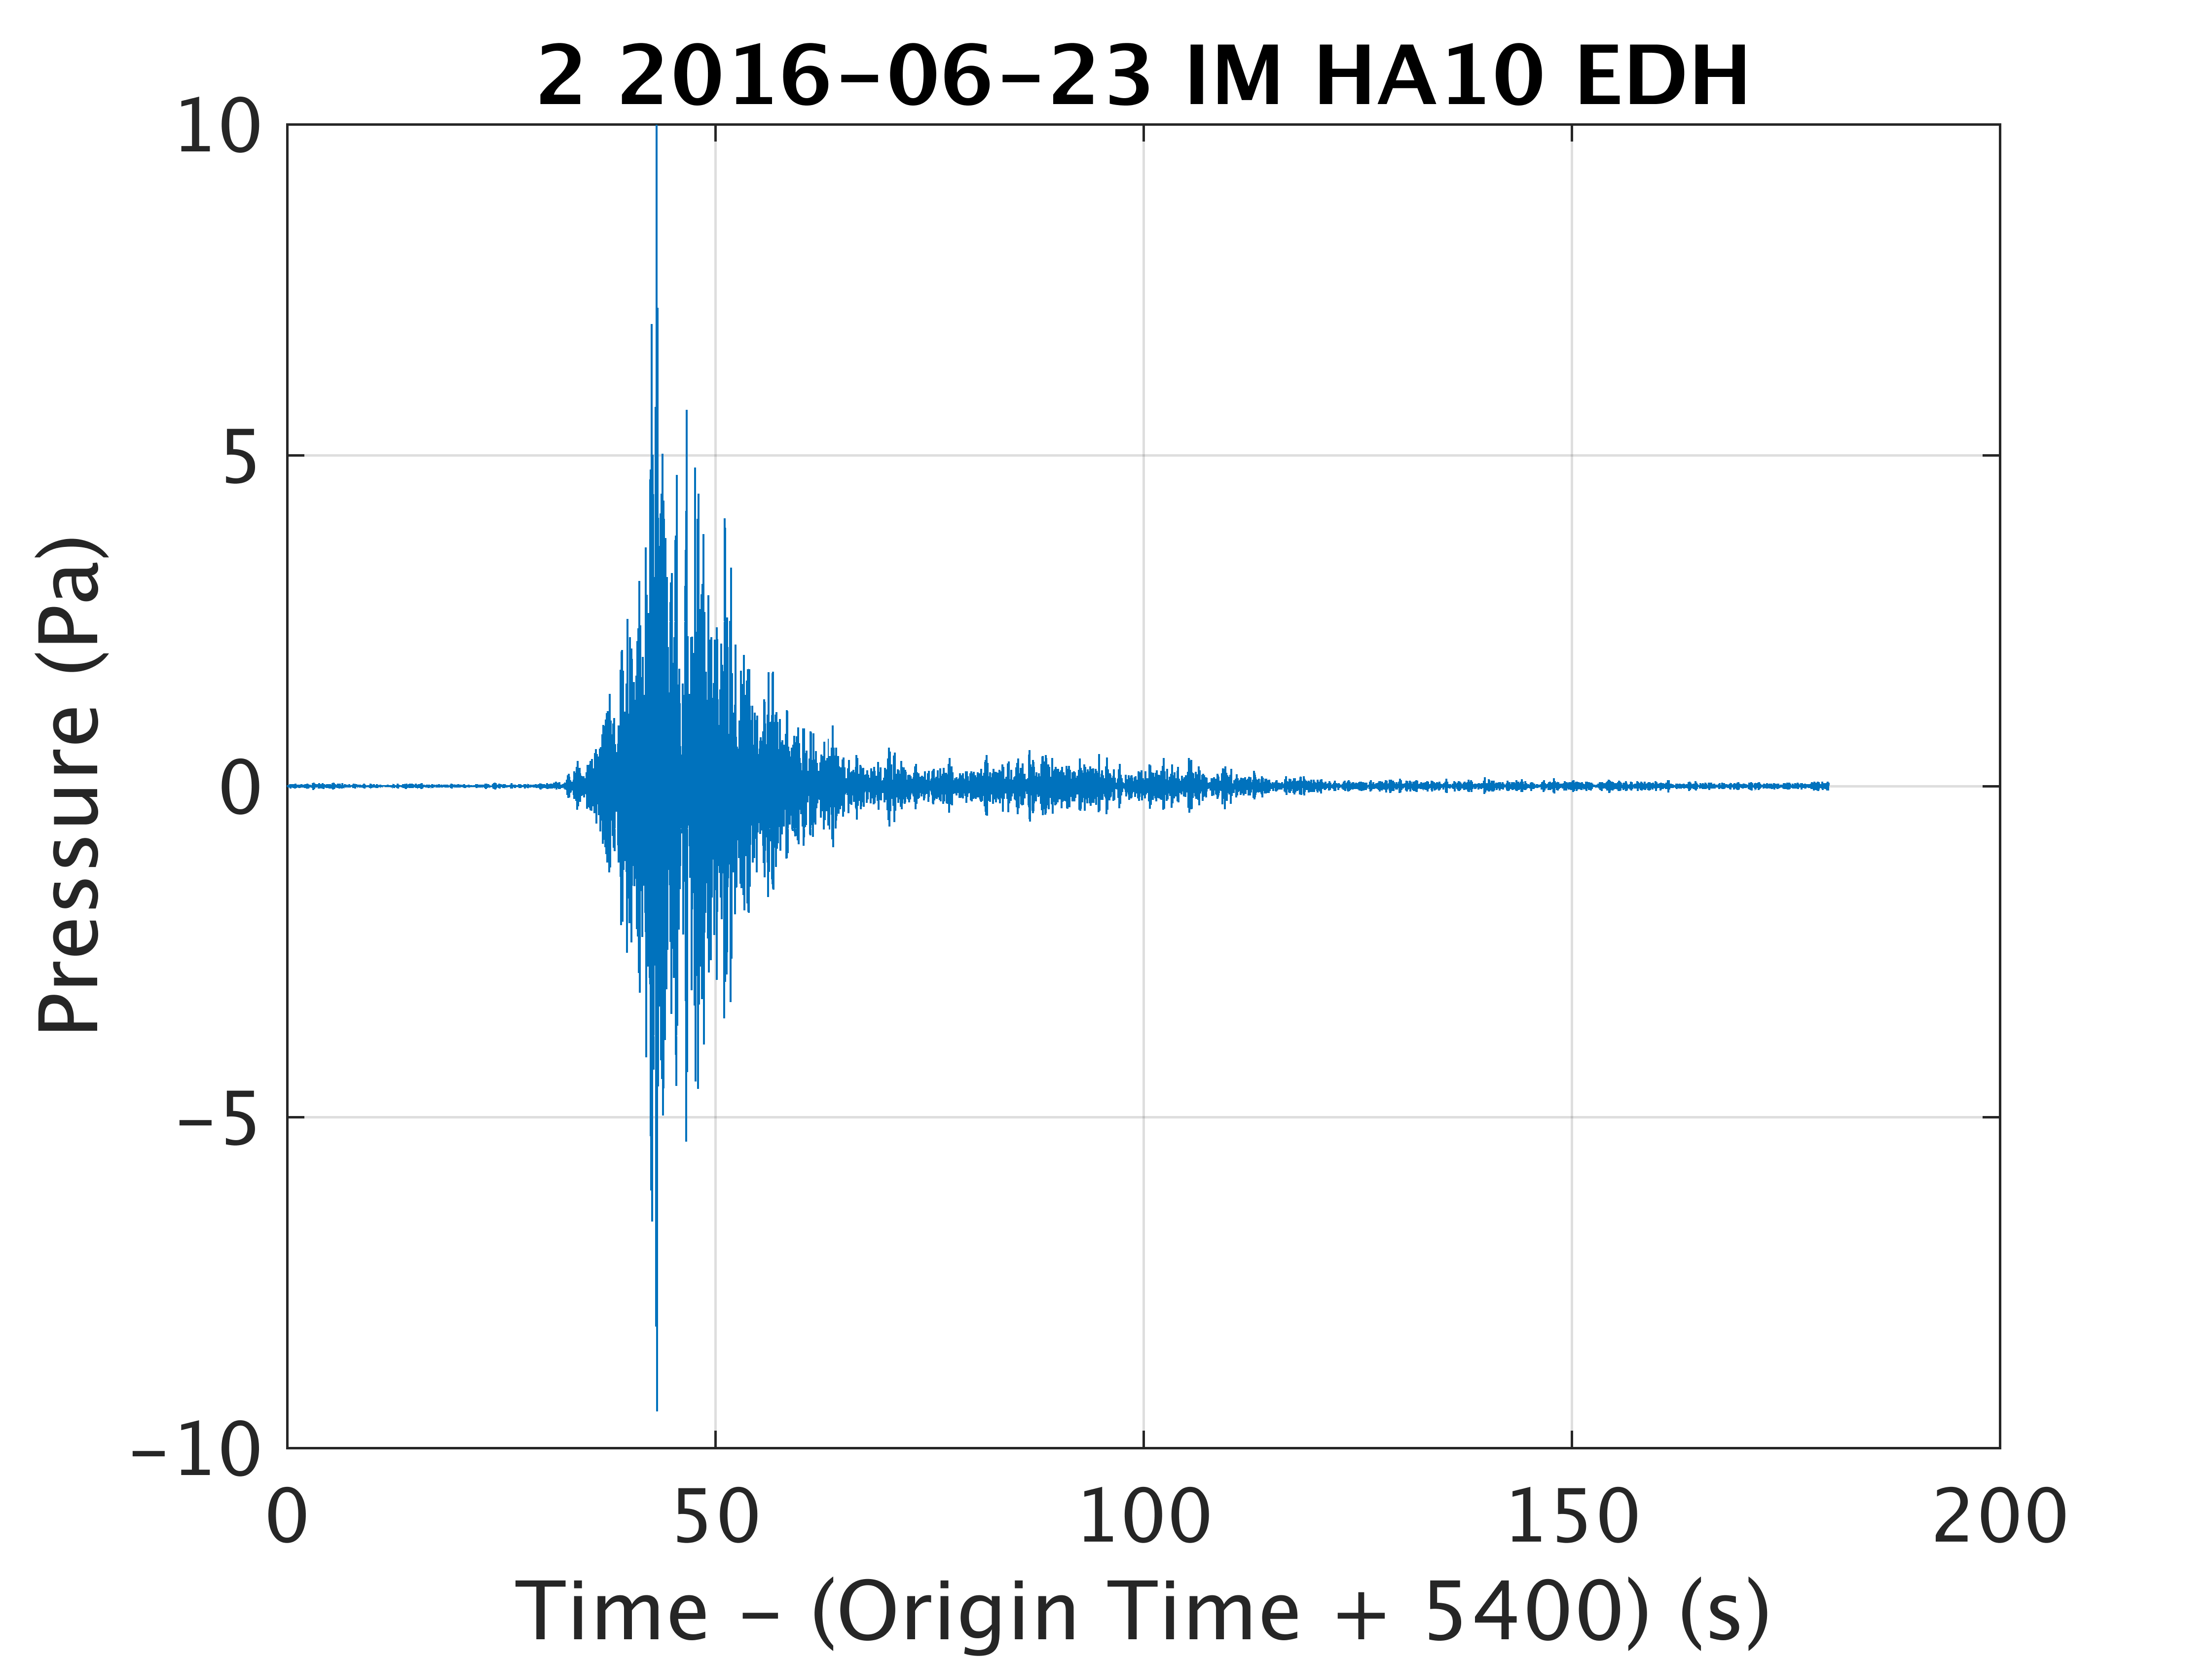
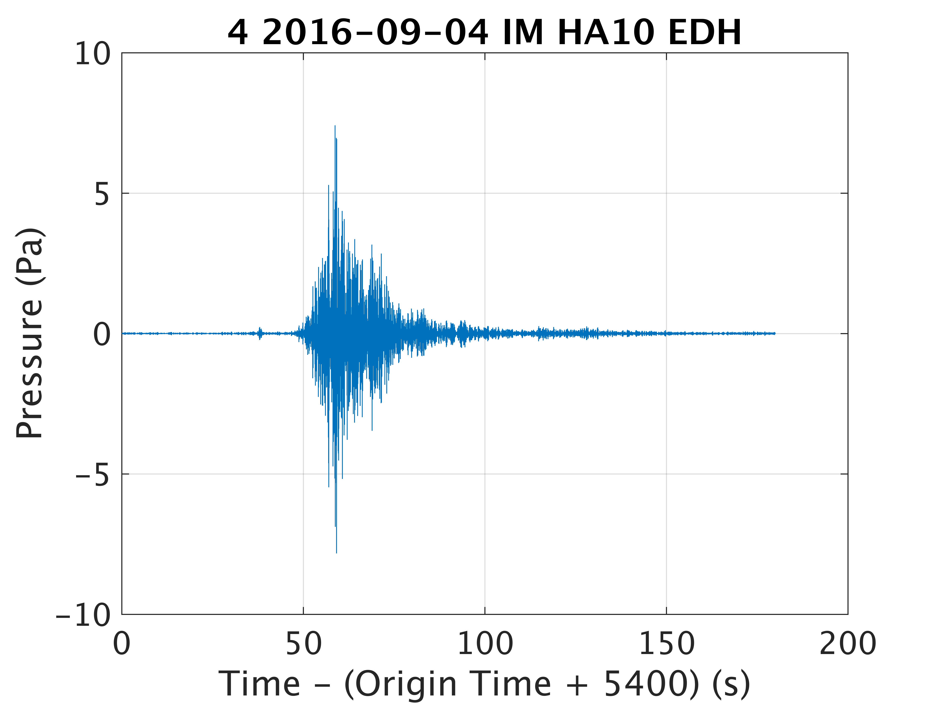
Seismometer recording (actual data!)
convolved with model Transfer Function
at ASCN AZ304
Measured
p_{estim.}(f) = T_{model}(f) u_{data}(f)
T_{model}
u _{data}
Estimation of the pressure at the hydrophone from modelled velocity → pressure transfer function and recorded seismometer data is work in progress…
p _{estimate}

Slide 22
Summary
Hybrid fluid underwater acoustic propagation model and elastic SPECFEM2D to provide time-series from explosion-generated signals (performed for all IMS T-stations and 4 non-IMS seismometers).
The attenuation in the sediment/bedrock appears to be a key parameter, which must be represented accurately in order to compute an accurate frequency domain transfer function.
Very good synthetic reconstruction of in-water pressure and in-ground velocity by forward modelling and by modelled time-domain transfer functions (model only).
Estimated ASCN seismometer vertical (and horizontal) velocity, obtained by applying the modelled transfer function to measured hydrophone data for two Florida explosions recorded at HA10, are in good agreement with data.
The projection backwards compared to above, i.e. estimation of the hydroacoustic pressure at HA10 by applying the modelled transfer function to the measured seismometer data appears more challenging for the Florida explosions.
Next step: find cases with more favorable seismometer SNR to try synthesizing hydrophone response features by applying the inverse of the model transfer function(s) presented above to seismometer data recordings. (T-phase station seismic noise and bandwidth limitations?)
The ultimate objective is to improve the characterization of hydro phase signals recorded by on-shore seismometers.

