Slide 1
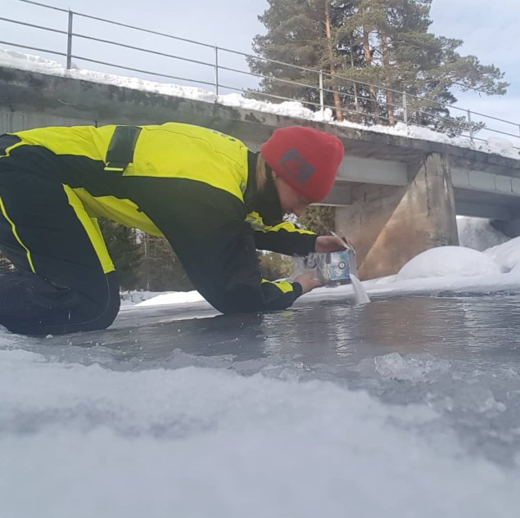
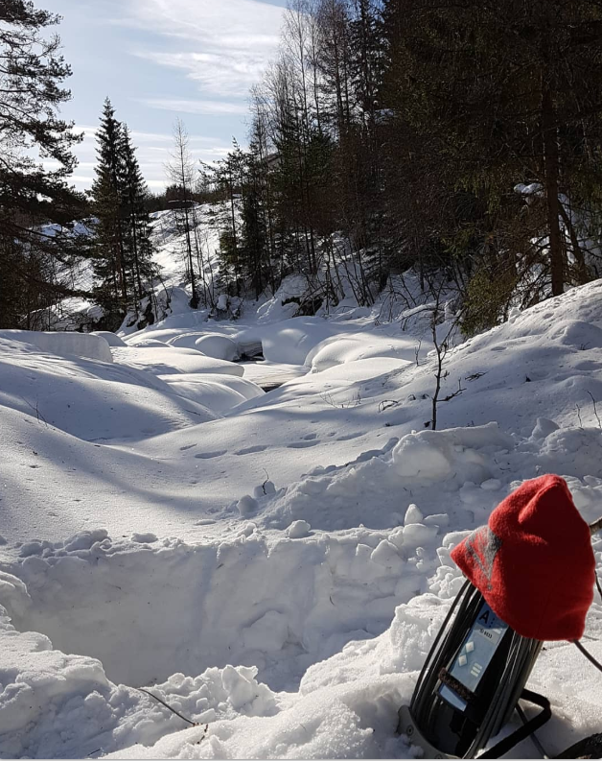
Uncertainty of discharge measurement using the salt dilution method:
a new framework
Alexandre Hauet¹, Kristoffer Florvaag-Dybvik¹, Mads-Peter Jakob Dahl¹, Frode Thorset Kvernhaugen¹, Knut Magne Møen¹, Gabriel Sentlinger²
¹Norges vassdrags- og energidirektorat (NVE), Oslo, Norway
²Fathom Scientific Ltd., R&D, Vancouver, Canada
Contact : ahau@nve.no

Slide 2
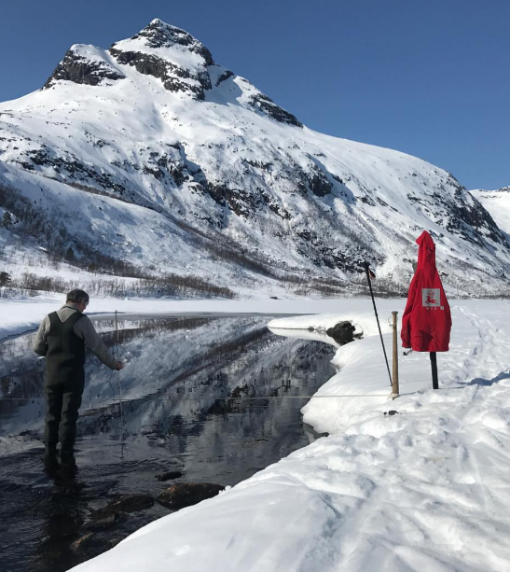
Uncertainty is boring and complex, so…
Why the hell computing uncertainty ???
For having an objective rating of the measurement
Is it a good / fair / poor gauging
To control and ensure the quality of gaugings in the database
Very important when collecting gauging from other institution
To propagate the uncertainty
To the rating curve
To the discharge time-series
To be able to compare values
Compare 2 gaugings
Compare a gauging and a threshold value
→ Verification of regulatory instream flow
Measured instream flow = 1.85 m³/s
Required instream flow = 2 m³/s
Discharge
Regulatory instream flow not respected
Deterministic approach

Slide 3
Uncertainty is boring and complex, so…
Why the hell computing uncertainty ???
For having an objective rating of the measurement
Is it a good / fair / poor gauging
To control and ensure the quality of gaugings in the database
Very important when collecting gauging from other institution
To propagate the uncertainty
To the rating curve
To the discharge time-series
To be able to compare values
Compare 2 gaugings
Compare a gauging and a threshold value
→ Verification of regulatory instream flow
Uncertainty → statistical distribution in which the error can be
Convenient (and often correct) to use a normal law
→ in hydrometry, we express the uncertainty at a confidence level of 95% (2σ)
Measured instream flow = 1,85 m³/s
+/- 0,3 m³/s
Required instream flow = 2 m³/s
Discharge
Regulatory instream flow probably respected
Statistical approach

Slide 4
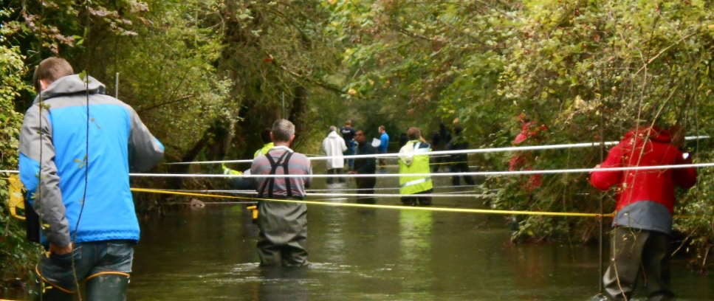
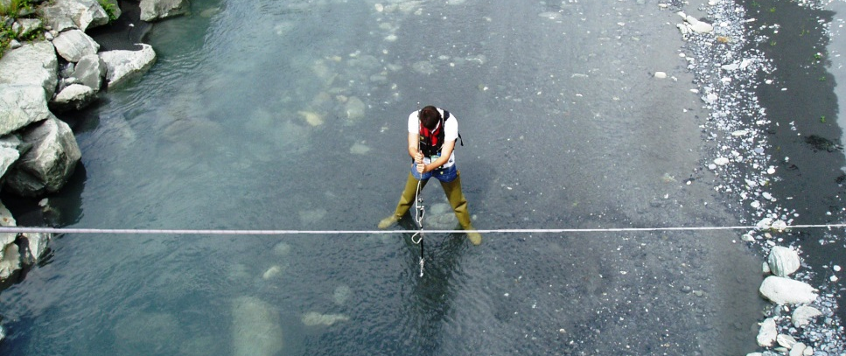
Hydrometry and Uncertainty
Two main methods for computing uncertainty in hydrometry
Inter-laboratory experiments (regatta)
Multiple repetitions of measurements of the same river discharge
Spreading of the results → empirical uncertainty
Results are valid only for the studied experiment and can not be generalized to other conditions
Analytical propagation (GUM)
List all the error sources and evaluate them
Combine the error sources using mathematics
Results can be computed for any gauging
« Analytical »
For any single gauging
Inter-laboratory method (“regatta”)
Propagation method
« Empirical »
In given conditions

Slide 5
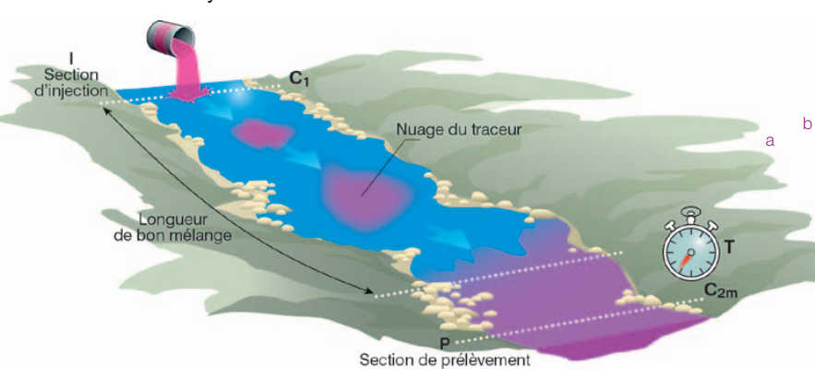
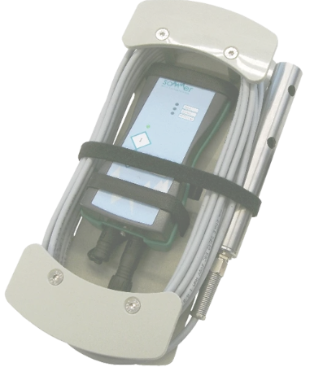
Uncertainty of salt dilution
Cd(t)
Method:
Injection of a known mass of salt M_{inj}
When the mixing length is reached, the mass flux of tracer at time t (kg/s), is :
Under the assumption of a steady flow
Cc can not be measured directly → measurement of the conductivity Cd and calibration of a Cc to Cd law:
Cc = CF*Cd
Calibration using standard additions of a calibration solution in a known volume of stream water
Conductivity (μS/cm)
M_{inj}
Cd(0)
Time (s)
CF
Conductivity (μS/cm)
Concentration (g/L)
| 5
Notes:
7 verticales

Slide 6
Uncertainty of salt dilution
Literature review:
Few literature about the uncertainty of salt dilution (less than 20 papers)
Most of the papers compare methods (dilution vs. current meters) and are not direct computation of uncertainty
Most of them are quite old (1960 – 1970’s)
ISO standard 9555 :
Quite old (1994)
Out-of-date : not adapted to new technologies and new equipment
Based on low sampling methods (physical samplings)
Not exhaustive
Necessity of building a new framework, up to date and exhaustive
Uncertainty of the discharge
Uncertainty on the pipettes and flask volumes
Uncertainty on timing of the samplings
Uncertainty on the number of sampling
| 6
Notes:
7 verticales

Slide 7
Uncertainty of salt dilution – GUM approach
Definition of the measurement equation →
List of Error sources :
Uncertainty in the mass of salt injected u(M).
Uncertainty in the computation of the area under the conductivity curve, which includes four components:
Uncertainty in the computation of the base conductivity u(Cdb), especially when the conductivity base is not stable in time
Uncertainty in the signal to noise of the conductivity u(Cdt - Cdb), including the variability of the signal and the resolution of the probes.
Uncertainty in the sampling u(samp) related to the number of points measured during the passage of the tracer wave.
Uncertainty in the setting of the end of the tracer's wave, u(limits).
Uncertainty in the correction of temperature u(temp) for the measurement of Cd.
Uncertainty in the Conductivity to Concentration law u(CF) during the calibration.
Uncertainty if the conductivity is out of the range of the Conductivity to Concentration law u(range).
Uncertainty in the measurement of time u(dt).
Some other error sources can be considered, like:
Uncertainty due to a not perfect mixing of the tracer u(mix), if the mixing length is not reached
Uncertainty due to a loss or a gain of tracer between the injection and the probes u(tracer), if tracer can be adsorbed for ex.
Uncertainty due to unsteadiness of the flow u(steady), i.e. variation of discharge during the measurement
Uncertainty due to systematic residuals errors u(s)
| 7
Notes:
7 verticales

Slide 8
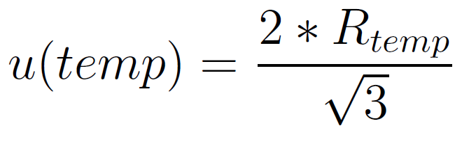
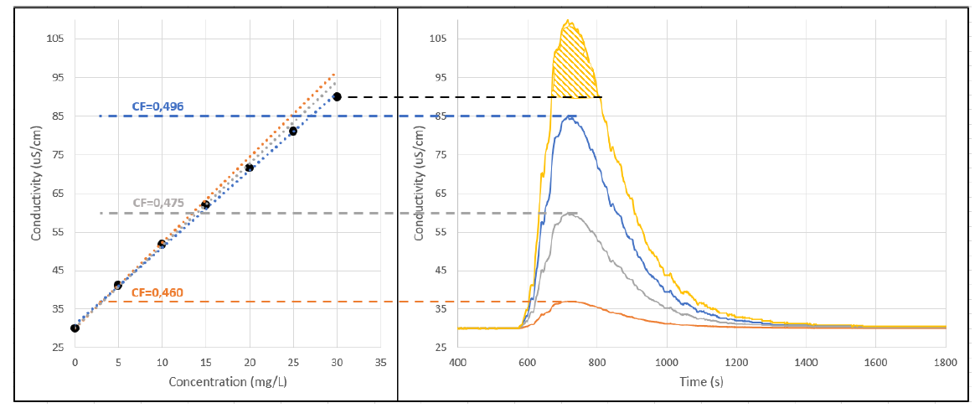
Uncertainty of salt dilution – GUM approach
Evaluation of the Error Sources
mass of salt injected u(M) → default value 0,5%, must be estimated by the user
variability of the base conductivity u(Cdb) → default value 0%, must be estimated by the user
noise of the signal u(Cdt - Cdb) → computed using the probes resolution R and the variability of the base conduct. s(Cd_{b})
sampling u(samp) related to the number of points measured → computed using a bootstrap subsampling
setting of the end of the tracer's wave, u(limits) → computed using sensitivity analysis on the location of the end of the wave
correction of temperature u(temp) for the measurement of Cd → computed using the temperature probes resolution
conductivity to Concentration law u(CF) during the calibration → computed using Monte Carlo simulation with pipette and flask tolerances and calibration solution uncertainty + uncertainty of the linear fit
conductivity out of the range of the calibration law u(range) → computed using adapted CF depending on the measurement range + 15% of uncertainty for the area of the curve out of the range of the calibration
measurement of time u(dt) → default value 0%, must be estimated by the user
not perfect mixing of the tracer u(mix) → computed using the discharges of the 2 probes
loss or a gain of tracer u(tracer) → default value 0%, must be estimated by the user
unsteadiness u(steady) → computed using possible variation of discharge , default =0%
systematic residuals errors u(s) → default value 0%, must be estimated by the user
| 8
Notes:
7 verticales

Slide 9
Uncertainty of salt dilution – GUM approach
Definition of the measurement equation →
List of Error sources
Evaluation of the Error Sources
Propagation of uncertainty
Simplification to a 1st order Taylor series expansion
Most of time, 2 probes are used for a measurement. We distinguish:
The errors not related to the number of probes: u(M); u(mix); u(tracer); u(steady)
The random uncertainties, that reduce and trend to zero when increasing the number of sensors: u(temp); u(Cdt-Cdb); u(dt) and u(samp)
The systematic errors, that would not reduce when increasing the number of sensors: u(CF); u(range); u(base) and u(limits)
| 9
Notes:
7 verticales

Slide 10
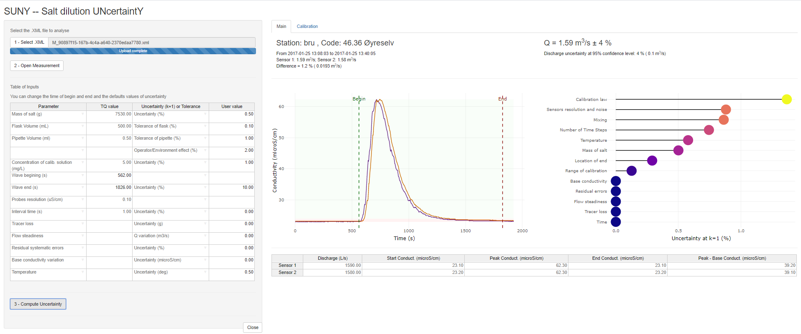
Uncertainty of salt dilution
Development of a software
SUNY, Salt UNcertaintY
R language, web Application
| 10
Notes:
7 verticales

Slide 11
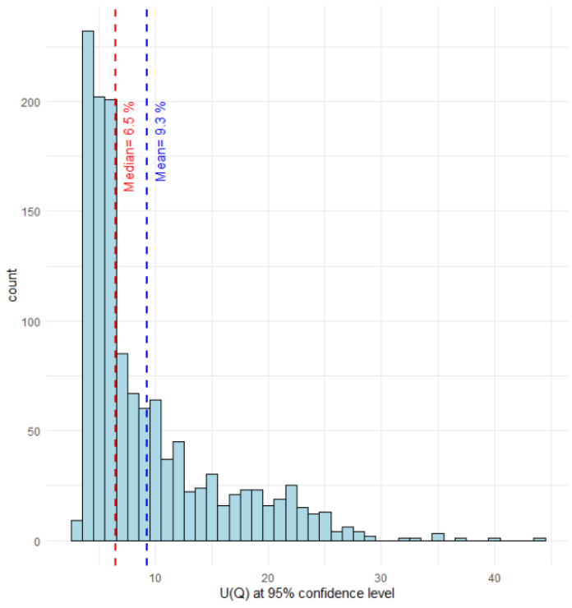
Application to NVE’s database
Database
1285 gaugings:
ranging from 1 L/s to 211 m³/s,
mean and median of 7,65 m³/s and 1,28 m³/s respectively → mainly low discharges
Total uncertainty computed with SUNY (at the 95% confidence level)
Ranges 3 to 44%, median of 6,5%
Most represented uncertainty values are 4, 5 and 6%.
Some defaults uncertainty values:
Temperature: 0,5 º
Mass of salt: 0 %
Base conductivity: 0%
Flow steadiness: 0 m³/s
Tracer loss: 0 g
Time: 0 s
| 11
Notes:
7 verticales

Slide 12
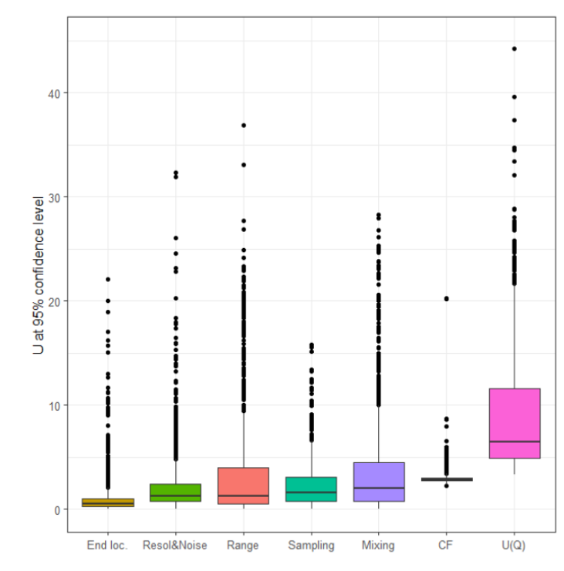
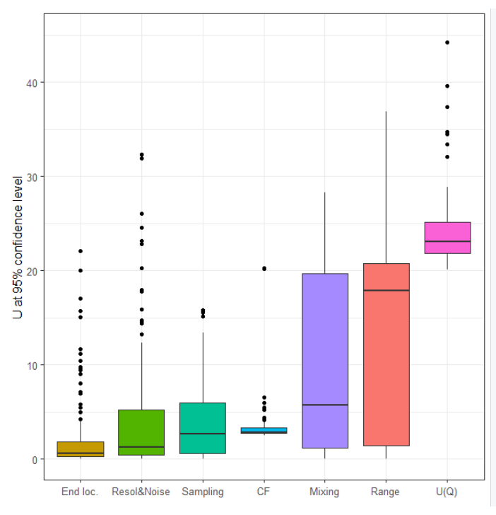
Application to NVE’s database
Budget of uncertainty sources computed with SUNY
U(CF) is quite always 3%, with very few dispersion (95% of the value are less than 4%)
U(mixing) and u(range) have low median values (2%), but they can reach very high values (95% > 14%)
Those two uncertainty sources are mainly responsible for measurements with high uncertainty.
U(Resol&Noise) and U(sampling) have low medians (1,5%), but they can reach quite high values (95% > 6%).
U(end loc.) has the lower median (0,5%) and the lowest 95% quantile (3,4%)
→ often low in the total budget, except for very few specific gaugings.
Budget for gaugings with total uncertainty > 20%
| 12
Notes:
7 verticales

Slide 13
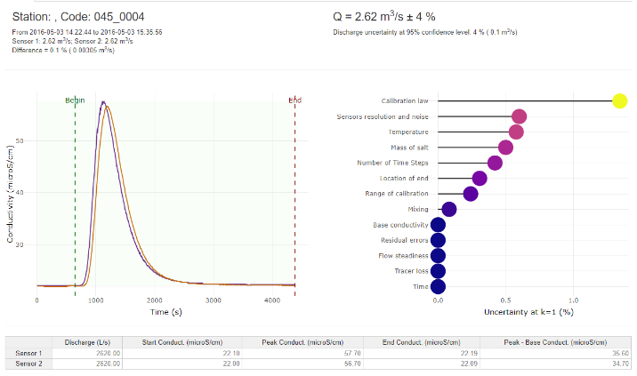
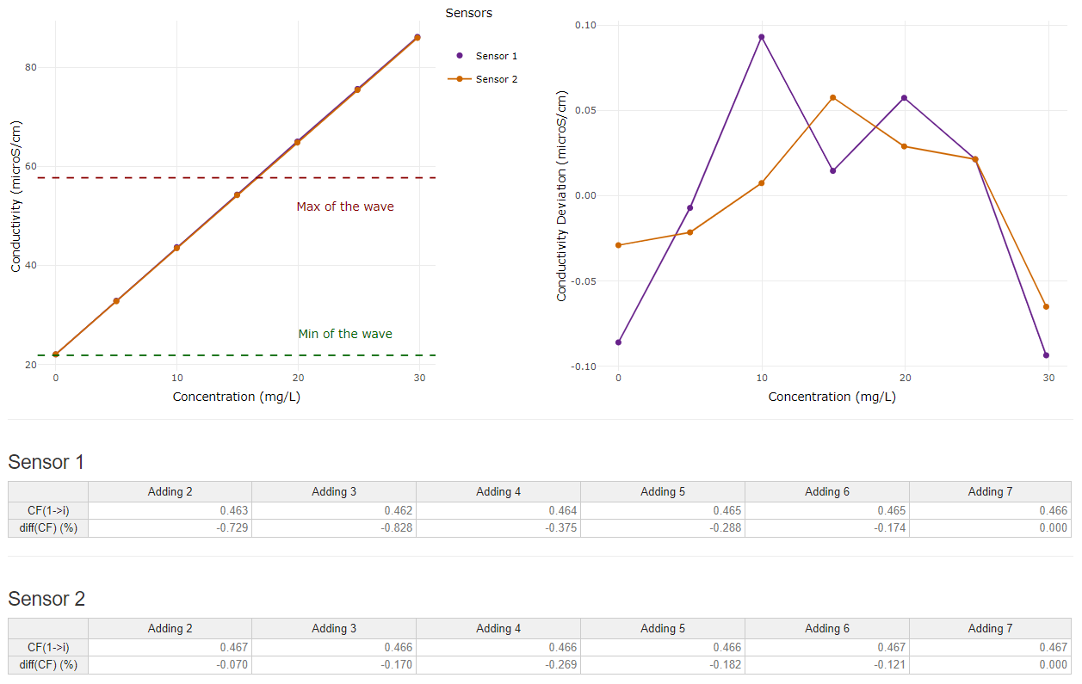
Some examples of measurements
Measurement with low uncertainty
Same discharge from the 2 probes, few noise, high peak (vs base), nice wave shape
U(Q) = 4%
| 13
Notes:
7 verticales

Slide 14
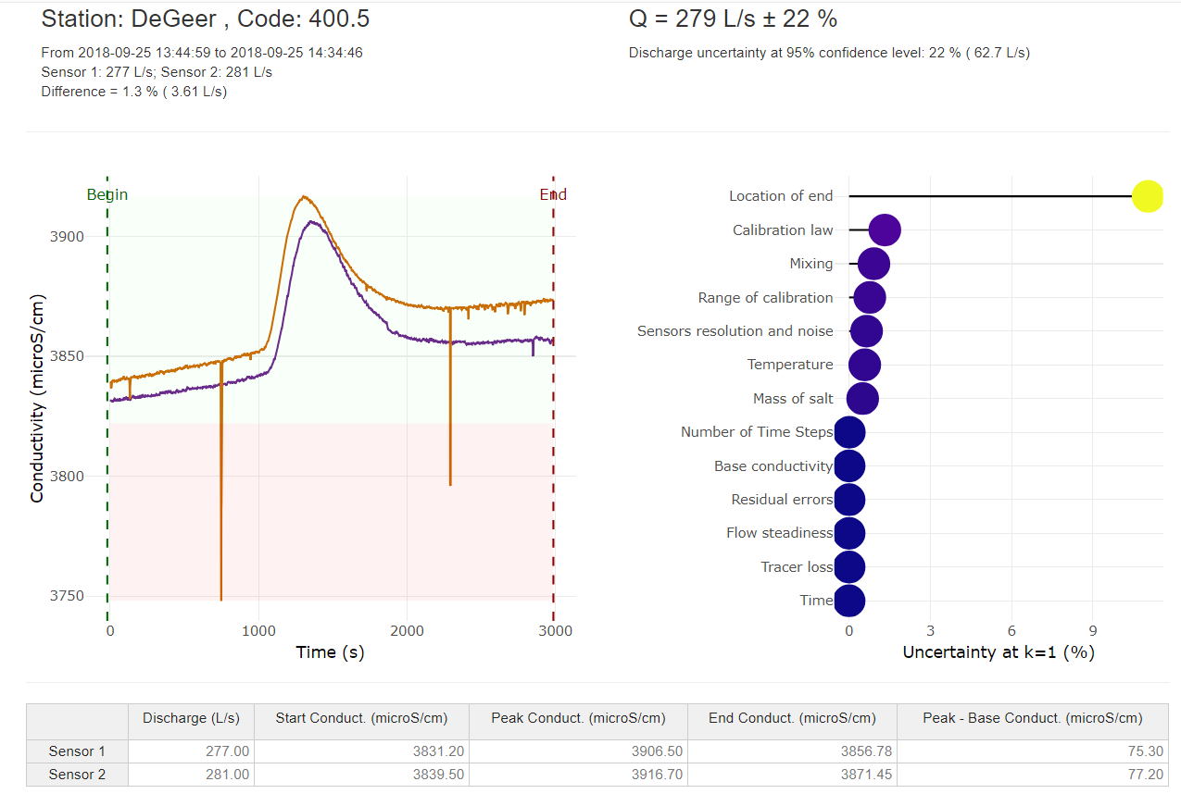
Some examples of measurements
High uncertainty due to the location of the end
Increasing base conductivity → complex to identify when the signal is back to the base value
| 14
Notes:
7 verticales

Slide 15
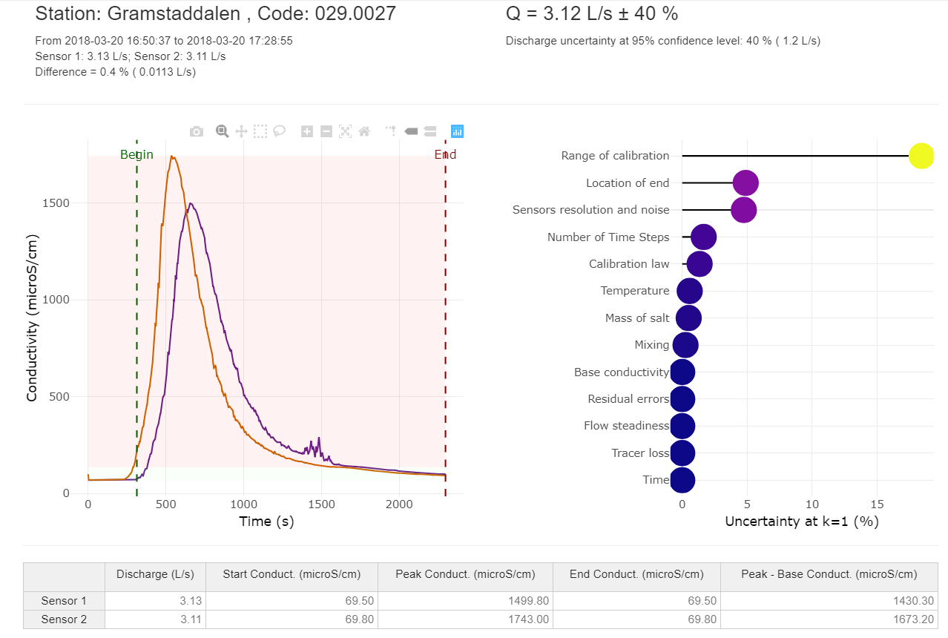
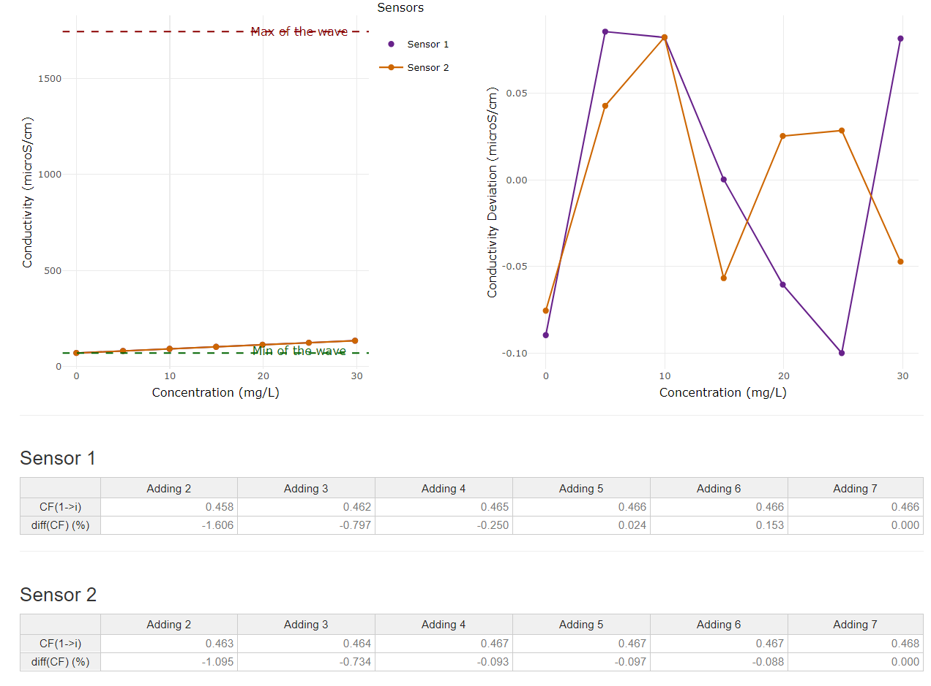
Some examples of measurements
High uncertainty due to range of calibration
Very high value of conductivity for the peak (1700 μS/cm) compared to the base (50 μS/cm)
The calibration, realized prior to the measurement, ranges from 50 to 100 μS/cm
→ a very important part of the wave is out of the range of the calibration (red background in the figure)
| 15
Notes:
7 verticales

Slide 16
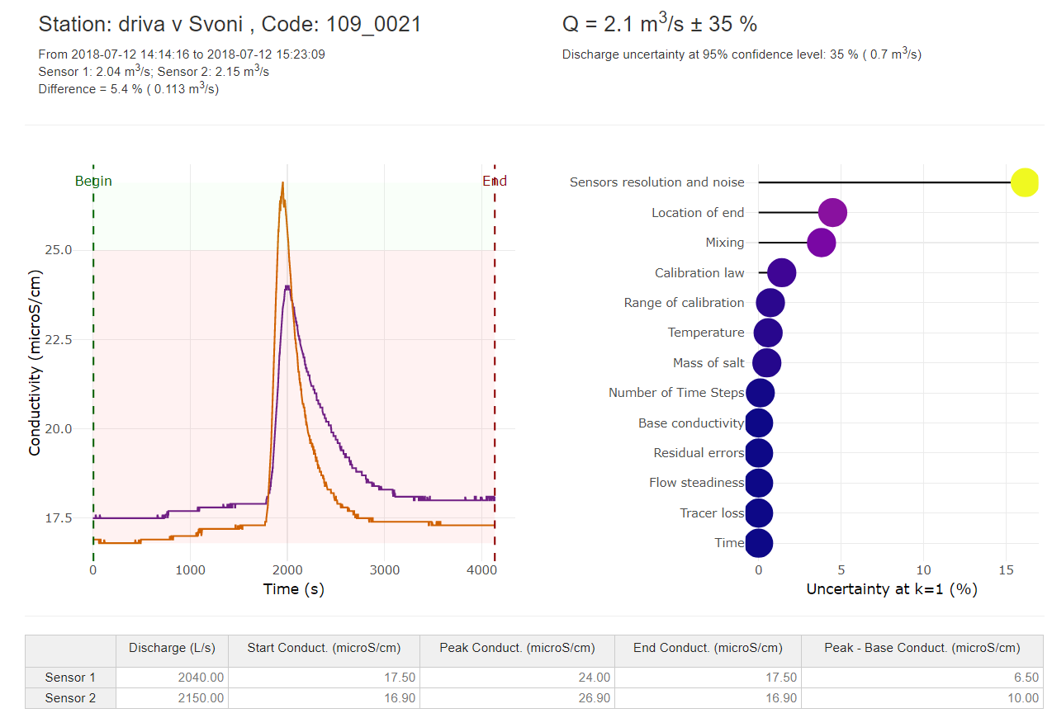
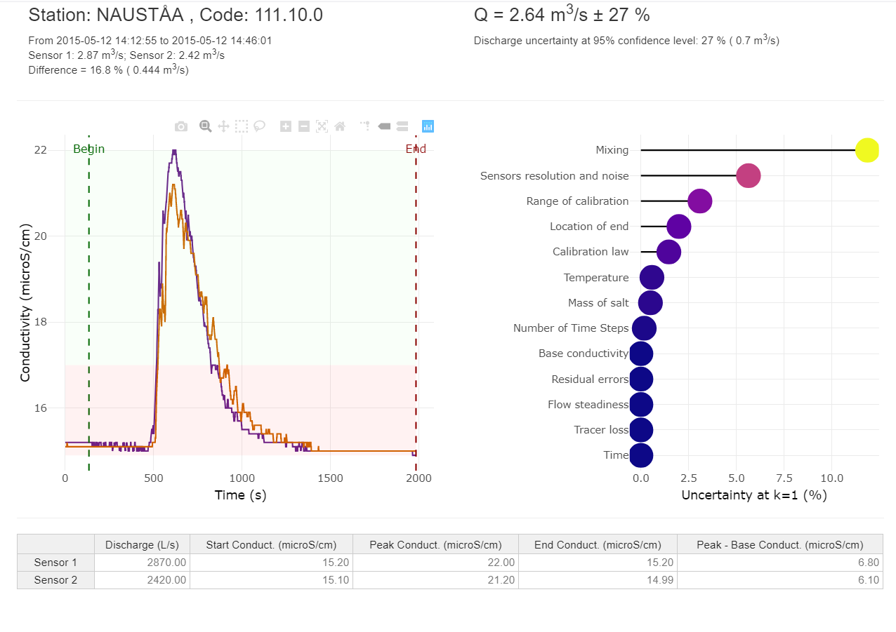
Some examples of measurements
High uncertainty due to noise and resolution of the probes
Impact of the probes’ resolution (0,1 μS/cm) and of the noise of the signal
Especially when the difference between the base and the peak value is small.
Effect of the resolution
Effect of the noise
| 16
Notes:
7 verticales

Slide 17
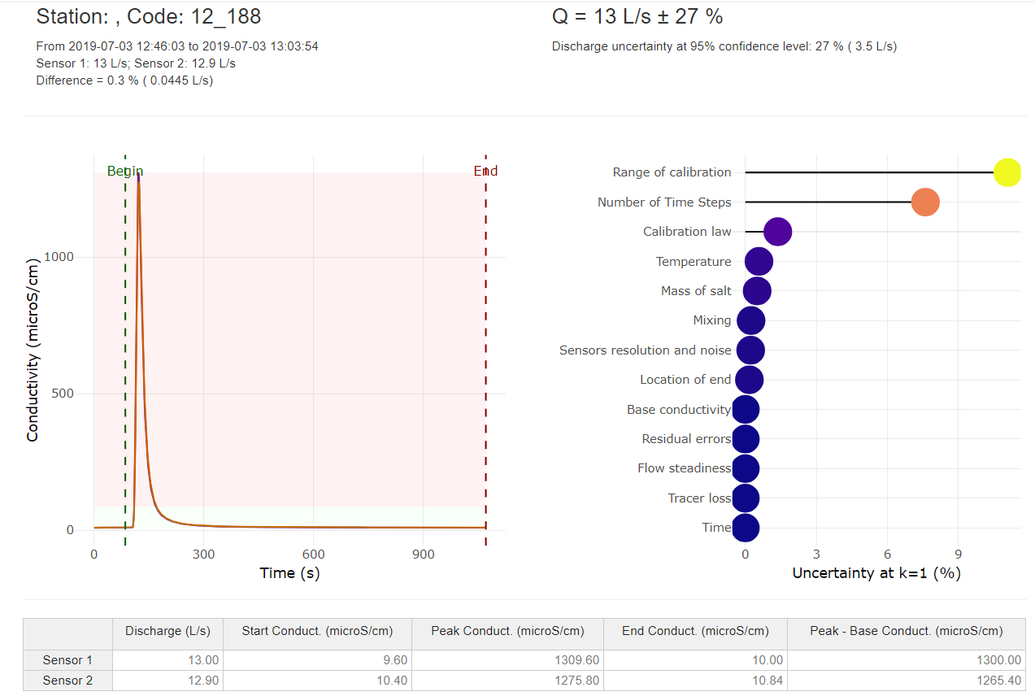
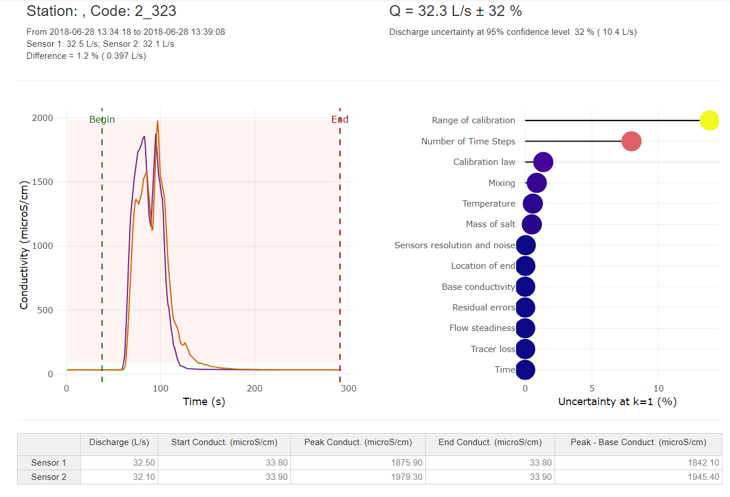
Some examples of measurements
High uncertainty due to the limited number of time steps
Very short duration of the wave or very complex wave shape and not enough samples to describe it
Very short duration of the wave
Complex shape of the wave
| 17
Notes:
7 verticales

Slide 18
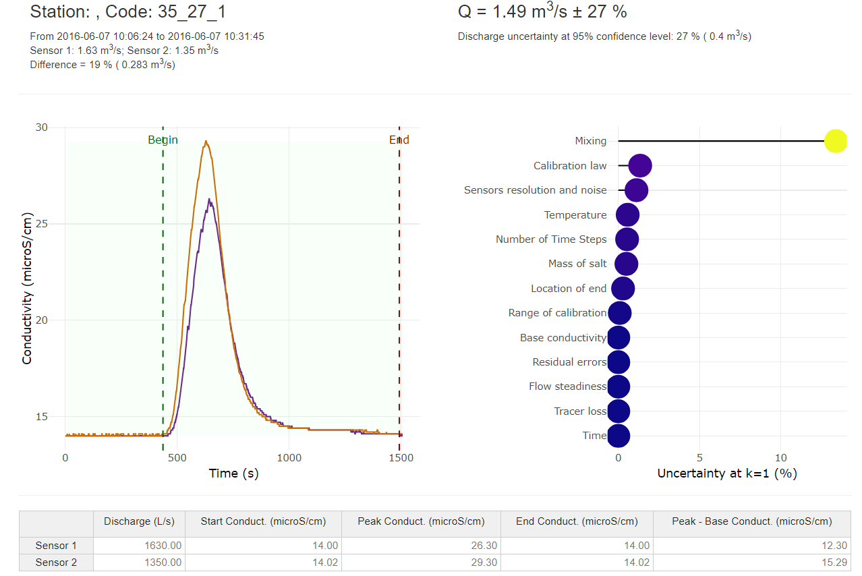
Some examples of measurements
High uncertainty due to bad mixing
Difference between the discharges computed by the two probes is important
| 18
Notes:
7 verticales

Slide 19
Conclusions
Development of a new framework for computing uncertainty of dilution measurements
Exhaustive, adapted to new sensors and methods
Application of the GUM protocol
Definition of the measurement, list of error sources, evaluation of error sources, propagation
Evaluation of error sources using different methods (default values, MC simulations, data analysis…)
Development of an associated software
Application to the uncertainty analysis to NVE’s database
1300 gaugings
Median total uncertainty of 6,5%
Main sources of uncertainty are due to bad mixing and measurement out of the range of calibration
The framework is efficient and in good agreement with the field hydrologist rating of the measurement
Can be applied to dilution measurements using other tracers (Uranine, Rhodamine)
Uncertainty of discharge measurement using the salt dilution method: a new framework
Contact : ahau@nve.no
| 19
Notes:
7 verticales

