Slide 1
Mutual increases in flood extents and magnitudes intensify flood hazard in Central and Western Europe
By Matthias Kemter^{1,2,3}, Bruno Merz^{1,2}, Norbert Marwan³, Sergiy Vorogushyn², Günter Blöschl⁴
1 - Potsdam University, 2 - Helmholtz Centre Potsdam, GFZ German Research Centre for Geosciences, 3 - Potsdam Institute for Climate Impact Research, 4 - Technical University Vienna

Slide 2
We measure the flood extent via the flood synchrony scale (Berghuijs et al. 2019), but what is that?

Slide 3
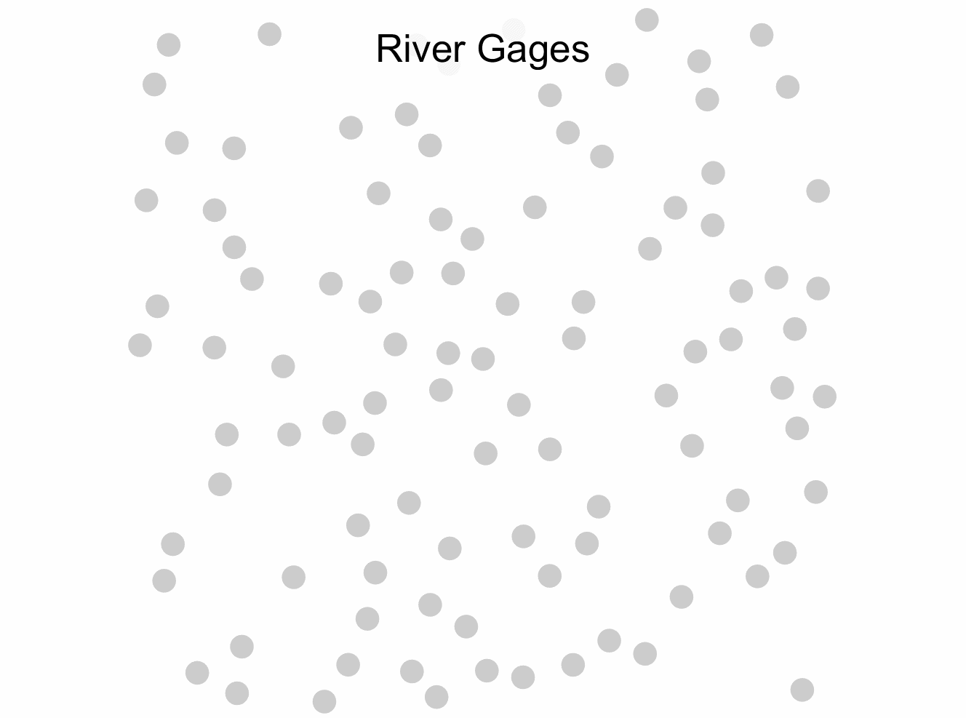

Slide 4
We have studied 3872 river gages, with at least 30 annual maximum floods recorded between 1960-2010.

Slide 5
Trends in Flood Synchrony Scales (1960-2010)
Extents increased in the West...
…and decreased in the East.
Kemter et al. 2020, GRL

Slide 6
Regional trends in flood extents and magnitudes are highly correlated (r=0.59)
Kemter et al. 2020, GRL

Slide 7
Annual values are also correlated
Black marker edges represent significant trends (95% confidence)
Kemter et al. 2020, GRL

Slide 8
This is likely caused by a similar correlation that exists for the most common flood drivers
Kemter et al. 2020, GRL

Slide 9
We classified all floods by their generating process, to find the drivers of the trends. This is based on catchment average time series of reanalysis data.

Slide 10
Classification Tree
Kemter et al. 2020, GRL

Slide 11
Regional relevance and trends of flood generating processes
Modified after Kemter et al. 2020, GRL

Slide 12
Flood extent trends are driven by changes in flood generation:
Western Europe
More soil moisture excess
Less snow
→ Greater extents
Eastern Europe
Less snowmelt
Higher process variance
→ Smaller extents

Slide 13
Summary
Magnitudes and extents are correlated for floods and their drivers
For floods, they show joint trends in many regions
These trends are driven by changing flood generation processes

Slide 14
More details here

Slide 15
References
Berghuijs, W. R., Allen, S. T., Harrigan, S., & Kirchner, J. W. (2019). Growing Spatial Scales of Synchronous River Flooding in Europe. Geophysical Research Letters, 46(3), 1423–1428. https://doi.org/10.1029/2018GL081883
Kemter, M., Merz, B., Marwan, N., Vorogushyn, S., & Blöschl, G. (2020). Joint trends in flood magnitudes and spatial extents across Europe. Geophysical Research Letters, 47(7). https://doi.org/10.1029/2020GL087464

