Slide 1
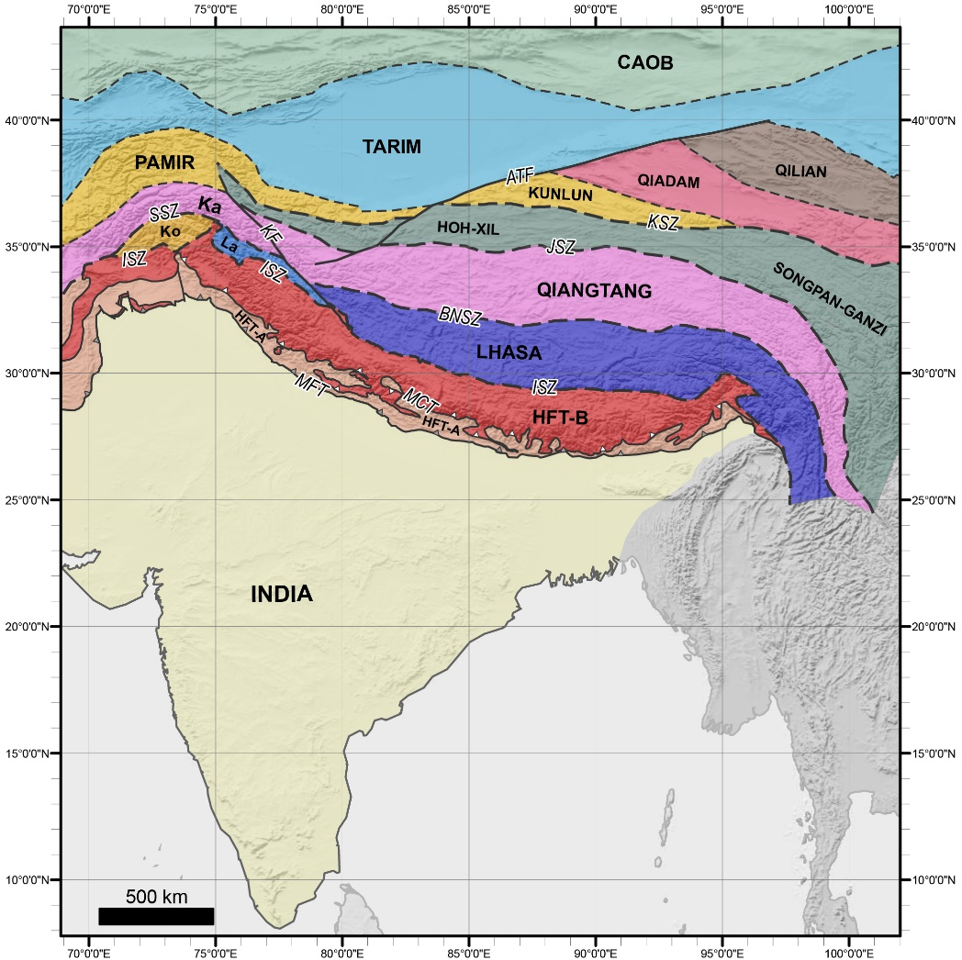
Integration of bedrock, seismic tomographic and plate kinematic constraints to test models of the India-Asia collision
(Amaru 2007)
RECENTLY PIBLISHED PAPER:
Parsons et al. 2020. Geological, geophysical and plate kinematic constraints for models of the India-Asia collision and the post-Triassic central Tethys oceans. Earth-Science Reviews,103084. https://doi.org/10.1016/j.earscirev.2020.103084
Parsons et al (2020)
Andy Parsons, Kasra Hosseini, Richard Palin, Karin Sigloch
University of Oxford
Notes:
The India-Asia collision is one of the most well-studied orogenic events on Earth; it recorded the terminal stages of the central Tethys ocean basins and offers invaluable insight into the geological processes associated with continental collision. In this study, we integrate bedrock datasets, observations of subducted slabs in the mantle, and plate kinematic constraints, to constrain models for the India-Asia collision and the central Tethys oceans.
Previously proposed models for the India-Asia collision differ in terms of subduction zone configurations and paleogeographic reconstructions of Greater India, which represents to northern passive margin of India prior to collision. Five distinct subduction zone configurations have been proposed previously, which differ in the number of active trenches (one or two trenches) in the central Neotethys Ocean and differ in the respective timing, duration, location and migration of those trenches. Three distinct paleogeographic reconstructions of Greater India have been proposed previously, which differ in size and structure. Here, we consider the validity of these subduction zone configurations and Greater India reconstructions with respect to the bedrock record, plate kinematics and the deep mantle structure of subducted slabs beneath the Indian hemisphere.
Following the assumption that slabs sink vertically through the mantle, the positions and geometries of subducted slabs determined from seismic tomography constrain the locations and kinematics of paleo-subduction zones. Integrating this with bedrock constraints allows us to constrain post-Triassic subduction zone configurations for the central Tethys oceans. Our analysis demonstrates that the Neotethys Ocean was consumed by at least two subduction zones since the Jurassic. At the onset of the India-Asia collision at 59±1 Ma, one subduction zone was active along the southern Asian continental margin at ~20°N. At that time, a second may have been active at subequatorial latitudes, but support for this from a bedrock perspective is lacking. This subduction zone configuration allows for three reconstructions for Greater India: The (1) minimum-area; (2) enlarged-area; and (3) Greater India Basin reconstructions. We integrate these reconstructions and subduction zone configurations in a plate kinematic framework to test their validity for the India-Asia collision.
Our findings show that no single model is entirely satisfactory and each invokes assumptions that challenge accepted concepts. These include our understanding of suture zones, subduction-erosion processes, and the limits of continental subduction. We explore these challenges and their implications for our understanding of the India-Asia collision and continental collisions in general.

Slide 2
Tibetan plateau amalgamated from multiple terranes – Permian to Cretaceous
Post-Triassic amalgamation involves the following terranes:
Karakoram (Ka)
Kohistan (Ko)
Ladakh (La)
Lhasa
Qiangtang
India-Asia collision initiated during Early Cenozoic (59 Ma)
BUT:
At onset of collision, India is located >2000-3000 km south of the Asian continent
Parsons et al (2020)
Parsons et al. 2020. Geological, geophysical and plate kinematic constraints for models of the India-Asia collision and the post-Triassic central Tethys oceans. Earth-Science Reviews,103084. https://doi.org/10.1016/j.earscirev.2020.103084
SEE NOTES BELOW FOR FIGURE CAPTION
Notes:
Figure 1. Terrane map of crustal blocks and bounding structures of the Himalaya-Tibet orogenic system. AFT – Altyn Tagh Fault; BNSZ – Bangong-Nujiang Suture Zone; CAOB – Central Asian Orogenic Belt; HFT-A – Himalaya Fold-and-Thrust Belt, Sequence A (includes Lesser Himalayan Sequence and Subhimalayan Zone; based on Martin 2017b); HFT-B – Himalaya Fold-and-Thrust Belt, Sequence B (includes Greater Himalayan Sequence and Tethyan Himalayan Sequence; based on Martin 2017b); ISZ – Indus Suture Zone; JSZ – Jinsha Suture Zone; Ka – Karakoram; KF – Karakoram Fault; Ko – Kohistan; KSZ – Kunlun Suture Zone; La – Ladakh; MFT – Main Frontal Thrust; MCT – Main Central Thrust; SSZ – Shyok Suture Zone. Drawn from Searle et al. (2011a), Parsons et al. (2016a), Martin (2017b), Goscombe et al. (2018), Li et al. (2018), and Kapp and DeCelles (2019). Georeferenced overlays (.kml, .kmz) and shapefiles of all points, lines, and polygons presented in our map figures are available for use and editing with global information system software (e.g. Google Earth, GPlates, ArcGIS) in Supplementary Materials 01 and 02.

Slide 3
Models for India-Asia collision categorised based on:
Subduction zone configurations
Greater India restorations

Slide 4
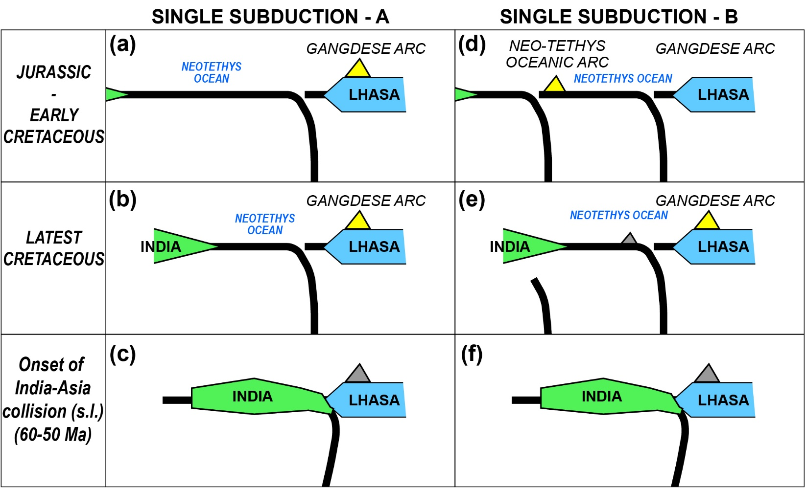
1) Subduction zone configurations:
Parsons et al. 2020. Geological, geophysical and plate kinematic constraints for models of the India-Asia collision and the post-Triassic central Tethys oceans. Earth-Science Reviews,103084. https://doi.org/10.1016/j.earscirev.2020.103084
SEE NOTES BELOW FOR FIGURE CAPTION
Notes:
Figure 4. Subduction zone configurations for models of the India-Asia collision. (a-c) Single subduction configuration – A. (d-e) Single subduction configuration – B. (g-i) Double subduction configuration with fixed (i.e. stationary) trenches. (j-l) Double subduction configuration with a north-migrating southern trench. (m-o) Two stage double subduction configuration in which the first trench migrates south towards India, followed by collision with India and initiation of a new subduction zone to the north. Yellow triangles show active volcanic arcs, and grey triangles show extinct volcanic arcs. Arrows show direction of trench migration.

Slide 5
1) Subduction zone configurations:
Parsons et al. 2020. Geological, geophysical and plate kinematic constraints for models of the India-Asia collision and the post-Triassic central Tethys oceans. Earth-Science Reviews,103084. https://doi.org/10.1016/j.earscirev.2020.103084
SEE NOTES BELOW FOR FIGURE CAPTION
Notes:
Figure 4. Subduction zone configurations for models of the India-Asia collision. (a-c) Single subduction configuration – A. (d-e) Single subduction configuration – B. (g-i) Double subduction configuration with fixed (i.e. stationary) trenches. (j-l) Double subduction configuration with a north-migrating southern trench. (m-o) Two stage double subduction configuration in which the first trench migrates south towards India, followed by collision with India and initiation of a new subduction zone to the north. Yellow triangles show active volcanic arcs, and grey triangles show extinct volcanic arcs. Arrows show direction of trench migration.

Slide 6
2) Greater India reconstructions:
DOUBLE SUBDUCTION
SINGLE SUBDUCTION
SINGLE SUBDUCTION
Parsons et al. 2020. Geological, geophysical and plate kinematic constraints for models of the India-Asia collision and the post-Triassic central Tethys oceans. Earth-Science Reviews,103084. https://doi.org/10.1016/j.earscirev.2020.103084
Parsons et al (2020)
SEE NOTES BELOW FOR FIGURE CAPTION
Notes:
Figure 5. Greater India restorations for models of the India-Asia collision. (a) Minimum-area restoration. (b) Enlarged-area reconstruction. (c) Greater India Basin reconstruction. GHS – Greater Himalayan Sequence; THS – Tethyan Himalayan Sequence.

Slide 7
Model testing in plate-mantle kinematic framework requires the following:
Timing of collision (CONSTRAINED: 59 ± 1 Ma – Kapp & DeCelles 2019)
Location of India at onset of collision
Location of Asia at onset of collision
Minimum size of pre-collision Greater India passive margin
Subduction history (bedrock record, seismic tomography)

Slide 8
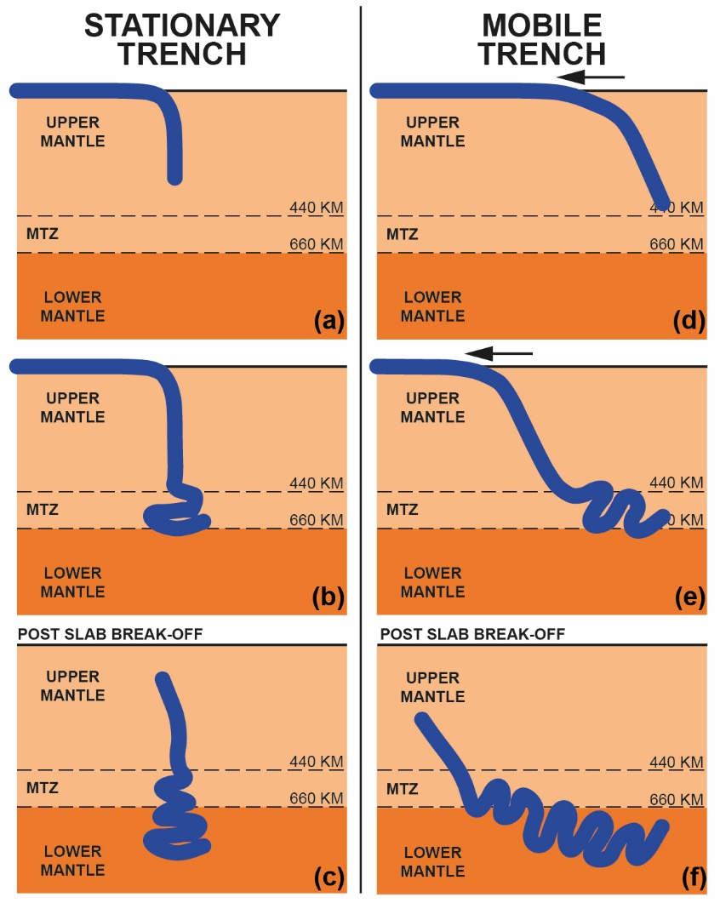
SUBDUCTION HISTORY (MANTLE RECORD)
Parsons et al (2020)
Subducted slabs mark locations of overlying paleo-trenches
Blue = fast anomaly
More dense
Subducted lithosphere
(Amaru 2007)
Slabs sink vertically in the mantle
Global average sinking rate = ~10-15 mm/year
Slab base = subduction initiation
Slab top = slab break-off
van der Meer 2009, Cizkova & Bina 2013; Sigloch & Mihalynuk 2013
Notes:
Figure 6. Cartoon representation of modes of sinking for subducted slabs (blue) in the upper and lower mantle for (a-c) stationary trenches; and (d-f) mobile trenches. The viscosity contrast across the mantle transition zone (MTZ) causes slab to decelerate and deform.

Slide 9
SUBDUCTION HISTORY (MANTLE RECORD)
5 global tomography models
(Hosseini et al 2020)
(Symons et al 2012)
(Schaeffer & Lebedev 2013)
(Amaru 2007)
(Li et al 2008)
- 7 lines of section - horizontal depth slices
Parsons et al. 2020. Geological, geophysical and plate kinematic constraints for models of the India-Asia collision and the post-Triassic central Tethys oceans. Earth-Science Reviews,103084. https://doi.org/10.1016/j.earscirev.2020.103084
The full tomography dataset used in this study can be viewed at: https://doi.org/10.1016/j.earscirev.2020.103084
SEE NOTES BELOW FOR FIGURE CAPTION
Notes:
Figure 15. Cross section D through seismic tomography models (a) DETOX-P2, (b) LLNL_G3Dv3, (c) UU-P07, (d) MITP08, and (e) SL2013sv3. Labels display positions of anomalies I to VI, marked on Figures 8-11. Locations of specific surface structures are labelled: AFT – Altyn Tagh Fault; BN – Bangong-Nuijang suture; ISZ – Indus suture; J – Jinsha suture; K – Kunlun suture; MFT – Main Frontal thrust; SS – Shyok suture; see Figures 1 and 2 for further reference. (f) Map trace of tomographic line of section, with geological structures and seismic tomography anomalies outlined. Location of cross section are displayed in Figures 8–11. Cross sections drawn using SubMachine (Hosseini et al., 2018).

Slide 10
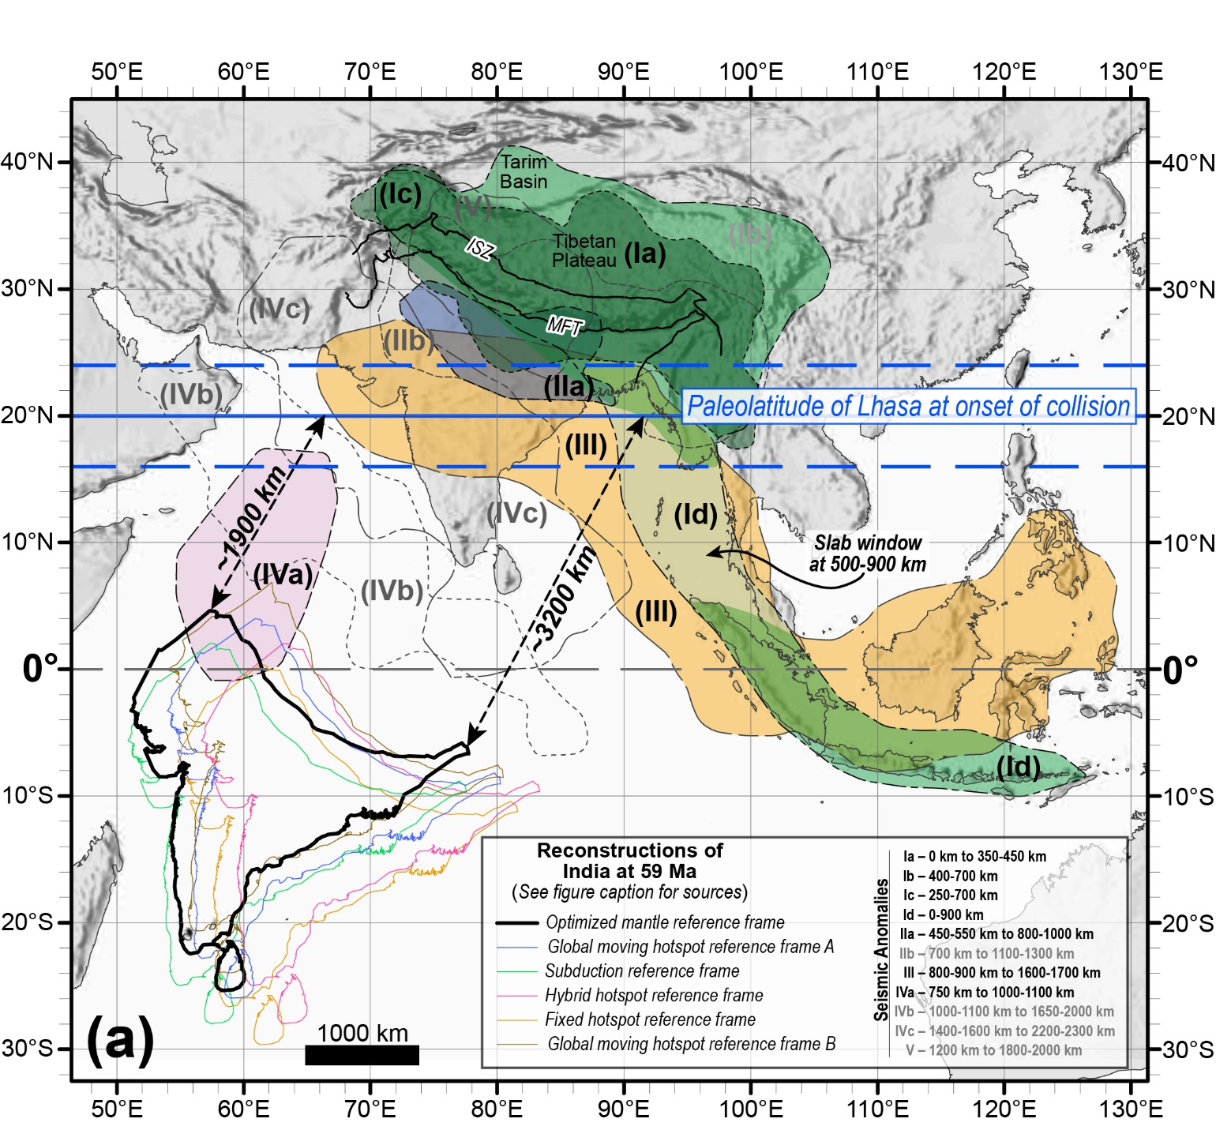
SUBDUCTION HISTORY (MANTLE RECORD)
At least 6 distinct anomalies
Anomalies II to V = three slabs
Parsons et al. 2020. Geological, geophysical and plate kinematic constraints for models of the India-Asia collision and the post-Triassic central Tethys oceans. Earth-Science Reviews,103084. https://doi.org/10.1016/j.earscirev.2020.103084
SEE NOTES BELOW FOR FIGURE CAPTION
Notes:
Figure 20 (LEFT). Outlines of Anomalies I to VI based on the combined +0.2% (solid outline, faded colour) and +0.3% (dashed outline, bold colour) velocity contours from in Figure 19, and as defined in Table 2.
Figure 8 (RIGHT). Kinematic restoration of India and the Asian continental margin at the onset of collision, 59 ± Ma, overlain by the outlines of seismic anomalies I to V at (a) 0-1700 km depth, and (b) 700-2300 km. Blue thick line corresponds to paleolatitude of the Lhasa block at 20° N ± 4° (errors marked by dashed blue lines) at the onset of collision (see Section 5.4 for discussion). Present day locations of the Main Frontal Thrust (MFT) and Indus Suture Zone (ISZ) are marked with black solid lines. Outlines of seismically fast anomalies I to V approximately corresponds to the largest areas defined by the dv/v = +0.2% contour around each anomaly. Seismic tomography lines of section shown in Figures 12-20 are drawn with solid grey lines. Distances at 59 Ma of ~1900 km and ~3200 km between South Asian margin and East and West syntaxes of Indian continent are marked by dashed black arrows. Reconstructions of India at 59 Ma are based on different reference frames and reconstruction models: Black line – Optimized mantle reference frame (Müller et al., 2019); Blue line – Global moving hotspot reference frame A (Torsvik et al., 2008, Matthews et al., 2016, Müller et al., 2016, Zahirovic et al., 2016, Young et al., 2018); Green – Subduction reference frame (van der Meer et al., 2010, Shephard et al., 2012); Purple – Hybrid hotspot reference frame (O'Neill et al., 2005, Seton et al., 2012, Shephard et al., 2012); Orange – Fixed hotspot reference frame (Müller et al., 1993, Shephard et al., 2012); Brown line – Global moving hotspot reference frame B (Doubrovine et al., 2012, van Hinsbergen et al., 2019). Georeferenced overlays (.kml, .kmz) and shapefiles of all points, lines, and polygons presented in our map figures are available for use and editing with global information system software (e.g. Google Earth, GPlates, ArcGIS) in Supplementary Materials 01 and 02.

Slide 11
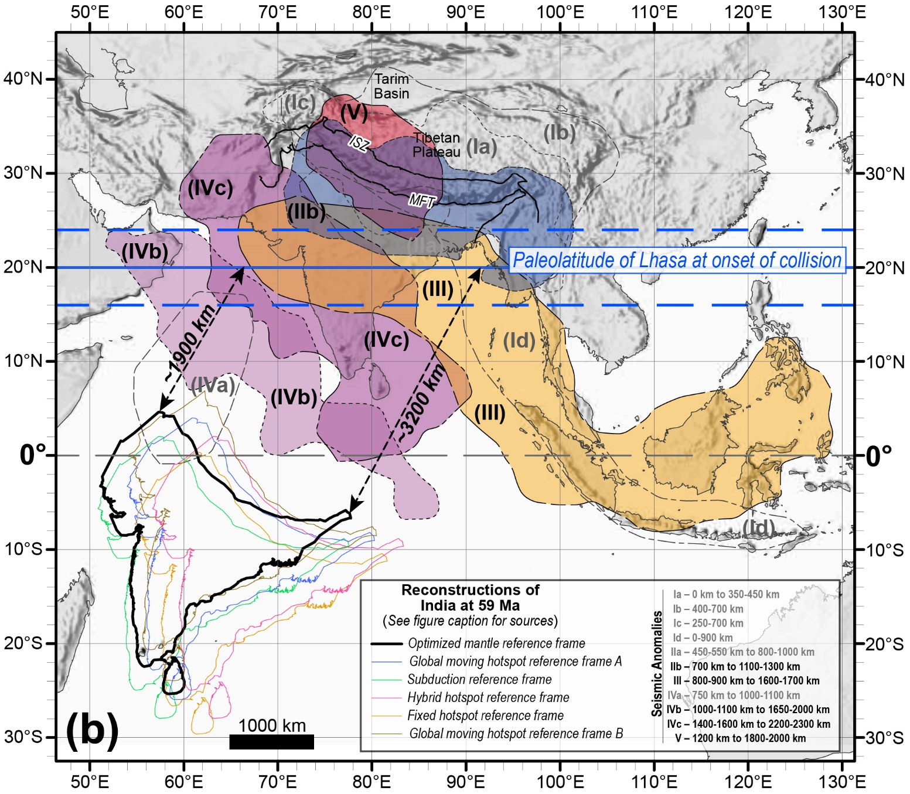
SUBDUCTION HISTORY (MANTLE RECORD)
At least 6 distinct anomalies
Anomalies II to V = three slabs
Parsons et al. 2020. Geological, geophysical and plate kinematic constraints for models of the India-Asia collision and the post-Triassic central Tethys oceans. Earth-Science Reviews,103084. https://doi.org/10.1016/j.earscirev.2020.103084
SEE NOTES BELOW FOR FIGURE CAPTION
Notes:
Figure 20 (LEFT). Outlines of Anomalies I to VI based on the combined +0.2% (solid outline, faded colour) and +0.3% (dashed outline, bold colour) velocity contours from in Figure 19, and as defined in Table 2.
Figure 8 (RIGHT). Kinematic restoration of India and the Asian continental margin at the onset of collision, 59 ± Ma, overlain by the outlines of seismic anomalies I to V at (a) 0-1700 km depth, and (b) 700-2300 km. Blue thick line corresponds to paleolatitude of the Lhasa block at 20° N ± 4° (errors marked by dashed blue lines) at the onset of collision (see Section 5.4 for discussion). Present day locations of the Main Frontal Thrust (MFT) and Indus Suture Zone (ISZ) are marked with black solid lines. Outlines of seismically fast anomalies I to V approximately corresponds to the largest areas defined by the dv/v = +0.2% contour around each anomaly. Seismic tomography lines of section shown in Figures 12-20 are drawn with solid grey lines. Distances at 59 Ma of ~1900 km and ~3200 km between South Asian margin and East and West syntaxes of Indian continent are marked by dashed black arrows. Reconstructions of India at 59 Ma are based on different reference frames and reconstruction models: Black line – Optimized mantle reference frame (Müller et al., 2019); Blue line – Global moving hotspot reference frame A (Torsvik et al., 2008, Matthews et al., 2016, Müller et al., 2016, Zahirovic et al., 2016, Young et al., 2018); Green – Subduction reference frame (van der Meer et al., 2010, Shephard et al., 2012); Purple – Hybrid hotspot reference frame (O'Neill et al., 2005, Seton et al., 2012, Shephard et al., 2012); Orange – Fixed hotspot reference frame (Müller et al., 1993, Shephard et al., 2012); Brown line – Global moving hotspot reference frame B (Doubrovine et al., 2012, van Hinsbergen et al., 2019). Georeferenced overlays (.kml, .kmz) and shapefiles of all points, lines, and polygons presented in our map figures are available for use and editing with global information system software (e.g. Google Earth, GPlates, ArcGIS) in Supplementary Materials 01 and 02.

Slide 12
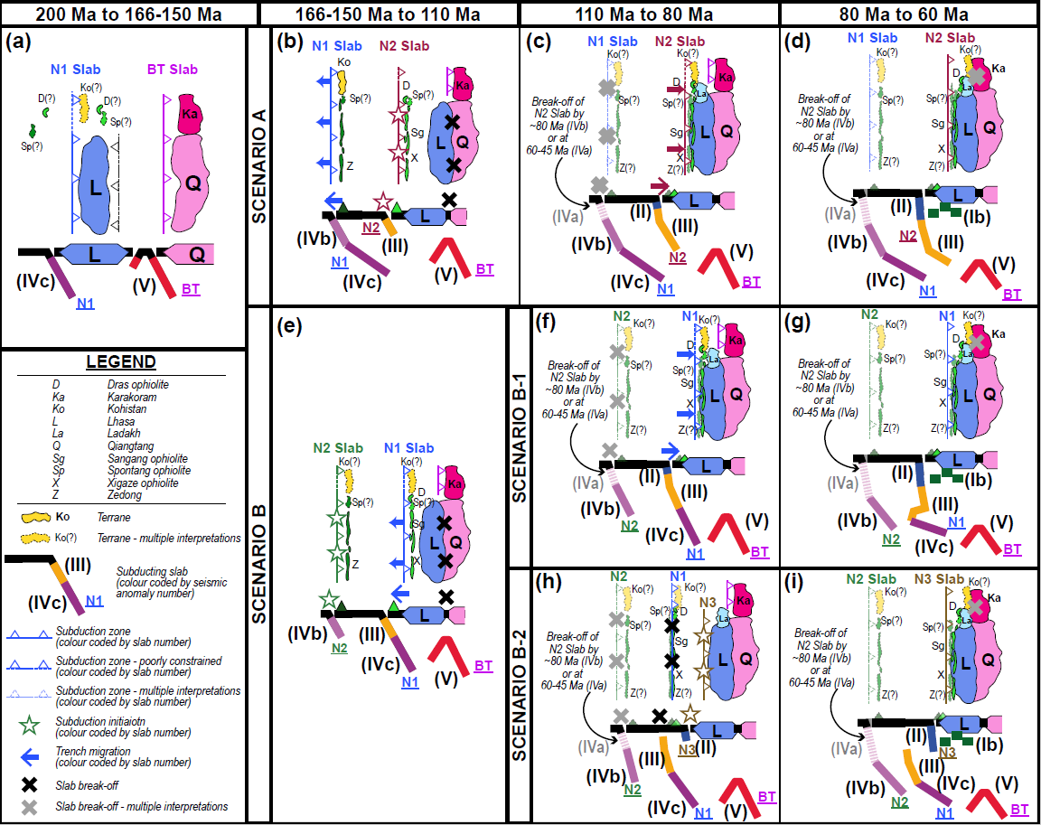
Viable subduction zone scenarios for 200 Ma to 60 Ma in central Neotethys Ocean based on integration of bedrock record and mantle tomography
Subduction zone configurations at 80-60 Ma provide template for models of the India-Asia collision after 60 Ma
Parsons et al. 2020. Geological, geophysical and plate kinematic constraints for models of the India-Asia collision and the post-Triassic central Tethys oceans. Earth-Science Reviews,103084. https://doi.org/10.1016/j.earscirev.2020.103084
SEE NOTES BELOW FOR FIGURE CAPTION
Notes:
Figure 22. Post-Triassic subduction zone configurations for the central Tethys Oceans based on integration of bedrock and mantle observations. (a-d) Scenario A. (e) Scenario B (f-g) Scenario B-1. (h-i) Scenario B-2.

Slide 13
Viable subduction zone configurations for India-Asia collision:
Anomaly IVa is poorly imaged due to low tomographic resolution and may or may not define equatorial intra-oceanic subduction zone across whole of central Neotethys at 60 Ma
Tomography cannot distinguish
between double and single subduction models ☹
What about plate kinematics,
bedrock data, and
Greater India restorations...?
Tomography cannot distinguish between these end member mantle structures ☹
Parsons et al (2020)

Slide 14
Model testing for the India-Asia collision in plate-mantle kinematic framework
The following models integrate bedrock, mantle structure (tomography), and plate kinematic constraints to test Greater India restoration for models of the India-Asia. Inconstancies between model predictions and observations are highlighted.

Slide 15
Top of intra-oceanic slab only partially imaged (Anomaly IVa)
No bedrock evidence for intra-oceanic arc west of Kohistan after ~110-80 Ma
Good bedrock evidence for Kohistan-Karakoram collision by 80 Ma
Parsons et al (2020)
Notes:
Figures 23. Plate kinematic-based scenarios for the India-Asia collision based on integration of geological, geophysical and kinematic datasets. Position of India based on plate reconstruction model of (Müller et al., 2019). Thick blue lines mark paleolatitude of Lhasa block (solid lines) plus errors (dashed lines) at timing of collision. Size of Greater India imaged beneath present-day Tibetan plateau (dark grey shaded area), the undeformed Lesser Himalayan Sequence (LHS – orange shaded area) and the undeformed Greater Himalayan Sequence (GHS) and Tethyan Himalayan Sequence (THS) (red shaded area) are based on Figure 21. Positions of seismically fast anomalies I to IV based on Figures 8–20. Present-day positions of the Main Frontal Thrust (MFT) and Indus Suture Zone (ISZ) marked by dark grey solid lines. Present-day coastline marked by thin light grey solid line. Abbreviations: Ka – Karakoram; Ko – Kohistan; La – Ladakh. (a) Minimum-area Greater India reconstruction / double subduction zone configuration: (a) Collision between India and the Neotethys (NT) intra-oceanic arc at 59 Ma. Kohistan block forms part of the intra-oceanic arc. Anomaly IV corresponds to Neotethys slab detached from Neotethys intra-oceanic arc following collision.

Slide 16
Requires wholesale subduction of ~2000 km by ~2500 km area of continental lithosphere…
Sinking rate estimates = 8-18 mm / yr
Parsons et al (2020)
Notes:
Figures 23. Plate kinematic-based scenarios for the India-Asia collision based on integration of geological, geophysical and kinematic datasets. Position of India based on plate reconstruction model of (Müller et al., 2019). Thick blue lines mark paleolatitude of Lhasa block (solid lines) plus errors (dashed lines) at timing of collision. Size of Greater India imaged beneath present-day Tibetan plateau (dark grey shaded area), the undeformed Lesser Himalayan Sequence (LHS – orange shaded area) and the undeformed Greater Himalayan Sequence (GHS) and Tethyan Himalayan Sequence (THS) (red shaded area) are based on Figure 21. Positions of seismically fast anomalies I to IV based on Figures 8–20. Present-day positions of the Main Frontal Thrust (MFT) and Indus Suture Zone (ISZ) marked by dark grey solid lines. Present-day coastline marked by thin light grey solid line. Abbreviations: Ka – Karakoram; Ko – Kohistan; La – Ladakh. (c) Enlarged-area Greater India reconstruction / single subduction zone configuration: (c) Collision between India and south Asian margin (Lhasa block) at 59 Ma. Anomalies II and III corresponds to Neotethys slab detached from Gangdese arc on the Lhasa, Ladakh and Kohistan blocks. Light grey shaded area marks size of Indian continental lithosphere that must be subducted completely.

Slide 17
Continental crust is denser than asthenospheric mantle at ≥8-9 Gpa (~250-300 km depth)
Lower crust (Rudnick & Gao 2014)
Upper crust (Rudnick & Gao 2014)
Blue = more dense than mantle
Red = less dense than mantle
Wholesale subduction of continent lithosphere is possible but requires specific (untested) criteria:
+ Lithospheric composition + Lithospheric strength + Subduction rate + External driving forces
Parsons et al (2020)
Notes:
Figure 24. Calculated pressure–temperature (P–T) pseudosections showing phase assemblages that would stabilize in average compositions of continental crust at upper mantle conditions (3–15 GPa), colour-contoured for relative density difference (Δρ) with respect to pyrolytic mantle. Equivalent plots contoured for absolute density are displayed in Supplementary Materials 08. Note that in addition to the labelled phases listed in each stability field, all stability fields include garnet (Grt), clinopyroxene (Cpx), rutile (Rt) and water (H₂O). Percentage density difference at any given P–T point is calculated as follows: 100 × [(ρC – ρM)/ρM)], where ρC = density of the crustal component and ρM = density of mantle pyrolite. Stippled region marks the range of slab-top geotherms in modern-day subduction zones, as determined by Syracuse et al. (2010). Upper and lower limits of this envelope are projected linearly at P > 8 GPa, which lies outside of the limits considered in that study. Linearized mantle geotherm is from Holland et al. (2013) and represents the maximum temperatures that subducted material could reach at any given pressure, assuming heating of slab components by conduction only. (a) Rudnick and Gao (2014) upper crust composition (10 mol. % H₂O); (c) Rudnick and Gao (2014) lower crust composition (2 mol. % H₂O).
Phase abbreviations are as follows: Acm – acmite; Cpv – Ca-perovskite; Cel – celadonite; Coe – coesite; Cpx – clinopyroxene (diopside/omphacite/jadeite); Crn – corundum; Grt – garnet; H2O – water; Hem – hematite; Hol – hollandite; Hpx – high-pressure orthopyroxene; Ilm – ilmenite; Kcm – K-cymrite; Lws – lawsonite; Mpv – Mg-perovskite; Ms – muscovite (phengite); Npv – Na-perovskite; Rt – rutile; San – sanidine; Stv – stishovite; Tpz – hydro-topaz; Wad – wadsleyite. Numbered fields contain the following assemblages (all including Grt, Cpx, Rt, and H₂O): 1 – Lws Hol Stv Hem; 2 – Hol Stv Hem Tpz; 3 – Hpx Hol Stv Hem Tpz; 4 – Lws Hol Stv Hem Tpz; 5 – Hpx Mpv Napv Kcm Stv; 6 – Hpx Napv Kcm Stv; 7 – Hpx Mpv Kcm Stv Tpz; 8 – Hpx Napv Kcm Stv Tpz; 9 – Hpx Kcm Stv Tpz; 10 – Hpx Mpv Napv Kcm Coe; 11 – Hpx Napv Kcm Coe; 12 – Hpx Mpv Kcm Coe Tpz; 13 – Hpx Napv Kcm Coe Tpz; 14 – Hpx Kcm Coe Tpz; 15 – Lws Ms Cel Kcm Coe Hem; 16 – Acm Wad Hol Stv; 17 – Lws Cel Stv Hem; 18 – Kcm Stv Hem; 19 – Lws Coe Hem; 20 – Kcm Coe Hem Ms; 21 – Ms Kcm San Coe Hem; 22 – Cpv Hpx Npv Kcm Stv; 23 – Hpx Npv Kcm Stv; 24 – Hpx Kcm Stv Hem; 25 – Acm Wad Kcm Stv; 26 – Cpv Lws Cel Coe Hem; 27 – Wad Hol Stv; 28 – Cpv Hpx Npv Kcm Stv; 29 – Acm Kcm Stv; 30 – Acm Kcm Coe; 31 – Lws Kcm Cel Coe Hem; 32 – Lws Ms Kcm Cel Coe Hem; 33 – Lws Ms Cel Coe Hem; 34 – Cel Kcm Ms Coe; 35 – Acm Stv; 36 – Lws Acm Cel Stv (−H₂O); 37 – Acm Kcm Stv; 38 – Lws Acm Cel Coe; 39 – Lws Cel Coe Hem; 40 – Ms Cel Coe Hem.

Slide 18
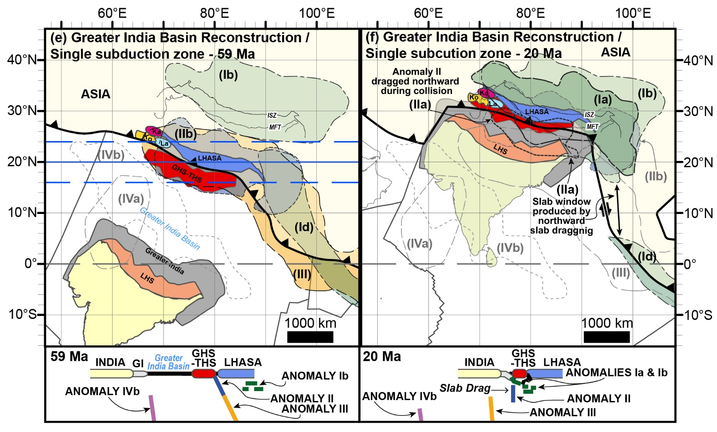
Requires a suture zone within Indian units of the Himalayan orogen that is yet to be identified
Parsons et al (2020)
Notes:
Figures 23. Plate kinematic-based scenarios for the India-Asia collision based on integration of geological, geophysical and kinematic datasets. Position of India based on plate reconstruction model of (Müller et al., 2019). Thick blue lines mark paleolatitude of Lhasa block (solid lines) plus errors (dashed lines) at timing of collision. Size of Greater India imaged beneath present-day Tibetan plateau (dark grey shaded area), the undeformed Lesser Himalayan Sequence (LHS – orange shaded area) and the undeformed Greater Himalayan Sequence (GHS) and Tethyan Himalayan Sequence (THS) (red shaded area) are based on Figure 21. Positions of seismically fast anomalies I to IV based on Figures 8–20. Present-day positions of the Main Frontal Thrust (MFT) and Indus Suture Zone (ISZ) marked by dark grey solid lines. Present-day coastline marked by thin light grey solid line. Abbreviations: Ka – Karakoram; Ko – Kohistan; La – Ladakh. (e) Greater India Basin reconstruction / single subduction zone configuration: (e) Collision between the GHS-THS microcontinent block and south-central Asian margin (Lhasa block) at 59 Ma. GHS-THS block is separated from the rest of India by oceanic lithosphere of the Greater India Basin. Anomalies IIb and III correspond to Neotethys slab detached from Gangdese arc on the Lhasa, Ladakh and Kohistan blocks.

Slide 19
The Greater India Basin sutured between GHS and LHS
CRYPTIC SUTURE???
(After Searle et al 2011)
Implies that the Main Central Thrust is the Greater India Basin suture
BUT…
No evidence for suture zone along MCT
No evidence for forearc or foredeep in LHS or GHS
Parsons et al (2020)
Notes:
Figures 23. Plate kinematic-based scenarios for the India-Asia collision based on integration of geological, geophysical and kinematic datasets. Position of India based on plate reconstruction model of (Müller et al., 2019). Thick blue lines mark paleolatitude of Lhasa block (solid lines) plus errors (dashed lines) at timing of collision. Size of Greater India imaged beneath present-day Tibetan plateau (dark grey shaded area), the undeformed Lesser Himalayan Sequence (LHS – orange shaded area) and the undeformed Greater Himalayan Sequence (GHS) and Tethyan Himalayan Sequence (THS) (red shaded area) are based on Figure 21. Positions of seismically fast anomalies I to IV based on Figures 8–20. Present-day positions of the Main Frontal Thrust (MFT) and Indus Suture Zone (ISZ) marked by dark grey solid lines. Present-day coastline marked by thin light grey solid line. Abbreviations: Ka – Karakoram; Ko – Kohistan; La – Ladakh. (e-f) Greater India Basin reconstruction / single subduction zone configuration: (f) Collision of India with the GHS-THS block at 20 Ma. Anomaly IIa corresponds to subducted Greater India Basin oceanic lithosphere. Anomaly II is dragged northwards during collision, which produces slab window in Anomaly Id (Figures 8a, 9b, 9d, 9e, 10). Anomaly Ia and Ib correspond to subducted Indian continental lithosphere and delaminated Asian lithosphere. Georeferenced overlays (.kml, .kmz) and shapefiles of all points, lines, and polygons presented in our map figures are available for use and editing with global information system software (e.g. Google Earth, GPlates, ArcGIS) in Supplementary Materials 01 and 02.

Slide 20
Cryptic sutures: a suture with no geological record?
Taiwan = subduction-erosion
Subduction-erosion removes upper plate via out-of-sequence thrusting. E.g.:
Taiwan orogen
Izu-Bonin trench
Tonga-Kermadec trench
Southern Andes trench
Border Ranges Fault, Talketna Arc, Alaska
May produce a cryptic suture zone
Possible examples:
Indus Suture, Kohistan
Annieopsquotch accretionary tract and Red Indian Line, Newfoundland
McIntosh et al 2005, Malavieille et al 2002
Complete absence of bedrock evidence for Greater India subduction zone is unprecedented
Parsons et al 2016a (GGG)
Himalaya = underplating & accretion
Is subduction-erosion of Greater India Basin trench compatible with Himalayan underplating and accretion…?
Notes:
Highlights a larger problem

Slide 21
All models carry significant inconsistencies
Poorly supported by bedrock record
Tomographic resolution too low to test presence of intra-oceanic slab
Extreme volume of continental subduction
Requires specific lithospheric criteria (untested & unconstrained)
No bedrock evidence for Greater India Basin suture
Subduction erosion hard to reconcile with underplating & accretion of GHS

Slide 22
Future research & hypotheses to test…
Timing of Karakoram-Kohistan collision
Evidence for or against post-80 Ma intra-oceanic magmatism in the Indus suture zone
Compatibility between Himalayan accretion and underplating and subduction-erosion of the Greater India Basin forearc
Pre-collisional restoration of Greater India prior to break-up of Gondwana, and its fit with western Australia and the surrounding continental blocks
The composition, structure and rheology of Greater India crust and lithosphere and their mechanical limits of continental subduction
New seismic tomography models of the Indian hemisphere with improved resolution beneath the Indian Ocean
Geophysical tests of the hypothesis that the Greater India Basin forearc was subducted beneath the Himalaya-Tibet orogenic system
Lithological properties of seismically fast material within the mantle transition zone.

Slide 23
Parsons et al. 2020. Geological, geophysical and plate kinematic constraints for models of the India-Asia collision and the post-Triassic central Tethys oceans. Earth-Science Reviews,103084. https://doi.org/10.1016/j.earscirev.2020.103084
SEE NOTES BELOW FOR FIGURE CAPTION
Notes:
Figure 2. Geological map and cross section of the Himalaya-Tibet orogenic system. (a) Geological map based on Yin and Harrison (2000) Searle et al. (2011a), Parsons et al. (2016a), Martin (2017b), Goscombe et al. (2018), Li et al. (2018), and Kapp and DeCelles (2019). (b) Lithospheric sketch cross-section after Godin and Harris (2014), based on the Hi-CLIMB receiver function profile of Nábělek et al. (2009). Georeferenced overlays (.kml, .kmz) and shapefiles of all points, lines, and polygons presented in our map figures are available for use and editing with global information system software (e.g. Google Earth, GPlates, ArcGIS) in Supplementary Materials 01 and 02.

Slide 24
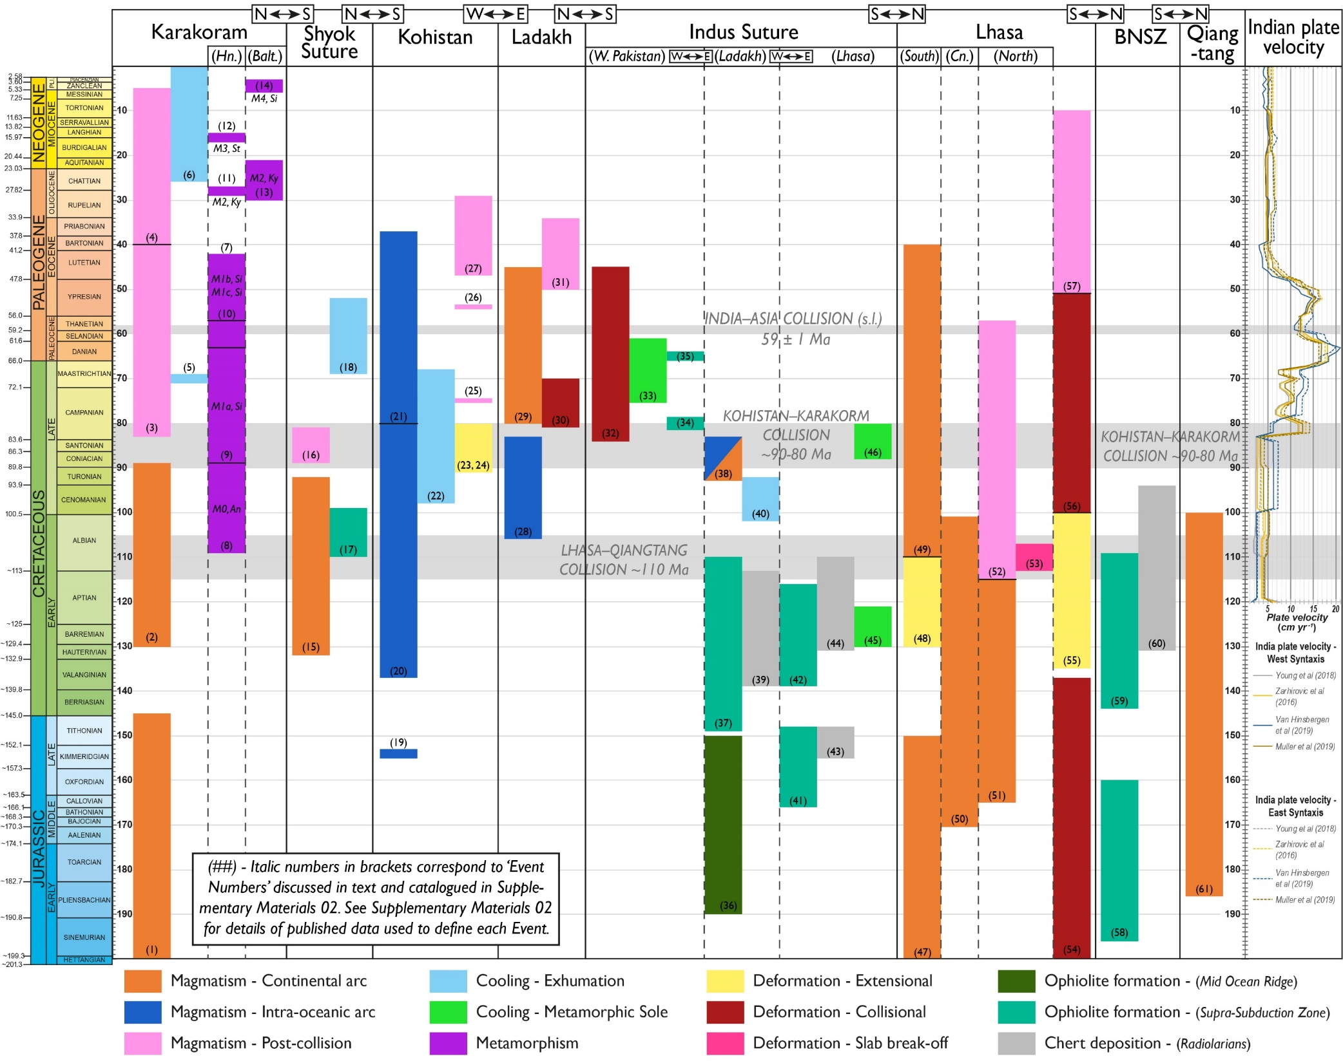
SUBDUCTION HISTORY:
(BEDROCK RECORD)
Qiangtang: ~185-110 Ma
Karakoram: ~200-145 Ma, 130-90 Ma
Lhasa: ~200-150 Ma, 110-40 Ma
Kohistan: ~155-40 Ma
Ladakh: ~105-85 Ma
Indus Suture Ophiolites: ~165-110 Ma
Other considerations: palaeomag, sedimentology, detrital zircon provenance
Parsons et al. 2020. Geological, geophysical and plate kinematic constraints for models of the India-Asia collision and the post-Triassic central Tethys oceans. Earth-Science Reviews,103084. https://doi.org/10.1016/j.earscirev.2020.103084
SEE NOTES BELOW FOR FIGURE CAPTION
Notes:
Figure 3. Jurassic to recent history of subduction, magmatism and accretion of crustal blocks of the Tibetan Plateau (See Figure 1 for crustal block locations). Coloured bars show type and duration of geological events. Italicised numbers are ‘Event Numbers’ used to match each geological event to their corresponding description in Supplementary Materials 04. Lengths of events are defined by a collection of overlapping published ages plus and minus their errors. Data sources for all Event Numbers are listed in Supplementary Materials 04. India plate velocity profiles are calculated for the East and West syntaxes using a variety of published plate reconstructions (see figure), relative to a fixed mantle reference frame using the GPlates velocity tool. Metamorphism on the Karakoram block is divided into previously defined metamorphic events, M0 to M4; M1 is divided into M1a, M1b M1c (See Supplementary Materials 03 and 04 for description). Abbreviations: An – andalusite grade; Balt. – Baltoro region, Karakoram; BNSZ – Bangong-Nujiang suture zone; Cn. – Central Lhasa; Hn. – Hunza region, Karakoram; Ky – kyanite grade; Si – sillimanite grade; W. Pakistan – West Pakistan. Time scale based on Geological Society of America stratigraphic chart.

Slide 25
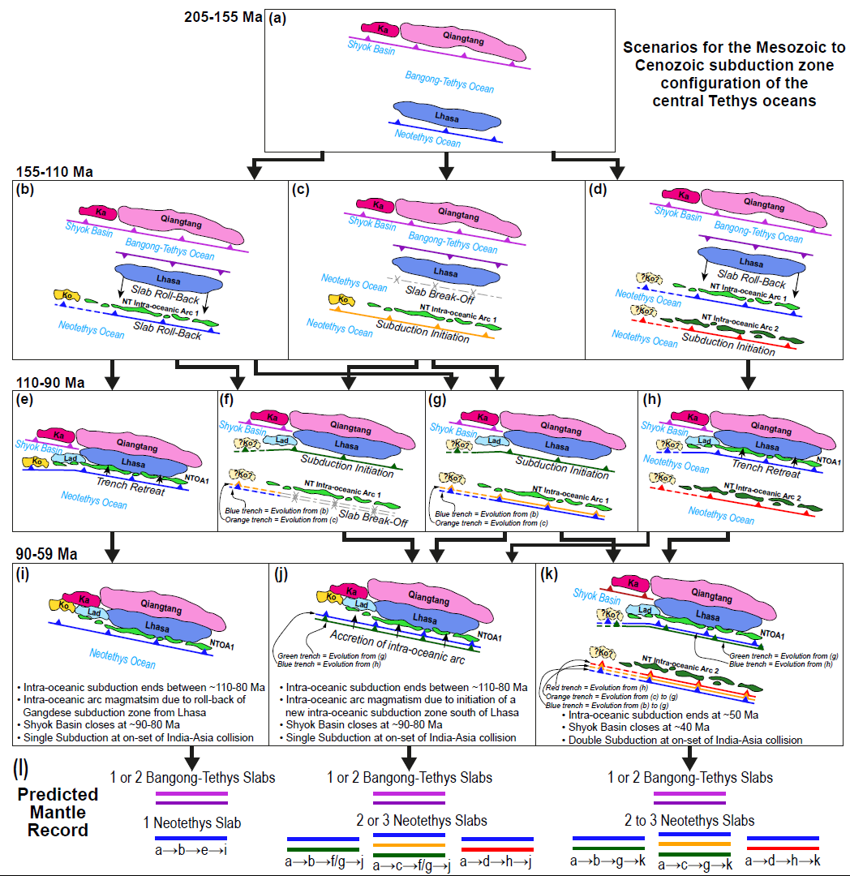
SUBDUCTION HISTORY:
(BEDROCK RECORD)
Permissible subduction zone configurations for the post-Triassic central Tethys oceans based on bedrock observations
Parsons et al. 2020. Geological, geophysical and plate kinematic constraints for models of the India-Asia collision and the post-Triassic central Tethys oceans. Earth-Science Reviews,103084. https://doi.org/10.1016/j.earscirev.2020.103084
SEE NOTES BELOW FOR FIGURE CAPTION
Notes:
Figure 7. (a-k) Mesozoic to Cenozoic subduction zone configuration for central Tethys region, based on published constrains (See Figure 3 & Supplementary Materials 03 and 04). Arrows between diagrams mark potential evolutionary scenarios for different subduction zone configurations. Subduction zones colours define distinct subducted slabs. Abbreviations: Ka – Karakoram; Ko – Kohistan; Lad – Ladakh; NTOA1 – Neotethys intra-oceanic arc 1. Dashed subduction zones and pale yellow dashed block labelled “?Ko?” correspond to equally plausible restorations of the Kohistan block for a given time period, based on the limited constraints. (l) Predicted number of slabs of subducted Bangong-Tethys and Neotethys ocean lithosphere, based on possible scenarios. Coloured lines for each slab match to specific colour-coded subduction zones in (a-k).

Slide 26
SIZE OF GREATER INDIA
Parsons et al. 2020. Geological, geophysical and plate kinematic constraints for models of the India-Asia collision and the post-Triassic central Tethys oceans. Earth-Science Reviews,103084. https://doi.org/10.1016/j.earscirev.2020.103084
SEE NOTES BELOW FOR FIGURE CAPTION
PRE-COLLISION INDIAN MARGIN ≥900 KM NORTH OF MFT
Notes:
Figure 21. (a-c) Spatial extent of underthrusted/subducted Indian lithosphere immediately beneath the Tibetan plateau, based on Himalayan crustal shortening estimates and geophysical subsurface imaging. (a) Blue shaded area with thick long-dashed line marks the edge of Indian continental lithosphere (Greater India) underlying the Tibetan plateau, estimated from geophysical datasets and cross section restorations. Thick short-dashed line shows extent of Indian lithosphere underlying the Tibetan plateau after vertical slabs of Indian continental lithosphere are unfolded to a horizontal position. Position and polarity of the Pamir and Hindu Kush subduction zones is based on Kufner et al. (2016). Red dashed line marks southern limit of southward subducting Asian continental lithosphere beneath the Tibetan Plateau; yellow area marks low seismic velocity zone in the upper mantle beneath the Tibetan Plateau (based on: Wittlinger et al., 1996, Liang et al., 2012, Zhang H. et al., 2012, Zhao et al., 2014). Coloured circles show the positions at which the Indian crust and lithosphere are imaged beneath the Tibetan Plateau. Colours correspond to: red – Indian lower crust imaged via receiver function surveys; green – Indian lithosphere imaged via receiver function surveys; blue - Indian lithosphere imaged via P- and S-wave tomography; yellow - Indian lithosphere imaged via Pn-wave tomography; purple - Indian lithosphere imaged via surface-wave tomography. Numbers next to coloured circle can be matched to their data sources presented in Table 4. Thick semi-transparent solid line marks northern limit of Indian lower crust imaged beneath Tibet. NE-SW trending, light and dark coloured bars respectively show minimum and maximum restored lengths of the LHS (blue), GHS (purple), and the THS (yellow), determined from cross section restoration. Cross section numbers can be matched with their data sources in Table 3. Red shaded area with short-dashed line outlines approximate combined area of the restored GHS and THS. Abbreviations on underlying map are as in Figures 1–2. (b-c) 150 km depth slice of tomography models (b) SL2013sv and (c) LLNL_G3Dv3. Estimated size of Greater India displayed by thick long-dashed line. Outline of seismically fast anomaly I is marked by thick grey dashed line. Estimated size of Indian continental crust and mantle lithosphere that must be removed via subduction to satisfy the enlarged-area Greater India reconstruction is outlined by blue dashed line, based on Figure 23c. Georeferenced overlays (.kml, .kmz) and shapefiles of all points, lines, and polygons presented in our map figures are available for use and editing with global information system software (e.g. Google Earth, GPlates, ArcGIS) in Supplementary Materials 01 and 02.

Slide 27
TOMOGRAPHY DATASETS DRAWN USING SUBMACHINE ←CLICK ME!

Slide 28
Parsons et al. 2020. Geological, geophysical and plate kinematic constraints for models of the India-Asia collision and the post-Triassic central Tethys oceans. Earth-Science Reviews,103084. https://doi.org/10.1016/j.earscirev.2020.103084
SEE NOTES BELOW FOR FIGURE CAPTION
Notes:
Figure 9. Seismic tomographic images of subducted slabs beneath the Indian hemisphere at 350 km and 600 km depth. Present-day coastlines and plate boundaries drawn with black solid line and red solid line, respectively. Outlines of anomalies are drawn with dashed lines; reconstruction of India at 59 Ma drawn with solid dark grey line (see also Figure 8). Major sutures drawn with light grey line (see also Figure 1). Lines of section shown in Figures 12-20 are drawn with solid grey lines. (a) 350 km and (b) 600 km depth slices from tomography model SL2013sv. (c) 350 km and (d) 600 km depth slices from tomography model LLNL_G3Dv3. (e) 350 km (f) and 600 km depth slices of Vote Maps for models SL2013sv, LLNL_G3Dv3, DETOX-P2, UU-P07 and MITP08. Contours on Vote maps show how many of the selected models identify a seismically fast anomaly (≥ +0.3 %) at any given point on the map. See Shephard et al. (2017) for further details of Vote Maps. Depth slices and Vote Maps drawn using SubMachine (Hosseini et al., 2018). Georeferenced overlays (.kml, .kmz) and shapefiles of all points, lines, and polygons presented in our map figures are available for use and editing with global information system software (e.g. Google Earth, GPlates, ArcGIS) in Supplementary Materials 01 and 02.

Slide 29
Parsons et al. 2020. Geological, geophysical and plate kinematic constraints for models of the India-Asia collision and the post-Triassic central Tethys oceans. Earth-Science Reviews,103084. https://doi.org/10.1016/j.earscirev.2020.103084
SEE NOTES BELOW FOR FIGURE CAPTION
Notes:
Figure 10. Seismic tomographic images of subducted slabs beneath the Indian hemisphere at 800 km depth. See Figure 9 for explanation of annotations and structures drawn over each depth slice. Depth slices shown for tomography models (a) DETOX-P2, (b) LLNL_G3Dv3, (c) UU-P07, and (d) MITP08. (e) Vote Map for models LLNL_G3Dv3, DETOX-P2, UU-P07 and MITP08. (f) Vote Map for P-wave models GyPSuM-P, HMSL-P06, PRI-P05, SP12RTS-P, SPani-P, DETOX-P2, GAP-P4, LLNL_G3Dv3, MITP08, UU-P07 (For model sources and details see Table 1). See Figure 9 for further details.

Slide 30
Parsons et al. 2020. Geological, geophysical and plate kinematic constraints for models of the India-Asia collision and the post-Triassic central Tethys oceans. Earth-Science Reviews,103084. https://doi.org/10.1016/j.earscirev.2020.103084
SEE NOTES BELOW FOR FIGURE CAPTION
Notes:
Figure 11. Seismic tomographic images of subducted slabs beneath the Indian hemisphere at 1300 km depth. See Figure 9 for explanation of annotations and structures drawn over each depth slice. Depth slices shown for tomography models (a) DETOX-P2, (b) LLNL_G3Dv3, (c) UU-P07, and (d) MITP08. (e) Vote Map for models LLNL_G3Dv3, DETOX-P2, UU-P07 and MITP08. (f) Vote Map for P-wave models GyPSuM-P, HMSL-P06, PRI-P05, SP12RTS-P, SPani-P, DETOX-P2, GAP-P4, LLNL_G3Dv3, MITP08, UU-P07 (For model sources and details, see Hosseini et al., 2018). See Figure 9 for further details.

Slide 31
Parsons et al. 2020. Geological, geophysical and plate kinematic constraints for models of the India-Asia collision and the post-Triassic central Tethys oceans. Earth-Science Reviews,103084. https://doi.org/10.1016/j.earscirev.2020.103084
SEE NOTES BELOW FOR FIGURE CAPTION
Notes:
Figure 12. Cross section A through seismic tomography models (a) DETOX-P2, (b) LLNL_G3Dv3, (c) UU-P07, (d) MITP08, and (e) SL2013sv3. Labels display positions of anomalies I to VI, marked on Figures 8-11. Locations of specific surface structures are labelled: AFT – Altyn Tagh Fault; BN – Bangong-Nuijang suture; ISZ – Indus suture; J – Jinsha suture; K – Kunlun suture; MFT – Main Frontal thrust; SS – Shyok suture; see Figures 1 and 2 for further reference. (f) Map trace of tomographic line of section, with geological structures and seismic tomography anomalies outlined. Location of cross section are displayed in Figures 8–11. Cross sections drawn using SubMachine (Hosseini et al., 2018).

Slide 32
Parsons et al. 2020. Geological, geophysical and plate kinematic constraints for models of the India-Asia collision and the post-Triassic central Tethys oceans. Earth-Science Reviews,103084. https://doi.org/10.1016/j.earscirev.2020.103084
SEE NOTES BELOW FOR FIGURE CAPTION
Notes:
Figure 13. Cross section B through seismic tomography models (a) DETOX-P2, (b) LLNL_G3Dv3, (c) UU-P07, (d) MITP08, and (e) SL2013sv3. Labels display positions of anomalies I to VI, marked on Figures 8-11. Locations of specific surface structures are labelled: AFT – Altyn Tagh Fault; BN – Bangong-Nuijang suture; ISZ – Indus suture; J – Jinsha suture; K – Kunlun suture; MFT – Main Frontal thrust; SS – Shyok suture; see Figures 1 and 2 for further reference. (f) Map trace of tomographic line of section, with geological structures and seismic tomography anomalies outlined. Location of cross section are displayed in Figures 8–11. Cross sections drawn using SubMachine (Hosseini et al., 2018).

Slide 33
Parsons et al. 2020. Geological, geophysical and plate kinematic constraints for models of the India-Asia collision and the post-Triassic central Tethys oceans. Earth-Science Reviews,103084. https://doi.org/10.1016/j.earscirev.2020.103084
SEE NOTES BELOW FOR FIGURE CAPTION
Notes:
Figure 14. Cross section C through seismic tomography models (a) DETOX-P2, (b) LLNL_G3Dv3, (c) UU-P07, (d) MITP08, and (e) SL2013sv3. Labels display positions of anomalies I to VI, marked on Figures 8-11. Locations of specific surface structures are labelled: AFT – Altyn Tagh Fault; BN – Bangong-Nuijang suture; ISZ – Indus suture; J – Jinsha suture; K – Kunlun suture; MFT – Main Frontal thrust; SS – Shyok suture; see Figures 1 and 2 for further reference. (f) Map trace of tomographic line of section, with geological structures and seismic tomography anomalies outlined. Location of cross section are displayed in Figures 8–11. Cross sections drawn using SubMachine (Hosseini et al., 2018).

Slide 34
Parsons et al. 2020. Geological, geophysical and plate kinematic constraints for models of the India-Asia collision and the post-Triassic central Tethys oceans. Earth-Science Reviews,103084. https://doi.org/10.1016/j.earscirev.2020.103084
SEE NOTES BELOW FOR FIGURE CAPTION
Notes:
Figure 15. Cross section D through seismic tomography models (a) DETOX-P2, (b) LLNL_G3Dv3, (c) UU-P07, (d) MITP08, and (e) SL2013sv3. Labels display positions of anomalies I to VI, marked on Figures 8-11. Locations of specific surface structures are labelled: AFT – Altyn Tagh Fault; BN – Bangong-Nuijang suture; ISZ – Indus suture; J – Jinsha suture; K – Kunlun suture; MFT – Main Frontal thrust; SS – Shyok suture; see Figures 1 and 2 for further reference. (f) Map trace of tomographic line of section, with geological structures and seismic tomography anomalies outlined. Location of cross section are displayed in Figures 8–11. Cross sections drawn using SubMachine (Hosseini et al., 2018).

Slide 35
Parsons et al. 2020. Geological, geophysical and plate kinematic constraints for models of the India-Asia collision and the post-Triassic central Tethys oceans. Earth-Science Reviews,103084. https://doi.org/10.1016/j.earscirev.2020.103084
SEE NOTES BELOW FOR FIGURE CAPTION
Notes:
Figure 16. Cross section E through seismic tomography models (a) DETOX-P2, (b) LLNL_G3Dv3, (c) UU-P07, (d) MITP08, and (e) SL2013sv3. Labels display positions of anomalies I to VI, marked on Figures 8-11. Locations of specific surface structures are labelled: AFT – Altyn Tagh Fault; BN – Bangong-Nuijang suture; ISZ – Indus suture; J – Jinsha suture; K – Kunlun suture; MFT – Main Frontal thrust; SS – Shyok suture; see Figures 1 and 2 for further reference. (f) Map trace of tomographic line of section, with geological structures and seismic tomography anomalies outlined. Location of cross section are displayed in Figures 8–11. Cross sections drawn using SubMachine (Hosseini et al., 2018).

Slide 36
Parsons et al. 2020. Geological, geophysical and plate kinematic constraints for models of the India-Asia collision and the post-Triassic central Tethys oceans. Earth-Science Reviews,103084. https://doi.org/10.1016/j.earscirev.2020.103084
SEE NOTES BELOW FOR FIGURE CAPTION
Notes:
Figure 17. Cross section F through seismic tomography models (a) DETOX-P2, (b) LLNL_G3Dv3, (c) UU-P07, (d) MITP08, and (e) SL2013sv3. Labels display positions of anomalies I to VI, marked on Figures 8-11. Locations of specific surface structures are labelled: AFT – Altyn Tagh Fault; BN – Bangong-Nuijang suture; ISZ – Indus suture; J – Jinsha suture; K – Kunlun suture; MFT – Main Frontal thrust; SS – Shyok suture; see Figures 1 and 2 for further reference. (f) Map trace of tomographic line of section, with geological structures and seismic tomography anomalies outlined. Location of cross section are displayed in Figures 8–11. Cross sections drawn using SubMachine (Hosseini et al., 2018).

Slide 37
Parsons et al. 2020. Geological, geophysical and plate kinematic constraints for models of the India-Asia collision and the post-Triassic central Tethys oceans. Earth-Science Reviews,103084. https://doi.org/10.1016/j.earscirev.2020.103084
SEE NOTES BELOW FOR FIGURE CAPTION
Notes:
Figure 18. Cross section G through seismic tomography models (a) DETOX-P2, (b) LLNL_G3Dv3, (c) UU-P07, (d) MITP08, and (e) SL2013sv3. Labels display positions of anomalies I to VI, marked on Figures 8-11. Locations of specific surface structures are labelled: AFT – Altyn Tagh Fault; BN – Bangong-Nuijang suture; ISZ – Indus suture; J – Jinsha suture; K – Kunlun suture; MFT – Main Frontal thrust; SS – Shyok suture; see Figures 1 and 2 for further reference. (f) Map trace of tomographic line of section, with geological structures and seismic tomography anomalies outlined. Location of cross section are displayed in Figures 8–11. Cross sections drawn using SubMachine (Hosseini et al., 2018).

Slide 38
Parsons et al. 2020. Geological, geophysical and plate kinematic constraints for models of the India-Asia collision and the post-Triassic central Tethys oceans. Earth-Science Reviews,103084. https://doi.org/10.1016/j.earscirev.2020.103084
SEE NOTES BELOW FOR FIGURE CAPTION
Notes:
Figure 19. Outlines of seismically fast anomalies, drawn from the +0.2% (short dashed line) and +0.3% (long dashed line) velocity contours of each tomography model (lines colour-coded by model) for cross sections A to G. For additional clarity, these cross sections are displayed without annotations, along with cross sections showing only +0.2%, and only +0.3% contours in Supplementary Materials 07.

Slide 39
Parsons et al. 2020. Geological, geophysical and plate kinematic constraints for models of the India-Asia collision and the post-Triassic central Tethys oceans. Earth-Science Reviews,103084. https://doi.org/10.1016/j.earscirev.2020.103084
SEE NOTES BELOW FOR FIGURE CAPTION
Notes:
Figure 20. Outlines of Anomalies I to VI based on the combined +0.2% (solid outline, faded colour) and +0.3% (dashed outline, bold colour) velocity contours from in Figure 19, and as defined in Table 2.

