Slide 1
From Google Maps to Air Quality: a big data approach to modelling real-time NO₂ concentrations in an urban street canyon from road traffic data
Helen Pearce
Dr. Zhaoya Gong
Dr. Xiaoming Cai
Prof. Bill Bloss

Slide 2
Introduction
Why is air pollution an issue?
64% of new paediatric asthma cases in urban centres attributed to elevated NO₂ levels (Achakulwisut et al., 2019)
In European cities, transport-related pollution drives adverse health outcomes
Limitations of current methods
Heavily reliant on historical data that is often limited in spatial and temporal resolutions
Traffic data typically captured with manual counting at a hourly resolution, with limited available data from ANPR cameras
Emissions models for large areas assume vehicles travel at the speed limit of the road, neglecting congestion effects

Slide 3
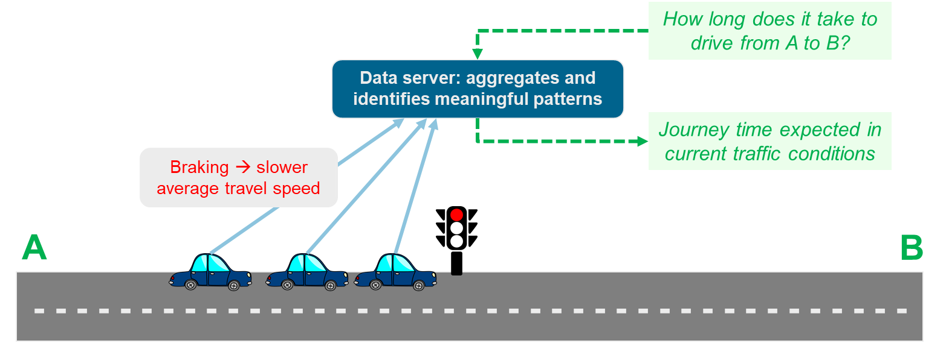
Objectives
Utilise novel methodology to obtain real-time high-resolution traffic speed data
Compare emissions generated using traditional static methods (vehicles assumed to be travelling at speed limit) and novel traffic data
Compare modelled air pollution concentrations using real-time traffic data to measurements and traditional methods

Slide 4
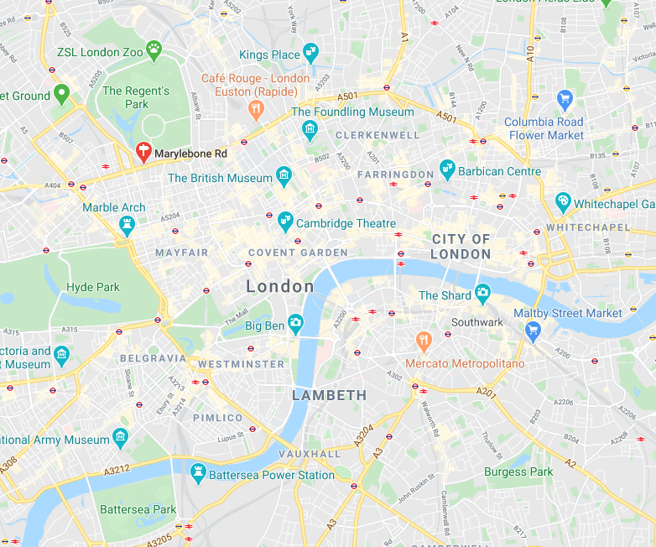
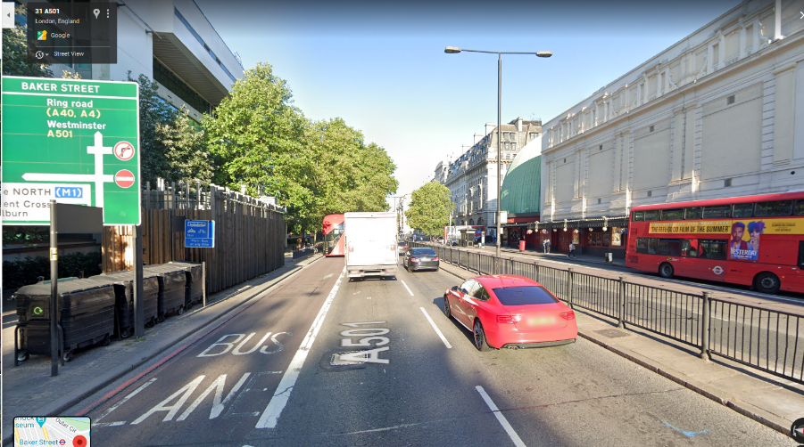
Data
Study location: Marylebone Road, London
Typical street canyon (aspect ratio ≈ 1)
Highly trafficked road (> 70,000 vehicles per day)
Speed limit: 30 mph (48 kph)
Hourly queries from July to October 2019 using Google platform (905 observations)
Comparison to air quality measurement site (NO₂), available online from Defra as part of the AURN network

Slide 5
Novel Methodology
Real-time traffic information from mapping platform to obtain vehicle journey times and therefore actual vehicle speed on an hourly basis
Emissions calculations using actual speed, London fleet characteristics, and National Atmospheric Emissions Inventory speed-related emission factors
Air quality box model to simulate pollutants within the environment: NO_{x} → O₃ chemistry, advection and dispersion
*Limitation acknowledged: this relies on data from users and can be manipulated. Google was chosen as it has a large market share and can therefore represent a significant group of people

Slide 6
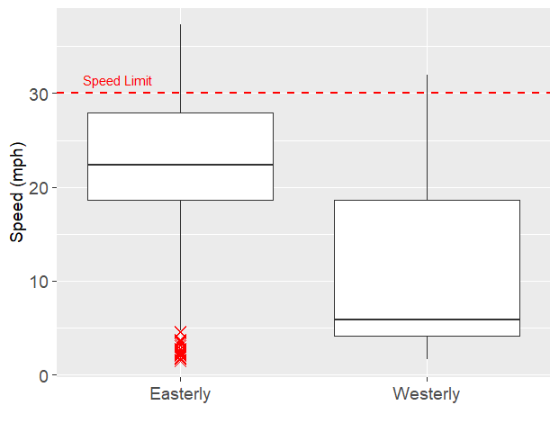
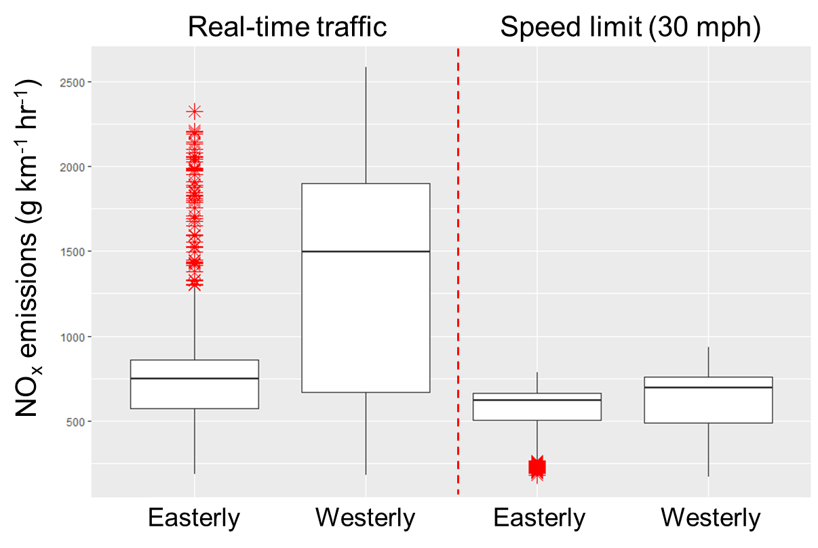
Results: Actual Speeds & Impact on Emissions
2500
30
2000
Speed (mph)
1500
20
1000
10
500
Easterly
Westerly
Westerly speeds (median = 5.9 mph) much lower than easterly travel speeds
Congestion has significant impact on travel speed of vehicles
Overall, emissions are greater when accounting for real-time traffic conditions (left) compared to assuming speed limit (right)
Notes:
Time series or box plot – or both?

Slide 7
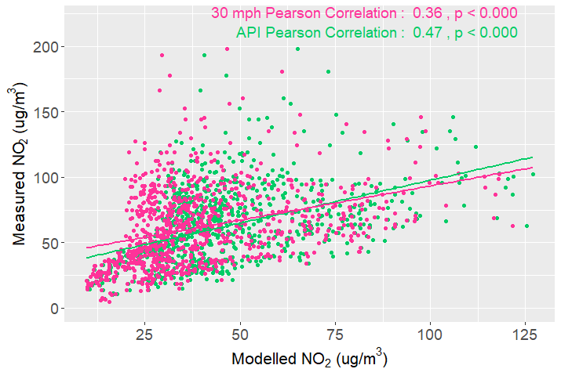
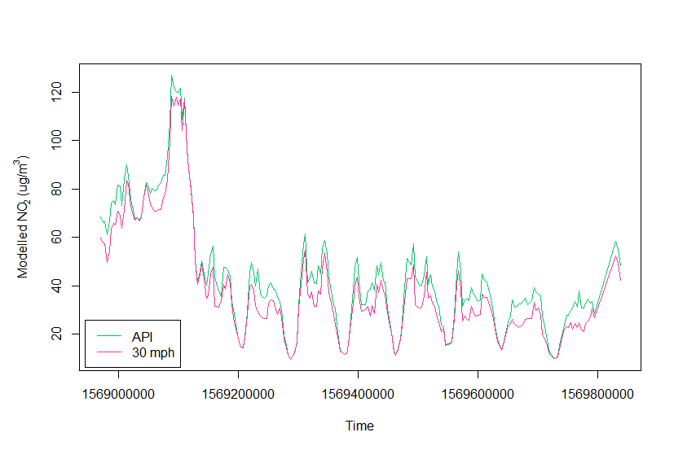
Results: Modelled Air Quality vs Observations
Using average speed resulted in an underestimation of pollutant concentrations and a weaker correlation (Pearson) to measured concentrations
20th Sep 2019
23rd Sep 2019
25th Sep 2019
27th Sep 2019
29th Sep 2019

Slide 8
Conclusions and Future Work
Novel methodology utilising crowd-sourced data can reveal important patterns of traffic activity
Real-time traffic information showed a large increase in emissions due to congestion effects
In comparison, the conventional average speed method underestimates pollutant concentrations
Future work could include on-site surveys to validate the data obtained from mapping platforms, and then applying methodology to multiple roads to cover a whole city region
Implications and potential applications: assessing policy implementation, health exposure studies at the resolution of an individual street

