Slide 1
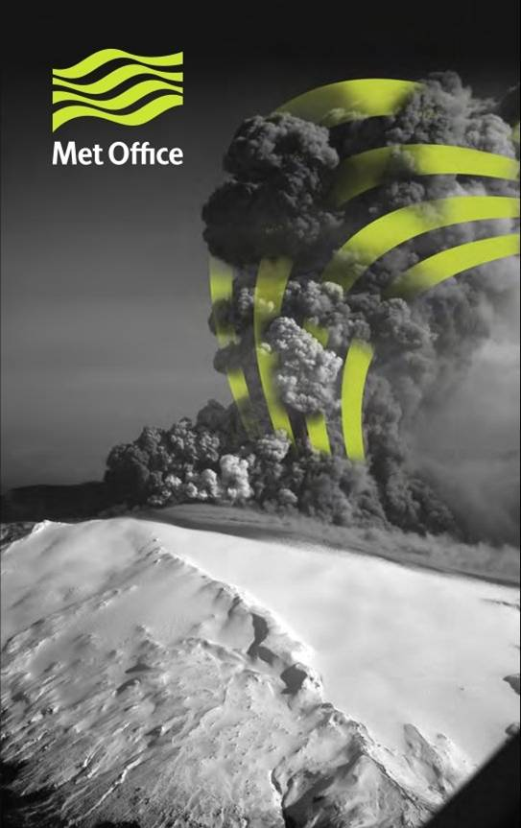
Dispersion Modelling at the London VAAC 10 Years after the Eyjafjallajökull Ash Cloud
Frances Beckett, Claire Witham, Susan Leadbetter, Ric Crocker, Helen Webster, Matthew Hort, Andrew Jones, Ben Devenish, David Thomson
Met Office, UK
New Paper:
https://www.mdpi.com/2073-4433/11/4/352

Slide 2
It has been 10 years since the ash cloud from the eruption of Eyjafjallajökull caused unprecedented disruption to air traffic across Europe.
During this event, the London Volcanic Ash Advisory Centre (VAAC) provided advice on the expected location of volcanic ash in the atmosphere using the atmospheric dispersion model NAME.
Changes in regulatory response during the eruption introduced the requirement to also provide forecasts of ash concentrations.
We present the development of NAME and modifications to its application in the London VAAC forecasting system since 2010, based on the lessons learned from the Eyjafjallajökull event.
Improvements since 2010
More skilful Meteorological Data
Improved implementation of Eruption Source Parameters (ESPs)
Improved representation of the vertical and horizontal transport of ash in NAME
New code optimisation
Meteorological Data (NWP):
Met Office UM Global
ECMWF IFS Global
Volcanic Ash Graphic + Volcanic Ash Advisory
Observations e.g.:
Satellite
Lidar
Aircraft
Operational Meteorologist
Eruption Source Parameters:
Plume Height + Location
Timings of Ash Release
Emission Rate
Particle Characteristics
Dispersion Model:
NAME
Figure: The forecasting process at the London VAAC.
NAME: Numerical Atmospheric-Dispersion Modelling Environment
NWP: Numerical Weather Prediction

Slide 3
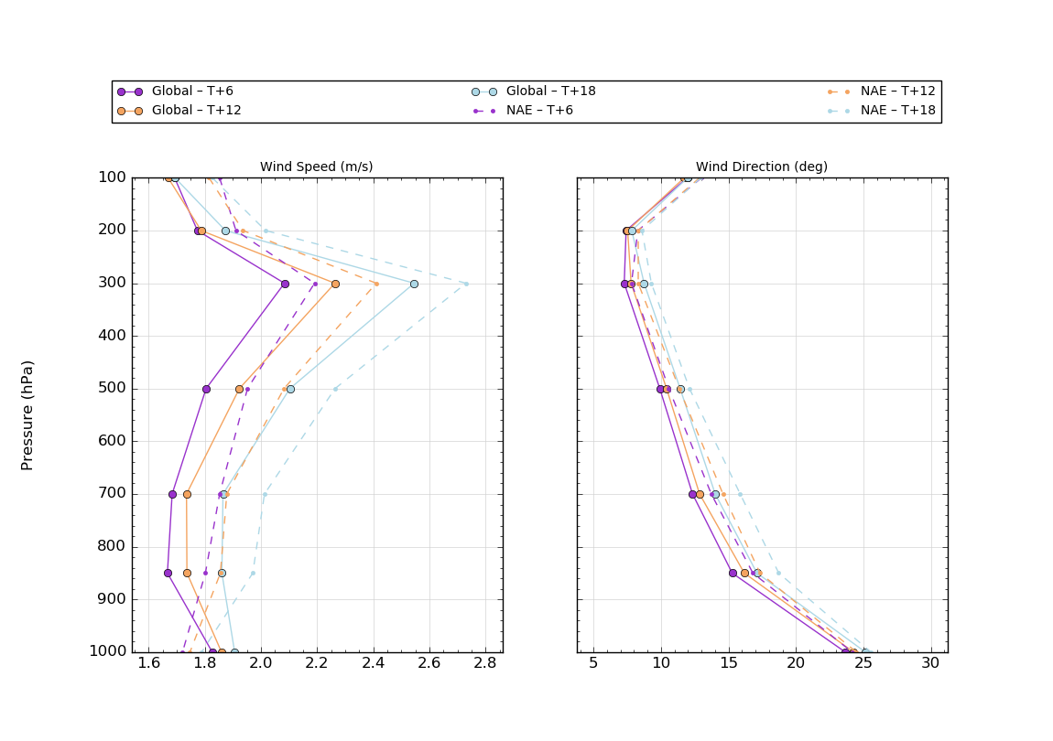
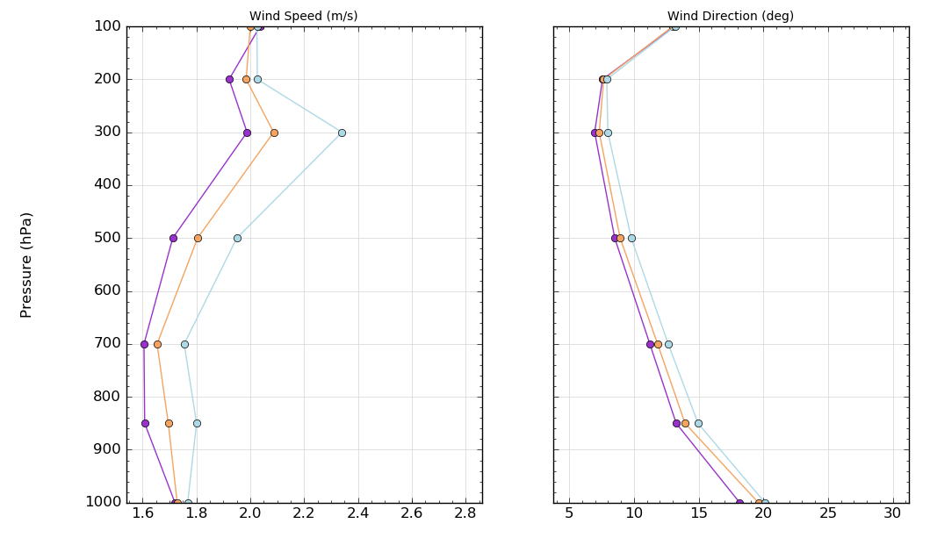
Mean Absolute Error
2010
1. More Skilful Meteorological Data
Forecast skill out to 3 - 10 days has increased by about one day per decade: in 2015, the 6-day forecast was as accurate as the 5-day forecast in 2005.
We found that the Global configuration of the UM was more skilful at representing upper air winds than the higher resolution limited area configuration (NAE) in 2010. The Global output is the default met data set used by the VAAC.
We have also introduced the option to use data from the O1280 version of the ECMWFs operational deterministic global model.
Pressure (hPa)
2019
Pressure (hPa)
Figure: Comparing Global model forecast wind speed and direction to radiosonde data. Data from the NAE during 2010 are also compared.
UM: Unified Model, the Met Office’s NWP NAE: North Atlantic and European
ECMWF: European Centre for Medium Range Weather Forecasts
Wind Speed (m s⁻¹)
Wind Direction (deg)

Slide 4
Default
MER
2. Improved Representation of ESPs
Source Vertical Distribution and MER
Implemented a Buoyant Plume Scheme (Devenish, 2013)
Implemented an Inversion Scheme (InTEM) (Pelley et al., 2015)
Particle Characteristics
The non-sphericity of ash is now represented (Saxby et al., 2020)
We have introduced optional PSDs representative of Coarse and Fine grained ash (Osman et al., 2020)
The London VAAC system also has the option to run with multiple scenarios, varying ash emission height, MER, DFAF, PSD and particle shape.
This allows the operational meteorologists to assess the sensitivity of their forecasts to ESPs.
PSD
Shape
Figure: Assessment of dispersion model sensitivity to ESPs, showing average ash concentration in the Eyjafjallajökull ash cloud at 00:00 – 06:00 UTC on the 7th May 2010 at FL00-200. The four maps show simulations initialized with: the VAAC Default ESPs, a MER and vertical distribution determined from the Buoyant Plume model, the VAAC’s Coarse PSD, and Extreme Particle Shape parameters.
MER: Mass Eruption Rate PSD: Particle Size Distribution
DFAF: Distal Fine Ash Fraction

Slide 5
3. Improved Representation of the Vertical and Horizontal Transport of Ash in NAME
Atmospheric Processes
Revised scheme for representing unresolved horizontal mesoscale motions (Webster et al., 2018)
New parametrization of deep convection over the entire troposphere (Meneguz and Thomson, 2014)
New wet deposition scheme which accounts for the known dependency of scavenging coefficients on particle size and solubility (Webster et al., 2017)
Sedimentation
Implemented the Ganser drag equation to represent non-spherical ash (Saxby et al., 2018, 2020)
4. New Code Optimisation
We are using a hybrid approach to running NAME on the VAAC system, using OpenMP and MPI. Run times have improved by approx. a factor of ten, compared to using our historical serial code (Stratford et al., 2018).
Figure: Comparison of NAME average ash concentrations in the Eyjafjallajökull ash cloud at 12:00 – 18:00 UTC on 18 May 2010 FL00-200, using the original and new wet deposition schemes.
OpenMP: shared memory parallelism
MPI: distributed memory parallelism

Slide 6
Recommendations for future scientific development for improving operational dispersion modelling of volcanic ash
Atmospheric Processes
Higher temporal and vertical resolution global met data
Representing varying free tropospheric turbulence (Dacre et al., 2015)
Using ensemble meteorological data (MOGREPS-G)
Modelling Volcanic Ash in the Atmosphere
Implementation of an umbrella cloud scheme (Webster et al., 2020)
Constraining uncertainty on MER and vertical distribution of ash at the source.
Representing near-source processes (aggregation, gravitational instabilities) and constraining DFAF.
Integrating Observations
Data assimilation and Inversion
Computer Resources
Further code optimisation and parallelisation strategies
Next generation modelling systems (architectures)
In addition, we advocate further model inter-comparison studies and conducting regular exercises.
Conclusions
Scientific and technical developments have resulted in a more robust modelling system at the London VAAC, ready to provide forecasts and guidance during the next volcanic ash event.
The work has involved collaboration with academic partners and staff at other operational institutions.
Future collaboration will be vital for the ongoing development and validation of volcanic ash dispersion models.
Acknowledgments: We would like to thank the London VAAC meteorologists for their input on operational dispersion modelling, Mike Bush and Ken Mylne (Met Office) for their advice on the use of NWP met data and Nina Kristiansen for her support. We would also like to thank Alison Rust, Costanza Bonadonna, Kathy Cashman, Jen Saxby, Evie Snee and Sara Osman for sharing their expertise on volcanic ash which has led to the improvements in the use of ESPs at the London VAAC.

