Slide 1


Y.X.Sun¹, Y.X.Hao¹, E. Roussos², Q.G.Zong¹, Y.Liu¹, X.Z.Zhou¹, Y.Chao¹, S.Lejosne ³ , P. Kollmann⁴ , N. Krupp²
Statistics On Saturnian Radiation Belts
And more
1: Institute of Space Physics and Applied Science,Peking University,Beijing China
2: Max Planck Institute for Solar System Research, Goettingen, Germany
3: Space Science Laboratory, University of California,Berkeley,USA
4: Johns Hopkins University Applied Physics Laboratory, Laurel MD, USA
EGU2020
Notes:
The Impact of Magnetospheric Convection
on Saturnian Radiation Belts

Slide 2
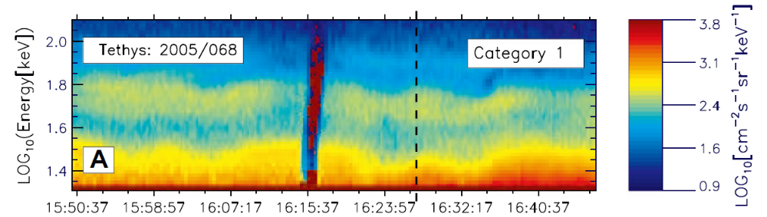
Convection at Saturn: microsignatures
Andriopoulou et al. (2012; 2014), also in Paranicas et al. (2005, 2009), Roussos et al. (2005, 2007, 2010, 2013, 2019), Thomsen et al. (2012), Wilson et al. (2013), Holmberg et al. (2014)
Notes:
Energetic electron microsignatures are localized electron dropouts observed in the particle fluxes. They are mainly created by the icy satellites that absorb the incident charged particles and create a flux-depleted region that maintains its coherence as it moves in
longitude and L-shell at the drifting rate of the missing particles (Van Allen et al., 1980; Paranicas and Cheng, 1997).
Circular orbit of the moon, low eccentricity
Magnetic field asymmetry could not explain
2

Slide 3
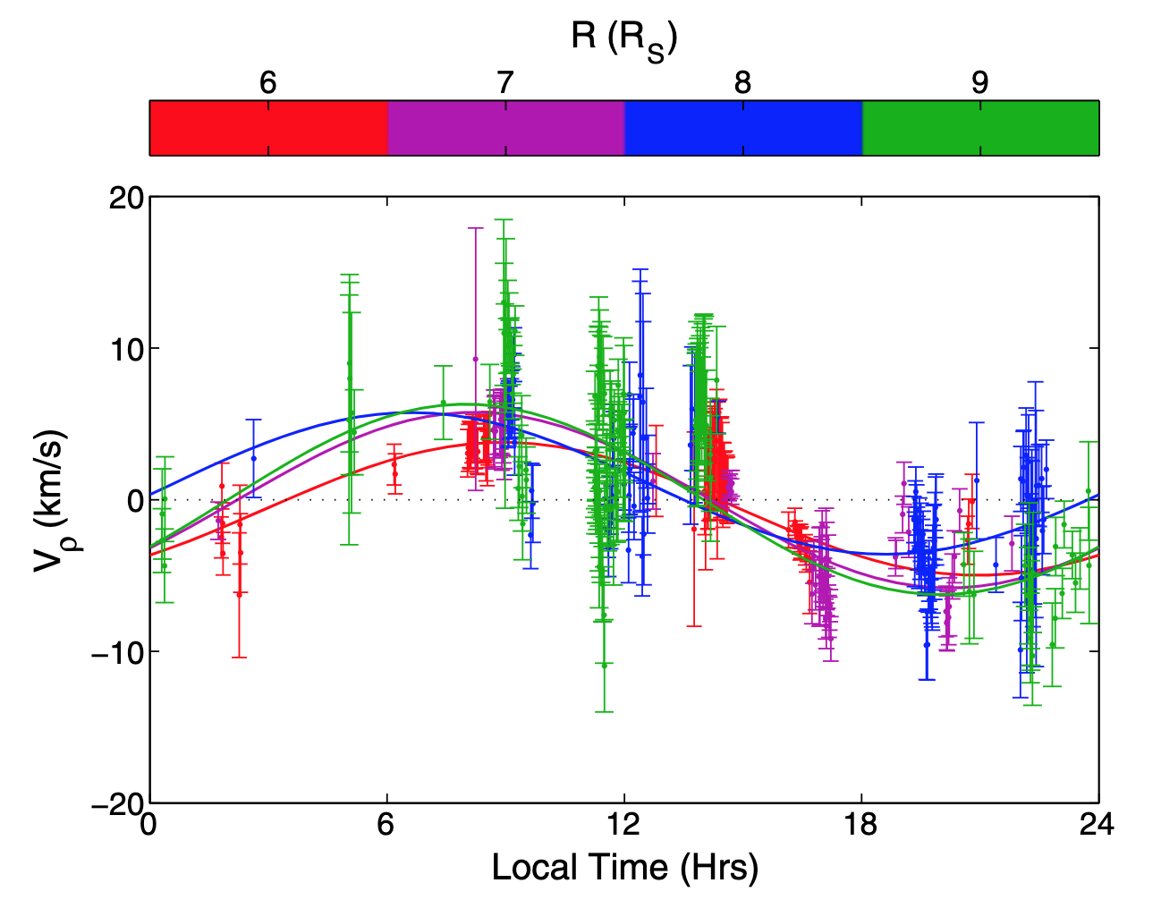
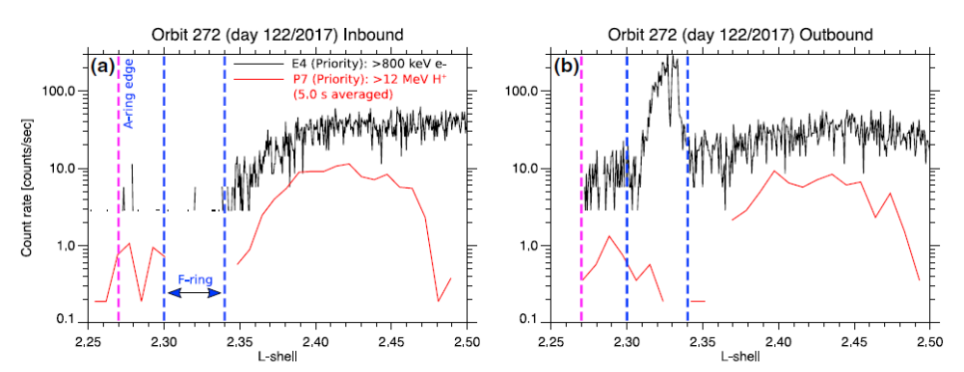
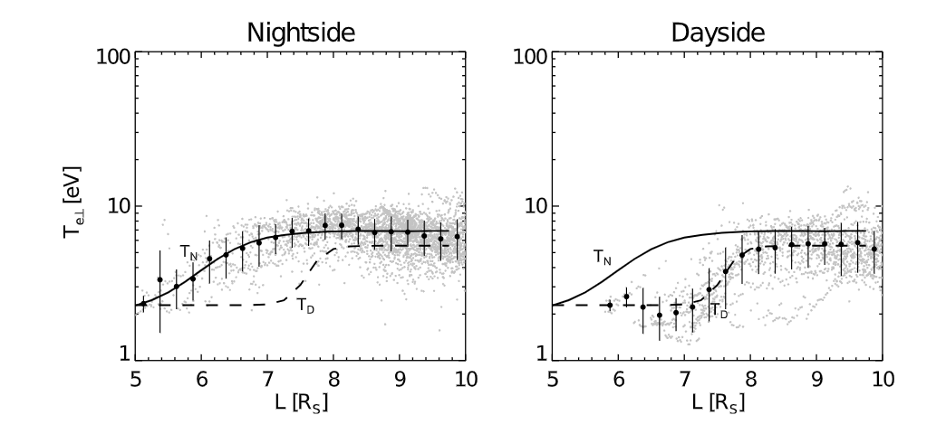
Convection at Saturn: more evidence
Convection properties
* Dawnward flow (<10 km/s)
* “Noon-midnight” electric field (offset ~30º towards dawn) of 0.1-1.0 mV/m
* Variable
Radial extent: ~ 2.3 - 15 R_{s}
Increasing with radial distance
Prenoon
Radial flows (dusk to dawn)
Postnoon
Day-night asymmetries
(particle distributions)
Local time confined microbelts
Andriopoulou et al. (2012; 2014), also in Paranicas et al. (2005, 2009), Roussos et al. (2005, 2007, 2010, 2013, 2019), Thomsen et al. (2012), Wilson et al. (2013), Holmberg et al. (2014)
Notes:
Corotation flow velocity 50 km/s
a dominant factor in the circulation of plasma in Saturn’s inner magnetosphere, not just low energy plasma but even higher energy particles.
The field magnitude and orientation were inferred from the displacement of “microsignatures” of satellites in energetic particle fluxes [e.g., Paranicas et al., 2005; Roussos et al., 2005; Andriopoulou et al., 2012, 2014], from the local time asymmetry of ring absorption signatures
in energetic particle fluxes [Paranicas et al., 2010], from the day-night asymmetries of low-energy ion
and electron temperatures and the phase-space densities of energetic ions and electrons [Thomsen et al.,
2012], and from the local time dependence of plasma radial velocities [Wilson et al., 2013].
3

Slide 4
Corotation Drift Resonance
Energetic electrons: subcorotate
Energetic ions: supercorotate
Corotation cancellation at “radiation belt energies” for electrons:
Saturn: 0.1-10 MeV
Jupiter: 10 – 200 MeV
Earth: ~keV (ions)
Roussos et al. (2018, Icarus)
Notes:
Rotating eastward as Earth,
however downward magnetic field at equator plane, therefore the magnetic gradient and curvature is opposite to Earth, that is
affected by convection flow
4

Slide 5
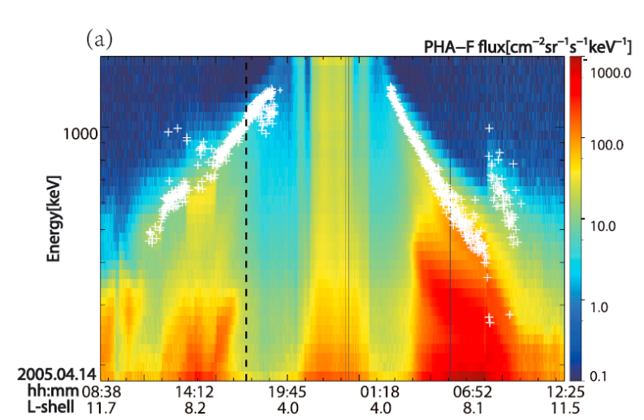
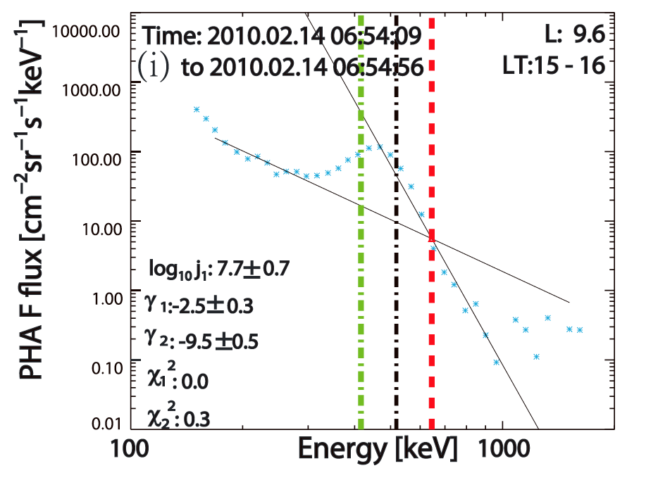

Spectral cutoff and/or “bump”
for local time stationary electrons (CDR)
$$f=\left\{\begin{aligned}j_{1}E^{γ_{1}},E<E_{C} \\ j_{2}E^{γ_{2}},E>E_{C}\end{aligned}\right.$$
Sun et al. (2019, GRL)
Notes:
Spectra double power law
PHA-F
Bump preference transport at CDR
5

Slide 6
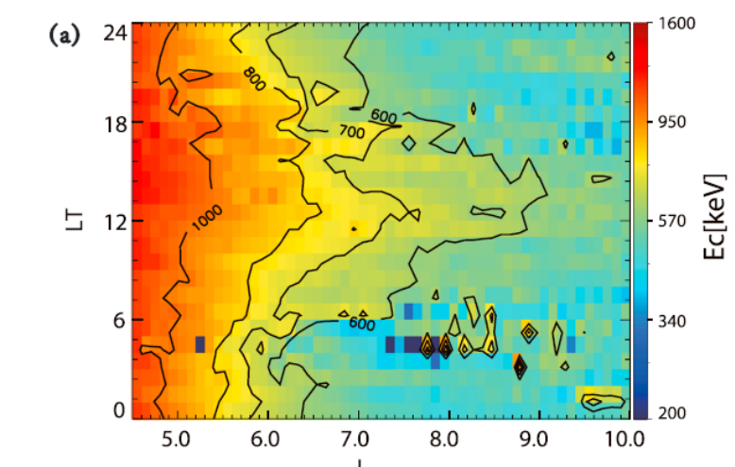
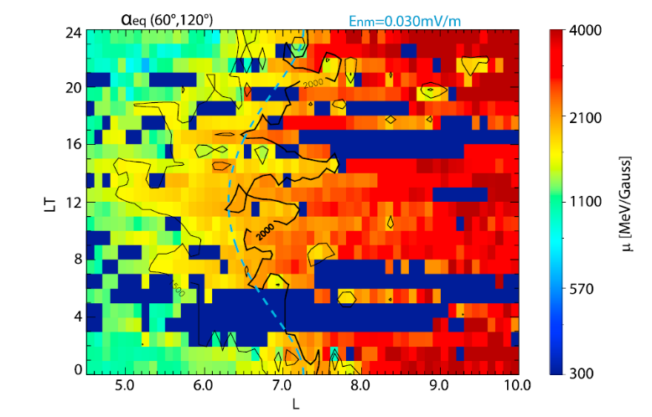
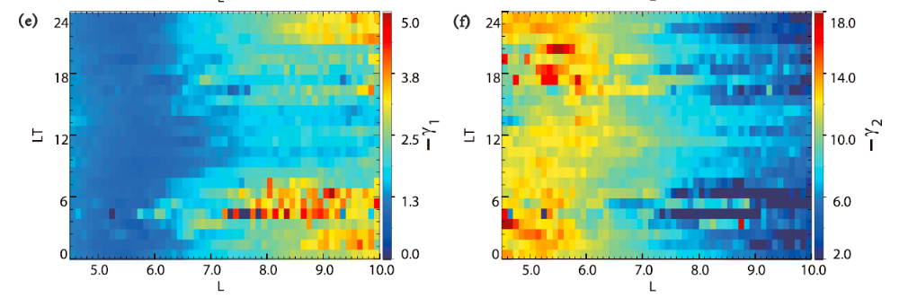
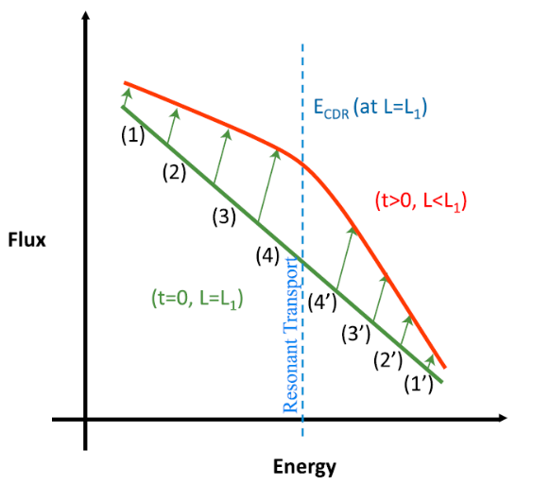
Spectra parameters local time asymmetry
Sun et al. (2019, GRL)
Notes:
Mechanisms shape the spectra index still unkown

Slide 7
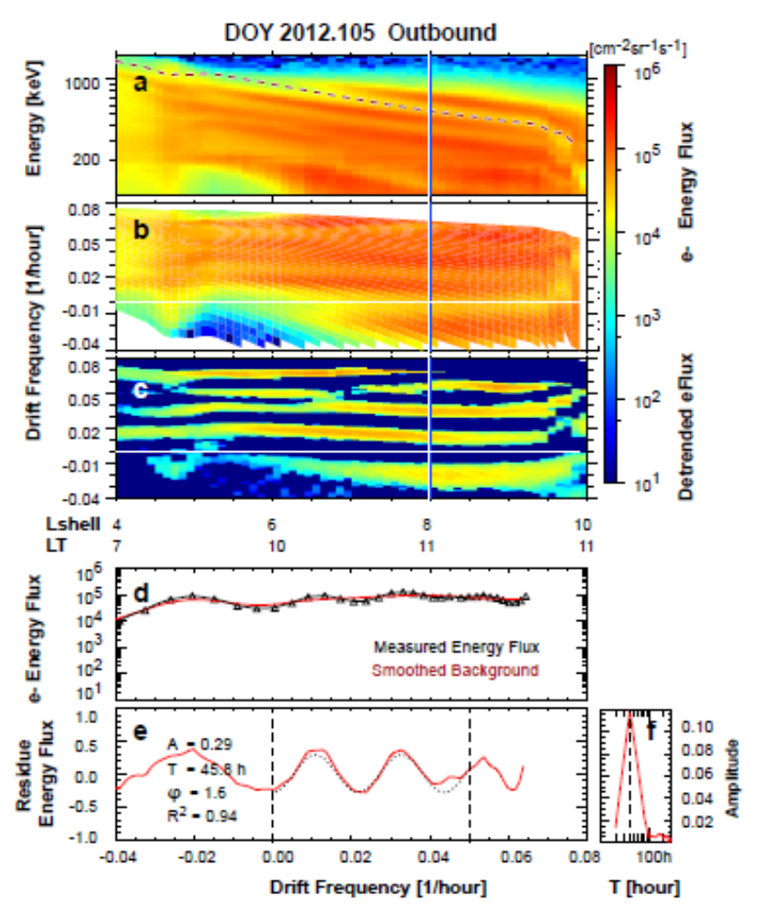
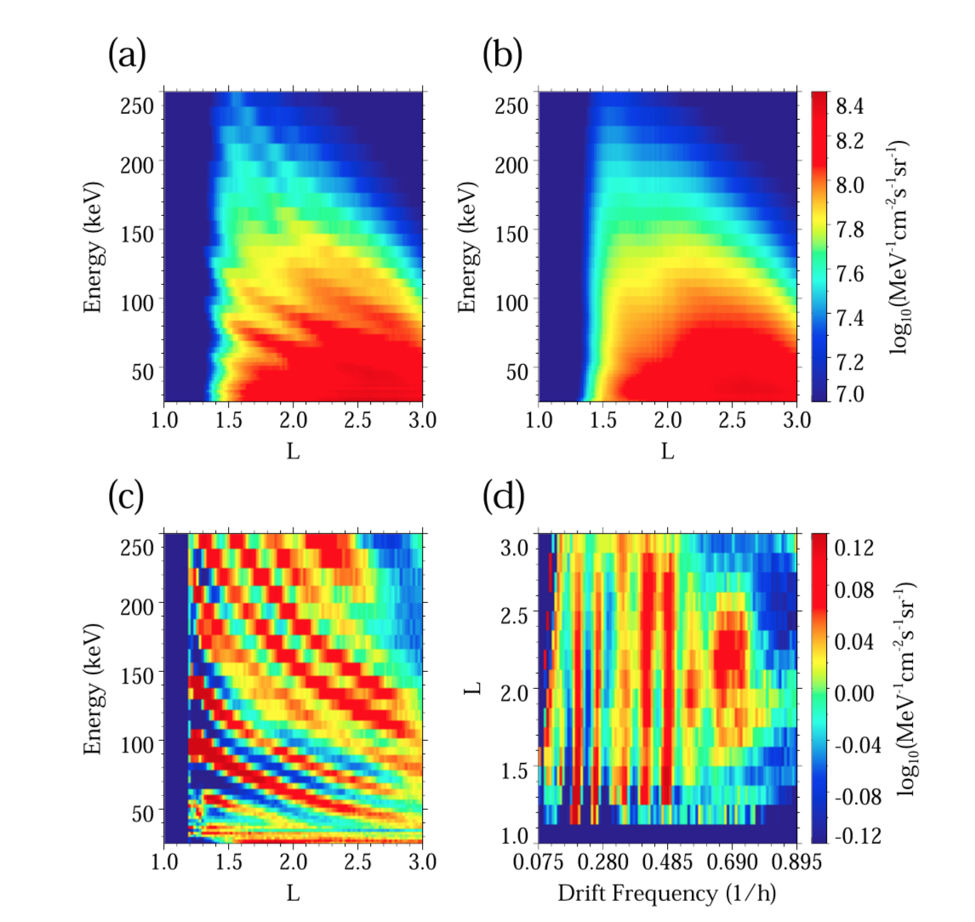
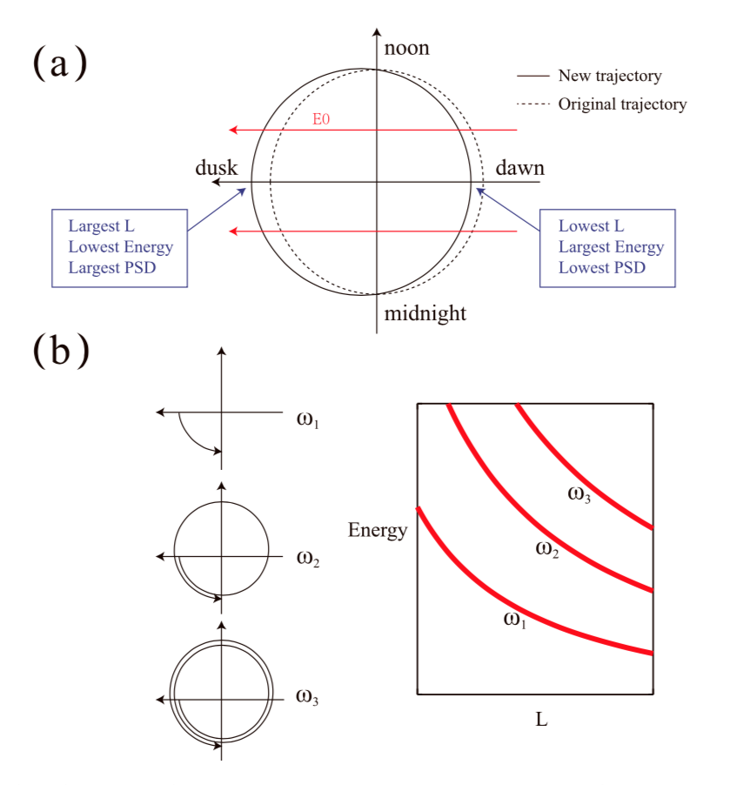
Zebra Stripes on Saturn
B
4<L<10 @Saturn
L<3 @Earth
Manuscript in preparation (Sun et al.)
[Ukhorskiy et al.,2014] [Liu et al.,2016]
Notes:
Basically it has been discussed 40 years at Earth. Frequency constant pattern
Assume a azimuthal symmetric psd, that is the orbit is circular. When electric field imposed, the drift trajectory distort, magnetic field pointing into the screen, noonward flow. Particles at midnight will drift inward, while at noon will outward. Finally a outward offset at dusk.

Slide 8



Sinusoidal Pattern
Monochromatic Electric Field
$E_{φ}=$ $E_{0}cos⁡(ωt−mφ+φ_{0})$
Phase Space Density Variation
$$f\left(μ,L,φ;t\right)=f_{0}\left(μ,L_{0}\right)≈f_{0}\left(μ,L\right)+{\frac{∂f_{0}}{∂L}|}_{μ}(L_{0}−L)$$
L shell Variation
$$\left(L_{0}−L\right)≈−\frac{L^{3}E_{0}}{B_{0}R_{S}\left(ω−mω_{d}\right)}[−\sin\left(−mφ+ωt+φ_{0}\right)+sin⁡(−mφ+mω_{d}t+φ_{0})]$$
$$f_{drift}=\frac{ω_{d}}{2π}=\frac{Ω_{corot}}{2π}−\frac{3γm_{0}β^{2}c^{3}L}{4πqB_{S}R_{S}^{2}}\frac{F(λ_{m})}{G(λ_{m})}$$
Notes:
W-mwd = 0 => resonance

Slide 9
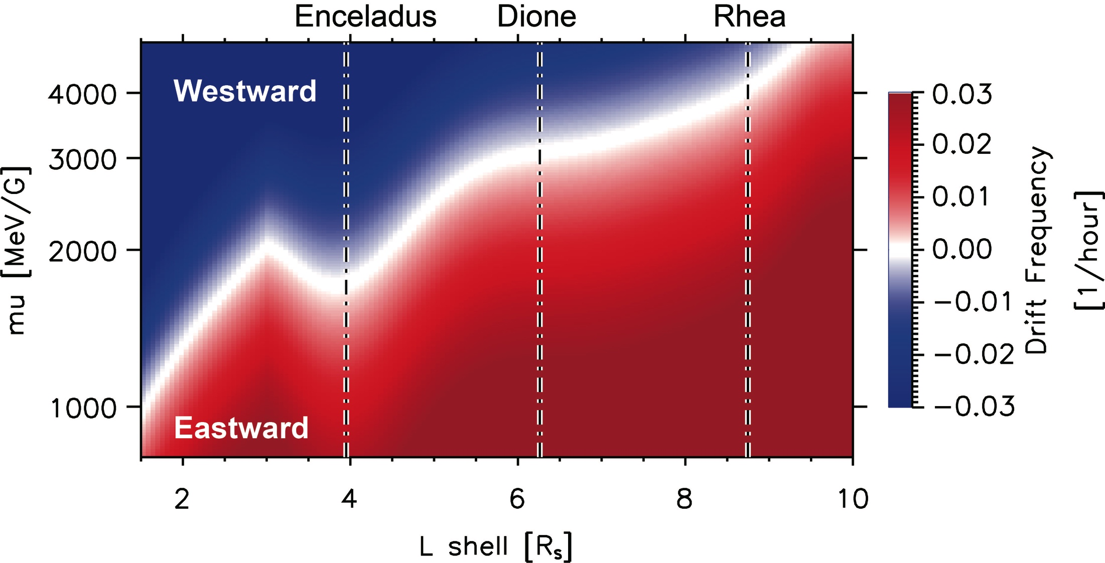
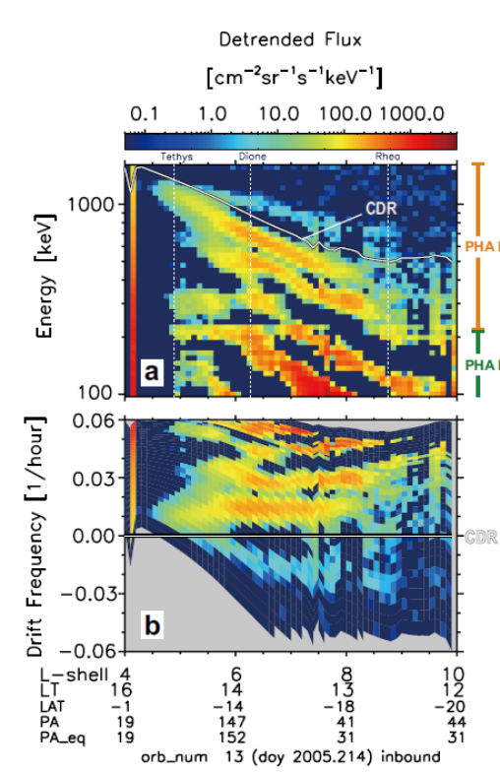
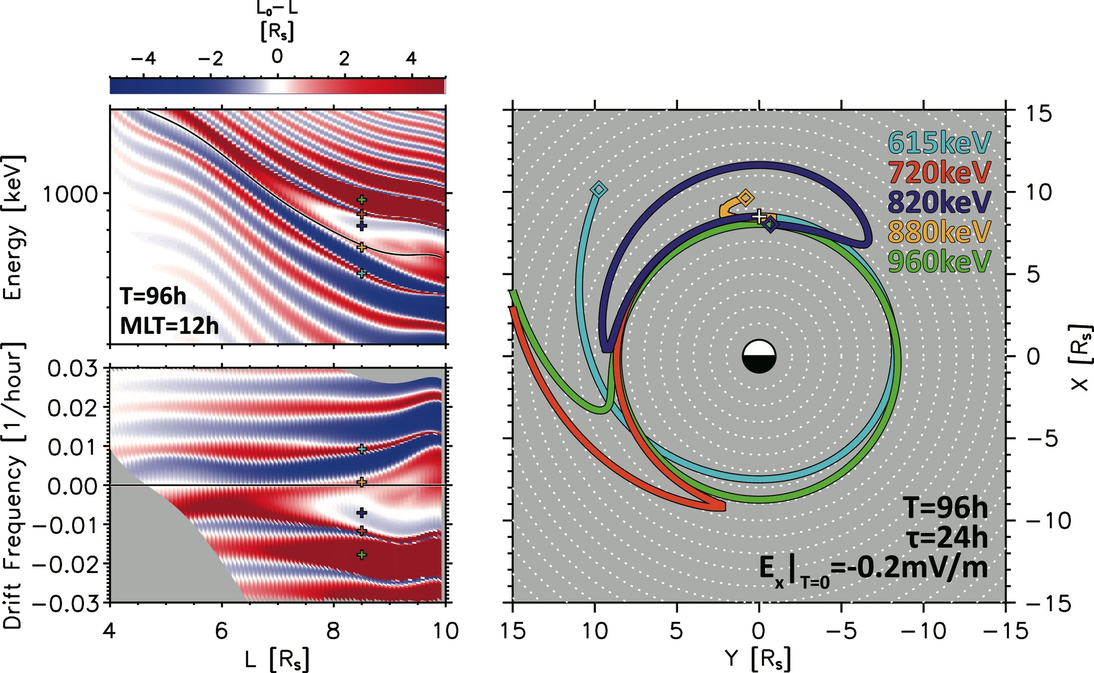
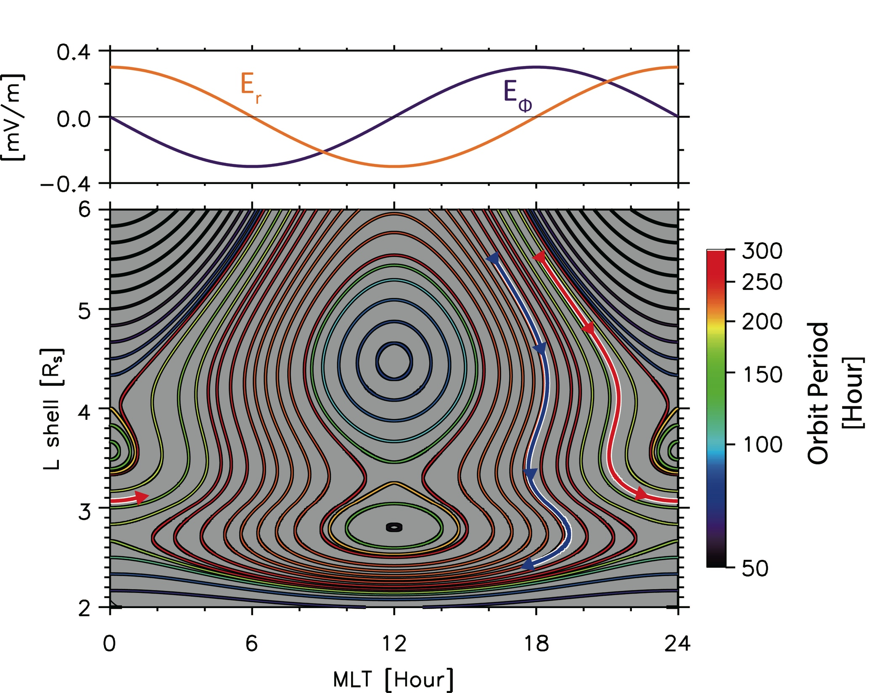
Mass Loading and Bifurcation
Manuscript submitted to NC(Hao et al.)

Slide 10



Statistics: Zebra Stripes Determination
$$p=Asin(2πTf_{d}−φ_{0})$$
$$R^{2}=1−\frac{\sum_{I}{{(p_{i}−\hat{p_{i}})}^{2}}}{\sum_{I}{{(p_{i}−\overline{p_{i}})}^{2}}}$$
$$N(R^{2 }≥0.5)≥20$$
Manuscript in preparation (Sun et al.)
Notes:
A residue energy flux

Slide 11
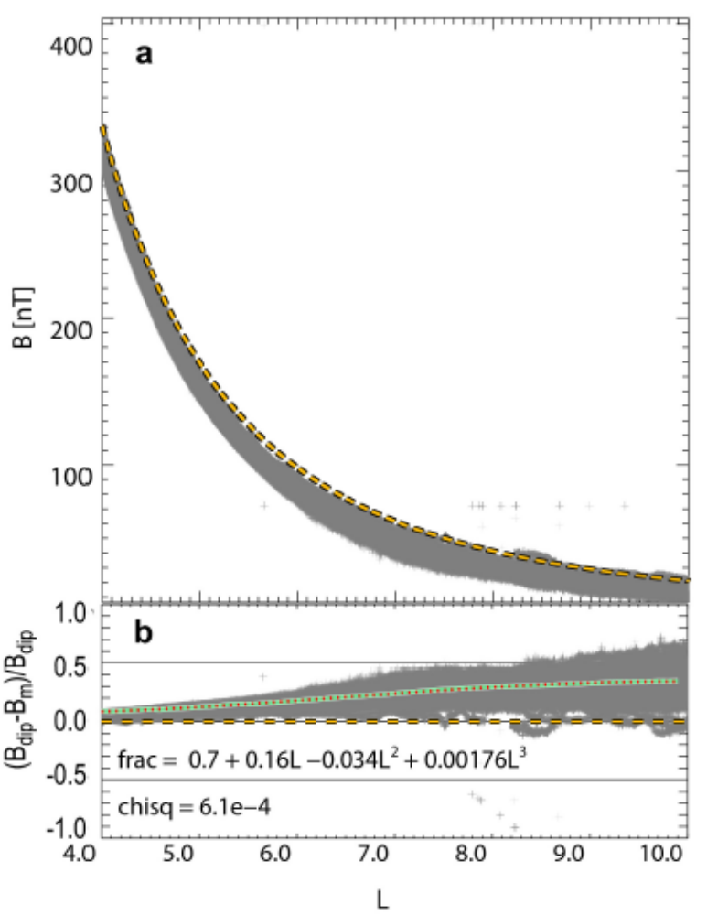



Dipole Field Modification
$$frac= \frac{B_{m}}{B_{dip}}=0.7+0.16L−0.034L^{2}+0.00176L^{3}$$
$$v_{mag}=\frac{1}{2}\frac{m}{qB^{3}}\left(v_{⊥}^{2}+2v_{∥}^{2}\right)B×∇_{⊥}B ∝ \frac{∇B}{B^{2}}$$
$$v_{mag}=v_{dip}/frac$$
Manuscript in preparation (Sun et al.)
Notes:
Inversely proportional to the strength of B
Frac in denominator

Slide 12
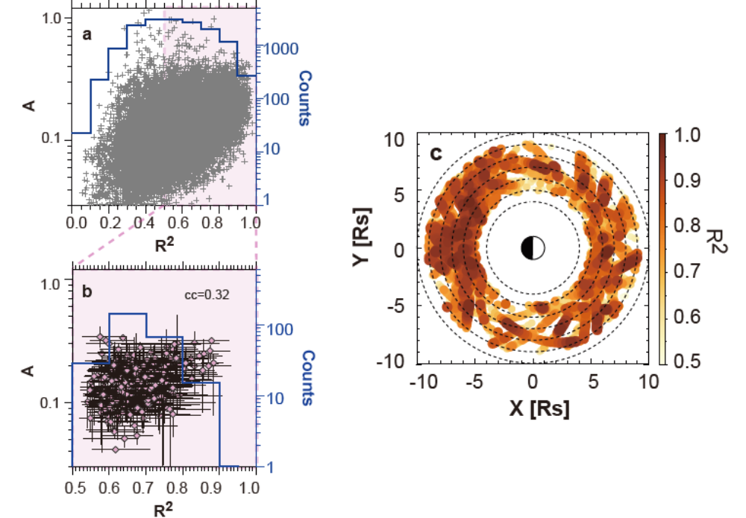
Ubiquity in Inner Magnetosphere
271 orbits
5<L<9
250 bounds selected
Manuscript in preparation (Sun et al.)
Notes:
Inbound and outbound legs
Evenly covered over Lshell and LT rather good R2 performance

Slide 13
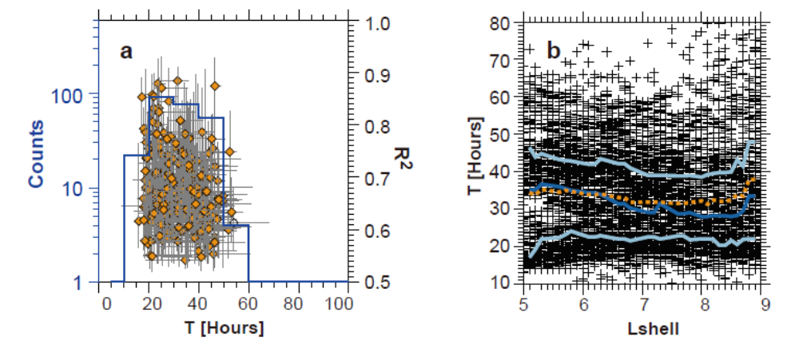
Time Scale
Life time ~ 50 h
Manuscript in preparation (Sun et al.)
Notes:
Lower limit: time needed for the stripe to be tight enough to fall into the range of detection
Upper limit: two possibility, too tight to be distinguish for the resolution, or overtaken by other mechanisms
T universe across such a broad L shell, suggesting the convection controls the whole region

Slide 14
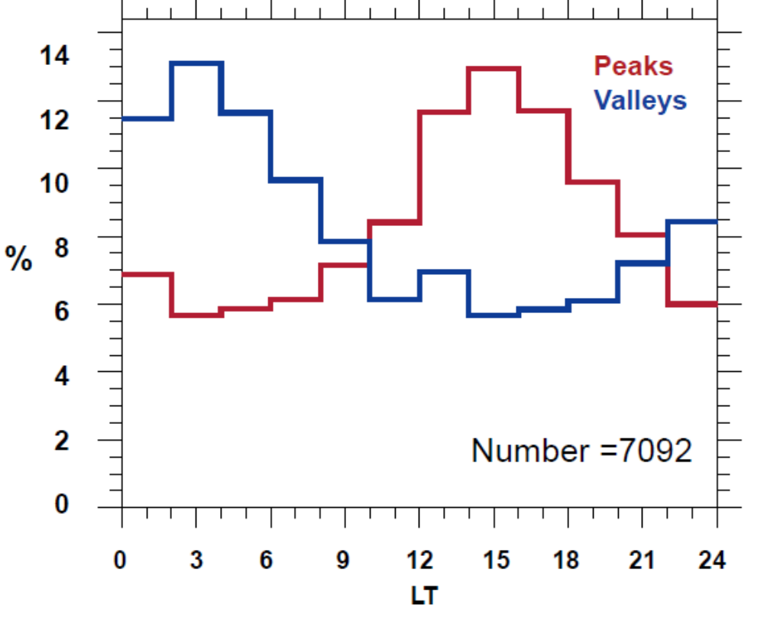
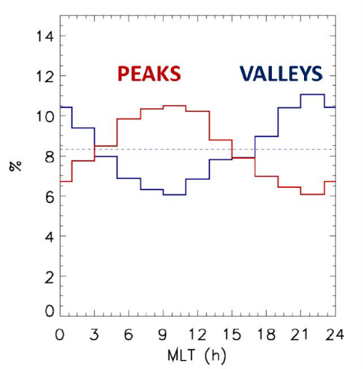
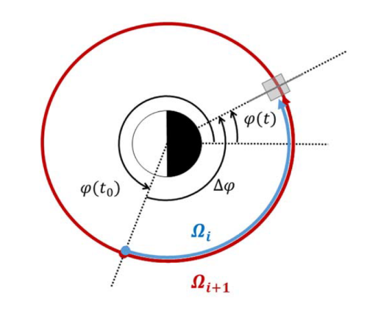
Hint on Convection Electric Field
[Liu et al.,2016]
Manuscript in preparation (Sun et al.)
[Lejosne et al.,2020]

Slide 15
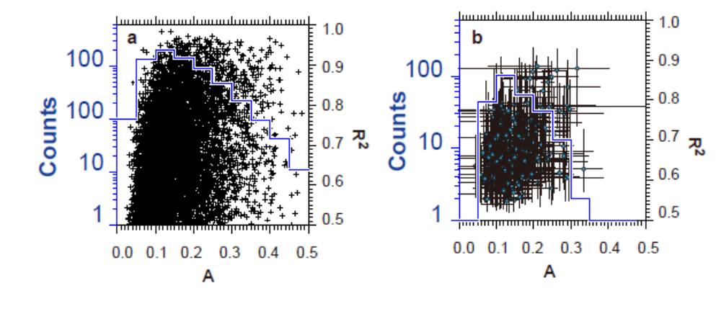

Contribution to Radiation Belt
$$f\left(μ,L,φ;t\right)=f_{0}\left(μ,L_{0}\right)≈f_{0}\left(μ,L\right)+{\frac{∂f_{0}}{∂L}|}_{μ}(L_{0}−L)$$
$$\left(L_{0}−L\right)≈−\frac{L^{3}E_{0}}{B_{0}R_{S}\left(ω−mω_{d}\right)}[−\sin\left(−mφ+ωt+φ_{0}\right)+sin⁡(−mφ+mω_{d}t+φ_{0})]$$
Manuscript in preparation (Sun et al.)
Notes:
E Variable and non-uniform

Slide 16
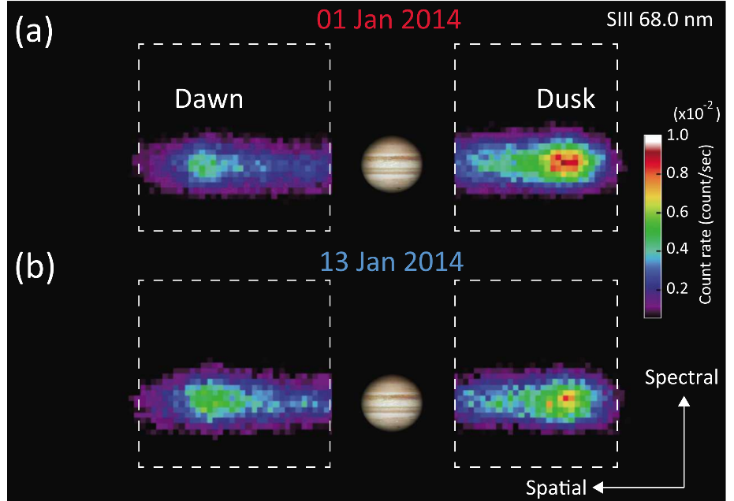
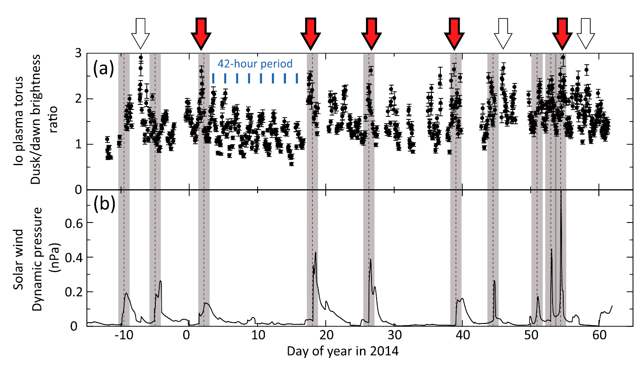
Convection at Jupiter: key signature
Dawn-dusk asymmetries in the UV emissions from the Io torus
IPT is offset 0.1–0.2 RJ toward the dawnside of Jupiter
→ dawn-dusk electric field heating electrons at dusk (Barbosa & Kivelson 1983; Ip & Goertz 1983; Murakami et al. 2016)
Electric field modulated by SW velocity
Radial distance range, exact pointing unknown
Never measured in-situ
Murakami et al. (2016)
Notes:
In addition, ground-based observations found that the radial position of the IPT is offset 0.1–0.2 RJ toward the dawnside of Jupiter
[Schneider and Trauger, 1995; Küppers and Jockers, 1997; Smyth et al., 2011].
In our result the mean value of dusk/dawn brightness ratio for the whole observation period is 1.5
eight drastic events with the dawn/dusk brightness ratio more than 2.5 for 70days, and five of eight events are related to SW dynamic pressure increase. by increasing the dusk emission and decreasing the dawn emission.
A dawn-to-dusk electric field can shift the position of IPT toward dawnside, and this shift results
in adiabatic heating at dusk and cooling at dawn, causing prominent dawn-dusk asymmetry in EUV emissions.
16

Slide 17
Convection at Jupiter: key signature
Dawn-dusk asymmetries in the UV emissions from the Io torus
IPT is offset 0.1–0.2 RJ toward the dawnside of Jupiter
→ dawn-dusk electric field heating electrons at dusk (Barbosa & Kivelson 1983; Ip & Goertz 1983; Murakami et al. 2016)
Electric field modulated by SW velocity
Radial distance range, exact pointing unknown
Never measured in-situ
Murakami et al. (2016)
Notes:
the existence of a dawn-dusk asymmetry of intensity tells us nothing about the component
of the electric field along the line of sight. [Jia et al., 2016] A noon-midnight component of the electric field would create noonmidnight
asymmetry in UV images, but such asymmetry cannot be detected from Earth [Thomas, 1993].
Spatial resolution 0.7Rj
The dawn-to-dusk electric field in the Earth’s inner magnetosphere can be generated by a
sunward convection flow in the Dungy cycle. However, as the equatorial magnetic field of Jupiter directs from
north to south, which is opposite to the Earth’s magnetic field, a flow down the tail is required in Jupiter’s
inner magnetosphere to generate the dawn-to-dusk electric field [Barbosa and Kivelson, 1983; Ip and
Goertz, 1983]. Recently, Delamere and Bagenal [2010, 2013] argued that the viscous interaction between
Jupiter’s magnetosphere and the solar wind is analogous to cometary mass loading; i.e., magnetospheric
plasma loss can be treated as mass pickup by the solar wind, and they suggested that this interaction can
significantly contribute to the tailward flow in Jupiter’s magnetosphere.
17

Slide 18
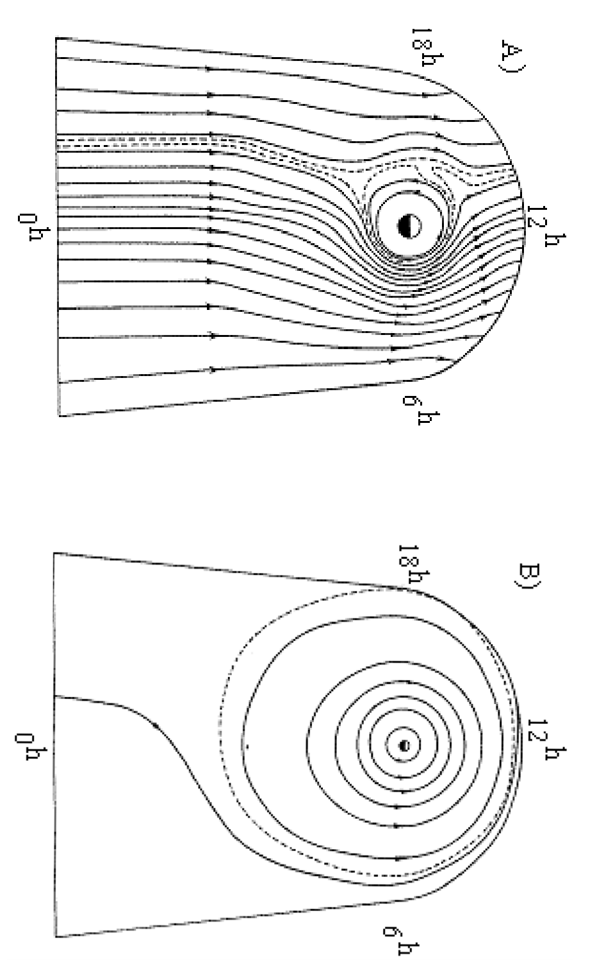
Comparing with corotation
 | Corotation electric field (mV/m) | Convective electric field (mV/m)
Saturn (L=5) | 8.2 | 0.3
Jupiter (L=6) | 150.0 | 3.8
Earth
Murakami et al. (2016)
Corotation electric field 30-40 times stronger than steady-state convection
Corotation dominating region => Similarity to Earth inner magnetosphere
Jupiter/
Saturn
Brice and Ioannides (1970)
Notes:
This scenario of global dynamics of cold plasma being controlled by the dawn-to-dusk electric field superposed on the corotation electric field seems to be similar to the Earth’s plasmasphere [Nishida, 1966].
18

Slide 19
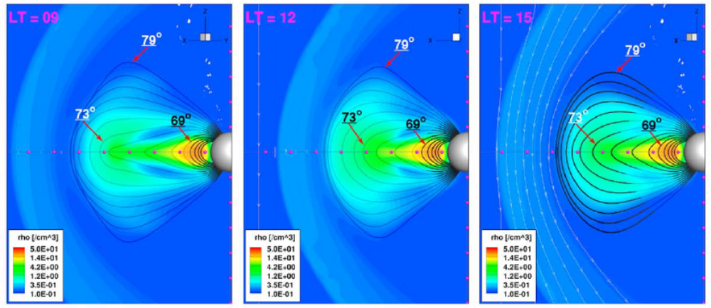
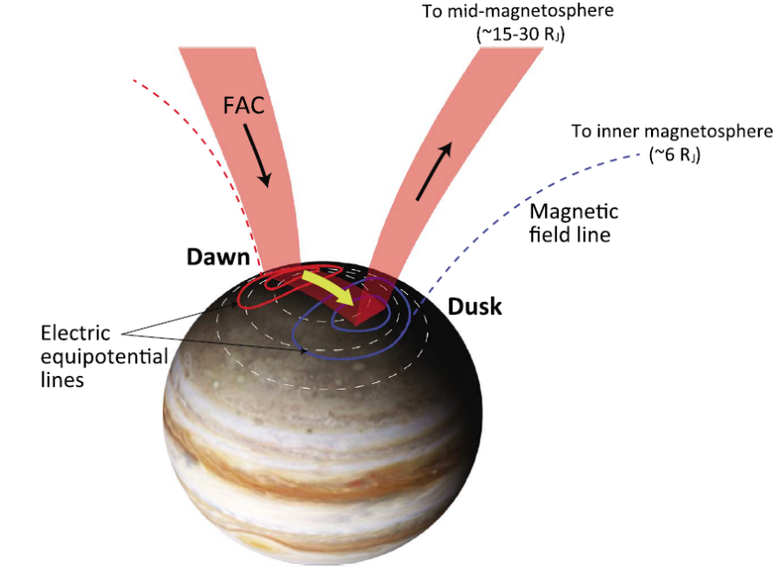
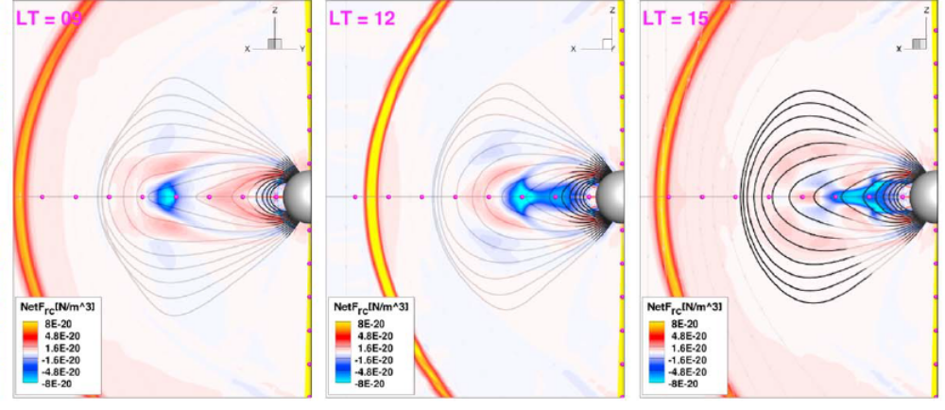
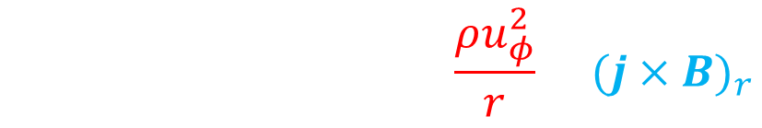
Possible Origin
B field distortion asymmetry
M-I Coupling
Goertz and Ip, 1984 Murakami et al. (2016)
$$ρu_{φ}\frac{∂}{r∂φ}u_{r}≅−∇_{r}p+\frac{ρu_{φ}^{2}}{r}+{(j×B)}_{r}$$
Jia and Kivelson. (2016)
Notes:
Kivelson:As plasma rotates from dawn to noon on a dipolarizing flux tube from the effects of magnetopause confinement, it flows away from the equator along the flux tube, the pressure gradient force continues to resist compression. Irreversibility of plasma expansion and contraction along flux tubes is the source of the asymmetry. Correspondingly, the plasma sheet remains far thicker and the field less stretched in the afternoon than in the morning. Different radial force balance in the morning and afternoon sectors produce a net dusk-to-dawn flow inside of L = 15 or equivalently, a large-scale electric field (E) oriented from postnoon to premidnight,
Within 17 RS, the pressure gradient force is weak and varies little with LT. The strong (outward) centripetal term dominates in
the morning sector (see Figure 3b) and results in outward flow. The inward j × B force dominates in much of
the afternoon sector and produces inward acceleration sufficient to reverse the direction of radial flow.
Murakimi: An azimuthal current at the equatorial disk in Jupiter’s middle magnetosphere (~15–30 RJ)
emerges due to the distortion of the dipolar magnetic configuration imposed by rotating heavy plasmas from
Io [e.g., Cowley and Bunce, 2001]。Due to the solar wind dynamic pressure, the magnetic field lines are compressed on the dayside
and extended on the nightside. Resulting nonaxis-symmetric modulation to the equatorial current system causes divergence of the azimuthal current yielding FACs that connect the magnetosphere with the ionosphere.
According to this explanation, the solar wind with higher dynamic pressure causes stronger FACs.
The interaction with the solar wind causes FACs flow into the ionosphere at dawn and flow away from the
ionosphere at dusk. As shown in Figure 4, horizontal closure of this FACs in the ionosphere requires an
additional electric potential pattern to be set up. The potential contour can be envisaged by setting positive
charge at the downward FAC region and vice versa. Then the newly generated electric field at low latitude in
the ionosphere is mapped to the inner magnetosphere as the dawn-to-dusk electric field.

Slide 20
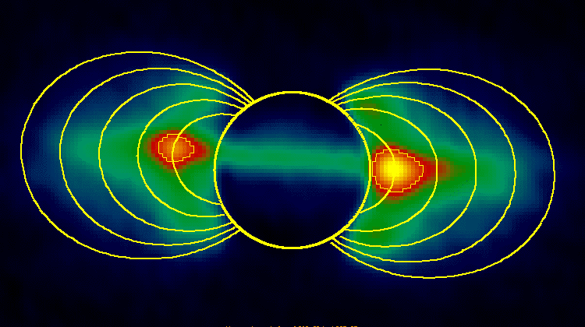
Conclusion and Open Questions
Magnetospheric convection supply and shape electron Radiation Belt.
Nearly half of Cassini's orbits have seen Zebra Stripes between L shell 5 and 9.
Quantitative analysis confirms Zebra Stripes a global and fast developed pattern.
Tracing back indicates a post-noon to post-midnight convection electric field.
Quantify the contribution to RB ?
Compare planetary study to Earth inner magnetosphere
Electric field origin @ Saturn Endogenous or External ?
Convection direction @ Jupiter N-M or D-D?
Jupiter
NASA/JPL/Caltech.
sunyixin@pku.edu.cn Thanks!(●’◡’●)
Notes:
This scenario also implies that dawn-to-dusk electric field under the influence of the solar wind can exist
inside of the Io’s orbit, even in the Jupiter’s radiation belt region (<3 RJ). The dawn-dusk asymmetry of
Jupiter’s synchrotron radiation has been known and has been explained in terms of the dawn-dusk potential
gap of the dynamo electric field induced by the diurnal wind at Jupiter’s upper atmosphere

