Slide 1
Future water supply and Demand in the Peruvian Andes: Assessment and implications
Geography and Environmental Science
Professor Andrew Wade (University of Reading, UK)

Slide 2
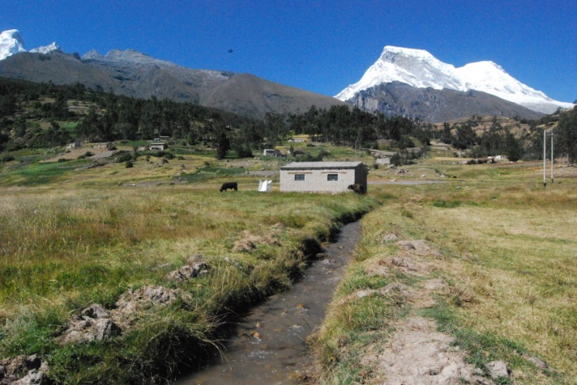
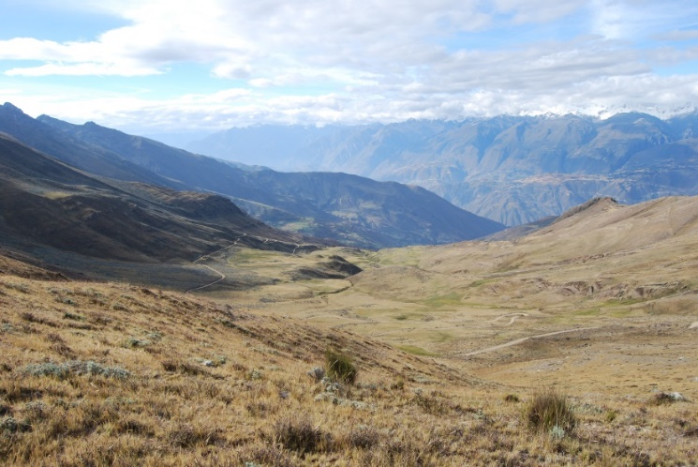
Overview
Aim: to understand how climate change will impact water availability, farming (lives and livelihoods) and local communities in the Peruvian Andes – (as a precursor to understanding adaptation)
Based on water balance, ethnographic and archaeological study
Detailed, nuanced study of four catchments and their communities
Present-day water gap in Rio Ancash determined
Future demand assessed
Next step: to assess future water availability (melt, lake release)
Cordillera Blanca
Cordillera Negra

Slide 3
Co-authors
Dr Harvey Rodda (Hydro-GIS Ltd, UK)
Professor Nick Branch (University of Reading, UK)
Marcos Bruzzone (Water Resource Associates, UK)
Dr Alex Herrera ( Universidad de los Andes - Colombia)
Dr Francisco Araujo-Ferreria (University of Reading, UK)
Dr Frank Meddens (Pre-Construct Archaeology Ltd, UK)
Douglas Walsh (Asociación Andina Cusichaca, Peru)
Dr Kevin Lane (Universidad de Buenos Aires, Argentina)

Slide 4
AIM
To understand how climate change will impact water availability, farming (lives and livelihoods) and local communities in the Peruvian Andes – (as a precursor to understanding adaptation)
Cordillera Blanca
Cordillera Negra

Slide 5
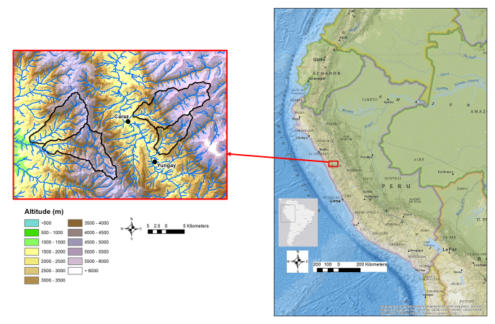
Study areas
Pamparomas
Rio Llullán
Rio Ancash
Chorrillos Valley

Slide 6
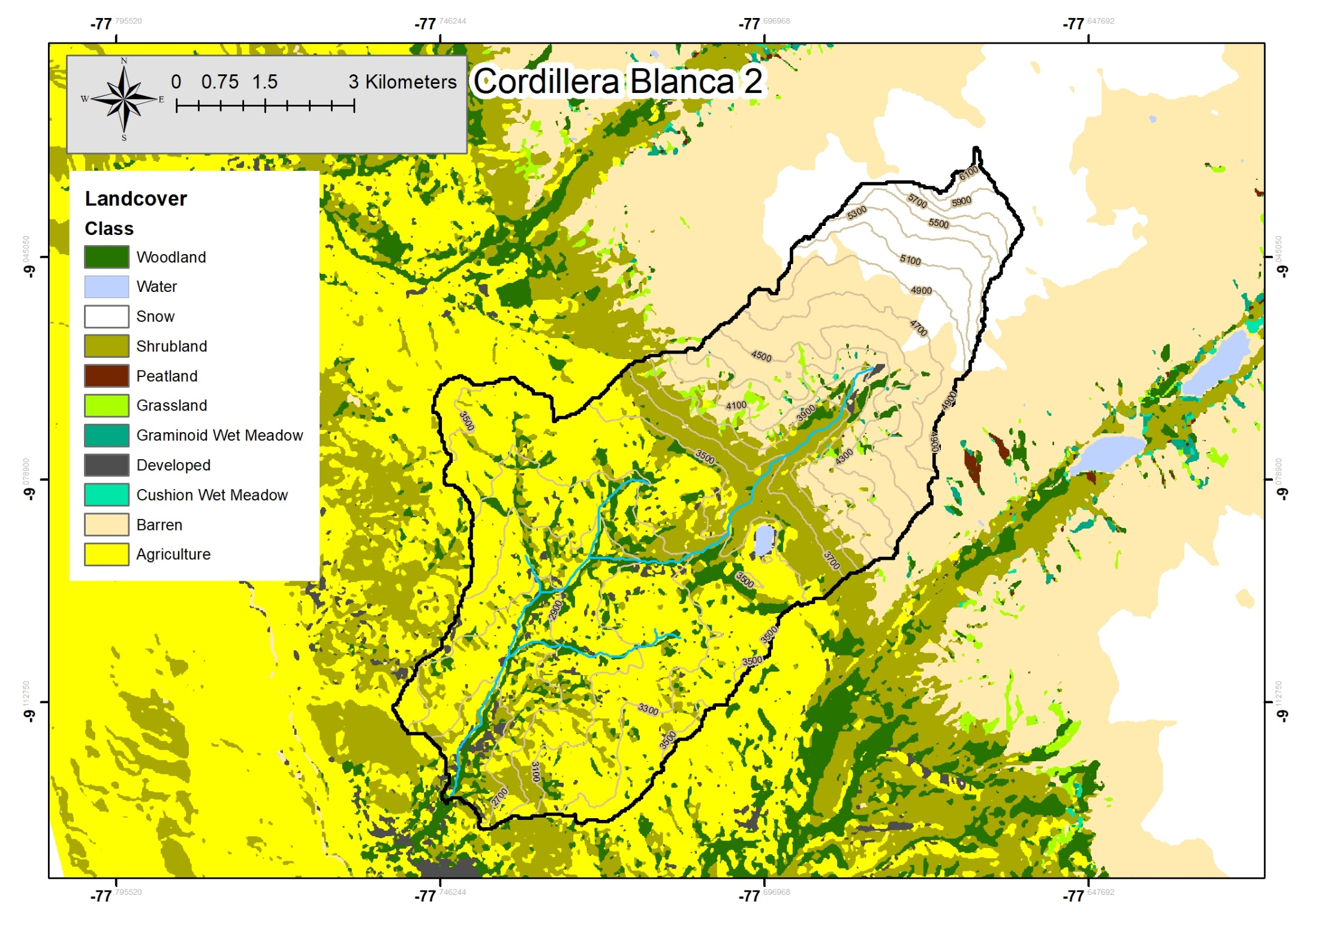
Rio Ancash

Slide 7
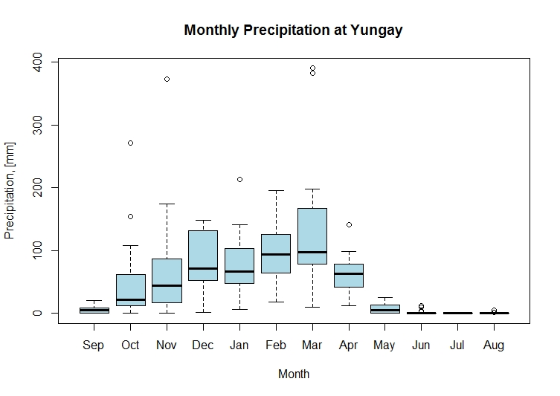
Variation in Precipitation
SENAHMI. Data from 01.09.1995 to 31.08.2014

Slide 8
Research questions
Is there sufficient water to sustain farming presently in the:
wet season?
dry season?
How will the water supply and demand change in the future (next 100-200 years), and what will the impact be on lives and livelihoods?
Can adaptation strategies be co-developed with local communities to address water availability (and quality) issues?

Slide 9
Methodology
Asses water supply
Precipitation
River and lake outflows
Irrigation flow (modern and ancient)
Groundwater (springs), Wetlands (store and release)
Done by flow gauging and isotopes, and historic data collation
Asses water demand
Cropwat
Done through crop area and cropping pattern assessment
Collation of weather data
Iterative procedure to discuss findings with local communities, both from water balance study but also other challenges highlighted by ethnographic study, and co-develop adaptation strategies.

Slide 10
Assessing Supply

Slide 11
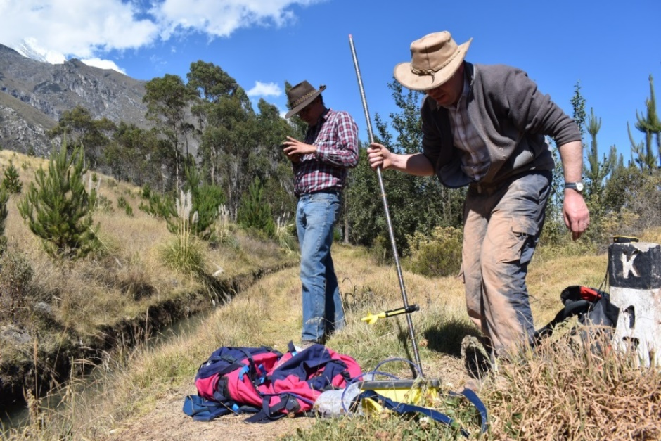
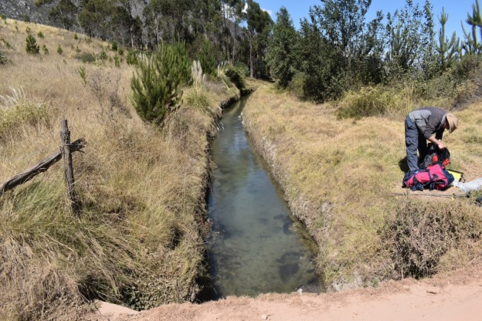
Flow gauging – Irrigation Canals
Llanganuco irrigation canal – Photos: Frank Meddens
Velocity-area gauging

Slide 12
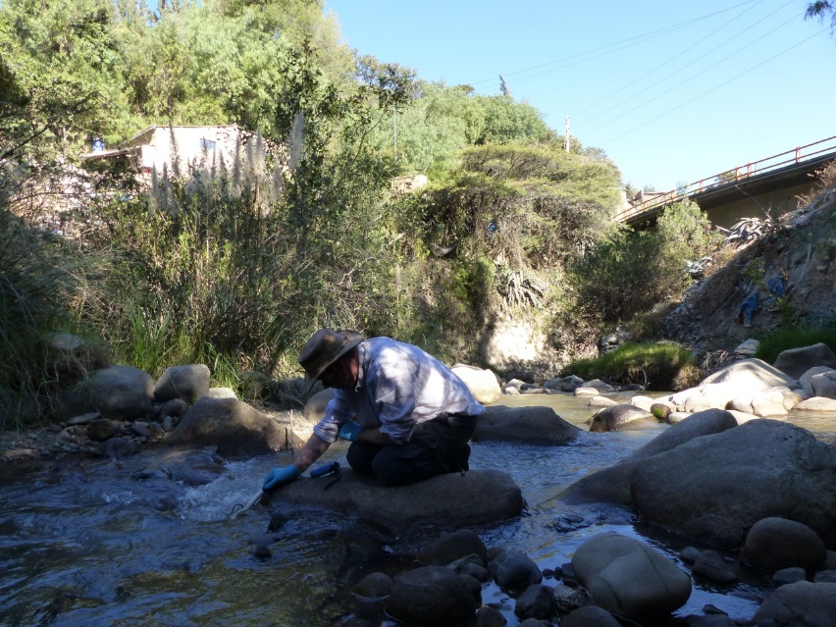
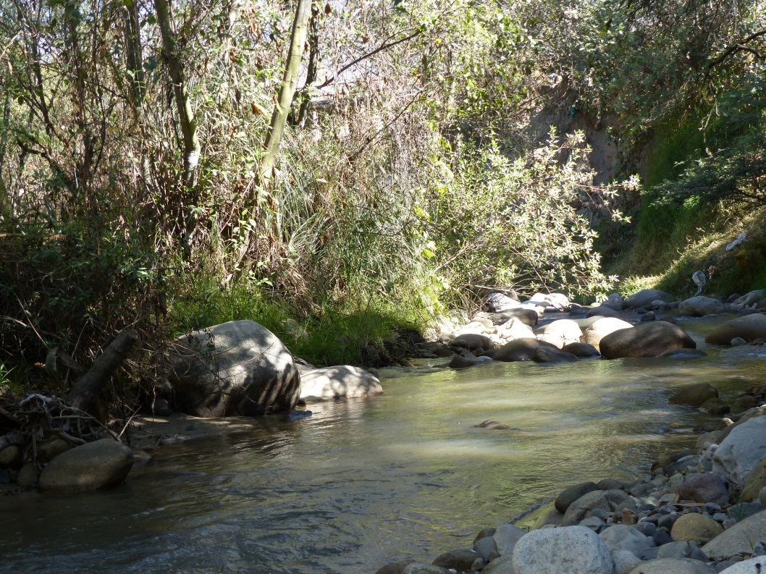
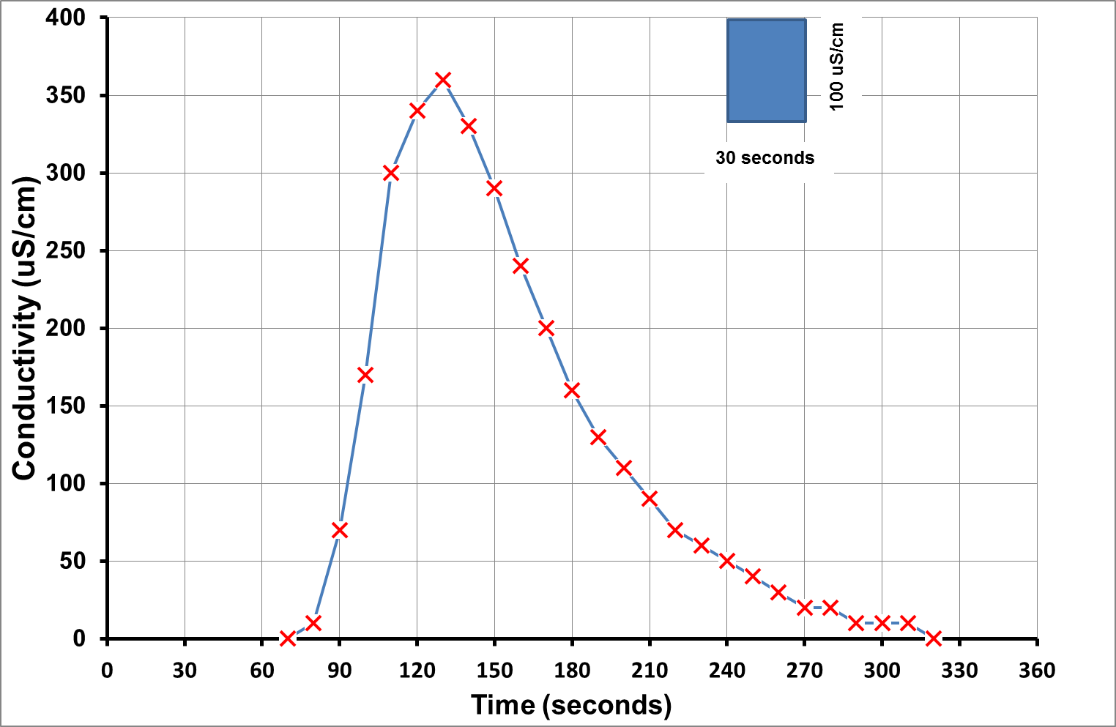
Flow gauging – RIO AnCASH
Rio Ancash– Photo: Frank Meddens
Dilution gauging

Slide 13
Assessing DEMAND

Slide 14
CROPWAT
Dry season irrigation requirements
Inputs
Precipitation
Air temperature
Sunshine hours
Relative humidity
Wind speed
Crop and crop co-efficients
Soil moisture and infiltration
Crop water demand

Slide 15
Preliminary results

Slide 16
Preliminary results
Catchment | Area (km²) | Crop Area (km²) | Total Crop Water Requirement (m³/day) | Maximum Available Irrigation Water (m³/day)
Present day | 137.5 | 26.2 | 48,900 | 30,900
Climate change | 137.5 | 26.2 | 52,160 | To be determined in next phase

Slide 17
Conclusions
Precipitation (wet season) and inundation irrigation are main ways to supply crops with water
Groundwater/springs and seeps from wetlands are used, but these sources are very localised
There is a water gap in the Rio Ancash in the dry period, as the crop water demand is only partially satisfied by the available irrigation water.
The CROPWAT Climate Change simulation in the Rio Ancash shows an increase in effective rainfall but this does not off set the larger increase in crop water requirements due to higher air temperatures, so irrigation requirements will become higher.

Slide 18
Next steps
Complete present-day water balance, and that under climate change
Consider different climate change scenarios and climate variability
Merge results with those from ethnography work to nuance understanding of key challenges.
Consider how glacial melt and lake levels will change over time, and the impact on water availability
Explore the water quality data collected
Under a new, follow-on project called CROPP led by Joy Singarayer (Reading) consider climate variability further, impacts on montane biodiversity, and further integrate hydrological and ethnographic research.

