Slide 1
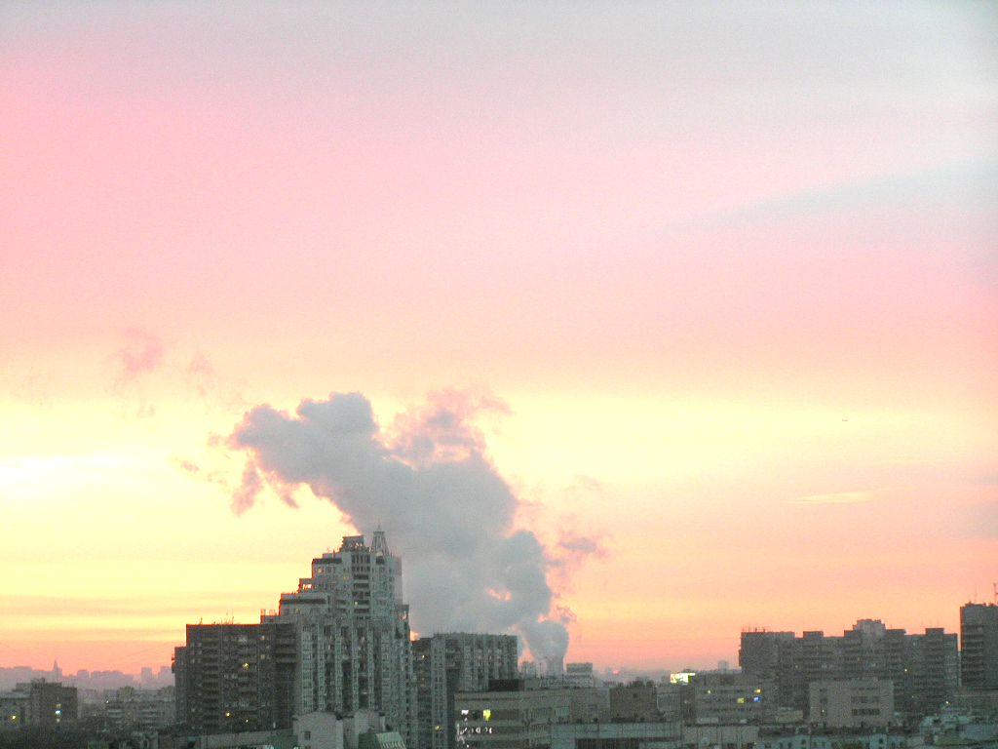
Urban aerosol in Moscow megacity and its radiative effects according to the AeroRadCity experiment and COSMO-ART modelling
Nataly Chubarova¹, Elizaveta Androsova¹, Alexander Kirsanov², Elena Volpert¹, Bernhard Vogel³,Heike Vogel³, Olga Popovicheva¹, Irina Eremina¹, and Gdaly Rivin^{1,2}
1 - Moscow State University, 119991, Moscow, Russian Federation (natalia.chubarova@gmail.com),
2 - Hydrometeorological Centre of Russia, 11-13, B. Predtechensky per., Moscow, 123242, Russia
3 - Karlsruhe Institute of Technology, Karlsruhe, Germany
May 4-8th, EGU General Assembly 2020, PEEX Special Session

Slide 2
Outline:
AeroRadCity experiment: aerosols and their gas-precursors.
Aerosol radiative effects.
Assessment of the urban aerosol component.
Characterization of aerosol wet deposition.

Slide 3
The Moscow AeroRadCity experiment, 2018-2019.
For understanding the physical processes of generating different aerosol types, their relationship with gas-precursors and their consequences for solar irradiance an intensive measurement campaign has been carried out in spring 2018, and 2019 at the Meteorological Observatory of Moscow State University (MO MSU).

Slide 4
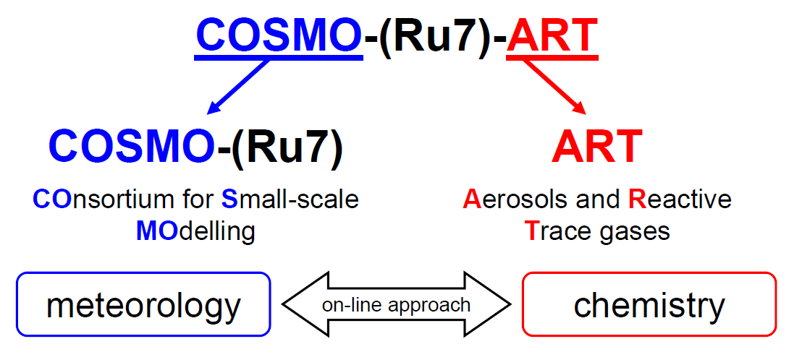
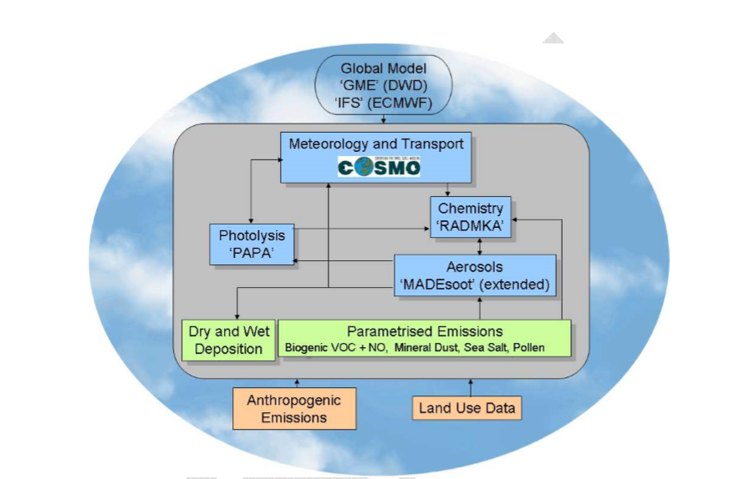
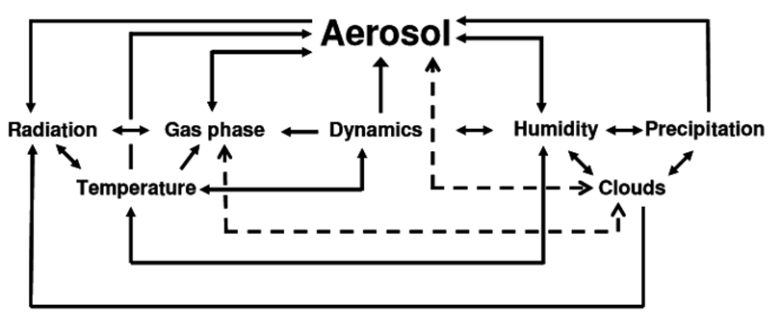
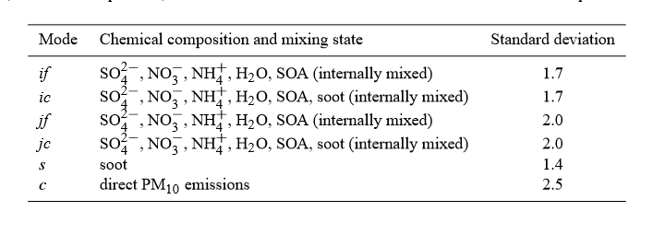
COSMO-ART model:
COSMO-Ru7-ART is the system for operational pollutant concentration forecast for the Moscow region
B. Vogel, et al. ACP, 2009
Vil’fand et al., 2017

Slide 5
Variability of different aerosol characteristics AOD500, AOD coarse/total ratio, PM10(mgm⁻³), Black Carbon (BC, mkgm⁻³), and Intensity of Particle Dispersion (IPD, in black) for quasi-homogeneous synoptic periods. 2018-2019.
IPD evaluation according to Kuznetsova et al., 2014

Slide 6
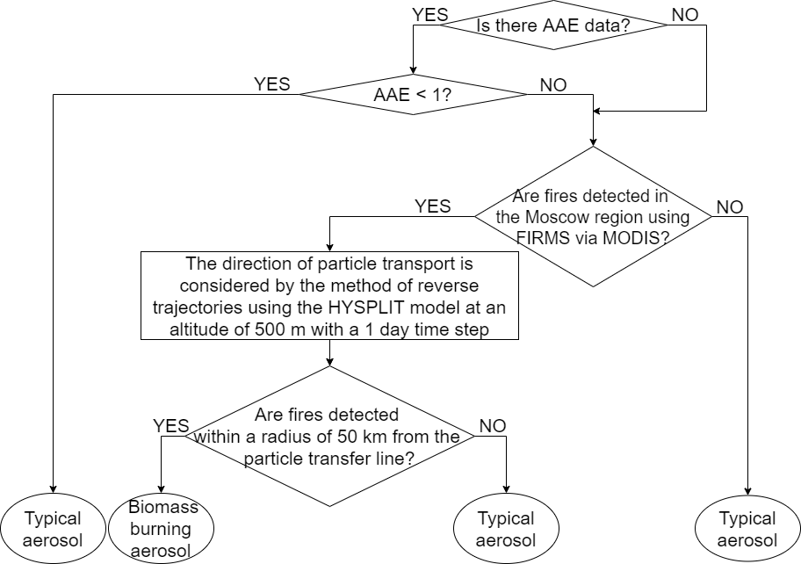
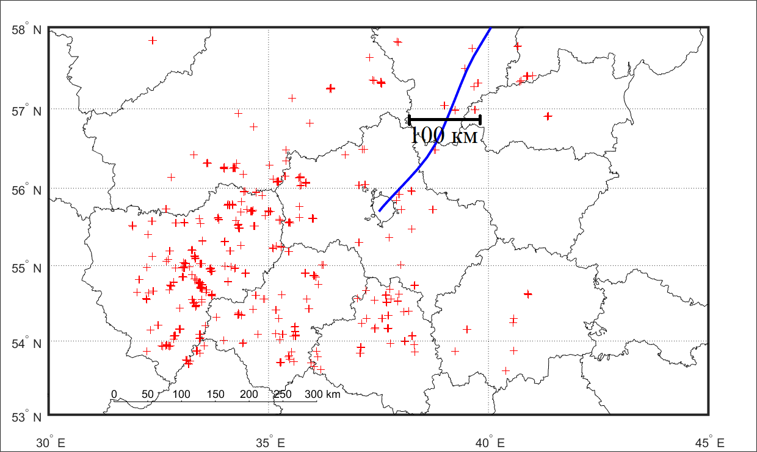
How to avoid Biomass burning (BB) aerosol?
backward
An example on advection of BB aerosol 29.04.2019
AAE – Angstrom Absorption Extinction parameter 440-870nm from CIMEL sun photometer

Slide 7
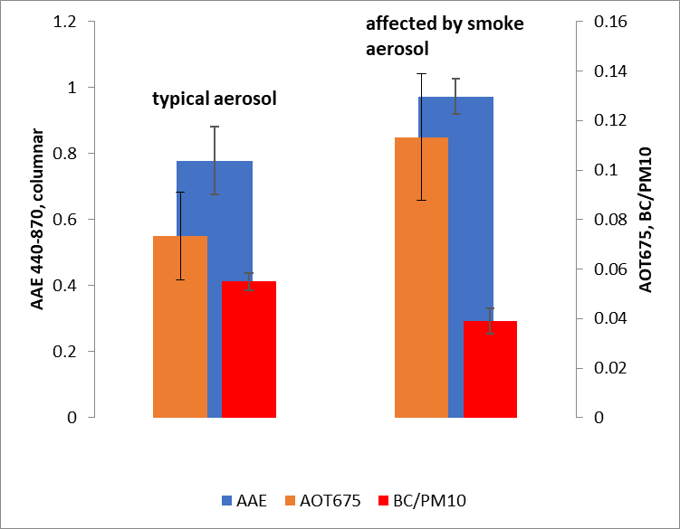
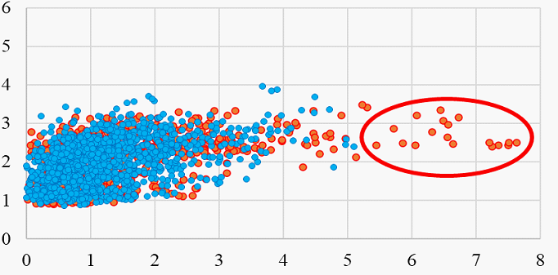
Mean ААЕ (Angstrom absorption exponent 440-870), АОТ675, BC/PM10 ratio for conditions with typical and affected by smoke BB aerosol
Advection of BC from the biomass burning sources
Notes:
10% significant level

Slide 8
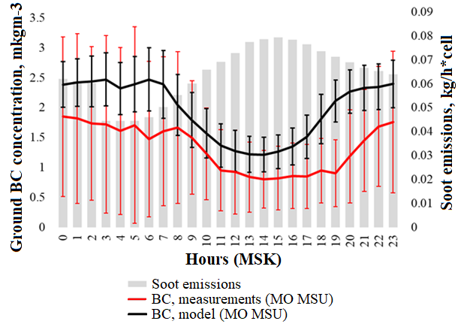
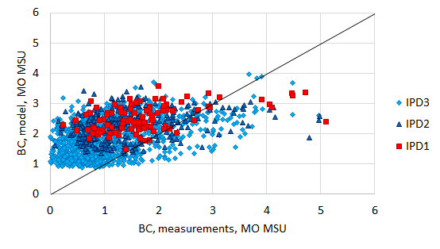
Black carbon aerosol: comparisons between model and measurements
IPD1 – very stable atmosphere
IPD2 - intermediate
IPD3 – unstable atmosphere
Notes:
Суточный ход приземных концентраций BC по данным измерений за период 2018-2019 гг. и данным моделирования с помощью модели COSMO-ART, а также эмиссий предшественников BC по данным TNO2010.

Slide 9
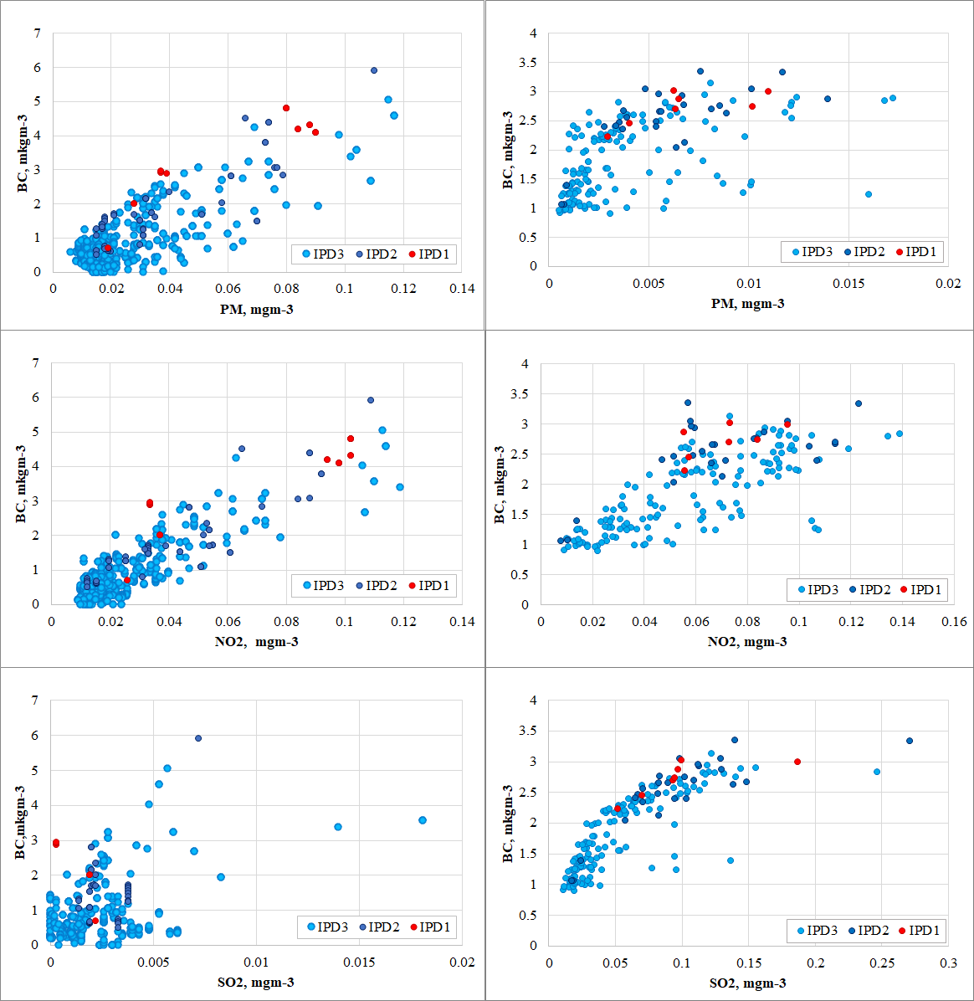
Measurements Modelling
Measured and modelled mass concentrations of Black carbon (BC) versus PM, NO₂ and SO₂ at different Intensity of Particle Dispersion (IPD) levels
An existing correlation between BC and NO₂ concentrations due to same source of traffic emissions.
No correlation between measured BC and SO₂ due to extremely low SO₂ concentrations in Moscow in contrast with modelled data.
BC = 35.986 * PM10 + 0.1114 (R = 0.63)
BC = 67.19 * NO + 0.7301 (R = 0.69)
BC = 35.495 * NO₂ + 0.1745 (R = 0.7)
Notes:
No effects of biomass burning cases. 2018-2019. 3-hour modelling results only for days with measurements.

Slide 10
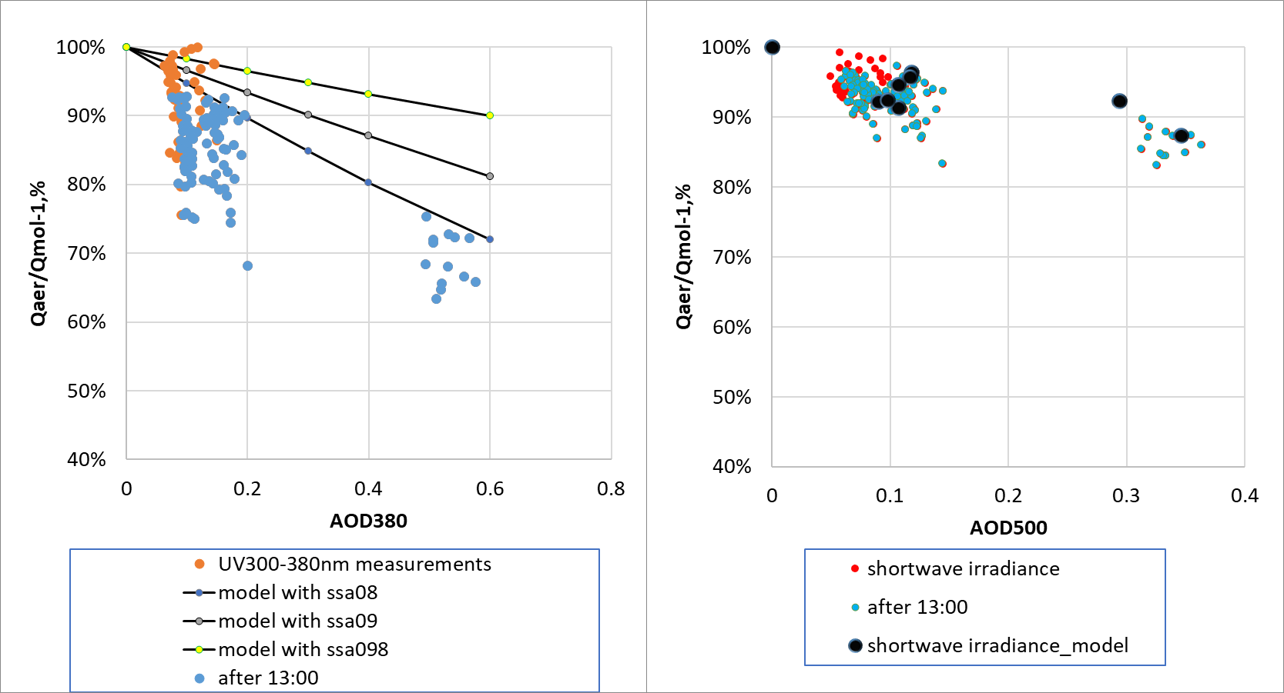
The dependence of normalized on molecular atmosphere UV (left) and shortwave (right) irradiance on aerosol optical depth according to observations and radiative transfer DISORT model. Clear sky conditions.
Radiative effects:
SSA=0.98
SSA=0.9
SSA=0.8
Chubarova et al., 2019

Slide 11
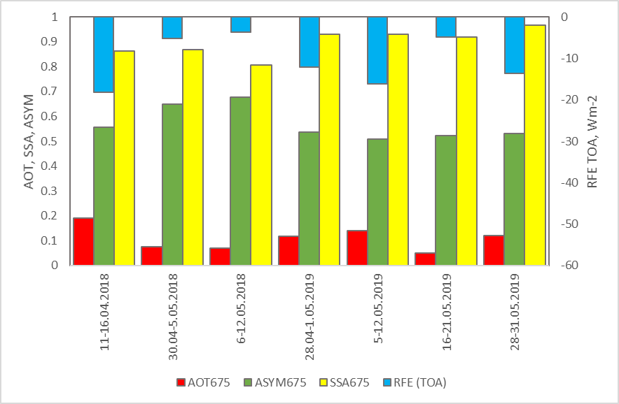
Radiative effects:
Aerosol radiative forcing effect (RFE) at the top of the atmosphere and aerosol characteristics in clear sky conditions during the experiment.
-3Wm-2
ASYM- aerosol asymmetry factor,
SSA – single scattering albedo,
AOD675 – aerosol optical thickness at 675nm
-18 Wm-2

Slide 12
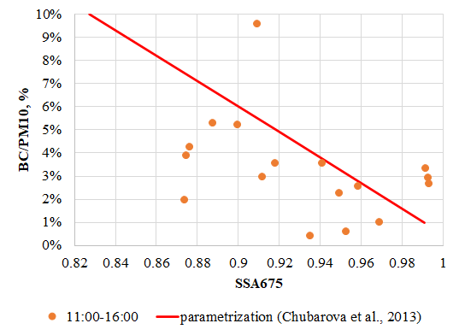
Single scattering albedo as a function of BC/PM10 only in well mixing conditions

Slide 13
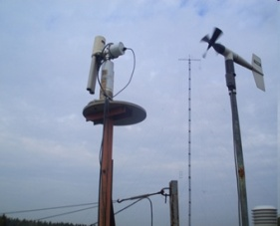
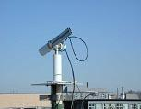
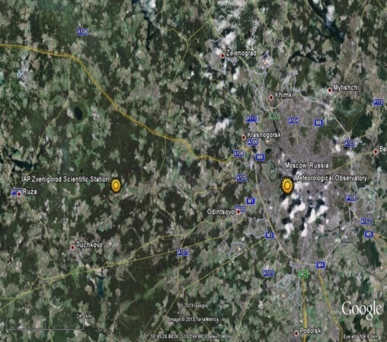
Urban aerosol pollution in Moscow as seen from the difference in aerosol between Moscow MSU MO and background conditions
Zvenigorod Moscow
(ZNS at the IAP RAS) ( MO MSU)
55 km distance;
upwind location of the background site;
same calibration;
3 minute of time difference.

Slide 14
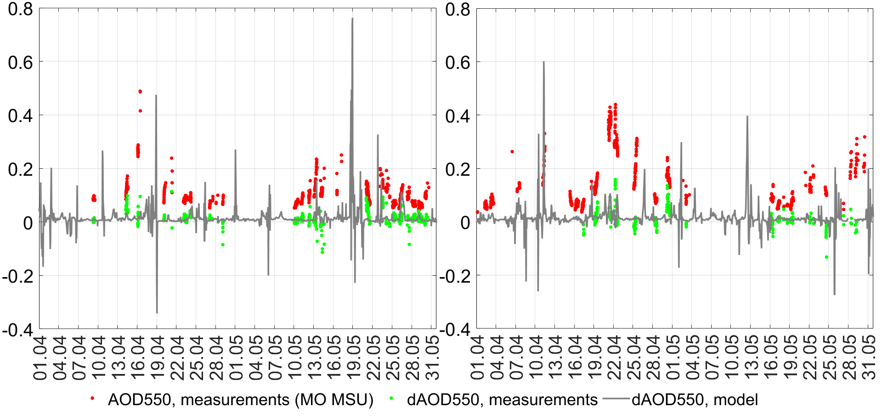
Time series of the observed and modelled AOD difference between Moscow and background conditions ( in Green and Grey color) and observed AOD in Moscow (in Red). 2018-2019. All sky conditions.
Too effective urban aerosol generation!
Compare GREY line with Green dots
2018 2019

Slide 15
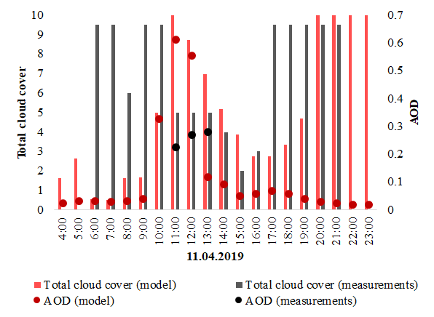
Diurnal cycle of cloudiness and aerosol optical thickness according to measurements and modelling. 11.04.2019.
urban

Slide 16
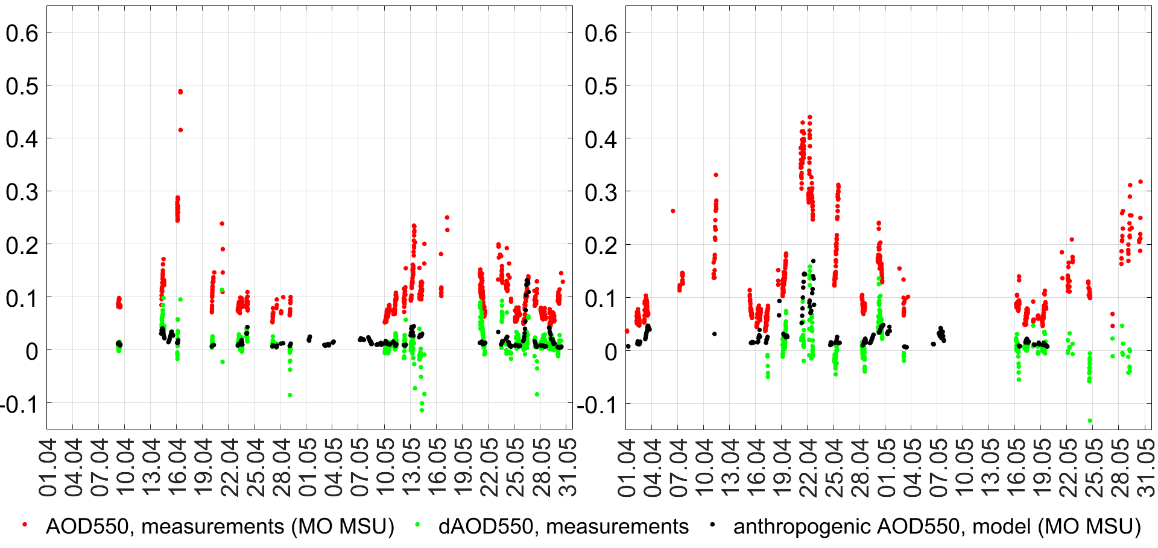
Time series of modelled urban AOD (in black), observed urban AOD difference (in green) and measured AOD500 in Moscow (in red). 2018-2019. Quasi-clear sky conditions.
2018 2019
Negative observed dAOD – mainly due to advection of Moscow urban pollution to Zvenigorod

Slide 17
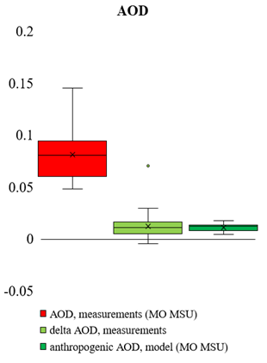
Main statistics on AOD550, PM and BC and their urban components in conditions with no air advection from Moscow to background Zvenigorod site. Quasi-clear conditions.
PARAMETER | Median values:
AOD, measurements (MO MSU) | 0.080
delta AOD, measurements ( urban) | 0.010
AOD, model (MO MSU), only anthropogenic emissions | 0.012
Notes:
Рисунок 3.4.11. Диаграммы размаха для АОТ и приземных концентраций PM и BC по результатам измерений и моделирования с исключением случаев восточной адвекции в Звенигороде.
Вопросы: какие условия? утренние случаи были или нет?

Slide 18
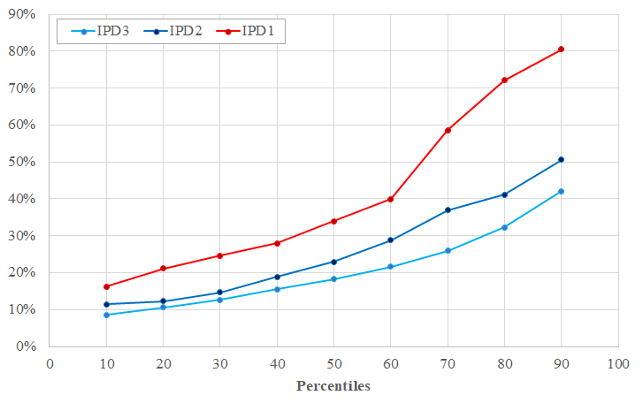
Ratio of AOD urban aerosol component (model estimates) in total AOD for different percentiles under various Intensity of Particle Dispersion (IPD) conditions.
 | IPD1 More stable | IPD2 | IPD3 Less stable
Median, 50% quantile | 34% | 23% | 18%
Notes:
Рисунок 3.3.13. Доля городской аэрозольной составляющей (модельные оценки) в общей величине измеренной АОТ для разных значений процентилей при различных режимах перемешивания с указанием медианы для разных ИРП.
Рисунок 3.3.11. Доля городской аэрозольной составляющей (модельные оценки) в общей величине PM для разных значений процентилей при различных режимах перемешивания с указанием медианы для разных ИРП при использовании полной статистики (все условия облачности) (справа)

Slide 19
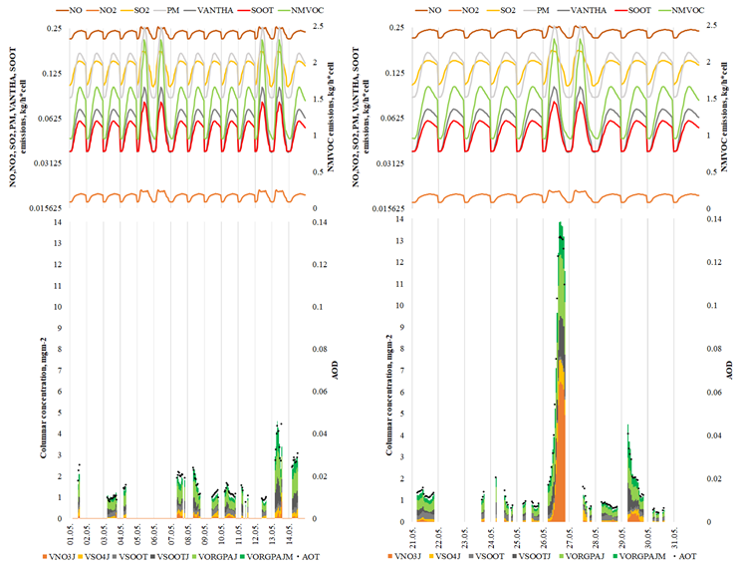
Different aerosol species modelling during the AeroRadCity experiment. Quasi clear conditions.
Notes:
Соотношение используемых в коде модели COSMO-ART суточных ходов эмиссий различных газовых и аэрозольных величин с полученным содержанием различных фракций аэрозоля в столбе атмосферы и АОТ in May 2018

Slide 20
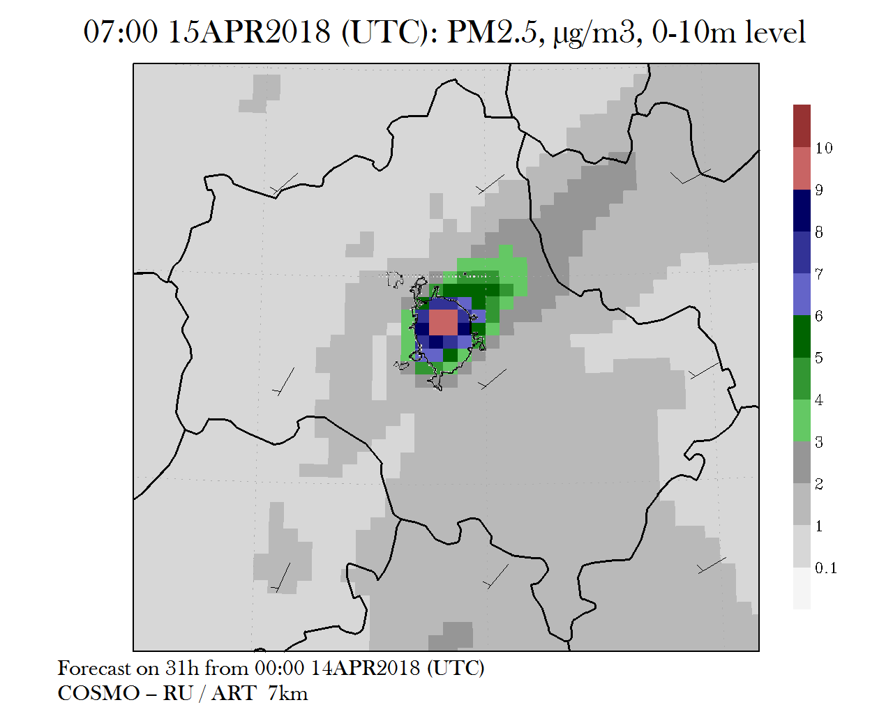
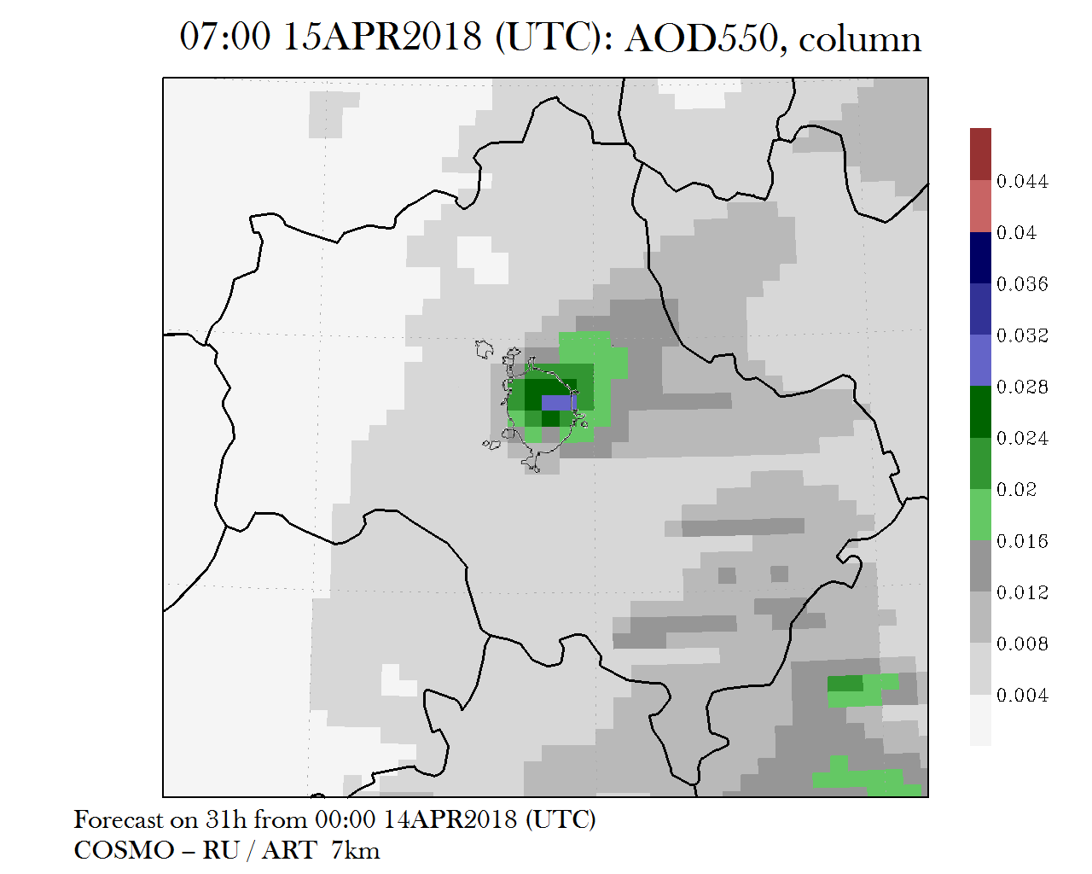
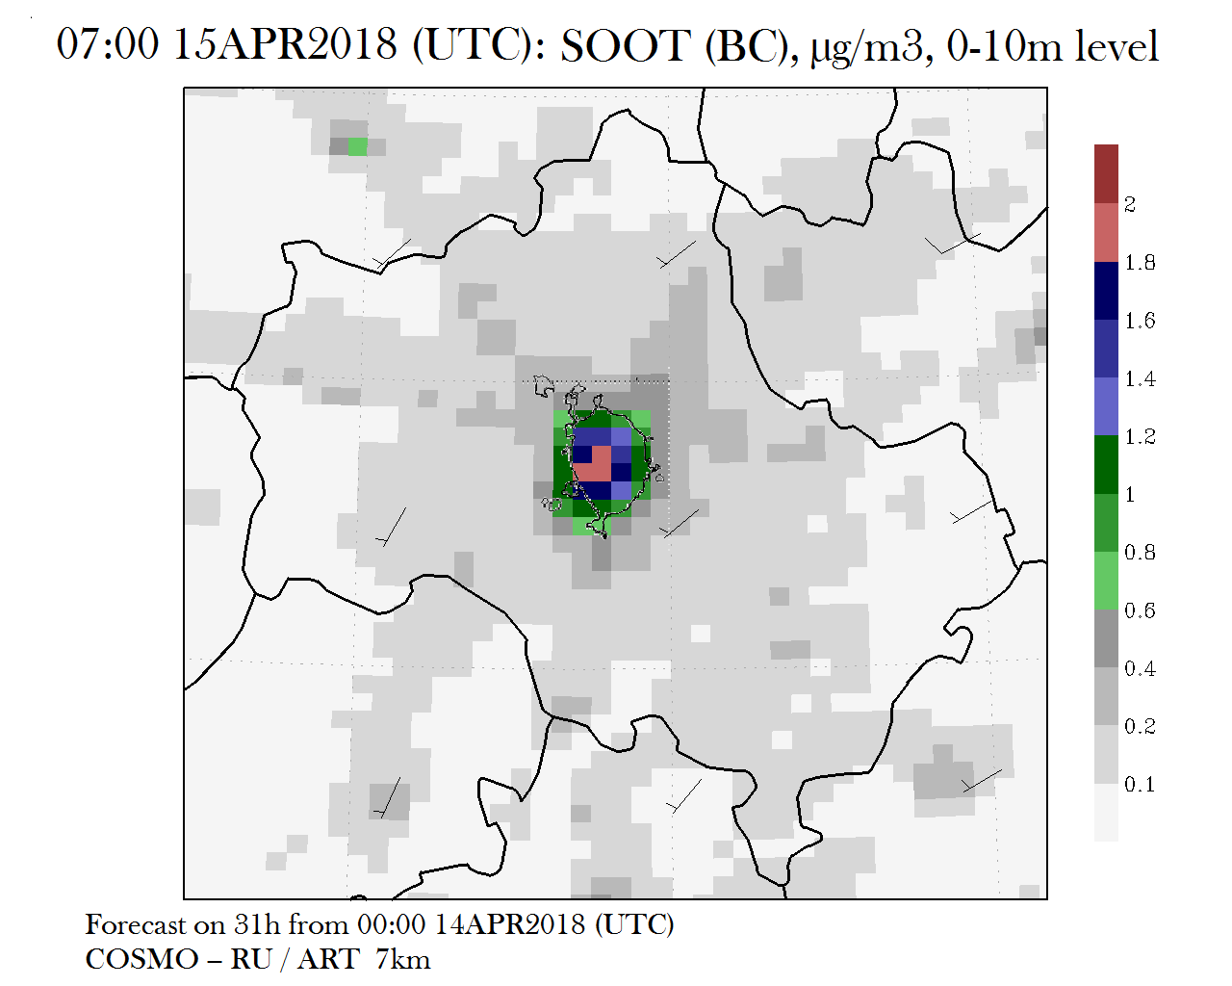
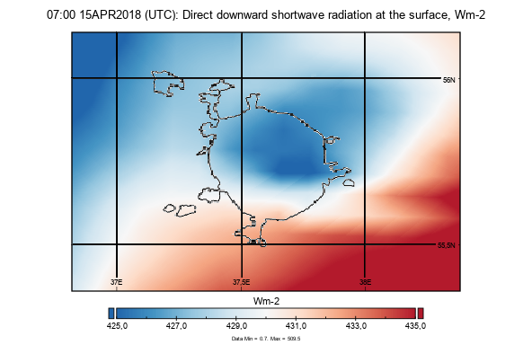
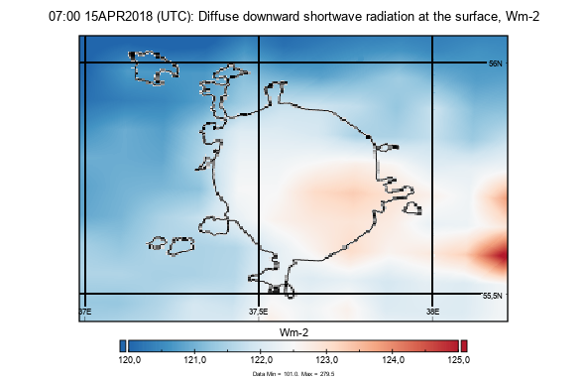
An example of radiative effect of Moscow urban aerosol for direct and diffuse irradince. 15/04/2018
Urban PM2.5
Urban AOD550
Black Carbon
А В С
DIFFUSE IRRADIANCE
DIRECT IRRADIANCE

Slide 21
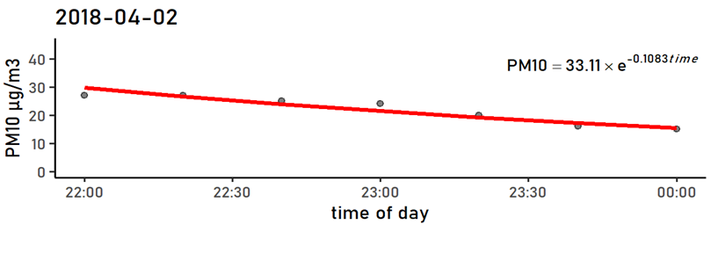
Wet deposition of aerosol.
DETERMINATION OF EXPONENTIAL WASHOUT COEFFICIENT
C=C_{O} exp(-α* time),
where
α - exponential washout coefficient (hour ⁻¹)
PM10 mass concentration measurements
with 20 minutes resolution

Slide 22
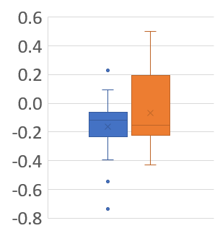
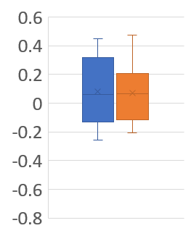
Wet deposition of aerosol.
Average exponential washout coefficients (α hour⁻¹ ) for PM10 and BC concentrations according to measurements during the experiment.
C=C_{O} exp(-α* time),
where α - exponential washout coefficient (hour ⁻¹)
PM10
α,hr⁻¹
α,hr⁻¹
BC mkgm⁻³
PM>10mkgm⁻³
PM<10mkgm⁻³
Main result:
Existing washout dependence of PM for PM>10 mkgm⁻³
and no dependence for BC.
α (PM)=0.17+-0.09 (hour-1)

Slide 23
PM changes during rain according to the COSMO-ART model simulations with and without wet deposition. April, 22nd, 2018.
Wet deposition of aerosol.
α ( measurements, PM)=0.26 hour⁻¹
Precipitation 2.3 mm
α( model, PM)=0.18 hour⁻¹
Precipitation 0.8 mm
Notes:
Выяснить, за счет чего наблюдается падение аэрозольной концентрации при отсутствии вымывания. ( смена воздушной массы?)

Slide 24
Conclusions:
During the AeroRadCity experiment we showed that COSMO-ART model provides quite satisfactory agreement in estimates of urban aerosol in quasi-clear conditions, but overestimates them in cloudy conditions.
The modelled BC concentrations are of the same order with measurements and has a good agreement with PM and NOx concentrations. No BC dependence on SO₂ according to the measurements!
Median urban component of AOD in Moscow is about 0.01 according to both modelling (with TNO2010 emissions) and measurements ( in agreement with satellite estimates (Zhdanova et al., 2020), however, in some conditions COSMO-ART model provides an increase of urban AOD aerosol up to 0.12. Using IPD indicators we showed an important role of meteorology in urban aerosol accumulation ( from 18% to 34% - from unstable to stable atmospheric conditions).
Solar Radiation: we have much more significant loss in UV irradiance (up to 30%) compared with shortwave irradiance (up 15%) during daytime in well-mixing atmosphere. Cooling radiative forcing effect is much less (up to -3 Wm⁻²) at both smaller AOT and SSA (the latter could be smaller due to increase in BC/PM ratio).
Existing washout dependence of PM for PM>10 mkgm⁻³ with α (PM)=0.17+-0.09 (hour⁻¹) and no dependence for BC is observed in any PM conditions and BC concentrations typical for Moscow region.

Slide 25
Acknowledgements.
We would like to thank Zvenigorod AERONET site stuff (IAP RAS) and Irina Shalygina (HMC) for IPD data.
The work was supported by the Russian Science Foundation, grant # 18-17-00149.

