Slide 1
The role of syn-eruptive crystallization on pantelleritic eruptive dynamics
Online
4-8 May
Stabile P.¹, Appiah E.¹ and carroll M.R.¹
¹School of Sciences and Technology, University of Camerino

Slide 2
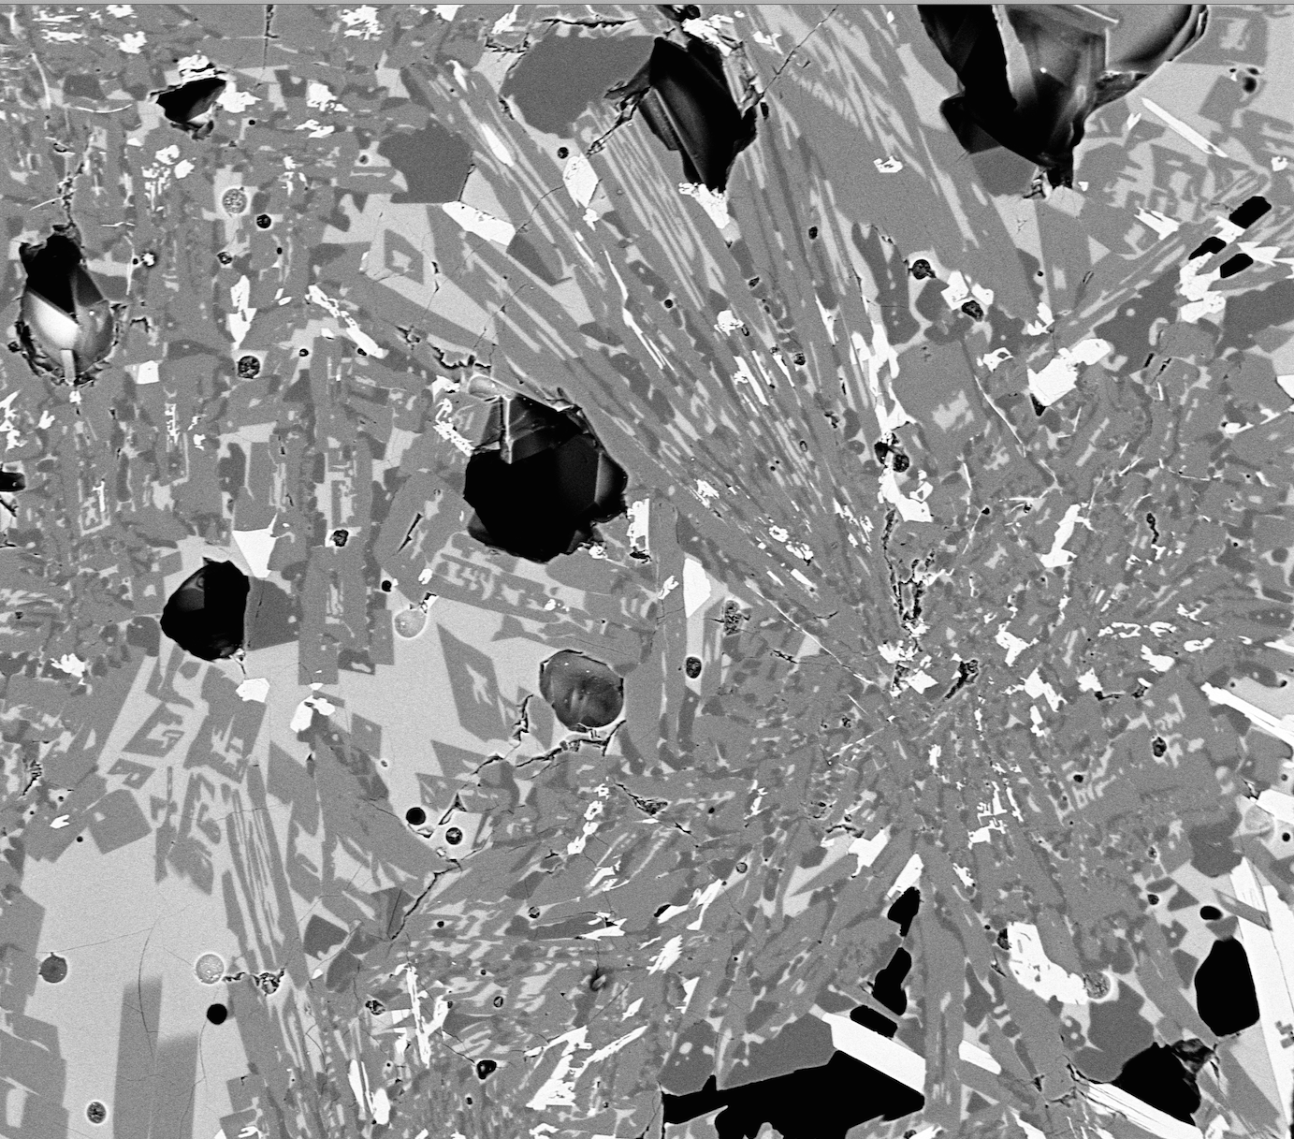
AIM AND MOTIVATION OF THE STUDY
The objective of this work is to investigate the Crystallization kinetics of alkali feldspars in pantelleritic melts in order to simulate the pre-and syn-eruptive conditions and reconstruct the cooling history of these strongly peralkaline systems.
Why these compositions?
The behavior of peralkaline melts is among the most debated, as eruptions involving this composition can produce large volumes of magma and involve a wide range of eruptive styles (lava flows to Strombolian to Plinian explosions) and are commonly associated with an enigmatic wide suite of eruption products including, but not limited to, obsidian lava flows, welded ignimbrites and pumice cones (Clarke et al., 2019).
Why this work?
Studying the textural fingerprint that a pantelleritic magma can produce during it ascent through the conduit can be useful to understand its rheological behavior. These information are of great interest for peralkaline rhyolites which are not so long systematically studied yet if compared to the relative calcalkaline melts.

Slide 3
Geological and petrological background
Pantelleria is a volcanic island in the Sicily Channel continental rift system.
Peralkalinity index of 1.1
SiO₂ of ca. 70 wt%
FeO_{tot} of 7.52 wt%
Fig.1- Structural tectonic sketch map of Pantelleria island (modified from Rotolo et al., 2007). The red star marks the analogue natural composition of our starting (PAN0113) which belongs to the Fastuca pumice fall eruptive unit.

Slide 4
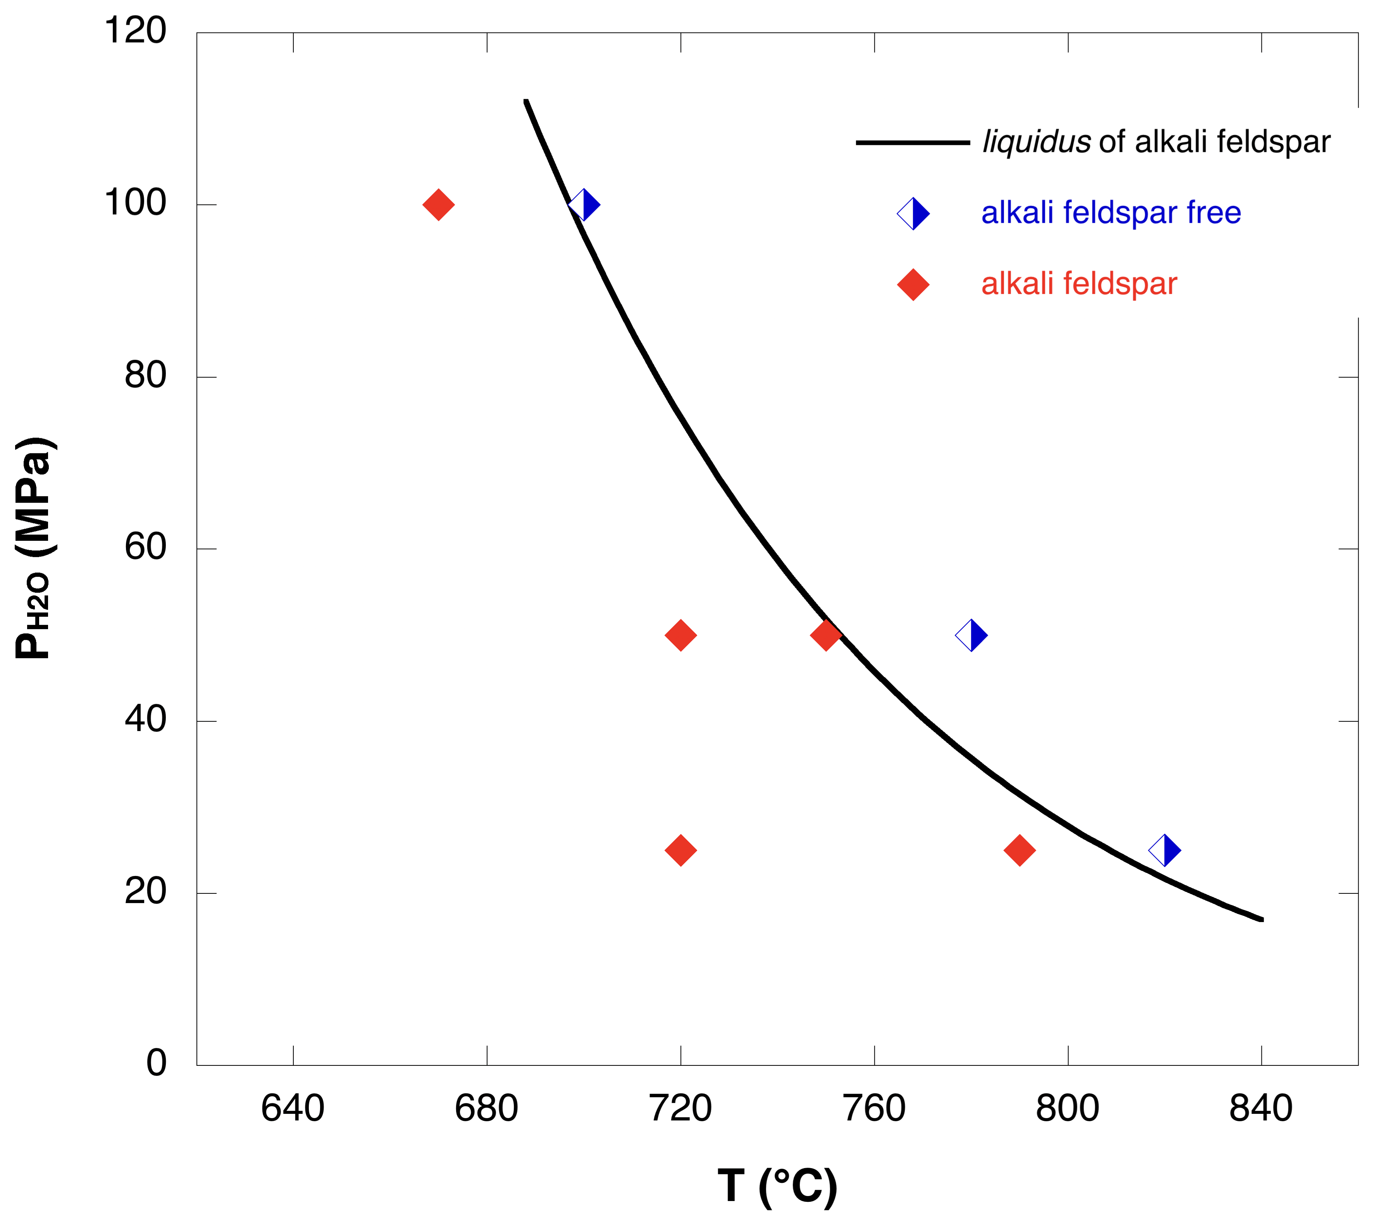
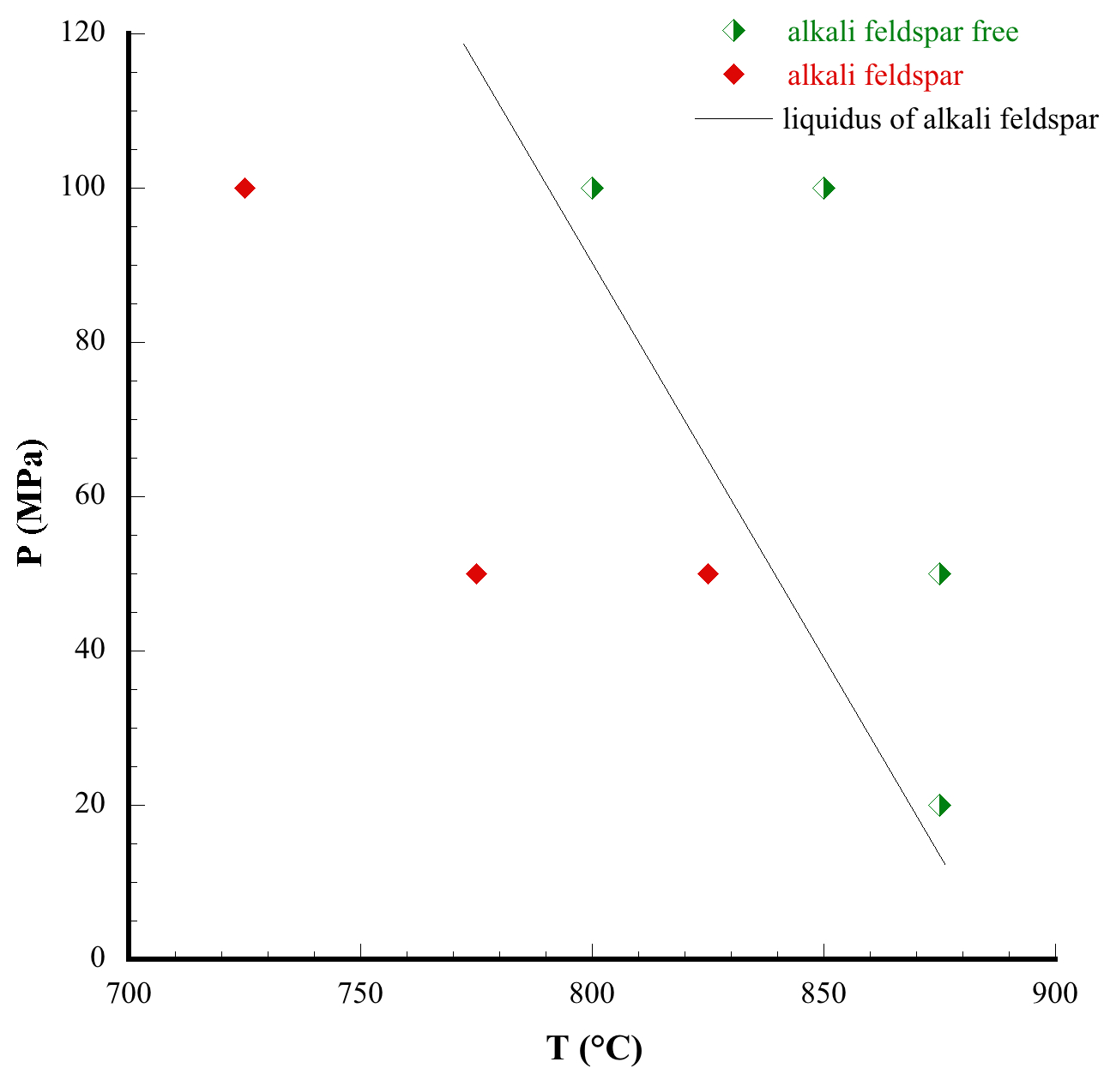
Phase diagrams of Alkali feldspar
Fig. 2- Liquidus of K-feld in PANT15 under water-saturated conditions, from Arzilli et al. (under review on Frontiers Earth Science).
Fig. 3- Liquidus of K-feld in PAN0113 at water- saturated conditions and QFM-1 (Stabile et al., in prep).

Slide 5
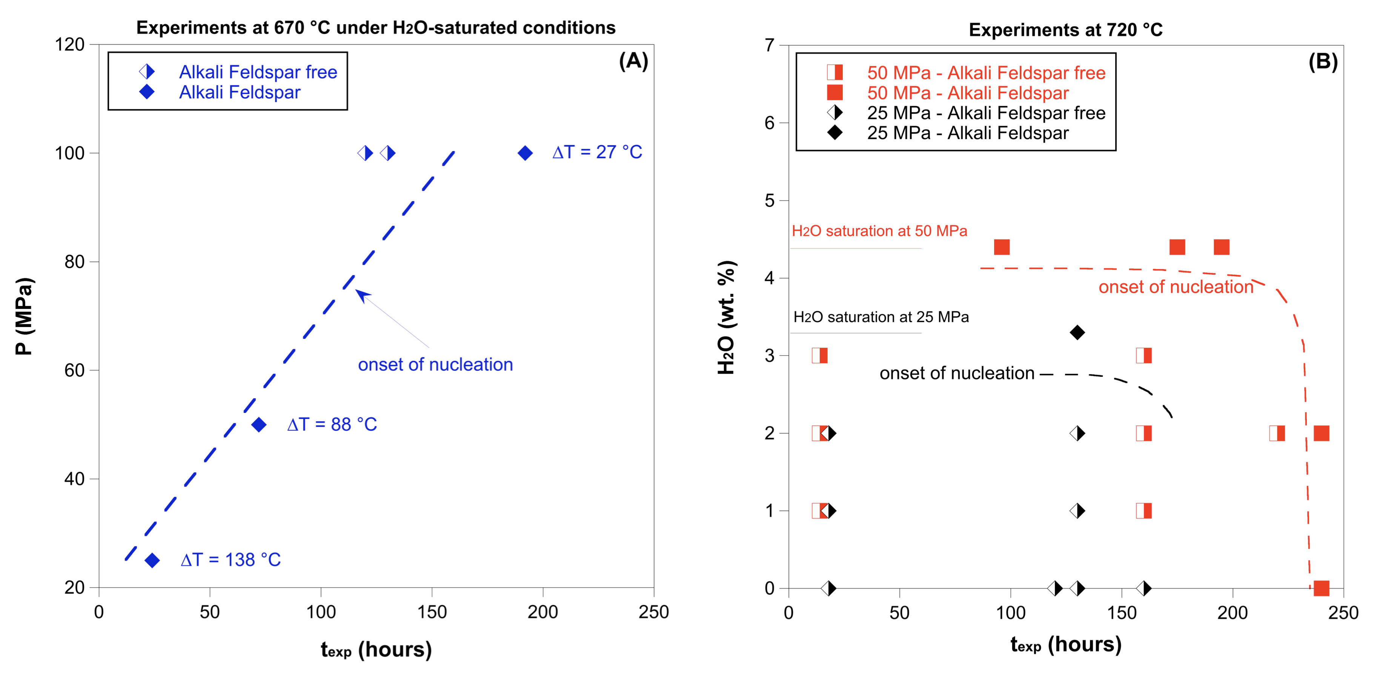
Nucleation delay of K-feld in pantelleritic melts
From Arzilli et al., (under review on Frontiers Earth Science)
Fig.4- Diagrams showing the nucleation delay as a function of pressure and final temperature, for different Tf series. (A) At 670 °C, under H2-saturated conditions, the nucleation of Alkali Feldspar is fast: 24 h (at 25 MPa), 72 h (at 50 MPa) and 130 h (at 100 MPa). (B) The values of delay change, at 720 °C, from 130 h (at 25 MPa) to 240 h (at 50 MPa).

Slide 6
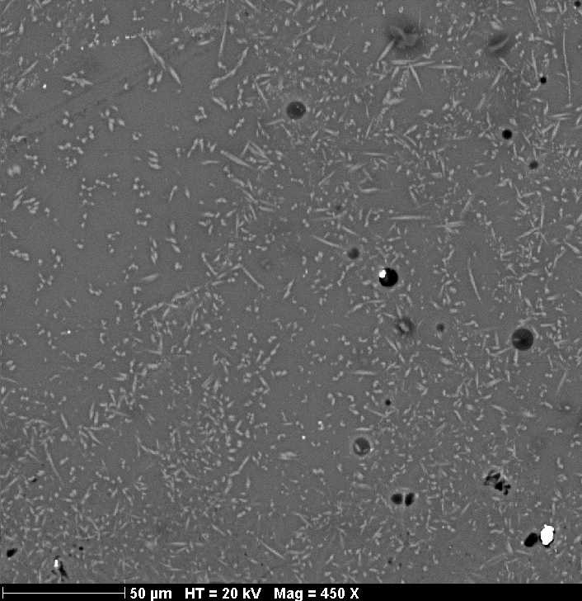
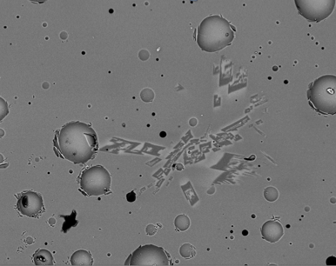
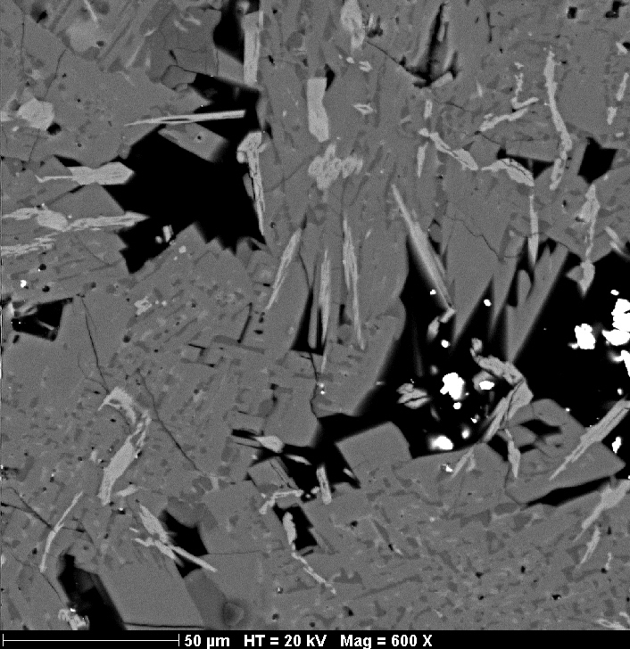
Single step cooling experiments (at P range between 25-100 MPa and T_{f} of 720°C and under water saturated conditions).
Some results @ 25 MPa
72 h
120 h
160 h
cpx
K-feld
cpx
K-feld
100μm HT= 15kV Mag=450 X
ΔT °C
Fig. 5- Backscattered SEM images of textural growth and evolution of k-feld as function of time and with decreasing ΔT.

Slide 7
Textural analysis reveal that φ varies from average pre-eruptive values of 0.02 to 0.55 during magma ascent from magma chamber depths (ca. 3-4 km, at 100 MPa) to shallower depths (corresponding to pressures of 50 MPa), leading to an increase of viscosity -up to 2 log units- which can enhance a more explosive magma eruptive behavior .
Rheological Implications
Fig. 6- Crystal fraction (Φ_{total}) behavior versus viscosity of the silicate melt estimated using the equation of Vona et al. (2011). The starting pre-eruptive low viscosity of the pure pantelleritic liquid was calculated using the model of Di Genova et al. (2013).

Slide 8
Cooling experiments were useful to investigate the pre-and syn-eruptive crystallization kinetics in peralkaline rhyolitic melts and simulating magma stagnation or ascent toward Earth’s surface
This, in turn, provides some constraints on the timescales and dynamics of magmatic processes of the pantelleritic melts.
TAKE HOME MESSAGE
Better study the effect of water on Nucleation delay of K-feld (need to implement cooling experiments at water saturated conditions for PAN0113).
Deeply investigate the volcanic and thermal history of these pantelleritic melt compositions.
Unraveling the most likely factors that contribute to the shift between explosive and effusive volcanic dynamics of pantelleritic systems.

