Slide 1
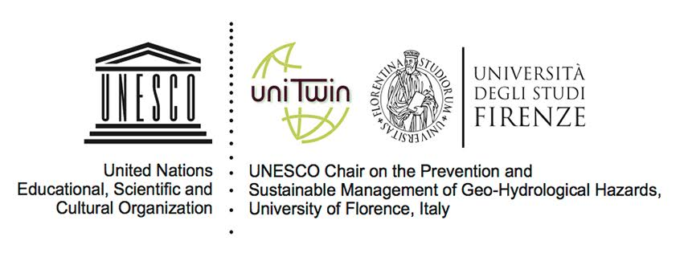
Evaluation of the natural risk perception, awareness, and preparedness at school by means of ad hoc questionnaires
#shareEGU20
Bandecchi A.E., Pazzi V., Morelli S., Valori L., Casagli N.

Slide 2
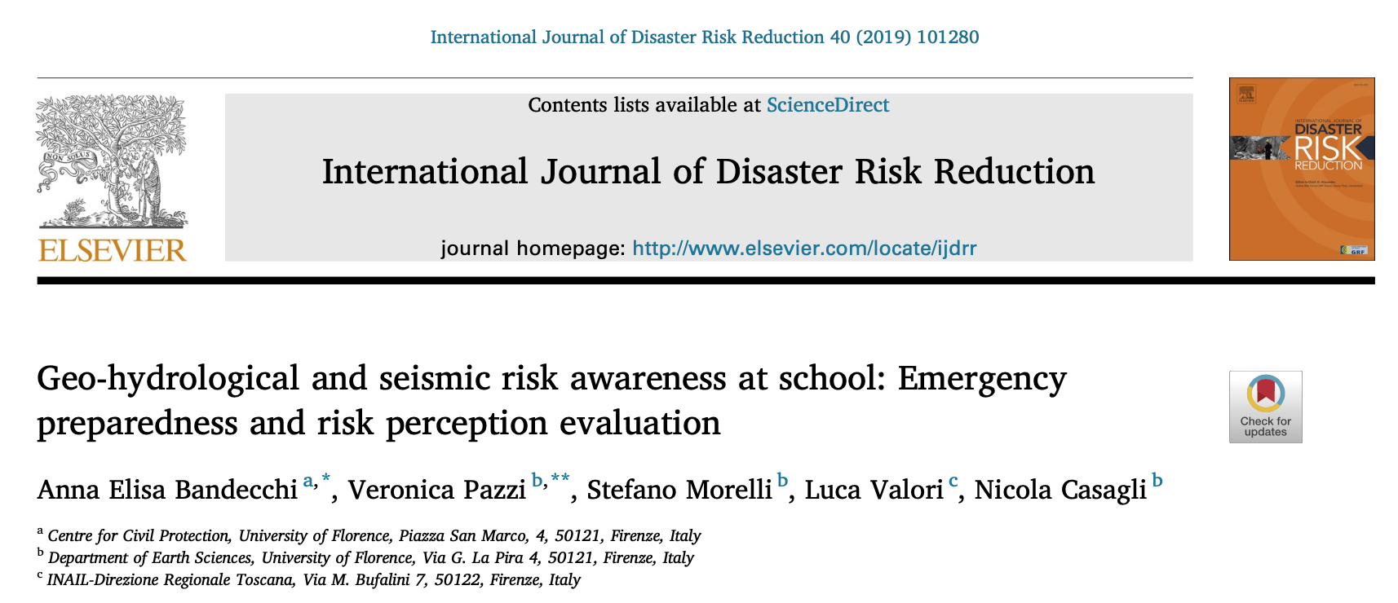
The literature on children’s natural risk perception is scarce and very recent compared with that about adults. Indeed, children’s perceptions about nature and environment are truly different from those of adults.
The available research mainly concerns the implementation of earthquake emergency measures, while not much is available on flood-risk perception and even less on landslides.

Slide 3
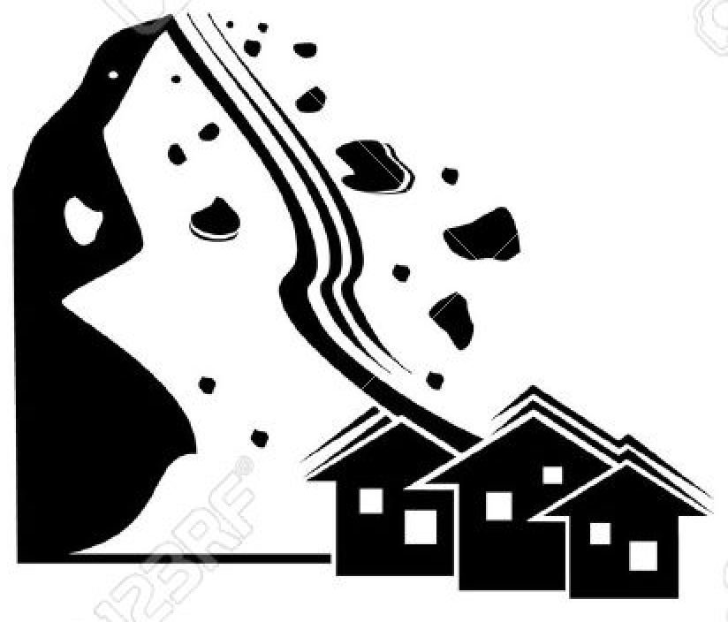
In Italy
40151 school buildings
41.6% at seismic rick
9.8% at geo-hydrological risk
7.2% at volcanic risk
55% built before 1976 (first national regulation on specific technical rules for the seismic design of structures)
80% has Evacuation Plans

Slide 4
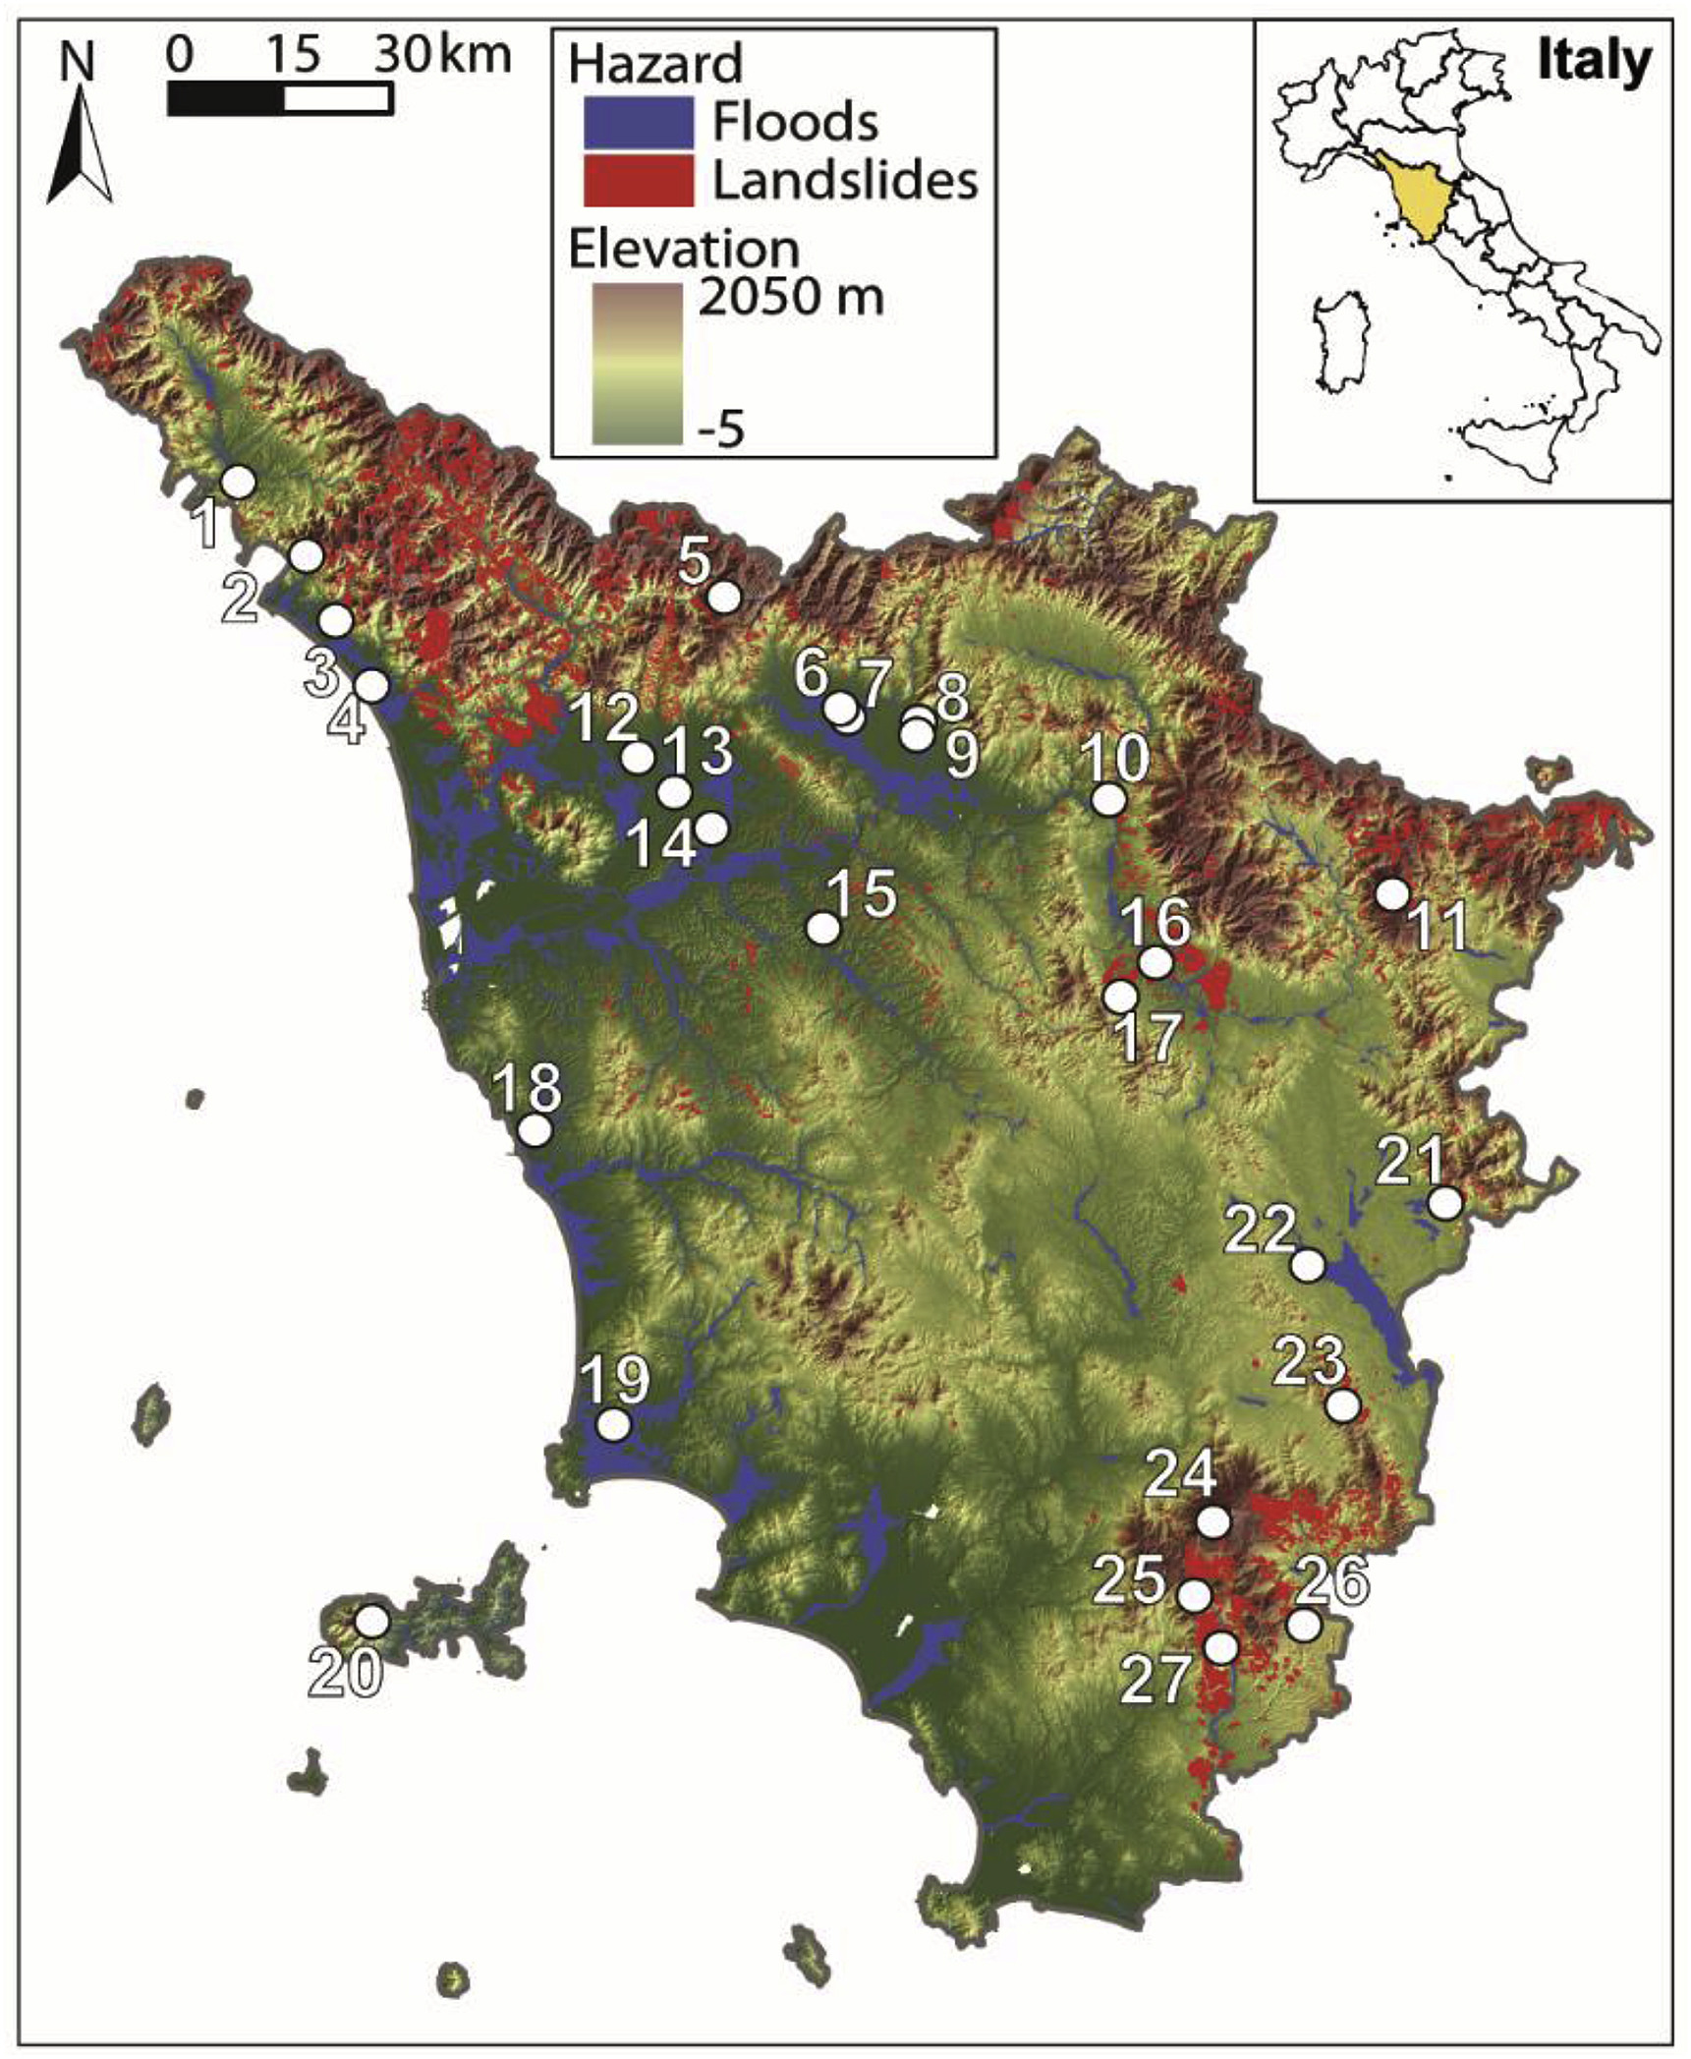
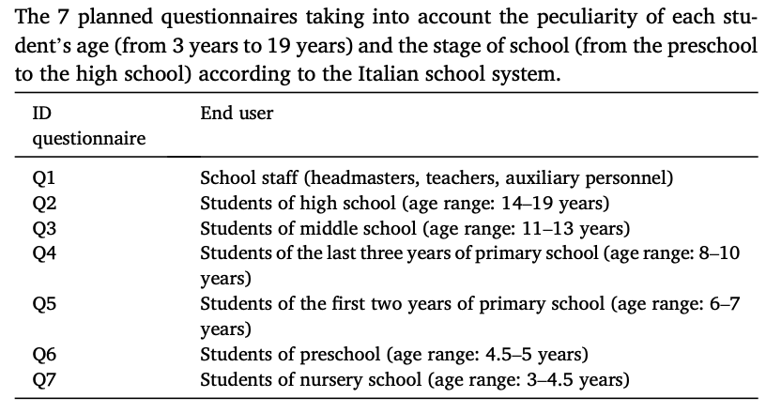
Case study: Tuscany (Italy)
27 schools
5899 interviewed people:
5079 students
(from 3 to 19 years old)
820 school personnel
7 different questionnaires

Slide 5
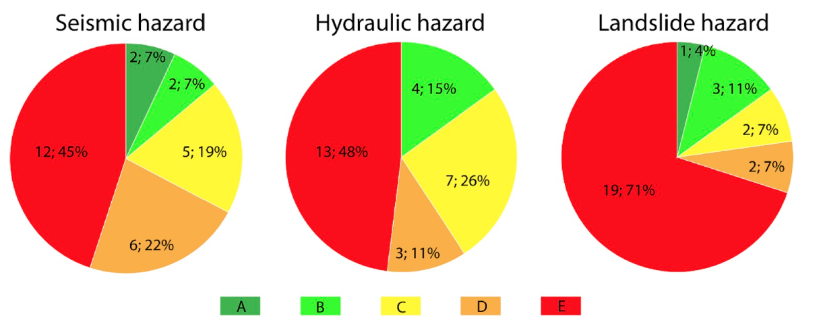
Perception
Percentage of correct answers
Number of schools and related percentage among the total (27 schools)

Slide 6
Preparedness
Percentage of correct answers
Evaluated based on good behaviours
Seismic
Hydraulic
Landslides
B
B
E
School personnel
Students
A
B
B

Slide 7
Awareness
Percentage of correct answers
Evaluated based on perception and preparedness
Seismic
Hydraulic
Landslides
D
C
E
School personnel
Students
C
C
C

Slide 8
Conclusions
young children’s knowledge is perfectly adequate to their age;
as the age and responsibilities increase, the awareness and preparation do not increase proportionally;
the competences of the school personnel are not sufficient, probably caused by critical issues emerged (i.e., it is not clear where family reunification must take place) and because the wrong hazard perception leads to underestimating the importance of prevention actions and disaster education.

