Slide 1
A visualization tool for flood dynamics monitoring using a graph-based approach
department of Environment
Remote Sensing | Spatial Analysis lab
Bos Debusscher, Frieke Van Coillie

Slide 2
Context
Flood extent maps and single date flood maps lack information on dynamics over time.
However, information on flood dynamics is crucial for several applications:
Disaster impact assessment (emergency relief, damage assessment, insurance claims …).
Data assimilation into hydrodynamic models (comparing with model dynamics, measuring point determination …).
Our goal is to develop a visualization framework for flood dynamics.

Slide 3
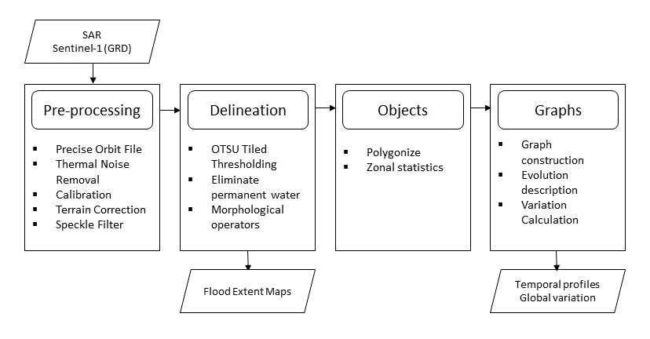
Methodology
The framework was developed for a small flood area of about 100 km² (Debusscher et al., 2019):
Binary flood maps are created on all available timesteps,
Flood polygons are grouped into graphs according to their spatial overlap,
Variation is calculated as a product of ∆_{overlap} and ∆_{backscatter} .
Upscaling was done for two larger flood areas: the Mozambique (Beira) flood of March 2019 and the India (Bihar) flood of September 2019. The latter is presented in the results.

Slide 4
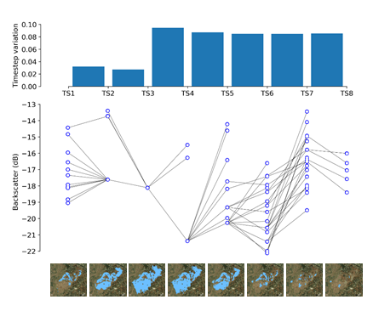
Methodology
Overlapping polygons are grouped in graphs (a set of nodes and edges). The nodes represent water polygons and the edges their spatial overlap.

Slide 5
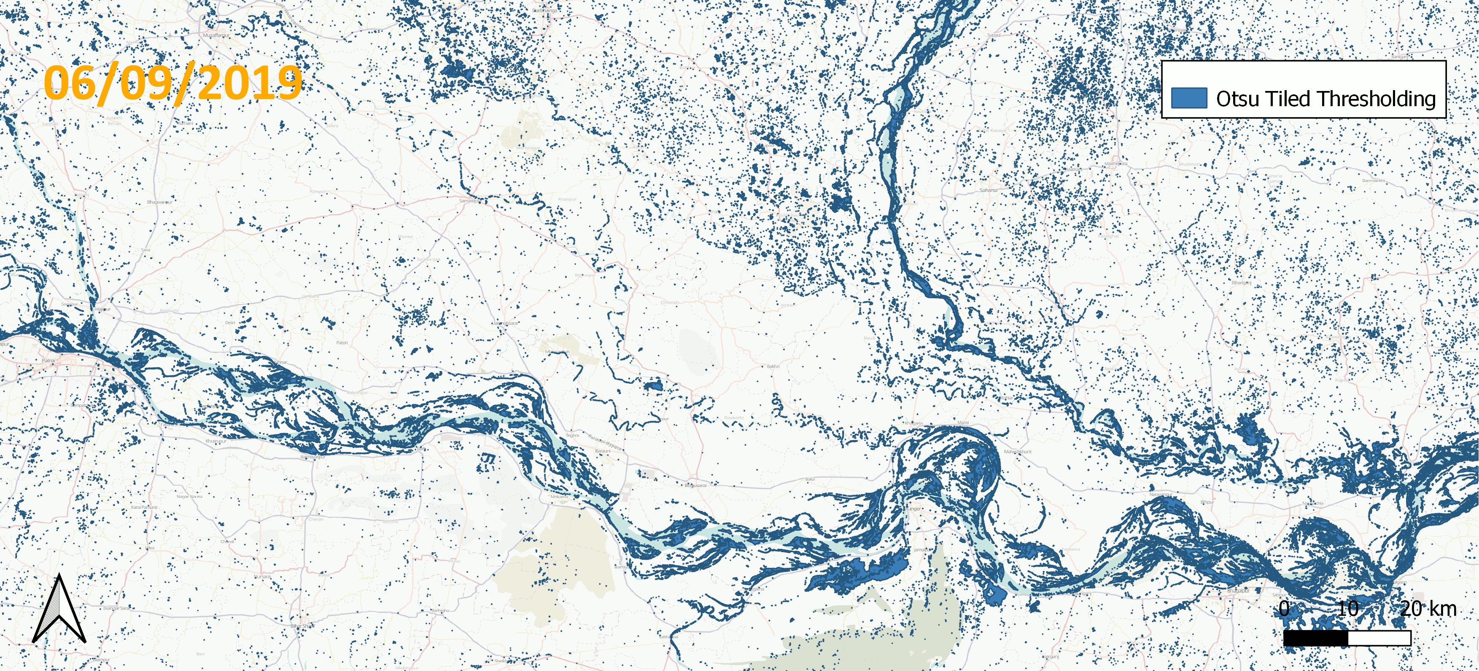
Results
Case study: Bihar (India), September 2019
Late monsoon rains affecting the Ganges river bed triggering floods in many low-lying areas, resulting in waist-deep floodwaters.
Results of pre-processing and delineation are depicted.

Slide 6
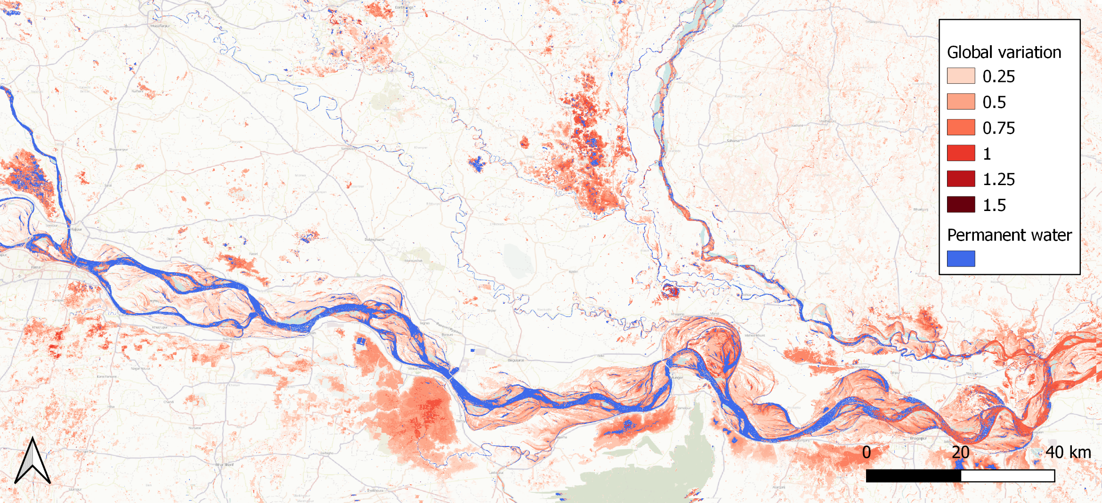
Results
Case study: Bihar (India), September 2019
Variation per timestep and the (summed) global variation are depicted here.

Slide 7
Conclusion
This framework is fast, effective and simple and can therefore serve in operational frameworks for multiple applications.
Future research will include further upscaling to country/continent scale and inclusion of different sensors and platforms (eg. Sentinel-2 …).

Slide 8
Reference Debusscher, B.; Van Coillie, F. Object-based flood analysis using a graph-based representation. Remote Sensing 2019, 11. doi:10.3390/rs11161883 Contact Bos Debusscher Department of Environment Remote Sensing | Spatial Analysis lab bos.debusscher@ugent.be

