Slide 1
Atmospheric satellite-based and in situ surface observations on summertime trace gases (CO, CO₂, CH₄) over the metropolitan area of Bucharest
M.P. Corbu^{1,4}, A. Calcan¹, I. Vizireanu¹, D.E. Moaca¹, R.V. Chiritescu^{2,3},
T. Röckmann⁵, H. Maazallahi⁵, J.M. Fernandez⁶, J. France⁶, G. Iorga^{2,4}
(1) National Institute for Aerospace Research “Elie Carafoli” - INCAS, Environmental Aerodynamics, (2) University of Bucharest, Faculty of Physics, (3) National Meteorological Administration, (4) University of Bucharest, Faculty of Chemistry, (5) University of Utrecht, Atmospheric physics and chemistry, (6) Royal Holloway University of London, Department of Earth Sciences (corbu.marius@incas.ro)
1. Introduction
2. Objectives
5. Conclusions.
Acknowledge-ments
3. Workflow
Navigation
The orange arrow (horizontal) takes you to the next slide
The orange arrow
(vertical) takes you
to the section menu
4. Results

Slide 2
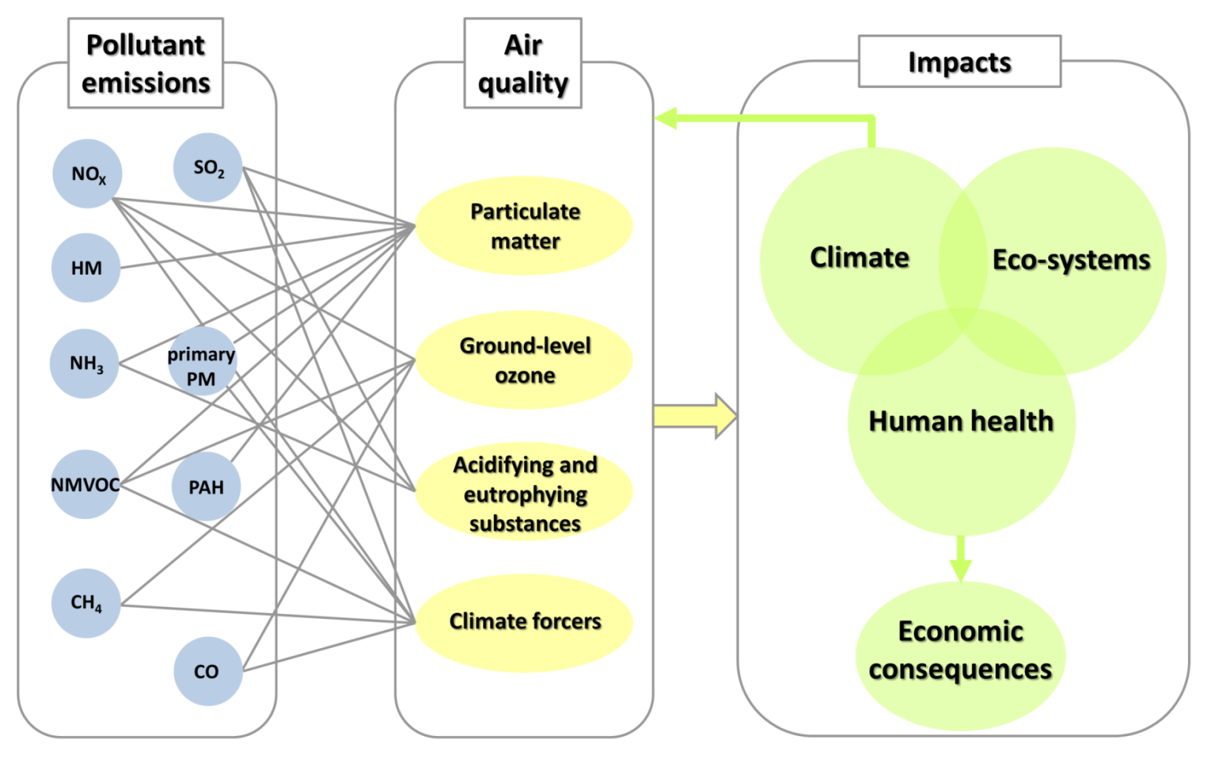
Introduction
Pollutants-- Air quality -- Short- and long-term consequences
Most
widespread
air
pollutants:
G. Iorga, Air Pollution Monitoring: A Case Study from Romania, Air Quality - Measurement and Modeling, 2016

Slide 3
Research idea
Sampling area
Bucharest
(44° 26’N, 26° 06’E)
Located in open plain; surface of about 285 km²; altitudes: 56 m a.s.l. (SE) to 92 m a.s.l. (W); relatively round shape.
Main Pollution Sources
Industrial –> electro-thermal power stations (CETs)
Traffic – mixed vehicle fleet (non-EURO ÷EURO6)
Construction sites
Residential heating sources
Various points/areas where domestic waste is collected and stored
Fig 1. Map of Bucharest. Some points of potential sources are indicated

Slide 4
Objectives
Romanian Methane Emissions from Oil & gas (ROMEO)
assessment of CO, CO₂ and CH₄ concentrations in Bucharest
determination of the CO, CO₂ and CH₄ background concentrations
identification of potential emissions hotspots and their causes (anthropogenic or natural/biogenic, local or distant)

Slide 5
Workflow
Surface data
CO, CO₂, CH₄
(mobile observatory)
DATABASE
Multiple sources
August 2019
Satellite data
CO₂, CH₄
(TROPOMI, SENTINEL-5P)
Synoptic meteorology
Backward air mass trajectories
In-situ meteorology
(T, p, RH, WS, WD)
CO, CO₂, CH₄
Concentration maps
CO/CO₂
CH₄/CO₂
Ratios
CO, CO₂, CH₄
Background concentrations
CO, CO₂, CH₄
Excess concentrations
Source identification

Slide 6
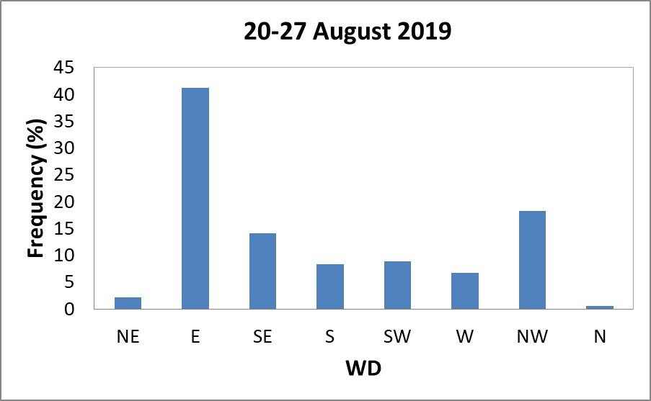
Workflow
Sampling campaign design and Data collection
Measurements Instruments Measured trace gases Sampling period
(resolution)
Two cars Picarro Analyzer CO, CO2, CH4 21-27 Aug 2019 ( 1 s)
Sentinel 5P TROPOMI CO, CH4 21-27 Aug 2019 (7 x 7 km²)
Meteorology during the sampling campaign
Date | Temperature (C) | Relative Humidity (%) | Pressure (hPa) | Wind Speed (m s⁻¹)
20.08.2019 | 26.39 ± 4.48 | 45 ± 14.75 | 1006.65 ± 0.65 | 0.86 ± 0.49
21.08.2019 | 26.66 ± 4.55 | 52 ± 14.67 | 1005.83 ± 1.02 | 1.14 ± 0.54
22.08.2019 | 27.46 ± 4.07 | 50 ± 14.25 | 1006.48 ± 0.78 | 1.66 ± 0.42
23.08.2019 | 26.70 ± 4.18 | 55 ± 17.20 | 1008.26 ± 0.85 | 1.41 ± 0.45
24.08.2019 | 27.57 ± 3.42 | 51 ± 10.93 | 1007.63 ± 0.94 | 1.72 ± 0.47
25.08.2019 | 27.11 ± 4.28 | 57 ± 15.32 | 1006.00 ± 0.90 | 1.87 ± 1.12
26.08.2019 | 28.12 ± 3.99 | 49 ± 15.62 | 1006.92 ± 0.85 | 1.28 ± 0.57
27.08.2019 | 27.63 ± 4.10 | 47 ± 14.63 | 1006.91 ± 0.89 | 1.08 ± 0.47

Slide 7
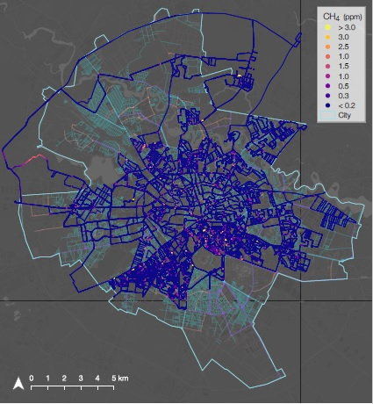
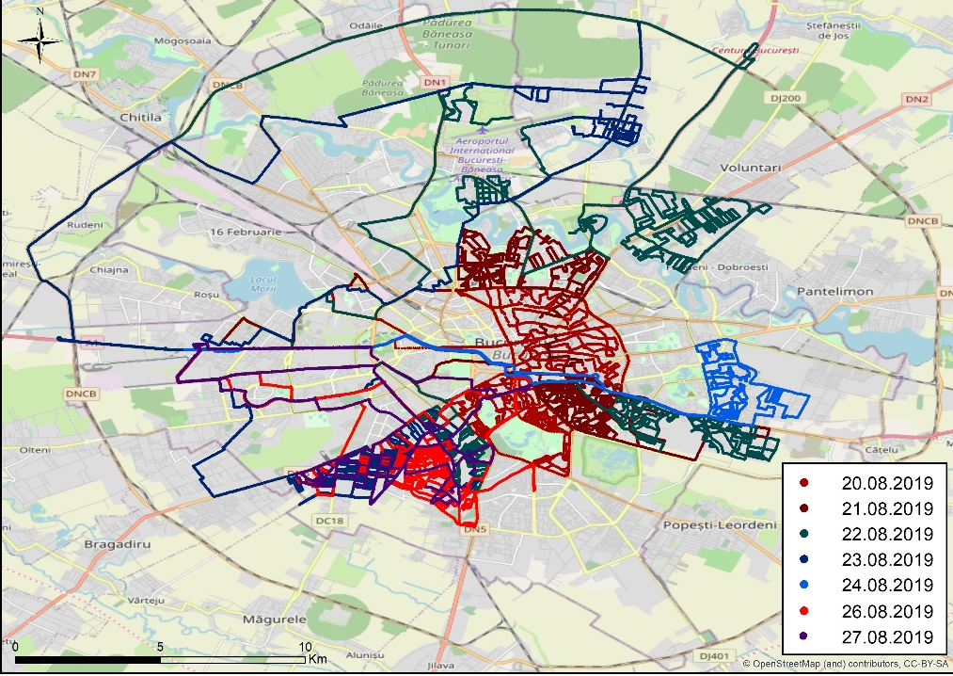
Results
Bucharest city measurements mapping
b)
Fig. 1. a) CH4 city mapping.
b) CO and CO₂ city mapping.
a)

Slide 8
Results
Background determination, Statistics
For the determination of the background a moving average type algorithm has been used.
Half sample size: 250
2nd lowest percentile
Table 1. Background statistics.
Trace gas | CO (ppm) | CO₂ (ppm)
Min | 0.16 | 404.06
Mean ±SD | 0.172 ±0.02 | 404.45 ±0.44
Max | 0.21 | 405.31
Table 2. Excess statistics.
Trace gas | CO (ppm) | CO₂ (ppm)
Min | 1.24E-07 | 5.41E-04
Mean | 33.54 | 1258.52
Max | 108.55 | 4829.15
Data loss:
CO < 2.50 %
CO₂ < 2.20 %

Slide 9
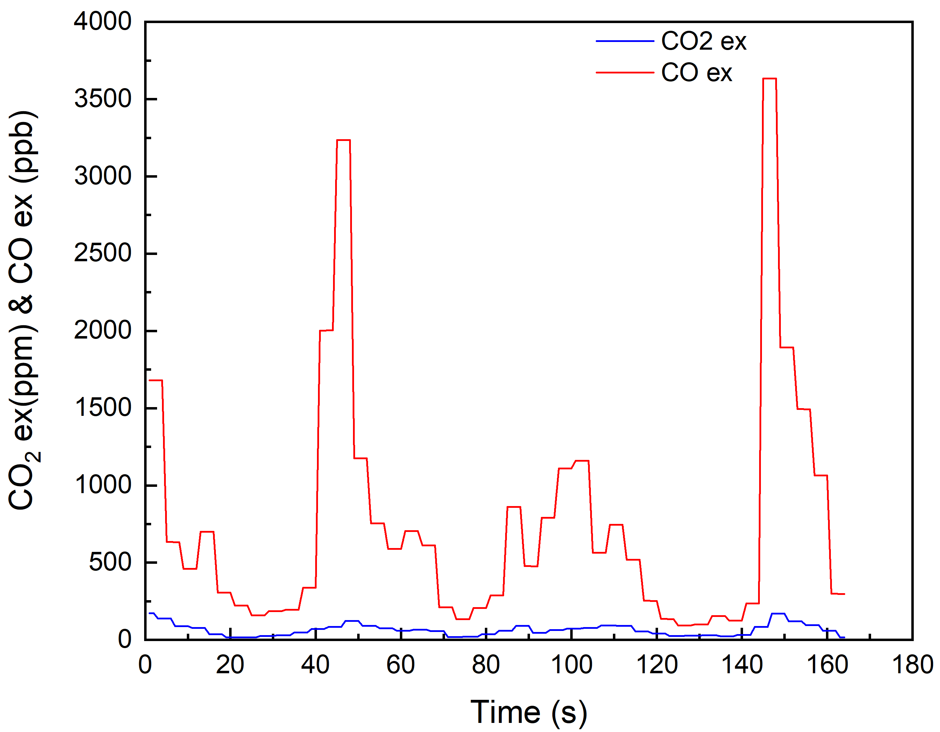
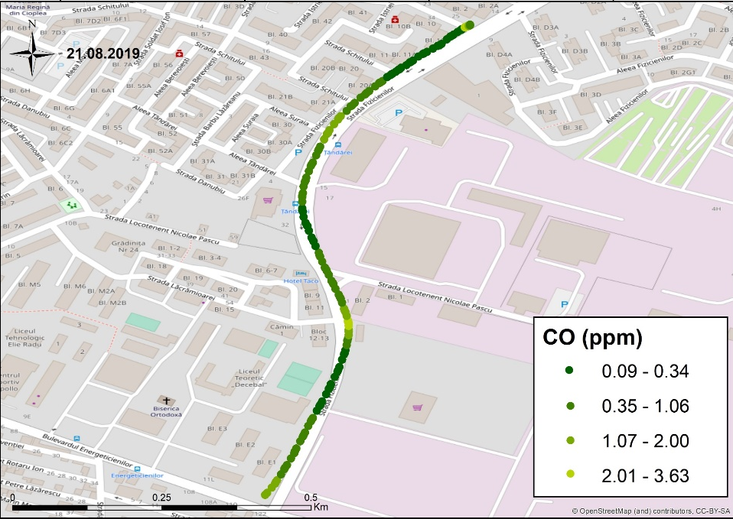
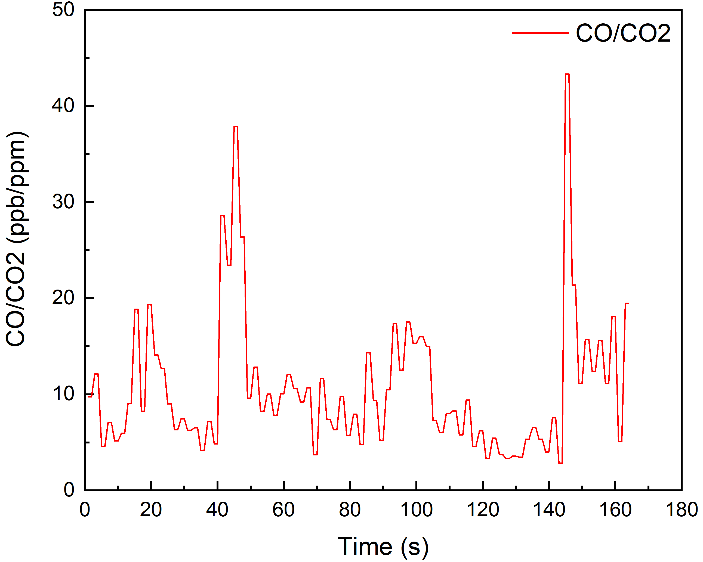
CO and CO₂ excess levels, CO:CO₂ ratio
Results
b)
a)
Fig. 2. a) Measurements near Thermo-electrical Plant.
b) CO and CO₂ excess level.
c) CO:CO₂ ratio.
c)

Slide 10
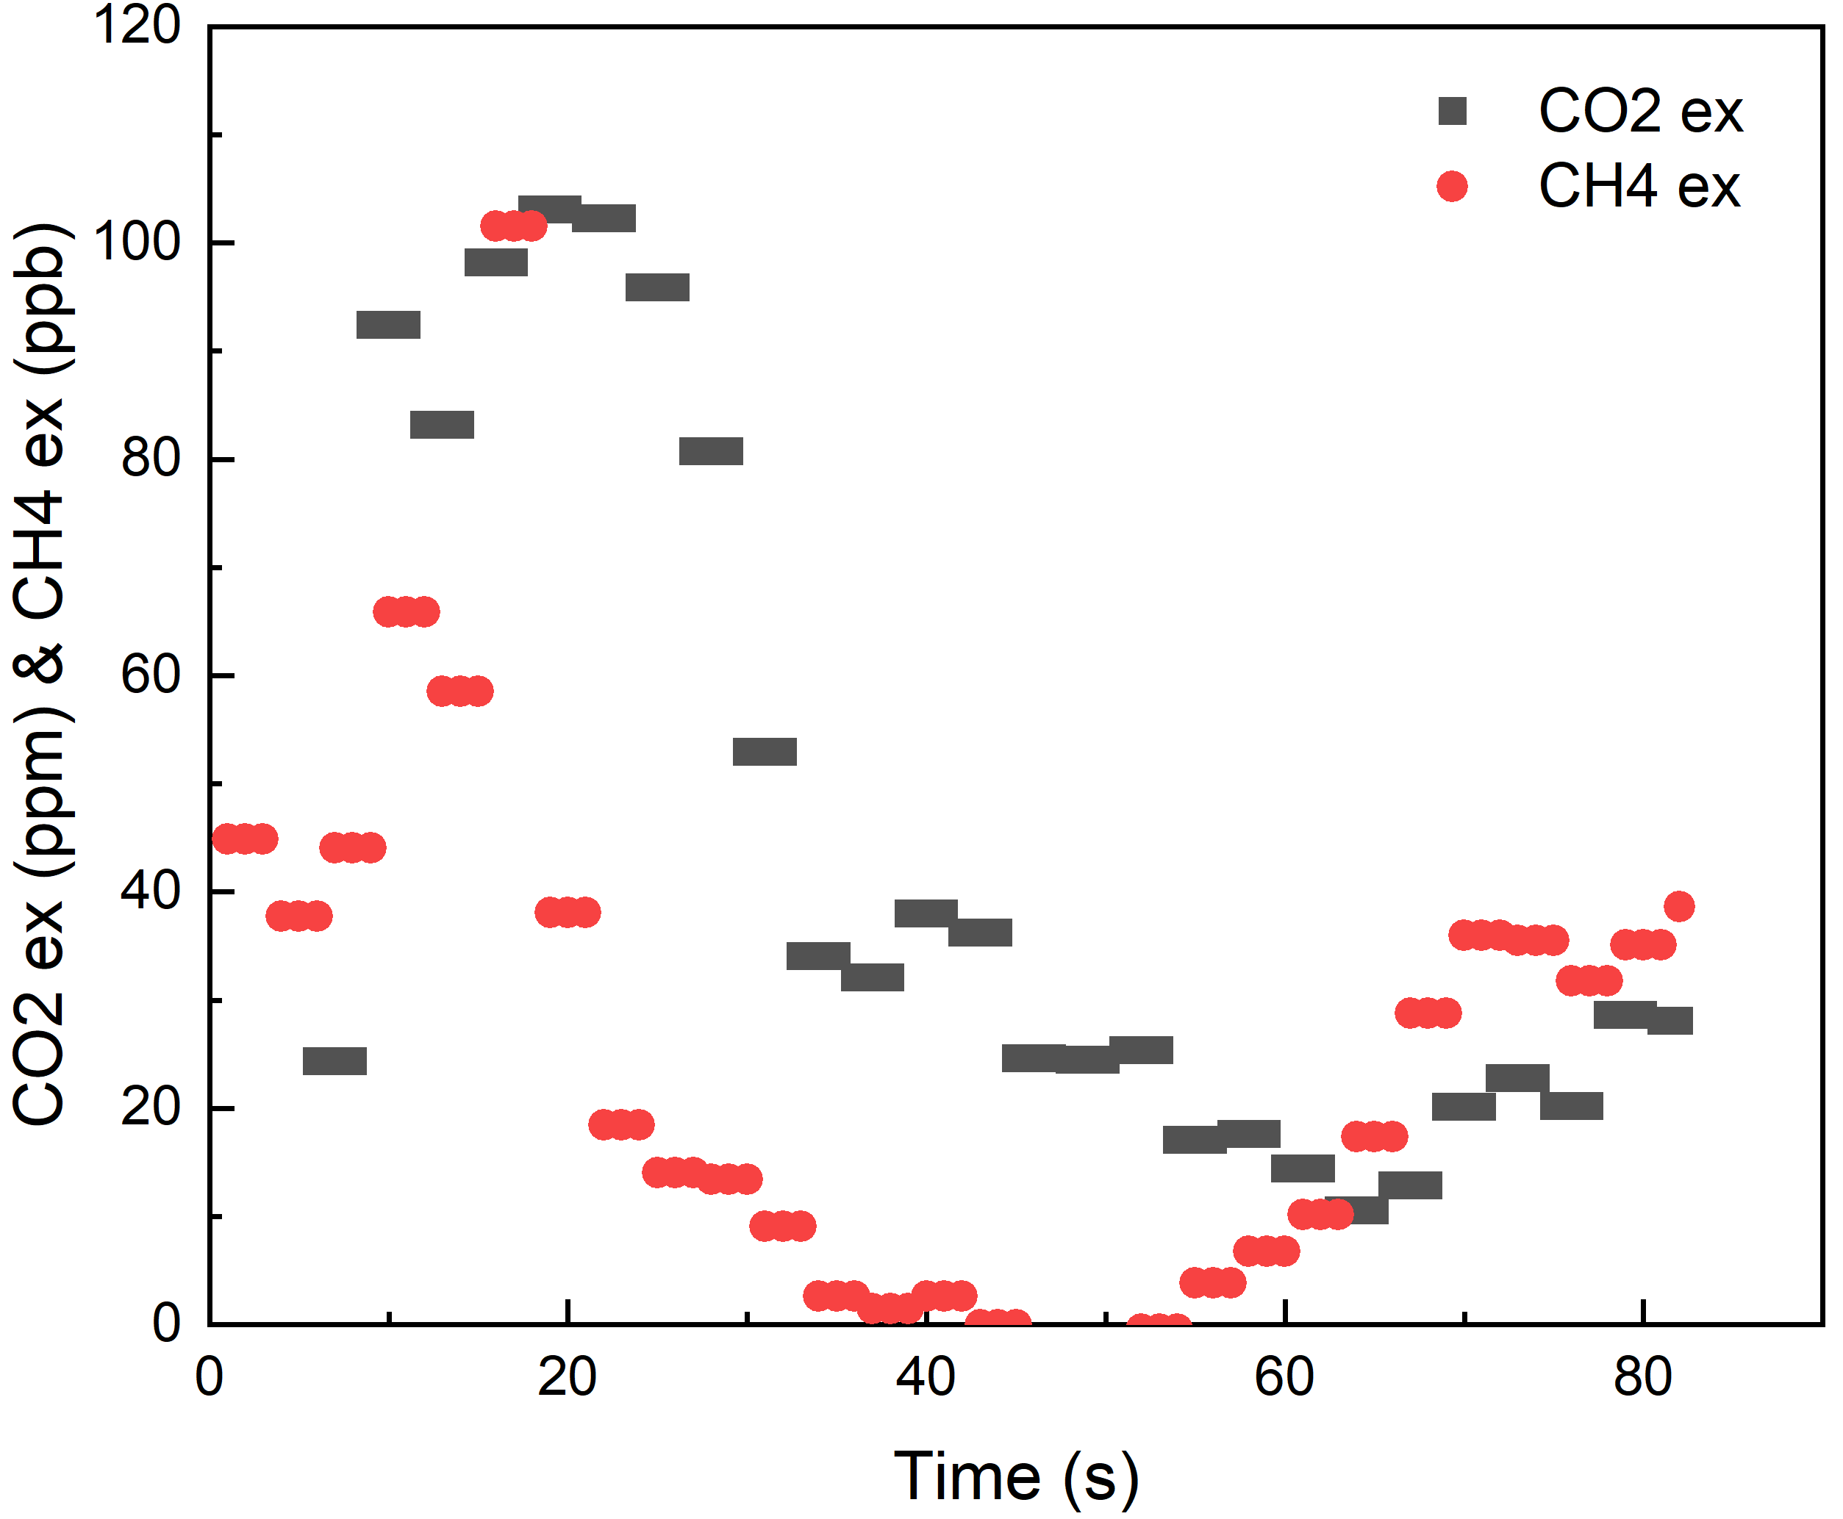
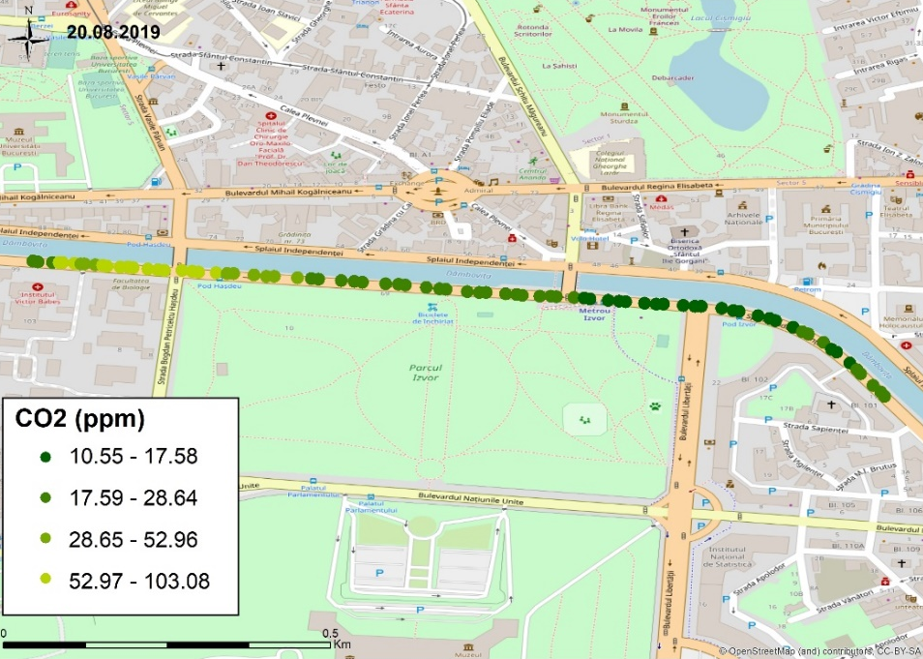
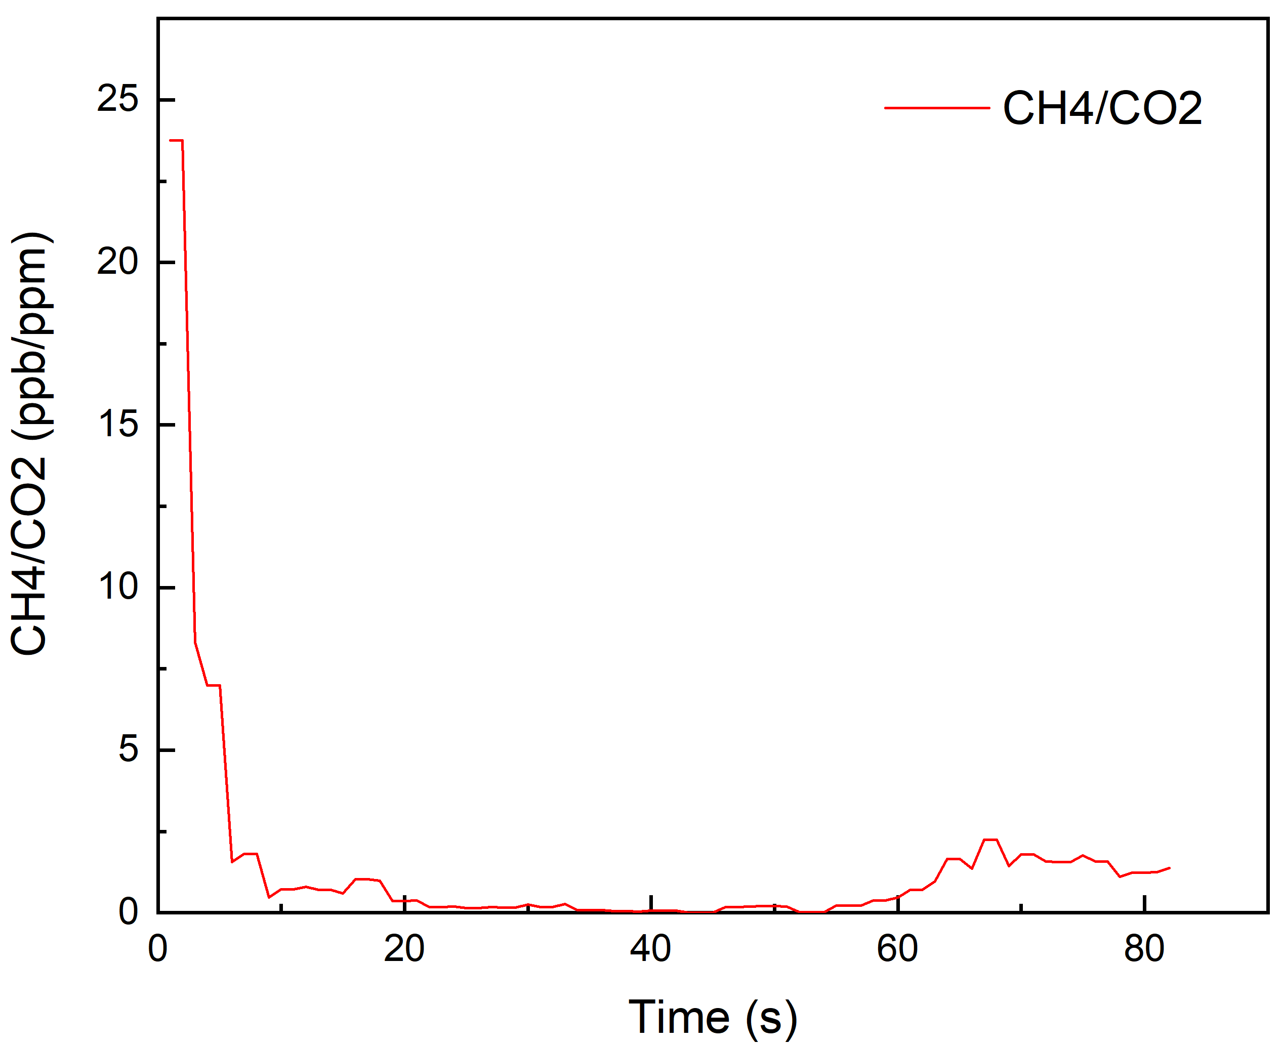
Results
CH₄ and CO₂ excess levels, CH₄:CO₂ ratio
b)
a)
Fig. 3. a) Izvor Park measurements.
b) CH₄ and CO₂ excess level.
c) CH₄:CO₂ ratio.
c)

Slide 11
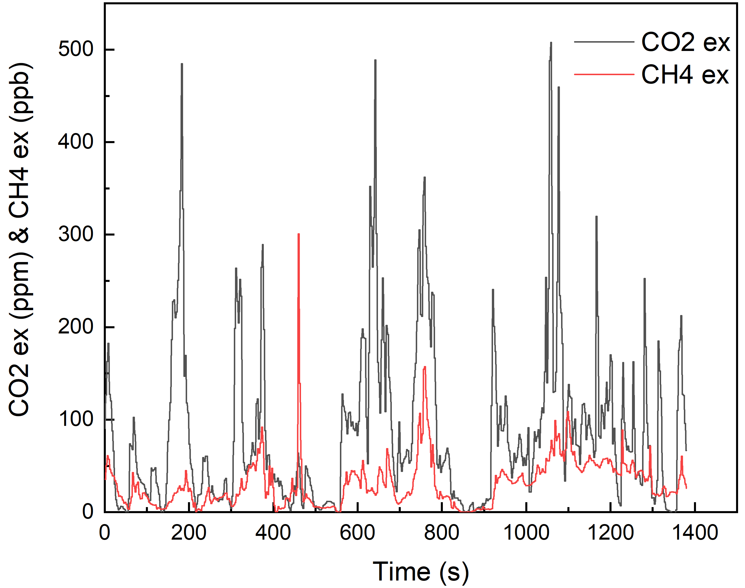
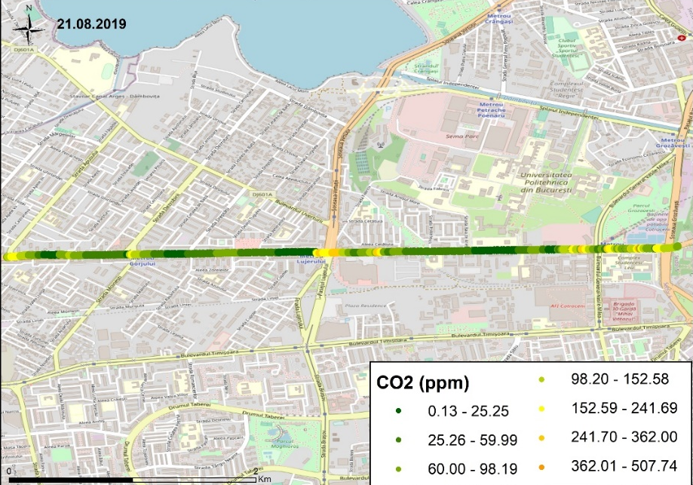
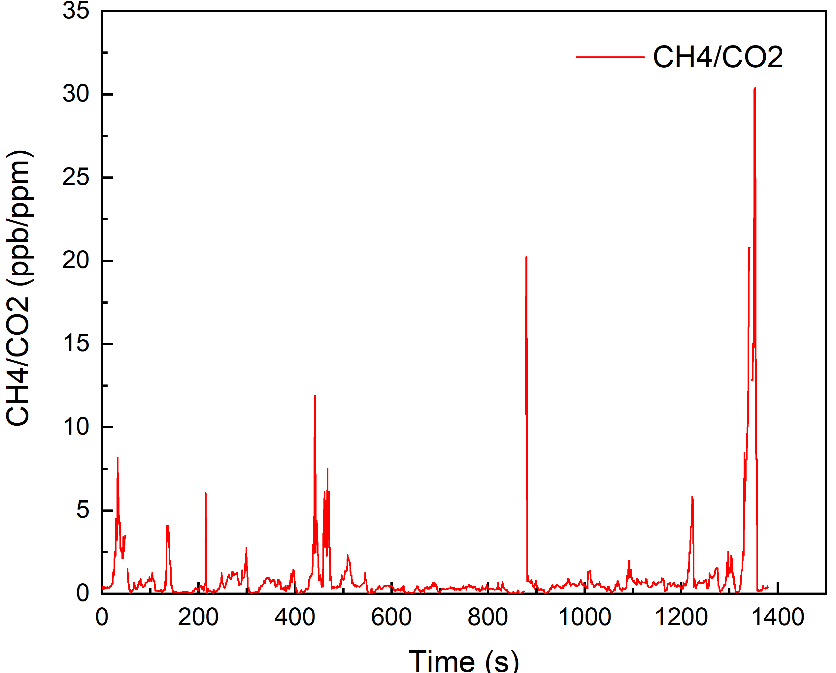
Results
CH₄ and CO₂ excess levels, CH₄:CO₂ ratio
b)
a)
Fig. 4. a) High traffic area sampling.
b) CH₄ and CO₂ excess level.
c) CH₄:CO₂ ratio.
c)

Slide 12
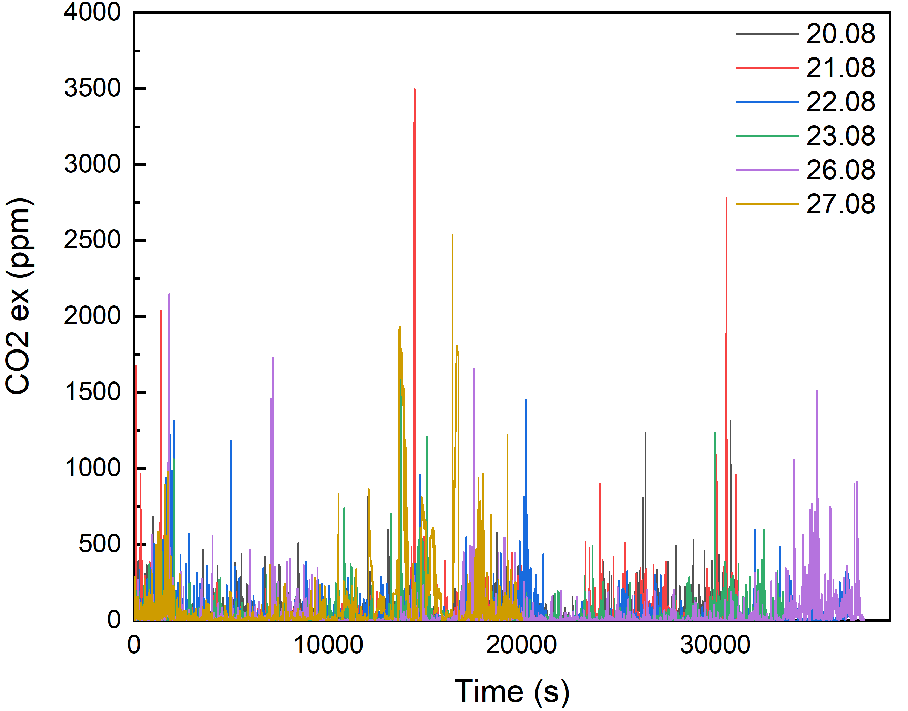
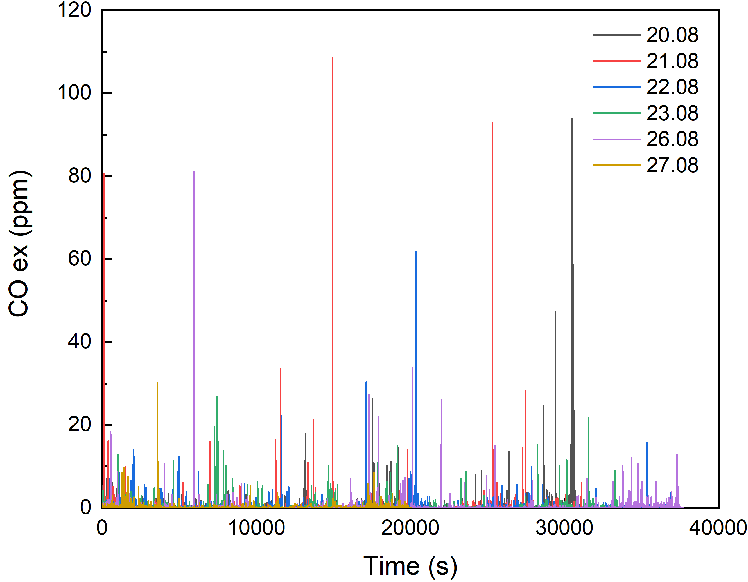
Results
CO and CO₂ excess levels
Fig. 5. Plots of CO₂ excess during the measurement campaign
Fig. 6. Plots of CO excess during the measurement campaign

Slide 13
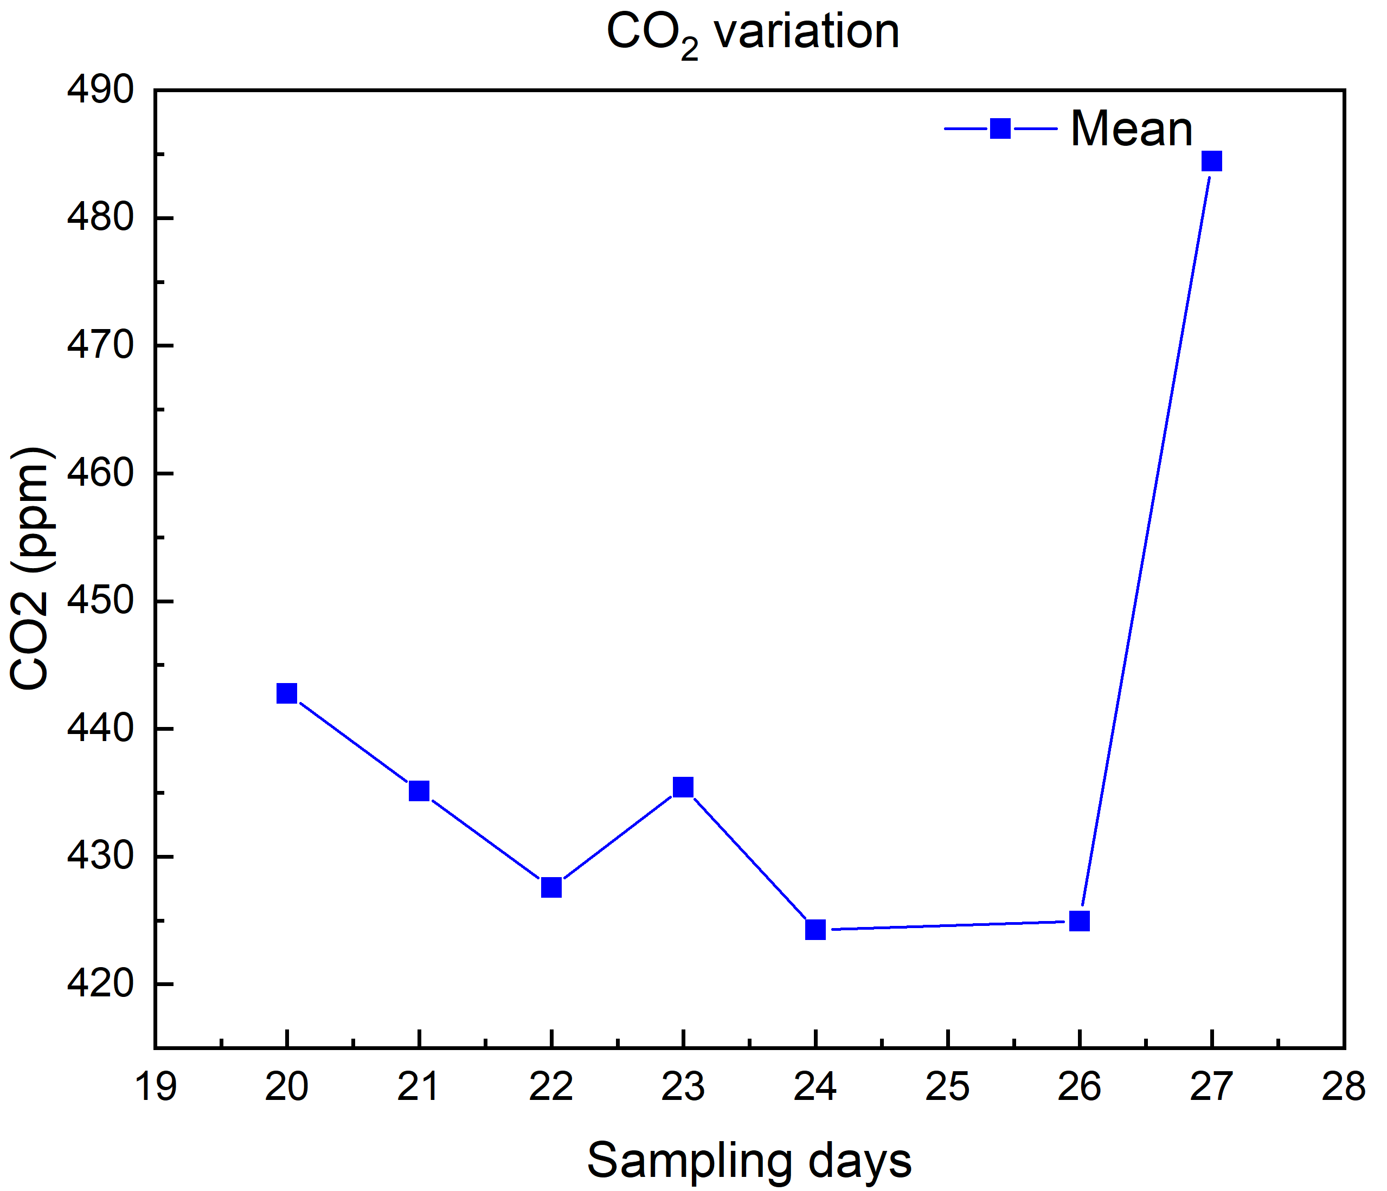
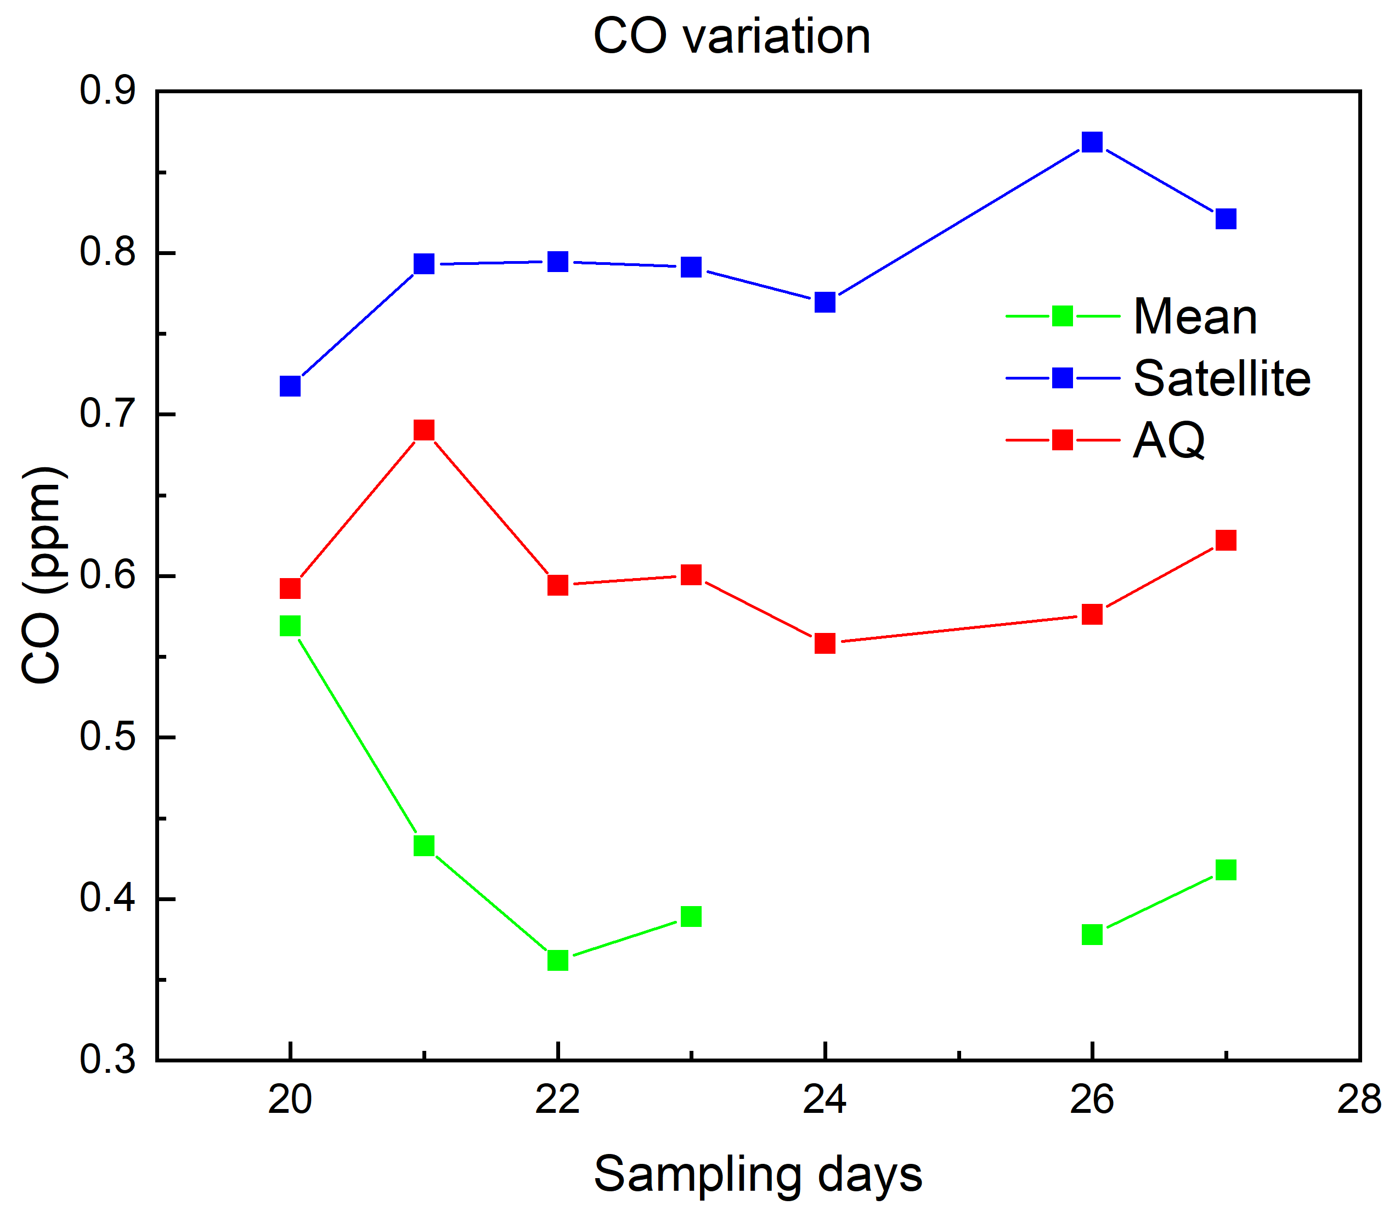
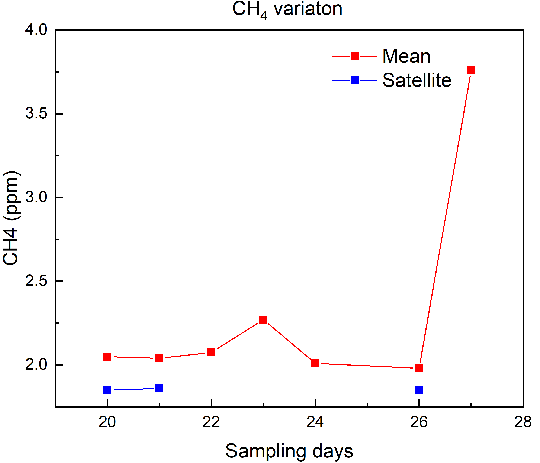
Results
Satellite, air quality monitoring and city campaign observations
b)
a)
Fig. 7. a) CO variation.
b) CO₂ variation.
c) CH₄ variation.
c)

Slide 14
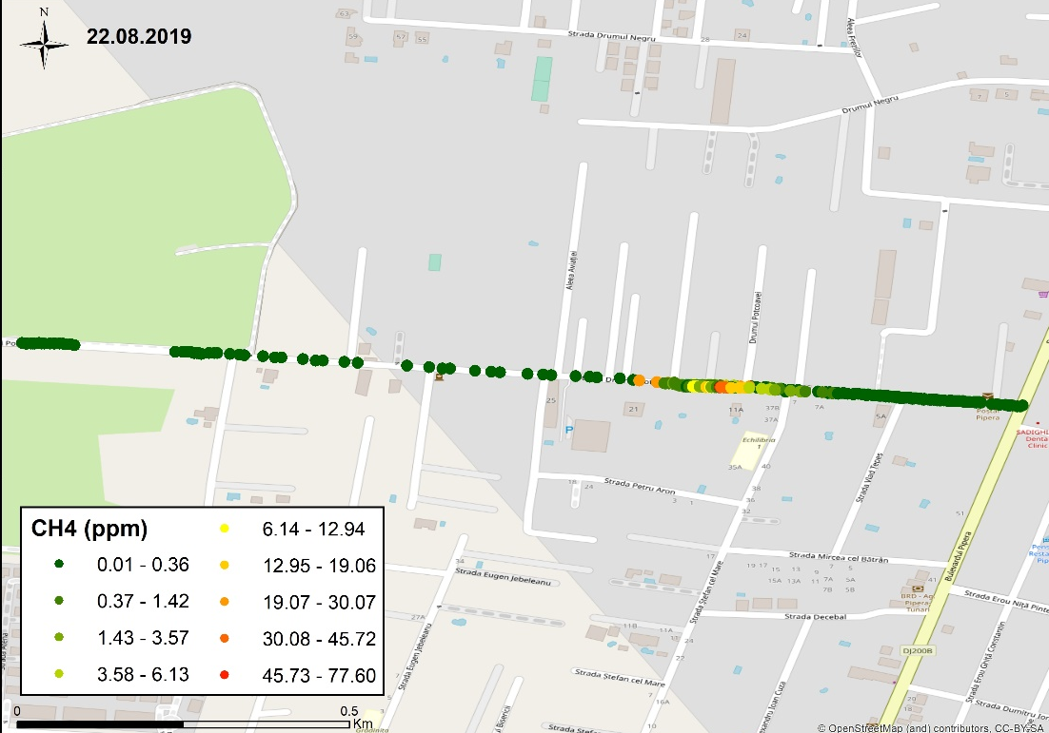
Results
Satellite and ground CH₄ measurements
Satellite observation on 21.08
Latitude 44.50 °N
Longitude 26.12 °E
Methane mixing ratio:
1850.16 (1.85 ppm)
After detecting this methane levels, we’ve contacted the gas distributor and together we’ve identified the source of the problem and they remedied it.
Fig. 8. Measurements of methane during the campaign.

Slide 15
Conclusions
We identified concentrations of CO up to 108 ppm, of CO₂ up to 6162 ppm, and of CH₄ up to 246 ppm
We identified background levels as follows: CO: 0.173±0.018 ppm, CO₂: 406.71±12.07 ppm, and CH₄: 1.93±0.016 ppm
On the Bucharest scale, in 2019, both atmospheric ground-based measure-ments and satellite data indicate points of high concentrations of CO, CO₂, CH₄
Identified hot-spots are, most likely, linked to local anthropogenic activities in the nearby surroundings
Results of our study provide an updated quantitative image of CO, CO₂, CH₄

Slide 16
Acknowledgements
This research is supported by ROMEO project, developed under UNEP’s financial support
PCA/CCAC/UU/DTIE19-EN652. Partial financial support from UB198/Int project is also acknowledged.
The authors acknowledge the free use of tropospheric CO and CH4 column data from TROPOMI (Sentinel-5P) sensor from https://s5phub.copernicus.eu, the NOAA Air Resources Laboratory for the provision of the HYSPLIT transport model available at READY website https://www.ready.noaa.gov and Rhenish Institute for Environmental Research at the University of Cologne http://www.eurad.uni-koeln.de/ for the synoptic weather maps.
Special thanks to all INCAS technical staff for their support in performing the campaigns.
Thank you!

