Slide 1
Modelling of SOC and carbon balance under Conservation Agriculture and conventional cropping systems in Southern Finland
Elena Valkama and Marco Acutis

Slide 2
Conservation Agriculture (CA)
Minimum soil disturbance
Permanent soil cover
Crop rotation and intercropping
In Europe, CA would reduce emissions by about 200 Mt CO₂ per year (FAO)

Slide 3
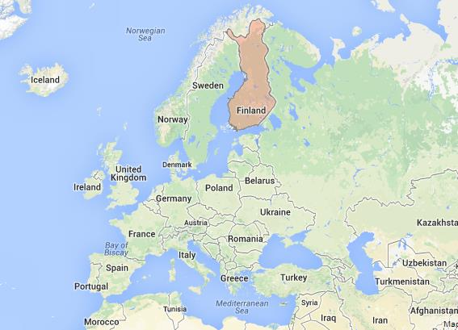
Methods
SOC modeling-
ARMOSA
Carbon credits
C balance-SALM
Boreal
(Dfs)
597 mm
4.1 ◦C

Slide 4
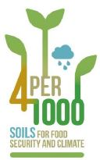
Simulated annual SOC stock changes
Valkama et al. (2020) Can conservation agriculture increase soil carbon sequestration? A modelling approach. Geoderma: 369 https://doi.org/10.1016/j.geoderma.2020.114298
Conv-R/Conv+R – Conventional (residues removed/retained);
NT-no-tillage;
CA- Conservation Agriculture; CA+CC - Conservation Agriculture + Cover Crops

Slide 5
Carbon balance and carbon credits
SALM -Sustainable Agricultural Land Management - is a VERIFIED CARBON STANDARD method
Developed by the World Bank’s BioCarbon Fund
1t CO₂ reduced=1 credit=21 €
Emissions
Sink
Conv+R – Conventional (residues retained)
CA+CC - Conservation Agriculture + Cover Crops

Slide 6
Conclusions
Conv+R emitted 2.0 t CO₂e ha⁻¹yr⁻¹, mainly due to SOC loss.
CA and CA+CC allowed to SOC sequestration, resulting in emissions reduction.
By adopting CA and CA+CC in Finland, there is a potential to obtain 2.5 and 3.7 carbon credits (52 and 77 € ha⁻¹yr⁻¹ ) respect to baseline.
Under future climate scenario, SOC decline for conventional systems will be more pronounced, and SOC sequestration will be possible to accomplish only for CA+CC.

