Slide 1
Resources for teachers on “The Ocean and Cryosphere in a Changing Climate”
David Wilgenbus, Lydie Lescarmontier, Mathilde Tricoire, Mariana Rocha, Nathalie Morata, Office for Climate Education (OCE)
Eric Guilyardi, Institut Pierre Simon Laplace (IPSL)
Robin Matthews, IPCC Working Group I Technical Support Unit
Jenny Schlüpmann, Freie Universität Berlin
EGU – remote presentation – 08 may 2020

Slide 2
THE OCE: A foundation in partnership with science and education communities
Under the auspices of
Founding members
With the support of

Slide 3
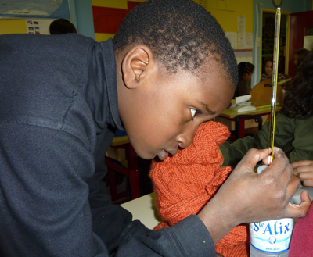
Main objectives of the Office for Climate Education
Promote climate education in primary and secondary schools, worldwide
Help our Youth to build a critical mind and a hopeful heart
Support teachers with
Free & multilingual education resources
Professional development
Networking
Phase its action with the IPCC reports
Involve scientific community, NGOs and education authorities
Promote active pedagogies and climate action

Slide 4
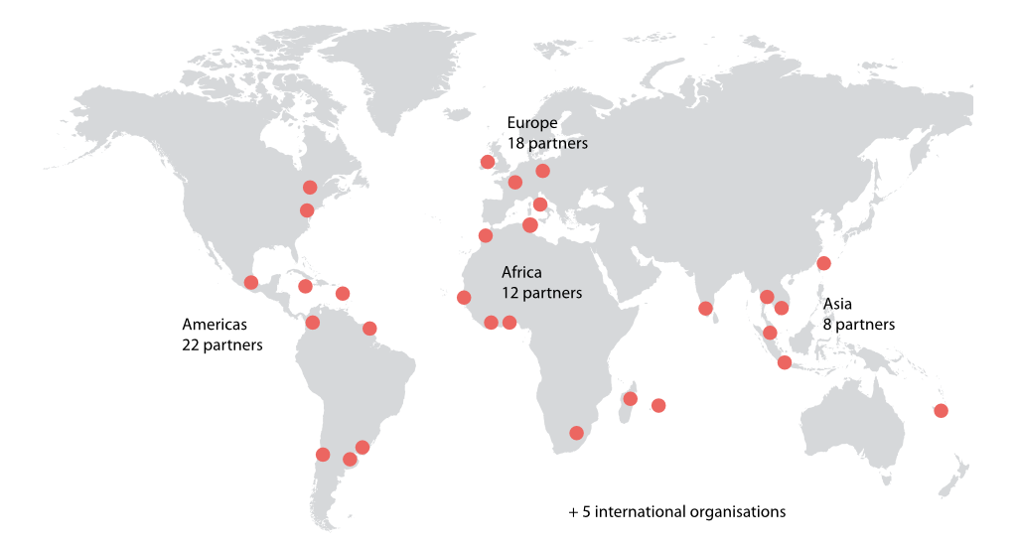
An international network of 60+ partners ⟹ adaptation to local contexts

Slide 5
IN 2020: A SET OF EDUCATION RESOURCES ON THE SUBJECT OF « OCEAN AND CRYOSPHERE »

Slide 6
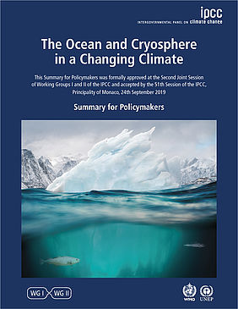
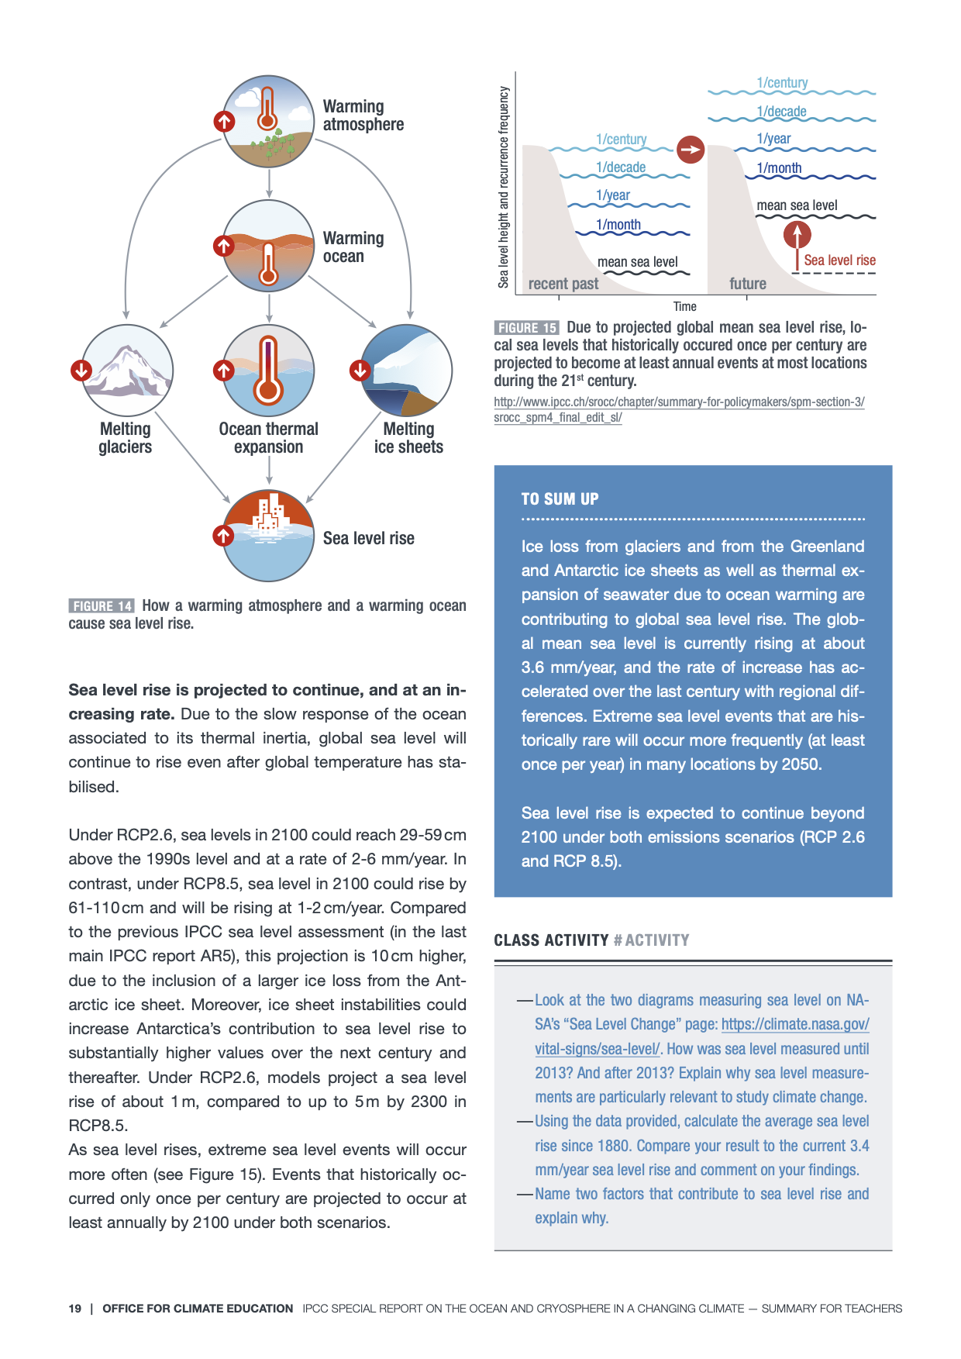
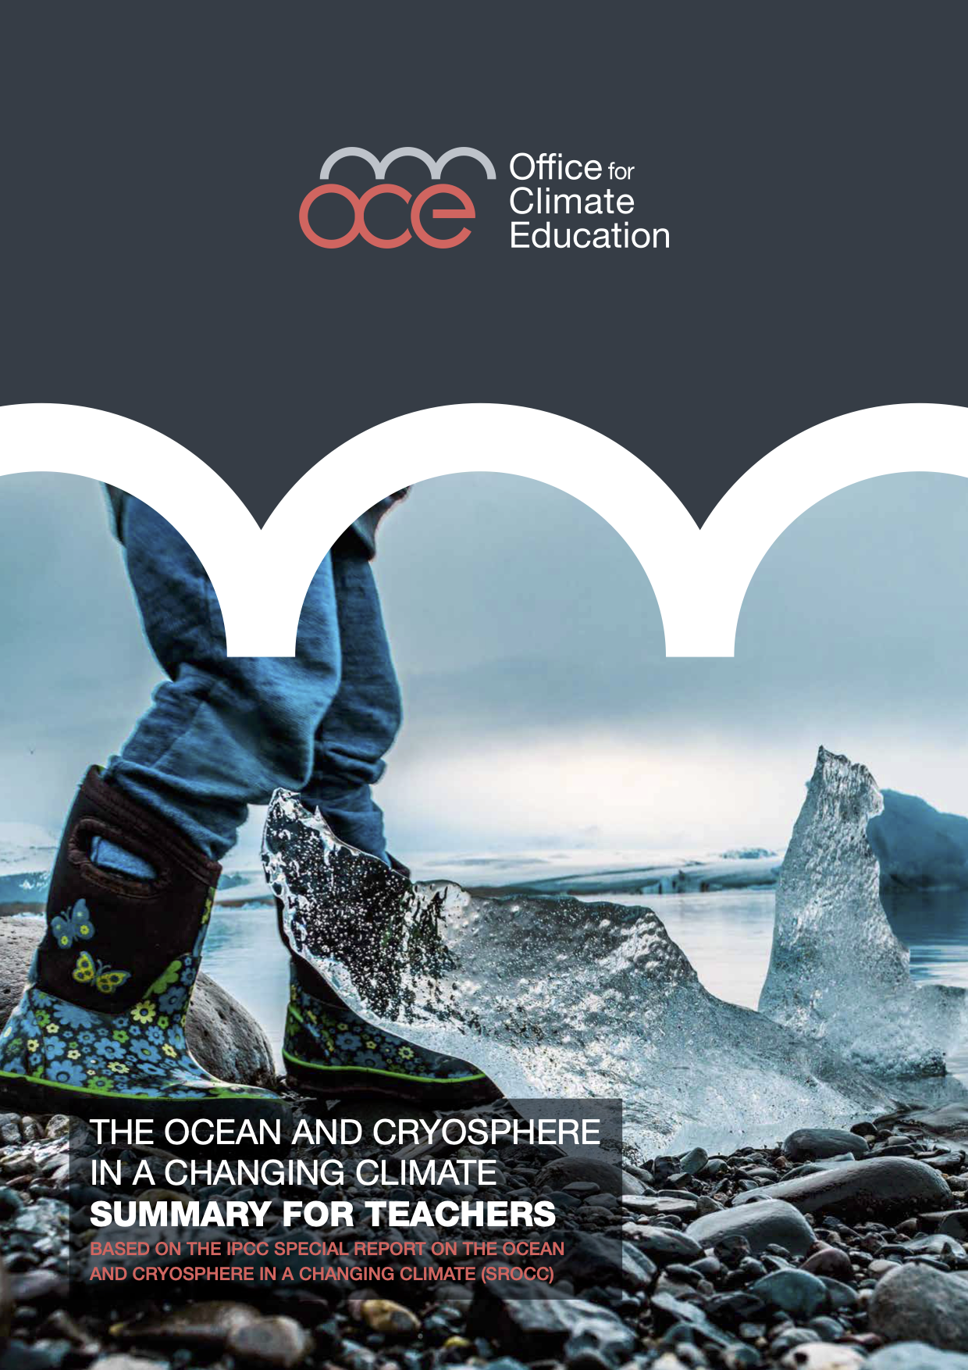
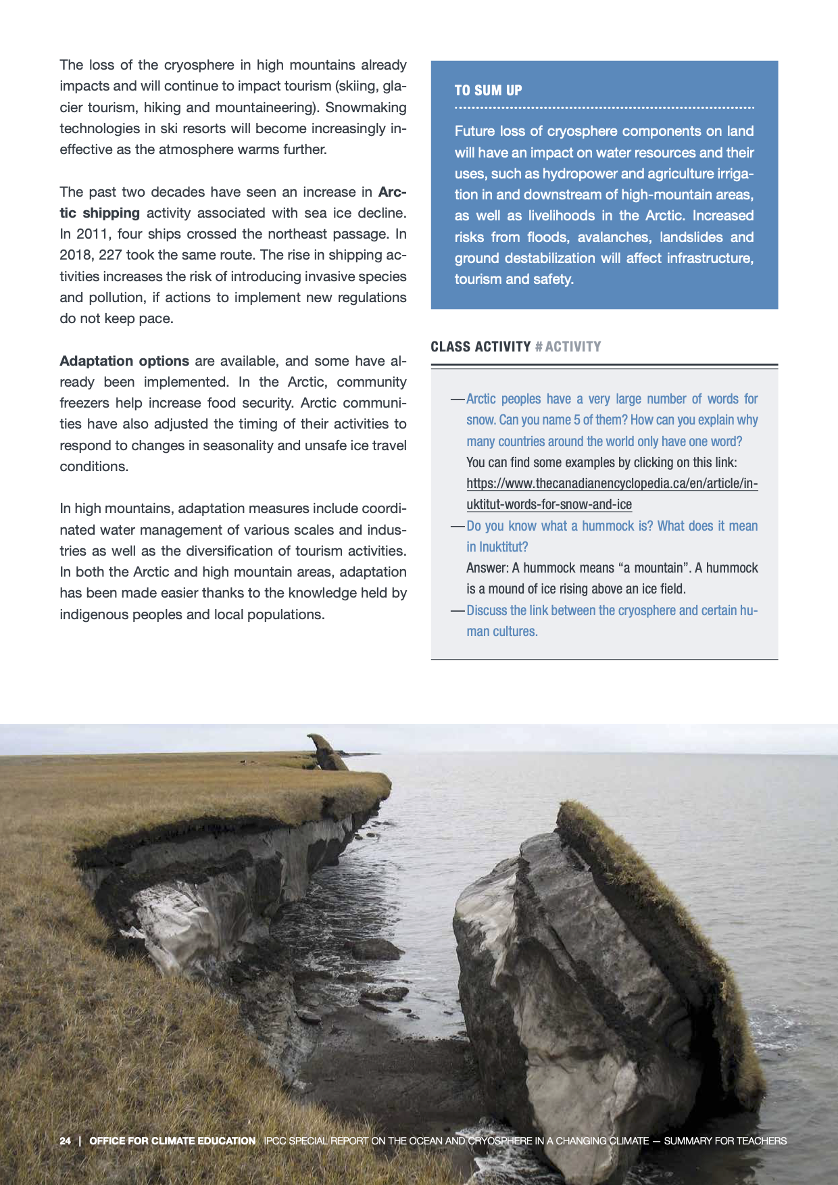
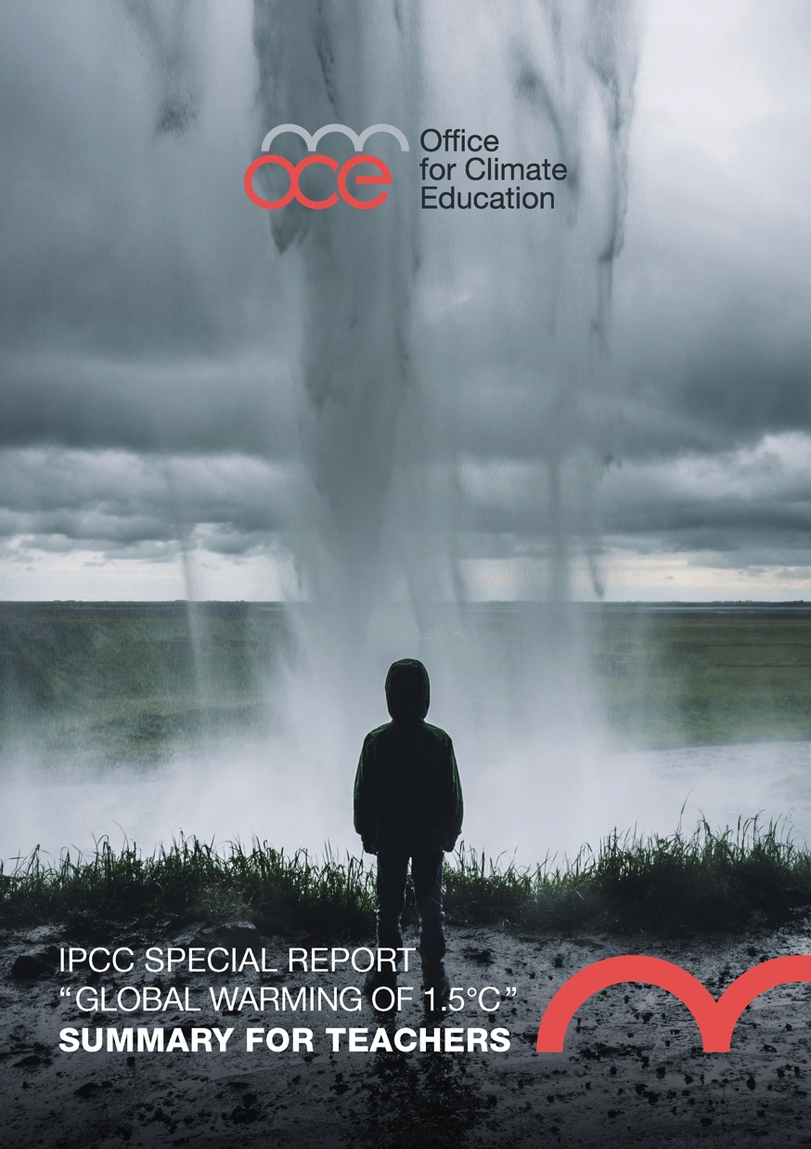
Adapting IPCC reports for primary and secondary school teachers
Simplify
Explain
Illustrate
Provide examples of activities
Note: A summary for teachers of the IPCC “1.5°C” special report is also available in EN / FR / ES / DE

Slide 7
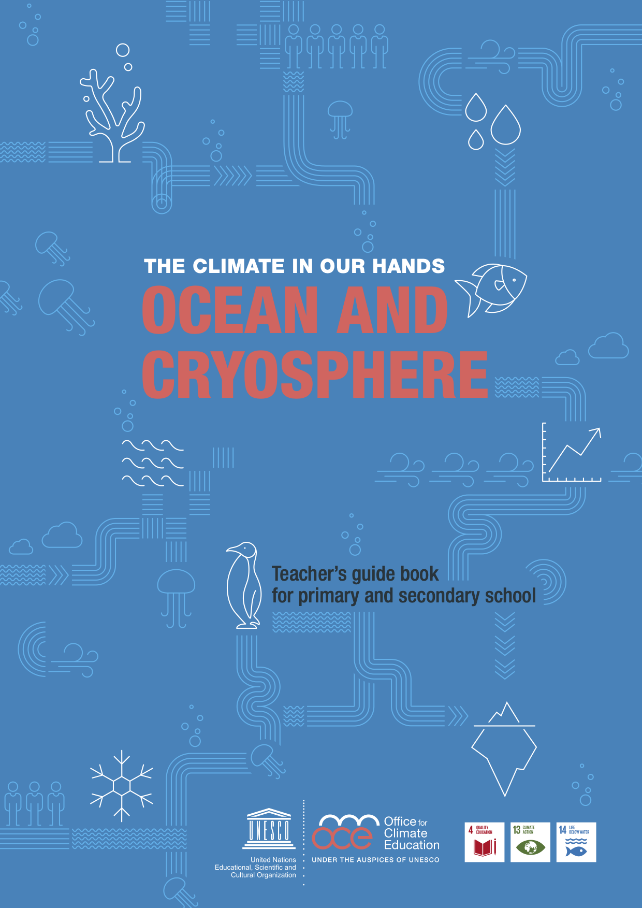
A TURN-KEY TEACHER’s guide book
200 pages
Free
Available in 4 languages : EN, FR, ES, DE
Tested in Class & validated by scientists
Scientific background
Pedagogical background
17 turn key lessons
3 local projects
Documents and multimedia addons

Slide 8
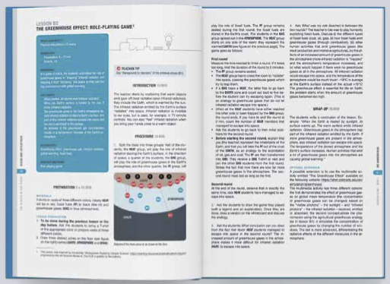
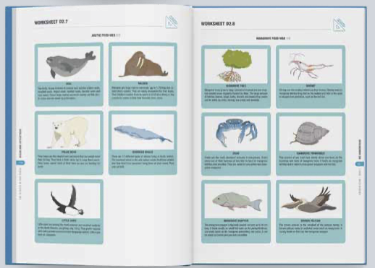
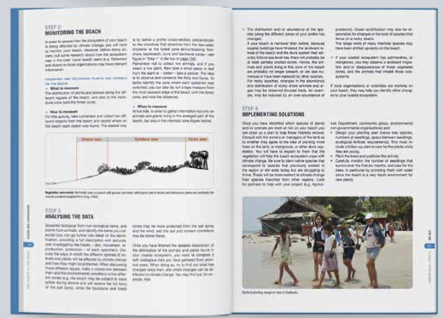
Storyline of the pedagogical project
Pedagogical approach
Inquiry-based science education
project-based learning
Action-oriented
Multidisciplinary

Slide 9
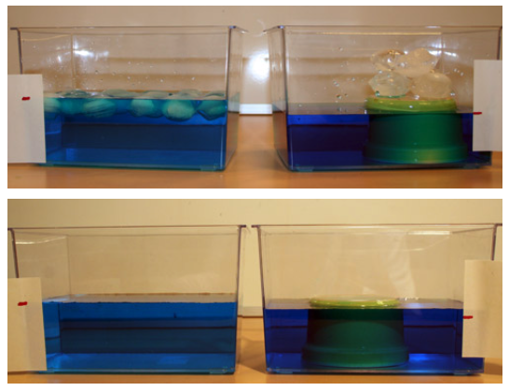
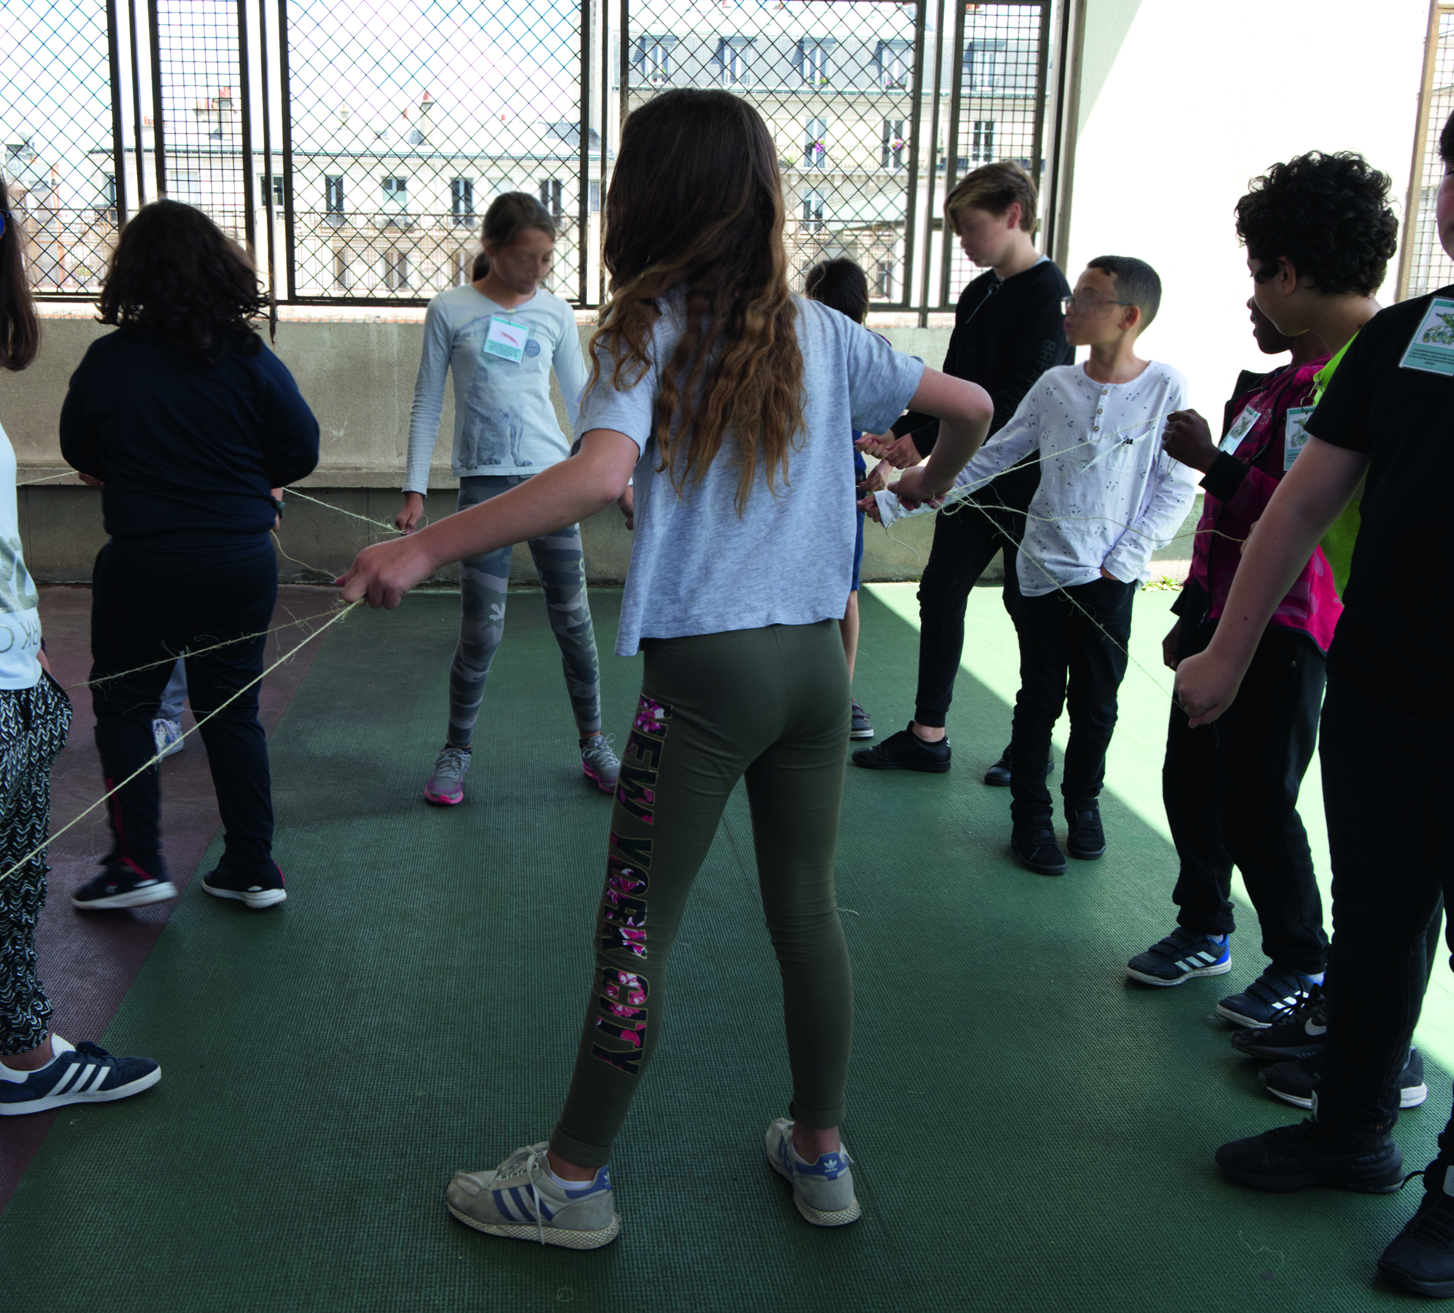
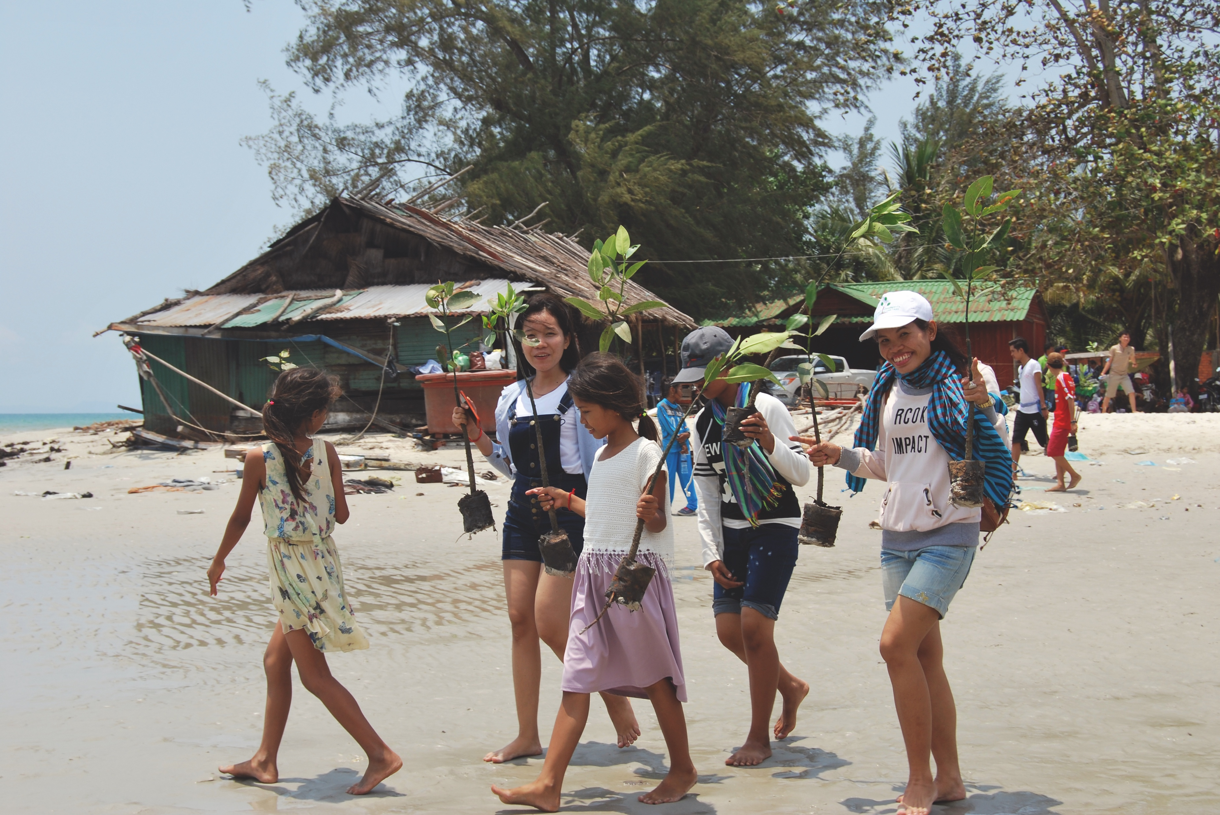
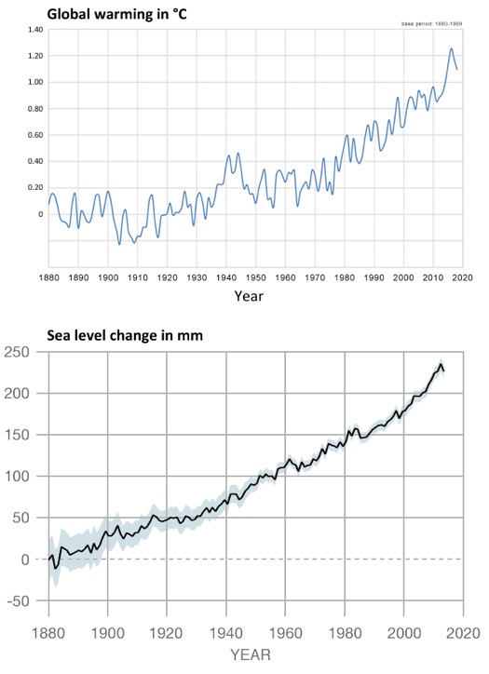
Pedagogical approach
ACTIVE PEDAGOGIES
Inquiry-based science education
Project-based learning
Action-oriented
Multidisciplinary
Different kind of activities
Experiment / modelling
Role playing game
Debate
Document study
Implementation of local project

Slide 10
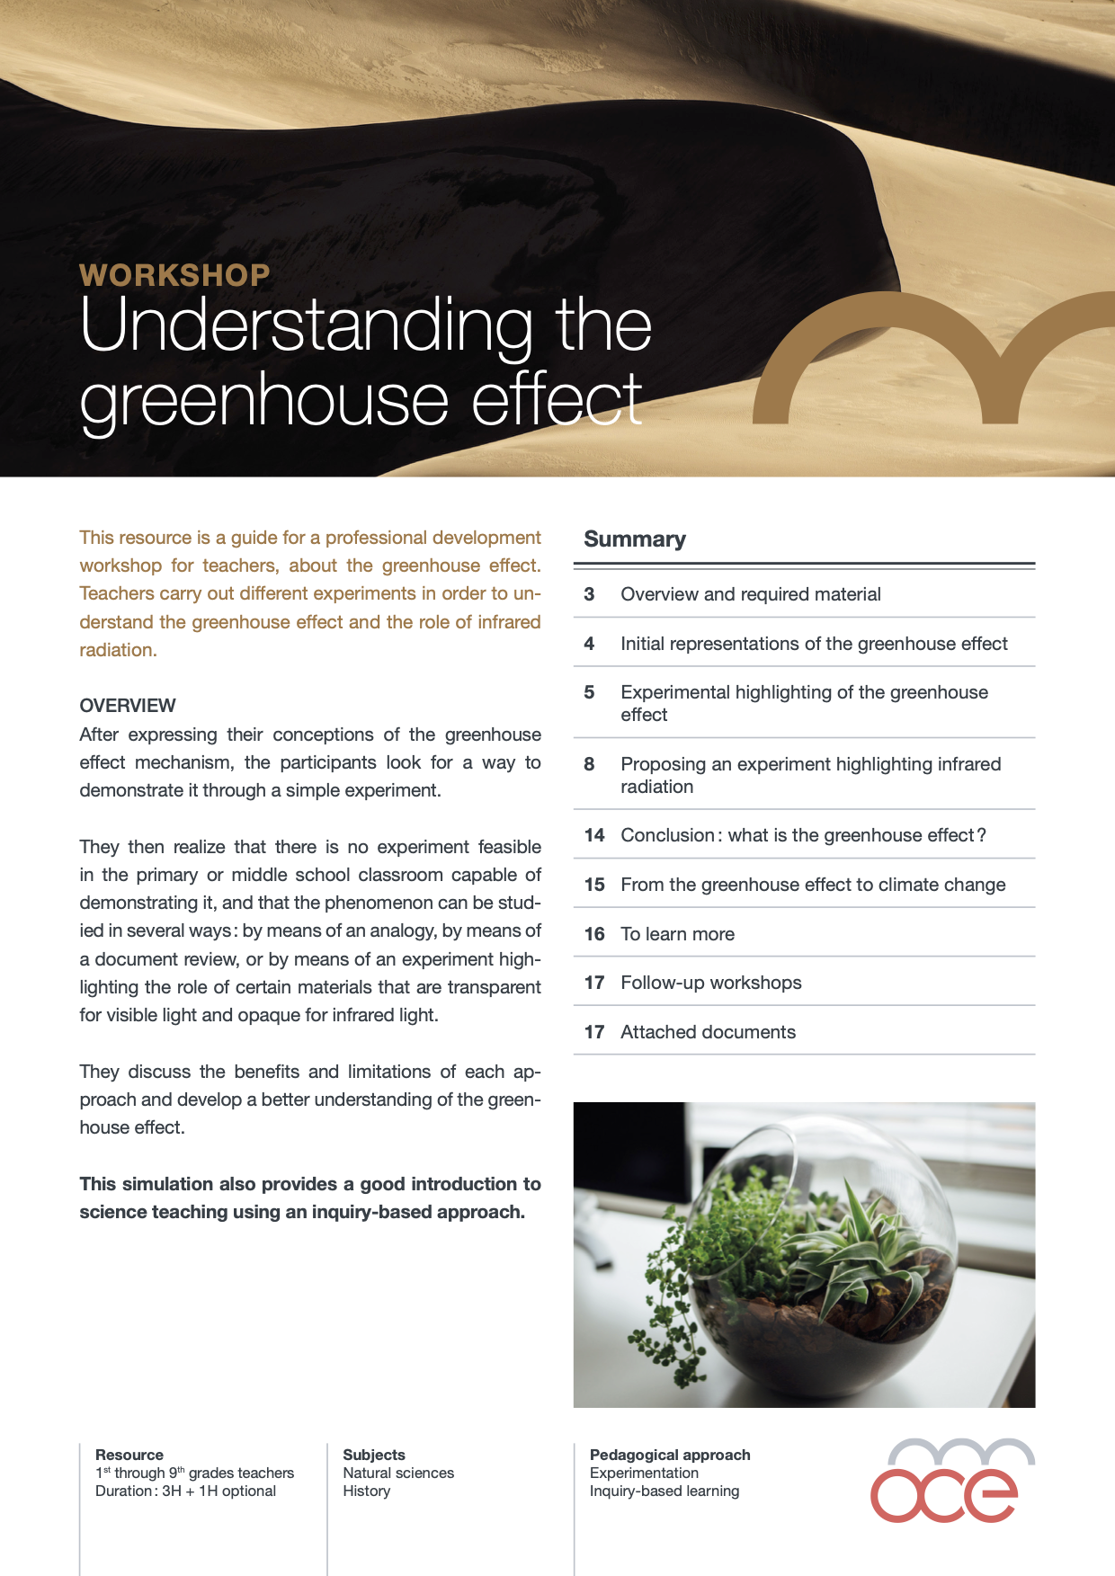
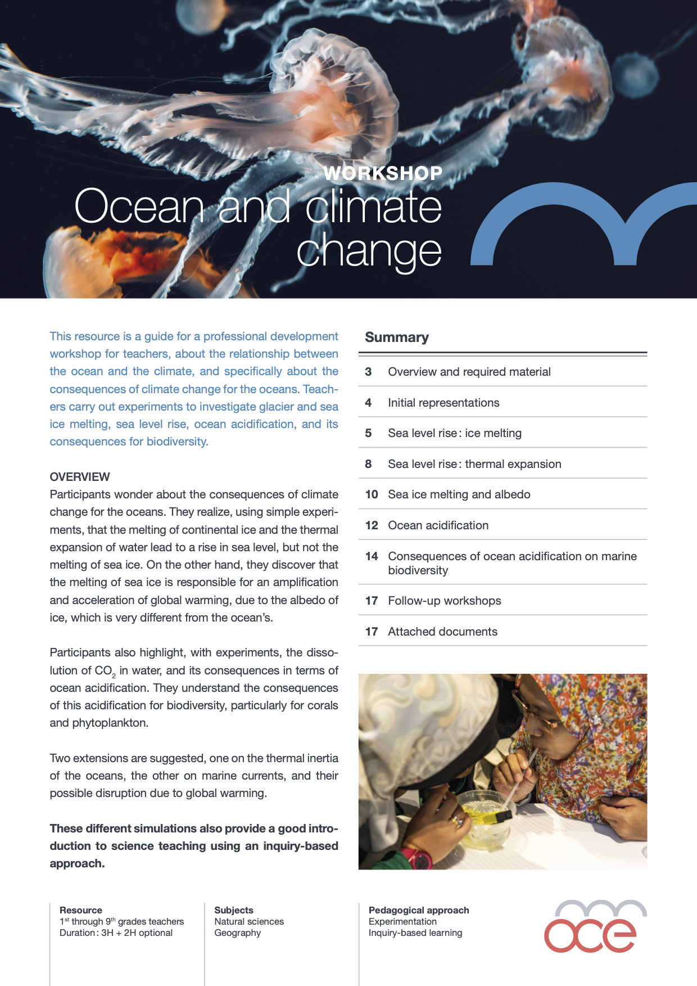
3 teacher training protocols

Slide 11
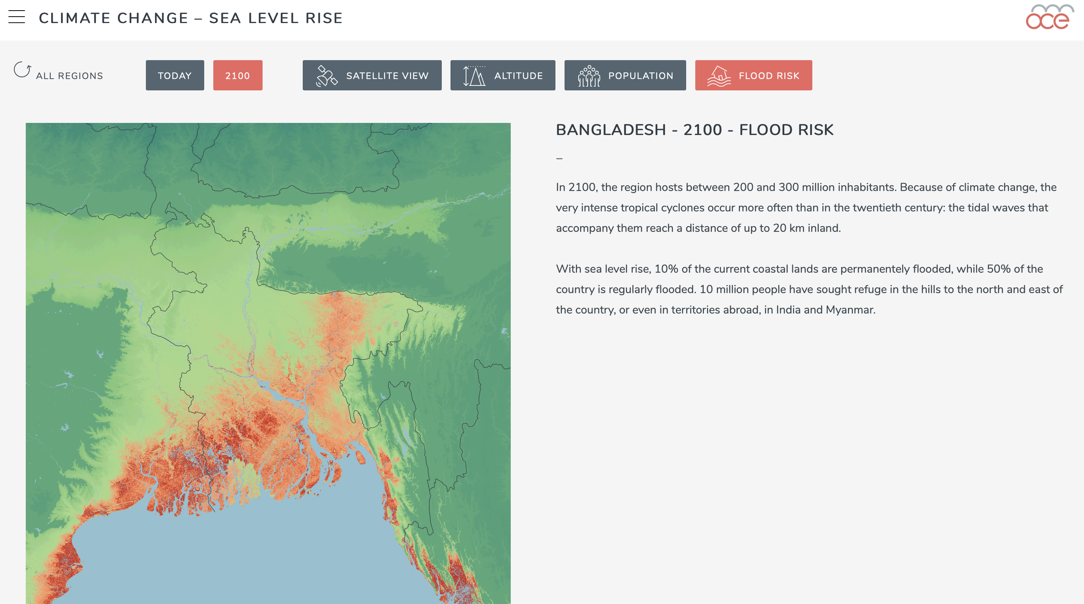
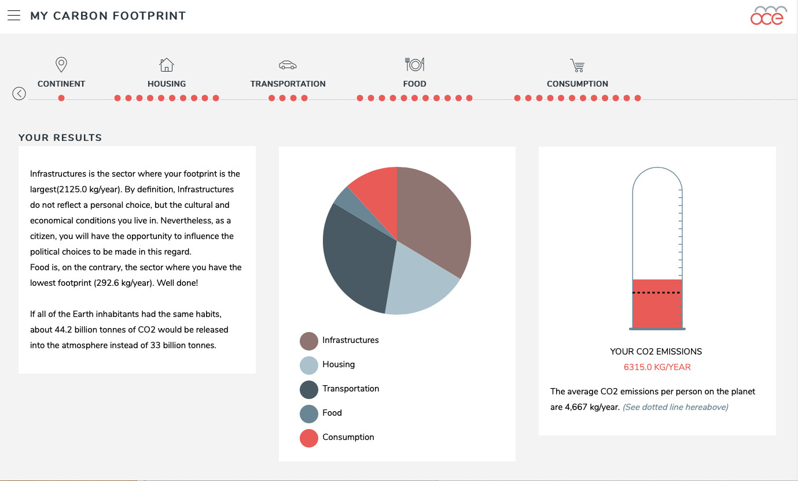
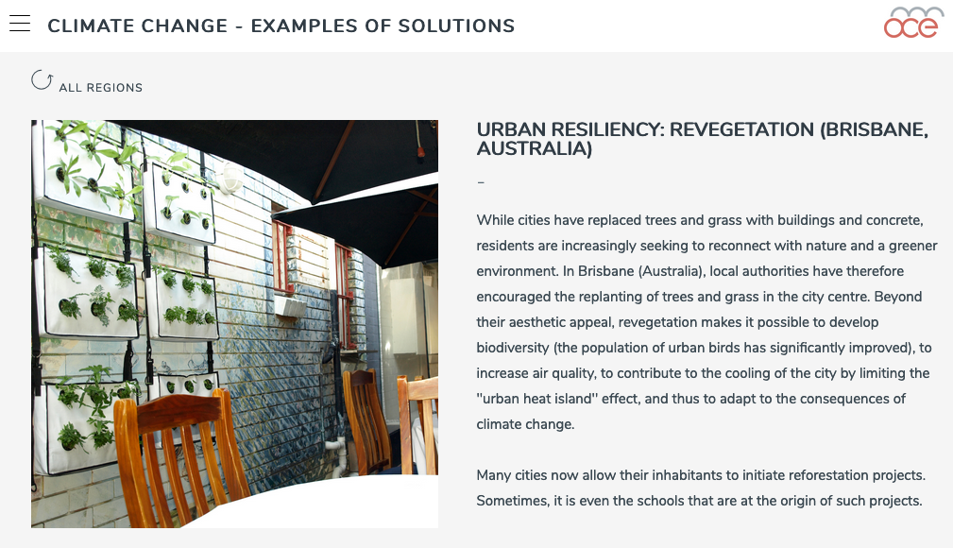
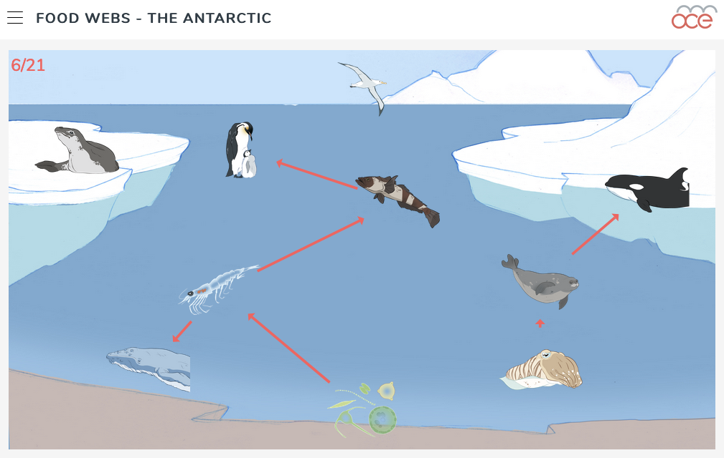
4 multimedia animations
Sea level rise
My Carbon footprint
Examples of solutions
Foodwebs

Slide 12
10 short + 1 long videos

Slide 13
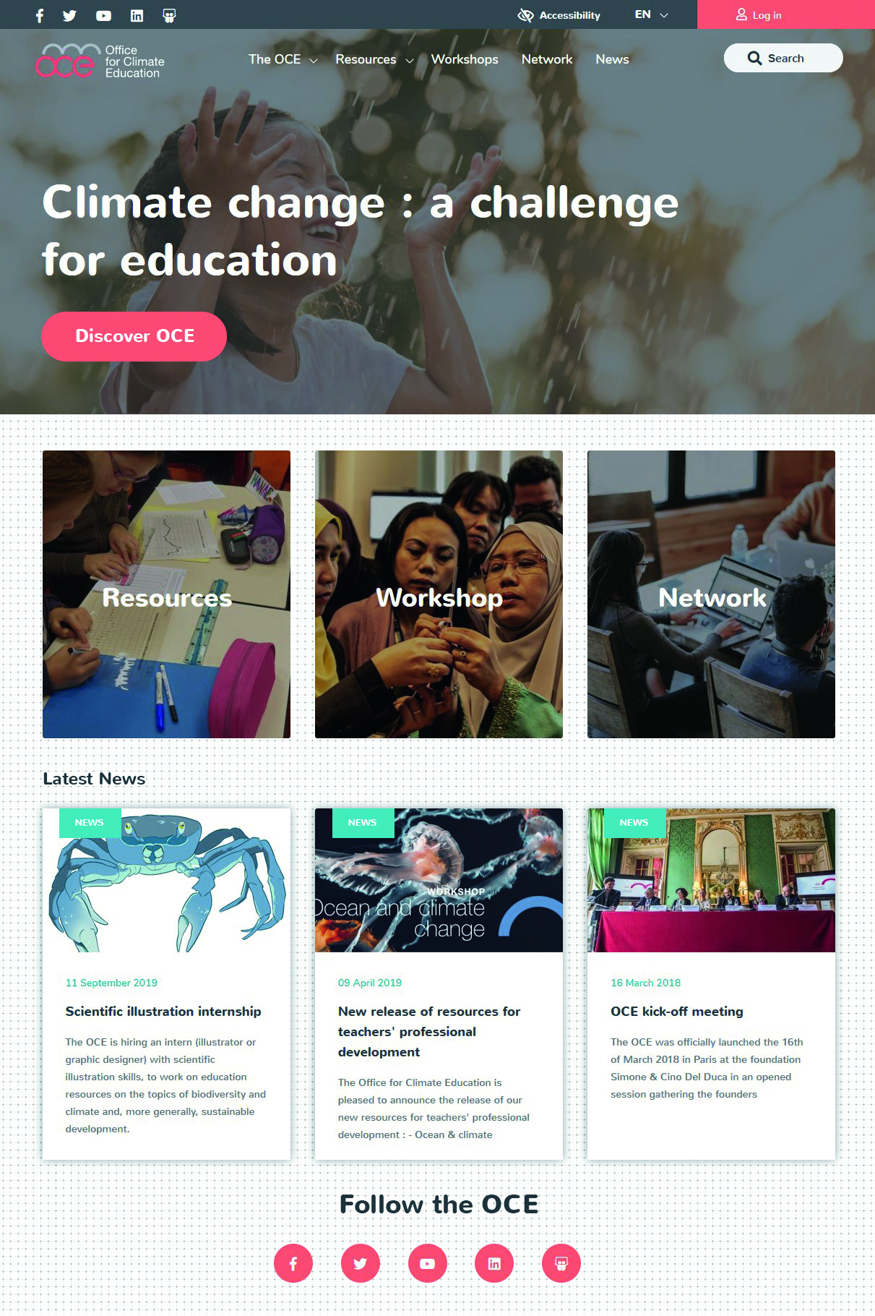
Where to find those resources? www.oce.global
Free resources in 4 languages
Workshops
Network
Projects

Slide 14
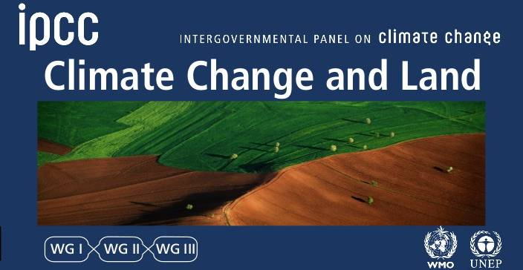
In 2021 : new resources to come… on the subject of “climate change and land”

Slide 15
contact@oce.global www.oce.global

