Slide 1

Paul Prikryl^{a,b,}*, Vojto Rušin^{c}, Pavel Šťastný^{d}, Maroš Turňa^{d}, Martina Zeleňáková^{e} ªPhysics Department, University of New Brunswick, Fredericton, NB, Canada
^{b}Geomagnetic Laboratory, Natural Resources Canada, Ottawa, ON, Canada
^{c}Astronomical Institute, Slovak Academy of Sciences, Tatranská Lomnica, Slovakia
^{d}Slovak Hydrometeorological Institute, Bratislava, Slovakia
^{e}Technical University of Košice, Košice, Slovakia
European Geosciences Union General Assembly, Vienna, Austria, 3–8 May 2020 – NH1.6/AS1/HS13
Extreme meteorological and hydrological events induced by severe weather and climate change
Severe weather in the context of solar wind coupling to the magnetosphere-ionosphere-atmosphere system
Notes:
This session is a forum for interdisciplinary exchange of research approaches and results. In this presentation we examine severe weather in the context of solar wind coupling to the magnetosphere-ionosphere-atmosphere system.

Slide 2
Outline
• Introduction & Motivation
• Statistical results
- Extratropical cyclones
- Heavy rainfall & Flash floods
• Interpretation
• Summary & Conclusions
Notes:
I will introduce it, show statistical results, how we interpret them, and conclude

Slide 3

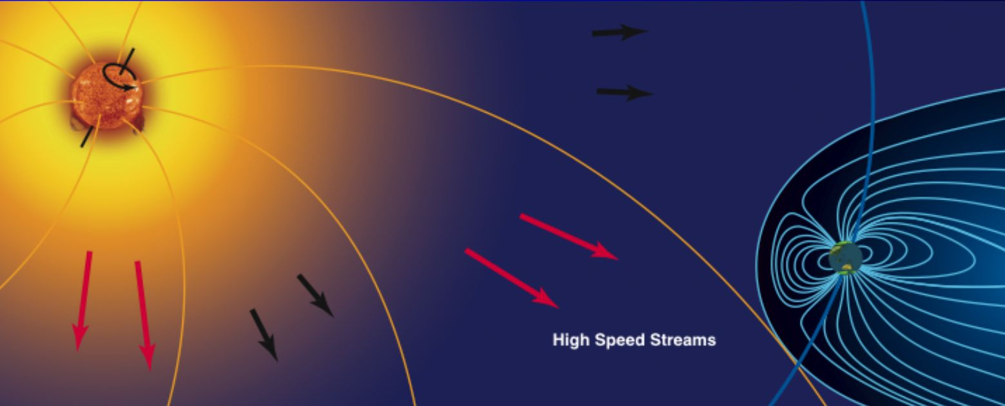

Solar wind – magnetosphere – ionosphere – atmosphere coupling
Ionospheric
convection
Alfvén waves
http://www.ava.fmi.fi/~minna/researchseminar/lectures/Eijanluento.pdf
Notes:
This diagram illustrates the solar wind - magnetosphere coupling process. The expanding atmosphere of the Sun, which we call solar wind, draws out magnetic fields from the Sun that couple to the Earth’s magnetosphere, connecting it to ionosphere and atmosphere. So it is in this the context we examine severe weather and a possible influence by solar wind.

Slide 4
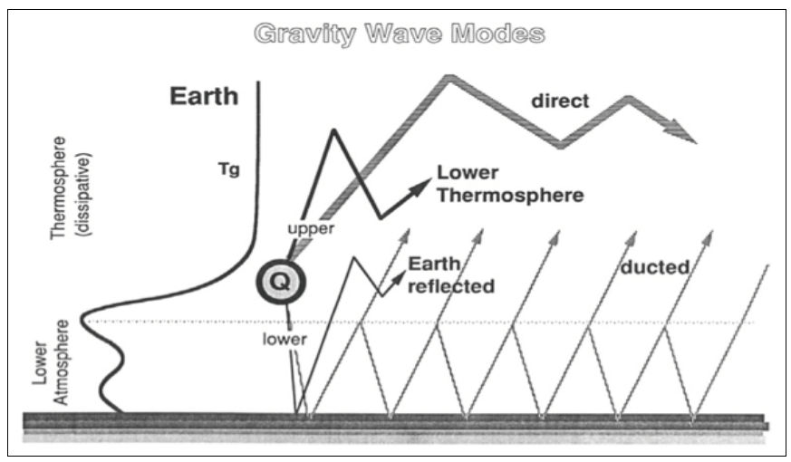
Mayr et al. (1990), Thermospheric gravity waves: Observations and interpretation using the transfer function model - Space Science Reviews 54, 297–375.
Notes:
Of course, solar wind is very much rarified medium, so it must be an indirect influence on troposphere, which we believe is mediated by AGWs. I will come to that later.

Slide 5
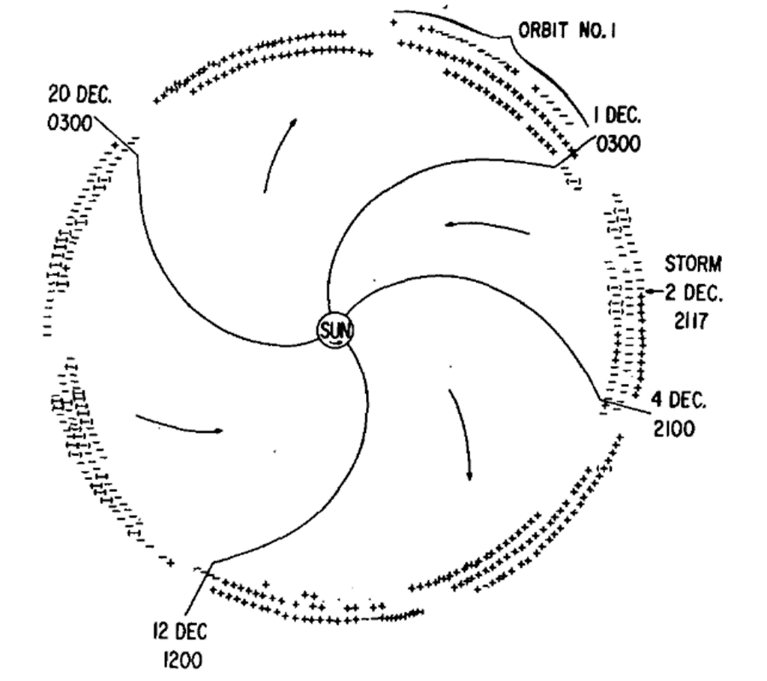
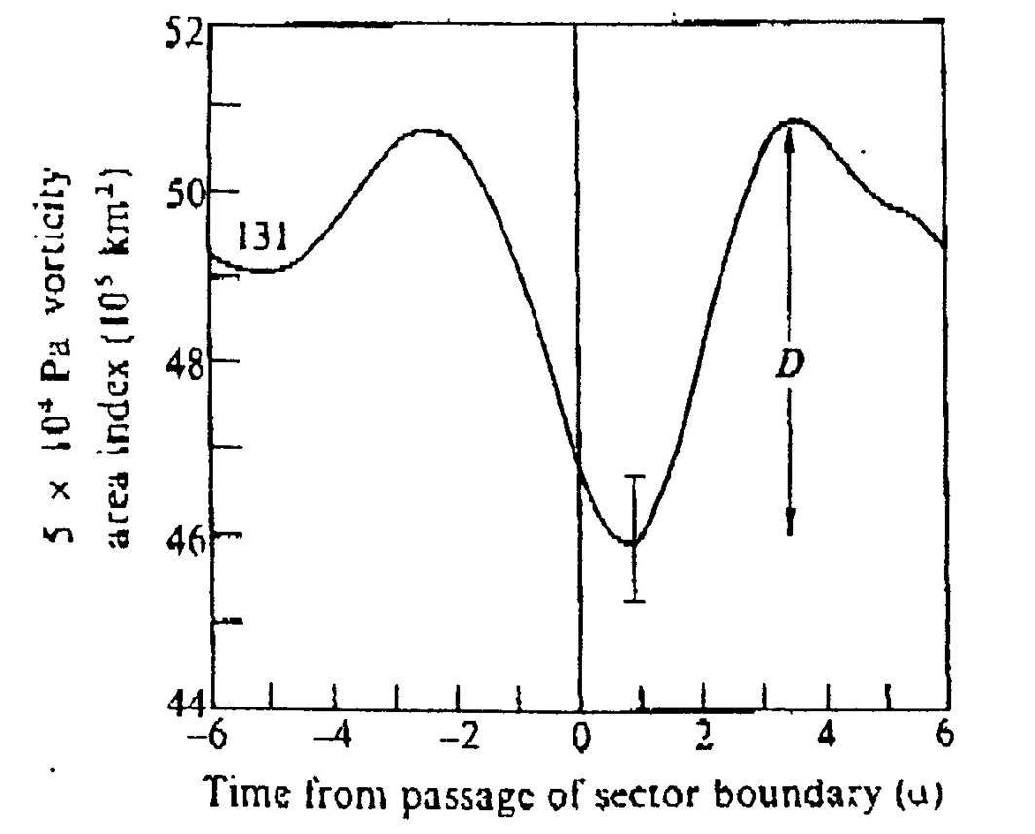
Motivation & Introduction
• Wilcox effect (Wilcox J. M., et al., Science, 180, 185-186, 1973.)
Nov-Mar 1963-1973
Vorticity Area Index
Wilcox et al., J. Atmos. Sci, Vol. 31, 581-588, 1974.
Notes:
The motivation for this work dates back more than 40 years. In 1970’s a solar physicist John Wilcox discovered a connection between the sector boundaries in the IMF (shown on the right) and vorticity in the upper troposphere. For the mid-latitude in winter, when the extratropical cyclones are most active, they found a statistically significant dip in Vorticity Area Index (VAI) just after the SBC and then an increase to a maximum a few days later. They used the SPE analysis method.

Slide 6
Motivation & Introduction
• Wilcox effect (Wilcox J. M., et al., Science, 180, 185-186, 1973.)
• Confirmed in the Northern and Southern Hemispheres
Prikryl et al., Ann. Geophys., 27, 1–30, 2009.
Notes:
We have revisited the Wilcox effect and showed its validity using the modern ERA40 reanalysis, both in the northern and southern hemisphere.

Slide 7
Superposed epoch analysis of green corona solar wind parameters and VAI – Wilcox effect
131 IMF sector
boundary crossings
Nov-Mar 1963-1973
Wilcox et al., Nature, 1975.
Prikryl et al., Ann. Geophys.,
27, 1–30, 2009.
Notes:
Of course, SBs are just markers in solar wind signalling the arrivals of HSS/CIRs from coronal holes. This slide shows SPE analysis of solar wind parameters measured near the Earth (bottom panel) and solar corona intensity on the central meridian on the Sun (top panel), keyed to SBCs. It shows an expected result, arrivals of HSS and a compression region on its leading edge, which we call co-rotating interaction region (CIR). What may be unexpected here, is the Wilcox effect that is shown over the mean corona intensity plot above.

Slide 8
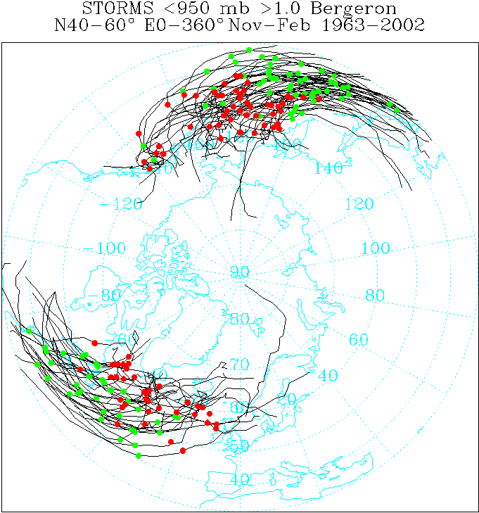
Explosive extratropical cyclones
Storm tracks obtained from the ERA-40
Prikryl et al., J. Atmos. Sol.-Terr. Phys., 149, 219–231, 2016.
Notes:
But the VAI is measure of storminess, representing the growth and decay of extratropical cyclones. These are the storm tracks of explosive extratropical cyclones, wth the maximum growth rate indicated by green dots. Red dots show minima in central pressure.

Slide 9
The SPE analysis keyed to max growth rate (<950mb) of 91 explosive extratropical cyclones in the Atlantic and Pacific
CIR: Co-rotating Interaction Region
SBC: IMF Sector Boundary Crossing
Prikryl et al., J. Atmos. Sol.-Terr. Phys., 149, 219–231, 2016.
Notes:
The SPE analysis (on the right) is now keyed to the maximum growth rate of these storms (black line in the bottom panel). So if this had nothing to do with the solar wind, the SPE analysis of SW parameters would be expected to show some random patterns or flat curves, depending on the number of cases superposed. But we consistently get this familiar pattern – The mean velocity (green line) ramping up from a minimum before to a maximum after the key time, while the other parameters showing peaks around or just before day 0.

Slide 10
These results indicate a tendency of explosive cyclones to follow arrivals of high-speed solar wind streams (HSS) from coronal holes, suggesting a link between the space weather and the tropospheric weather.
Notes:
Such patterns indicate a tendency of explosive development following arrivals of HSS/CIR and suggest a link between the solar wind and troposphere.

Slide 11
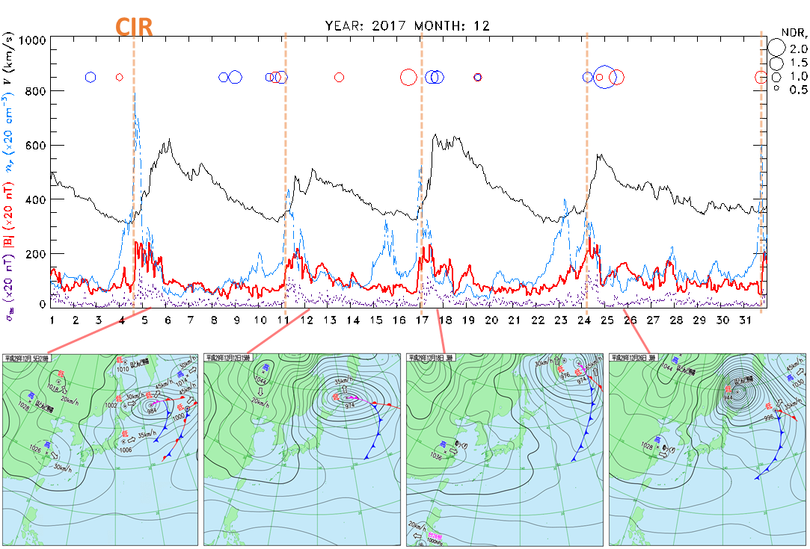
Explosive cyclones over Japan in December 2017
Pacific
Atlantic
Notes:
Here we show a few examples of explosive extratropical cyclones following arrivals of HSS/CIRs – pressure Lows rapidly deepening over Japan.

Slide 12
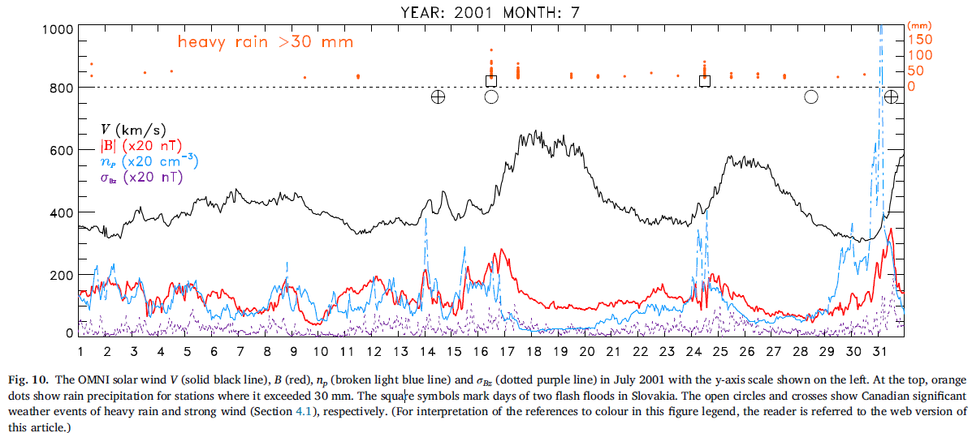
Heavy rainfall and flash floods in Slovakia
CIR
Čierny Hron
a Osrblianka
Štrbský potok
Prikryl et al., J. Atmos. Sol.-Terr. Phys., 171, 94–110, 2018.
Notes:
Similarly, here are events of heavy rainfall and flash floods. Two flash floods that followed HSS arrivals. Is this just a coincidence?

Slide 13
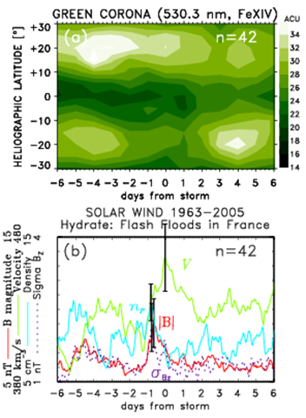
Flash floods in France (1963-2005)
The SPE analysis of time series of (a) green corona intensity and (b) solar wind plasma parameters keyed to start dates of flash floods in France (Hydrate project database)
www.Hydrate.tesaf.unipd.it
Notes:
Here are some statistical results. The SPE analysis of solar wind, this time keyed to dates of flash floods in France from the Hydrate Project database. A familiar pattern is revealed – The mean V ramping up from a minimum to a maximum, suggesting that these events tend to follow arrivals of HSS.

Slide 14
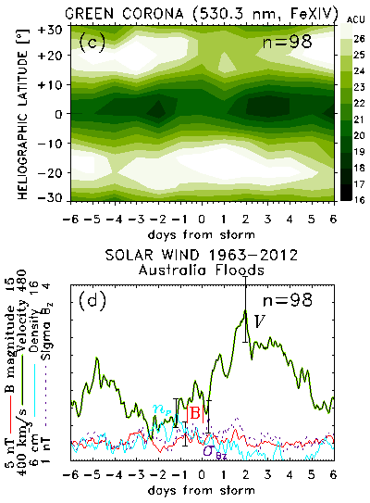
Major coastal flooding in southeastern Australia (1963-2012) .
The SPE analysis of time series of (a) green corona intensity and (b) solar wind plasma parameters keyed to start dates of floods in southeastern Australia (Callaghan, J., Power, S. B., Aust. Met. and Ocean. J., 64, 183–213, 2014.)
Notes:
Using the dates of major coastal flooding in southeastern Australia (1963-2012) even more clear pattern is revealed – The mean V ramping up from a minimum to a maximum, suggesting that these events tend to follow arrivals of HSS.

Slide 15
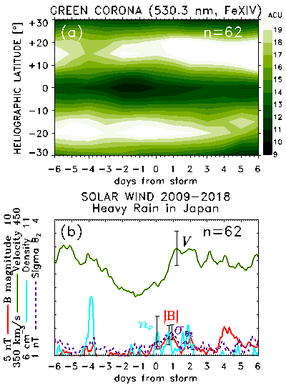
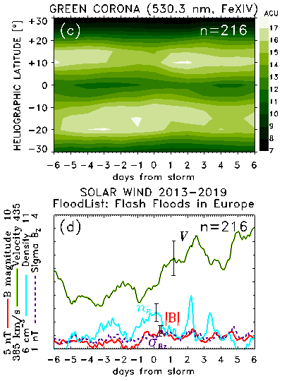
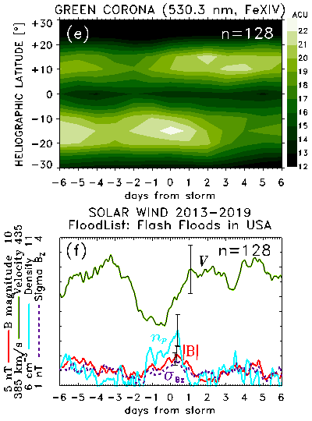
Heavy rainfall / flash floods
Japan Europe USA
The JMA annual nationwide summaries of severe weather events since 2009
Project FloodList, the European system for Earth monitoring and reporting floods and flooding news since 2008
http://floodlist.com/
http://www.jma.go.jp/jma/kishou/books/kishougaikyo/index.html
Notes:
Using other data sources: Here we show similar results – a tendency of these events in Japan, Europe and USA to follow arrivals of HSS/CIRs. Very similar patterns are revealed in each of these cases.

Slide 16
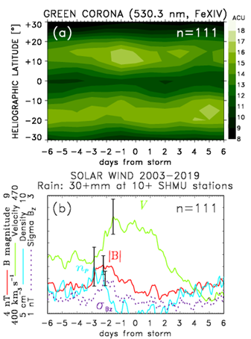
Rainfall ≥30 mm/24h at ≥10 stations
in Slovakia
The SPE analysis of time series of (a) green corona intensity and (b) solar wind plasma parameters keyed to start dates of heavy rainfall in Slovakia
Notes:
To remove any sense of subjectivity in the selection of these events, here we used database of rainfall in Slovakia and applied a simple criterion: Rainfall ≥30 mm/24h at ≥10 stations. We get a similar result. The pattern is there.

Slide 17
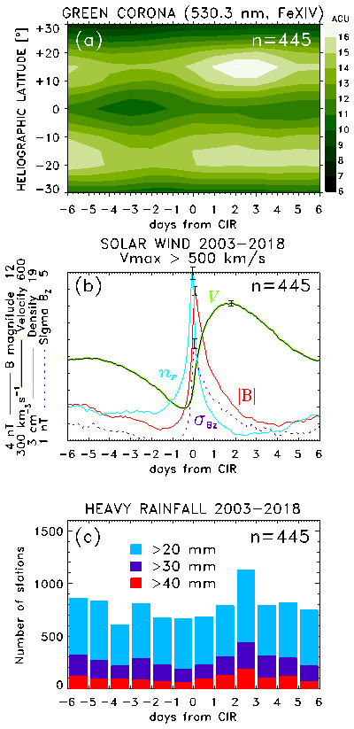
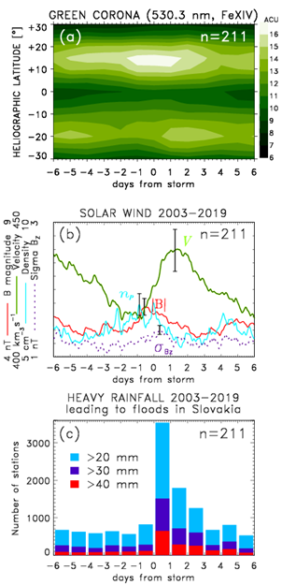
Heavy rainfall & floods
in Slovakia
The SPE analysis
keyed to
(left) HSS/CIRs
& (right) start
dates of heavy
rainfall leading
to floods
Days from CIR
Days from heavy rainfall
Notes:
Another way to show this tendency: On the left, the SPE analysis is keyed to actual arrivals of HSS/CIR. That gives an expected result for the solar wind and corona intensity. But the histogram below shows the cumulative number of stations where rainfall exceeded given thresholds. It shows a clear increase after day0, peaking on day +2.
On the right, the SPE analysis is keyed to start dates/times of heavy rainfall that lead to floods in Slovakia. These were taken from annual reports on floods. The histogram shows number of stations with heavy rainfall. But if we look at solar wind: The mean solar wind parameters show a familiar pattern that is similar to the one on the left, naturally with smaller amplitude. It indicates that these events tend to follow arrivals of HSS/CIRs.

Slide 18
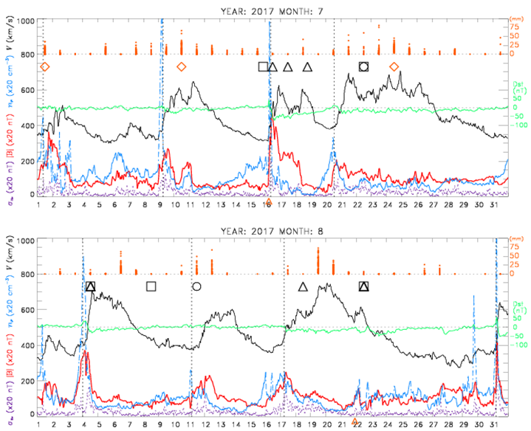
The OMNI solar wind V, B, n_{p}, σ_{Bz}
in July and August 2017
Heavy rainfall
/ floods
CIR
CIR
CIR
Rainfall in Slovakia
Europe
USA
Japan
◊
Slovakia
ICME
CIR
CIR
ICME
Notes:
A few examples to illustrate that: Heavy rain/flood events in Europe, USA, Japan and Slovakia in July and August 2017. the first two HSS followed by floods in Slovakia, the next two with floods in Eurorpe and USA, and so on in August. Sometimes the flash floods occurred in Europe and USA on the same day.

Slide 19
Can convective bursts be triggered/initiated by aurorally-generated gravity waves?
Possible sources:
Joule heating, Lorentz force or energetic particle precipitation in the high-latitude lower thermosphere. (Chimonas and Hines, 1970; Chimonas, 1970; Testud, 1970; Richmond, 1978)
Notes:
How can we explain these results?
We suggested aurorally-generated AGWs triggering instabilities in the troposphere.

Slide 20
Mayr et al. (1990), Thermospheric gravity waves: Observations and interpretation using the transfer function model. Space Science Reviews 54, 297–375.
Notes:
These AGWs propagate upward and downward and can reach troposphere.
It is well known that auroral activity generate large- and medium-scale gravity waves that propagate globally from sources in the lower thermosphere. This is a diagram from a review paper by Mayr et al. showing different modes of propagation. They used TFM to describe the response in the atmosphere and showed that propagating waves originating in the thermosphere can excite a spectrum of AGWs, including the ducted mode with GWs propagating in the lower atmosphere.

Slide 21
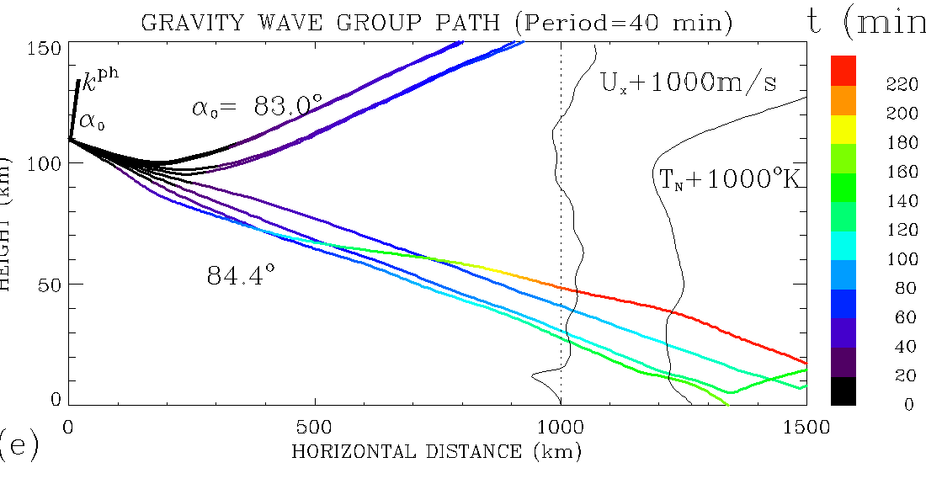
Ray tracing gravity waves
Solar wind pressure pulses modulated ionospheric convection – a source of TIDs
Ray tracing gravity wave energy (group)
using dispersion relation by Hines (1960)
(ω² – ω_{a}²) ω² / C² – ω² (k_{x}² +k_{z}²) +ω_{b}²k_{x}² = 0
ω_{a} = γg/2C is the acoustic cutoff frequency,
γ, C, g are the ratio of specific heats, speed of sound,
and acceleration due to gravity,
k_{x} and k_{z} are the components of the wave vector k.
Brunt-Väisälä (buoyancy) frequency ω_{b} is defined as
ω_{b}² = (γ-1)g² / C² + (g / C²) (dC² / dz)
Prikryl P., et al., Ann. Geophys., 27, 31-57, 2009.
Notes:
This can also be shown by ray tracing of GWs using the dispersion relation. It is shown that these AGWs can propagate not only upward but also downward and reach troposphere.

Slide 22
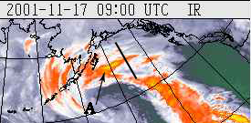
Gravity waves initiate convection
Solar wind pressure pulses modulated ionospheric convection – a source of TIDs
Ray tracing of gravity wave energy
using dispersion relation by Hines (1960)
Down-going GWs reach troposphere may initiate convection forming cloud bands in extratropical cyclones.
Prikryl P., et al., Ann. Geophys., 27, 31-57, 2009.
Notes:
We believe that despite the small amplitude, but subject to amplification, they can trigger/release instabilities, to initialize convection that leads to cloud bands, for example.

Slide 23
Slantwise convection initiated by AGWs
The slopes of isolines of potential temperature θ and geostrophic momentum Mg in the x-z plane are such that ∂θ/∂z > 0 and ∂Mg/∂x > 0, meaning that the atmosphere is stable to purely vertical and horizontal displacements.
RELEASED
WARM
Cross-section of
warm frontal zone
COLD
North
South
The instability is an interplay of buoyancy and Coriolis restoring forces.
Notes:
As shown here:
Symmetric instability released by a gravity wave perturbation. The slopes of isolines of potential temperature θ and geostrophic momentum M_{g} in the x-z plane are such that ∂θ/∂z > 0 and ∂M_{g}/∂x > 0, meaning that the atmosphere is stable to purely vertical and horizontal displacements. Slantwise displacements with intermediate slopes between the isolines of θ and M_{g} are symmetrically unstable. A vertical perturbation ∆w_{gw} due to a gravity wave (dark blue arrows) vectorially added to the upward tilting flow (light blue arrow) in the vicinity of a warm front will release the MSI, thus leading to slantwise convection (red dotted arrow).

Slide 24
Summary and Conclusions
Severe weather events including
- explosive extratropical cyclones (Prikryl et al., 2009, 2016)
- rapid intensification of tropical cyclones (Prikryl et al., 2019)
- heavy rainfall and flash floods (Prikryl et al., 2018)
tend to follow arrivals of solar wind HSS/CIRs or ICMEs.
The coupling of solar wind (e.g., solar wind Alfvén waves) to magnetosphere-ionosphere-atmosphere generates atmospheric gravity waves (AGWs).
AGWs propagate globally from lower thermosphere at high latitudes upward & downward, and can reach troposphere.
AGWs can trigger/release moist instabilities to initiate convection leading to precipitation (heavy snow or rainfall) and latent heat release provides energy to intensify storms

Slide 25
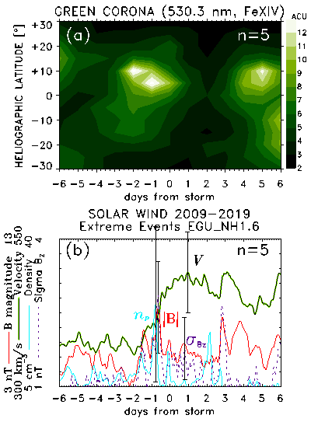
Extreme events reported at EGU2020 NH1.6
D1936 |EGU2020-10538 …an extreme rainfall event on 04 November 2015 in the Alexandria region
D1939 |EGU2020-3881 …catastrophic flash flood occurred in Mallorca on October 9th, 2018
D1941 |EGU2020-10453 …the 12-13 September 2019 flash floods event in Eastern Spain
D1945 |EGU2020-17847 …A severe weather events hit Italy on July 9-10, 2019 causing heavy damages by the falling of large-size hail.
D1967 |EGU2020-14631 …During 22-24 June 2009, Austria witnessed a rampant rainfall spell that spread across populated areas of the country. High-intensity rainfall caused 3000+ landslides in Feldbach, and property damages worth €10,000,000 in Styria itself.
The SPE analysis of time series of green corona intensity and solar wind plasma parameters keyed to start dates of 5 extreme weather events

Slide 26
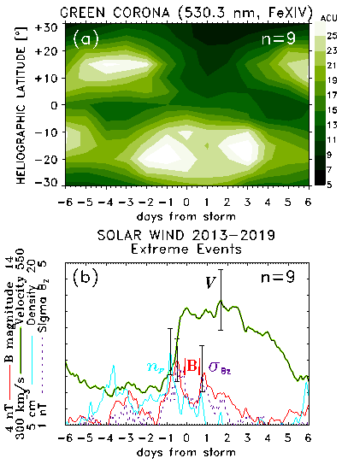
Extreme events similar to EGU2020 NH1.6
October 26 to 31, 2016 Flash flood in Egypt
October 25, 2015 Floods struck Alexandria in Egypt
October 30, 2013 Flash Floods in Balearic Islands, Spain
Nov. 28 – 29, 2017 Heavy Rain Floods, Andalusia, Spain
June 2-3, 2018 Torrential rain in parts of southern Spain
November 10-13, 2013 Floods in Abruzzo and Marche, Italy
August 2, 2014 Flash Floods in Treviso, Italy
May 31 to June 1, 2018 Storms Bring Damaging Floods to Parts of Northern and Central Europe
November 15-17, 2019 Heavy Rain Triggers Deadly Landslides and Floods in Austria
The SPE analysis of time series of green corona intensity and solar wind plasma parameters keyed to start dates of 9 extreme weather events

