Slide 1
EGU2020-5011 – D3341
CL1.12 – 6/4/2020, 10:45-12:30
https://doi.org/10.5194/egusphere-egu2020-5011
Tracking Late Quaternary ice-sheet dynamics by multi-proxy detrital mineral U-Pb analysis: A case study from the Odyssea contourite, Ross Sea, Antarctica
Roland Neofitu¹, Chris Mark¹, Michele Rebesco², Renata Giulia Lucchi², Nessim Douss², Caterina Morigi³, Sam Kelley¹, and J. Stephen Daly¹
¹School of Earth Sciences, University College Dublin, Dublin, Ireland (roland.neofitu@ucdconnect.ie)
²Istituto Nazionale di Oceanografia e di Geofisica Sperimentale, Sgonico, Italy
³Department of Earth Sciences, University of Pisa, Pisa, Italy

Slide 2
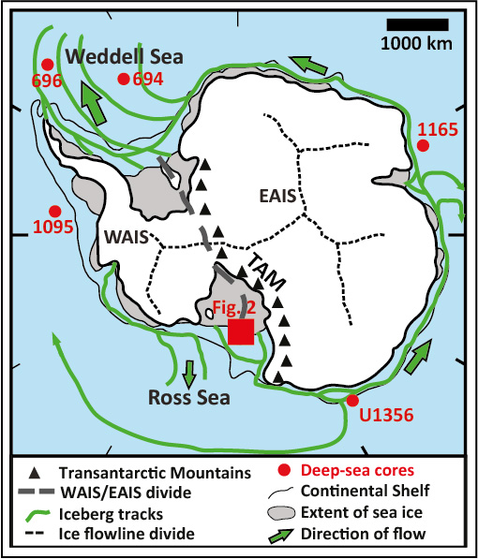
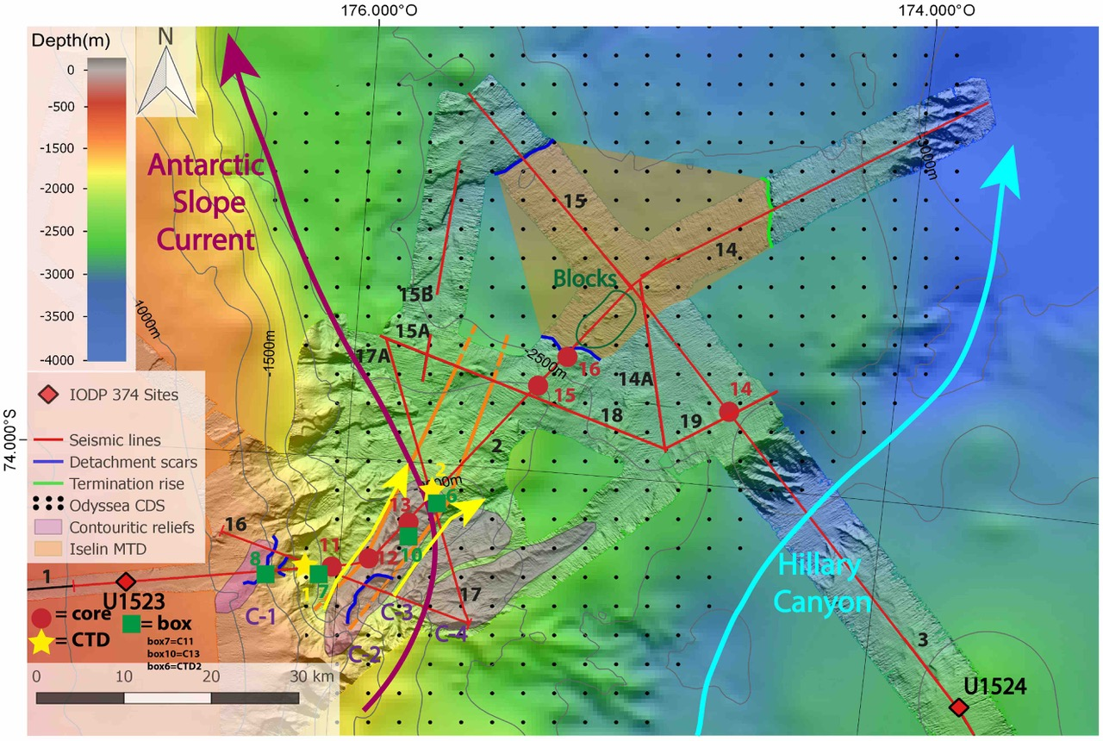
Samples taken from Ross Sea (Fig 1.), Odyssea contourite (Fig. 2), which formed as a result of slope current deposition.
U-Pb analysis of detrital minerals will be used to assess provenance change during MIS2-3.
13
Fig. 1 – Location map of deep-sea drilling core samples to be analysed throughout the project, as well as location of Fig. 2, where samples for this study are from. Modified after McKay et al. (2017) and Budge and Long (2018).
Fig. 2 – Location map of gravity core used for this study (core 13).

Slide 3
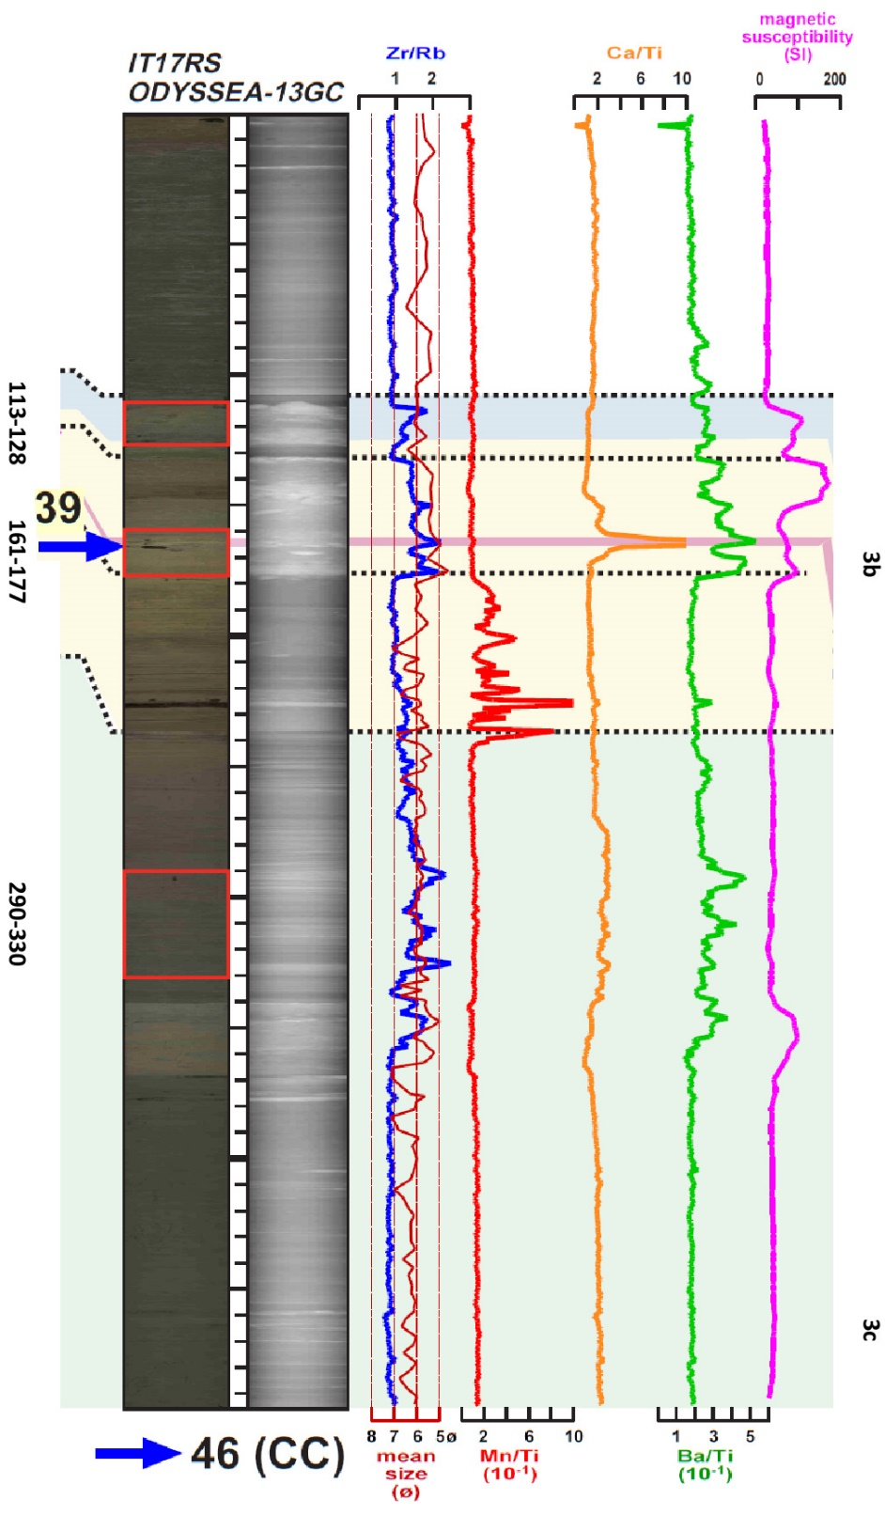
Fig 3. – Log of gravity core 13. Red boxes indicate samples used in this study. Log data from Rebesco et al., 2020, EGU2020-12940 – D3142.
Sampling:
3 samples selected, based on:
Zr/Rb ratio – used to identify HM bands (zircon abundance normalised to terrigenous content);
Magnetic susceptibility – used to identify terrigenous input.
The upper two sample groups were found to have sufficient apatites and zircons for analysis, with the lower-most group being almost completely devoid of heavy minerals.
Sources:
Candidate sources onshore include Cenozoic volcanics, and Mesozoic-Palaeozoic plutons, clastic sediment, and metamorphics.
Analytical approach:
U-Pb analysis will be carried out in order to determine sedimentary provenance of samples;
Primarily apatites and zircons will be used, to allow for better source discrimination;
This will allow us to determine depositional processes at the time, particularly regarding ocean current directions.

