Slide 1



Soil water contents and displacements monitoring, integrated into a Hydrological-Geotechnical Model for the evaluation of large-scale susceptibility to landslides triggered by rainfalls
Roberto Passalacqua, Rossella Bovolenta, Bianca Federici, and Alessandro Iacopino
Dipartimento di Ingegneria Civile, Chimica e Ambientale (DICCA)

Slide 2
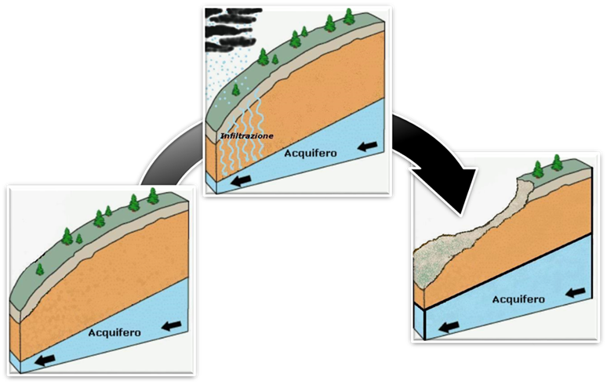
INFILTRATION
SOIL WATER TABLE
Roberto Passalacqua, Rossella Bovolenta, Bianca Federici, and Alessandro Iacopino
SOIL WATER TABLE
SOIL WATER TABLE

Slide 3
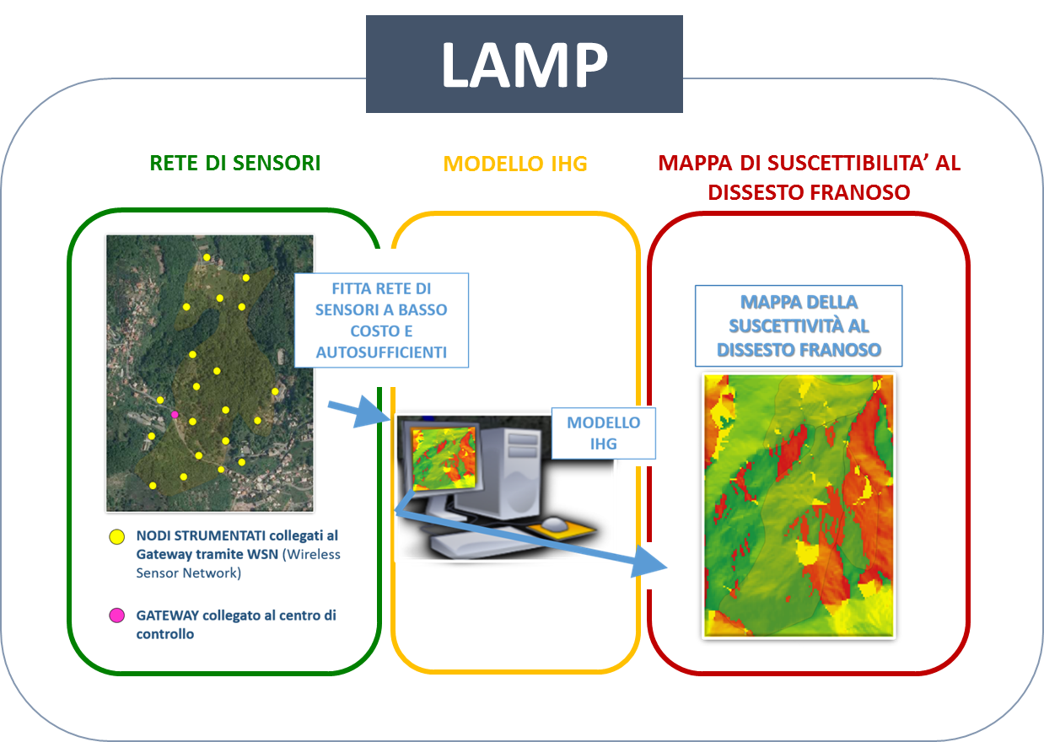
SENSOR NETWORK
IHG MODEL
LANDSLIDE SUSCEPTIBILITY MAP
LAMP
(Landslide Monitoring and Predicting)
Landslide susceptibility map pertinent to measured/forecasted rainfalls
Wireless Sensor Network (WSN) composed of low-cost self-sufficient sensors
Roberto Passalacqua, Rossella Bovolenta, Bianca Federici, and Alessandro Iacopino
Physically based Integrated Hydrological Geotechnical (IHG) model
NODE
GATEWAY

Slide 4
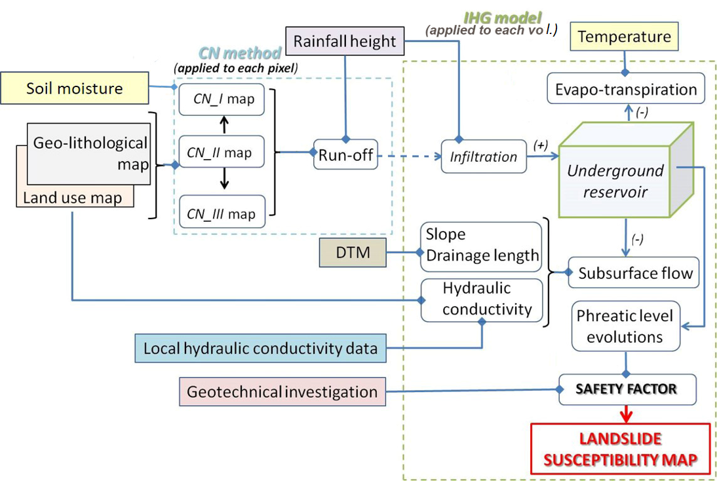
Flow chart of the IHG model
Sensor network
The IHG model is fed by data measured by a Wireless Sensor Network (WSN) composed of low-cost self-sufficient sensors.
Roberto Passalacqua, Rossella Bovolenta, Bianca Federici, and Alessandro Iacopino
WSN observes:
rain
temperature
displacement (measured by mass-market GNSS receivers in RTK)
soil water content (measured by capacitive sensors).

Slide 5
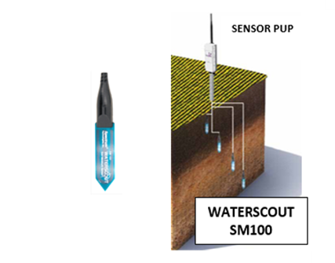
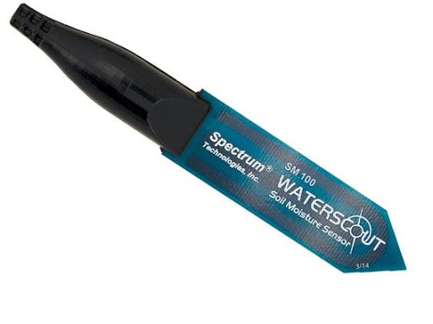
A FOCUS ON THE SOIL WATER MOISTURE MEASUREMENT
Roberto Passalacqua, Rossella Bovolenta, Bianca Federici, and Alessandro Iacopino
WaterScout SM100

Slide 6
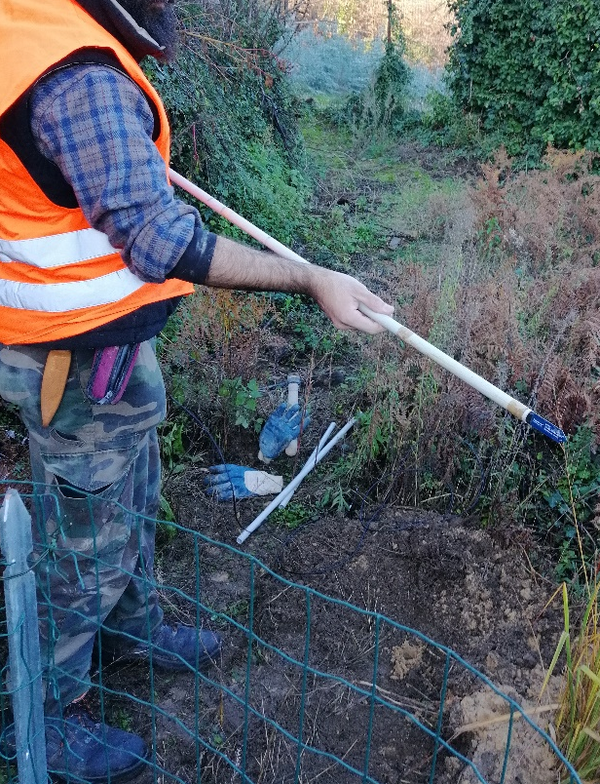
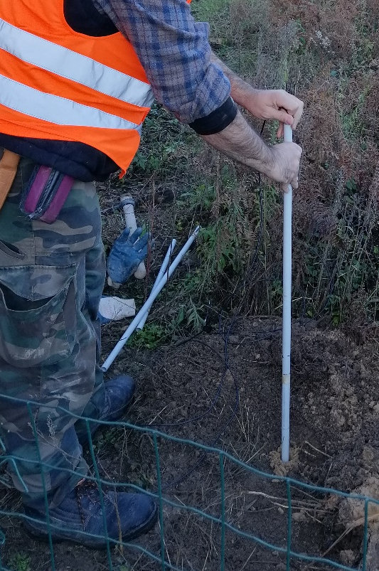
A pipe is used for the WaterScout installation.
The sensors can be installed in vertical or horizontal direction.
Roberto Passalacqua, Rossella Bovolenta, Bianca Federici, and Alessandro Iacopino

Slide 7
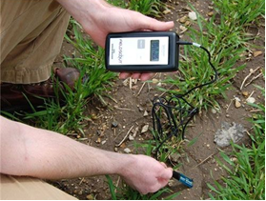
The sensor functionality has to be checked by a FieldScout soil sensor reader.
Roberto Passalacqua, Rossella Bovolenta, Bianca Federici, and Alessandro Iacopino
Soil Samples has been extracted in the sites of interest for lab analyses.
The calibration of the WaterScout sensor is in progress.

Slide 8
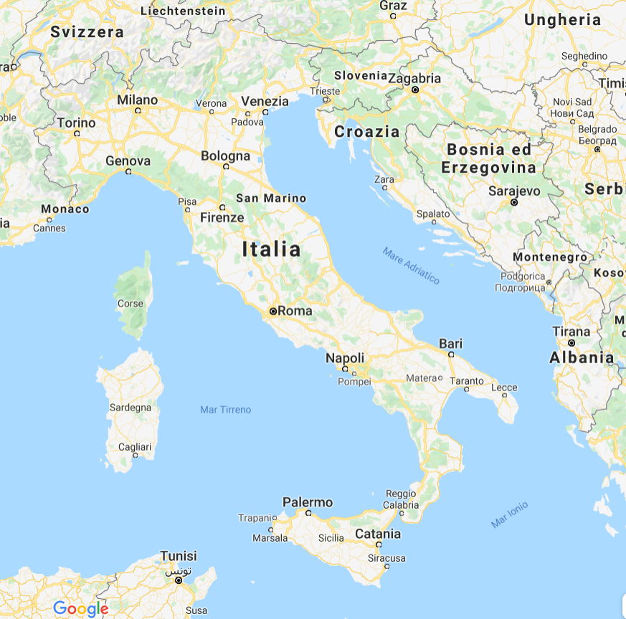
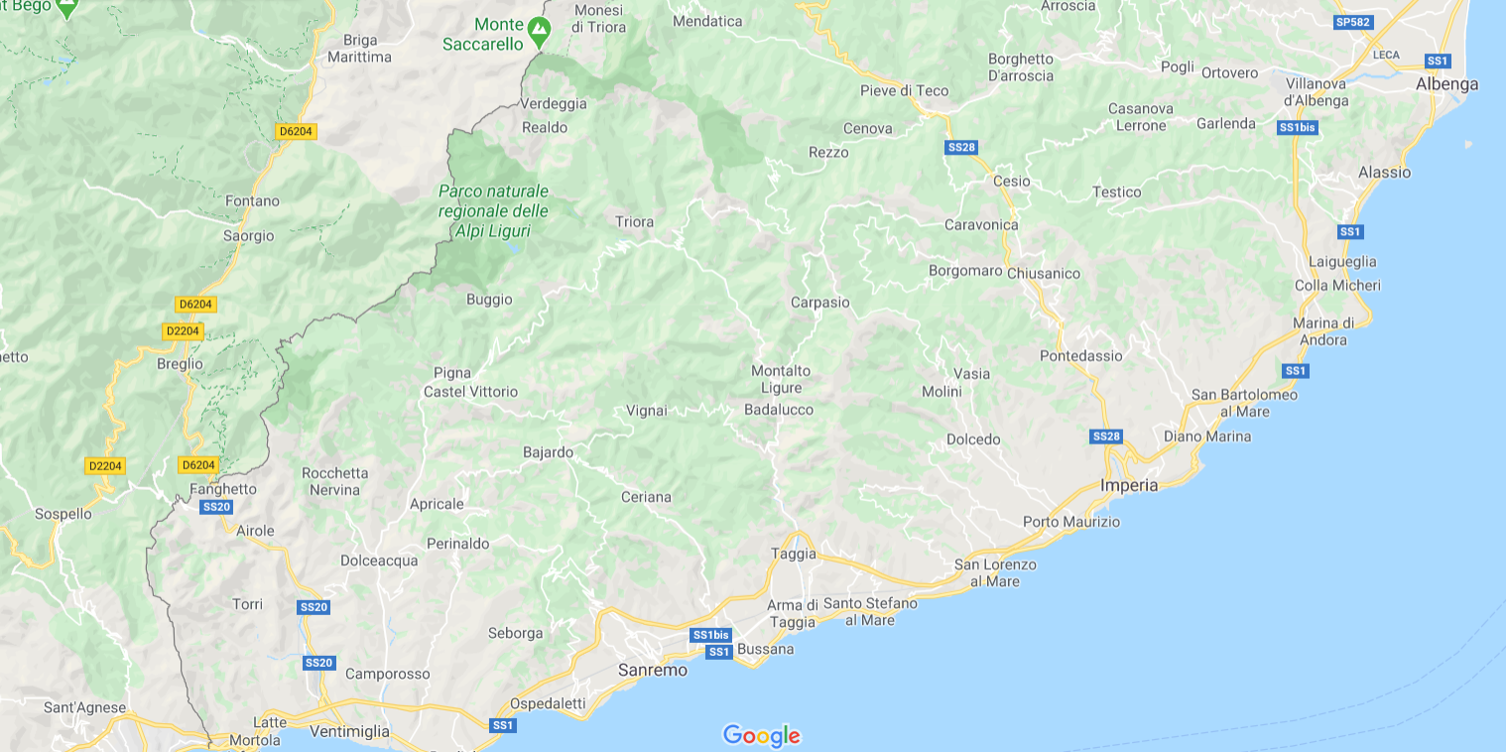
The monitoring networks (installed only few months ago!!) in two Italian sites, Mendatica and Ceriana, are currently providing information in real time.
Roberto Passalacqua, Rossella Bovolenta, Bianca Federici, and Alessandro Iacopino
Liguria (italy)

Slide 9
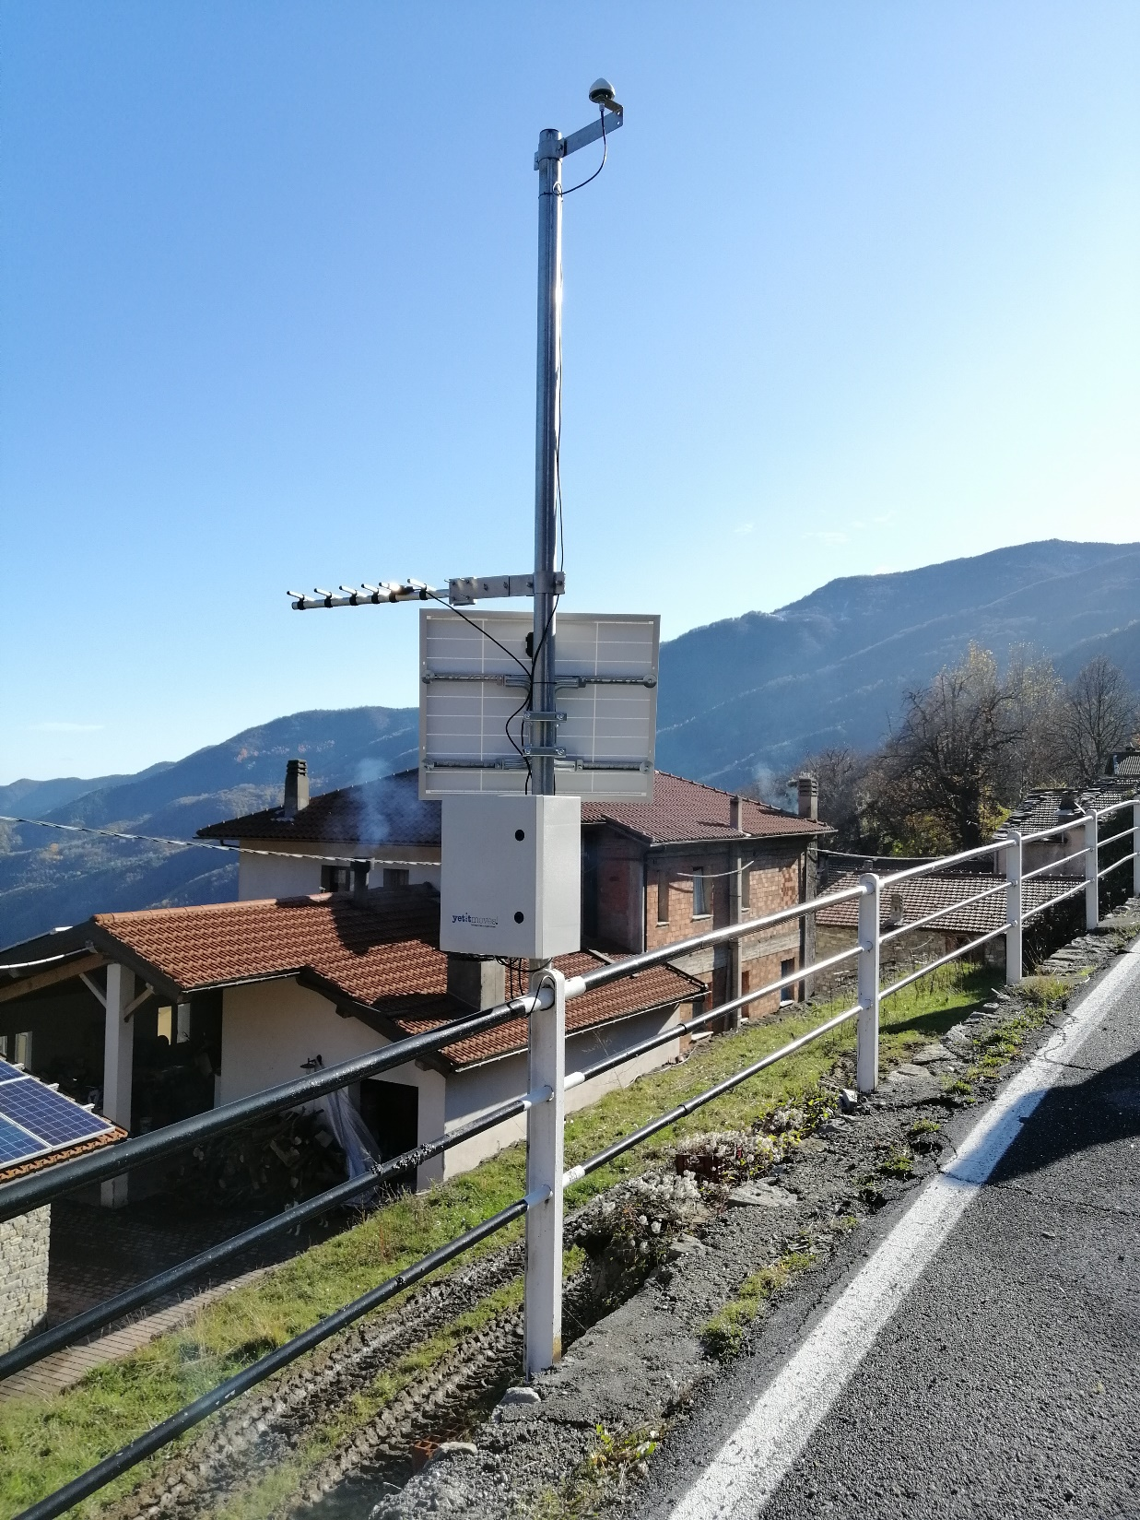
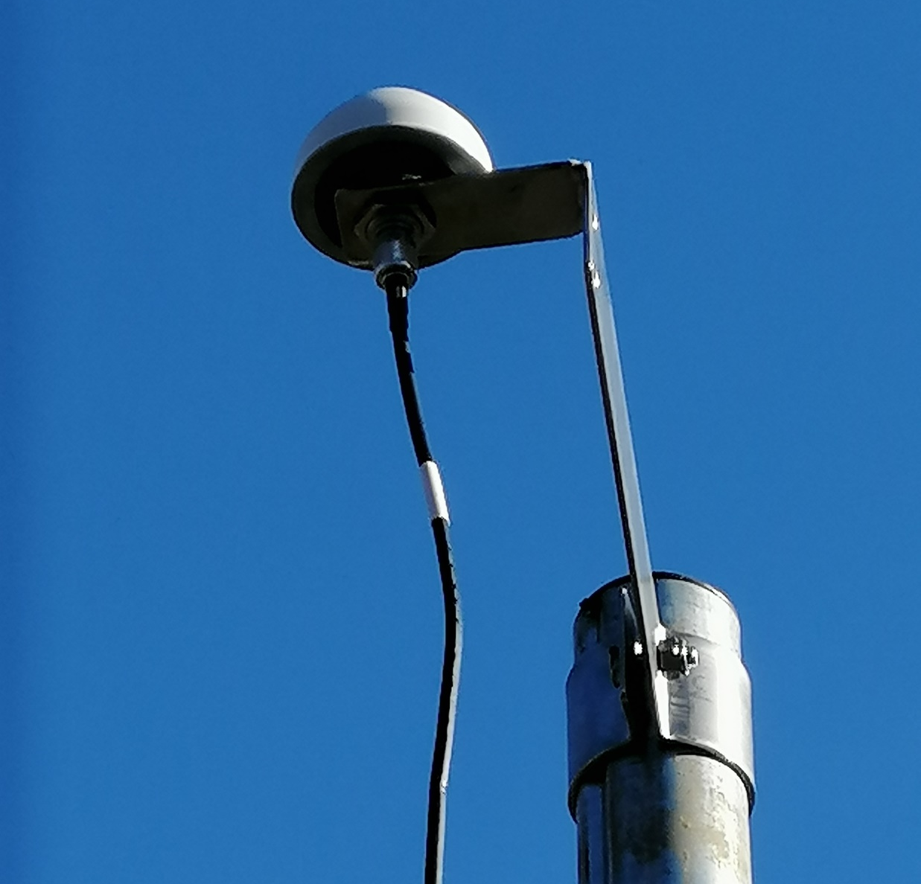
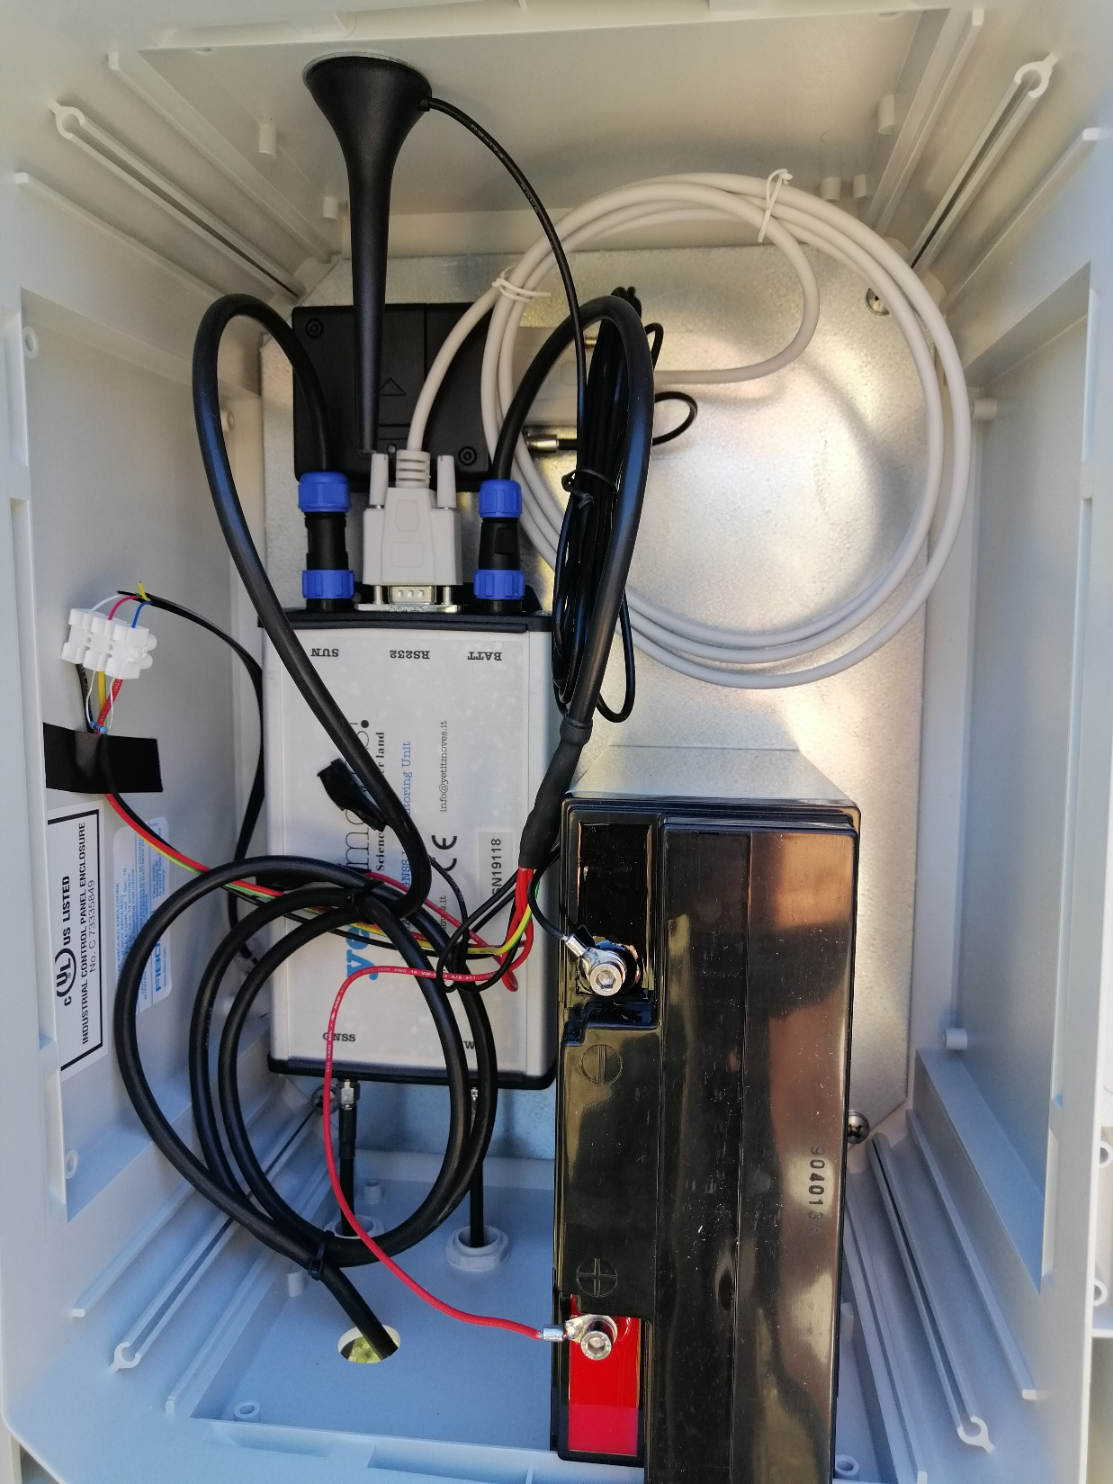
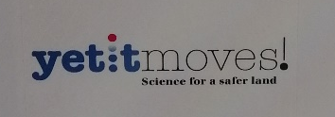
A FOCUS ON MASS-MARKET GNSS RECEIVERS
Roberto Passalacqua, Rossella Bovolenta, Bianca Federici, and Alessandro Iacopino

Slide 10
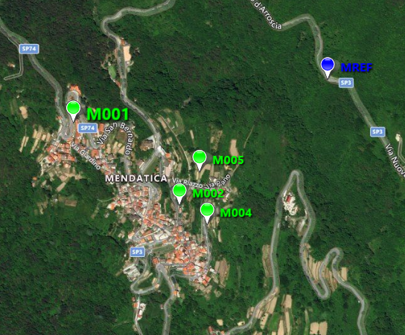
The GNSS network in Mendatica:
Roberto Passalacqua, Rossella Bovolenta, Bianca Federici, and Alessandro Iacopino

Slide 11
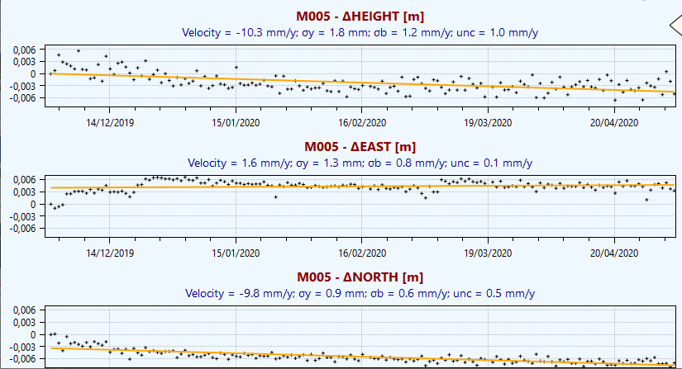
Example of GNSS observation in Mendatica from the end of November 2019 to today:
Roberto Passalacqua, Rossella Bovolenta, Bianca Federici, and Alessandro Iacopino

Slide 12
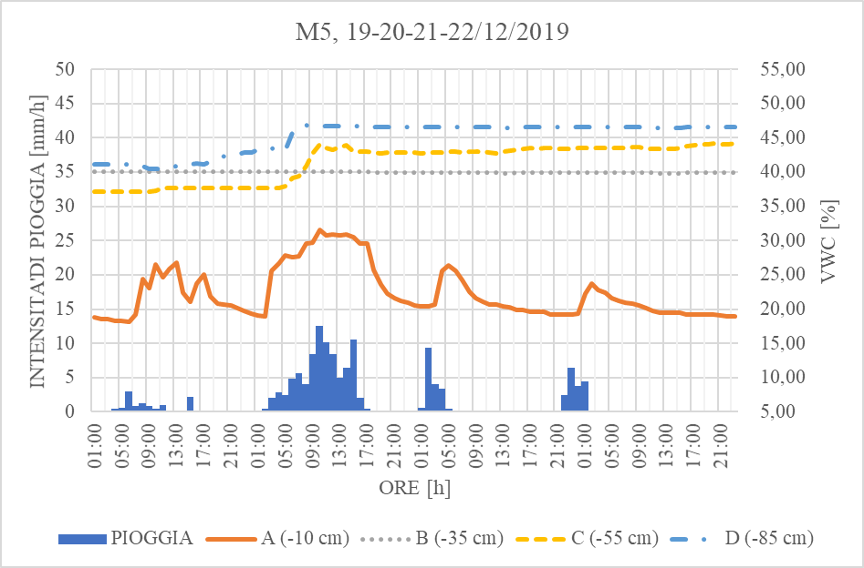
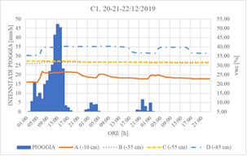
Mendatica (Liguria-ITALY)
preliminary results
Graphs of the soil water moisture, measured during intense rainfalls (measured by rain gauges installed on the sites or in the vicinity).
It is necessary to emphasize that the Volumetric Water Content values are not calibrated since the calibration curves have not yet been obtained.
It is possible to note that the trends are in agreement with the rains measured by the rain gauges (especially for the sensors A, located 10cm below the ground level).
Roberto Passalacqua, Rossella Bovolenta, Bianca Federici, and Alessandro Iacopino
Ceriana (Liguria-ITALY)

Slide 13
CONCLUSIONS
Most of the Italian territory is subject to landslides and therefore the possibility of using low-cost sensors for widespread monitoring networks is particularly attractive, provided that the sensors are characterized by satisfactory accuracy and precision, low cost and good compatibility with the acquisition systems.
LAMP adopts a physically based model, which integrates the hydrological and geotechnical modeling. Temperature and soil moisture sensors are used to feed the model, in addition to rain data obtained by rain gauges or meteorological radars. Moreover, GNSS receivers are arranged on the ground level.
The final products of the model are landslide susceptibility maps in case of measured or forecasted rainfalls.
The first soil moisture values detected by the wireless sensor networks installed in two sites are encouraging.
The analysis of a correlation between rainfall, soil moisture values and displacements will be performed.
Roberto Passalacqua, Rossella Bovolenta, Bianca Federici, and Alessandro Iacopino

Slide 14
Thanks for your attention
Roberto Passalacqua, Rossella Bovolenta, Bianca Federici, and Alessandro Iacopino
… and Thanks to the INTERREG-ALCOTRA project called AD-VITAM

