Slide 1




The forgotten drought of 1765-1768: Reconstructing and re-evaluating historical droughts in the British and Irish Isles
Conor Murphy¹, Robert Wilby², Tom Matthews², Csaba Horvath¹, Arlene Crampsie³, Francis Ludlow⁴, Simon Noone¹, Jordan Brannigan¹, Jamie Hannaford⁵, Robert MacLeman⁶, and Eva Jobbova³
Corresponding author: conor.muphy@mu.ie
EGU 2020 Session CL1.20: Historical climatology and hydrology: the role of documentary evidence in the reconstruction of past (hydro)climate and its variabilities
Chat Mon, 04 May, 16:15–18:00

Slide 2
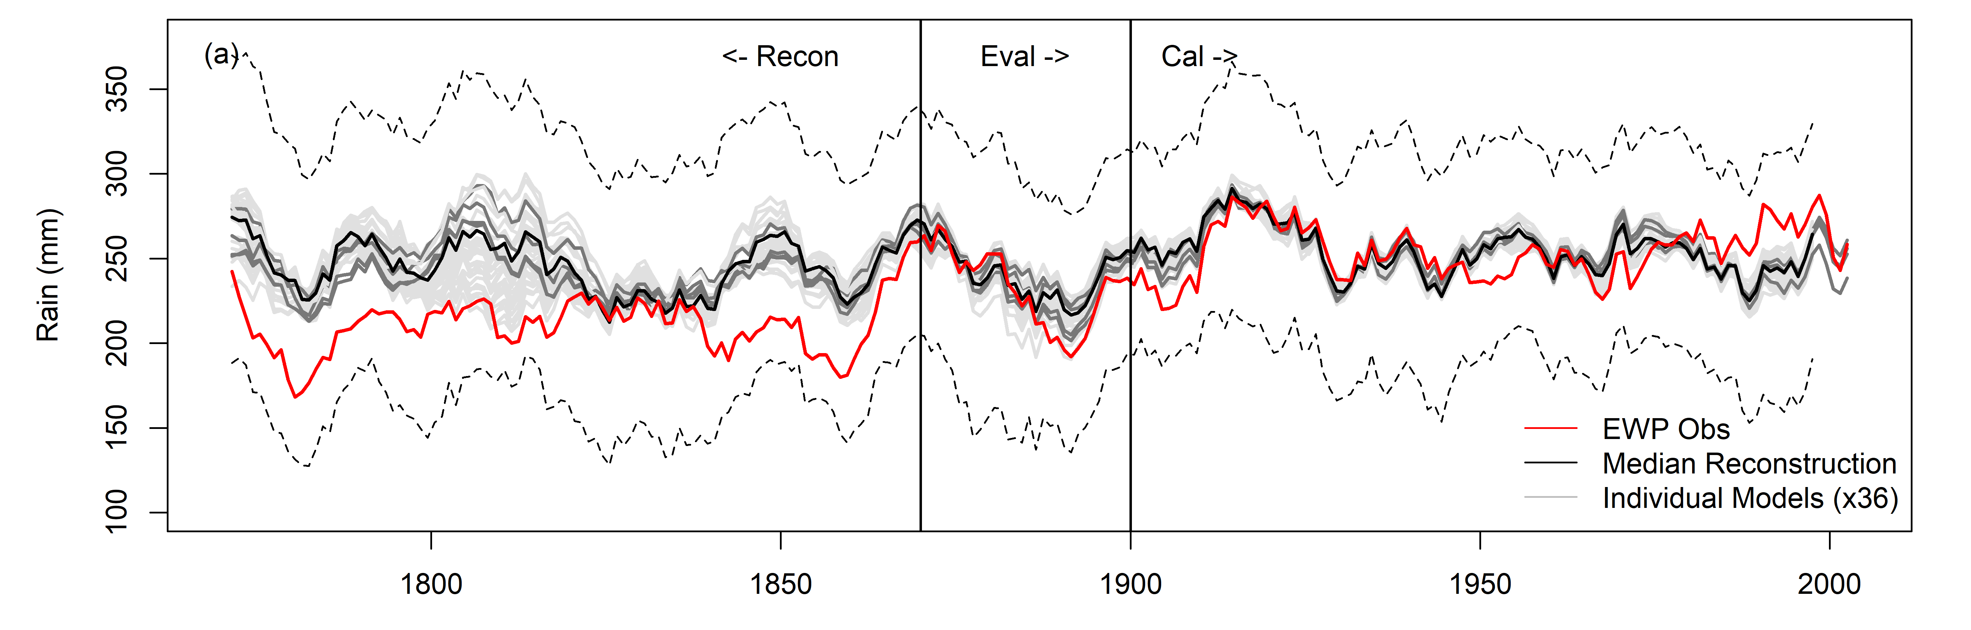
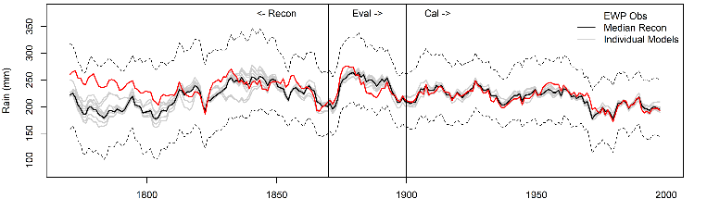
Early winter and summer in EWP?
EWP Winter (top) and summer (bottom) decadal mean precipitation 1766-2002. Red is obs, black is reconstructed median for individual models (grey) .
https://rmets.onlinelibrary.wiley.com/doi/full/10.1002/joc.6208

Slide 3
Research Questions (approach)
Are the biases in early winter and summer series in EWP identified by Murphy et al. (2019) evident in other long-term precipitation series in the British Irish Isles?
  Reconstruct the following long-term monthly series using multiple linear regression: EWP; Island of Ireland (1711) series, Scottish series to evaluate early records.
What impact may early record precipitation errors have on our understanding of historical drought?
  Extract and analyse Standardised Precipitation Index (SPI) for observed and reconstructed series and compare
https://rmets.onlinelibrary.wiley.com/doi/full/10.1002/joc.6521

Slide 4
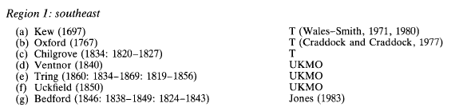
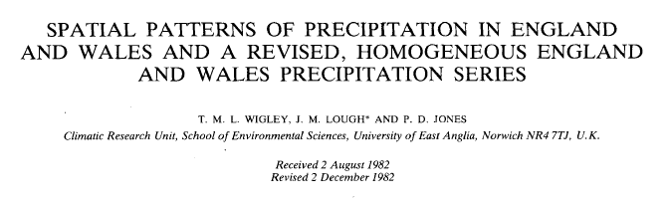

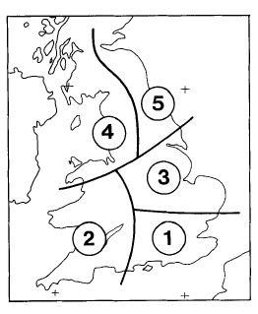

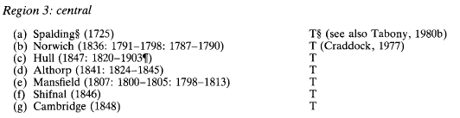
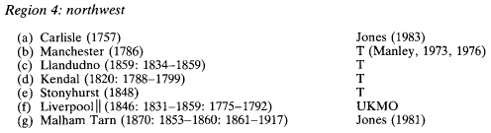
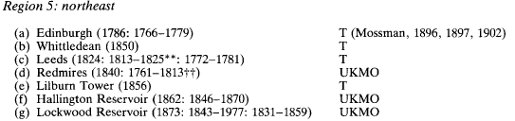
England and Wales Precipitation (EWP)
https://rmets.onlinelibrary.wiley.com/doi/abs/10.1002/joc.3370040102

Slide 5
The Island of Ireland (IoI) rainfall record (1711-2016)
https://www.clim-past.net/14/413/2018/

Slide 6
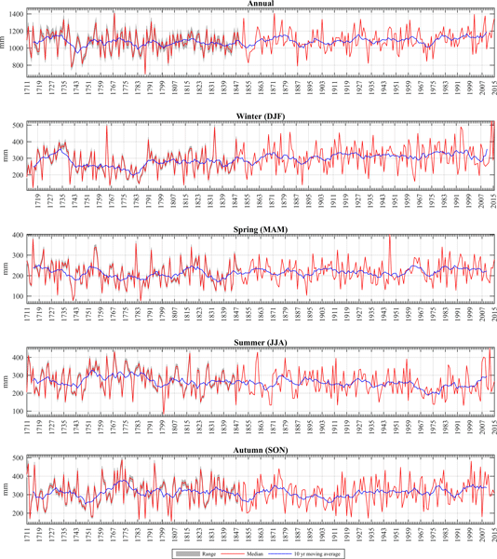
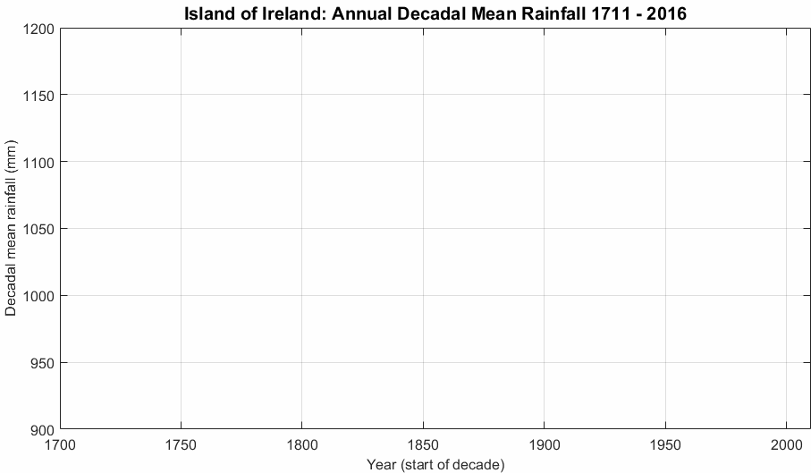
Murphy et al. (2018) suspect that
early winters – too dry?
Summer 1760-1800 – too wet?
https://www.clim-past.net/14/413/2018/

Slide 7
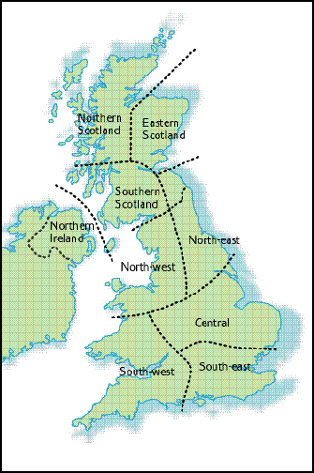
Scottish Precipitation 1752 onwards
+
https://www.metoffice.gov.uk/hadobs/hadukp/
https://rmets.onlinelibrary.wiley.com/doi/abs/10.1002/joc.3370150506

Slide 8
Predictors for reconstructing monthly series
Central England Temperature (CET) (Manley, 1974; Parker et al., 1992).
London Sea Level Pressure (LSLP): A 315-year (1692–2007) daily series of mean SLP (MSLP) for the city of London (Cornes et al., 2012a). Data is quality controlled, corrected and homogenized to represent daily means of MSLP at standard modern-day conditions.
Dublin (DSLP) and Edinburgh (ESLP) Sea Level Pressure: monthly MSLP data for Dublin and Edinburgh were derived from the ADVICE database (Jones et al.,1999; Jones et al., 1987).
Paris London Index (PL): Measure of westerly air flow over NW Europe. Used as indictor of the state of the NAO (Cornes et al., 2013)
https://rmets.onlinelibrary.wiley.com/doi/full/10.1002/joc.6521

Slide 9
Training our models 1900-2000
Evaluating our models 1870-1899
Winter [DJF]
Spring [MAM]
Summer [JJA]
Autumn [SON]
https://rmets.onlinelibrary.wiley.com/doi/full/10.1002/joc.6521

Slide 10
Comparison of observed and reconstructed running decadal monthly mean series
EWP
Same finding as Muphy et al. (2019) EWP winter too dry pre 1870
Summer – July and August too wet in early records.
Other months v. good. Additional verification below for MJJA precipitation using additional observations
Comparison of standardised (1900-1970) MJJA precipitation for the derived Avg (brown) series (composite of 7 quality assured long term precipitation stations from across UK: Carlisle, Manchester, Kew, Oxford, Spalding, Edinburgh, Chatsworth) with observed EWP (black), statistically reconstructed EWP.ext (red)
https://rmets.onlinelibrary.wiley.com/doi/full/10.1002/joc.6521

Slide 11
Ireland
Similar biases in Irish and Scottish reconstructions but subtle differences
Scotland
https://rmets.onlinelibrary.wiley.com/doi/full/10.1002/joc.6521

Slide 12
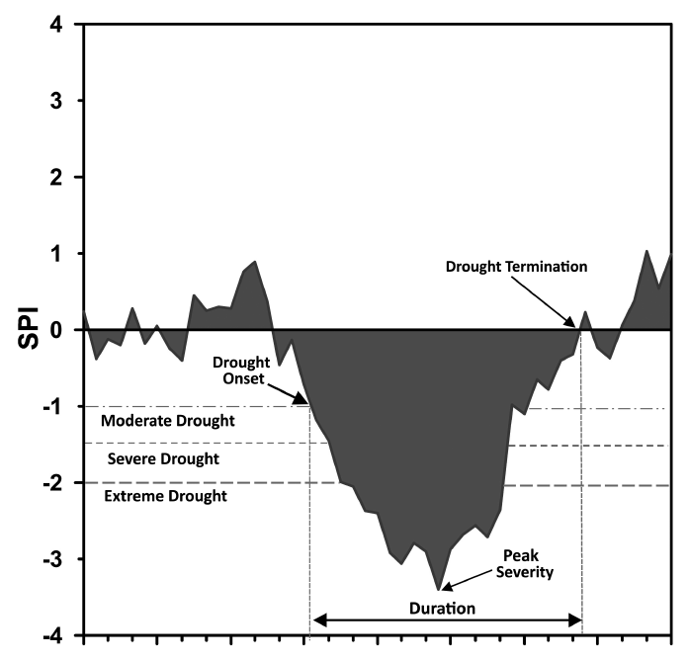
Drought start SPI values of -1
Drought termination SPI values return to positive values
Moderate Drought SPI values -1 to -1.5
Severe Drought SPI values -1.5 to -2.00
Extreme Drought SPI values -2.00
Drought Duration number of months drought persist
Drought peak intensity maximum SPI value reached over drought
Application of the Standardised Precipitation Index – We focus on SPI-12
https://rmets.onlinelibrary.wiley.com/doi/full/10.1002/joc.6521

Slide 13
EWP: Evaluation of SPI12
Black = Reconstructed/Red =Observed
Orange = Severe Drought
Blue = Extreme Drought
Strong agreement after 1870
Key differences – 1850s, 1800s, 1834-36, 1788-89, 1765-68
Cole and Marsh (2006)
https://rmets.onlinelibrary.wiley.com/doi/full/10.1002/joc.6521

Slide 14
Ireland: Evaluation of SPI12
Black = Reconstructed/Red =Observed
Orange = Severe Drought
Blue = Extreme Drought
Strong agreement after 1870s
Key differences – Many extreme droughts in obs series not in reconstruction – winters too dry in early IoI_1711 series
Extreme droughts are identified in the reconstructions for 1834-1836, 1783-1786, 1781-1782 and 1765-1768.
Both the 1834-1836 and 1765-1768 events are also evident in the observed series.
1765-68 is the stand out event in terms of intensity, duration and accumulated deficits – very dry spring and summer 1765 and a succession of dry winters.
https://rmets.onlinelibrary.wiley.com/doi/full/10.1002/joc.6521

Slide 15
Scotland: Evaluation of SPI12
Black = Reconstructed/Red =Observed
Orange = Severe Drought
Blue = Extreme Drought
First assessment of historical droughts in Scotland
Strong agreement after 1870s
1800s not particularly drought rich
Extreme droughts in the late 1780s and 1790s in the observations, are only present as severe or moderate droughts in the reconstructions.
Of note from the Scottish SPI-12 reconstructions are the protracted extreme droughts, in excess of 40 months duration, in the early records. These include 1854-1859 (53 months), 1780-1784 (47 months), 1765-1769 (47 months). Each of these events are also evident in the observations
1765-68 is the stand out event in terms of intensity, duration and accumulated deficits
https://rmets.onlinelibrary.wiley.com/doi/full/10.1002/joc.6521

Slide 16
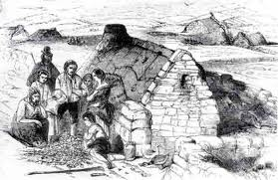
Documentary evidence for 1765-68 drought?
Dr. John Rutty notes of 1765: “The extreme drought of summer was such that some treesdropt their leaves for want of moisture, and the cattle wanted grass to supply milk and butter for the poor..”
William Wilde notes of 1765 “Very dry summer, with parching northeast winds. Extreme drought in Ireland in summer”
Source; Donnelly (1978)
Sinclair (1794) in his statistical account of Scotland notes that “In 1765, both sheep and black cattle suffered greatly from another drought..”
In response to the drought conditions The Freeman’s Journal on 3 August reported that “on account of the present long succession of dry weather, orders will speedily be issued for prayers to be read for rain, in all churches and chapels throughout England and Wales. Prayers have already been said on the above account in several churches in this metropolis”.
The Whiteboys were a secret Irish agrarian organization in 18th-century Ireland which took vigilante action to defend tenants’ land rights to subsistence farming
https://rmets.onlinelibrary.wiley.com/doi/full/10.1002/joc.6521

Slide 17
Since publication precipitation records from the 10-year books held at UKMO have become available. They show exceptionally dry spring and summer 1765 and succession of dry winters
https://www.metoffice.gov.uk/research/library-and-archive/archive/ten-year-rainfall-books

Slide 18
https://www.metoffice.gov.uk/research/library-and-archive/archive/ten-year-rainfall-books

Slide 19
Conclusions
We reconstructed monthly precipitation for three regional precipitation series representing the British-Irish Isles (England and Wales, Scotland and Ireland) and re-evaluated historical droughts for the period 1748–2000.
In line with Murphy et al. (2019) we found that observed pre-1870 winter precipitation totals are too low across each series. For summer months, observed pre-1850 totals across each series are too high, especially in July.
After 1870 we found strong agreement in the occurrence and severity of drought events. Prior to 1870, differences were identified across each regional series, even for some well-established drought events in the 1850 s and 1800s.
The most notable event in our reconstructions is the drought of 1765–1768. This ‘forgotten’ drought ranks as the most severe event, in terms of accumulated deficits across all three regional series, and the most intense event in Ireland and Scotland. Documentary evidence, predominantly from newspaper articles, confirms its existence and provides initial insight into its socio-economic impact.
https://rmets.onlinelibrary.wiley.com/doi/full/10.1002/joc.6521

