Slide 1


Production of upgraded recycled aggregates from construction and demolition waste for replacement of primary sand in cement mortars
Michael Galetakis, Athanasia Soultana, Theodoros Daskalakis
Professor PhD Candidate Dipl. Mineral Resources Engineer
School of Mineral Resources Engineering, Technical University of Crete

Slide 2
Aim of the study
  Production of upgraded recycled concrete sand by means of selective crushing and autogenous grinding of waste concrete.
  Cement mortars production with the use of upgraded recycled concrete sand for total replacement of natural aggregates.

Slide 3
Contents
Introduction
  Waste concrete
  Recycled concrete aggregates
Materials and methods
  Waste concrete characterization and sand production
  Mortars production and laboratory tests
Results
  Recycled sands characterization
  Cement mortars testing results
Conclusions - Suggestions for future research

Slide 4
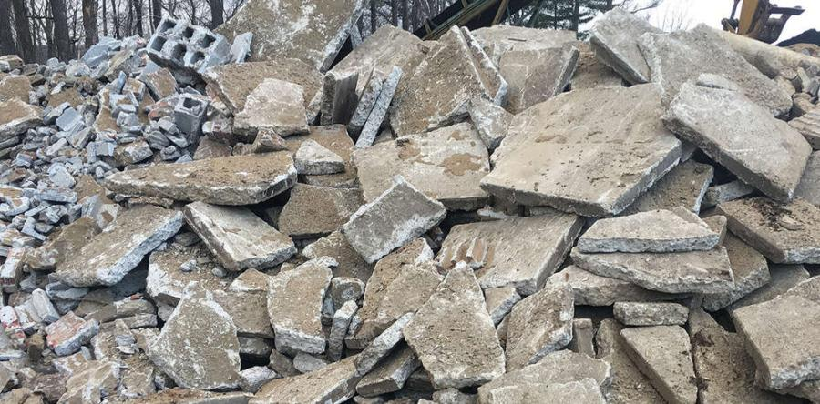
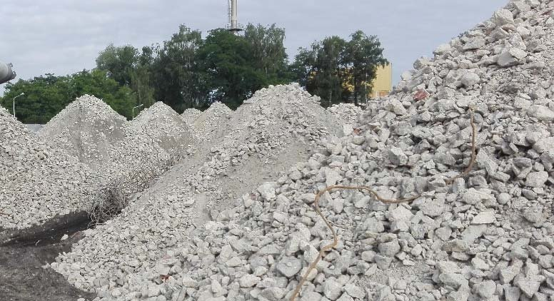
Waste concrete - Recycled concrete aggregates (RCA)
Waste concrete derives from construction and demolition activities.
Recycling could minimize landfilled waste and mineral resources depletion. Current recycling is limited to the use of the coarser RCA fraction.
RCA quality is lower than that of natural aggregates due to the adhered porous cement mortar. In order to produce RCA of higher quality, waste concrete is subjected to a number of crushing stages (selective size reduction).
Ordinary crushers cannot separate effectively concrete to its constituents (hydrated cement paste and aggregates coexist). Selective crushing and autogenous grinding of concrete can remove more hydrated cement paste and liberate aggregates.
Waste concrete
Piles of crushed concrete waste

Slide 5
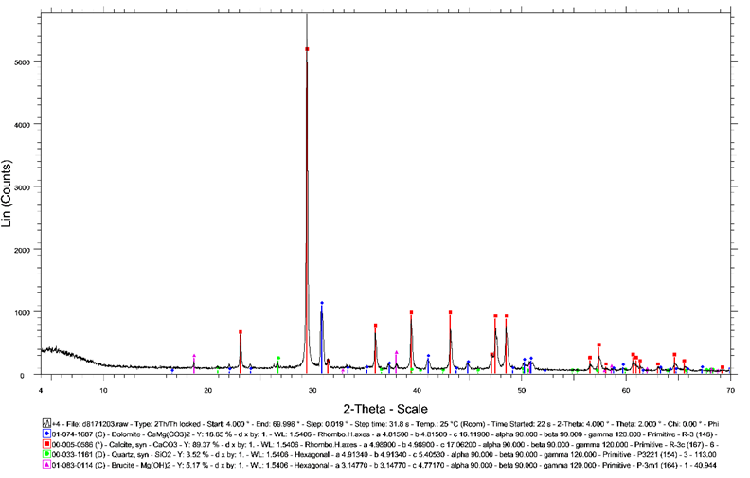
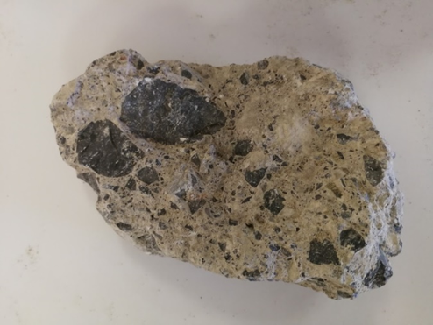
Waste concrete characterization and sand production
Waste concrete derived from a construction and demolition processing plant located in Crete (Greece).
Initial sample +32 mm crushed to -16 mm.
Calcite (84.5%)
Dolomite (13%)
Quartz (1.5%)
Brucite (1.0%)
Aggregates
XRD analysis
Mineralogical composition is associated with the origin of the concrete aggregates (extracted from limestone deposits).
Hydrated cement paste

Slide 6
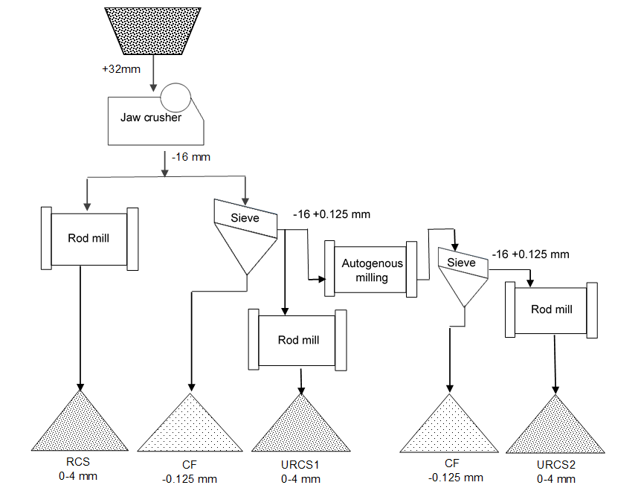
Autogenous grinding time (32 min) was calculated based on the change in the amount of liberated aggregates with varying grinding duration (0, 2, 4, 8, 16, 32 and 64 min).
Sand characterization:
Particle size analysis
Water absorption
Grain angularity
Morphology examination using a stereo-microscope
Sand meets the requirements of EN 13139 standard
RCS: simple recycled concrete sand, URCS1: 1st stage upgraded recycled concrete sand
URCS2: 2nd stage upgraded recycled concrete sand, CF: concrete fines derived from crushing and grinding procedures

Slide 7
Mortars production and laboratory tests
Mortars were manufactured and tested according to EN 196-1 (40x40x160 mm³ specimens cured for 28 days in a curing chamber at 20 ± 2 °C and a relative humidity of at least 95%).
Crushed primary limestone sand (CPLS) was used for comparison reasons.
Laboratory testing included measurement of compressive and flexural strength, density and water absorption.
 | Compositions
 | RCS | URCS1 | URCS2 | CPLS
CEM I 42.5N, g | 586 | 586 | 586 | 586
RCS, g | 1758 | - | - | -
URCS1, g | - | 1758 | - | -
URCS2, g | - | - | 1758 | -
CPLS, g | - | - | - | 1758
Water, g | 375 | 369 | 369 | 293
Water-to-binder ratio | 0.64 | 0.63 | 0.63 | 0.50
Corrected water-to-binder ratio* | 0.49 | 0.48 | 0.48 | 0.48
*Calculated after subtracting the water absorbed by the aggregates

Slide 8
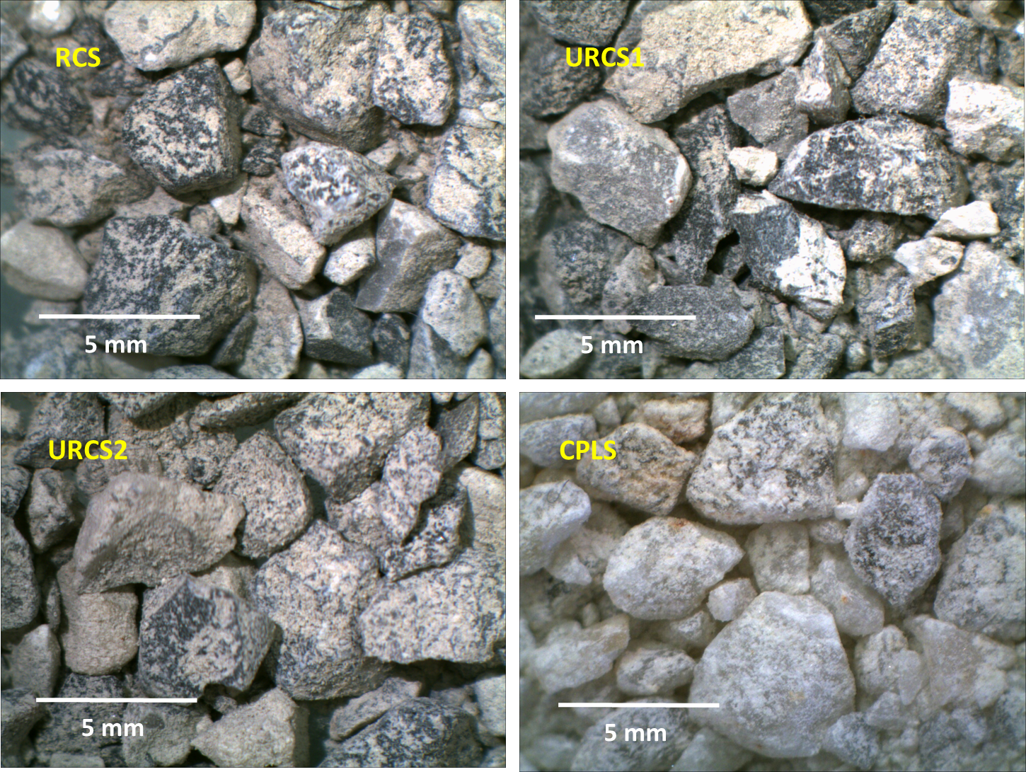
Recycled sands characterization
 | RCS | URCS1 | URCS2 | CPLS
Flow time (s) | 20 | 19 | 19 | 18
Water absorption (%) | 5.7 | 5.1 | 5.0 | 0.7
All recycled concrete sands’ grains are more angular than those of CPLS.
Several grains of recycled concrete sand have adhered cement paste.

Slide 9
Cement mortars testing results
Compositions | Compressive strength (MPa) | Flexural strength (MPa) | Density (kg/m³) | Water absorption (%)
RCS | 49.2 | 4.8 | 2135 | 10.6
URCS1 | 52.4 | 6.2 | 2146 | 11.3
URCS2 | 51.8 | 5.7 | 2168 | 11.2
CPLS | 64.9 | 6.6 | 2540 | 7.5
The first upgrading stage is sufficient to improve the quality of the RCA and enhance the properties of the produced mortars.

Slide 10
Conclusions - Suggestions for future research
The first upgrading stage is sufficient to improve the quality of the recycled aggregates. The second stage did not provoke any further improvement.
Upgraded recycled concrete sands had an improved quality compared to the simple recycled concrete sand. Although, the quality of the primary limestone sand was higher than the upgraded sand.
Further investigation of autogenous grinding process by altering the granulometry of feed material.
Investigation of the use of other selective aggregate-cement paste liberation technologies.
Recycling of concrete fines produced during crushing and grinding processes through thermal treatment for the production of activated cementitious material (formation of unhydrated compounds which have cementitious properties).

Slide 11
Acknowledgments
This work was performed within the framework of the funded project “National Contribution to European competitive projects – BEWEXMIN” managed by the Research Committee of the Technical University of Crete (ΚΑΕ 81281).

Slide 12
Thank you!

