Slide 1
Automated First Guess TAFs
Andre Lanyon, Jessica Standen, Piers Buchanan
EGU General Assembly 2020

Slide 2

TAFs Overview
TAF term | Deterministic | Probabilistic | Temporal uncertainty
BECMG | ✓ | ✗ | ✓
TEMPO | ✓ | ✗ | ✓
PROB30 | ✗ | ✓ | ✗
PROB40 | ✗ | ✓ | ✗
PROB30 TEMPO | ✗ | ✓ | ✓
PROB40 TEMPO | ✗ | ✓ | ✓
  TAFs (Terminal Aerodrome Forecasts) are the format for reporting aviation weather forecast information
  They are manually produced and issued by Operational Meteorologists (in the UK)
  A variety of deterministic and probabilistic terms are used, with some terms containing temporal uncertainty
  For example, a TEMPO group indicates that an alternative category is forecast with 100% probability (deterministic) to occur at least once and for up to half of the TEMPO period (temporal uncertainty)
www.metoffice.gov.uk © Crown Copyright 2020, Met Office

Slide 3
Automated First Guess TAFs
  Automated first guess TAFs are being developed in the Met Office, with the research funded by the Civil Aviation Authority
  They use site-specific numerical weather prediction (NWP) model data to routinely produce TAFs in the same format as that issued by Operational Meteorologists
  They are intended to provide a first guess solution for Operational Meteorologists to start the writing of TAFs from
  The logic encoding the model data into the TAF format is based on practical experience of writing TAFs as an Operational Meteorologist - the intention of this approach is to produce readable, sensible and usable TAFs that would require minimal intervention in most situations
  It is hoped that the use of automated first guess TAFs will improve the efficiency of TAF production, allowing Operational Meteorologists to use their expertise more effectively - for example, by adding value to model output or providing extra consultancy services
www.metoffice.gov.uk © Crown Copyright 2020, Met Office

Slide 4
Comparisons with Issued TAFs
The table above compares 3 first guess TAFs to the equivalent operationally issued TAFs
In all 3 examples, base conditions in first guess TAFs were similar to those in operationally issued TAFs
Change group values were also similar
There were differences in timings and the types of change groups used
Note that these are all examples of simple weather situations – differences become more apparent as weather becomes more complex
www.metoffice.gov.uk © Crown Copyright 2020, Met Office

Slide 5
Comparison of TAFs with METARS
The table on the left shows a first guess TAF and the equivalent operationally issued TAF (left column) and the METARs (Meteorological Terminal Aviation Routine Weather Reports) issued for the TAF forecast period (right column)
The first guess TAF indicates a risk of much lower visibility (100m in freezing fog) than the operationally issued TAF (6000m)
METARS show visibility generally stayed above 10,000m, although it did drop to 7000m at 0420Z, justifying the risk given in the operational TAF (although this occurred just outside of the PROB30 TEMPO period)
Very low visibility and freezing fog in first guess TAF appears pessimistic – however, screen temperature was below freezing and close to dew point for much of the night, so it could be argued that the 30% risk was justified
www.metoffice.gov.uk © Crown Copyright 2020, Met Office

Slide 6
Verification - Method
Verification scores for first guess TAFs were compared to equivalent scores for operationally issued TAFs
The verification method used was Sharpe et al¹ as this is the TAF verification method currently in use at the Met Office
3 years of data were used between 01/11/2016 and 01/11/2019, with 4 TAFs per day produced for 28 UK civil airports
Only visibility and cloud base were verified, as wind and significant weather are not currently verified at the Met Office
The results shown on the next slide are based on the Gerrity score, which was chosen as a good overall performance measure for the following reasons:
  It is the main score to be used in TAF verification at the Met Office
  It is a multi-category verification score
  It penalises large errors more than small errors
  It rewards correct forecasting of rare events
¹M. A. Sharpe, C. E. Bysouth and M. Trueman, “Towards an improved analysis of Terminal Aerodrome Forecasts,” Meteorological Applications, vol. 23, pp. 698-704, 2016
www.metoffice.gov.uk © Crown Copyright 2020, Met Office

Slide 7
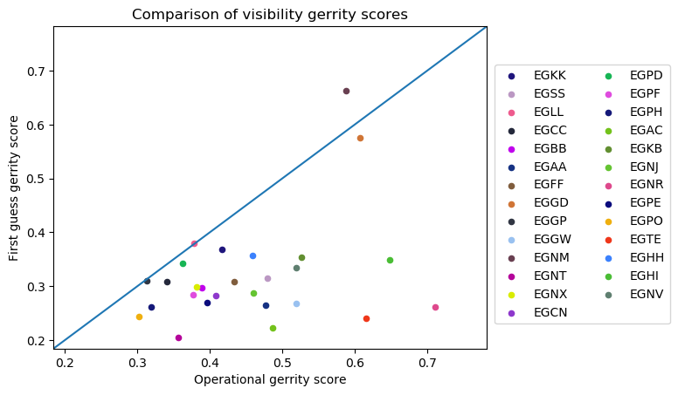
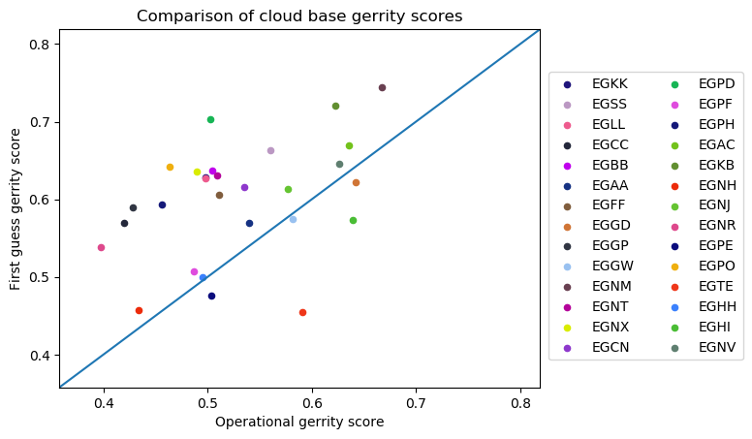
Verification- Results
First Guess TAF Gerrity score
Comparison of Visibility Gerrity Scores
In both plots, Gerrity scores based on first guess TAFs are compared to those based on operational TAFs
Each dot represents the scores of one airport
Blue diagonal lines indicate where scores would be equal - if the dot is below the line the operationally issued TAF scored higher and if above the line the first guess TAF scored higher
Visibility scores were generally better for operationally issued TAFs
Cloud base scores were generally better for first guess TAFs
The differences in the scores seem to be mainly attributed to the forecasting of rare events (i.e. very low visibility and very low cloud) – these are better captured in operationally issued TAFs for visibility, and in first guess TAFs for cloud base
Operational TAF Gerrity score
First Guess TAF Gerrity score
Comparison of Cloud Base Gerrity Scores
Operational TAF Gerrity score
www.metoffice.gov.uk © Crown Copyright 2020, Met Office

Slide 8
Next Steps
Operational Meteorologists will be consulted with in order to identify any potential improvements
Real-time observations will be incorporated in order to improve the forecasts in the first few hours of the TAF periods
Verification results will be analysed further, which could lead to changes in how model data is interpreted – by correcting for any biases for example
As changes are made, further verification will be necessary to ensure performance has improved
www.metoffice.gov.uk © Crown Copyright 2020, Met Office

Slide 9
Summary
If successful, first guess TAFs could improve the efficiency of TAF production, allowing Operational Meteorologists to use their time more effectively
Subjective comparisons to operationally issued TAFs indicate first guess TAFs generally provide sensible, legal and useable TAFs – there are differences, as should be expected, and these are more apparent in complex weather situations
Initial verification results are encouraging, but also indicate where the first guess TAFs should be improved (e.g. for low visibility forecasts)
www.metoffice.gov.uk © Crown Copyright 2020, Met Office

