Slide 1
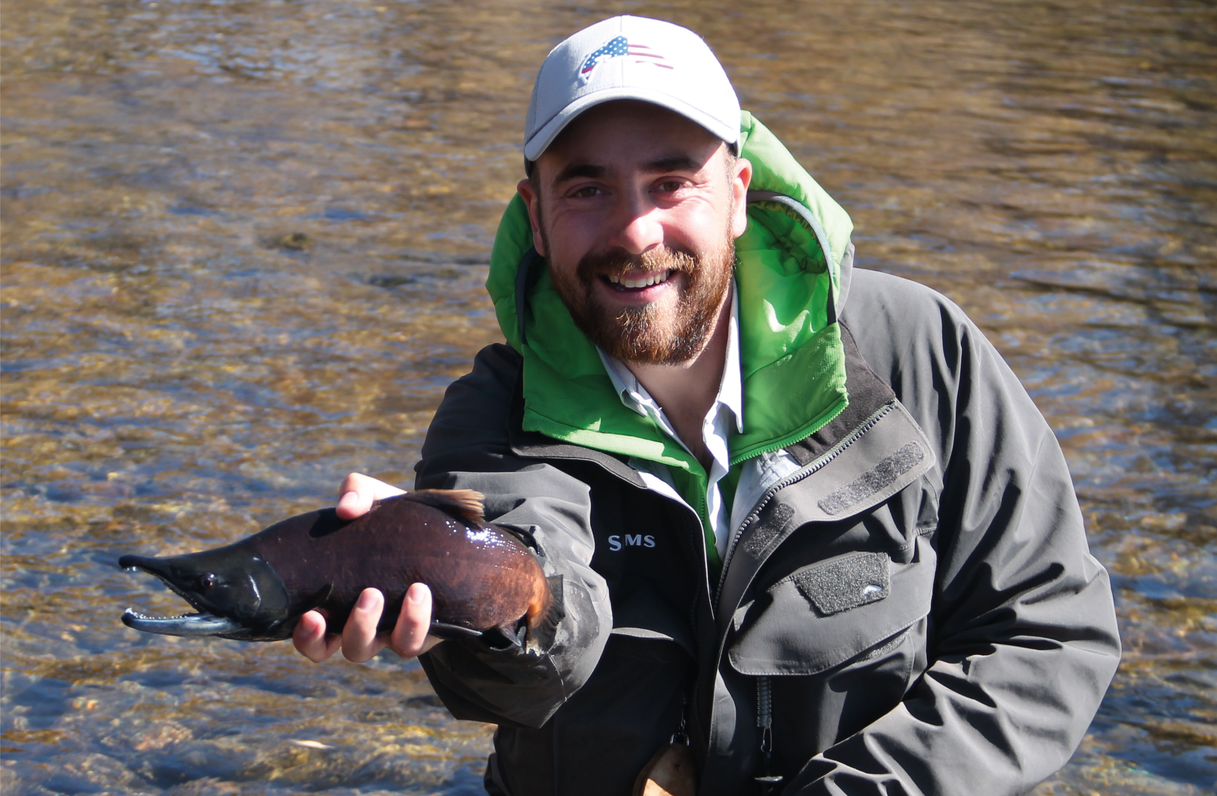
A better appreciation of glacial floodplain morphodynamics reveals that disturbances are not spatially homogenous: implications for biofilm development ¹Roncoroni M., ¹Clémençon M., ²Brandani J., ²Battin T.I., ¹Lane S.N. ¹Institute of Earth Surface Dynamics (IDYST), University of Lausanne ²Stream Biofilm and Ecosystem Research Laboratory (SBER), École Polytechnique Fédérale de Lausanne matteo.roncoroni@unil.ch

Slide 2
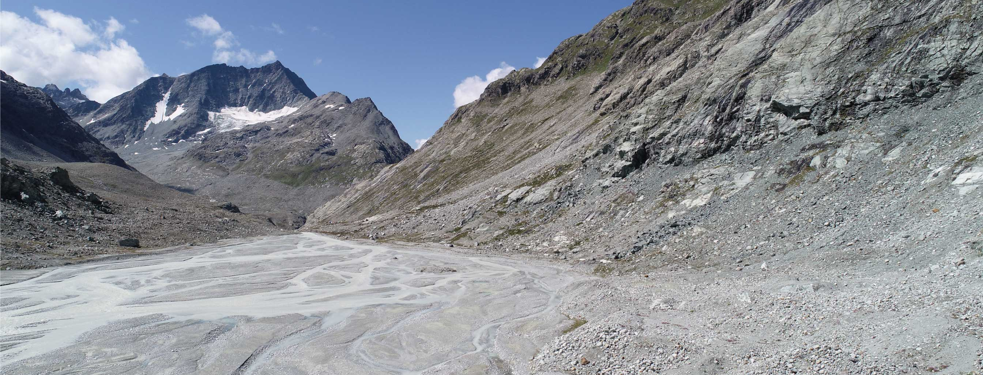
Introduction
The current glacier retreat exposes new terrains to potential ecological colonization (e.g., Milner et al., 2009)
Floodplain of the Otemma Glacier (Valais, Switzerland) - © Roncoroni M.

Slide 3
Introduction
Highly unstable terrains (Heckmann et al., 2016) that are continuously reworked (Bakker et al., 2019)
→ Disturbance-dominated regime
→ Biofilm development may be slowed or even precluded, especially during the melt-season
However …
some zones may experience habitat stability, hence support biofilm development during the melt-season.
Well developed biofilms during the melt-season - © Roncoroni M.

Slide 4
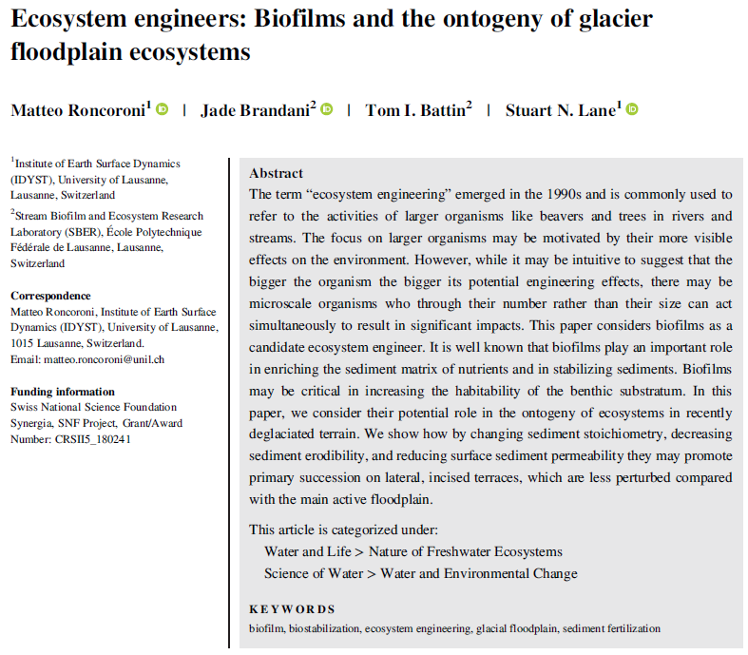
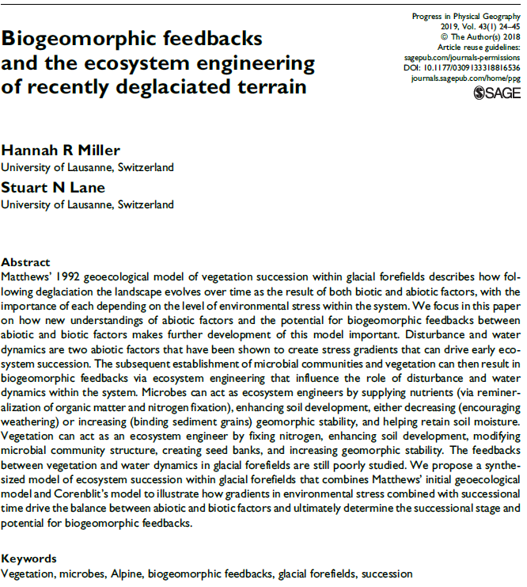
Introduction
Although biofilm biomass might not reach high levels the during summer, those biofilms may be important in engineering the environment for vegetation (Miller and Lane, 2018; Roncoroni et al., 2019)

Slide 5
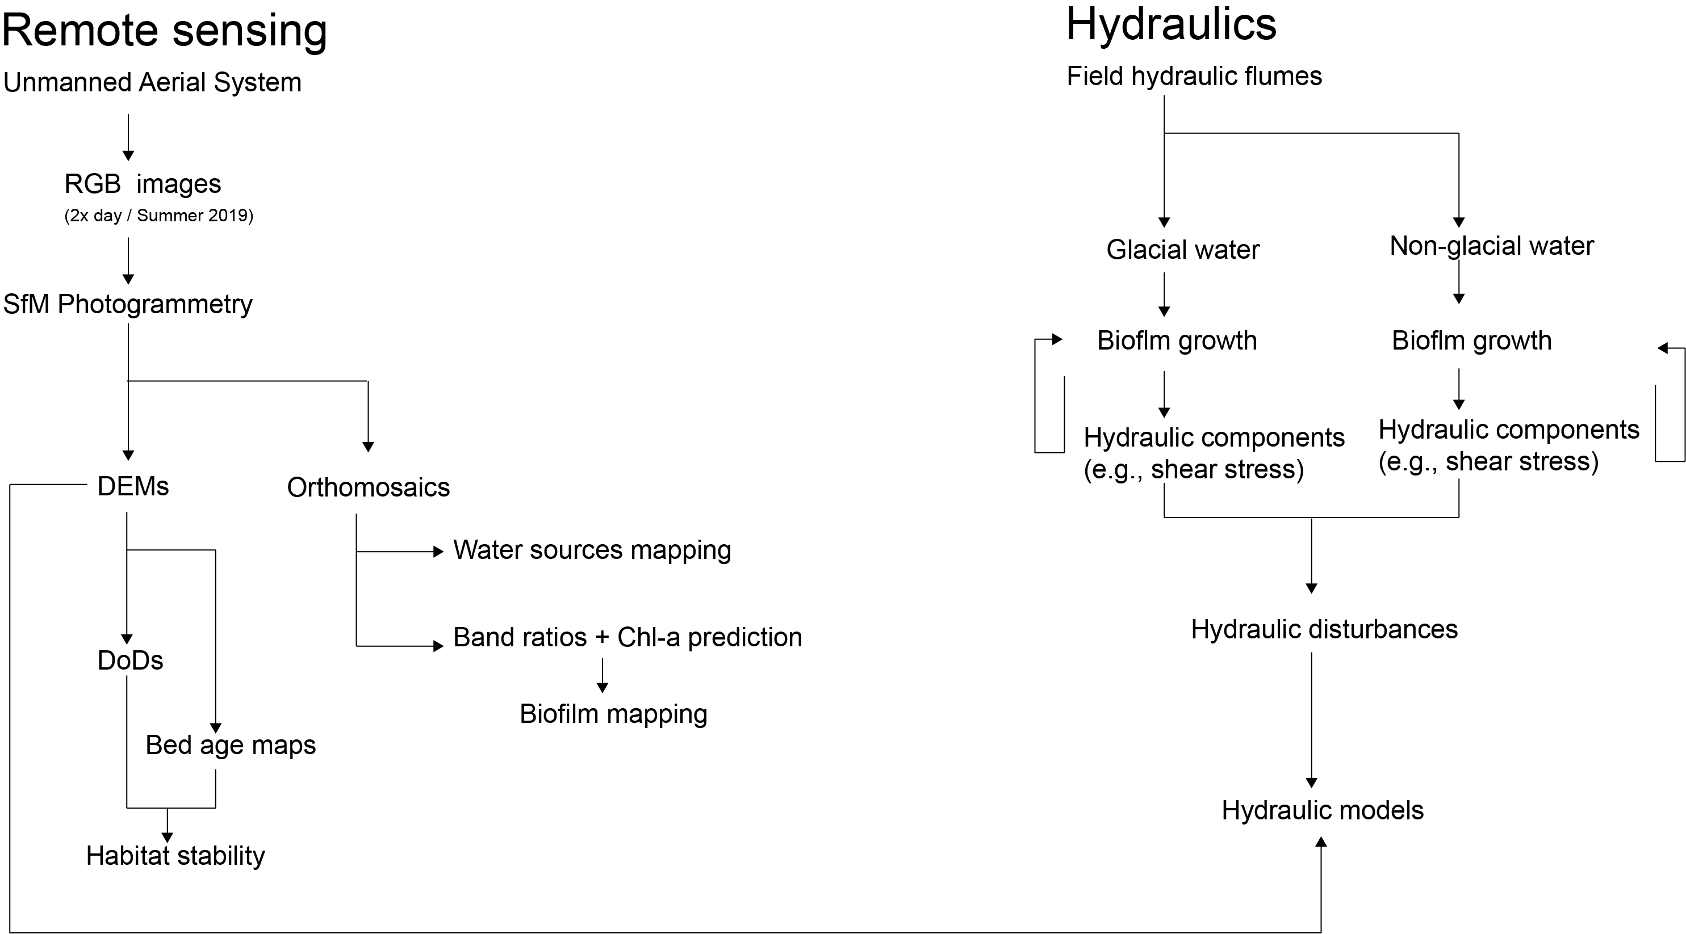
Method overview

Slide 6
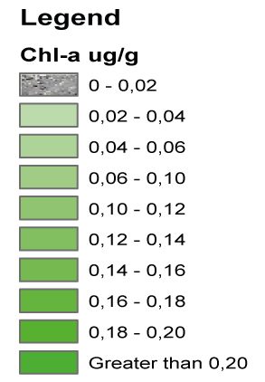
Preliminary results Biofilm mapping and Chl-a prediction with visible band (RGB) ratios
Prediction of the Chl-a concentration for the Otemma’s forefield (10/07/19)

Slide 7
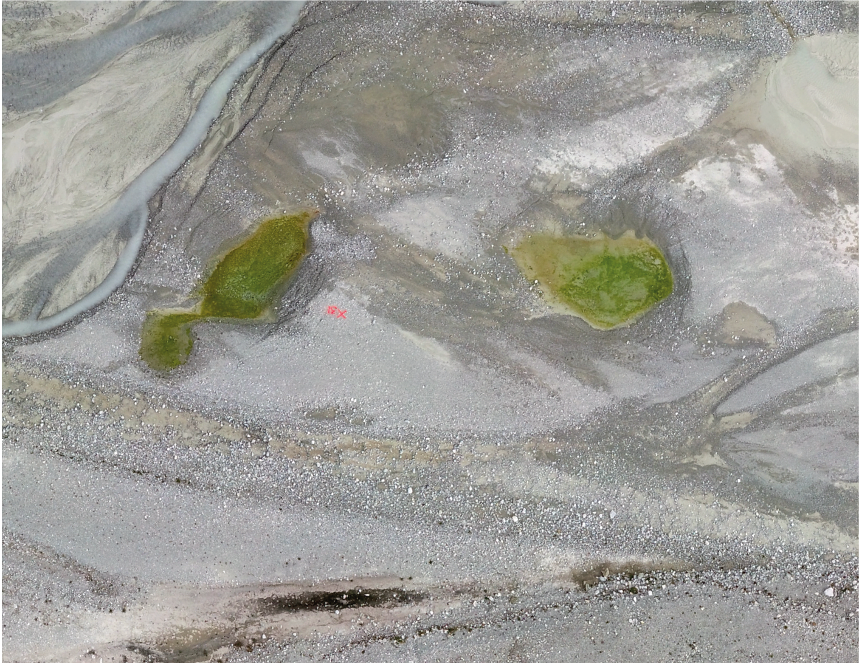
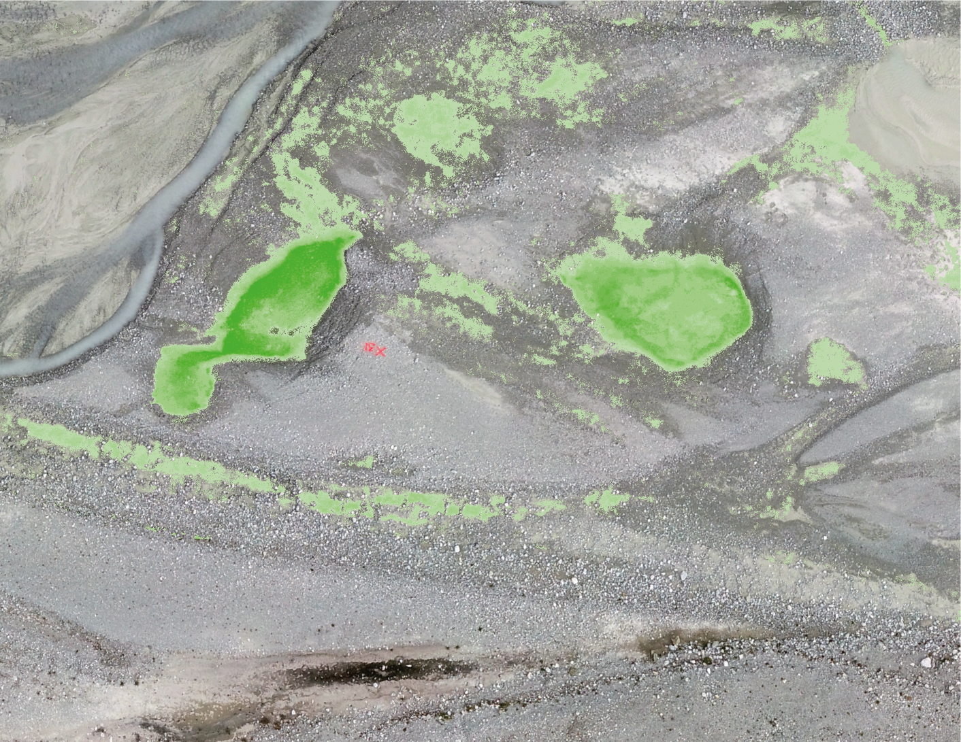
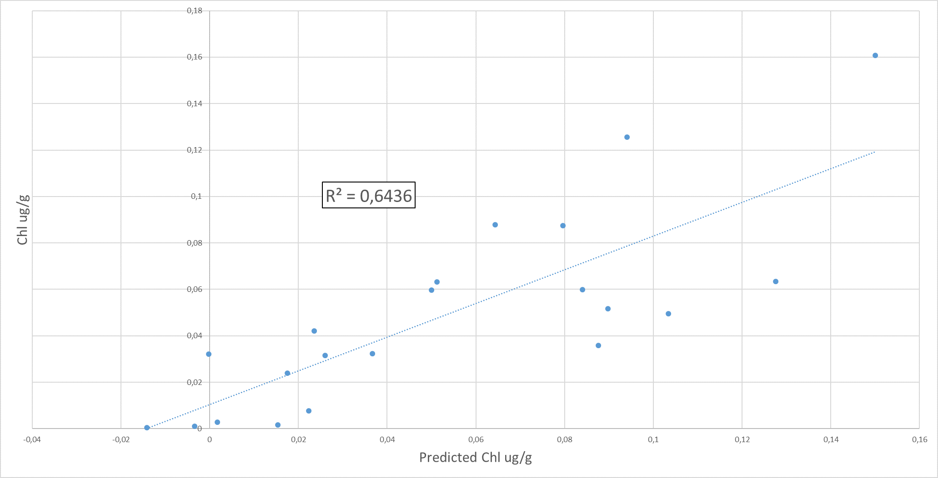
Preliminary results Biofilm mapping and Chl-a prediction with visible band (RGB) ratios
Prediction of the Chl-a concentration for the Otemma’s forefield (10/07/19)
Actual Chl-a concentration versus predicted Chl-a concentration (R²= 0.64)

Slide 8
Conclusions
Our preliminary results might already suggest that well developed biofilms exist in specific zones (i.e., where habitat stability is greater) during the summer, and this is confirmed by visual observations in our study site.
A better understanding of biofilm development in summer and its relationship with floodplain morphodynamics may reveal new patterns of ecological succession in recent deglaciated terrains.

Slide 9
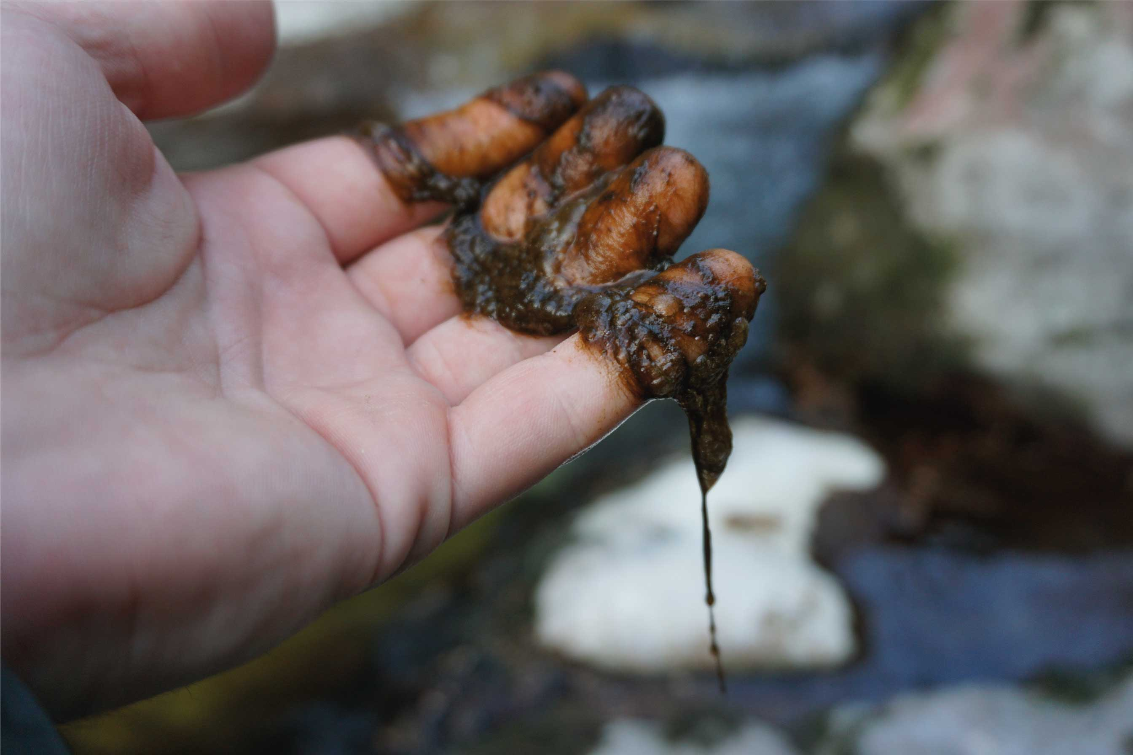
Thank you
© Curato J.
This study is benefited through the financial support from SNF Project CRSII5_180241 ENSEMBLE awarded to T. I. Battin, S. N. Lane, M. Lever and P. Wilmes

Slide 10
References
Bakker, M., Antoniazza, G., Odermatt, E., & Lane, S. N. (2019). Morphological Response of an Alpine Braided Reach to Sediment‐Laden Flow Events. Journal of Geophysical Research: Earth Surface. https://doi.org/10.1029/2018JF004811
Miller, H. R., & Lane, S. N. (2019). Biogeomorphic feedbacks and the ecosystem engineering of recently deglaciated terrain. Progress in Physical Geography: Earth and Environment, 43(1), 24–45. https://doi.org/10.1177/0309133318816536
Milner, A. M., Brown, L. E., & Hannah, D. M. (2009). Hydroecological response of river systems to shrinking glaciers. Hydrological Processes, 23(1), 62–77. https://doi.org/10.1002/hyp.7197
Roncoroni, M., Brandani, J., Battin, T. I., & Lane, S. N. (2019). Ecosystem engineers: Biofilms and the ontogeny of glacier floodplain ecosystems. Wiley Interdisciplinary Reviews: Water, 6(6). https://doi.org/10.1002/wat2.1390

