Slide 1
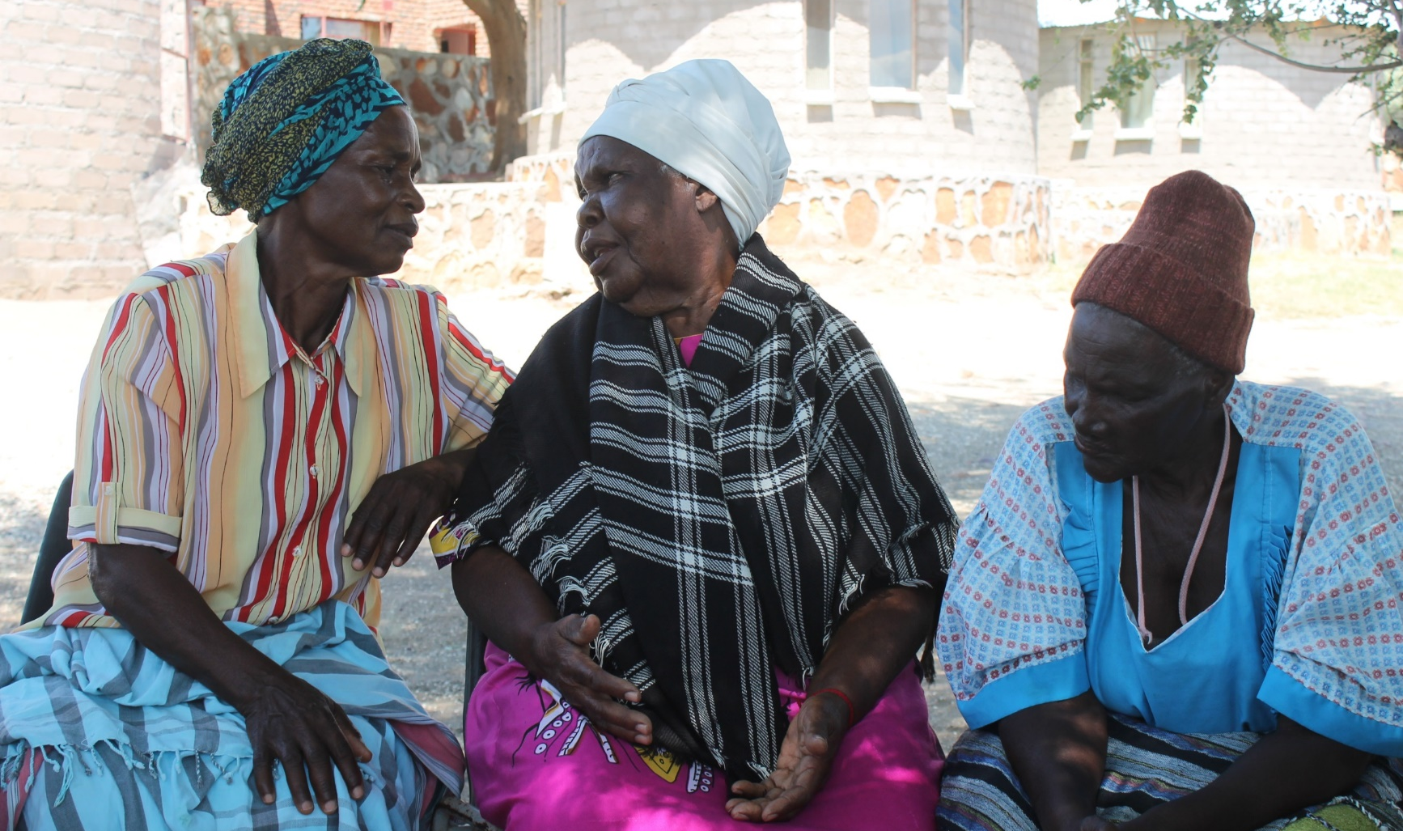
Social science for hydrologists: considerations when doing fieldwork with human participants, Rangecroft et al., 2020
1.
Introduction
sally.rangecroft@plymouth.ac.uk
2.
Aims:
Facilitating collaboration and interdisciplinarity through understanding
3.
Key concepts to consider when planning & conducting fieldwork with participants:
HOME PAGE
Good ethical practice
PICO Navigation
Click buttons for the section
To go back and forth
To go back to this home page
Key information
Data collection methods
Power dynamics
Positionality
Local partnerships
Communication of science
Post-fieldwork reflections
Validation
4.
Considerations for researching alongside
different disciplines
5.
Summary & Recommendations
1/4
2 minute madness
Notes:
Please play the powerpoint as slideshow to use the PICO interactive navigation as indented

Slide 2
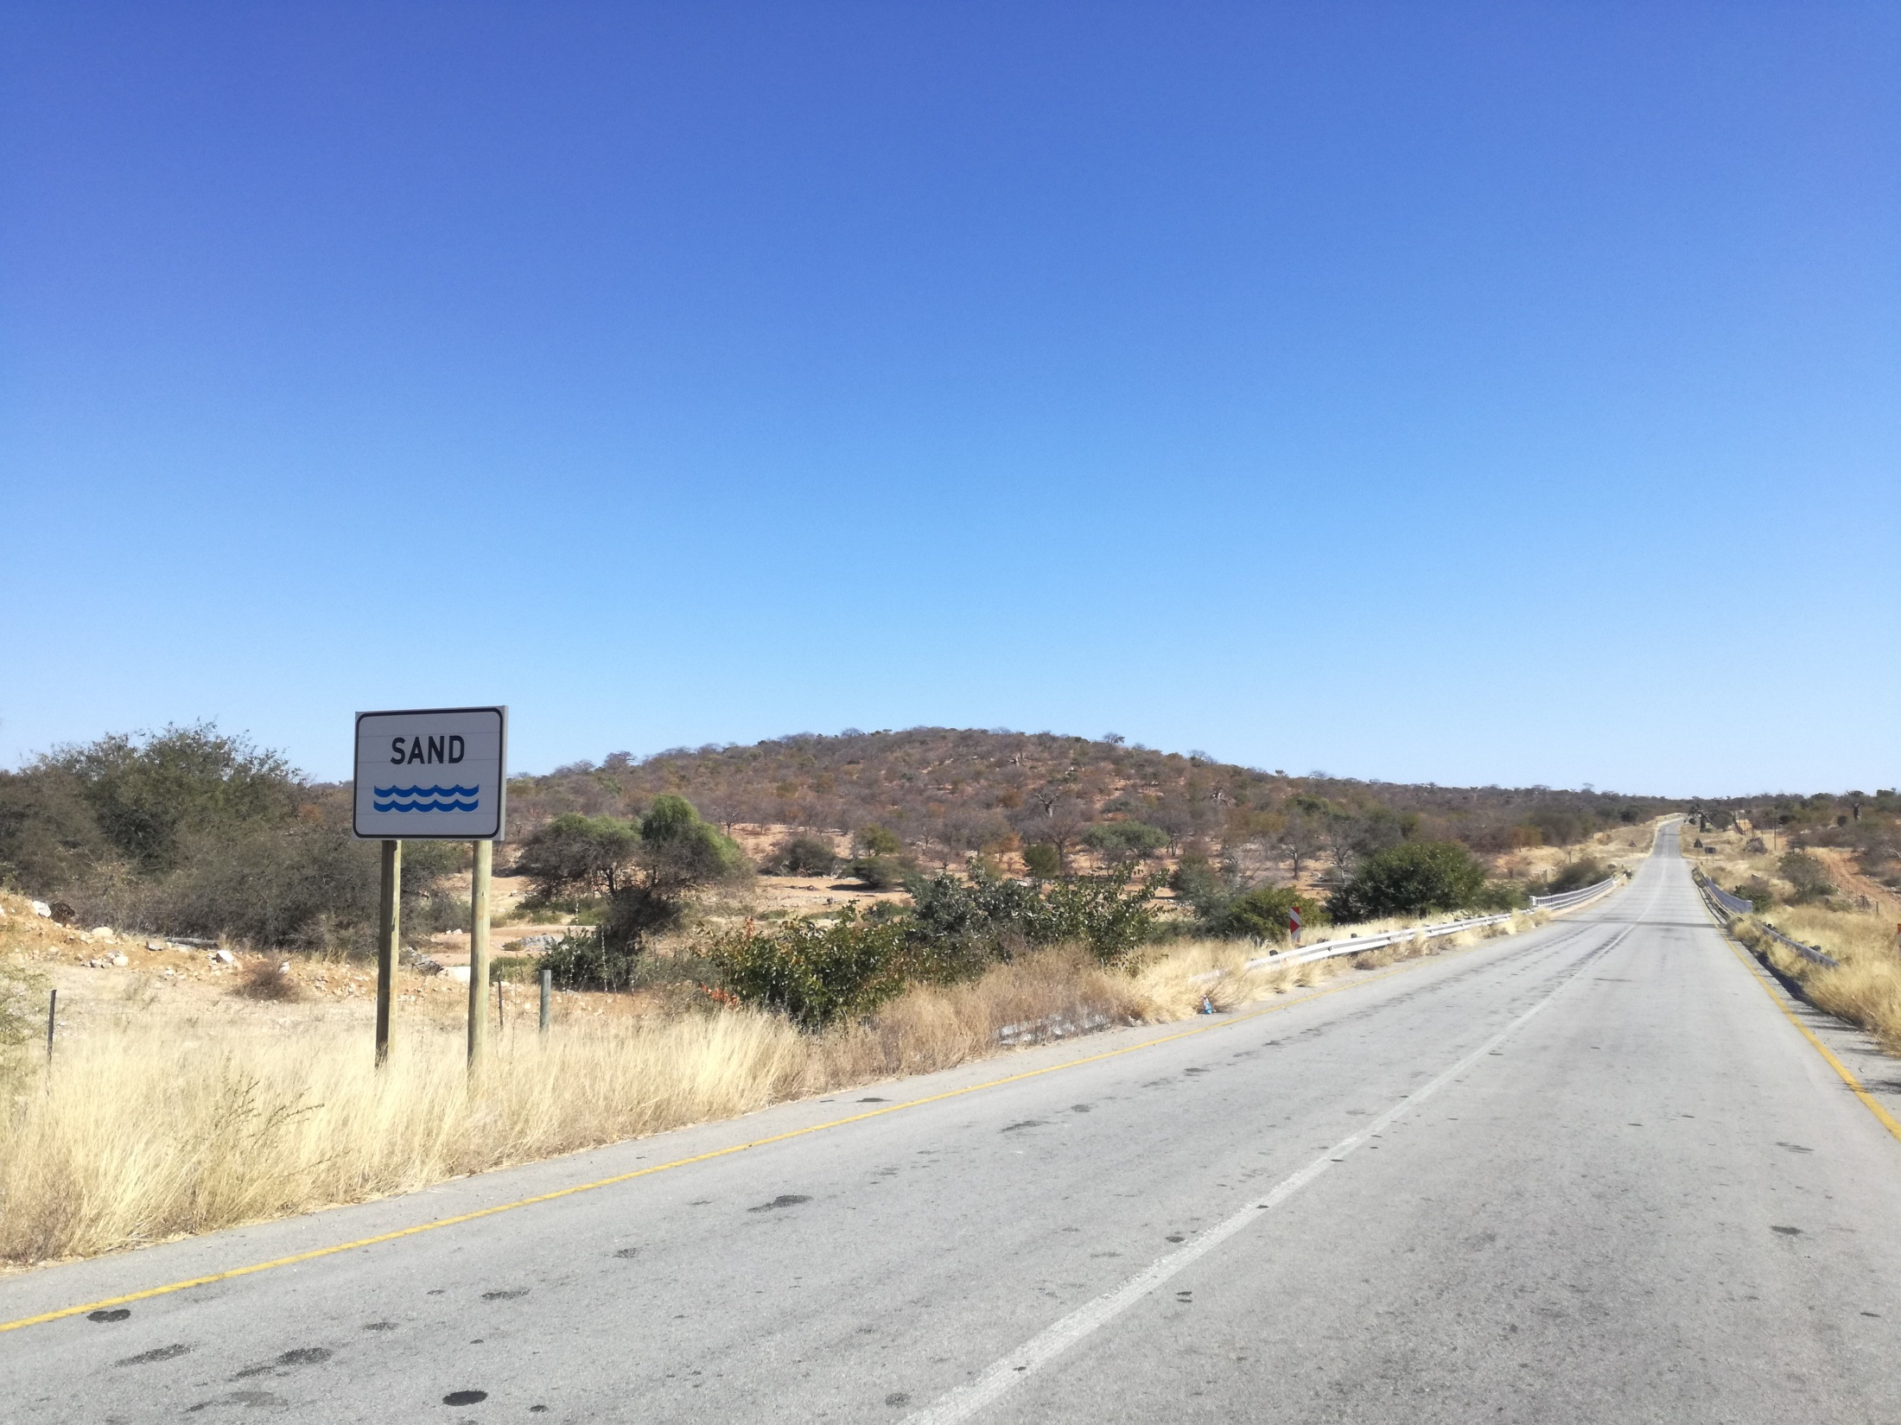
Human participants: e.g. individuals, policy-makers, community leaders, government representatives, etc.
PICO 2 minute madness
Hydrologists are increasingly collecting qualitative data and conducting fieldwork with human participants themselves and collaboratively with others.
Aspects might be unfamiliar to hydrologists, or might require a different approach and consideration between social and natural scientists.
1. Introduction
3. Key concepts for consideration
Good ethical practice
Data collection methods
Power dynamics
Positionality
Local partnerships
Communication of science
Post-fieldwork reflections
Validation
Encourage interdisciplinary work by better preparing hydrologists for collaboration, enabling more holistic, ethical, and successful research.
We seek to achieve this by facilitating collaboration through improved understanding.
There can be communication barriers and challenges between the researchers themselves, especially when working across disciplines.
One key challenge for interdisciplinary research is a lack of common language.
Differences in philosophies and methodologies can cause barriers.
2. Aims
4. Working with different disciplines
5. Summary & Recommendations: Next slide
2/4
2 minute madness
Rangecroft et al., 2020. Social science for hydrologists: considerations when doing fieldwork with human participants, EGU2020

Slide 3
In this PICO we help to bridge the gap for hydrologists who may be working with social scientists and human participants
PICO 2 minute madness
Summary & Recommendations
Fieldwork with human participants:
Good ethical principles should underpin all research with human participants, protecting both the participants and the researchers.
Differences in power and positionality of researchers and participants, and amongst participants can affect data collection and interpretation. Power relations can be planned for in the research design.
Qualitative data collection can be more time-intensive, but gain a wealth of information and context.
Dedicated time to build trust with local partners and participants.
Pre-fieldwork training with translators/field assistants, and post-fieldwork debriefing sessions to maximise communication between researchers and local partners about data collection and interpretation.
Knowledge sharing can be two-way: data collection and/or communicating science.
Treat social and hydrological data equally as they can yield valuable insights on human-water relations.
Interdisciplinary research:
Interdisciplinary collaborations can suffer from a number of challenges and barriers due to differences in philosophies, methods, vocabularies, and potentially a lack of experience in the other discipline.
However, it is these differences in perspective and complexity which is needed for understanding real world problems and potential solutions.
It is worth investing time to build understanding across the disciplines to foster improved collaborations. Place importance and time on exchange activities, such as meetings for specific discussions on vocabulary, research methodologies and design amongst researchers.
Establish a common language, develop a joint vocabulary.
Encouraging researchers to have equal input into the design of all stages of the research.
Share knowledge between disciplines to enable them to expand beyond their own.
Most importantly: Time invested in building these true collaborations will help to build trust amongst researchers, participants and practitioners alike, enabling more meaningful and fruitful research
3/4
2 minute madness
Rangecroft et al., 2020. Social science for hydrologists: considerations when doing fieldwork with human participants, EGU2020

Slide 4
Discussion points
PICO 2 minute madness
Fieldwork with human participants and interdisciplinary collaborations:
Your experiences?
Have you conducted fieldwork with human participants?
What methods did you use? What worked well? What would you advice others?
What is your discipline background? Did you work closely with another disciplines?
Was it actually an active collaboration? If so, what worked well for you? Why? How?
Did you experience any challenges on fieldwork? How did you overcome them?
Did you experience any challenges with interdisciplinary collaborations? If so, what were the barriers? How did you overcome them?
Overall, what did you learn?
Do you have recommendations to share?
Please feel free to expand on these discussion points, or raise any of your own from browsing our research presentation. We welcome your experiences and thoughts!
4/4
2 minute madness
Rangecroft et al., 2020. Social science for hydrologists: considerations when doing fieldwork with human participants, EGU2020

Slide 5
Social science for hydrologists: considerations when doing fieldwork with human participants
Sally Rangecroft¹, Eddie Banks², Rosie Day³, Guiliano Di Baldassarre^{4,5}, Theresa Frommen⁶, Yasunori Hayashi⁷, Britta Höllermann⁸, Karen Lebek⁶, Elena Mondino^{4,5}, Melanie Rohse⁹, Maria Rusca^{4,5}, Marthe Wens¹⁰, and Anne Van Loon^{3,10}
1

Slide 6
1. Introduction: Problem statement
Water is at the core of many current and future global challenges, which involve hydrological, technical and social processes.
Thus, successful interdisciplinary research on water issues, human activities, actions and responses is increasingly important.
Hydrologists are increasingly collecting qualitative data and conducting fieldwork with human participants themselves and collaboratively with others.
Hydrologists who are planning and undertaking
fieldwork involving human participants may be
underprepared because they are unfamiliar with
key social science approaches and concepts.
Human participants: e.g. individuals, policy-makers, community leaders, government representatives, etc.
2
Rangecroft et al., 2020. Social science for hydrologists: considerations when doing fieldwork with human participants, EGU2020

Slide 7
Interdisciplinarity: Collaborative working?
Hydrologists
Social scientists
Quantitative
Qualitative
Physical variables
Water
Perceptions
Numerical modelling
Governance
A topic with both nature and humans at its heart
Future simulations
Behavioural challenges
Water availability
Water use
Environmental impacts
Societal impacts
Nature
Humans
How to maximise the expertise from both disciplines, and collaborate successfully?
3
Rangecroft et al., 2020. Social science for hydrologists: considerations when doing fieldwork with human participants, EGU2020

Slide 8
Reality?
Due to differences in approaches and desired outcomes, hydrologists and social scientists can easily end up remaining disconnected during research (Evers et al., 2017).
Differences in backgrounds, approaches and concepts, and therefore fundamental ethics, research design, participant involvement and results.
Working between different disciplines, and their different philosophies, methodologies and vocabularies, can create challenges (Krueger et al., 2016).
4
Rangecroft et al., 2020. Social science for hydrologists: considerations when doing fieldwork with human participants, EGU2020

Slide 9
2. Aims
Encourage interdisciplinary work by better preparing hydrologists for collaboration, enabling more holistic, ethical, and successful research
How?
By facilitating collaboration through understanding. Here we help to bridge the gap for hydrologists who may be working with social scientists and human participants
5
Rangecroft et al., 2020. Social science for hydrologists: considerations when doing fieldwork with human participants, EGU2020

Slide 10
Aims
Number of key concepts and methods from the social sciences for hydrologists to be aware of when planning and conducting fieldwork involving human participants, and/or throughout an interdisciplinary project (Section 3).
These aspects might be unfamiliar to hydrologists, or might require a different approach and consideration between social and natural scientists.
These include working with research participants, ethical considerations and the different theoretical lenses that social scientists use to examine real world problems and human interactions (Wesselink et al., 2017) (Section 3).
Other issues that are related to working collaboratively with social scientists (e.g. vocabulary differences) (Section 4).
6
Rangecroft et al., 2020. Social science for hydrologists: considerations when doing fieldwork with human participants, EGU2020

Slide 11
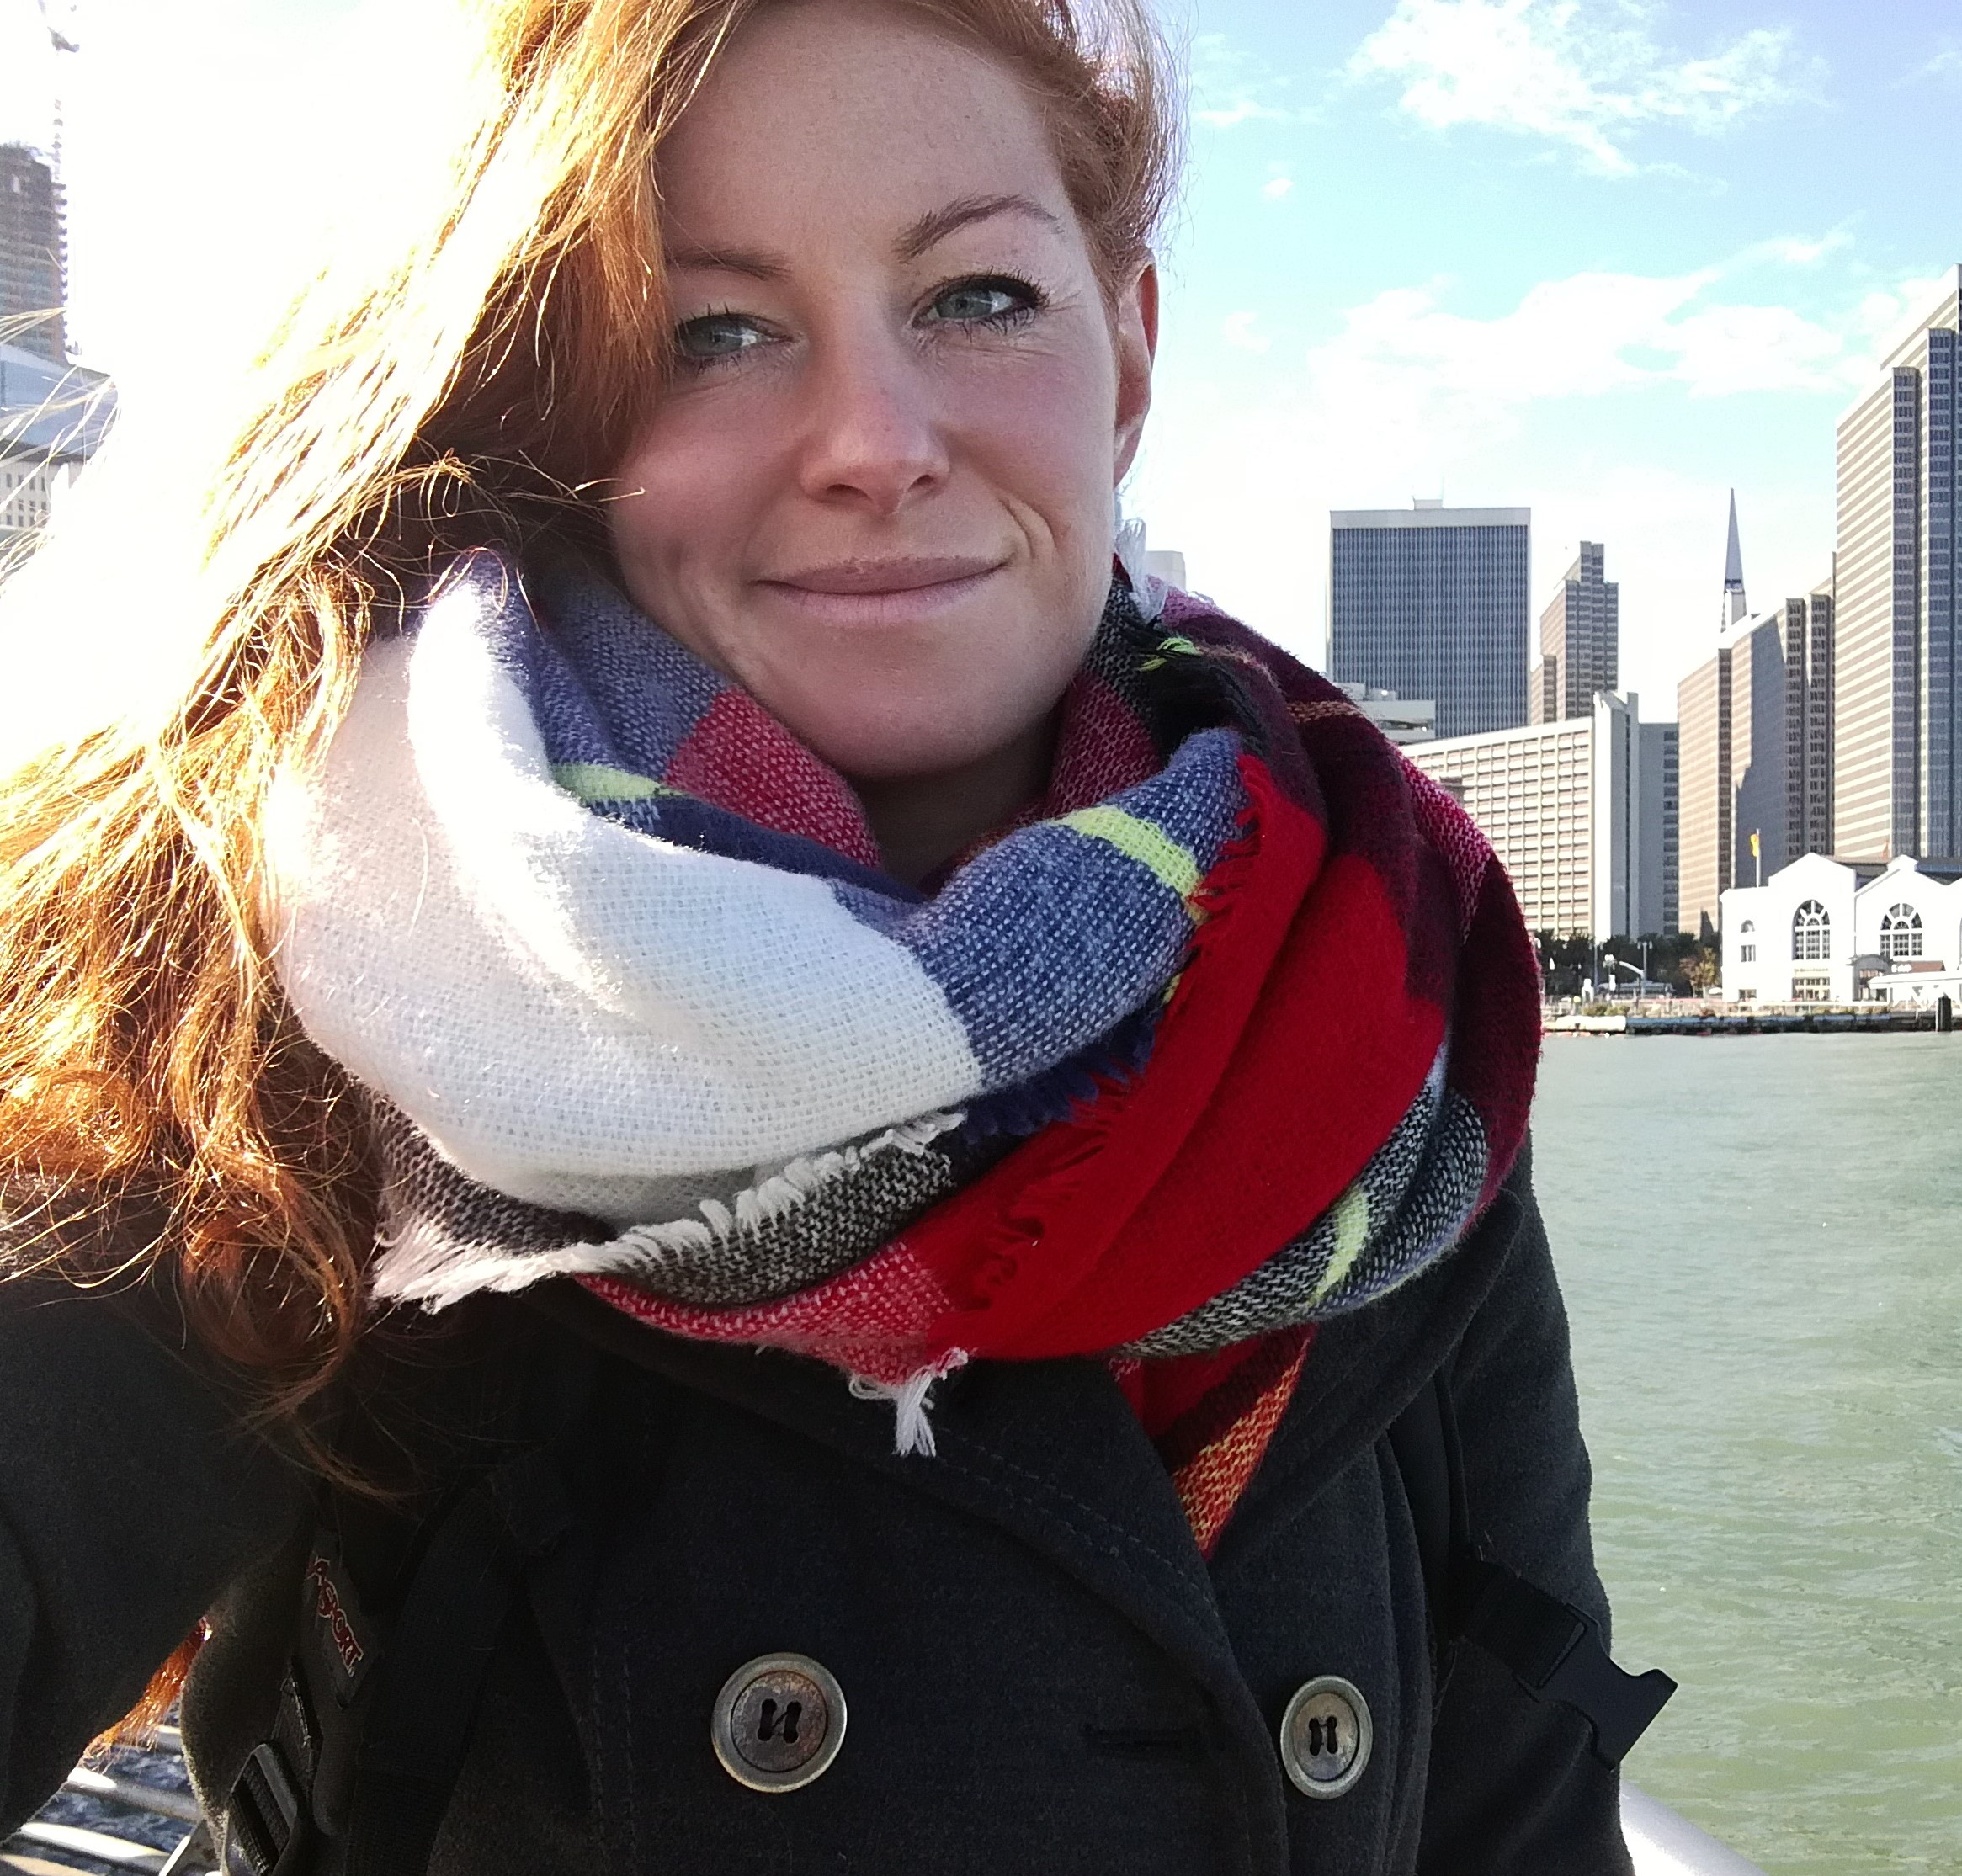
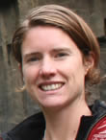
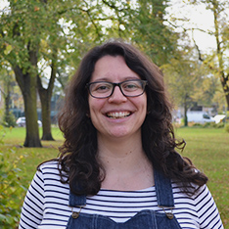
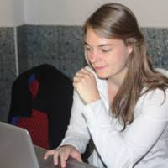
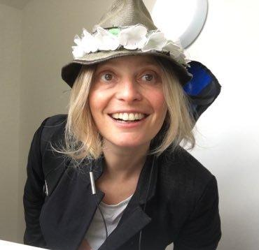
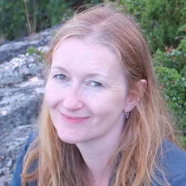
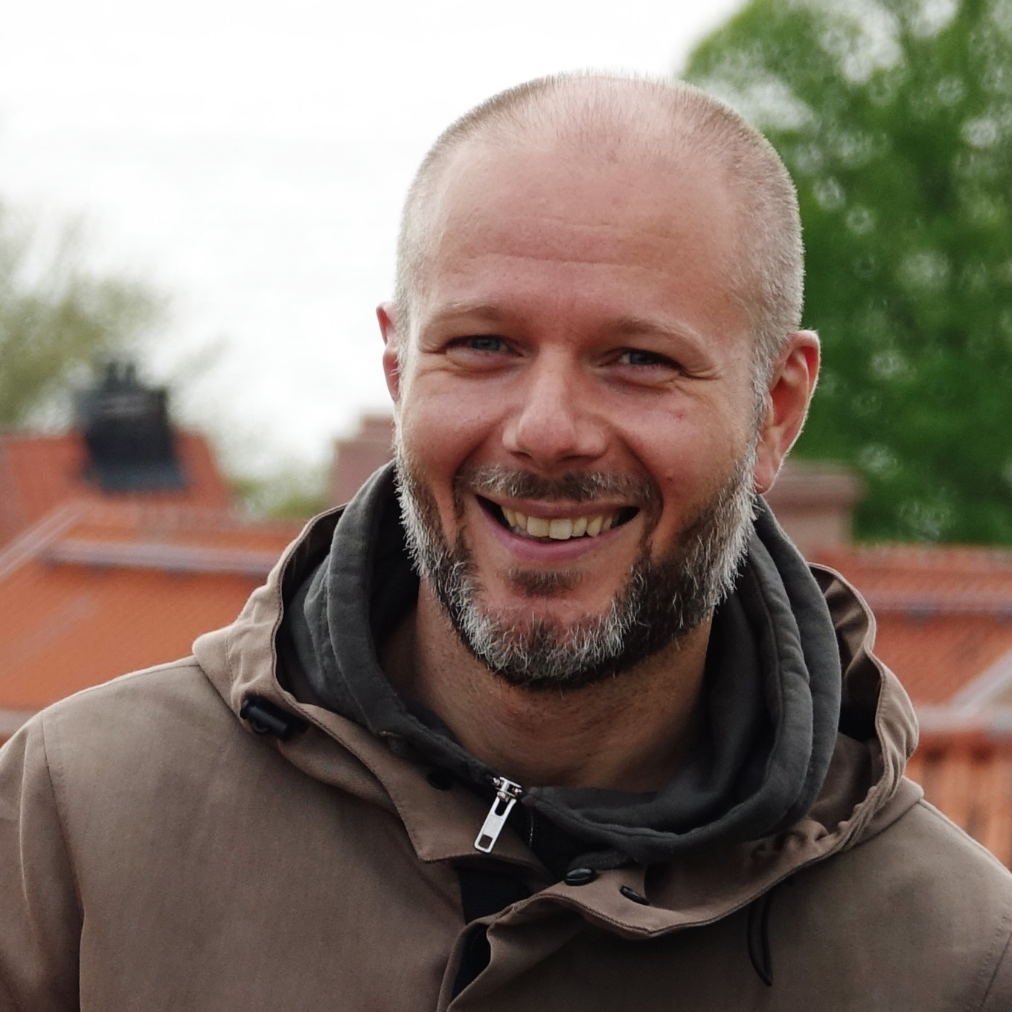
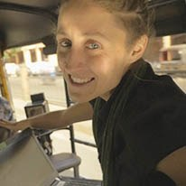
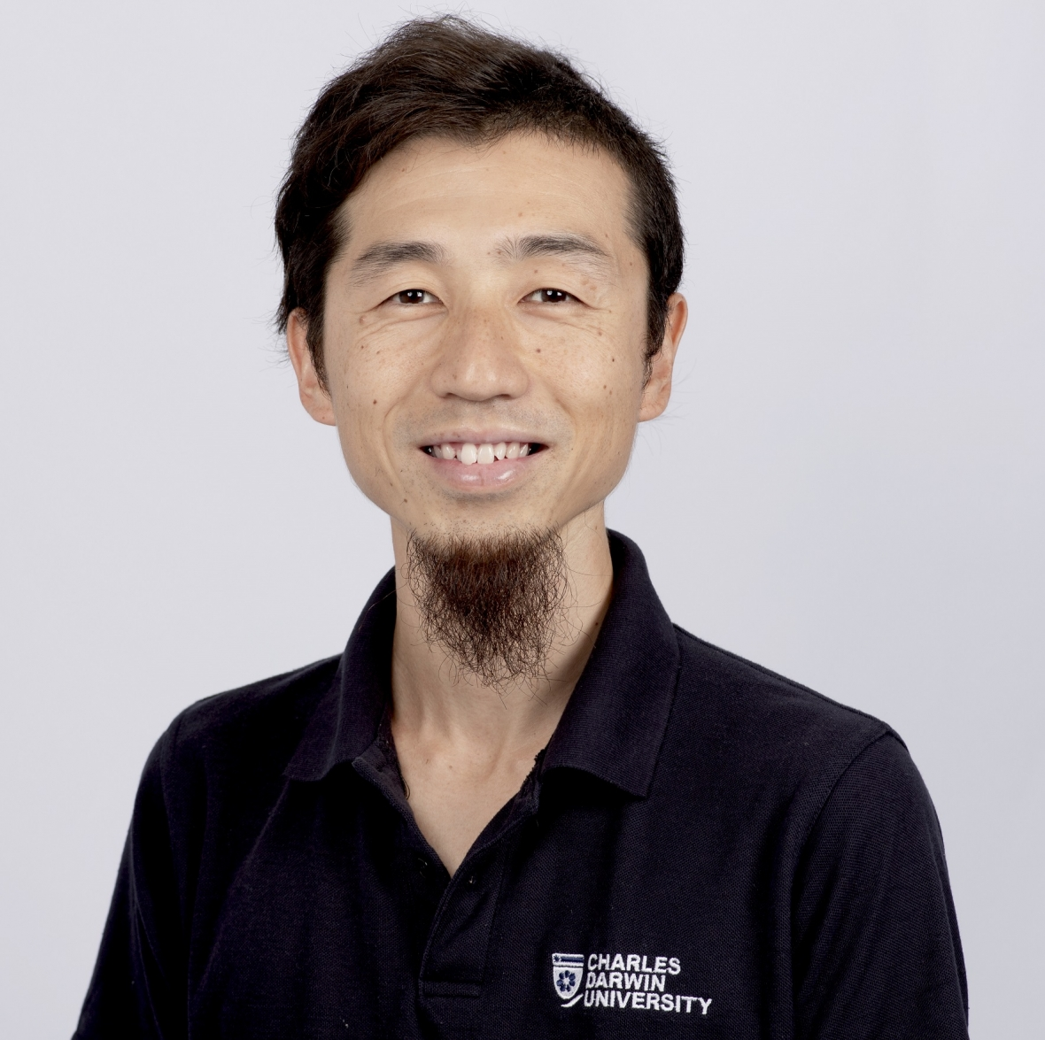
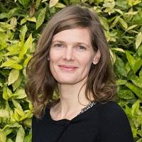
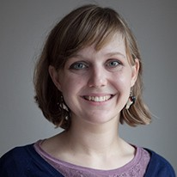
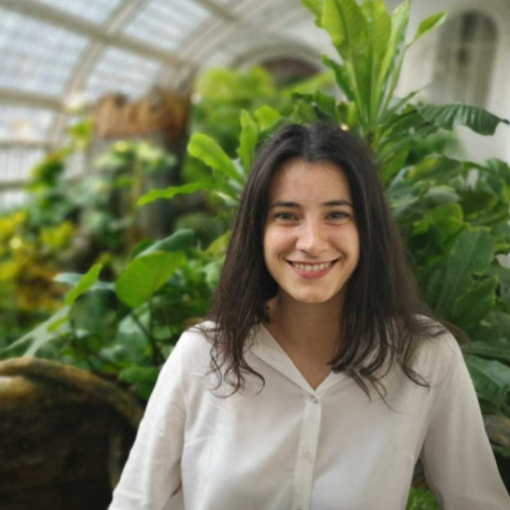
Who we are?
Introduction
Back to
Back to
Combination of physical scientists, social scientists and interdisciplinary scientists.
A cross section of researchers at different career: PhD students, post-docs, lecturers, senior academics.
All with experience of working with human participants in the field, but from very different aspects, methods and research questions.
We have all worked on a variety of different projects across the world, but all seeking to understand and address water issues.
Sally Rangecroft,
University of Plymouth, UK
Anne Van Loon,
VU Amsterdam,
Netherlands
Melanie Rohse,
Anglia Ruskin University, UK
Marthe Wens,
VU Amsterdam,
Netherlands
Eddie Banks,
Flinders University, Australia
Rosie Day,
University of Birmingham, UK
Maria Rusca,
CNDS & Uppsala University, Sweden
Guiliano Di Baldassarre, CNDS & Uppsala University, Sweden
Theresa Frommen, Humboldt University Berlin, Germany
Yasunori Hayashi, Charles Darwin University, Australia
Britta Höllermann, University of Bonn, Germany
Karen Lebek, Humboldt University Berlin, Germany
Elena Mondino, CNDS & Uppsala University, Sweden
7

Slide 12
3. Social science for natural scientists? Key considerations for fieldwork with human participants
Good ethical practice
Data collection methods
Power dynamics
Positionality
Local partnerships
Communication of science
Post-fieldwork reflections
Validation
8
Rangecroft et al., 2020. Social science for hydrologists: considerations when doing fieldwork with human participants, EGU2020

Slide 13
3.1 Ethics: Putting good ethical practice in place
Ethical principles underpin all research with human participants
Ensure the excellence and integrity of research
Protects both participants in research, and the researchers
Guiding principles (Wellcome Trust, 2014):
i) respect for individuals;
ii) acting in people’s best interests;
iii) being fair.
Challenges:
Every institute is different
Lack of awareness for needing ethical approval
Difficult for short research projects
Recommendations: Early collaboration can help establish clear understanding of the intended approaches, interactions and outputs from the different disciplines and partners involved in the project is necessary to consider all potential ethical issues and how those can be best dealt with.
9
Rangecroft et al., 2020. Social science for hydrologists: considerations when doing fieldwork with human participants, EGU2020

Slide 14
Ethics in the field
Informed consent: Typically seek to ensure participants are informed in plain language about:
The purpose of the research;
How their input will be used;
What to expect from the research process.
Request consent for photographs to be taken and used/shared.
Ensure participants understand that their data can be withdrawn from the study and how.
Flexibility and common sense are required when doing fieldwork with participants to adapt to local circumstances.
Recommendation: Oral consent rather than written consent may be required.
10
Rangecroft et al., 2020. Social science for hydrologists: considerations when doing fieldwork with human participants, EGU2020

Slide 15
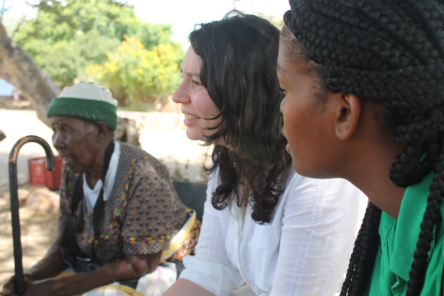
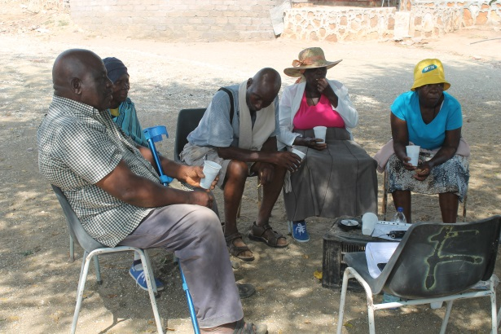
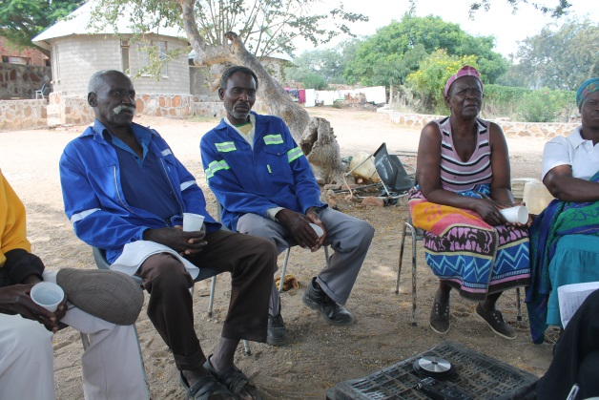
Participant consent before data collection, Folovhodwe, South Africa, 2017
At the start of every interview information on the project and use of participant data was verbally given to participants in their native language before oral consent was sought from all participants. Oral consents were recorded
Photo credits:
Sally Rangecroft
11
Rangecroft et al., 2020. Social science for hydrologists: considerations when doing fieldwork with human participants, EGU2020

Slide 16
3.2 Data collection methods
Collaboration involves different perspectives and methodologies.
Qualitative data collection can be more time-intensive, but gain a wealth of information and context.
Possible data collection methods for fieldwork with participants:
- Questionnaires
- Interviews
- Focus groups
- Workshops
- Narrative interviews
Participant observations
Choice experiments
Serious gaming
Transect walks
Participatory research (e.g. Photovoice)
Recommendations: Seek to achieve at least a basic common understanding of the types of theory, methods, aims, data and analysis used by the others.
12
Rangecroft et al., 2020. Social science for hydrologists: considerations when doing fieldwork with human participants, EGU2020

Slide 17
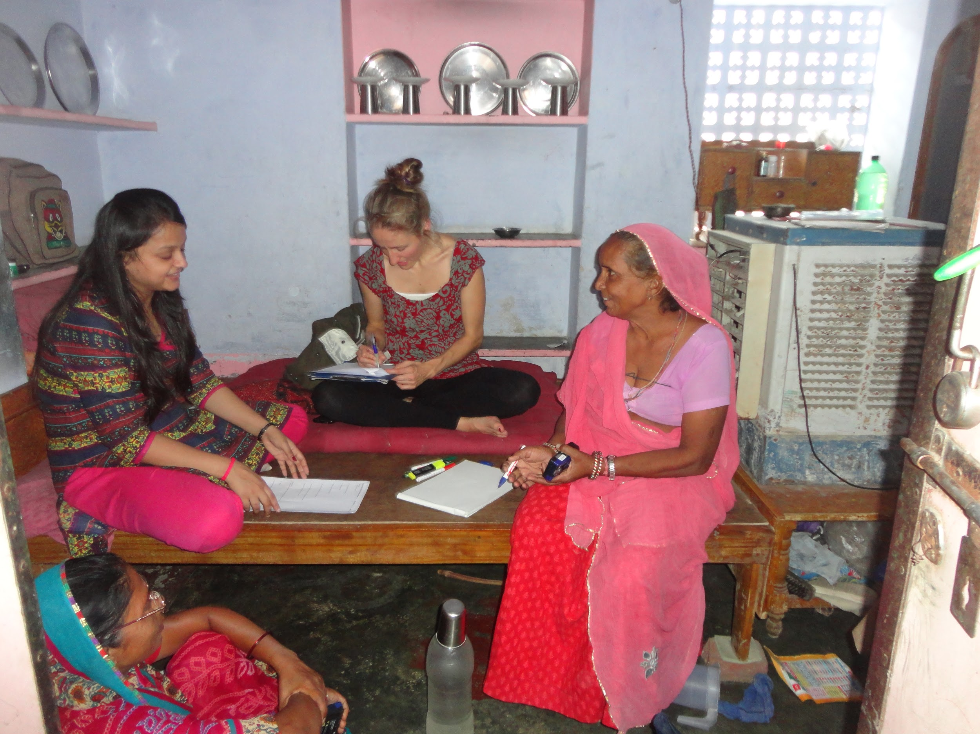
Interviews, Jaipur, India, 2015
Interviews were held at participants houses to help create a trustful atmosphere
Photo credit:
Theresa Frommen
13
Rangecroft et al., 2020. Social science for hydrologists: considerations when doing fieldwork with human participants, EGU2020

Slide 18
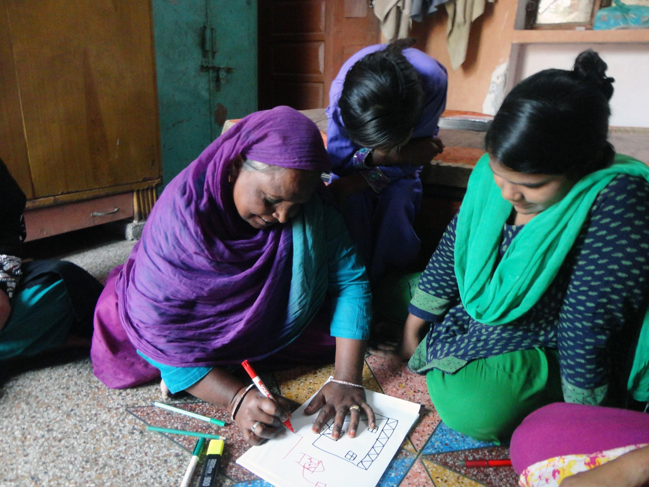
Interview with creative activity, Jaipur, India, 2015
‘Draw something that makes you happy’ activity within interviews to collect qualitative data and to stimulate discussions in a different way than talking
Photo credit:
Theresa Frommen
14
Rangecroft et al., 2020. Social science for hydrologists: considerations when doing fieldwork with human participants, EGU2020

Slide 19
Focus group discussion, Mkula, Tanzania, 2019
Focus group discussions with farmers of an irrigation scheme were held in their community owned milling house as a neutral and comfortable setting
Photo credit:
Britta Höllermann
15
Rangecroft et al., 2020. Social science for hydrologists: considerations when doing fieldwork with human participants, EGU2020

Slide 20
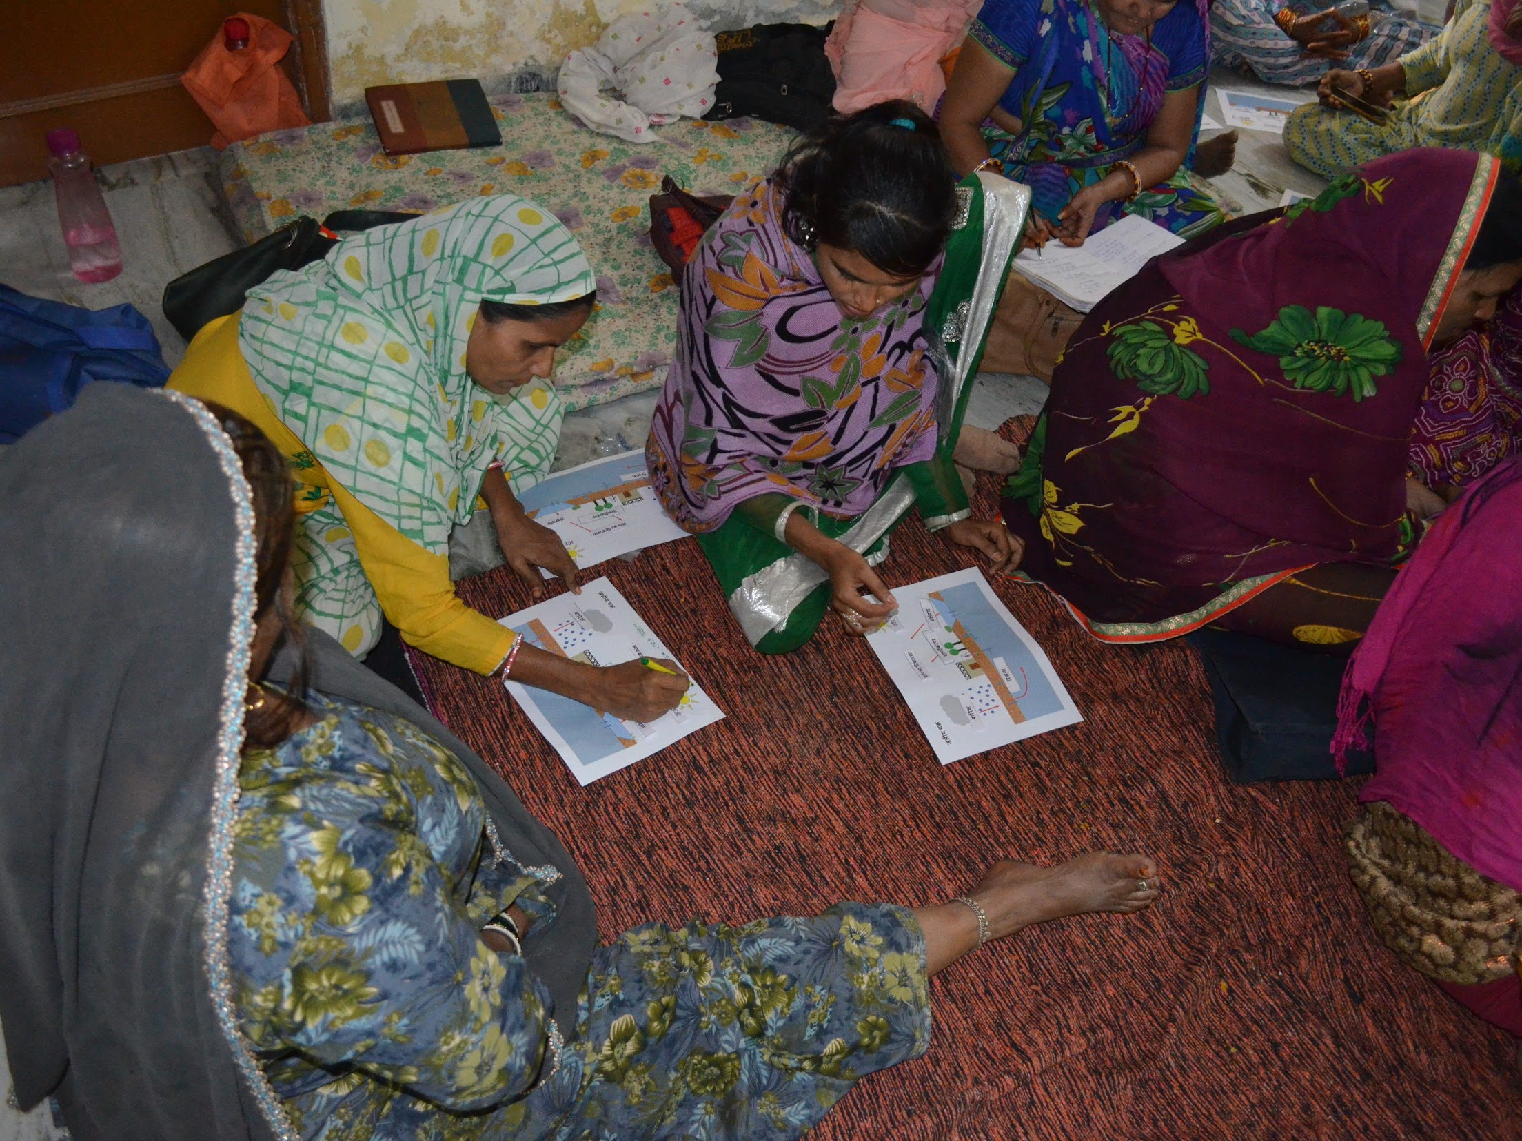
Interactive hydrologic cycle game, Jaipur, India, 2016
Interactive parts keep up interest during workshops.
Here, the women could take the water cycle sheet home with them, which pleased them very much and which may also lead to a long- term engagement with the topic
Photo credit:
Theresa Frommen
16
Rangecroft et al., 2020. Social science for hydrologists: considerations when doing fieldwork with human participants, EGU2020

Slide 21
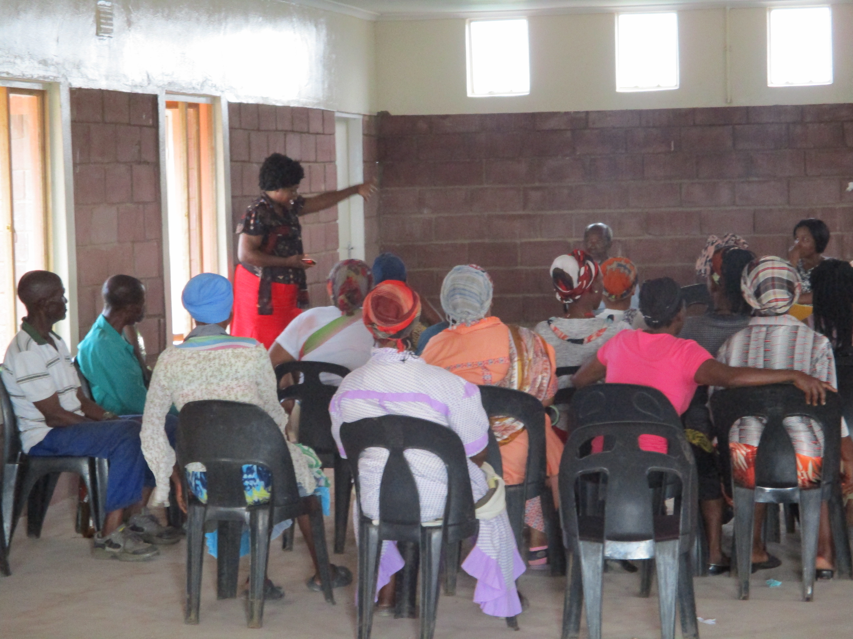
Participatory observations, Kwazulu-Natal, South Africa, 2018
Participatory observation in a community meeting on conflicts over water in the study area deepened our understanding of causes for conflicts and power relations
Photo credit:
Karen Lebek
17
Rangecroft et al., 2020. Social science for hydrologists: considerations when doing fieldwork with human participants, EGU2020

Slide 22
Participatory observational walks across farmers’ fields, Njage, Tanzania, 2019
Observational transect walks allow for the collection of data in context and provide insight from participants
Photo credit:
Britta Höllermann
18
Rangecroft et al., 2020. Social science for hydrologists: considerations when doing fieldwork with human participants, EGU2020

Slide 23
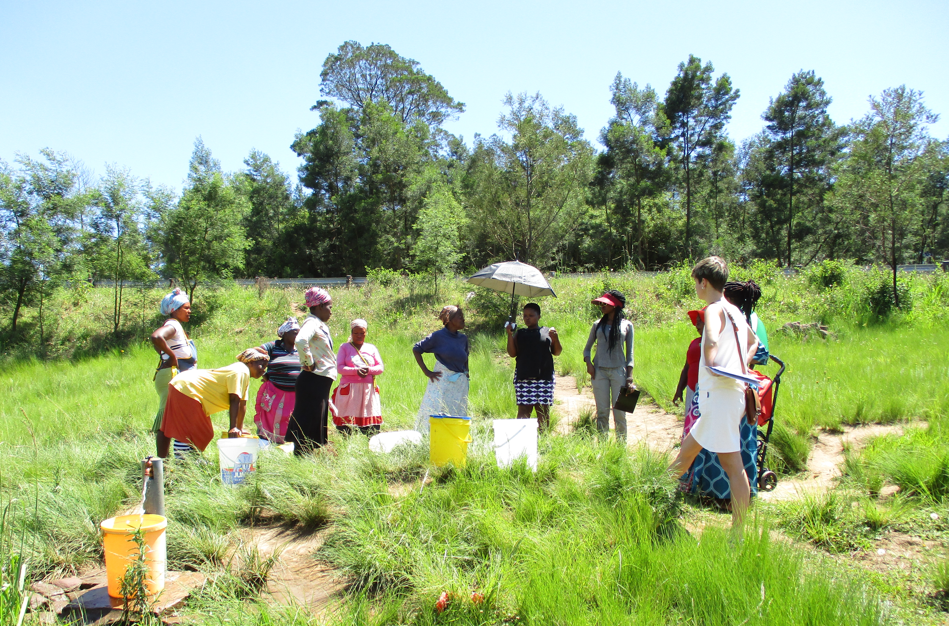
Site visits and conversations, Kwazulu-Natal, South Africa, 2018
Observations of water collection practices and informal conversation at a public standpipe served as an entry point into a survey on household water security
Photo credit:
Karen Lebek
19
Rangecroft et al., 2020. Social science for hydrologists: considerations when doing fieldwork with human participants, EGU2020

Slide 24
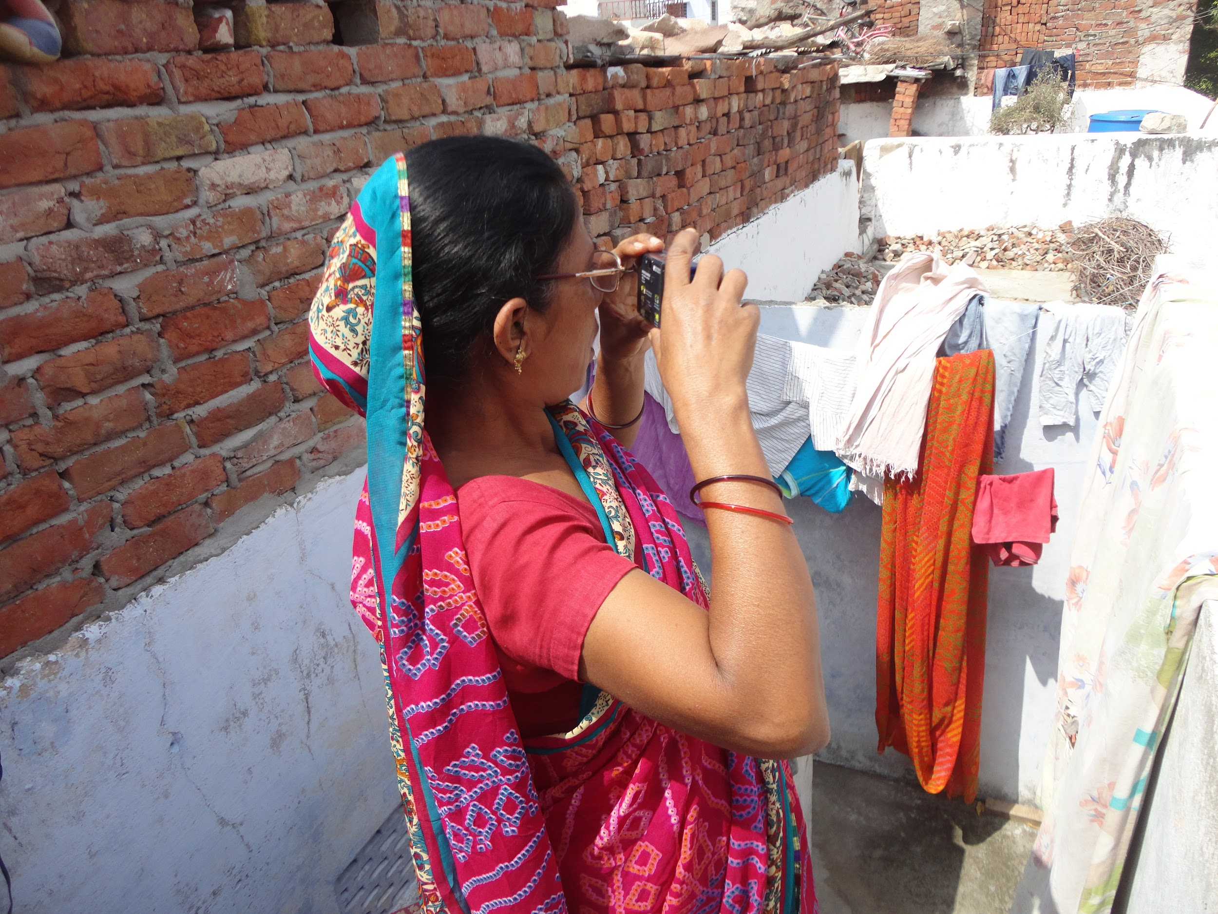
Participatory research (Photovoice), Jaipur, India, 2015
Camera based tasks in Photovice allowed participants to move from objects of study to actively participating subjects
Photo credit:
Theresa Frommen
20
Rangecroft et al., 2020. Social science for hydrologists: considerations when doing fieldwork with human participants, EGU2020

Slide 25
3.3 Power dynamics
Power relations between research participants, and between participants and researchers.
Differences might arise from varying personal values and beliefs, gender, race and social-economic background, might affect the research process and outcomes.
Where possible – identify likely power dynamics before fieldwork so they can be taken into account.
Sometimes – keeping discussions with men and women separate can help reduce potential power differences.
Researchers should also find out about
‘marginalised people’ and try to ensure their
voice is heard by the researcher.
Recommendations: Power dynamics between the research participants themselves, and the researchers, should be considered, and planned for in the research design. Importance of local partners.
21
Rangecroft et al., 2020. Social science for hydrologists: considerations when doing fieldwork with human participants, EGU2020

Slide 26
Focus group discussion with only female farmers, Njage, Tanzania, 2019
Focus group held with only female farmers to address power dynamics related to gender in this study region in Tanzania
Photo credit:
Britta Höllermann
22
Rangecroft et al., 2020. Social science for hydrologists: considerations when doing fieldwork with human participants, EGU2020

Slide 27
Narrative group interviews with elderly participants only, Folovhodwe, South Africa, 2017
Narrative group interviews held with different generations to address power dynamics amongst research participants in this community
Photo credit:
Sally Rangecroft
23
Rangecroft et al., 2020. Social science for hydrologists: considerations when doing fieldwork with human participants, EGU2020

Slide 28
3.4 Positionality
Differences in backgrounds (education, class, age, gender, etc.) between the researcher and the participant.
Researcher is likely to not be objective.
Different disciplines and cultures may have different philosophies of research – important to acknowledge these when working together.
Recommendations: Acknowledge these differences across disciplines. Working with multiple researchers, with different positionalities, is advantageous for addressing the issue of positionality.
24
Rangecroft et al., 2020. Social science for hydrologists: considerations when doing fieldwork with human participants, EGU2020

Slide 29
3.5 Local partnerships
Local partners and organisations are crucial to fieldwork with human participants due to their insights in local issues, culture, language, and their knowledge of community gatekeepers and how best to approach them.
Important to build trust and develop these relationships.
Not being geographically close can reduce communication mainly to emails and calls, which can lead to misunderstandings.
Recommendations: Spend time to build good relationships with local partners. Allow time for pre-fieldwork meetings with local partners, crucial to building trust and a shared understanding for the research.
25
Rangecroft et al., 2020. Social science for hydrologists: considerations when doing fieldwork with human participants, EGU2020

Slide 30
Preparing field measurements with local field assistants, Njage, Tanzania, 2019
Importance of engaging local field assistants to increase trust in partnership, co-ownership and responsibility
Photo credit:
Britta Höllermann
26
Rangecroft et al., 2020. Social science for hydrologists: considerations when doing fieldwork with human participants, EGU2020

Slide 31
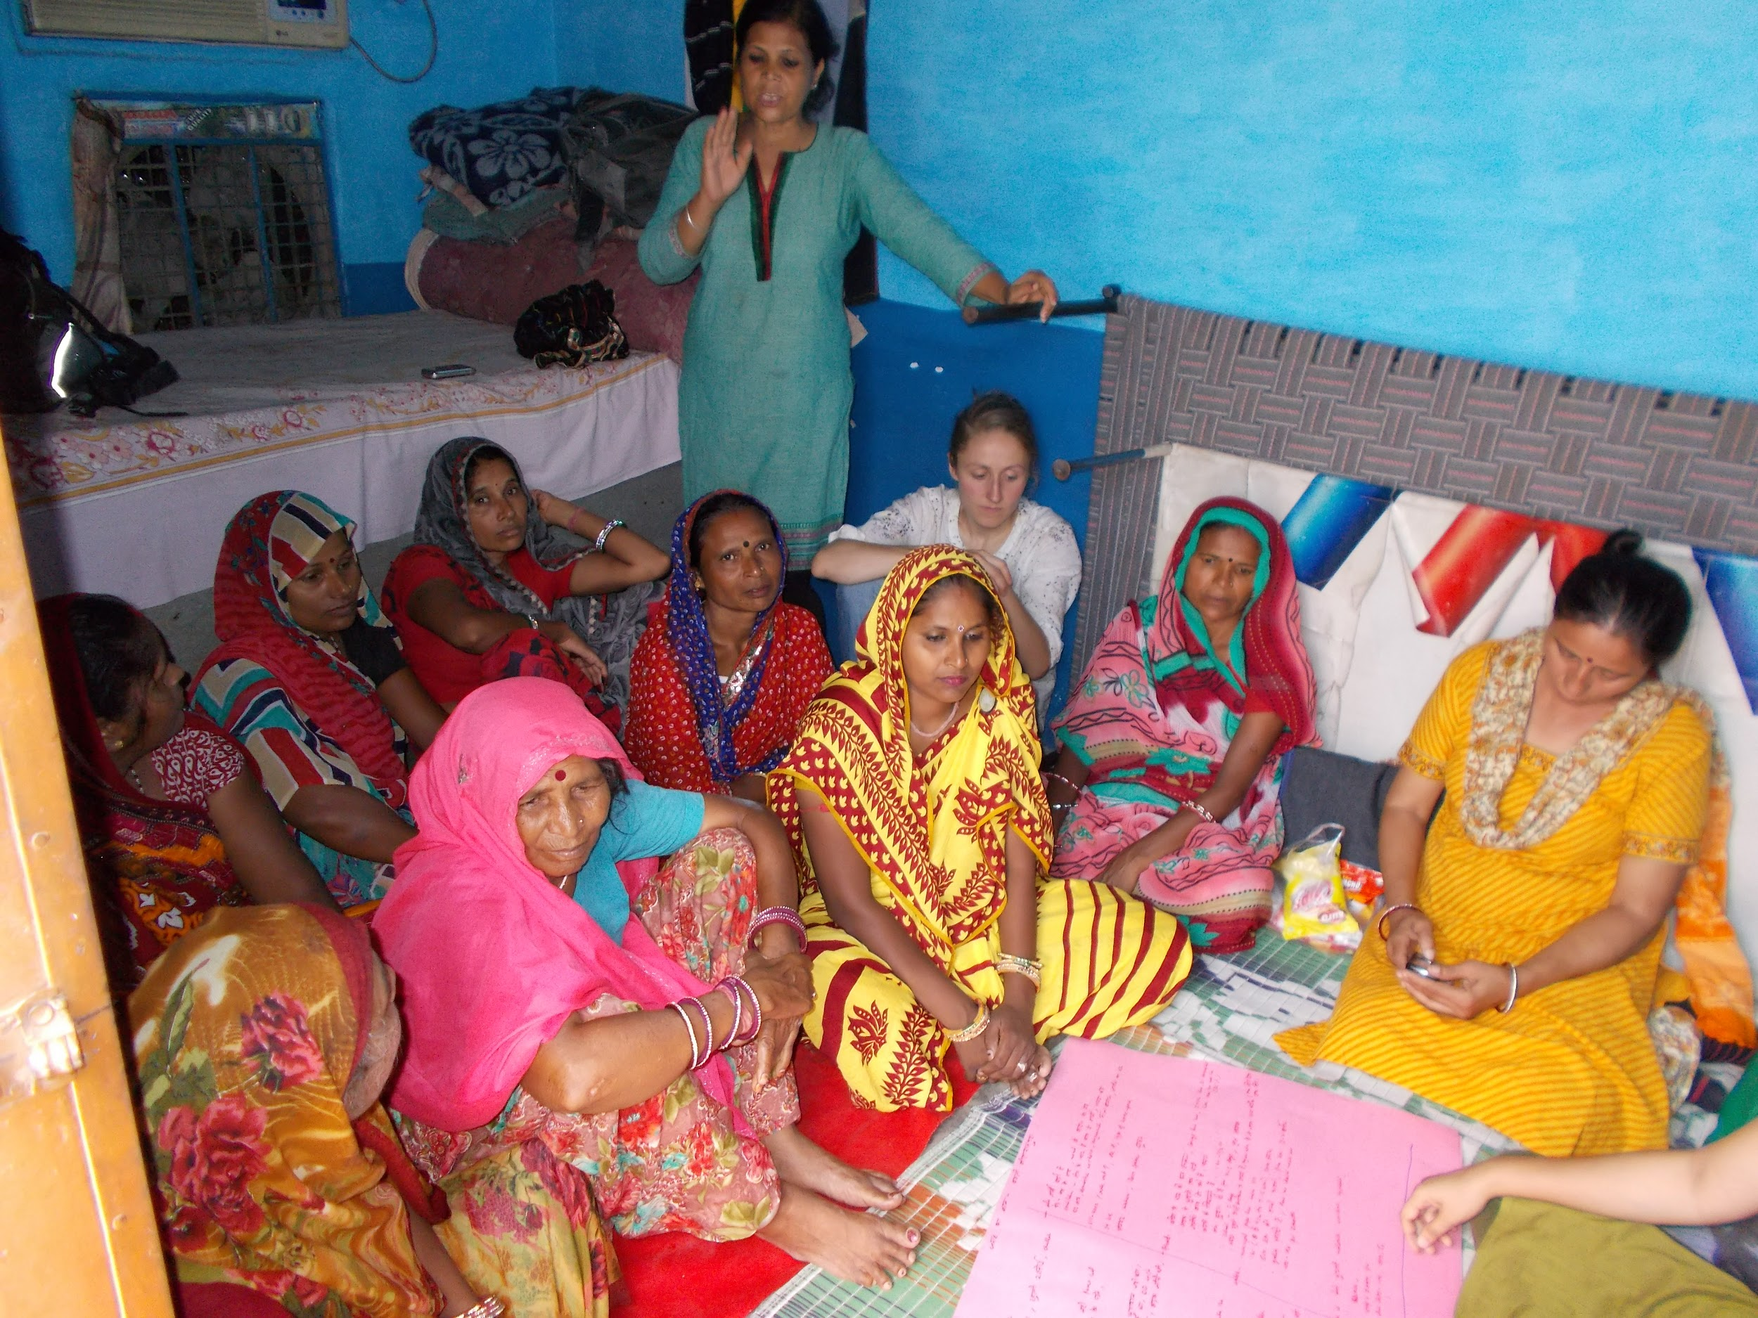
Accompanying the local partner organization, Jaipur, India, 2015
Visiting with a local partner in India during their fieldwork to get to build trust with the organisation and to see how they work with the communities
Photo credit:
Theresa Frommen
27
Rangecroft et al., 2020. Social science for hydrologists: considerations when doing fieldwork with human participants, EGU2020

Slide 32
3.6 Communicating science
Communication barriers with participants
Tools for communicating science
Communication of local knowledge
3.6.1
3.6.2
3.6.3
28
Rangecroft et al., 2020. Social science for hydrologists: considerations when doing fieldwork with human participants, EGU2020

Slide 33
3.6.1 Communication barriers with participants
Important to be aware of potential miscommunications.
Communicating scientific concepts.
Differences in vocabularies and translations.
Local dialect / non-native researchers.
Communication through emails, calls or translators.
Assumptions and expectations of participants.
Recommendations: Even if they cannot be completely prevented, have a strategy in place to deal with miscommunications. Work directly with local partners to identify potential miscommunications. Use pre-fieldwork training with translators/field assistants, and post-fieldwork debriefing sessions.
29
Rangecroft et al., 2020. Social science for hydrologists: considerations when doing fieldwork with human participants, EGU2020

Slide 34
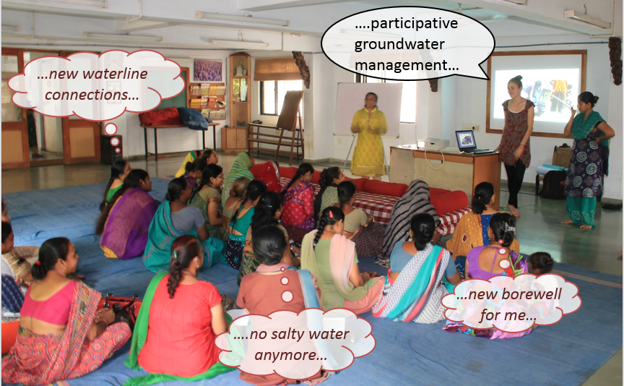
Communication barriers, Ahmedabad, India, 2016
Addressing assumptions and expectations with participants to ensure transparency and participant engagement
Photo credit:
Theresa Frommen
30
Rangecroft et al., 2020. Social science for hydrologists: considerations when doing fieldwork with human participants, EGU2020

Slide 35
3.6.2 Tools for communicating science
Finding the most effective way to communicate between science and local knowledge can be challenging.
Visual aids – graphs, maps, time series (e.g. discharge, temperature).
However, participants may not be used to working with maps (2D, birds eye view) or time series.
Use of images.
Use of storylines / scenarios.
Recommendations: Tailor the communication tool to the needs of the target audience to make it effective. Local partners can help guide what is most appropriate. Working directly with experts in science communication and artists as this can be very beneficial for making complex information accessible for diverse audiences.
31
Rangecroft et al., 2020. Social science for hydrologists: considerations when doing fieldwork with human participants, EGU2020

Slide 36
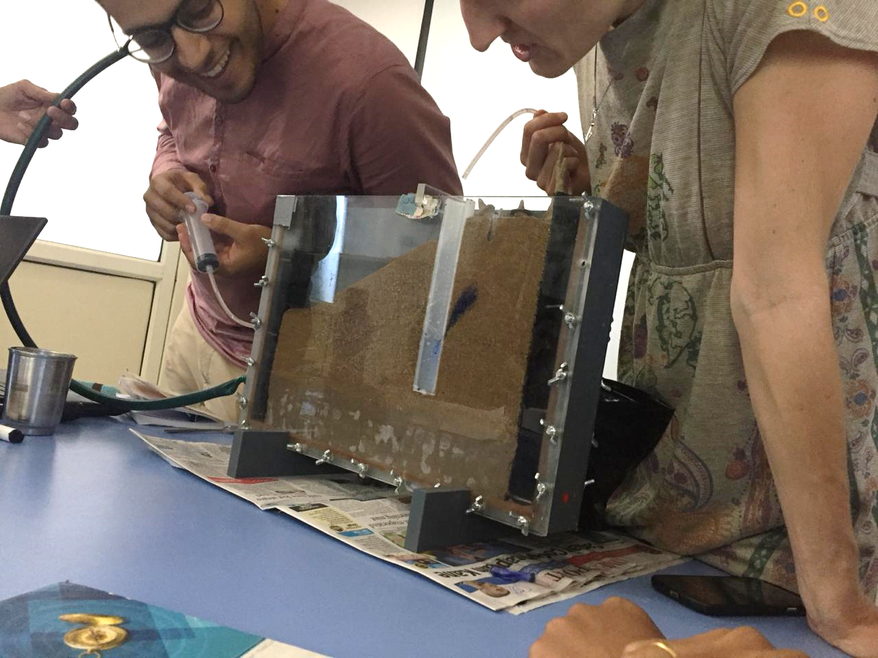
Groundwater sand tank workshop, Ahmedabad, India, 2018
Workshop held using a sand tank to help participants visualize the hidden resource groundwater
Photo credit:
Theresa Frommen
32
Rangecroft et al., 2020. Social science for hydrologists: considerations when doing fieldwork with human participants, EGU2020

Slide 37
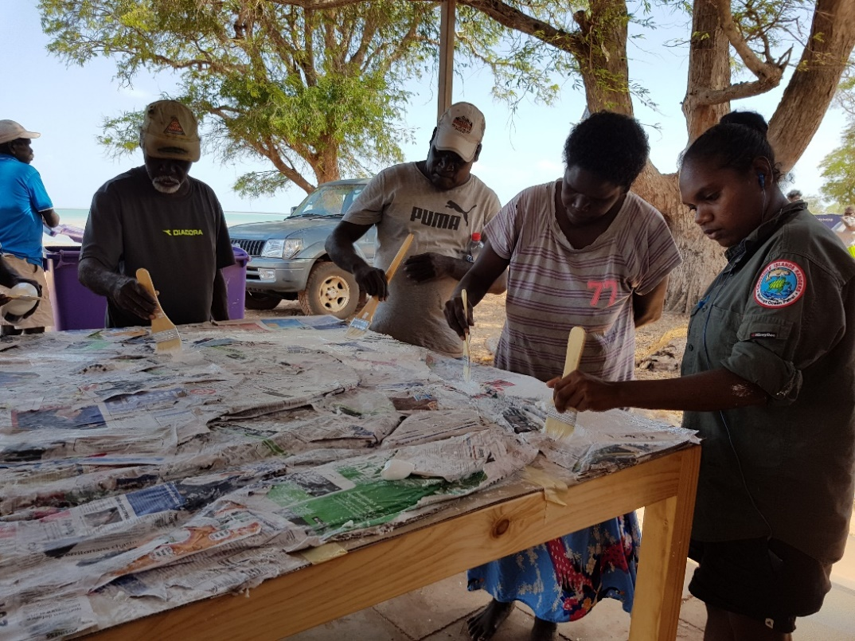
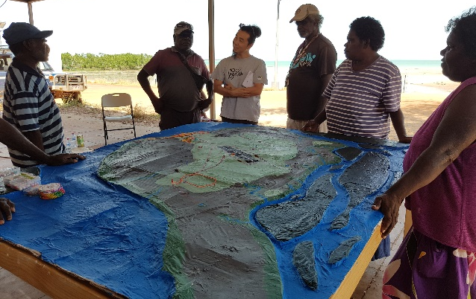
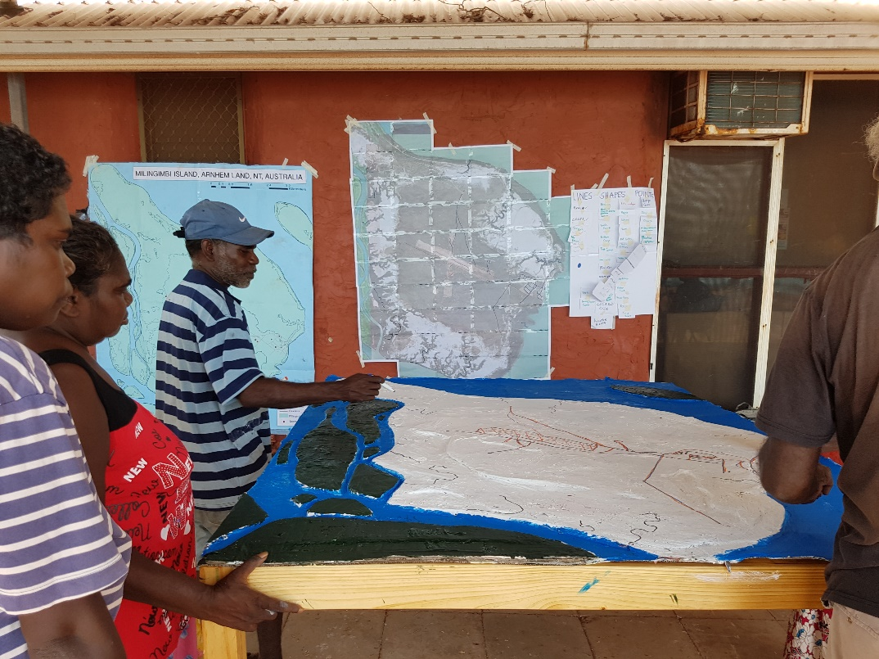
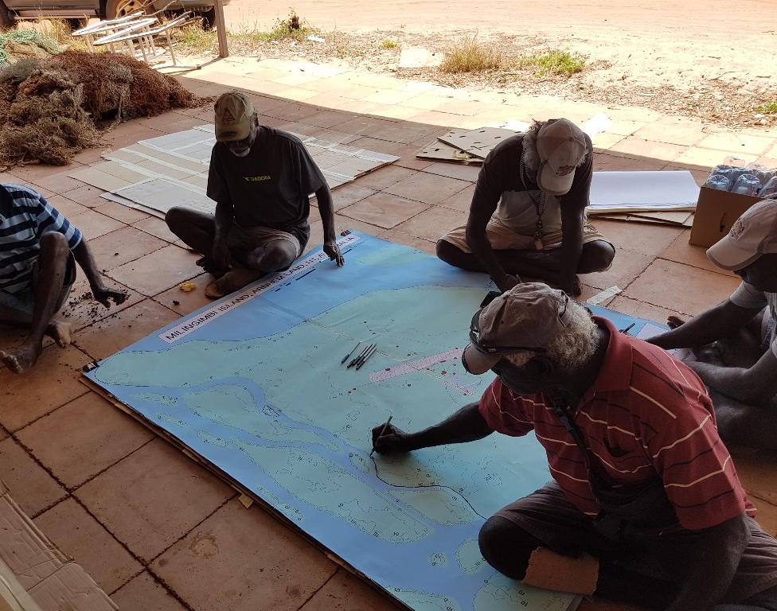
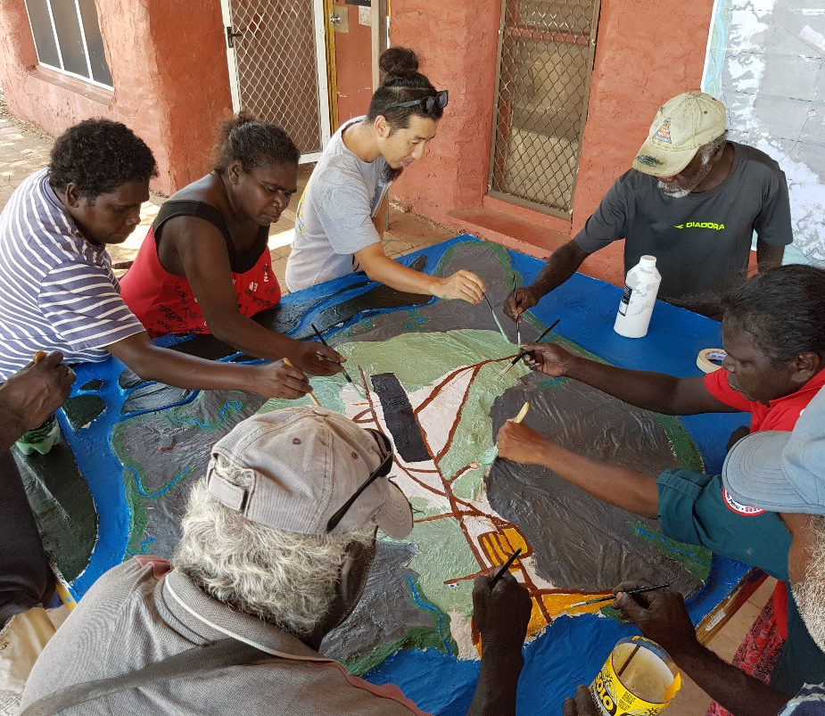
Participatory 3D mapping, Milingimbi Island, Australia
Working with local participants (landowners, traditional owners, community) to map and identify key features for the study area. Participants then helped build the map in 3D to scale
Photo credits:
Franz Billones
33
Rangecroft et al., 2020. Social science for hydrologists: considerations when doing fieldwork with human participants, EGU2020

Slide 38
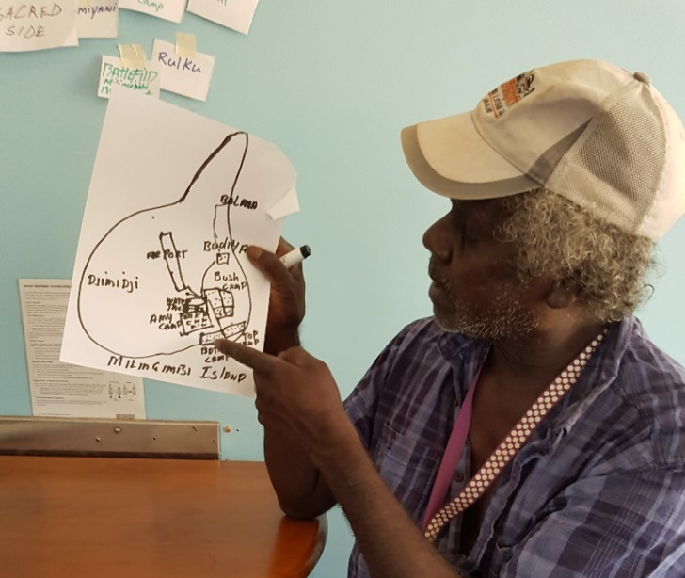
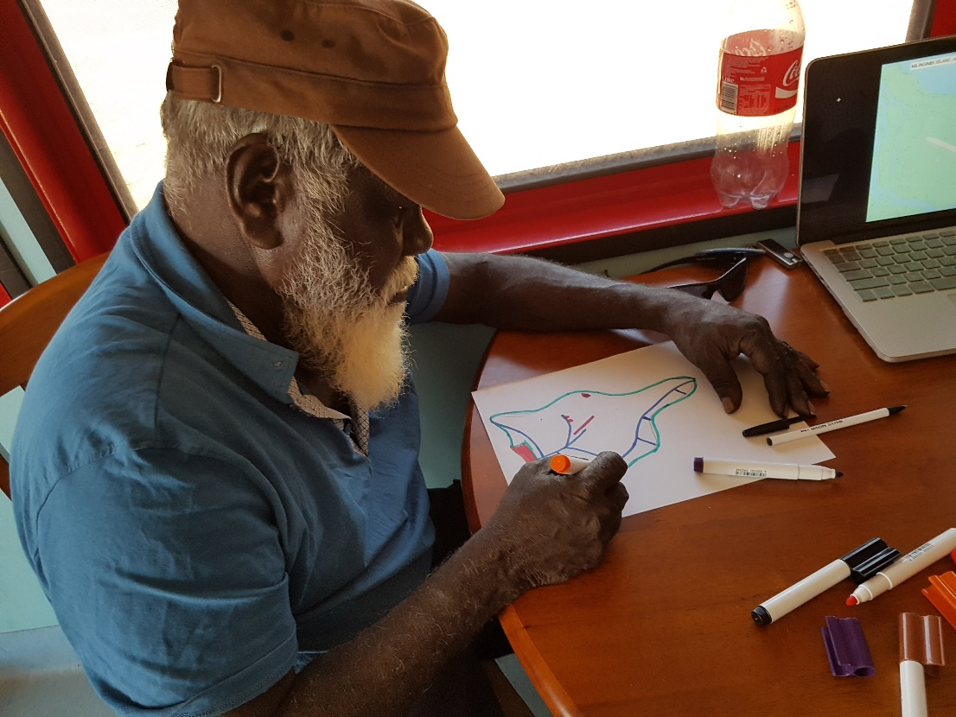
Participatory mapping, Milingimbi Island, Australia
Farmer explaining planting technique by drawing a sketch on the floor, Njage, Tanzania, 2019
Knowledge sharing can be two-way: data collection and/or communicating science
Photo credits:
Franz Billones
Photo credit:
Britta Höllermann
34
Rangecroft et al., 2020. Social science for hydrologists: considerations when doing fieldwork with human participants, EGU2020

Slide 39
3.6.3 Communication of local knowledge
Feeding results or information back to policy makers.
Allowing community voices to be heard – videos, artwork, songs etc.
However, when communicating local knowledge, researchers need to be very aware of power dynamics, their own positionality, and any cultural sensitivities.
Recommendations: A range of methods can be used to communicate local knowledge to policy makers or other groups. Extremely important to work with local partners and those with understanding of social processes.
35
Rangecroft et al., 2020. Social science for hydrologists: considerations when doing fieldwork with human participants, EGU2020

Slide 40
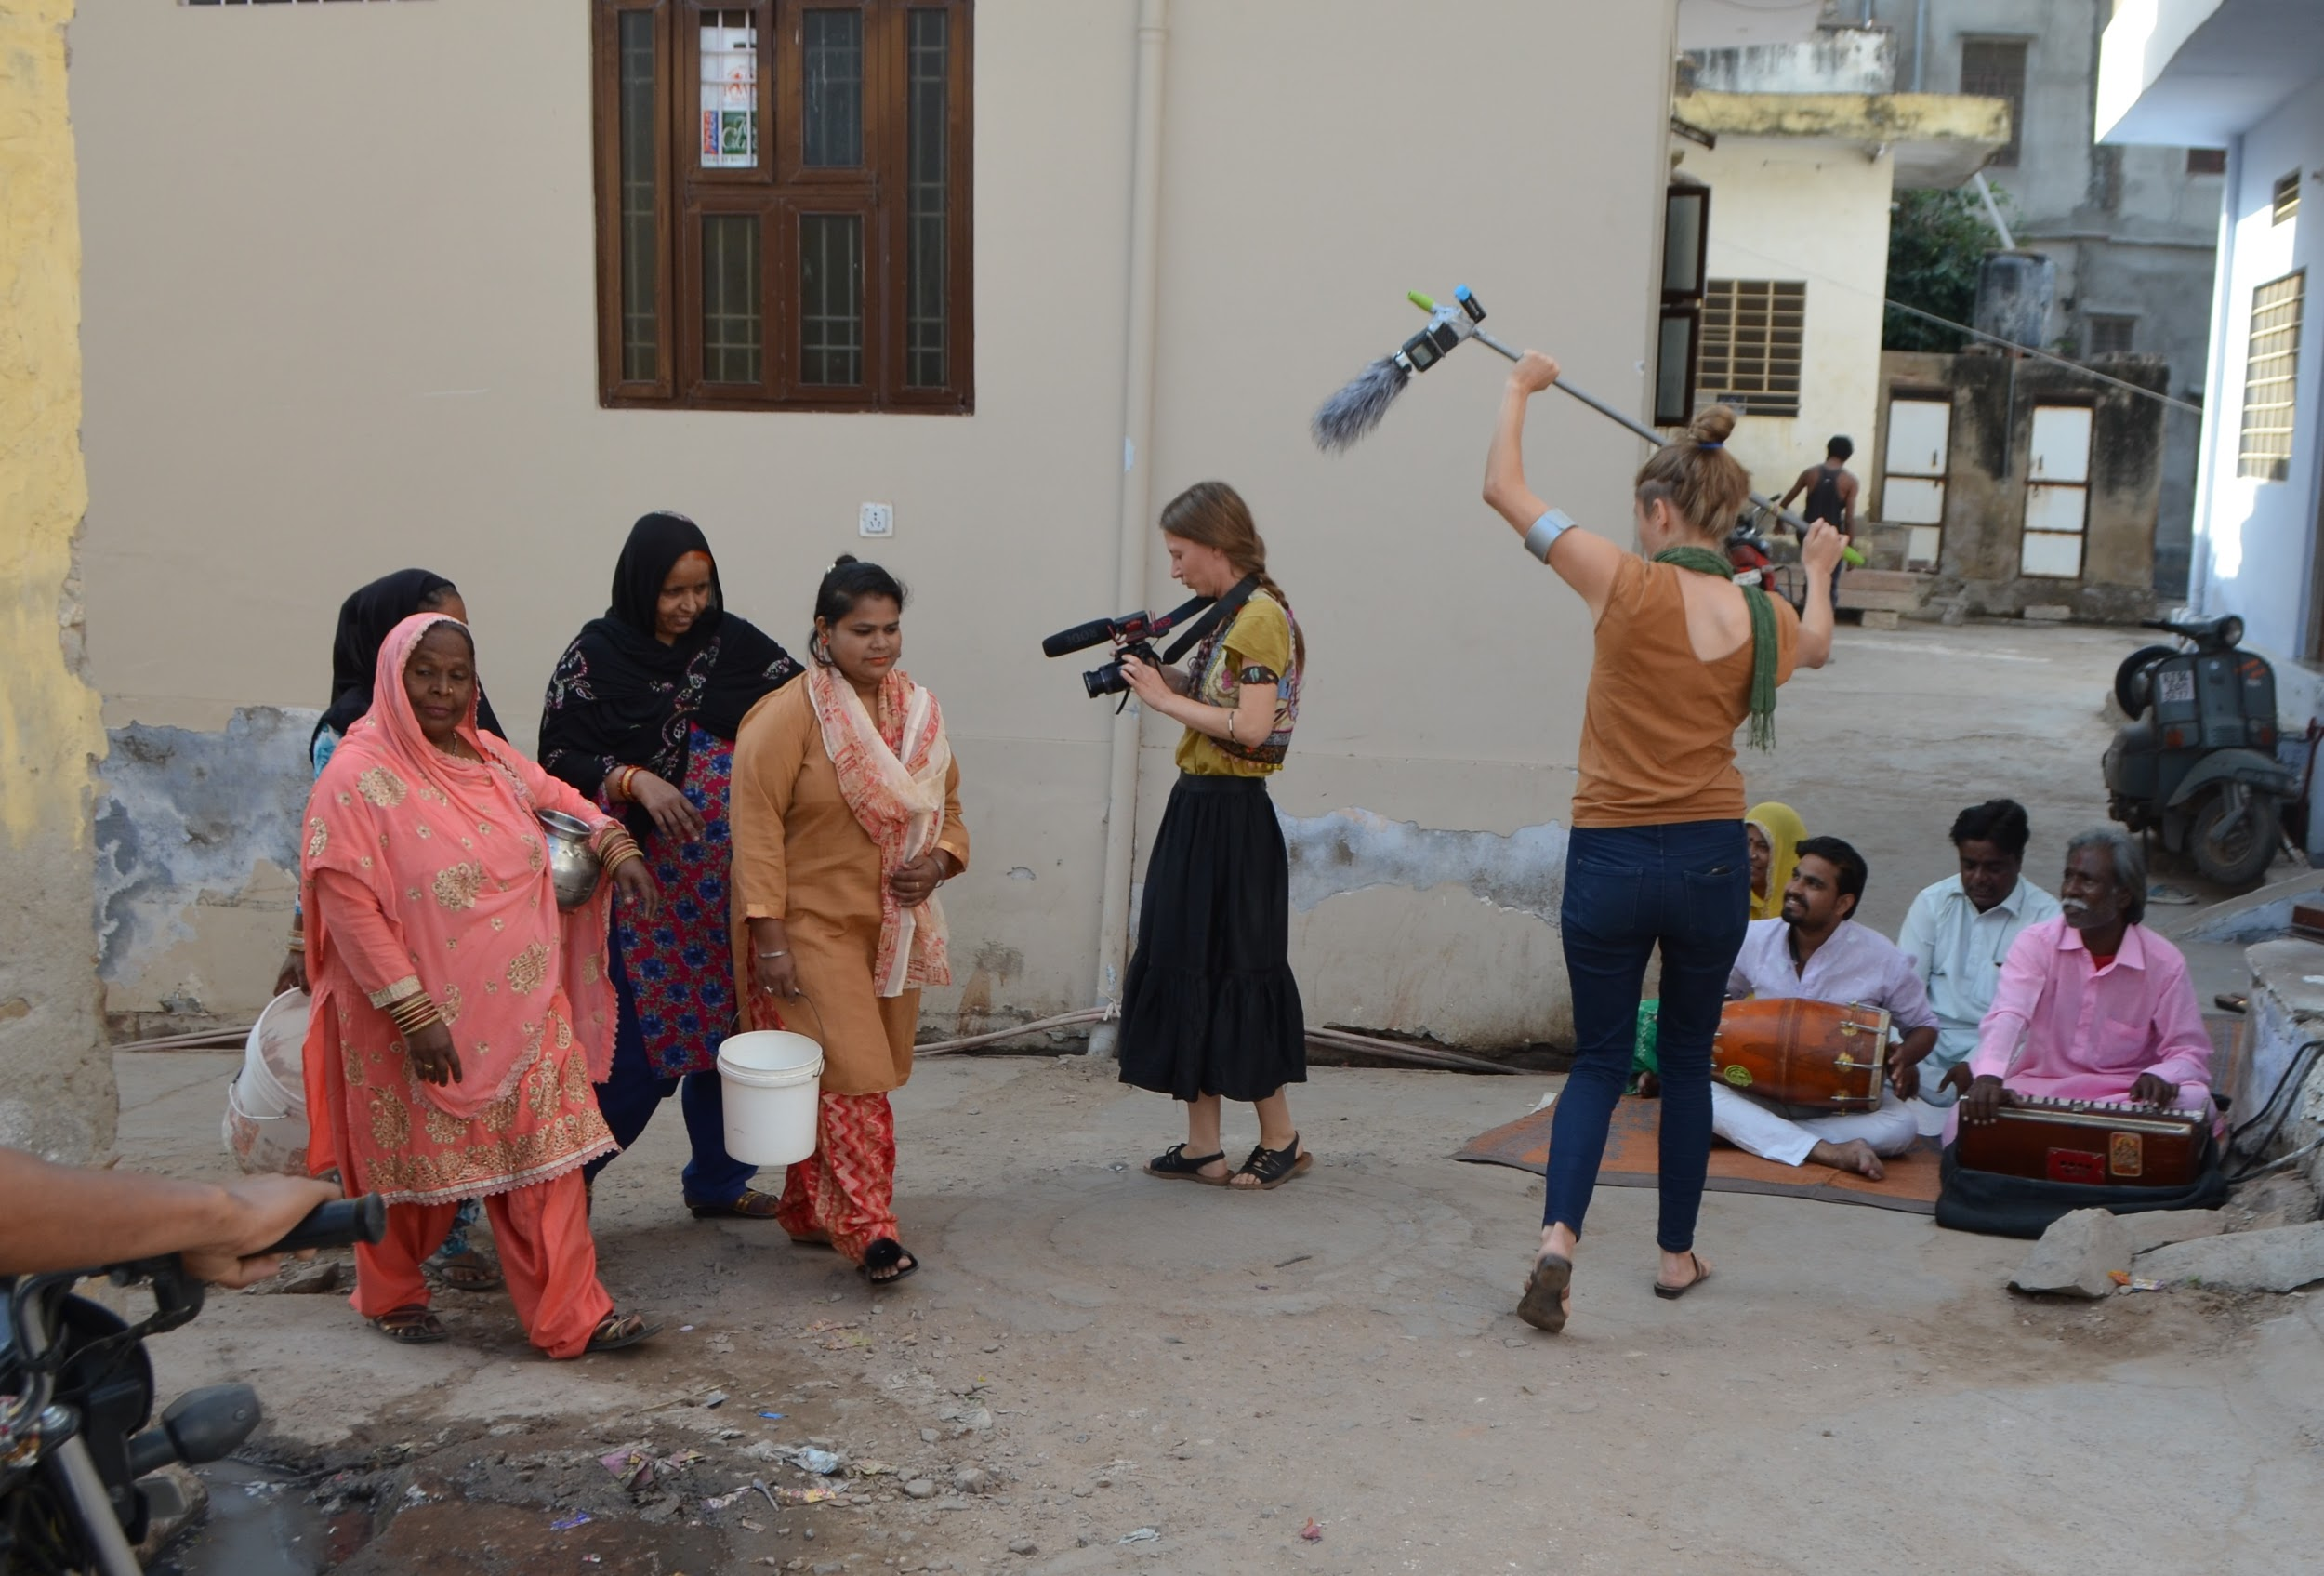
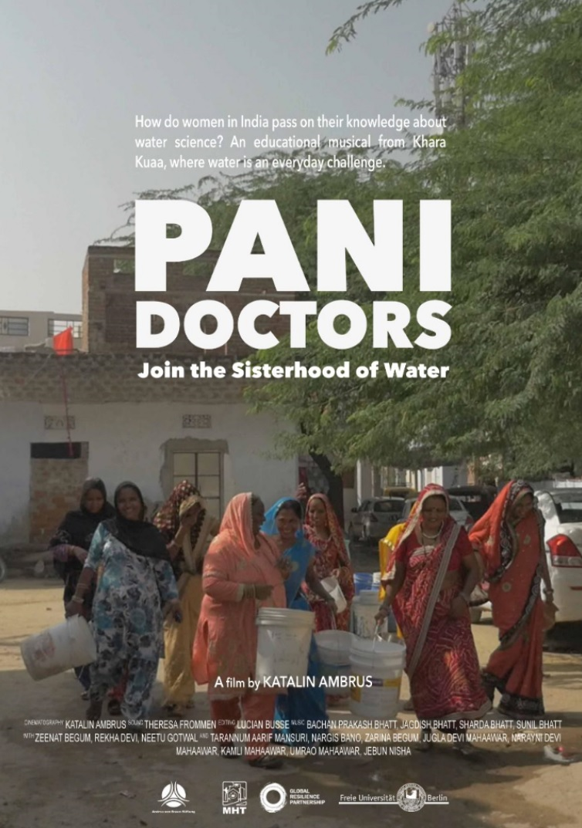
Participatory film-making, Jaipur, India, 2018
Water knowledge is produced by various stakeholders within society. Participatory film-making can be a first step to give voice to non-certified knowledge
Photo credit:
Theresa Frommen
36
Rangecroft et al., 2020. Social science for hydrologists: considerations when doing fieldwork with human participants, EGU2020

Slide 41
3.7 Post-fieldwork reflections
Research diaries – good practice, maybe not common for natural scientists?
By reflecting on impressions in a research diary, information from other sources can be contextualised.
Debrief meetings – extremely important between researchers and facilitators/ translators.
Debrief meetings allow for reflection on the methodology, and can encourage positive modifications to the field approach.
Recommendations: Keep research field diaries for observations and context. Encourage daily debrief meetings to maximise channels of communication and feedback on fieldwork.
37
Rangecroft et al., 2020. Social science for hydrologists: considerations when doing fieldwork with human participants, EGU2020

Slide 42
3.8 Validation
Respondent validation or “member checks” – participants check the accuracy of initial data, or the interpretations made.
Mixed-methods approach and methods triangulation during fieldwork.
Discrepancies and conflicting data can point to interesting findings.
Recommendations: Treat social and hydrological data equally as they can yield valuable insights on human-water relations and the different meaning that water has to different people. Discrepancies between these data may also be an interesting result in themselves.
38
Rangecroft et al., 2020. Social science for hydrologists: considerations when doing fieldwork with human participants, EGU2020

Slide 43
4. Researching alongside different disciplines
Whilst there can be communication barriers with participants (section 3.6.1) and local partners (section 3.5), there can also be communication barriers and challenges between the researchers themselves, especially when working across disciplines.
A key challenge for interdisciplinary research is a lack of common language between the various researchers involved to discuss core concepts and applications (Lowe et al., 2013).
Another challenge between natural and social scientists is their different methodological approach.
39
Rangecroft et al., 2020. Social science for hydrologists: considerations when doing fieldwork with human participants, EGU2020

Slide 44
Lack of a common language
A key challenge for interdisciplinary research is a lack of common language between the various researchers involved to discuss core concepts and applications (Lowe et al., 2013).
Different disciplines, and even those taking different approaches within the same discipline, may have different starting points for thinking about specific words (Krueger et al., 2016) e.g. ‘forecasts’, ‘projections’ ‘uncertainty’ and ‘modelling’.
Particularly problematic when scientists communicate without noticing that a particular word or term has a specific disciplinary interpretation, unknown or different to other disciplines.
Recommendation: As part of the research development, it can be important, if not essential, to develop a joint vocabulary to work as a research team.
40
Rangecroft et al., 2020. Social science for hydrologists: considerations when doing fieldwork with human participants, EGU2020

Slide 45
Different methodological approaches
Potential barrier to understanding each others practices and methods.
Different disciplines and cultures may have varying philosophies of research (e.g. amongst hydrologists and social scientists, positivist approach vs. constructivist approach).
Whilst there might be discrepancies between the data obtained from the different methodologies, this does not mean that one approach and its results may be ‘valid’ and the other not. Instead, the differences can be an interesting results themselves.
Recommendation: The aim of interdisciplinary research and collaboration is not to merely agree upon one common methodological approach (Bergmann et al., 2012), but to build a mutual recognition of the different concepts.
41
Rangecroft et al., 2020. Social science for hydrologists: considerations when doing fieldwork with human participants, EGU2020

Slide 46
Challenges
Recommendations
Different methods
Lack of experience in the other discipline
Different vocabularies
Different philosophies
Different research interests & research questions
Difference in cultures and expectations
Differences in power and positionality
Encouraging researchers to have equal input into the design of all stages of the research.
Dedicated time to building trust, mutual recognition and understanding between disciplines.
Seek to achieve at least a basic common understanding of the types of theory, methods, aims, data and analysis used by the other disciplines.
Accommodate meetings for specific discussions on vocabulary, research methodologies and design, and workshop design amongst researchers.
Establish a joint language.
Build time into the project proposal for these exchange activities at the start of the project.
Openness of researchers to learn about the other discipline.
Maximise the advantages of working with different disciplines, backgrounds and understandings.
42
Rangecroft et al., 2020. Social science for hydrologists: considerations when doing fieldwork with human participants, EGU2020

Slide 47
5. Summary & Recommendations
To explore and address current and future water related issues there is the need for true collaborative, interdisciplinary research.
Working between different disciplines with their disparate philosophies, methodologies and vocabularies can cause barriers and challenges for collaboration.
However, it can also bring the perspective and complexity needed for understanding real world problems and potential solutions.
It is important for researchers to consider how best to approach these collaborations, and how best to equip the other disciplines to enable them to expand beyond their own.
e.g. Key aspects of social science practices (good ethical practice), methods (data collection methods), and philosophies (power dynamics, positionality) which, if better understood by natural scientists, can help foster a stronger joint research vision, maximise research design, data collection, interpretation and impact.
43
Rangecroft et al., 2020. Social science for hydrologists: considerations when doing fieldwork with human participants, EGU2020

Slide 48
Fieldwork with human participants
Local partners and organisations are crucial to fieldwork with human participants. Building trust between researchers, local partners and participants is essential for successful fieldwork, but can take time.
Good ethical practice should underpin all research with human participants.
Power dynamics can be planned for in the research design, but these arrangements might not always be possible in the field.
Working amongst different disciplines, backgrounds and understandings can help to address positionality issues.
Pre-fieldwork training with translators/field assistants, and post-fieldwork debriefing sessions can maximise communication between researchers and data interpretation.
Knowledge sharing can be two-way: data collection and/or communicating science.
Treat social and hydrological data equally as they can yield valuable insights on human-water relations.
Here we aimed to bridge the gap between disciplines for hydrologists working with social scientists and human participants
44
Rangecroft et al., 2020. Social science for hydrologists: considerations when doing fieldwork with human participants, EGU2020

Slide 49
Interdisciplinary collaborations
If possible, invest time and effort in the initial scoping phase to help encourage integration whilst developing the research ideas (Strang, 2009; Phillipson et al., 2009; Lowe et al., 2013).
Encouraging researchers to have equal input into the design of all stages of the research.
It is worth investing time throughout the research to build understanding across the disciplines to foster improved collaborations.
Place importance and time on exchange activities, such as meetings for specific discussions on vocabulary, research methodologies and design amongst researchers.
Discuss and establish a common language, developing a joint vocabulary.
Share knowledge between disciplines to enable them to expand beyond their own.
Maximise the expertise of different researchers for a holistic ethical, and successful research.
Do not be afraid of the differences in research; find and maximise the strengths of these differences
45
Rangecroft et al., 2020. Social science for hydrologists: considerations when doing fieldwork with human participants, EGU2020

Slide 50
Summary & Recommendations
Invest time and effort into exchange activities to help encourage integration and understanding between disciplines.
Building trust between researchers, local partners and participants is essential for successful fieldwork.
Importance of pre-fieldwork training and debrief meetings in the field to help improve communication channels with local partners and fieldwork researchers.
Seek to see the different disciplines, with their approaches and interpretations, with equal value.
Collaboration with social scientists stays important and research ethics, design, participant involvement and results, may be compromised without the input and experience of social scientists themselves.
Facilitating these collaborations between the natural and social sciences will improve interdisciplinary water research, leading to a better understanding of the interactions between water and society.
Most importantly: Time invested in building these true collaborations will help to build trust amongst researchers, participants and practitioners alike, enabling more meaningful & successful research
46
Rangecroft et al., 2020. Social science for hydrologists: considerations when doing fieldwork with human participants, EGU2020

Slide 51
Fieldwork with human participants & interdisciplinary collaborations: Your experiences?
Have you conducted fieldwork with human participants?
What methods did you use? What worked well? What would you advice others?
What is your discipline background? Did you work closely with another disciplines?
Was it actually an active collaboration? If so, what worked well for you? Why? How?
Did you experience any challenges on fieldwork? How did you overcome them?
Did you experience any challenges with interdisciplinary collaborations? If so, what were the barriers? How did you overcome them?
Overall, what did you learn?
Do you have recommendations to share?
Please feel free to expand on these discussion points, or raise any of your own from this presentation.
We welcome your experiences and thoughts!
47
Rangecroft et al., 2020. Social science for hydrologists: considerations when doing fieldwork with human participants, EGU2020

Slide 52
Thank you for participating!
RETURN TO HOME PAGE
Facilitating collaboration through understanding
sally.rangecroft@plymouth.ac.uk
48
Rangecroft et al., 2020. Social science for hydrologists: considerations when doing fieldwork with human participants, EGU2020

