Slide 1
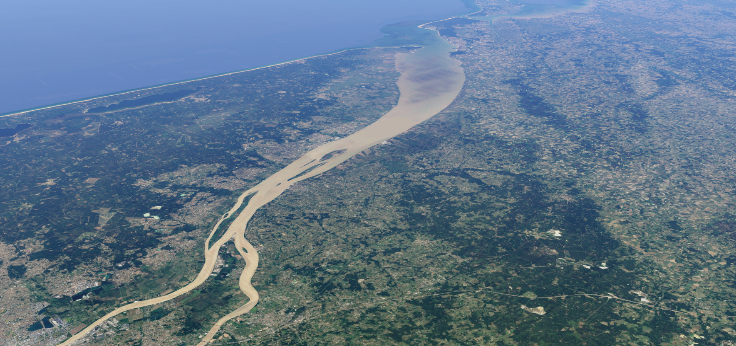

Modeling the influence of the gravitational circulation on estuarine sand dunes
Aerial picture of the Gironde estuary
From Google Maps
Wessel M. van der Sande*, Pieter C. Roos, Suzanne J.M.H. Hulscher
Water Engineering and Management, University of Twente
*w.m.vandersande@utwente.nl

Slide 2
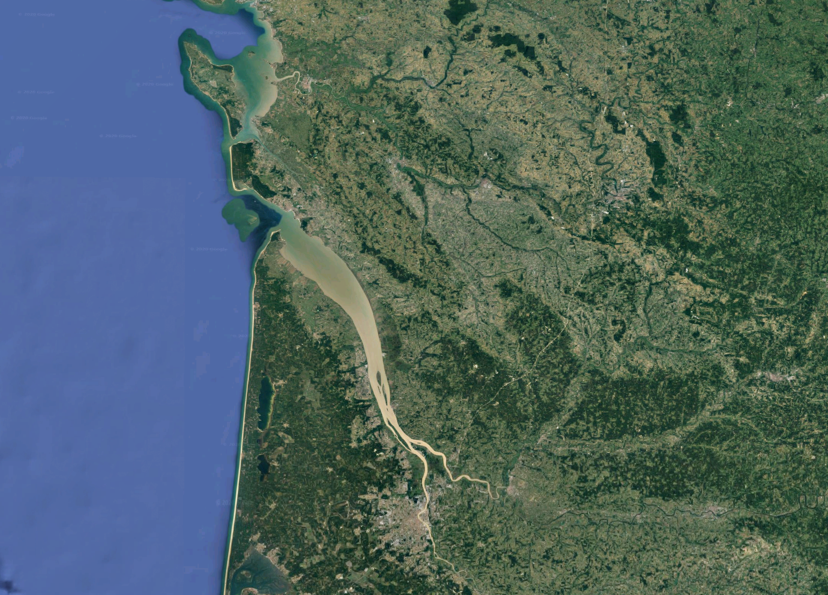
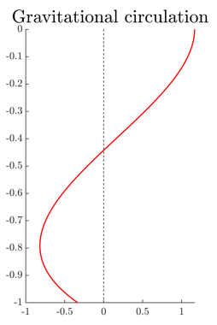


Estuarine sand dunes
Large-scale bedforms occurring in various estuaries
Focus: Gironde (South-West France)
Case: observed seasonal reversal of dune asymmetry and migration
  High discharge: flood-dominated, landward sediment transport and migration
  Low discharge: ebb-dominated, seaward sediment transport and migration
Sand dune field
Bordeaux
Due to gravitational
circulation?
Picture from Google Maps
Magnitude depends on longitudinal salinity gradient
Seaward
Bed topography in the sand dune field of the Gironde. From Berné et al., 1993
Landward

Slide 3
Goal
Method
Process-based insight into effect of gravitational circulation on estuarine sand dunes
  Sediment transport direction in estuaries due to
    Tide
    River discharge
    Longitudinal salinity gradient
  (initial) bedform growth
  and migration rate
Idealized process-based modeling
  Solution basic state
    Flow and sediment transport over a flat bed
    Basic state sediment transport direction determines migration direction of bedforms
Focus of this presentation
Main innovation
  Linear stability analysis
    Flow and sediment transport over a perturbed bed
Outlook

Slide 4
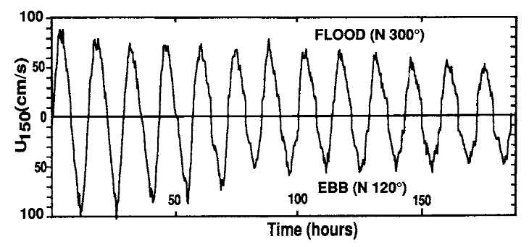
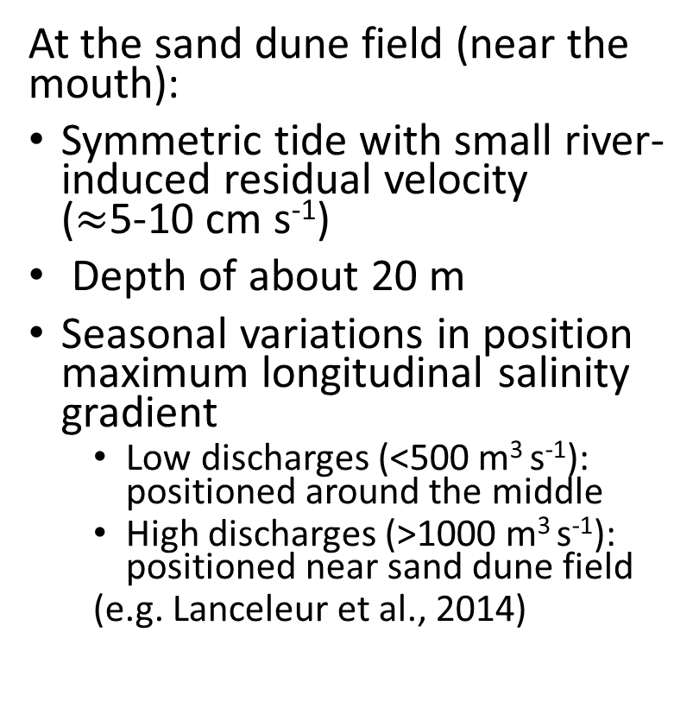
Background information Gironde
At the sand dune field (near the mouth):
Symmetric tide with small river-induced residual velocity
($≈$5-10 cm s⁻¹)
Depth of about 20 m
Seasonal variations in position maximum longitudinal salinity gradient
  Low discharges (<500 m³ s⁻¹): positioned around the middle
  High discharges (>1000 m³ s⁻¹): positioned near sand dune field
  (e.g. Lanceleur et al., 2014)
Sand dune field
High discharge
Max. salinity gradient
Flow velocities in the Gironde during river discharge of about 500 m³ s⁻¹. From Berné et al., 1993
Low discharge
Picture from Google Maps
High discharge: increased magnitude of gravitational circulation at sand dune field

Slide 5
Model overview
River
Tide
Depth
Sand dune field
Local model domain
Ingredients:
2DV shallow water equations with:
  Symmetric tide
  River discharge
  Longitudinal salinity gradient
  Constant eddy viscosity with partial slip condition at the bed
Bed-load sediment transport
Suspended sediment transport
For now: flat bed (basic state)
Bordeaux
Picture from Google Maps

Slide 6
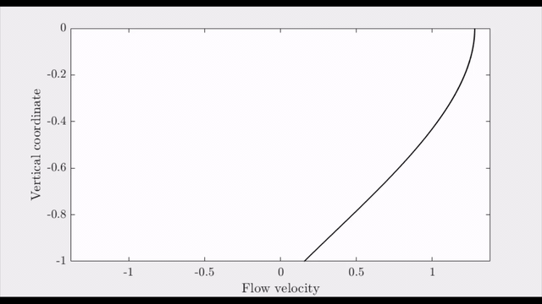
Flow solution (basic state)
Seaward
Landward

Slide 7
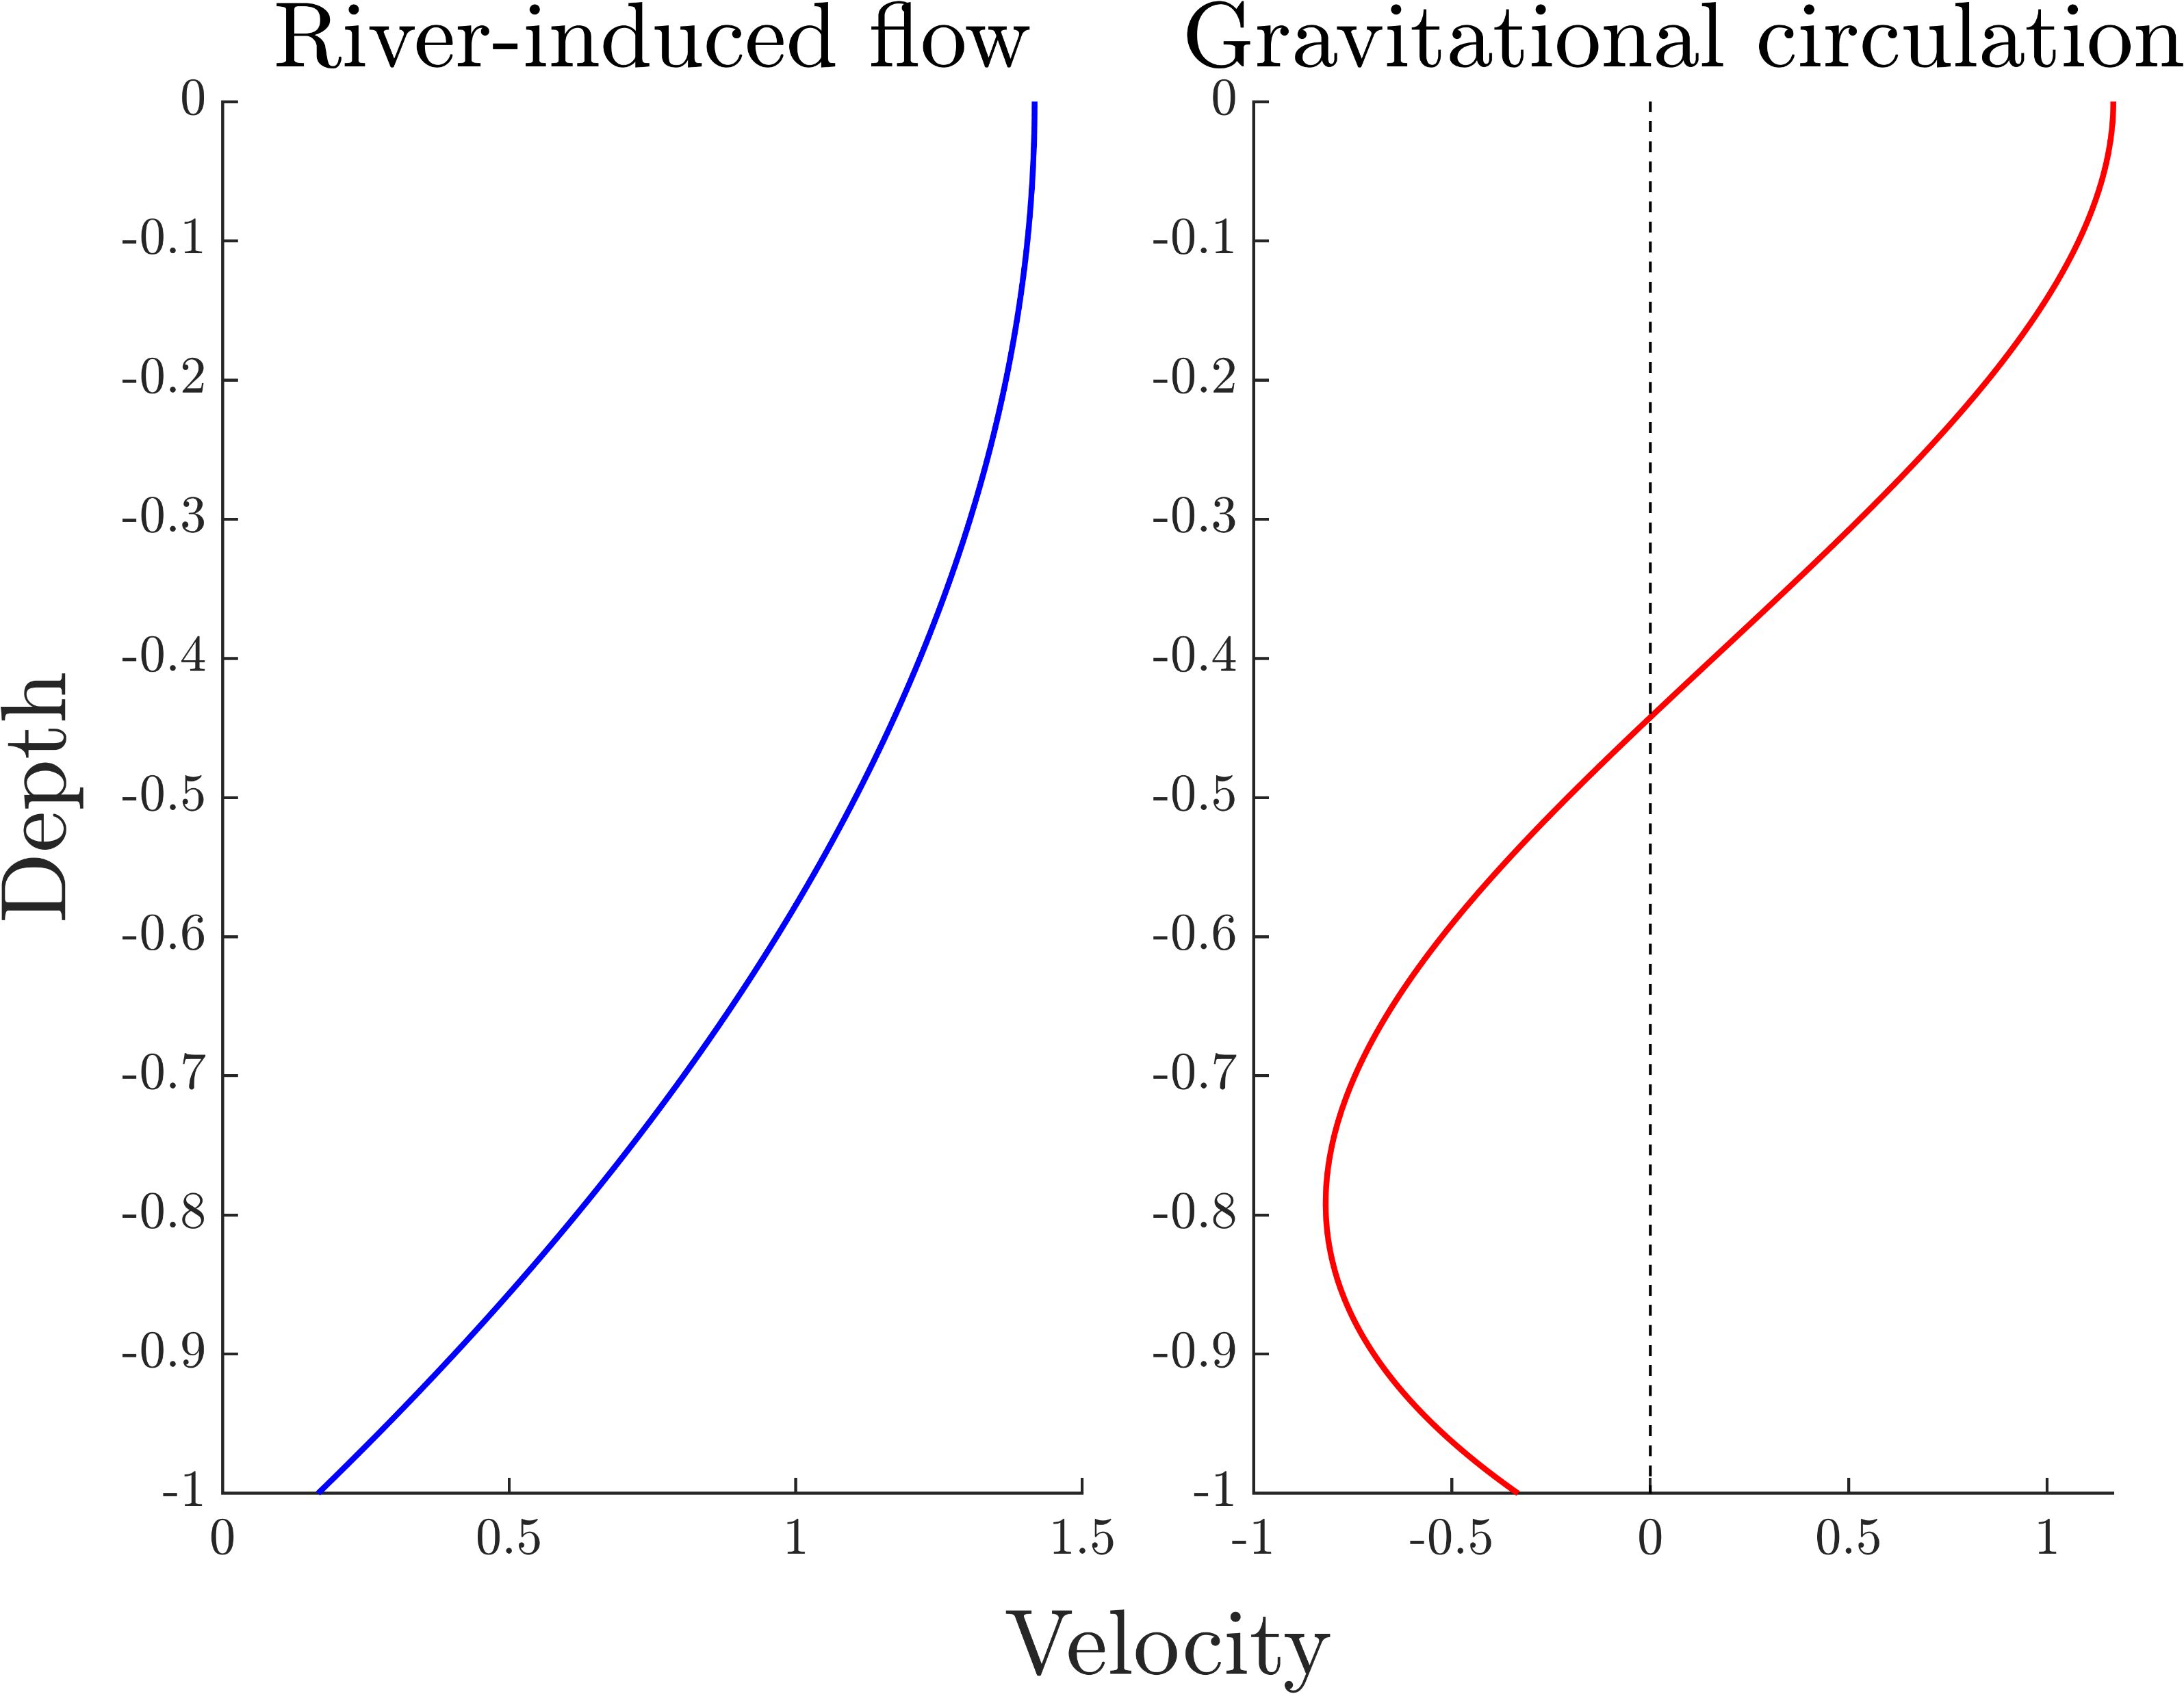



Tide-averaged flow
$$=$$
$$+$$
Tide-averaged (residual) flow
Seaward
Seaward
Landward

Slide 8
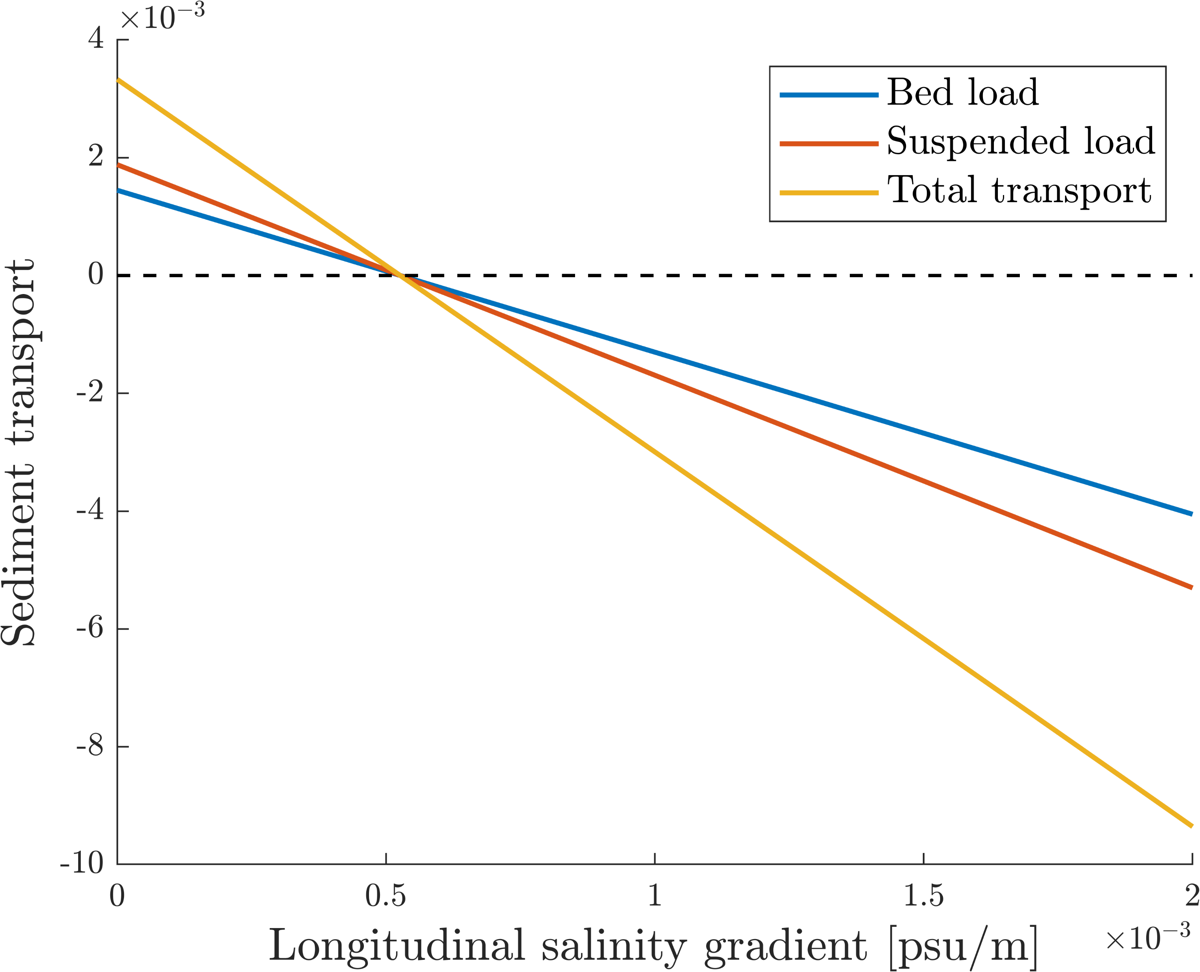
Sediment transport: sensitivity to longitudinal salinity gradient
Seaward
Landward
Landward sediment transport for significant longitudinal salinity gradient

Slide 9
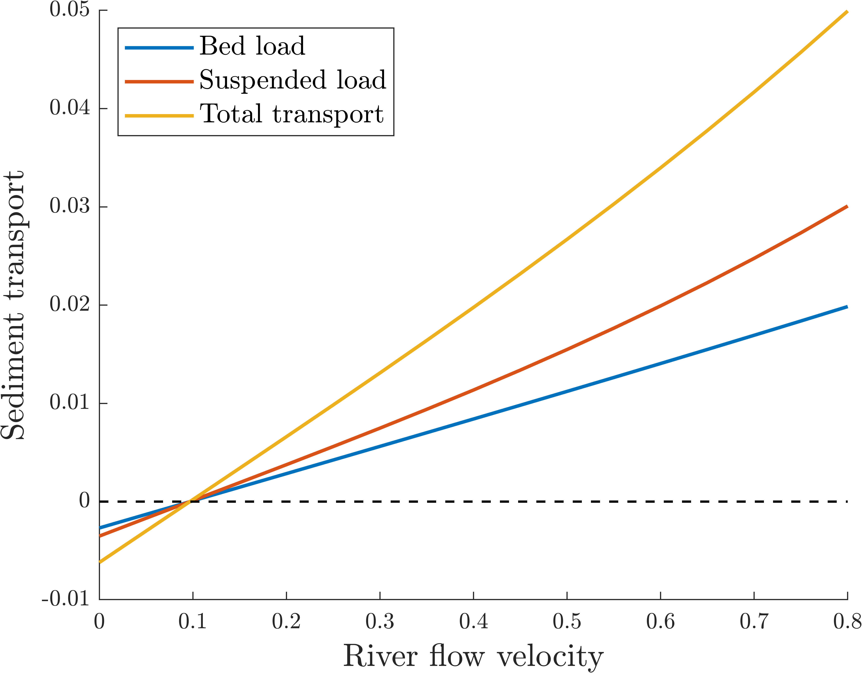
Sediment transport: sensitivity to river flow
Landward sediment transport for small river flow velocities
Caused by gravitational circulation (not possible with only symmetric tide and seaward river flow)
Seaward
Landward
[m/s]

Slide 10
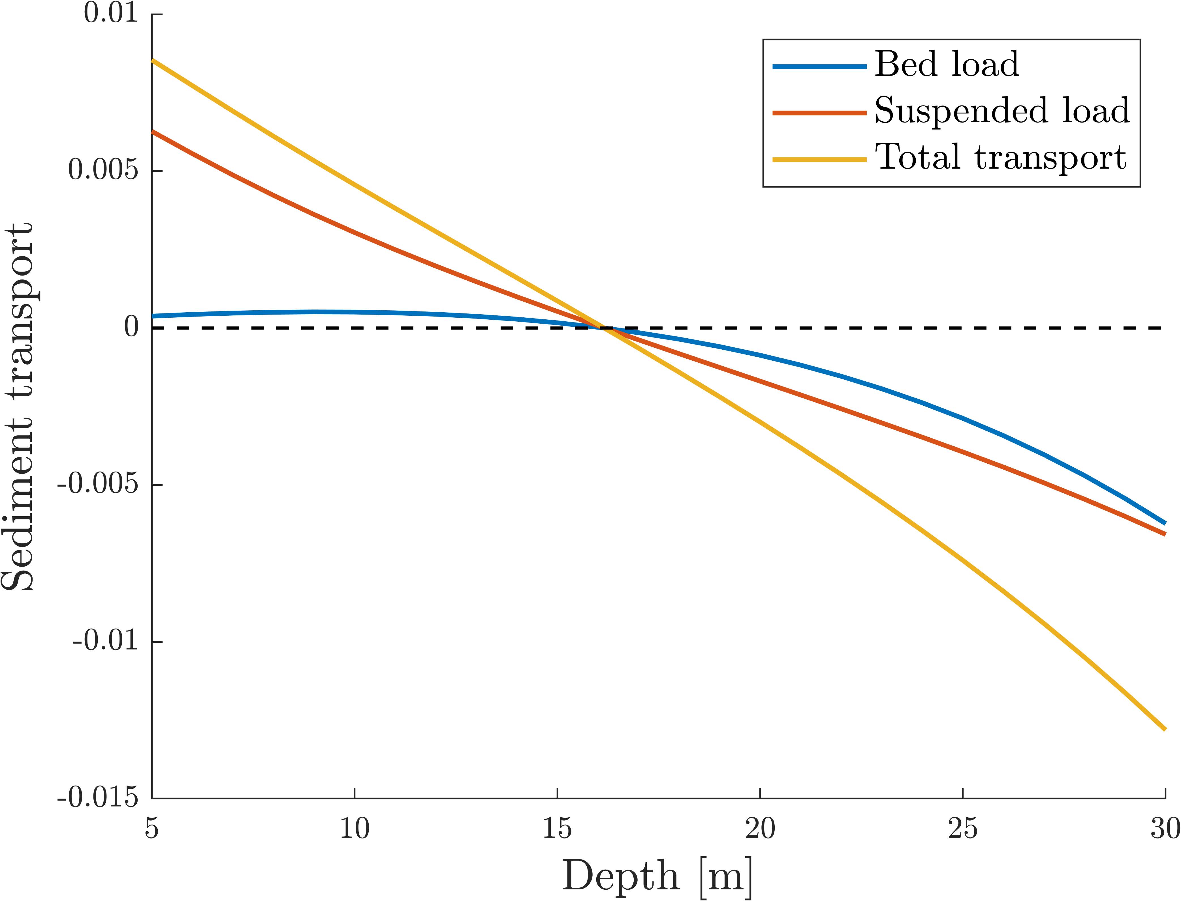
Sediment transport: sensitivity to depth
Seaward
Landward
Landward sediment transport for large depths

Slide 11
Conclusions
Net landward sediment flux opposite to river flow can occur if:
  There is a significant longitudinal salinity gradient
  The river flow is sufficiently small
  The depth is sufficiently large
  Suspended sediment is predominantly transported in the lower half of the water column

Slide 12



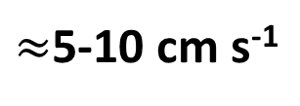
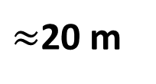
Outlook
Application to Gironde
Net landward sediment flux opposite to river flow can occur if:
  There is a significant longitudinal salinity gradient
  The river flow is sufficiently small
  The depth is sufficiently large
  Suspended sediment is predominantly transported
  in the lower half of the water column
  Thus: model shows that gravitational circulation may explain the reversal of bedform migration in the Gironde
&
During high discharge
Not during low discharge!
$≈$5-10 cm s⁻¹
$≈$20 m
More information required
Application to other estuaries/tidal channels (e.g. Marsdiep, NL)
Linear stability analysis: introducing small-amplitude perturbations to the bed to see what bedform lengths and migration rates we can expect

Slide 13
References
Acknowledgments
We thank Theo Gerkema (NIOZ) for the discussions on the model and application
Berne, S., Castaing, P., le Drezen, E., Lericolais, G., 1993. Morphology, Internal Structure, and Reversal of Asymmetry of Large Subtidal Dunes in the Entrance to Gironde Estuary (France). J. Sediment. Petrol. 63, 780–793. https://doi.org/10.1306/d4267c03-2b26-11d7-8648000102c1865d
Lanceleur, L., Schäfer, J., Blanc, G., Coynel, A., Bossy, C., Baudrimont, M., Glé, C., Larrose, A., Renault, S., & Strady, E. (2013). Silver behaviour along the salinity gradient of the Gironde Estuary. Environmental Science and Pollution Research, 20(3), 1352–1366. https://doi.org/10.1007/s11356-012-1045-3

