Slide 1
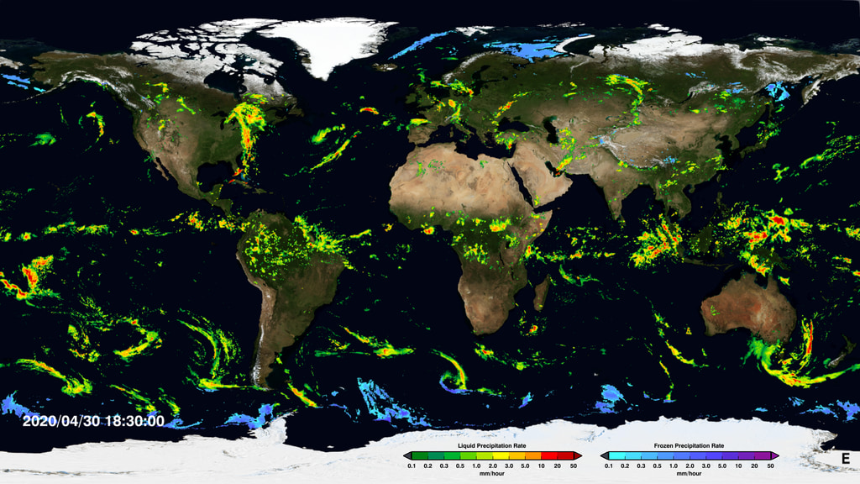
IMERG Multi-Satellite Products Across Two Decades
George J. Huffman(1), David T. Bolvin(1,2),
Dan Braithwaite(3), Kuolin Hsu(3), Robert Joyce(4,5),
Christopher Kidd(1,6), Eric Nelkin(1,2), Soroosh Sorooshian(3),
Jackson Tan(1,7), Pingping Xie(5)
(1) NASA/GSFC Earth Sciences Division – Atmospheres
(2) Science Systems and Applications, Inc.
(3) Univ. of California Irvine
(4) Innovim
(5) NOAA/NWS Climate Prediction Center
(6) Univ. of Maryland / ESSIC
(7) Univ. Space Res. Assoc.
george.j.huffman@nasa.gov
See https://svs.gsfc.nasa.gov/cgi-bin/details.cgi?aid=4285
U.S. Gov’t. Work

Slide 2
1. IMERG – Quick Description
IMERG is a single integrated code system for near-real and post-real time
• “Early” – 4 hr (flash flooding)
• “Late” – 14 hr (crop forecasting)
• “Final” – 3 months (research)
• half-hourly and monthly (Final only)
• 0.1º global CED grid
• morphed precip, 60º N-S in V05, 90º N-S in V06
Combined product (calibrator) adjusted to GPCP V2.3 seasonal climatology zonally for reasonable bias
• see S2
 | Half-hourly data file (Early, Late, Final)
1 | [multi-sat.] precipitationCal
2 | [multi-sat.] precipitationUncal
3 | [multi-sat. precip] randomError
4 | [PMW] HQprecipitation
5 | [PMW] HQprecipSource [identifier]
6 | [PMW] HQobservationTime
7 | IRprecipitation
8 | IRkalmanFilterWeight
9 | [phase] probabilityLiquidPrecipitation
10 | precipitationQualityIndex
 | Monthly data file (Final)
1 | [sat.-gauge] precipitation
2 | [sat.-gauge precip] randomError
3 | GaugeRelativeWeighting
4 | probabilityLiquidPrecipitation [phase]
5 | precipitationQualityIndex
see S3
U.S. Gov’t. Work

Slide 3
1. IMERG – V06 Upgrades
Morphing vector source switched to MERRA-2/GEOS FP
Morphed precip extended from 60º N-S (V05 and earlier) to 90º N-S, but
• masked out for icy/snowy surfaces
Extension to TRMM era
• currently to June 2000, planning January 1998
• compute calibrations for older satellites against TRMM
• compute TRMM-era microwave calibrations in the band 33ºN-S and
• blend with adjusted monthly climatological GPM-era microwave calibrations over 25º-90º N,S
Half-hourly Quality Index modified (see S4)
• t=0 values estimated (set to 1 in V05)
• shifted to 0.1º grid (0.25º in V05)
Full intercalibration to Combined Radar-Radiometer Algorithm (CORRA)
• V05 took shortcuts
Revisions to internals raises the maximum precip rate from 50 to 120 mm/hr and no longer discrete
• files bigger due to less compressibility
• allows really tiny numbers
U.S. Gov’t. Work

Slide 4
1. IMERG – V06 Roll-Out
Began Version 06 IMERG Retrospective Processing (RP) on 13 March 2019
• the GPM era was launched first, Final Run first
• Initial Processing (IP) for V06 Early and Late Runs started at the same time
• errors in RP and IP required re-doing some data records
• the TRMM era Final Run RP came next
• 4 km merged global IR data files continue to be delayed for January 1998-January 2000
• we built up the requisite 3 months of calibration data starting from February 2000
• the first month of data is thus June 2000
• the initial 29 months of data will be incorporated when feasible
• Early and Late Run RP uses Final RP intermediate files, so they come after Final RP
• Final is always ~3.5 months behind, so the Early and Late RP had to wait on Final IP to fill in the last 3 months before May 2019
• Final RP finished 3 July 2019, Early and Late RP finished 20 August 2019
TMPA research and real-time products ended with end of 2019 (with a 4.5 month advance notice)
Version 07 release should be in about 2 years (early 2022?)
U.S. Gov’t. Work

Slide 5
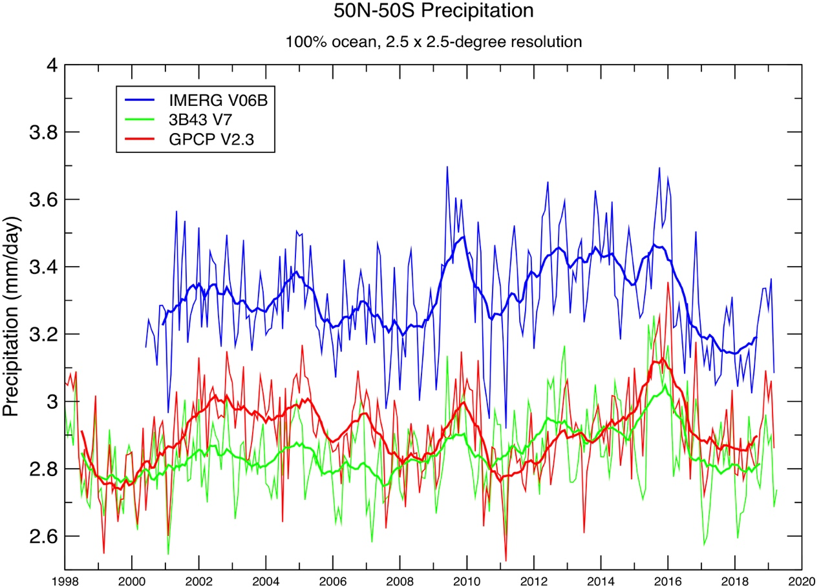
2. Early Results – Ocean (50ºN-S) Precip Timeseries (1/2)
V06 Final Run starts June 2000
V06 is higher than 3B43 (TMPA) and GPCP over ocean
• reason for this is under study
TRMM-era IMERG has a strong semi-annual signal
• GPM-era IMERG and 3B43 dominated by the annual cycle
Interannual variation
• has similar peaks/troughs for all datasets
• GPCP (passive microwave calibration) lags phase of 3B43 (through 2013), IMERG (both PMW/radar calibration)
• after September 2014, 3B43 (PMW calibration) matches GPCP phase
50ºN-S, 100% ocean, 2.5ºx2.5º grid
Precip Averages — 50ºN-S, 100% ocean, 2.5ºx2.5º grid
E. Nelkin (SSAI; GSFC)
U.S. Gov’t. Work

Slide 6
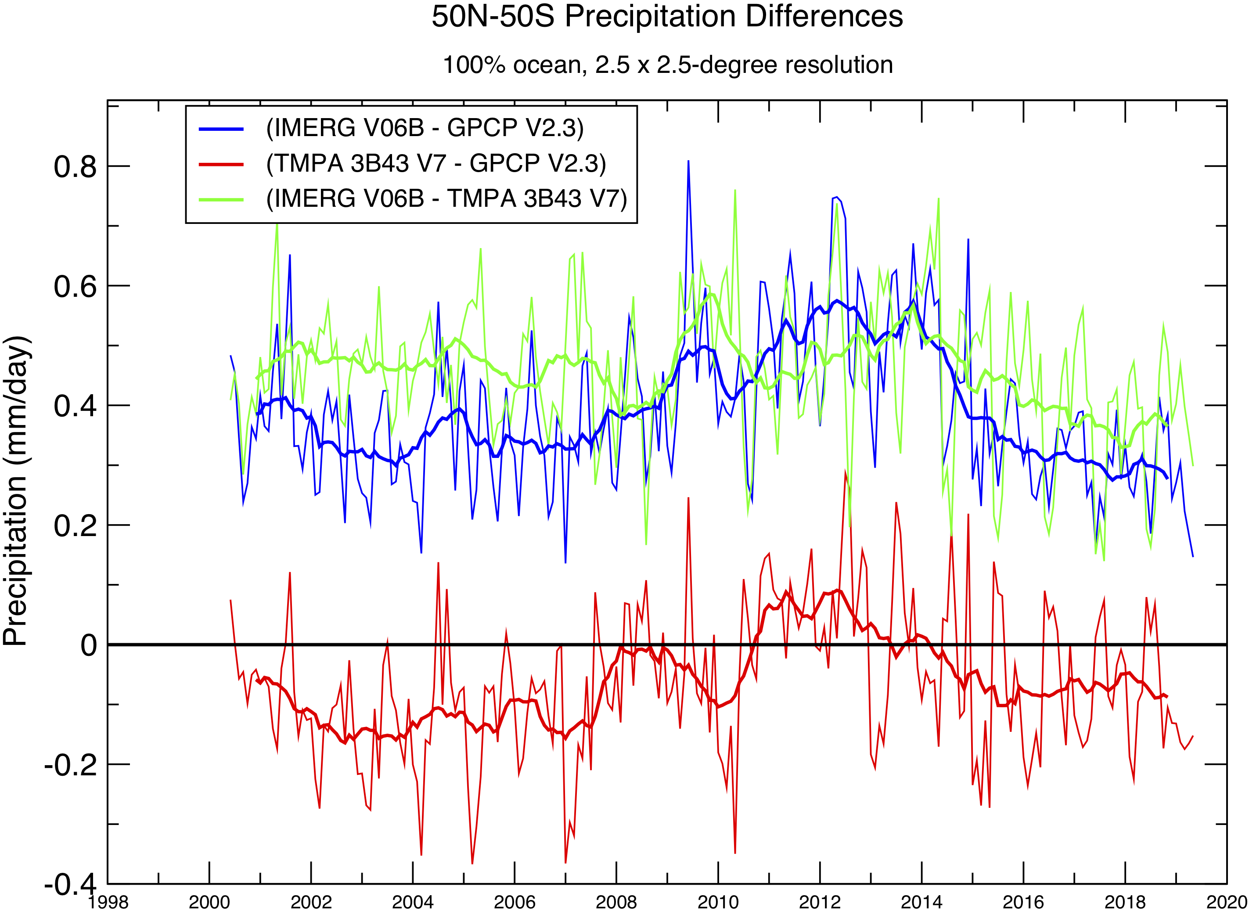
2. Early Results – Ocean (50ºN-S) Precip Timeseries (2/2)
Additional multi-year variations
• IMERG and 3B43 are High Resolution Precipitation Products, not CDRs
• difference plots tend to emphasize multi-year variations
• IMERG and 3B43 resemble each other more than GPCP (green line flatter)
• the interannual variations tend to be similar
• phasing differences and differences in amplitude of interannual variation have similar magnitudes
Precip Differences — 50ºN-S, 100% ocean, 2.5ºx2.5º grid
E. Nelkin (SSAI; GSFC)
U.S. Gov’t. Work

Slide 7
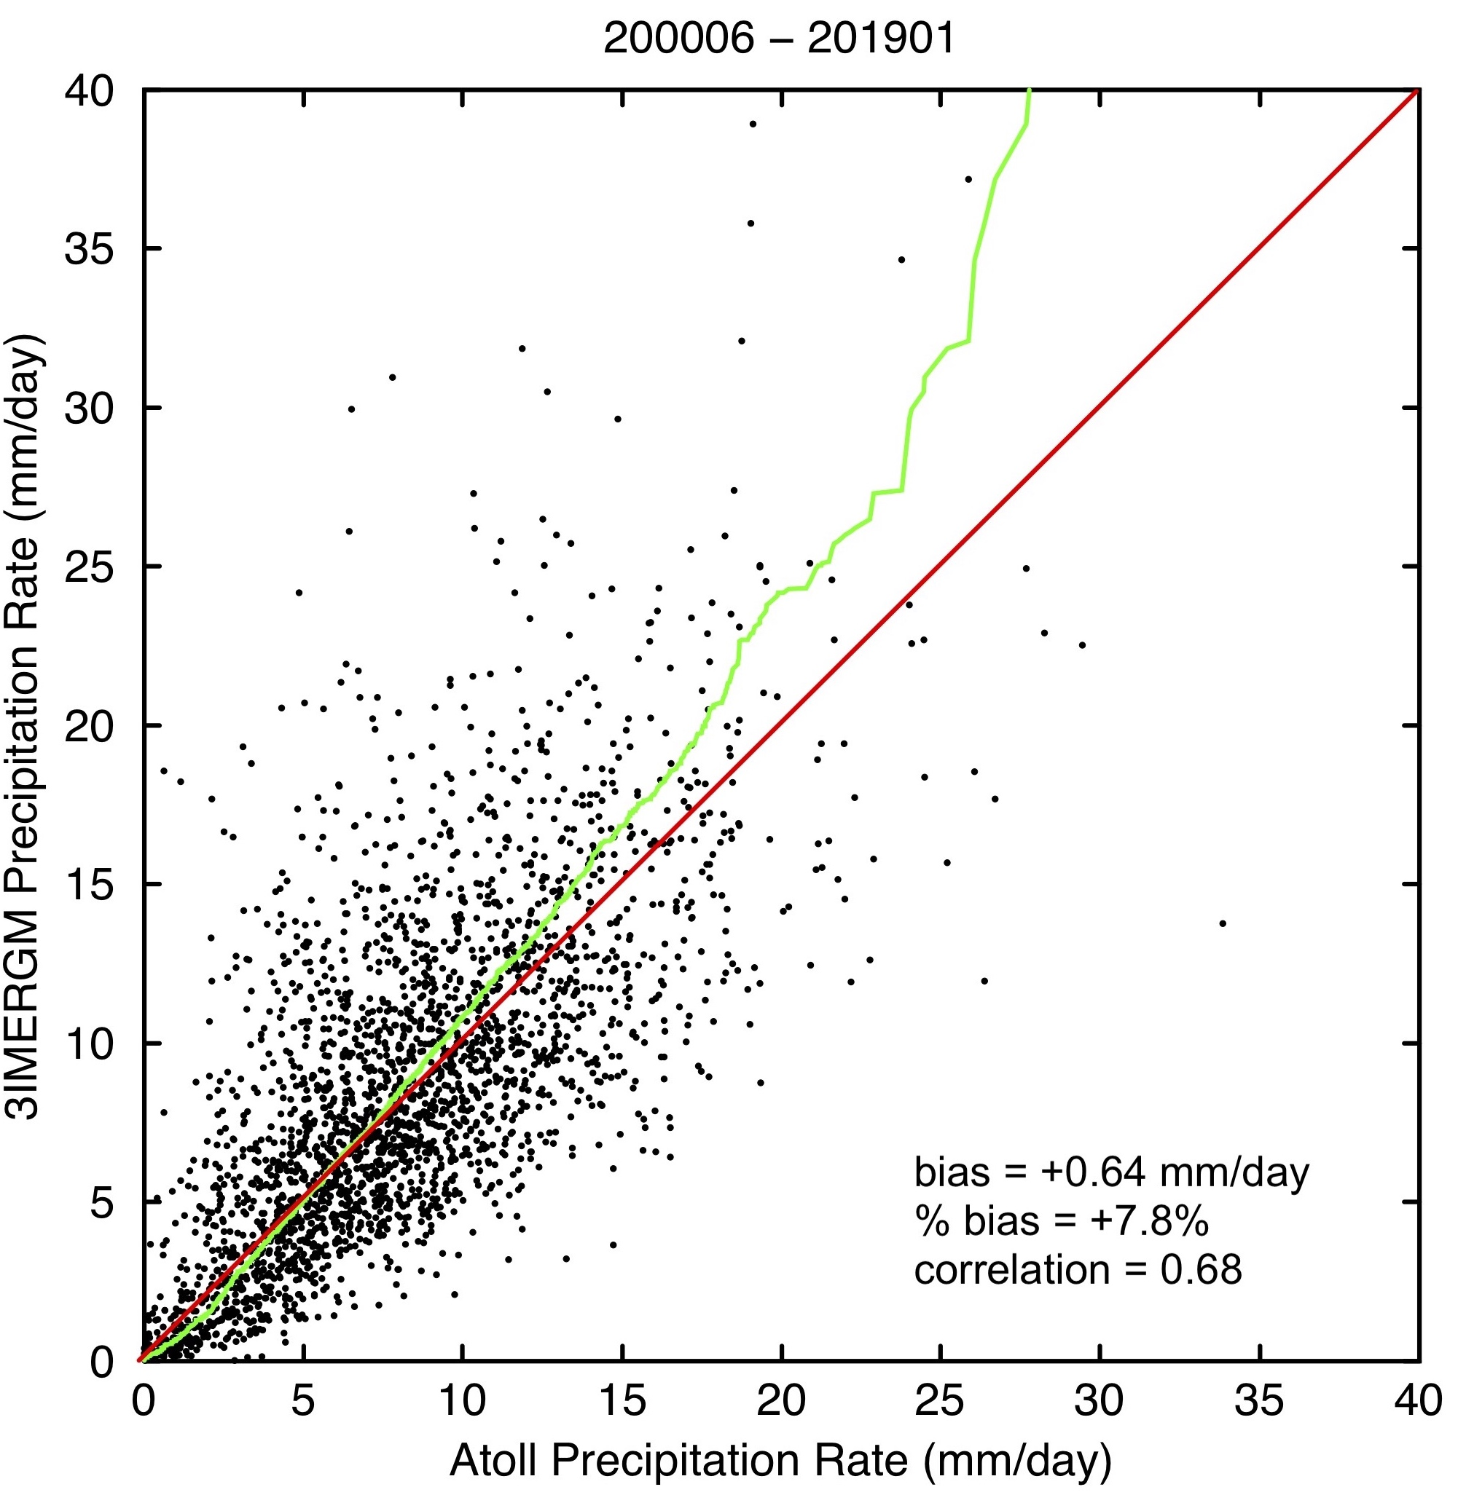
2. Early Results – IMERG Final, Monthly for Atolls
Monthly accumulations for tropical Pacific atolls
• Pacific Rainfall Database (PACRAIN)
• match of gauge to encompassing 0.1º grid box
• all useful months
• stations have various periods of record (potentially changing the regions sampled)
• 38 “good” atolls, averaging ~11/month
• bias varies with precip rate
• IMERG under-(over-)estimates at low(high) rates
• atoll gauges lack undercatch correction
• likely ~5-10%, so overall IMERG bias is (amazingly) good, but rate biases remain
See S4 for a land case (Hurricane Harvey)
D.Bolvin (SSAI; GSFC)

Slide 8
2. Early Results – Tropical Ocean (20ºN-S) Monthly Precip
Histogram Timeseries
IMERG Final, monthly tropical ocean 20ºN-S
Histogram of Final Run monthly tropical oceanic precip on 0.1º grid, 20º N-S (top)
• log(counts) to help draw out small values
Anomaly (bottom) helps guide interpretation
• log scale in both directions from zero
• filtered in time to emphasize main features
Initial impressions
• mid-to-high rates sometimes (2009-10) vary together, but not always (2006-07)
• lower rates tend to vary in the opposite direction
• start of GPM calibration (June 2014) seems to shift the PDF to lower rates
• persistent mid-range positive anomalies in 2009-14 remain to be explained
This discussion will help determine reliability for trend analysis
Monthly precip rate (mm/d)
IMERG Final anomalies, monthly tropical ocean 20ºN-S
Monthly precip rate (mm/d)
U.S. Gov’t. Work
G. Potter (USRA; GSFC)

Slide 9
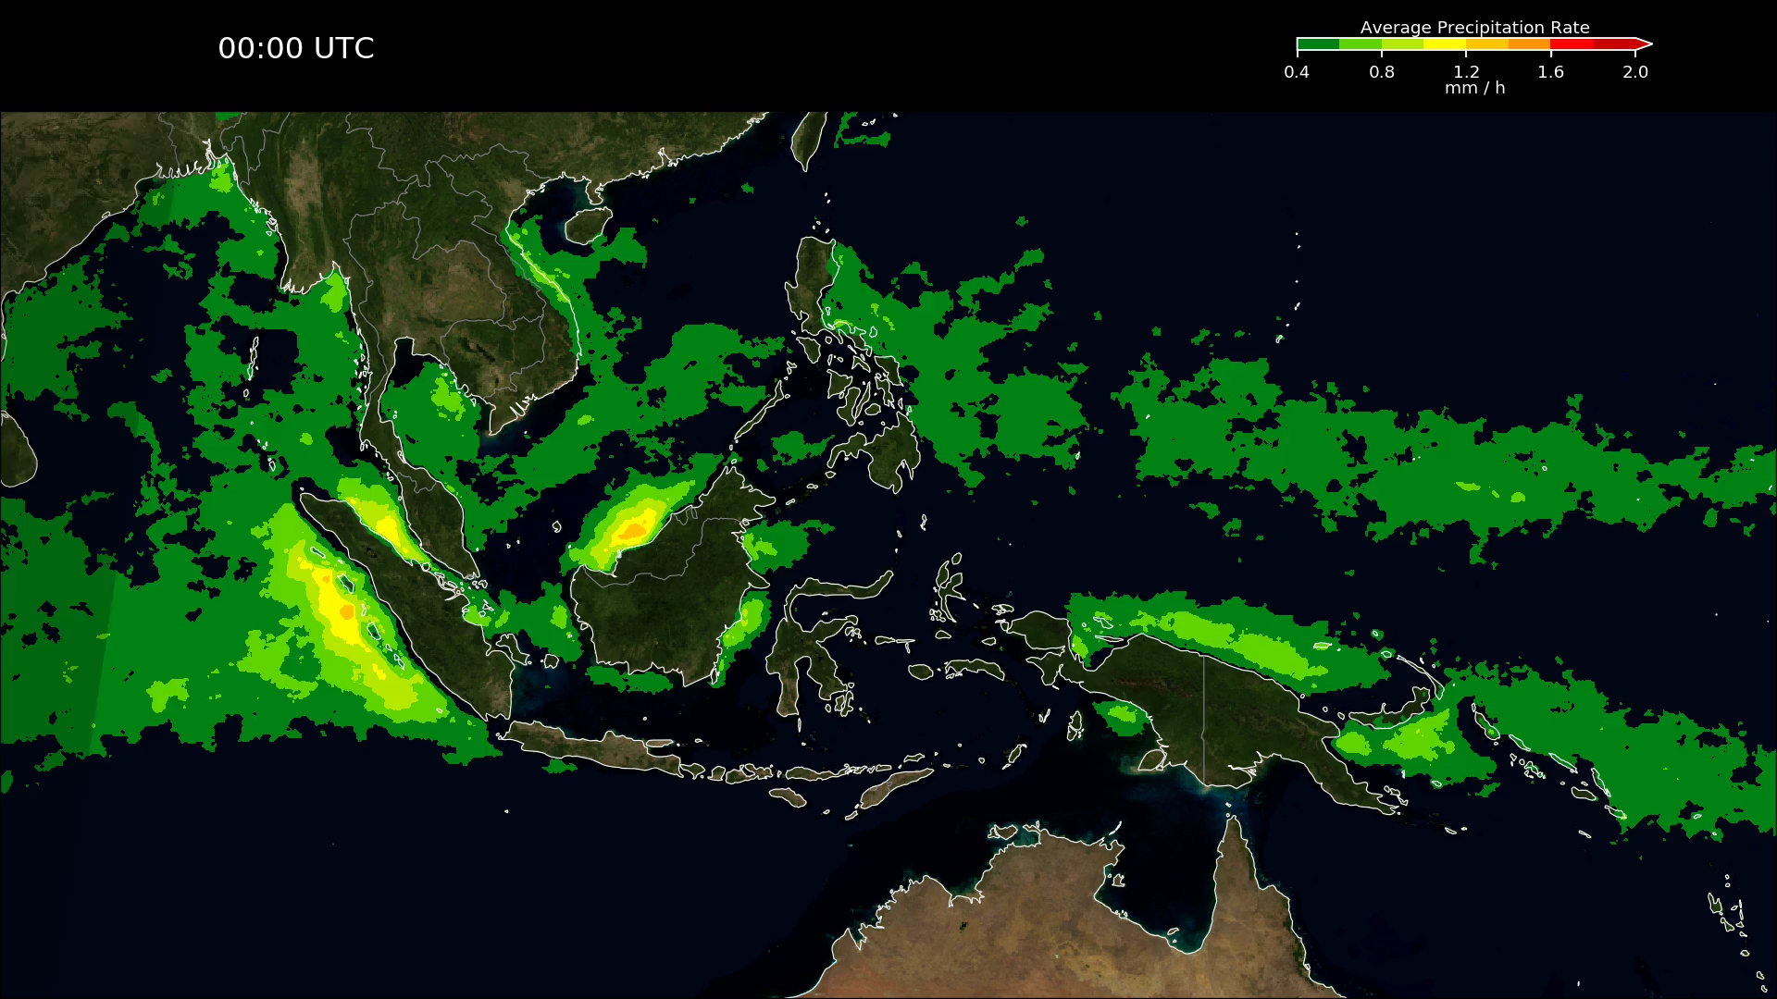
2. Early Results – Final Run, September-November Diurnal Cycle, Maritime Continent
Average September-November for 2001 to 2018, Final Run
• day/night shading
• Blue Marble land
• smoothed in space and time
• even 18 years of seasonal data still has lumps
Reminiscent of IMERG V05, but
• less “flashing” due to inter-satellite differences and morphing
• better data coverage at higher latitudes (not seen here)
J. Tan (USRA; GSFC)
Reminiscent of TMPA, but
• more detailed, broader spatial coverage
• no interpolations between the 3-hourly times
• less IR-based precip used (which tends to have a phase lag)
U.S. Gov’t. Work

Slide 10
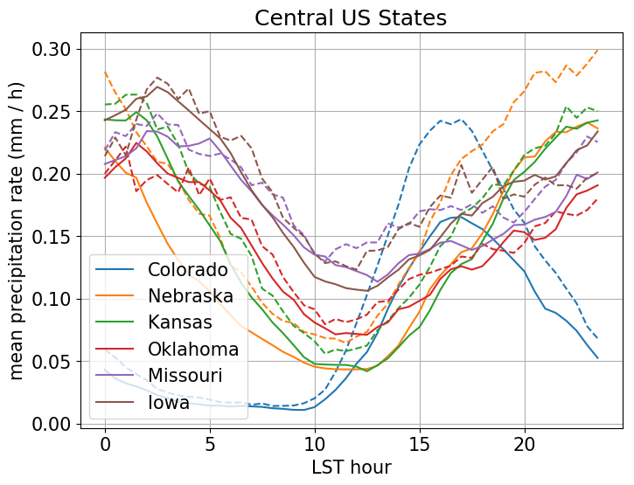
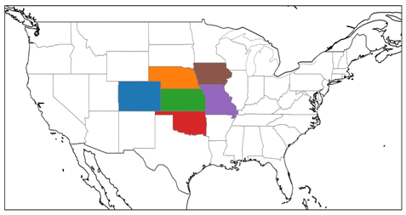
2. Early Results – Final Run, June-August Diurnal Cycle in Central U.S. (GPM Era)
Average June-August for 2014 to 2018 (5 summers) for 6 states, Final Run
Compared to Multi-Radar Multi-Sensor (MRMS, dashed), Final (solid) shows:
• lower averages (despite use of gauge data)
• lower amplitude cycle in Colorado
• higher amplitude cycle in Iowa
• very similar curve shapes, peak times
This version of MRMS only starts in 2014, so an extended comparison requires different data
IMERG-Final – solid
MRMS – dashed
J. Tan (USRA; GSFC)
U.S. Gov’t. Work

Slide 11
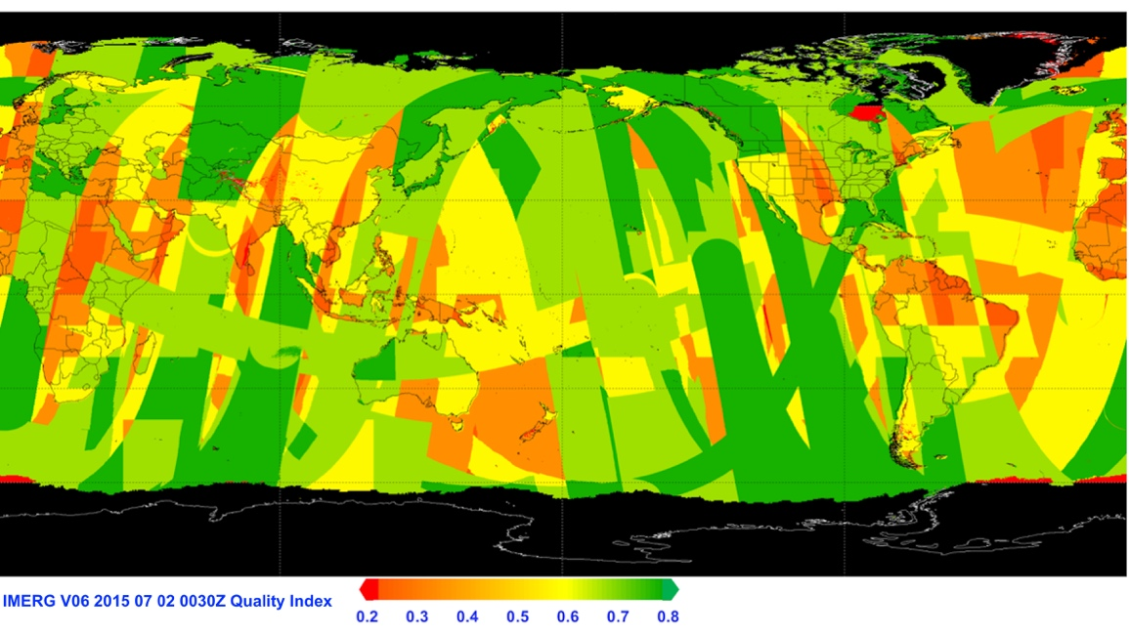
2. Early Results – Half-hourly Quality Index (1/2)
Revised in V06
• approx. Kalman Filter correlation
• based on
• times to 2 nearest PMWs (only 1 for Early) for morphed data
• IR at/near time (when used)
• where r is correlation, and the i’s are for forward propagation, backward propagation, and IR
• or, an approximate at-overpass correlation when a PMW is used for that half hour
• revised to 0.1º grid (0.25º in V05)
• thin strips due to inter-swath gaps
• blocks due to regional variations
• snow/ice masking will drop out microwave values
D.Bolvin (SSAI; GSFC)
The goal is a simple “stoplight” index
• ranges of QI will be assigned
• good 0.6-1
• use with caution 0.4-0.6
• questionable 0-0.4
• is this a useful parameter?
U.S. Gov’t. Work

Slide 12
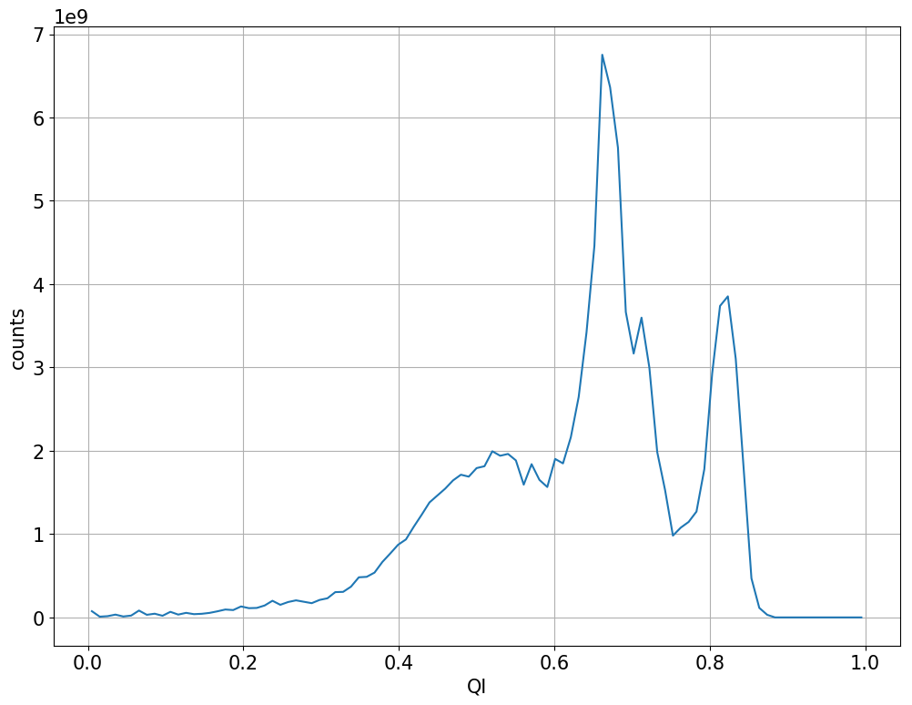
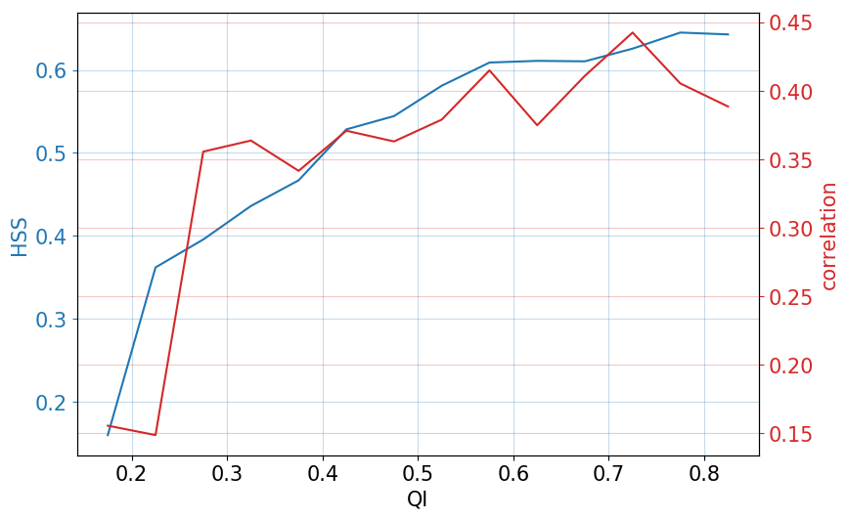
2. Early Results – Half-hourly Quality Index (2/2)
IMERG-Final QI Histogram Jun 2014 – May 2015
IMERG-Final Heidke Score and Correlation against MRMS over CONUS as a Function of QI
Jun 2014 – May 2015
Imager overpasses
Sounder overpasses and short morphs
Long morphs
(Mostly) IR
J. Tan (USRA; GSFC)
J. Tan (USRA; GSFC)
U.S. Gov’t. Work

Slide 13
3. Development Work for V07
Multi-satellite issues
• address shifts in PDF between overpass and morphed estimates
• work toward a cloud development component in the morphing system
• address apparent persistent biases
• improve motion vectors near topography
• improve error estimation (as possible)
• develop additional data sets based on observation-model combinations (as possible)
General precipitation algorithmic issues
• more-advanced IR algorithm
• work toward PMW retrievals (i.e., GPROF) that work better over snow/ice
• evaluate ancillary data sources and algorithm for Prob. of Liq. Precip. Phase
• introduce alternative/additional satellites at high latitudes (TOVS, AIRS, AVHRR, etc.)
• work toward improved wind-loss correction to gauge data
U.S. Gov’t. Work

Slide 14
4. Final Remarks
IMERG is now V06B
• the product structure remains the same
• Early, Late, Final
• 0.1ºx0.1º half-hourly (and monthly in Final)
• new source for morphing vectors
• higher-latitude coverage
• extension back to 2000 (and eventually 1998)
• improved Quality Index
• TMPA ends with December 2019
See https://svs.gsfc.nasa.gov/cgi-bin/details.cgi?aid=4285
U.S. Gov’t. Work

Slide 15
Supplemental Slides
U.S. Gov’t. Work

Slide 16
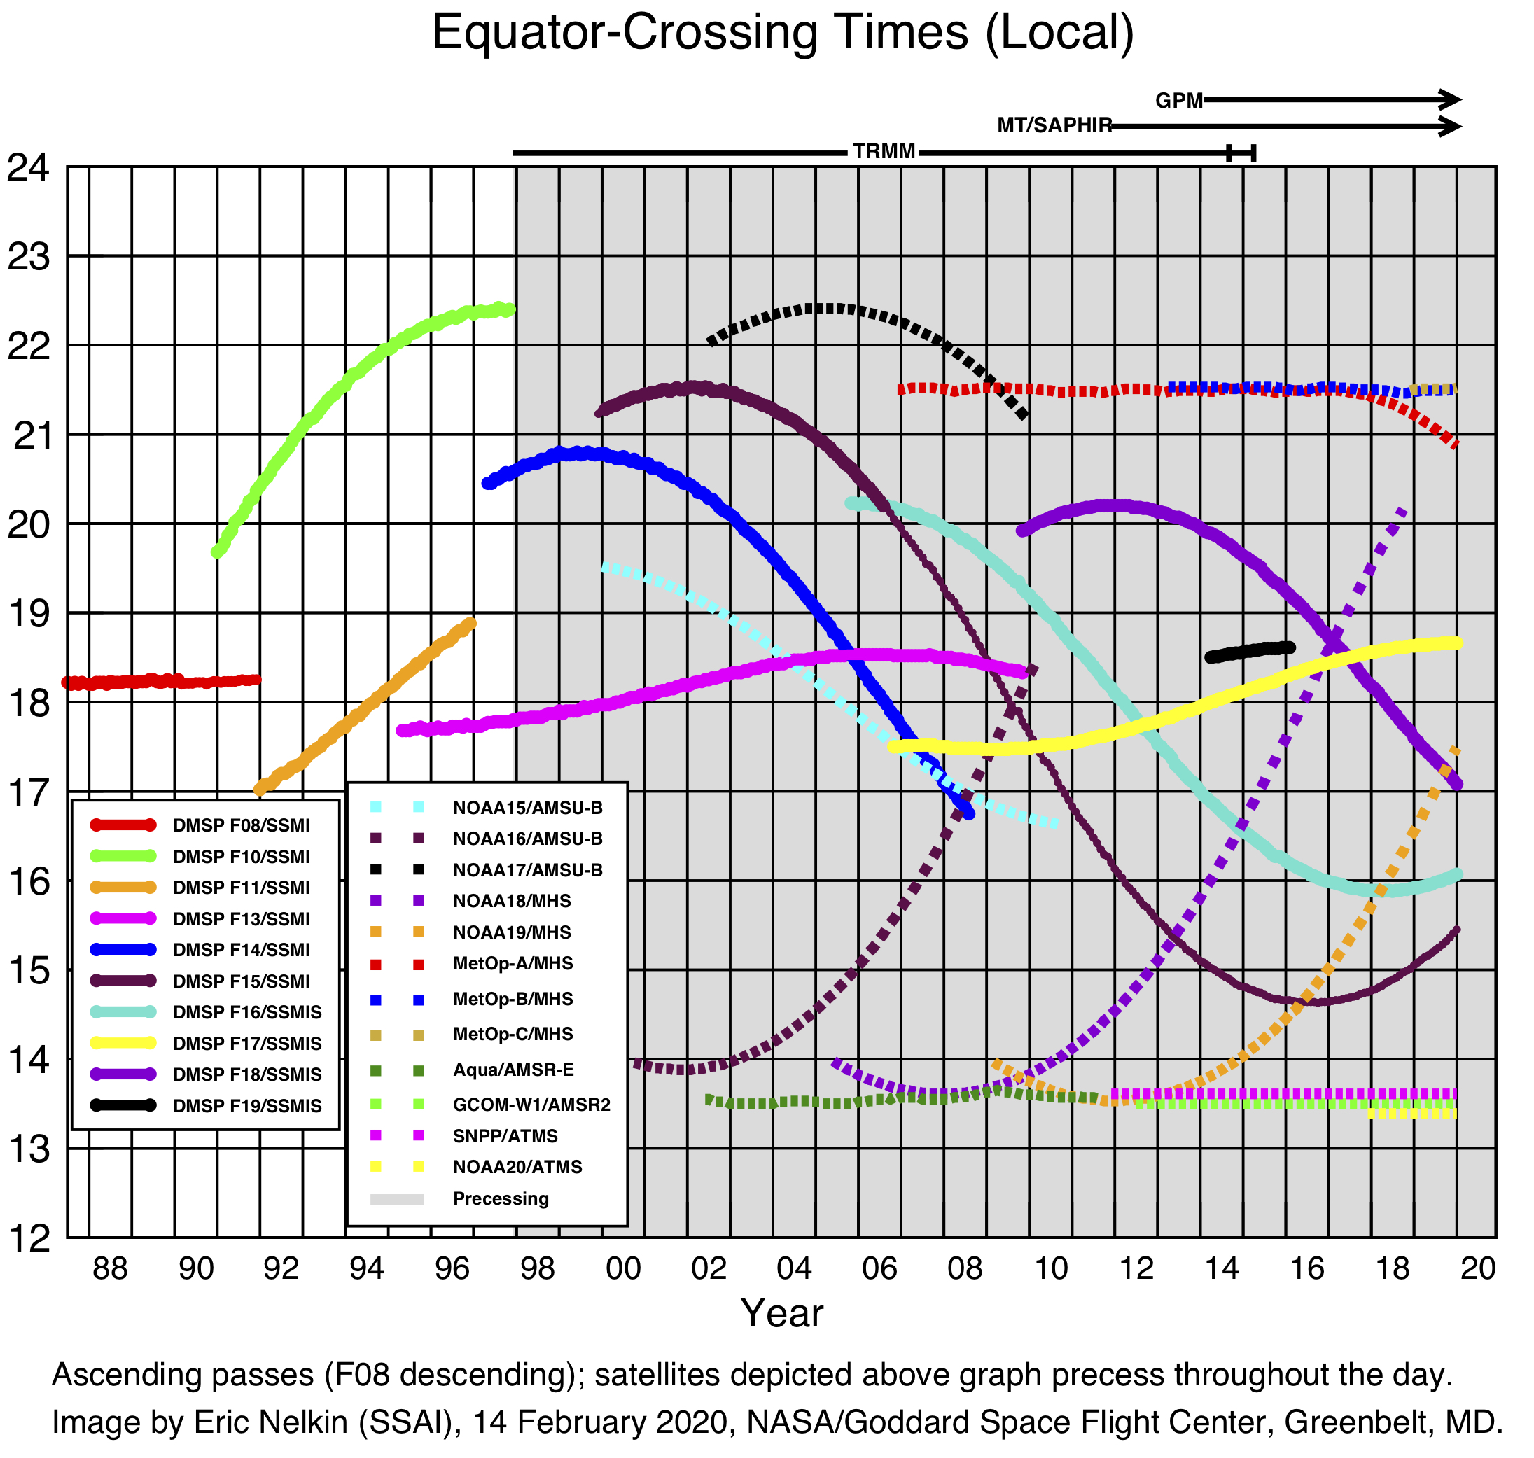
S1. Introduction – The Constellation
Presently 3-hourly observations >90% of the time, globally
The current GPM constellation includes:
• 5 polar-orbit passive microwave imagers
• 5 polar-orbit passive microwave sounders
• input precip estimates
• GPROF (LEO PMW) + PRPS (SAPHIR)
• PERSIANN-CCS (GEO IR)
• CORRA (combined PMW-Ku radar)
• GPCP SG (monthly satellite-gauge)
The constellation is evolving
• launch manifests are assured for sounders, sparse for imagers
U.S. Gov’t. Work

Slide 17
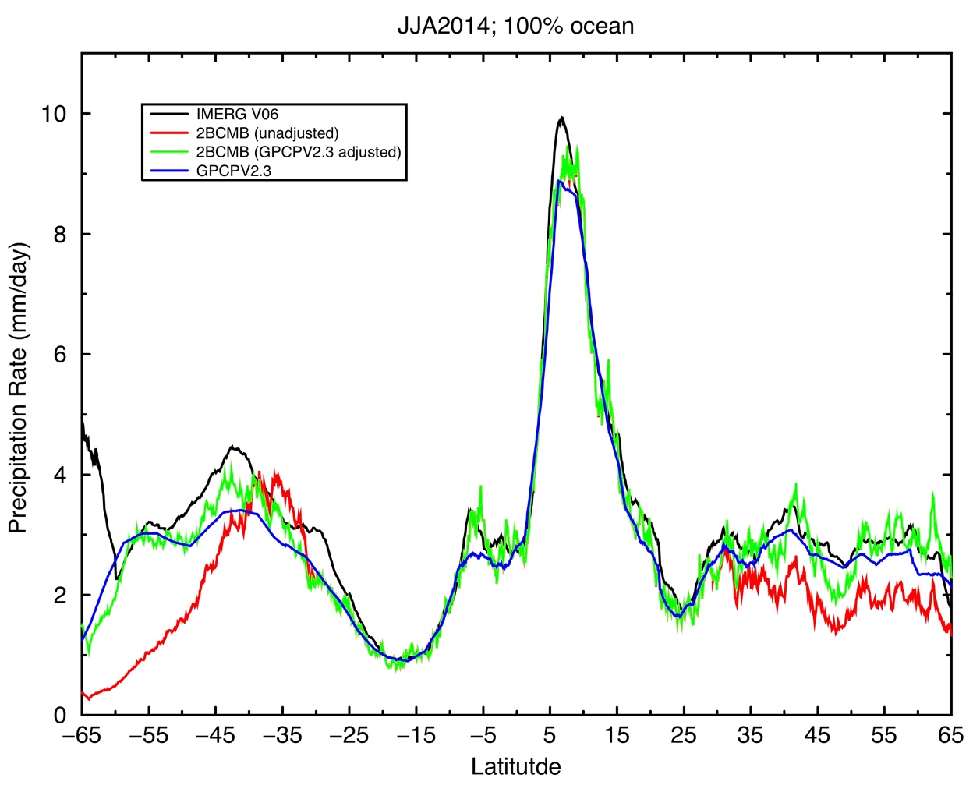
S2. Early Results – Calibration (1/2)
Combined product (calibrator) adjusted to GPCP V2.3 seasonal climatology zonally for reasonable bias
• GPM core products have similar bias (by design)
• these profiles are systematically low in the extratropical oceans vs.
• GPCP V2.3 SG product
• Behrangi Multi-satellite CloudSat, TRMM, Aqua (MCTA) product
  • over land GPCP adjustment provides a first cut at the adjustment to gauges used in the Final
CORRA
CORRA
Latitude
D. Bolvin (SSAI; GSFC)
U.S. Gov’t. Work

Slide 18
S2. Early Results – Calibration (2/2)
Calibration sequence is
• CORRA climatologically calibrated to GPCP over ocean outside 30ºN-S
• GMI calibrated to monthly CORRA
• GPM constellation climatologically calibrated to GMI
Adjustments working roughly as intended
• CORRA is low at higher latitudes
• adjustments in Southern Ocean are large and need analysis
• IMERG subsetted to coincidence with CORRA is much closer to (adjusted) CORRA
CORRA
CORRA
Latitude
D. Bolvin (SSAI; GSFC)
U.S. Gov’t. Work

Slide 19
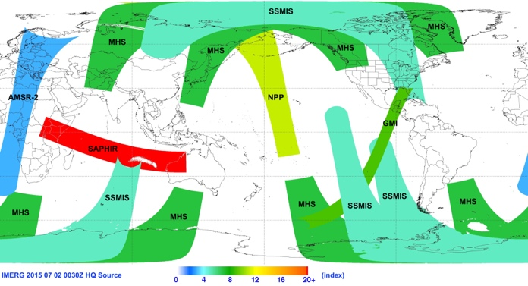
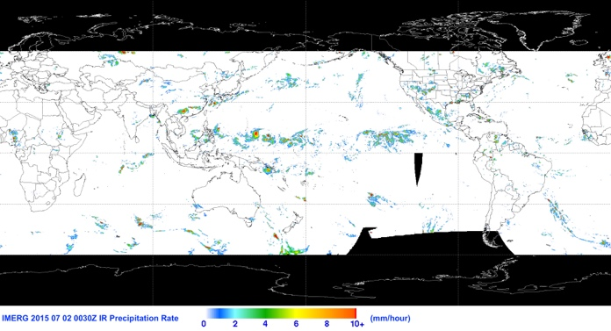
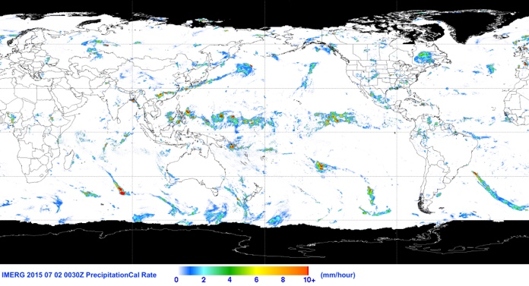
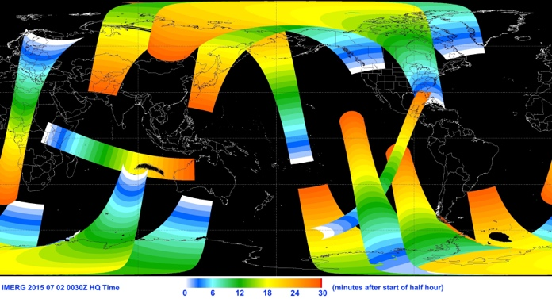
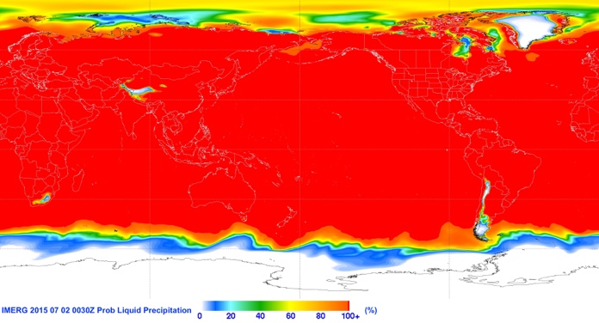
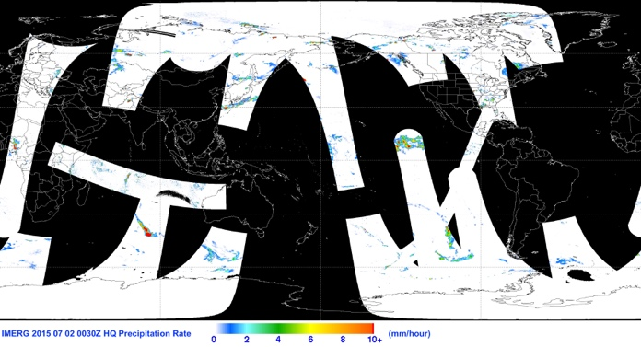
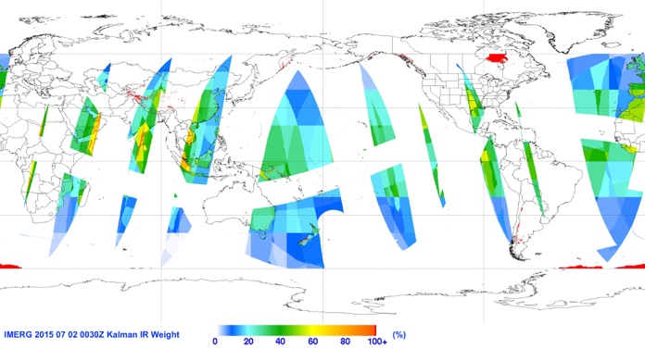

S3. IMERG – Examples of Data Fields
PMW
sensor
IR precip
cal precip
(uncal precip)
PMW
time into half hour
probability of liquid phase
2 July 2015 0030 UTC
PMW
precip
Quality Index
IR weight
U.S. Gov’t. Work

Slide 20
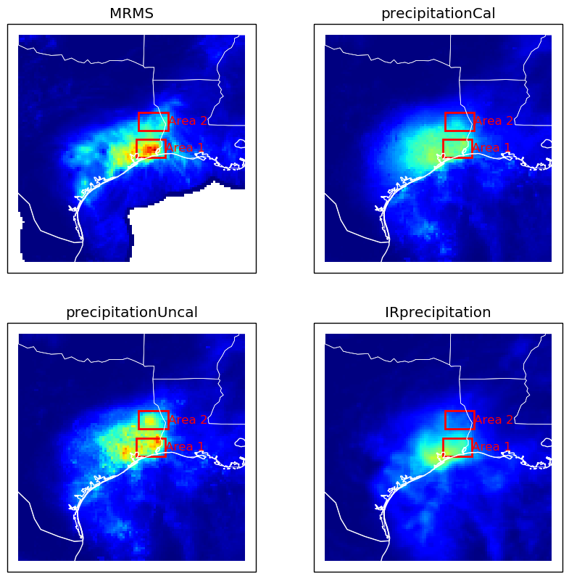
S4. Early Results – Hurricane Harvey, 25-31 August 2017, IMERG and MRMS (1/2)
Harvey loitered over southeast Texas for a week
• MRMS considered the best estimate
• some questions about the details of the gauge calibration of the radar estimate
• over land
• Uncal (just the intercalibrated satellite estimates) under(over)-estimated in Area 1(2)
• should be similar to Late Run
• Cal (with gauge adjustment) pulls both areas down
• microwave-adjusted PERSIANN-CCS IR has the focus too far southwest
J. Tan (USRA; GSFC)
U.S. Gov’t. Work

Slide 21
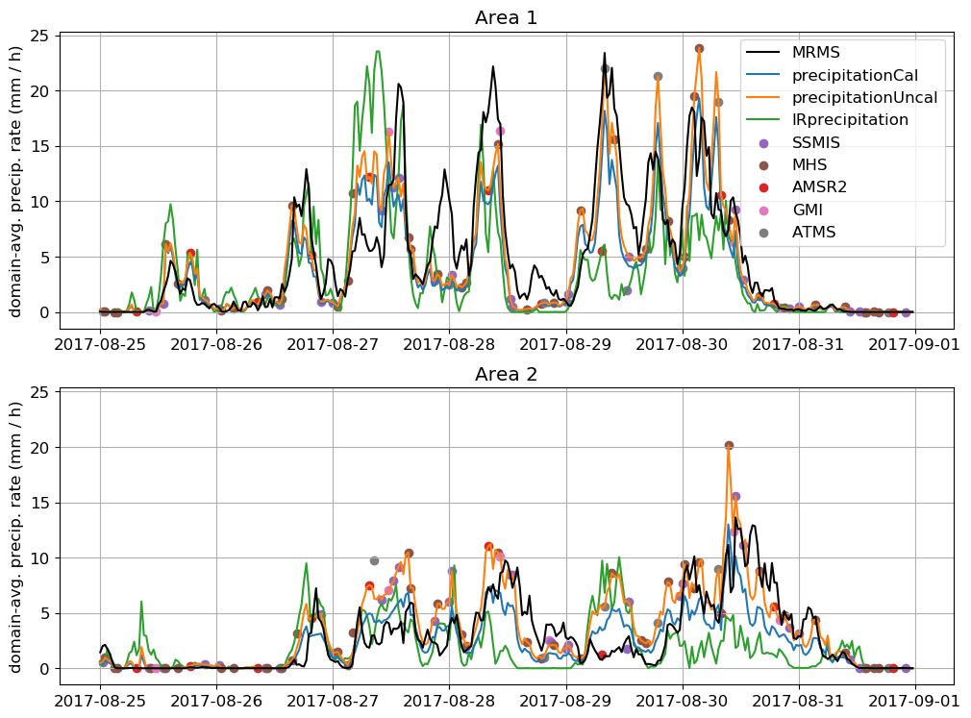
S4. Early Results – Hurricane Harvey, 25-31 August 2017, IMERG and MRMS (2/2)
IMERG largely driven by microwave overpasses (dots)
• except duplicate times
• not just time interpolation
• systems move into / out of the box between overpasses
• satellites show coherent differences from MRMS
• microwave only “sees” the solid hydrometeors (scattering channels), since over land
• IR looks at Tb within “clustered” data
• both are calibrated to statistics of time/space cubes of data
• Cal is basically ( Uncal x factor )
• short-interval differences show some cancellation over the whole event
• but several-hour differences can be dramatic
J. Tan (USRA; GSFC)
U.S. Gov’t. Work

